Slide 1
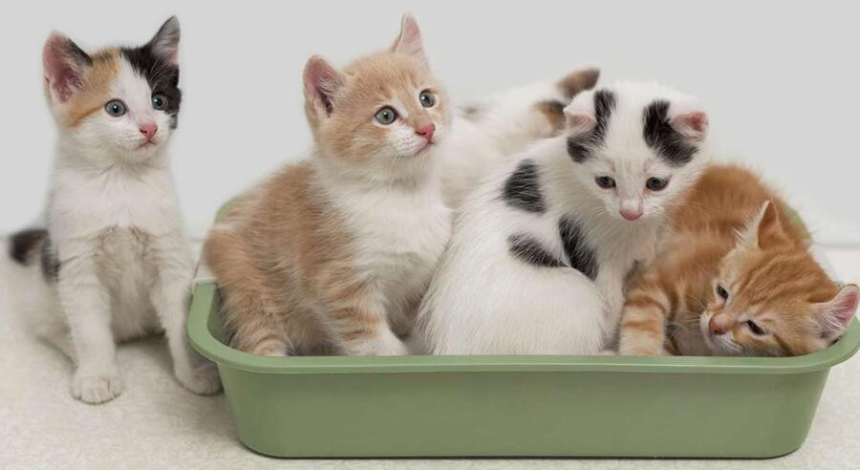
Litter and You
We’re not talking about the kind that cats use, either.

Slide 2
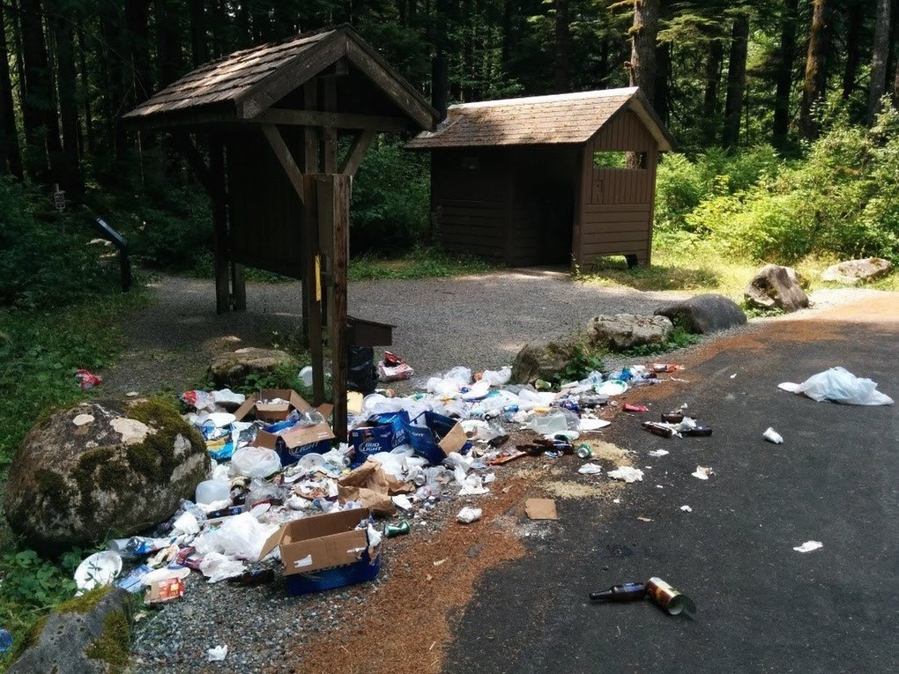
What is litter?
Waste that has been left in oceans, lakes, rivers, sidewalks, roads, parks, etc.
Photo courtesy of Seattle Times
Litter is a type of pollution-harmful waste, chemicals, or noise in an environment.
There is often a lot of plastic in litter.
Plastic is a man-made material created by blending chemicals from oil, natural gas, and coal.
When a lot of plastic is found in litter, it’s often called plastic pollution.

Slide 3
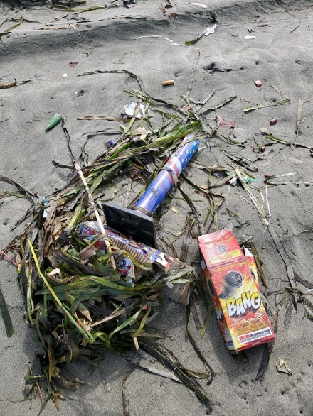
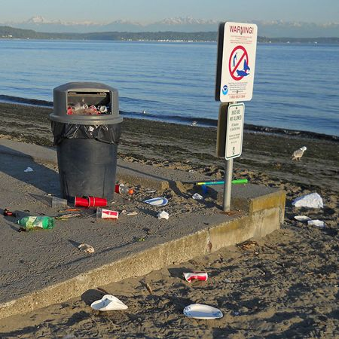
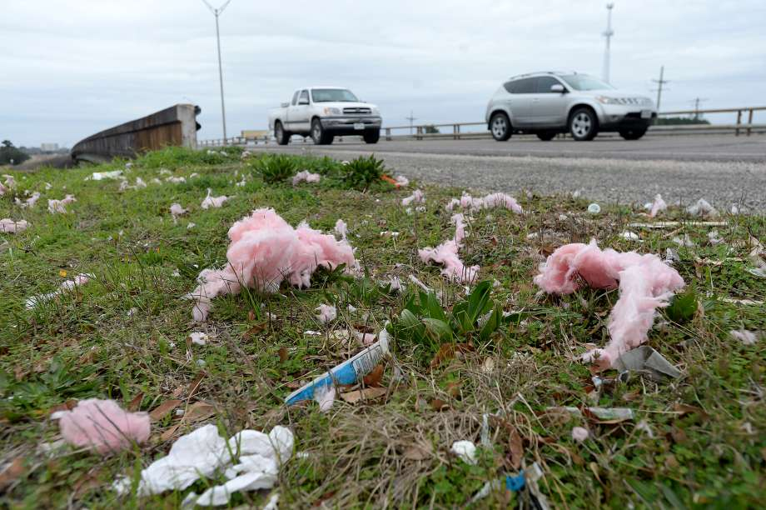
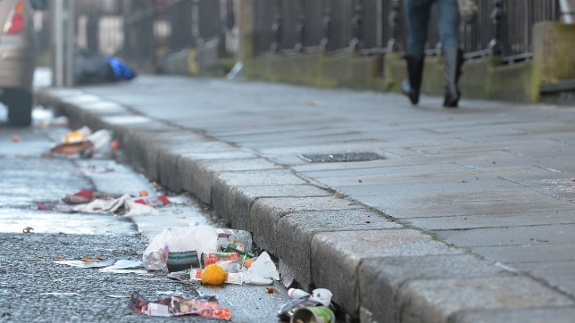
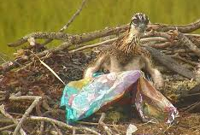
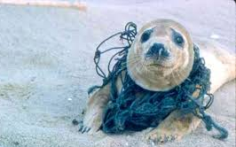
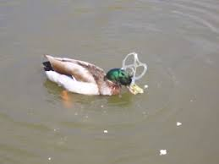
Where have you seen litter?
Photo courtesy of the Beaumont Enterprise
Photo courtesy of the Irish Times
Question: What impacts have you noticed litter have on its surroundings?
What impacts might litter have to wildlife and their habitats?
Notes:
Before clicking, ask students to raise their hand if they’ve ever seen litter.
After this slide, break students up into breakout rooms or small groups.

Slide 4
With your group:
Answer the following questions:
What is litter? What is plastic pollution?
Do you think litter and plastic pollution are a problem where you live? What about in the United States? And in Washington State? Why or why not?
Notes:
When the class comes back together, have students share their answers.

Slide 5
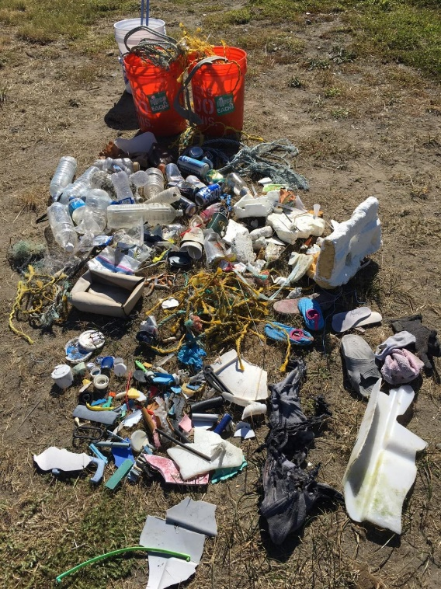
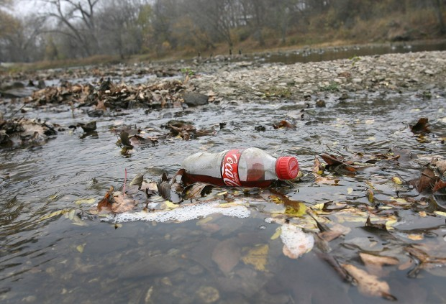
Where does litter and plastic pollution come from?
Write or draw three ways that litter and plastic pollution might get transported to the ocean, city streets, highways, beaches, rivers, parks, mountains, etc.

Slide 6
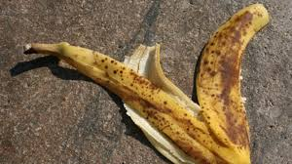
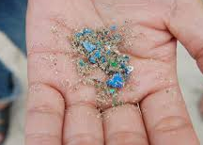
Plastic pollution and wildlife
Plastic pollution and litter affects everyone. From wildlife to humans, we all deal with the lasting effects of plastic pollution.
Biodegradable: Items that break down naturally, by bacteria or invertebrates.
Single-use plastic: Plastic objects that are used once before being thrown away.
Microplastic: Plastics that are smaller than
5 millimeters (about the size of a sesame seed).
Notes:
You may have already talked about some of the impacts plastic and litter have on wildlife. Let’s dive a little deeper. Teacher: Have your class listen as you read the short story “Michael’s meals”.

Slide 7
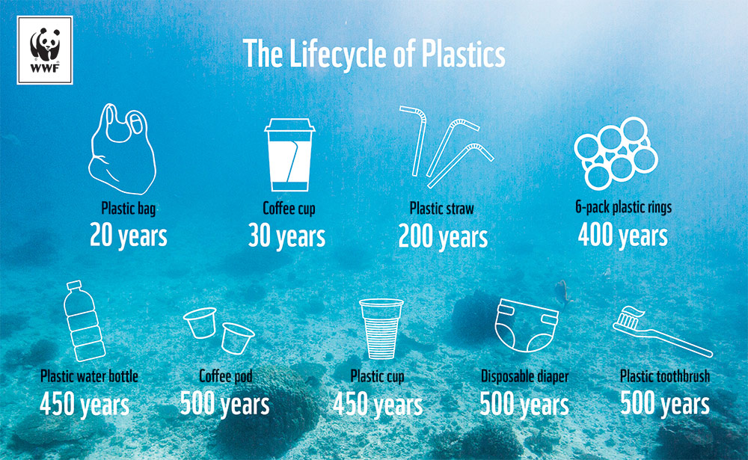
Plastic pollution and wildlife
Many fish like Walleye die of starvation from eating plastic that looks like their food. This is the unfortunate future many creatures face who live in and near the ocean.
How do you think eating a plastic-filled fish would affect Michael’s family’s health?
Notes:
For the picture: Take a look at how long it takes various plastics to break down completely.
How do you think wildlife habitat changes when it becomes polluted with plastic?

Slide 8
Plastic pollution and wildlife
Other animals are impacted as well.
Some animals suffocate in plastic bags while others get entangled in netting and fishing line. These are just a few examples of the ways that wildlife in our state are affected by litter and plastic pollution. The chemicals in the plastic can also seep into local waterways, affecting the ocean and the water we drink.

Slide 9
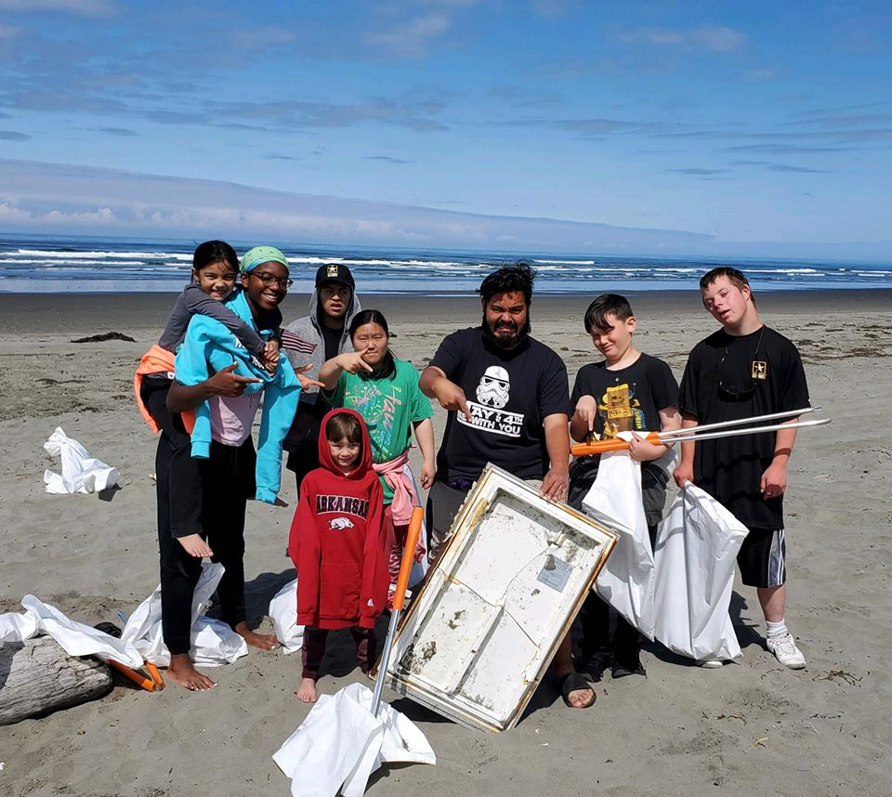
What can we do?
This is a problem that can be fixed!
But, it involves Y-O-U.
Notes:
Ask students to share with the class some things they could do to solve the plastic pollution and litter problems.

Slide 10
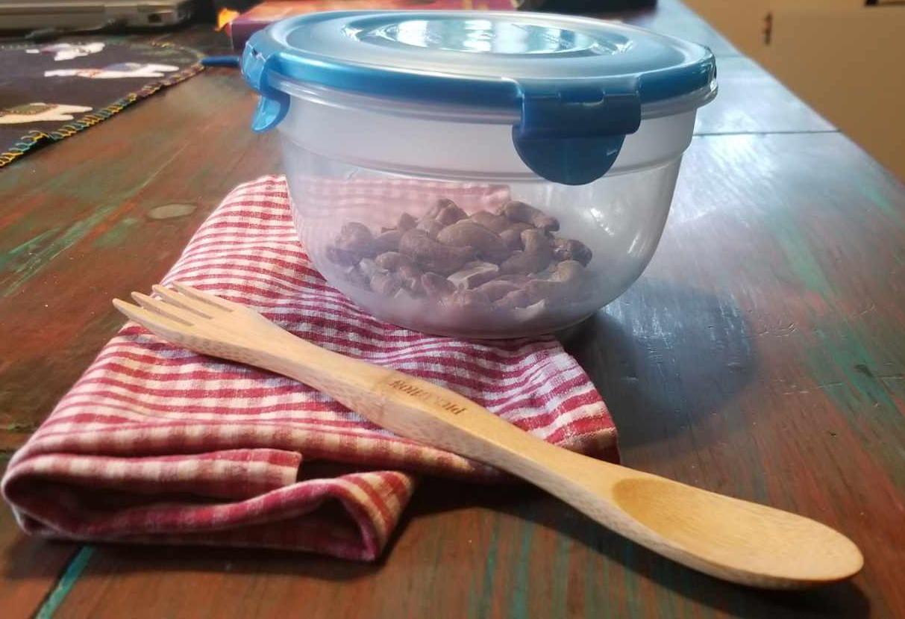
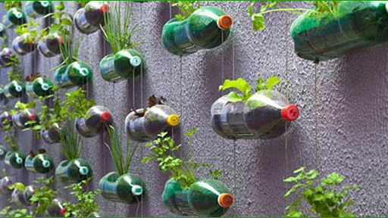
What can we do?
Reduce your single-use plastics. If you don’t use them, they can’t become litter or pollution!
Learn how to make your own reusable sandwich wrap.
Reuse items and give your old “junk” another life. Find a creative use for things you would otherwise throw away.
Learn about at-home activities to reduce waste.
Recycle cleaned out plastics and give it another life. Did you know that only 12% of plastics are recycled?
Learn about the life cycle of a plastic bottle.
Notes:
After students have given their ideas, review this list with them. The end of this slide will introduce their next activity, the clean up.

Slide 11
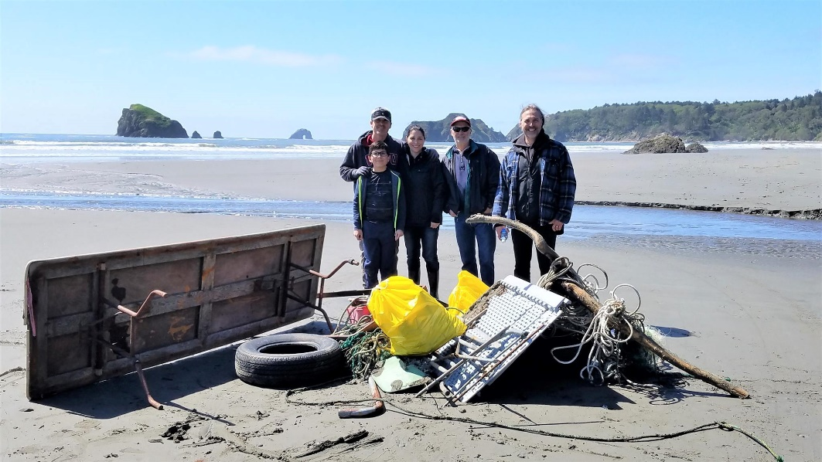
What can we do?
Dispose of garbage properly.
If you’re on a boat, or in a truck, make sure items are secured.
Educate others about the impacts of plastic and litter on wildlife.
Be part of a coastal or public lands clean up!
Notes:
After students have given their ideas, review this list with them. The end of this slide will introduce their next activity, the clean up.
After the clean up you will come back to these slides and have students brainstorm ways they can prevent litter and plastic pollution in their community.

Slide 12
Questions?

