Slide 1
Barriers to survival

Slide 2
What type of relationship did you determine existed between Southern Resident orcas and Chinook salmon?

Slide 3
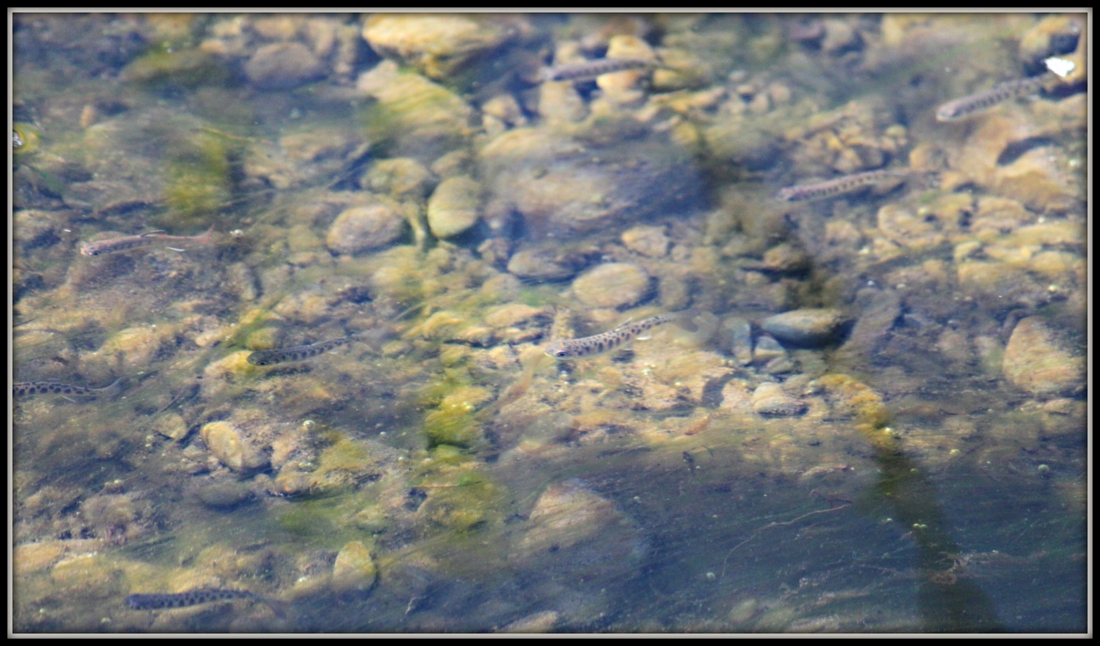
A focus on Chinook
Today we are going to focus on one variable, the decline of Chinook salmon.
Think to yourself:
Why might Chinook populations be declining?
What steps could be taken to help improve Chinook populations?
Chinook fry in a stream.

Slide 4
A focus on Chinook
Habitat loss
Chinook abundance in the Salish Sea ecosystem has decreased as urbanization, coastal modifications, and some resource harvesting practices have impacted the quality and quantity of salmon habitat.
Climate change
Impacts from climate change on Chinook salmon include habitat changes, such as increased winter flooding, decreased summer and fall stream flows, and increased temperatures in streams and estuaries. Even small shifts in water temperature could alter the timing of migration, reduce growth, reduce availability of oxygen in the water, reduce availability of preferred food sources, and increase the susceptibility to toxins, parasites, and disease.
Information from U.S. EPA

Slide 5
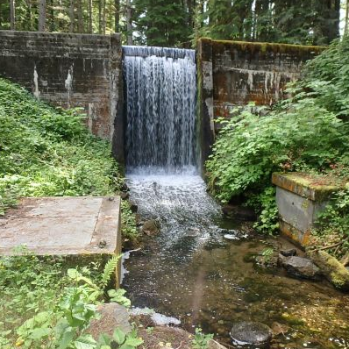
A focus on Chinook
Barriers to passage
As Chinook return from the ocean and migrate back up their natal streams, there are often human-made barriers that prevent them from returning to spawning grounds.
If they are unable to spawn, populations decline.
Read:
Fish Passage: A Sense of Urgency
Steep water drops like this make it impossible for salmon to migrate back up their natal steams.
Notes:
Go through this story map with students, have them read aloud. Make sure to highlight the area where they can report a passage to fish barriers.

Slide 6
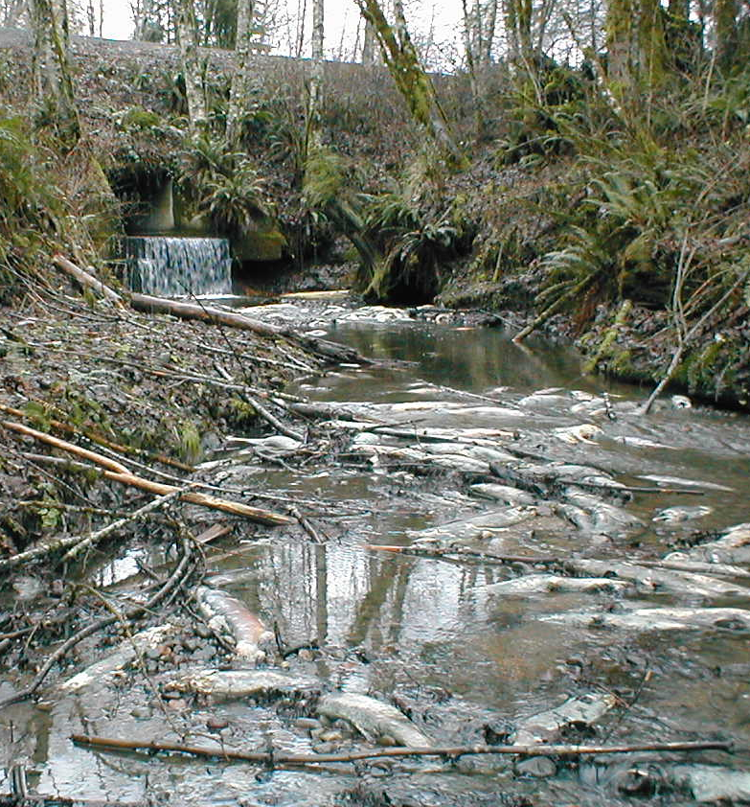
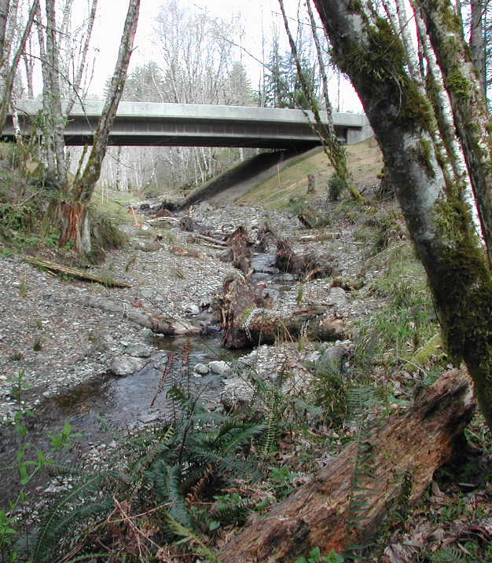
Species recovery
Washington Department of Fish and Wildlife biologists, technicians, and engineers work with partners statewide to help remove barriers to fish migration.
Both pictures show the same section of the same stream.
In the picture on the left, salmon were unable to navigate up the water drop. This resulted in pre-spawn death for many salmon.​
The picture on the right shows the stream after the barrier had been corrected. ​
Can you spot the differences?
Notes:
Go through this story map with students, have them read aloud. Make sure to highlight the area where they can report a passage to fish barriers.

Slide 7
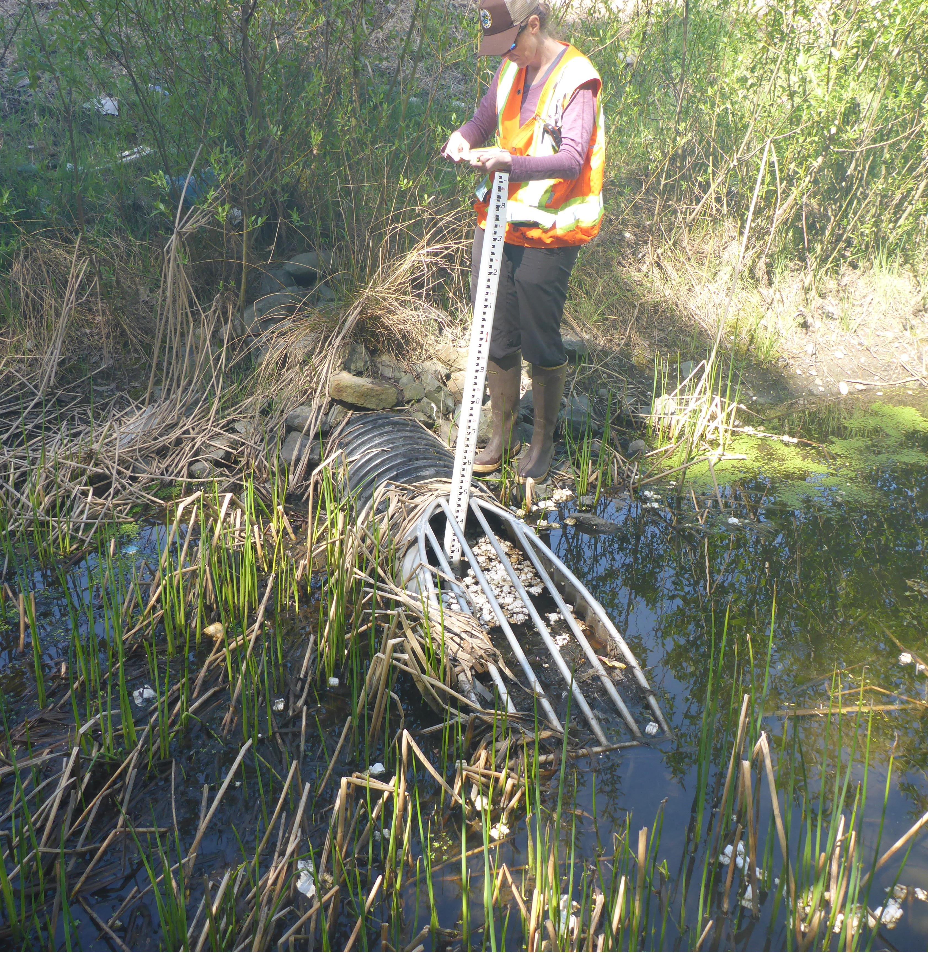
The people who make recovery happen
Meet Kate.
She’s a WDFW fish passage biologist who teaches people how to determine if something is a barrier to fish swimming upstream.
Once Kate understands where the barriers are, she works with landowners to help fix the structures so salmon can swim upstream. She looks at patterns, interprets maps, and uses math to help salmon and steelhead.

Slide 8
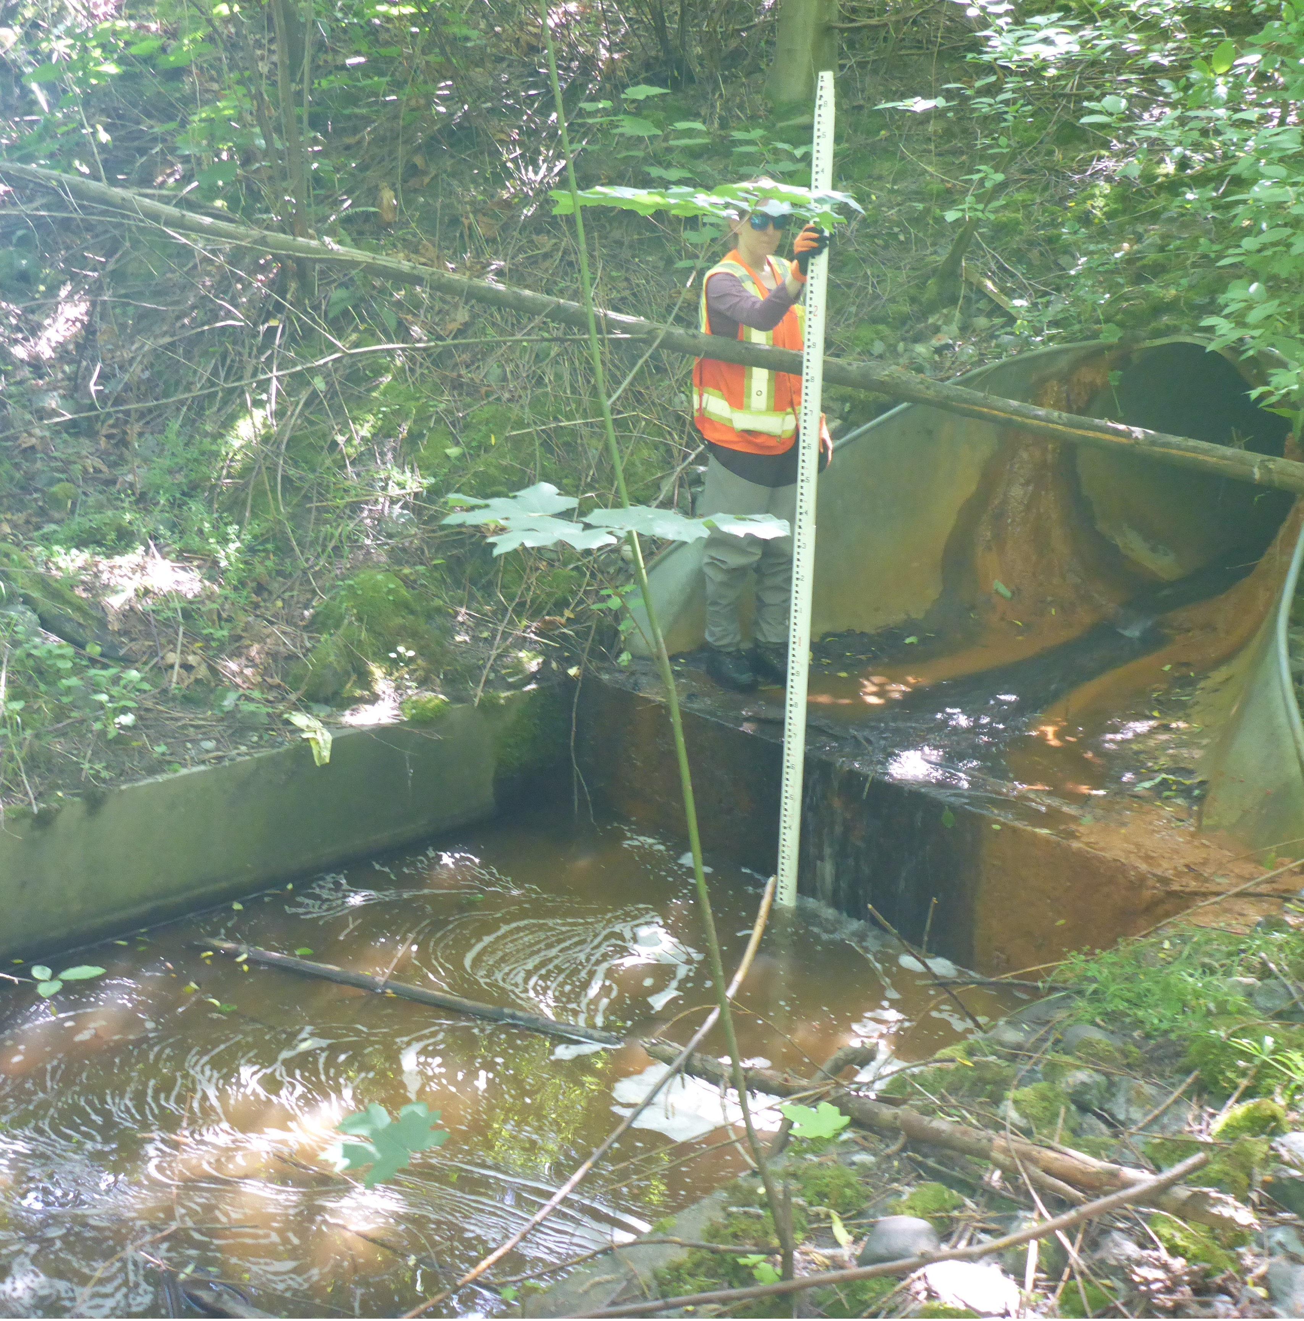
The people who make recovery happen (This could be you!)
Kate found her way to this career because she liked asking questions and being outside, especially near water. She studied science in college and got to take kids fishing as her first job!
She’s travelled throughout the country for her career- from New York to Montana to Hawaii and back to Washington. She gets to help people understand more about fish and help create sustainable populations of salmonids.

Slide 9
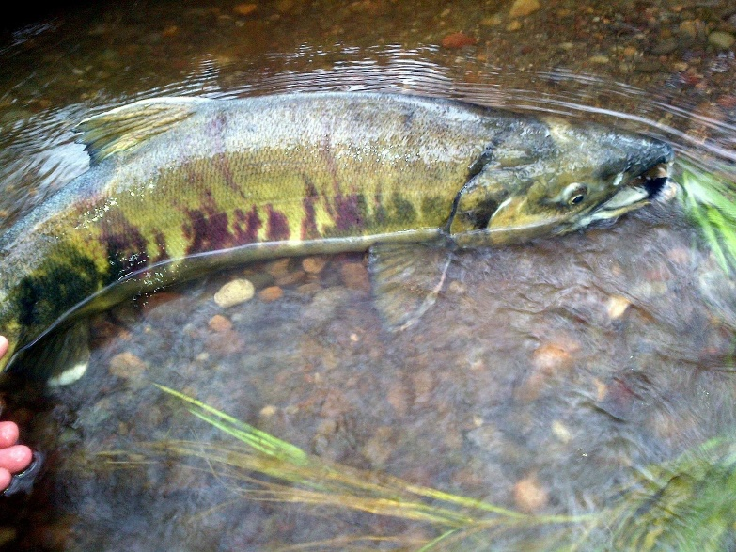
What else is being done to help Southern Resident Orcas and Chinook?
Washington Department of Fish and Wildlife is….
Leading salmon habitat restoration projects throughout Puget Sound
Supporting additional protections for forage fish and salmon
Working to increase the number of salmon produced at hatcheries
Developing a commercial whale-watching licensing program with support from our Commercial Whale Watching Licensing Program Advisory Committee
Ramping up outreach, education, and enforcement of Southern Resident orca protections

Slide 10
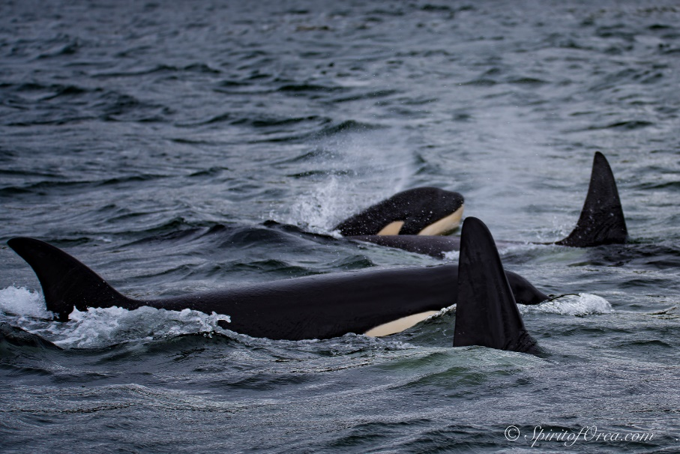
What can we do?
Check out this list from State of Salmon.
Reduce use of water and electricity.
Participate in stream restoration projects.
Pick up dog poop to prevent it from entering waterways!
Educate others about the threats facing salmon and Southern Resident orcas.
Check out how many and where the fish passage barriers are in Washington.
What are other ways you and your family could help these species?
Photo courtesy of Ken Rhea

