Slide 1
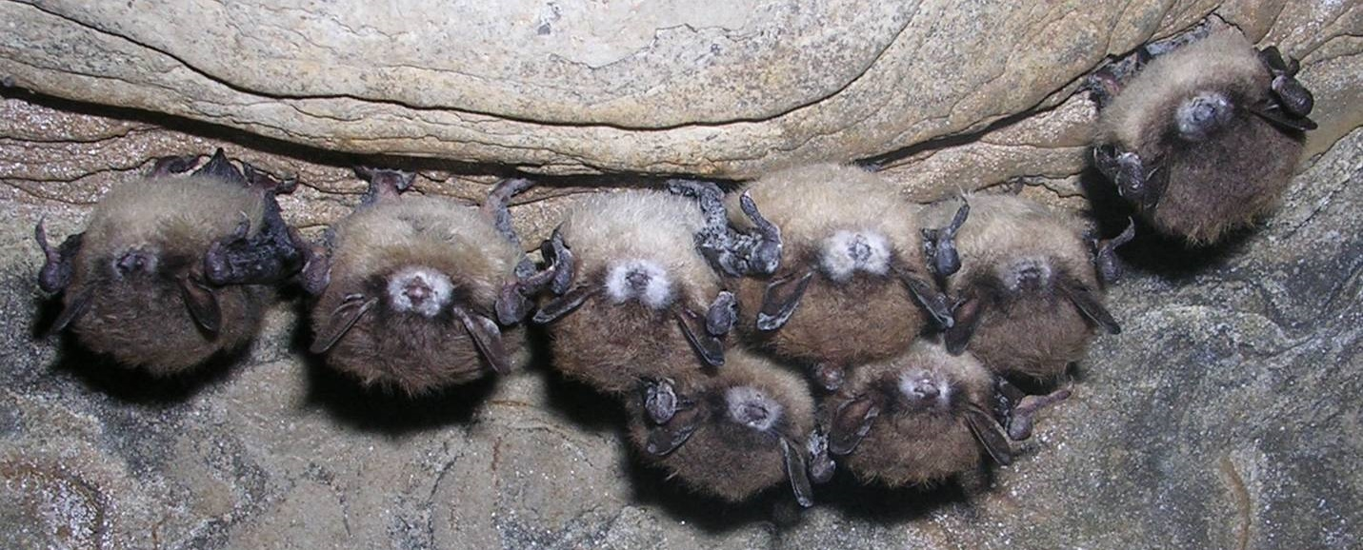
White-Nose Syndrome: A Deadly Bat Disease
Notes:
Today we will be discussing a deadly bat disease called white-nose syndrome and the importance of bats to our ecosystems and economy.

Slide 2
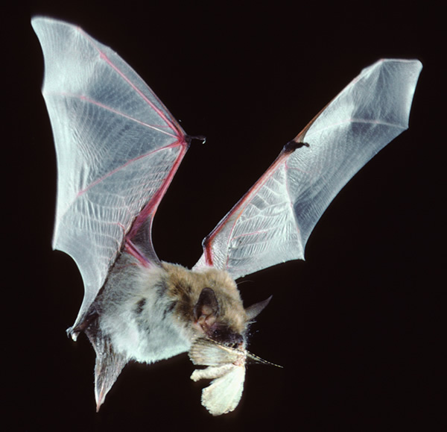
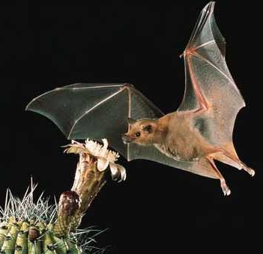
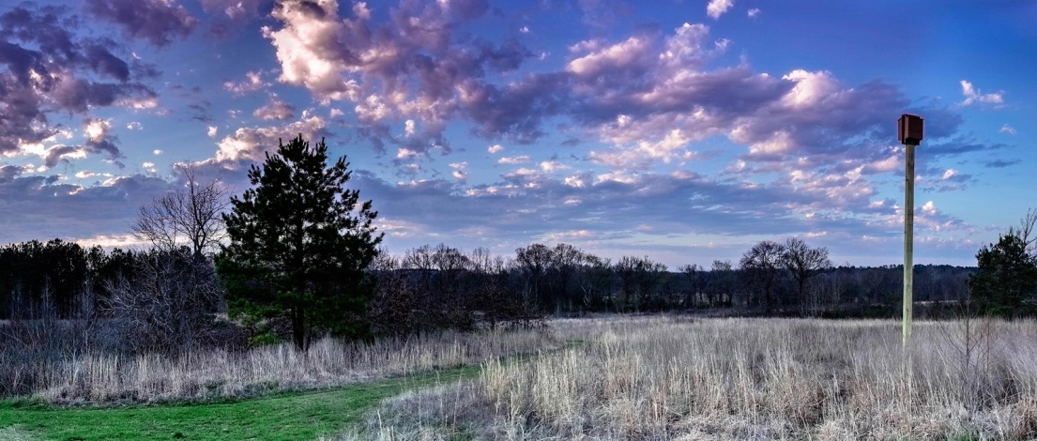
Why are bats important?
Provide essential ecosystem services:
Pest control – save billions of dollars
Feed on pesky insects (e.g., mosquitos)
Pollinators (e.g., bananas, agave, cactus)
Disperse seeds – especially in tropics
Photo: M. Tuttle
Photo; BCI
Photo: NE Ecological Services
Notes:
Why are bats important and why should we care about protecting them? Bats provide essential ecosystem services including feeding on insects that are pests in the agriculture industry and those that are disease vectors such as mosquitoes.

Slide 3
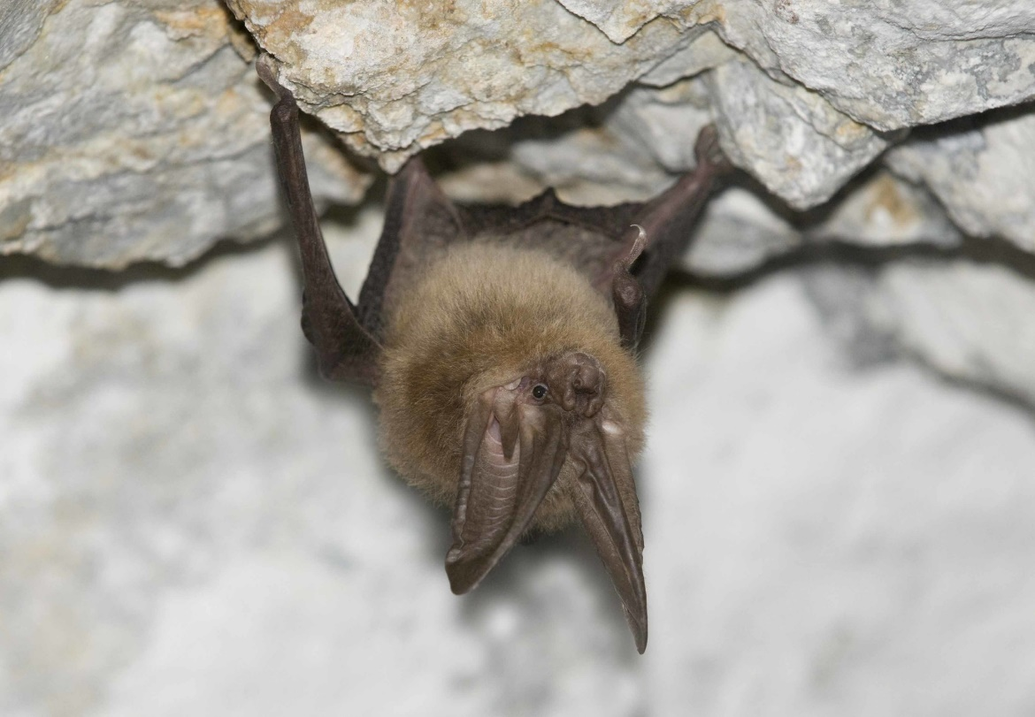
Bats in Washington
Washington has 15 of the 32 species who reside in North America.
The list includes:
Big brown bat
California myotis (bat)
Canyon Bat
Fringed myotis (bat)
Hoary Bat
Little brown bat
Long-legged myotis (bat)
Pallid bat
Red bat
Silver-haired bat
Spotted bat
Townsend’s big-eared bat
Western Long-eared bat
Western small-footed myotis (bat)
Yuma myotis (bat)
Washington bats are microchiroptera meaning “small hand.” They are strictly insectivorous and use echolocation to find their prey.
Photo; BCI
Notes:
All of Washington bats eat insects, but there are some species in other parts of North America that feed on pollen or fruit, therefore they act as pollinators for some plants such as agaves or bananas as well as disperse seeds to help with forest regeneration.

Slide 4
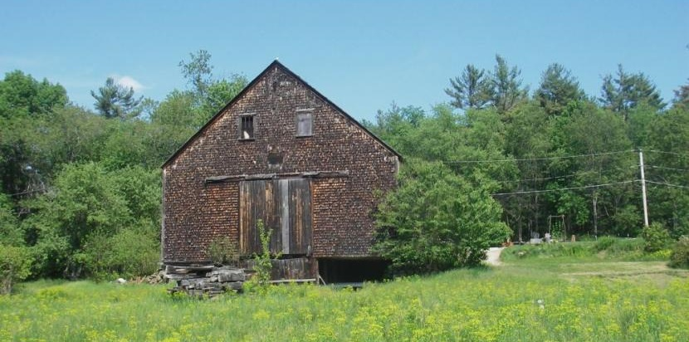
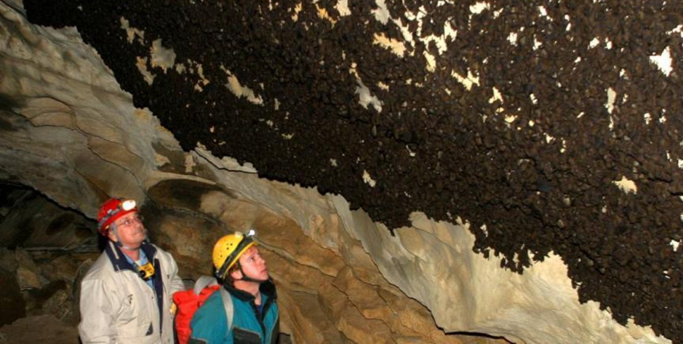
Threats to Bats
Degraded or loss of roosting and foraging habitat
Disturbances at roosts
Wind Energy
About 600,000 bats per year killed
Emerging infectious disease, e.g., white-nose syndrome (WNS)
Persecution and/or disturbance by humans
Exterminating in homes, disturbance of hibernacula, bushmeat trade, guano mining
Photo: Requiem for NH
Photo; BCI
Photo: USGS
Notes:
Unfortunately, there are several threats to bats.
Degraded or loss of roosting or foraging habitat.
Disturbances at roosts which can result in roost abandonment and use of less favorable habitats that may effect their survival and reproduction success.
Wind energy is also a more recent threat to bats, causing high mortality rates among some species.
And lastly, emerging infectious diseases such as white-nose syndrome pose a serious threat to bat populations and is why we are here today.
In Washington, WNS is a new threat and will be the focus of the rest of this presentation.

Slide 5
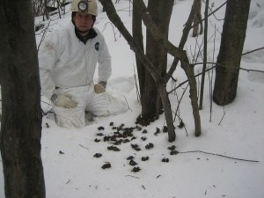
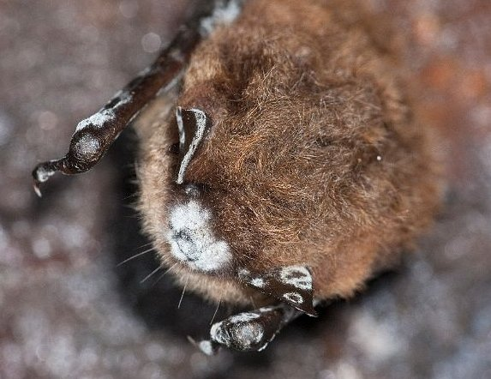
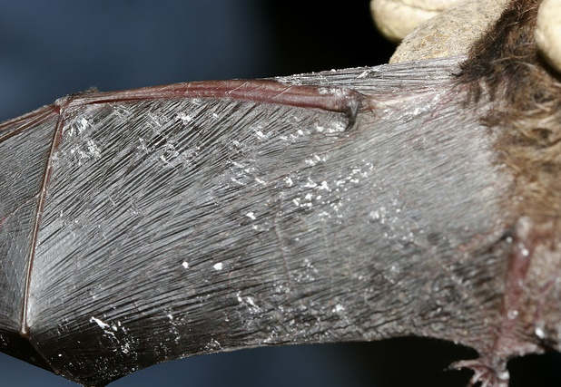
White-nose Syndrome
WNS first discovered in North America in 2006/2007: cave in New York
35 states and seven provinces confirmed
Evidence of causative agent in four add’l states
Fungal disease – causative agent Pseudogymnoascus destructans (Pd)
Cold loving fungus (4 – 14 ºC, >90% relative humidity)
Invasive species, likely of foreign origin
Evidence of vast Eurasia distribution
Photo: Requiem for NH
Photo: MI DNR
Photo: L. Master
Photo; BCI
Photo: R. Von Linden
Photo: USGS
Notes:
So what is white-nose syndrome and what do we know about it?
WNS was first discovered in North America during the winter of 2006/2007 in a cave in New York. It is a fungal disease – a white fungus grows on the face, ears, and wings of bats during hibernation.
The fungus makes the bat wake up – uses fat reserves.
No prey available during winter.
Starvation, dehydration, unable to fly, etc.
Has killed up to 100% of hibernating populations.

Slide 6
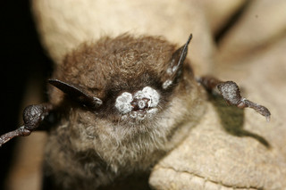
White-nose Syndrome
The fungus is believed to be spread by bat-to-bat or bat-to-environment contact. Scientists think it is also being spread by humans who enter hibernacula carrying fungal spores on their clothing, shoes, or equipment.
If a bat becomes infected with WNS during their winter hibernation, the fungus can grow on the bat’s nose, wings, and ears giving it a white, fuzzy appearance.
Photo: Requiem for NH
Ryan von Linden/New York Department of Environmental Conservation
Photo; BCI
Marvin Moriarty/USFWS
Notes:
The disease is primarily transmitted by bat-to-bat or bat-to-environment contact but humans have been shown to spread the fungus inadvertently on footwear, clothing, or equipment used in contaminated areas.
This is how it was believed to arrive in North America from Europe.
WNS does not effect humans or other wildlife.

Slide 7
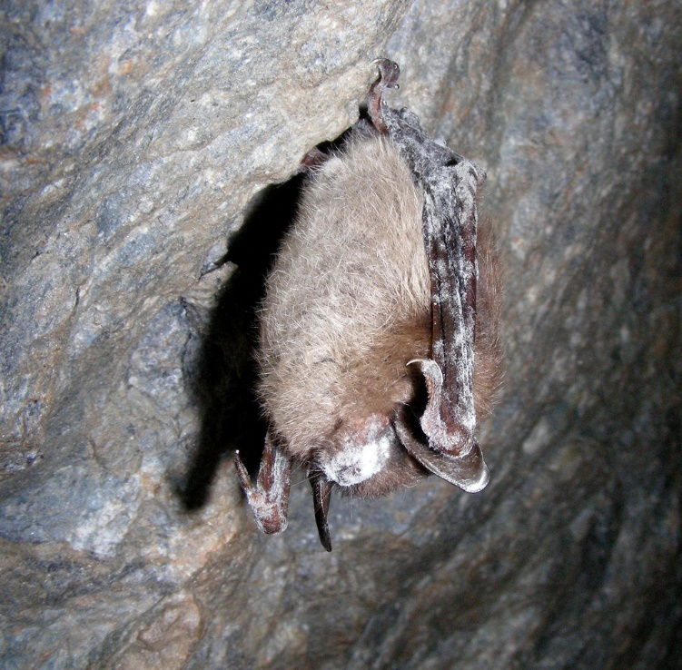
White-nose Syndrome
The fungus grows into the soft tissue of the bat and causes dehydration.
Affected bats arouse more often during hibernation which causes them to use crucial fat reserves, leading to possible starvation and death.
Additional causes of mortality from the disease include wing damage, inability to regulate body temperature, breathing disruptions, and dehydration.
Photo: Requiem for NH
Ryan von Linden/New York Department of Environmental Conservation
Marvin Moriarty/USFWS
Photo; BCI
Notes:
The disease is primarily transmitted by bat-to-bat or bat-to-environment contact but humans have been shown to spread the fungus inadvertently on footwear, clothing, or equipment used in contaminated areas.
This is how it was believed to arrive in North America from Europe.
WNS does not effect humans or other wildlife.

Slide 8
Notes:
This is the current distribution of WNS as of 2019 You can see ground zero in New York and how its spread since 2006. It has spread somewhat expectantly until 2016 when it was found in Washington.

Slide 9
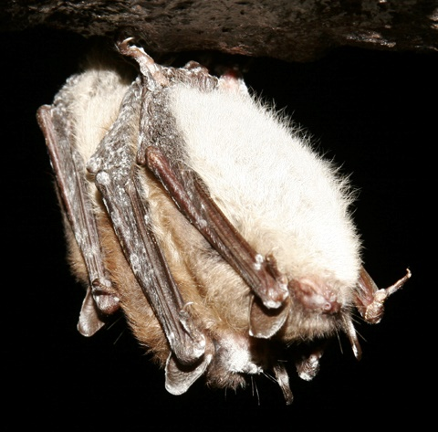
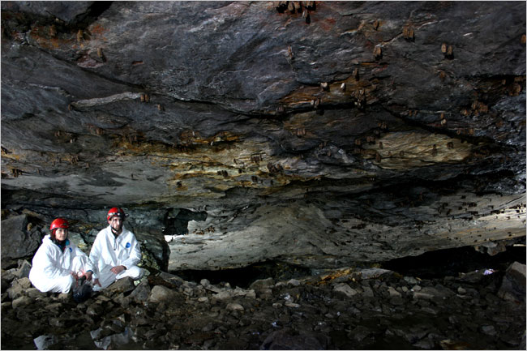
White-nose Syndrome
Killed >6 million hibernating bats in Eastern North America
>90% mortality rate at some hibernacula
Transmitted by bat-to-bat or bat-to-environment contact
Humans shown to inadvertently spread
Does not infect humans or other wildlife
Photo: Requiem for NH
Photo: R. Von Linden
Photo; BCI
Notes:
The disease is primarily transmitted by bat-to-bat or bat-to-environment contact but humans have been shown to spread the fungus inadvertently on footwear, clothing, or equipment used in contaminated areas.
This is how it was believed to arrive in North America from Europe.
WNS does not effect humans or other wildlife.

Slide 10
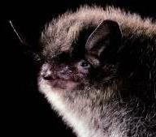
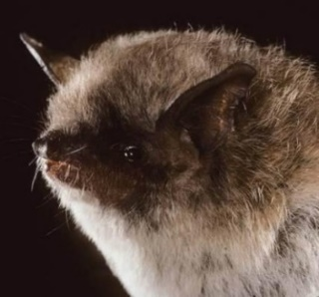
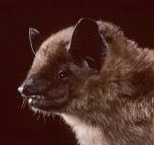
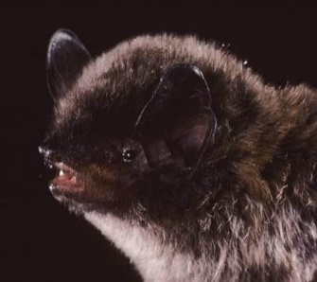
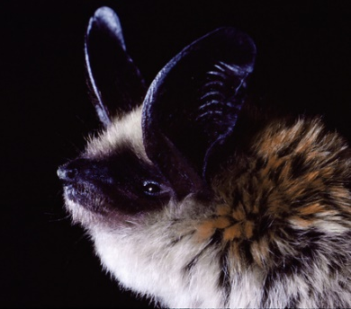
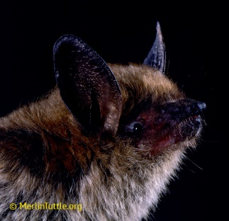
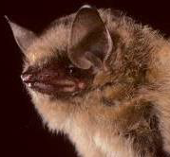
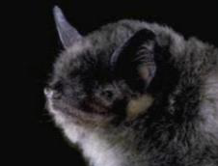
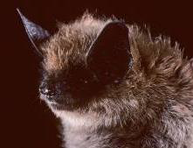
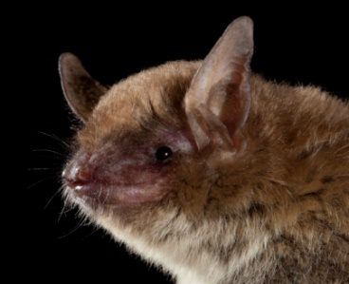
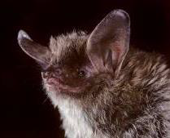
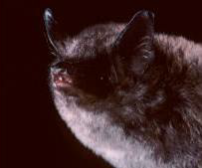
13 Species Confirmed with WNS
Photo: Requiem for NH
Little brown bat
(Myotis lucifugus)
Yuma myotis
(Myotis yumanensis)
Big brown bat
(Eptesicus fuscus)
Long-legged myotis
(Myotis volans)
Western long-eared myotis
(Myotis evotis)
Fringed myotis
(Myotis thysanodes)
Tri-colored bat
(Perimyotis subflavus)
Gray bat
(Myotis grisescens)
Eastern small-footed bat
(Myotis leibii)
Cave myotis
(Myotis velifer)
It’s unknown what other western bat species will be impacted.
Northern long-eared bat
(Myotis septentrionalis)
Southeastern bat
(Myotis austroriparius)
Indiana bat
(Myotis sodalis)
Photos: M. Tuttle
Notes:
There are 13 species confirmed with WNS currently. The impacts of WNS on these species varies, but have been particularly detrimental to these 4 species which as warranted their listing as endangered or threatened in some states as well as the Northern being listed as federally threatened. The species found in WA include the little brown bat, Yuma myotis, big brown bat, fringed myotis, Western long-eared myotis and long-legged myotis. There are 10 other species in WA though that we do not know If they are vulnerable to WNS.

Slide 11
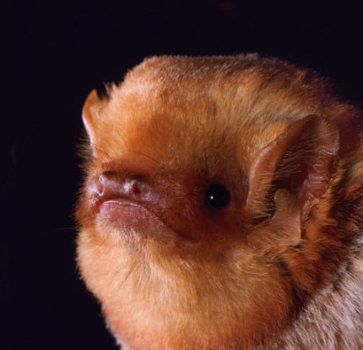
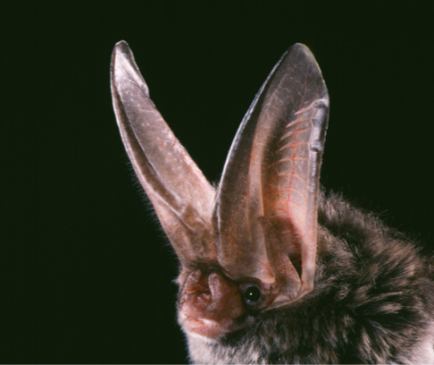
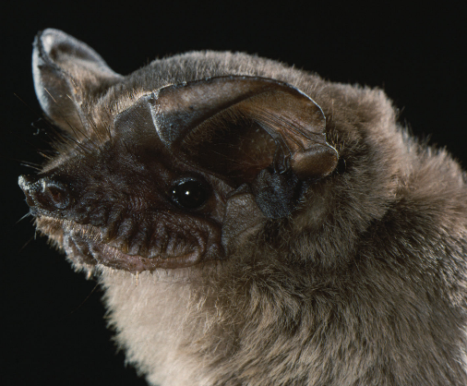
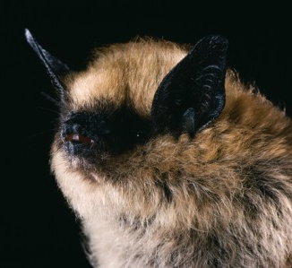
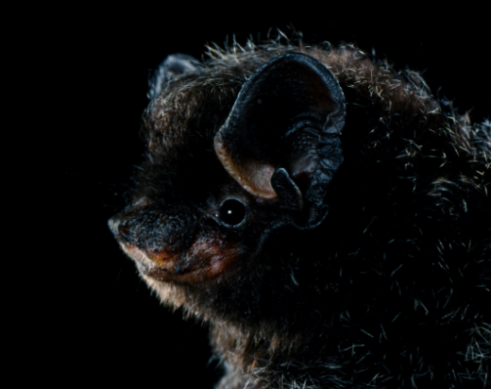
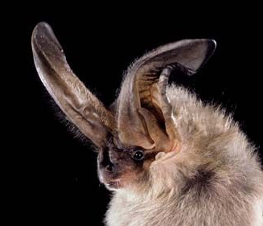
6 Species Confirmed to carry Pseudogymnoascus destructans
Eastern red bat
(Lasiurus borealis)
Rafinesque’s big-eared bat
(Corynorhinus rafinesquii)
Mexican free-tailed bat
(Tadarida brasilensis)
Western small-footed myotis
(Myotis ciliolabrum)
Silver-haired bat
(Lasionycteris noctivagans)
Townsend’s big-eared bat
(Corynorhinus townsendii)
Unknown what other western bat species can transmit Pd
Photos: M. Tuttle
Notes:
There are also species that have been found to carry the fungus Pseudogymnoascus destructans (Pd), but not get affected by white-nose syndrome. Five of these species are found in western North America. Again, we are unsure which other species found in WA are capable of transmitting Pd.

Slide 12
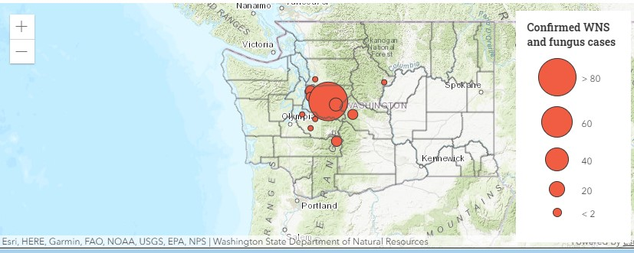
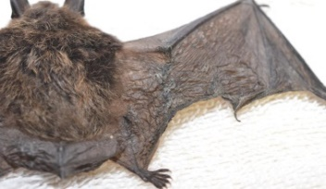
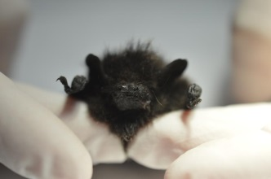
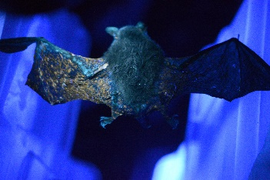
WNS in Washington
Photo: Requiem for NH
The presence of the fungus on the bat's wing illuminates a bright orange color when put under a UV light.
Little brown bat (Myotis lucifugus)
Photo; BCI
Silver-haired bat (Lasionycteris noctivagans)
Yuma myotis (Myotis yumanensis)
Notes:
Counties with confirmed cases of white-nose syndrome
King
Pierce
Kittitas
Counties confirmed to have the fungus present that causes white-nose syndrome
Chelan
King
Kittitas
Lewis
Pierce
Snohomish

Slide 13
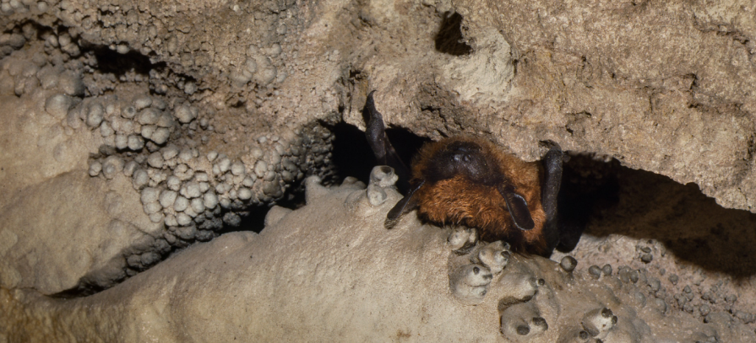
WNS in Washington
What are the potential impacts on Washington’s bat populations?
Roosting ecology for Washington bat species unclear
Use of hibernation
Winter roost selection
Roost conditions
Maternity roosts
Photo; BCI
Photo: M. Tuttle
Notes:
After the discovery of WNS and subsequent detections, one of the main questions has been what are the potential impacts on WA bat population? Will it be as severe as in Eastern North America? There are aspects of the roosting ecology of many species in Washington that are unclear that make it difficult to answer that question. For example, we are unsure where many bat species hibernate, which makes it difficult to know if their hibernacula provide conditions suitable for Pd persistence. Washington Department of Fish and Wildlife conducts work outside of the winter period at summer/maternity colonies, but we don’t have information on these locations as well for some species, making it problematic to track the progression of the disease in some areas and in some species.

Slide 14
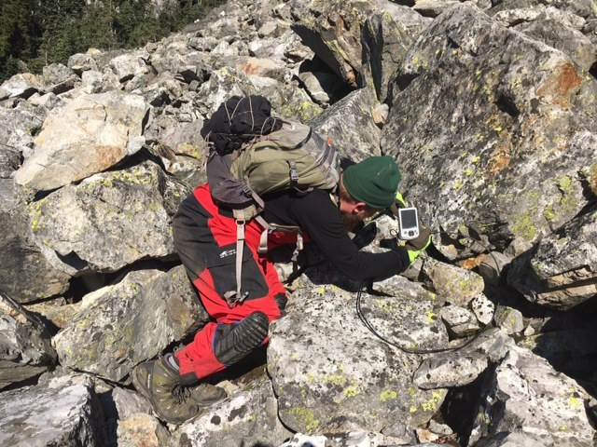
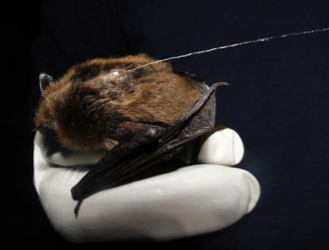
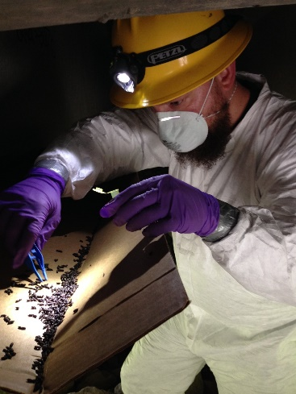
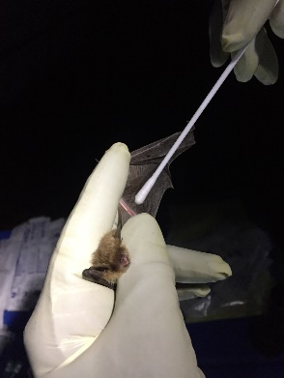
How are bat biologists helping?
WDFW biologists have partnered with federal wildlife agencies and local organizations to survey and monitor the spread of WNS.
This includes swabbing bats for WNS, doing regular bat counts, monitoring hibernacula, tracking bats, and educating the public about WNS and the importance of bats.

Slide 15
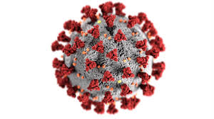
What about bats and COVID-19?
Scientists are still investigating the origins of how the virus responsible for the COVID-19 pandemic got into the human population.
Regardless of the viral origins, COVID-19 is now a human disease and the risk of getting sick is from another person, not from wildlife. You cannot catch COVID-19 from a bat.
According to Bat Conservation International:
“Bats are natural hosts to coronaviruses, including some that are closely related to the SARS-CoV-2 virus that caused COVID-19. Other wildlife can also be hosts to coronaviruses. Bats with coronaviruses in the wild are not a threat to human health if protected and left undisturbed. Bats and other wildlife do not spread the disease among humans—only humans spread COVID-19 to other humans.”
Photo; BCI

Slide 16
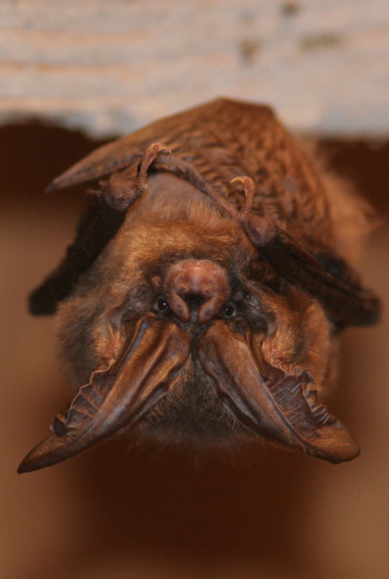
Other batty myths
Contrary to some popular belief, bats are not blind. Bats have excellent hearing and good eyesight.
Bats do not become entangled in peoples' hair. If a flying bat comes close to your head, it's probably because it is hunting insects that have been attracted to your body heat.
All bats don't have rabies. In fact, it's estimated that less than 1% of bats get rabies.
No Washington bats feed on blood.
Notes:
If a bat does contract rabies, it is unlikely to be a threat to humans as long as simple precautions are followed. Most bats infected with rabies become paralyzed and fall to the ground. (Note: Young bats also fall to the ground when learning to fly. They may also have hit a window and been stunned, or simply be cold and unable to fly.) This means a person may contract rabies from a bat only if they pick up a sick bat, which then bites the person in self-defense. Thus, if you do not handle bats, your odds of contracting rabies are extremely small.

Slide 17
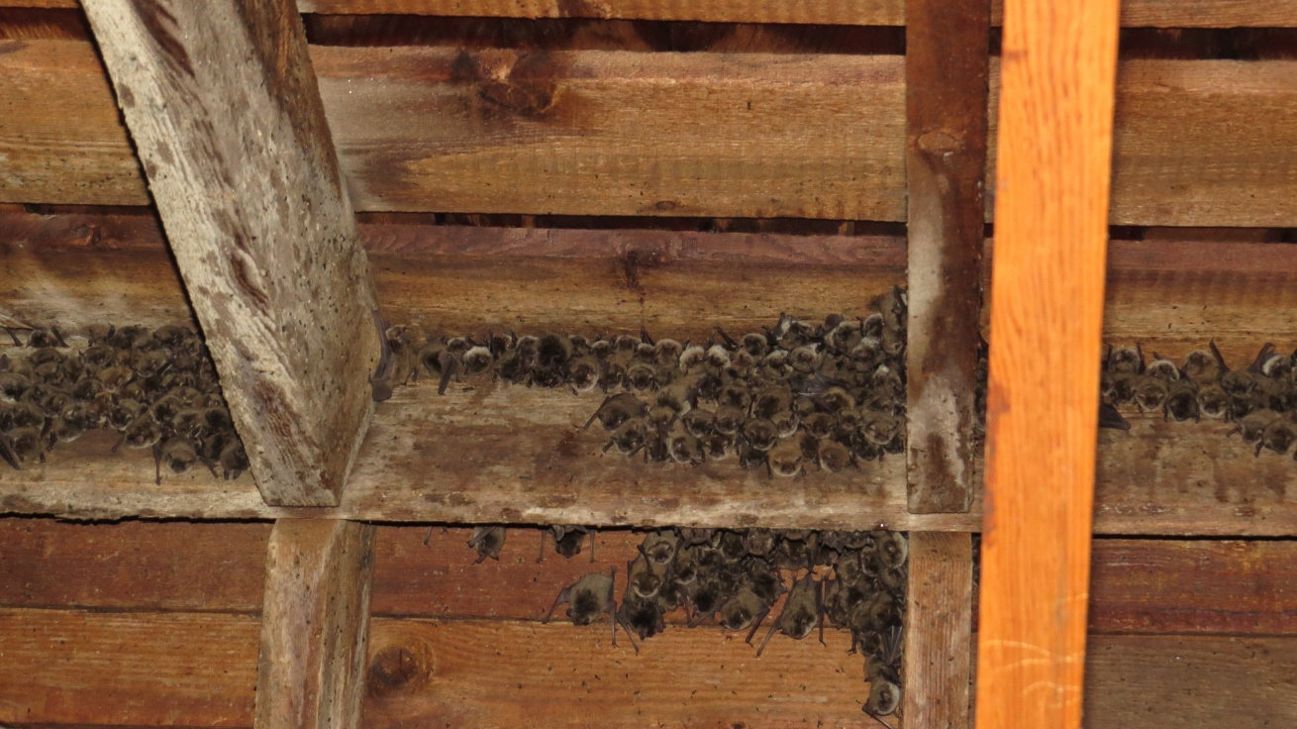
Report groups of bats you see using the online observation reporting form. This information will help WDFW understand our bat populations and monitor white-nose syndrome in Washington. Do not handle live bats. If you have found a sick or dead bat, please report it using the online reporting form. Avoid entering areas where bats may be living to limit the potential of transmitting the fungus that causes the disease and disturbing vulnerable bats. Do not allow pets to access areas where bats may be roosting or overwintering as they may carry the fungus to new sites.
Don’t forget:

Slide 18
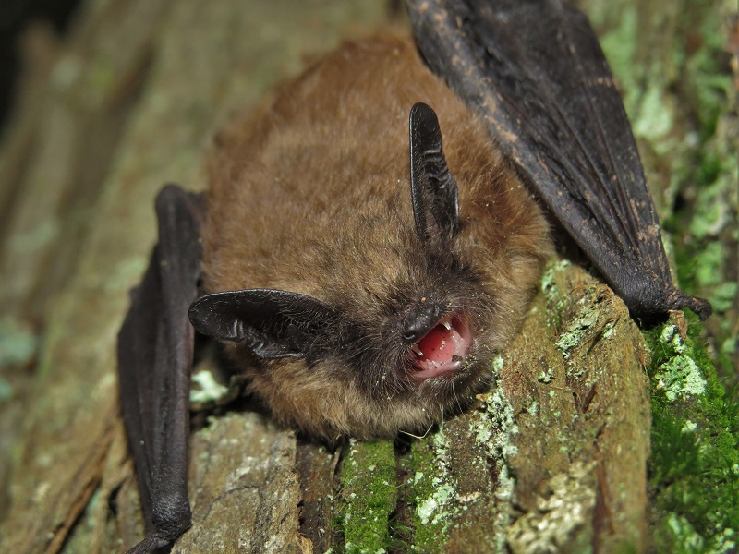
If you find a bat:
Outdoors 1. Do not touch the bat. Leave it in place. 2. For the bat's protection, practice physical distancing and keep 6 feet away from the bat. 3. If the bat must be moved, use a shovel or long-handled tool to pick it up and move it. 4. Report sick, injured, or dead bats online. Please also report groups of bats. These reports provide valuable information to track bat populations in Washington. 5. Remember - a small percentage of bats can carry rabies. If you have touched a bat or suspect exposure, contact your local Department of Health immediately.
In your home 1. If you have touched a bat or suspect exposure, contact your local Department of Health immediately.
For more information on bats in Washington and how to exclude them from buildings, visit our Living with Wildlife webpage.

