Slide 1
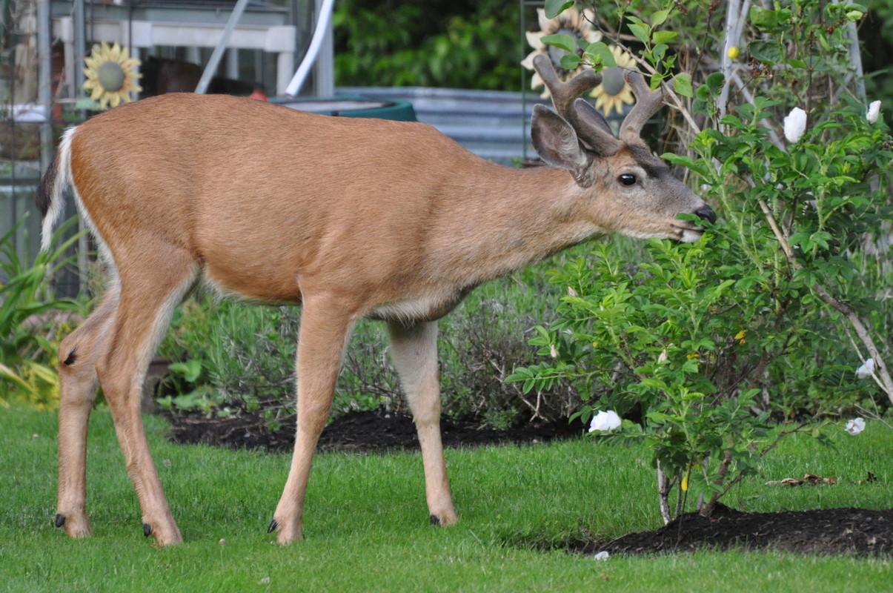
Living with Wildlife

Slide 2


What is wildlife?
Notes:
It may seem like a simple question, but ask students what it means for an animal to be considered wildlife?

Slide 3
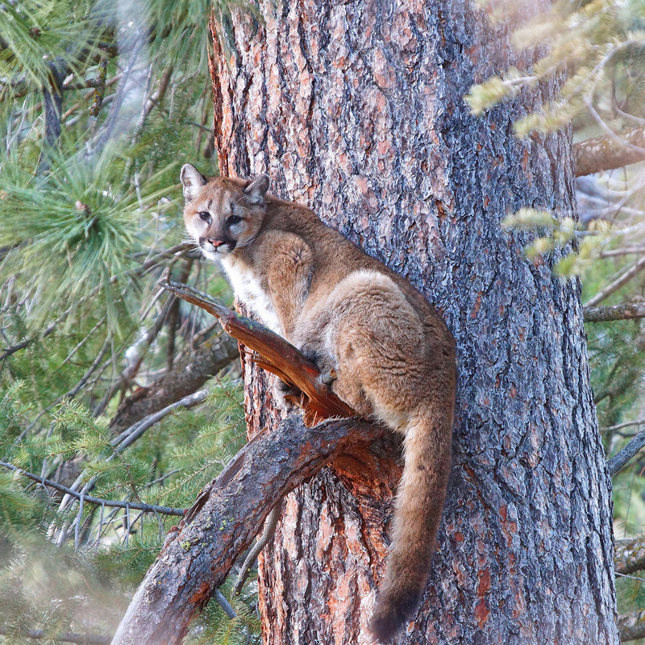
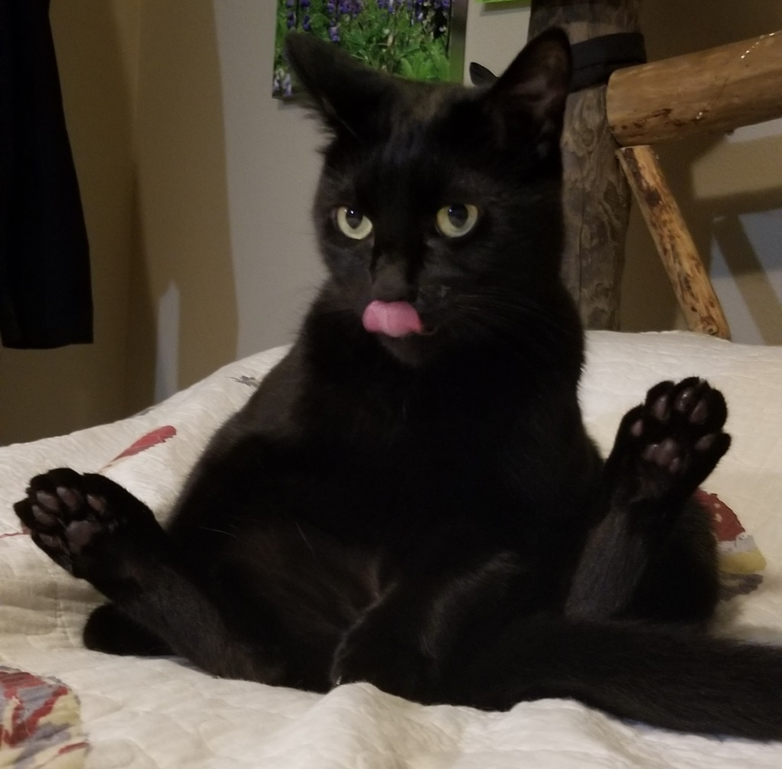
How are wildlife and domestic animals different?
Domestic animals have been selectively bred by humans over many generations.
Wild animals have survived in their ecosystems for the entire existence of their species. They have never been selectively bred for the purposes of humans.
Notes:
There are differences between wildlife and domestic animals

Slide 4
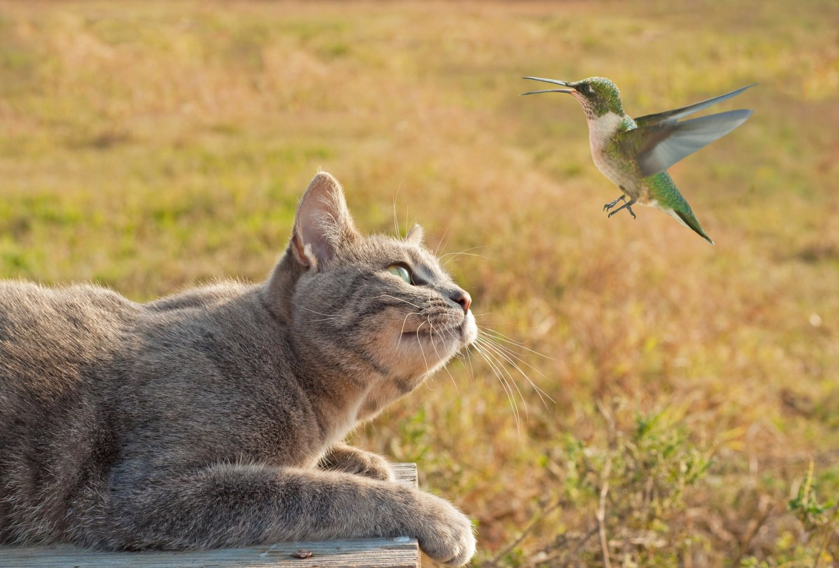
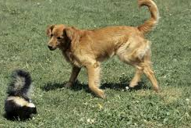
Do wildlife and domestic animals ever share spaces?
Photo courtesy of Birdlife International
Notes:
Ask students to name examples of spaces wildlife and domestic animals might share. Click to show the pictures after they share some examples. In the above photos we have a domestic cat interacting with a humming bird and a domestic dog interacting with a skunk.

Slide 5
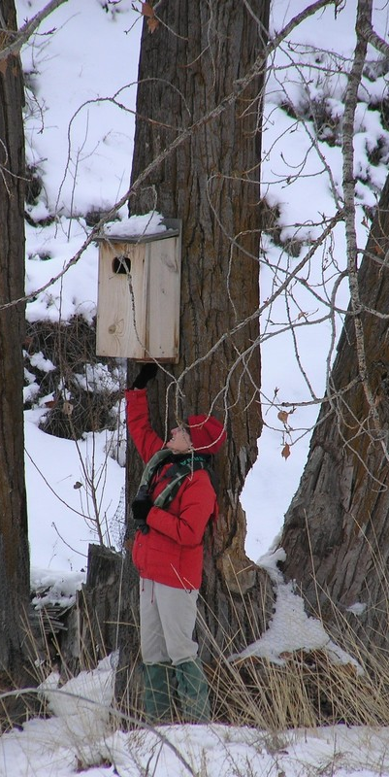
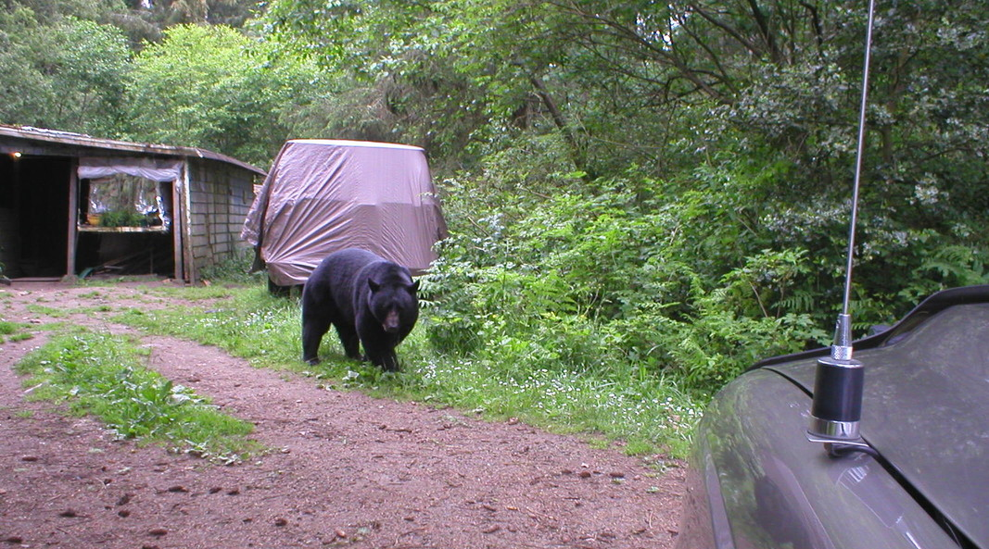
Do wildlife and people ever share spaces?
Notes:
What sort of spaces does wildlife share with humans? Can domestic animals, humans and wildlife ever share the same spaces? Do you think this has a positive impact or negative impact on humans?

Slide 6
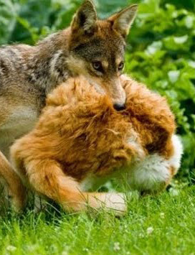
Sharing spaces
Sometimes problems arise when humans, domestic animals, and wildlife all share the same space.
Notes:
A recent study by the National Park Service found that urban coyotes eat mostly garbage and domestic cats. How might eating a diet of mostly garbage affect coyotes? How does this impact cat owners in urban areas? What ideas might you have that could solve this issue between coyotes, humans, and domestic animals?

Slide 7
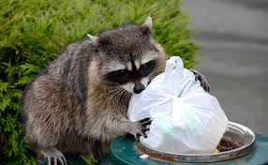
Human-wildlife interactions
As urban spaces expand and humans move into more suburban and rural areas, wildlife habitat becomes fragmented, making human-wildlife interactions more likely to increase.
Scientists predict we may also see more human-wildlife interactions as climate change shifts ranges of species. ​
Photo courtesy of Missouri Department of Conservation
Notes:
As habitat fragmentation occurs, some species like coyotes adapt to changing environments and feed upon a new prey source.
Raccoons are often referred to as “trash pandas”. What could humans do to mitigate raccoons getting into garbage cans?

Slide 8
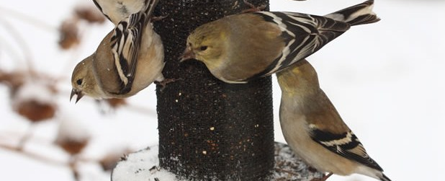
Why do these problems occur?
With a partner, think about the previous slides.
What could be some root causes of coyotes, bears, and raccoons living in or visiting residential areas?
How might people avoid attracting wildlife?
Can humans negatively affect wildlife behavior?
Can humans positively affect wildlife behavior?

Slide 9
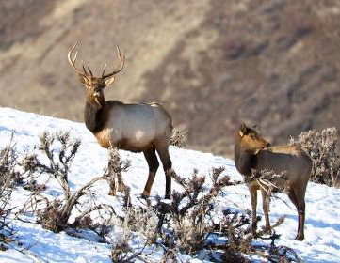
Human-wildlife conflict often begins when wild animals are fed by humans.
Can you think of examples where people feed wildlife?​
​
Why might people want to avoid
attracting wildlife? ​
How can people avoid attracting
wildlife?
Feeding Wildlife

Slide 10
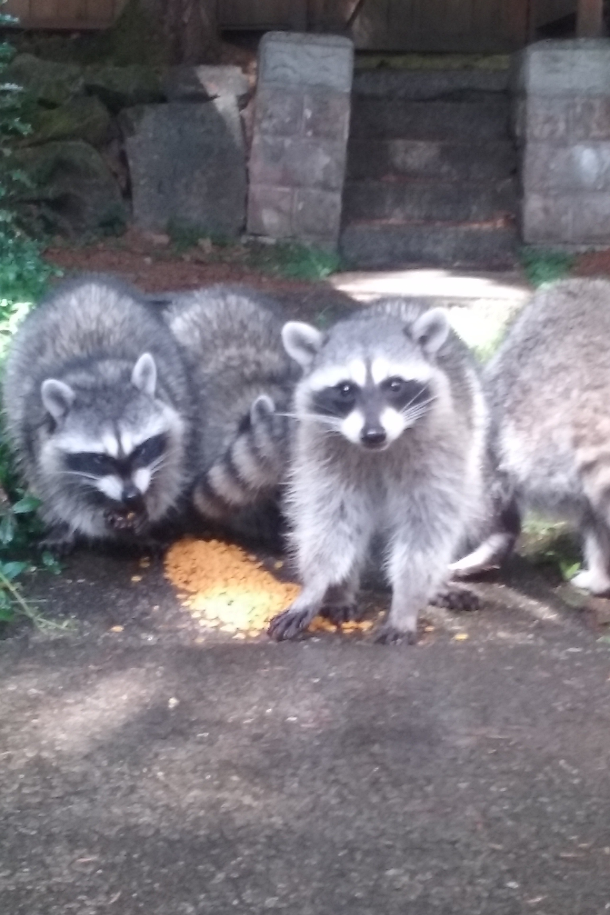
Feeding wildlife
Although well-intentioned, feeding wildlife can have a series of harmful impacts to both people and wildlife.
What do you think these impacts might be?
Notes:
In addition to being bad for the animals' health, feeding wildlife makes them more vulnerable to disease, predation and poaching. Additionally, it may bring wildlife into unwanted areas like farms and neighborhoods.
Have students brainstorm what harmful interactions might occur when people feed wildlife. Some examples may include:
People feed the animal something not naturally part of its diet (such as the raccoons eating goldfish in the picture) this could be harmful to the animal's health.
Feeding prey species such as elk and deer might also bring in unwanted carnivores such as cougars and bears.
Animals might become reliant on humans for food and continue to enter human spaces looking for food. Not everyone in the community wants wildlife near their homes.

Slide 11
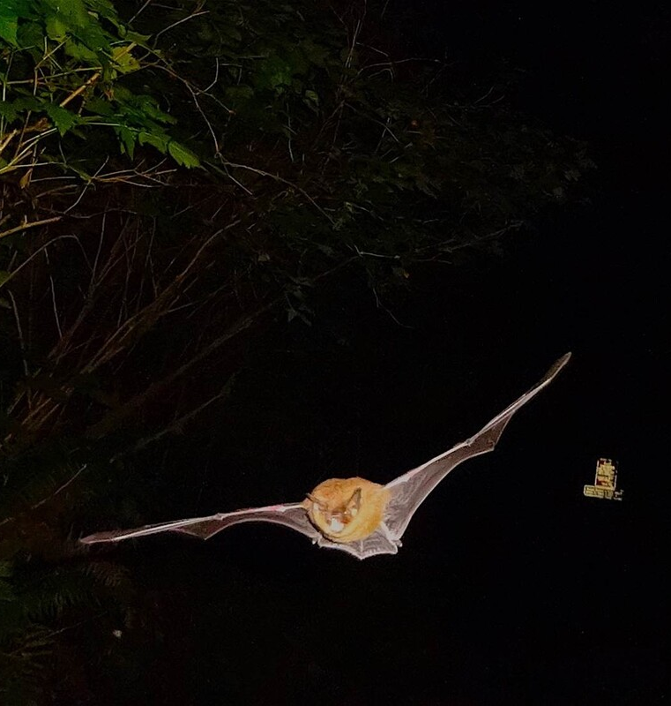
Are there any benefits to living with wildlife?
Wildlife provide many benefits to humans. These benefits are known as ecosystem services.
For example:
  Bats eat thousands of insects that bug us, literally!
  The carcass from cougar prey feeds many other animals and enriches the soil, keeping our forests and deserts healthy.
Notes:
Introduce concept of ecosystem services-benefits people obtain from ecosystems and organisms who live in the ecosystems

Slide 12
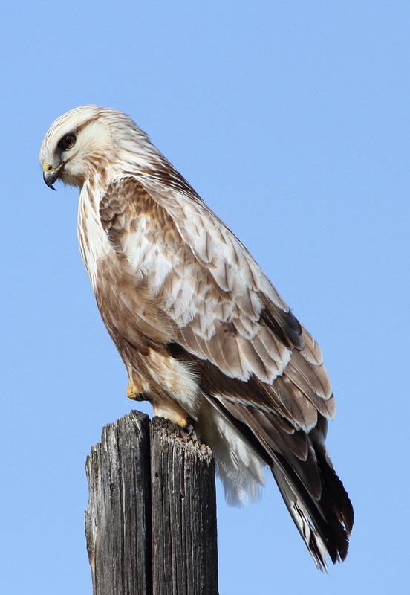
Can humans help wildlife?
You bet! Sometimes our actions have positive, though unintentional, effects on wildlife.
For example:
  Electricity poles and fencing provide a variety of perch options for hawks looking for rodents in fields.
  Abandoned buildings create roosts for hibernating bats.
  Docks create places for seals to give birth to their pups.
Notes:
Introduce concept of ecosystem services-benefits people obtain from ecosystems and organisms who live in the ecosystems

Slide 13
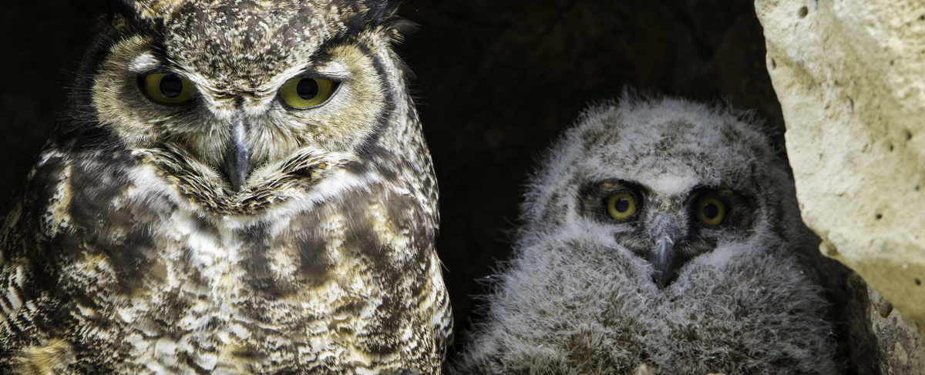
So can we live together?
It’s a tricky question.
Human-wildlife interactions require different solutions that are dependent upon the species and people involved.
It takes a variety of people from different backgrounds with differing viewpoints to come together to find solutions and learn how to co-exist with wildlife.
Notes:
Introduce co-existence here- helping people share the landscape with wildlife.

Slide 14
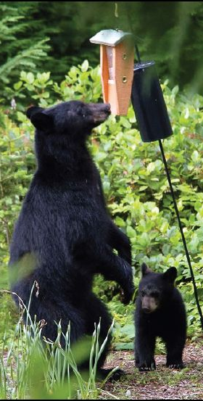
Human-wildlife conflict?
What are some ways that humans and wildlife experience conflict in your: neighborhood, town, city, county, or state?
Notes:
Ask students to name ways they know about humans and wildlife coming into conflict with each other. Make sure to write these topics down and send them out on a shared document to students.

