Slide 1
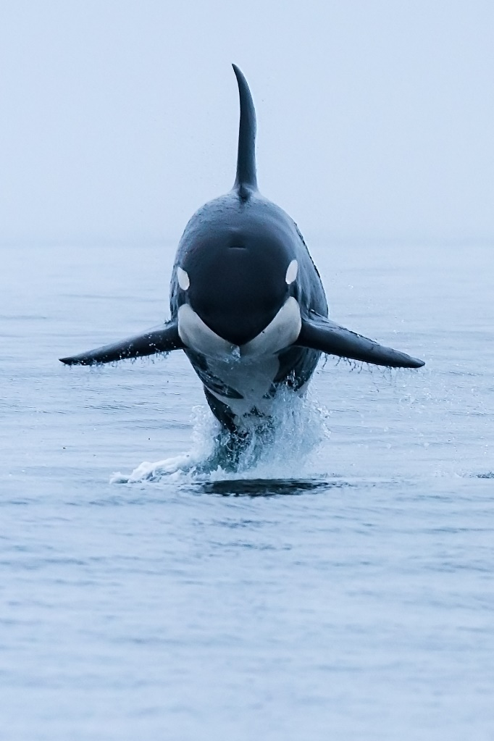
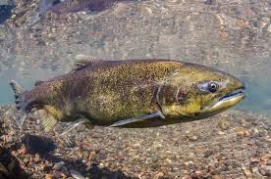
Salmon and orcas in the Salish Sea
Photo courtesy of University of Washington

Slide 2
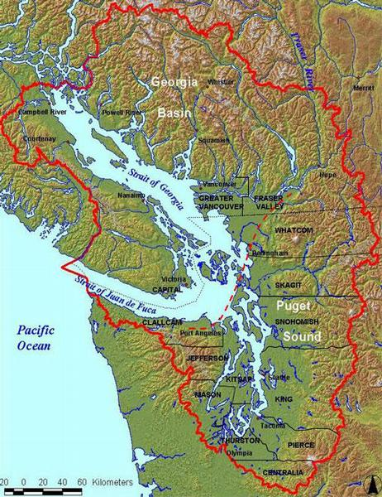
First, let’s get to know salmon
There are five kinds of salmon who live in the Salish Sea.
Photo courtesy of Georgia Strait Alliance

Slide 3
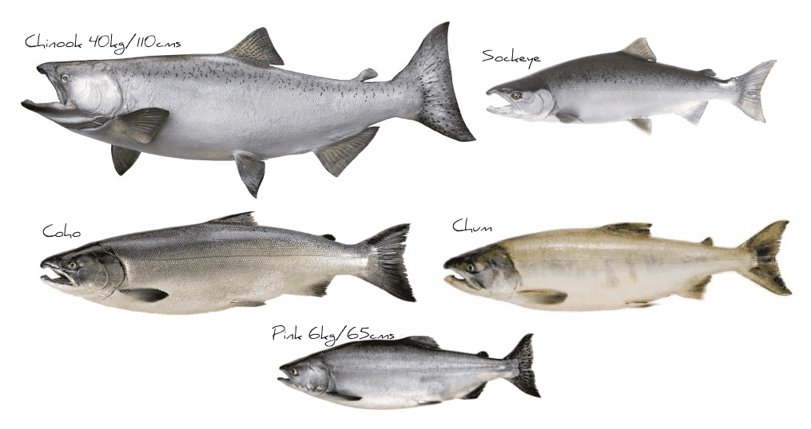
Salmon belong to the genus Oncorhynchus which is Greek for hooked nose.
You may have heard one of these species called by a different name as salmon have many nicknames:
Chinook or king
sockeye or red
coho or silver
chum or dog
pink or humpy

Slide 4
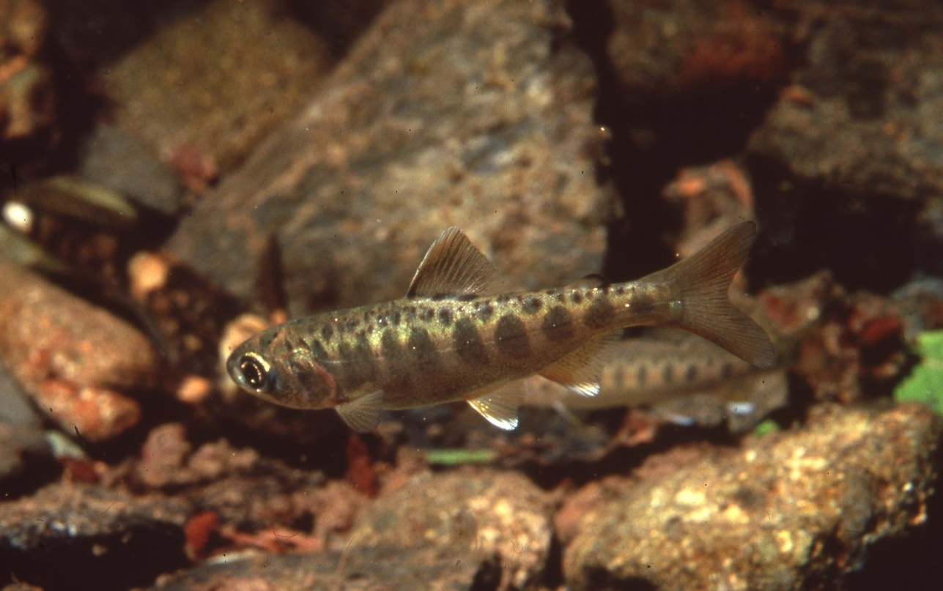
Salmon are anadromous (uh-na-druh-muhs)
This means they are born in freshwater rivers, lakes or streams before migrating to the ocean to spend their adult life.
A juvenile (fry) Chinook salmon in a river.
Notes:
Briefly review the salmon lifecycle graphic with students.

Slide 5
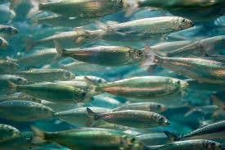
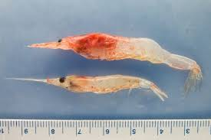
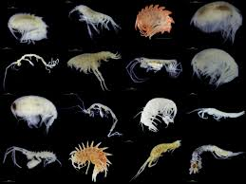
Salmon are anadromous (uh-na-druh-muhs)
While in the ocean, salmon feed on other fishes, amphipods (a small crustacean), and krill. This rich food supply helps them grow quickly.
The different species of salmon spend anywhere between two and five years in the ocean before returning to their natal (home) streams.

Slide 6
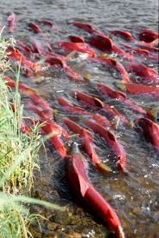
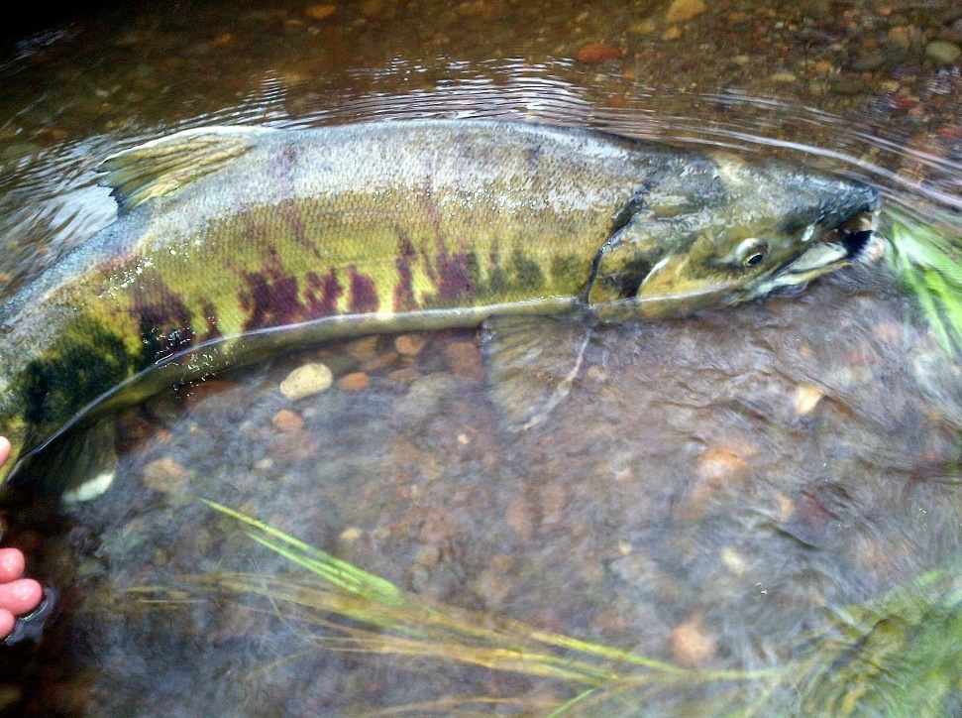
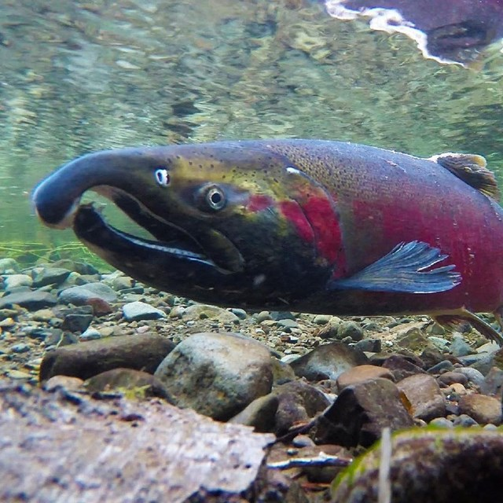
Salmon are anadromous (uh-na-druh-muhs)
When they return to their natal streams, their bodies change color and shape and the salmon spawn and deposit milt (sperm) and eggs into the water.
Sockeye
Chum
Coho
Photo courtesy of NPS.gov
Notes:
Salmon come back to the exact same stream they are born in. They may migrate back to these streams from hundreds or even thousands of miles away.

Slide 7
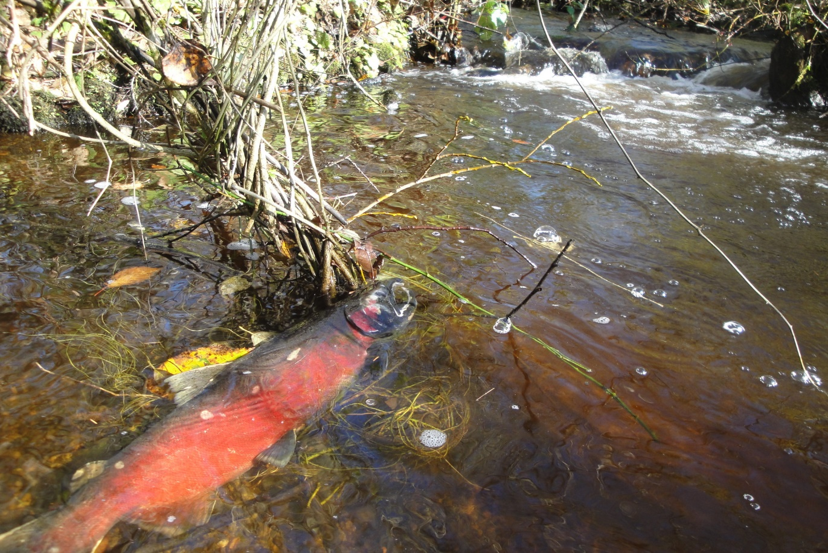
Salmon are anadromous (uh-na-druh-muhs)
After spawning, salmon begin to die, leaving the rich ocean nutrients to help support freshwater ecosystems.
Notes:
After surviving as fry, making it to the ocean to grow, then swimming for miles avoiding predators along the way to make it to thier home stream to spawn their lifecycle comes to a close.

Slide 8
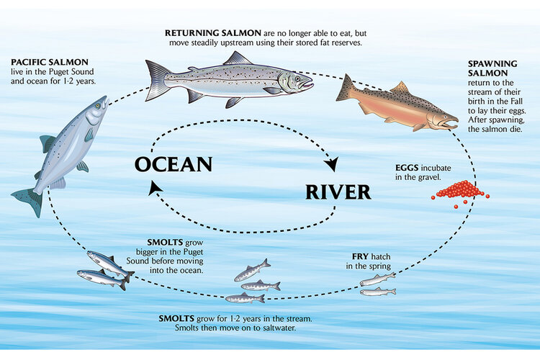
The salmon life cycle
At almost every stage of their life, salmon are an important species for a variety of animals and their ecosystem.
Notes:
Leave this slide on a few moments for students to review the salmon lifecycle. Introduce ecosystem as a vocab word-A system of living organisms and non-living components (rocks, air, wind, etc.) who function together in a specific environment.

Slide 9
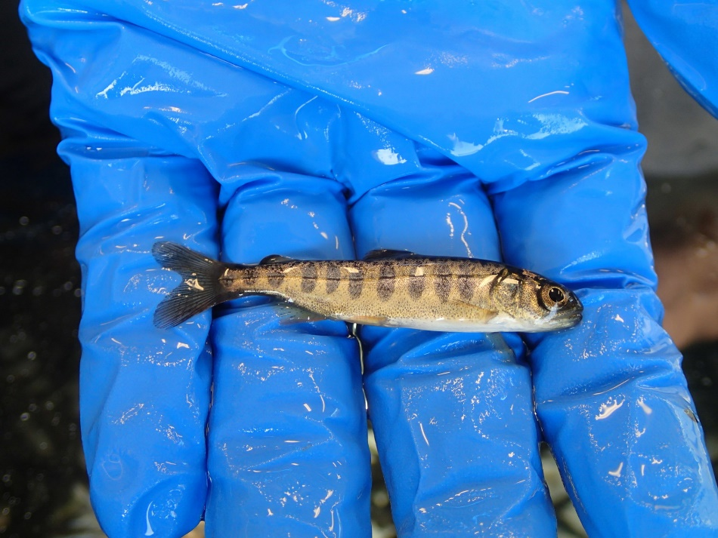
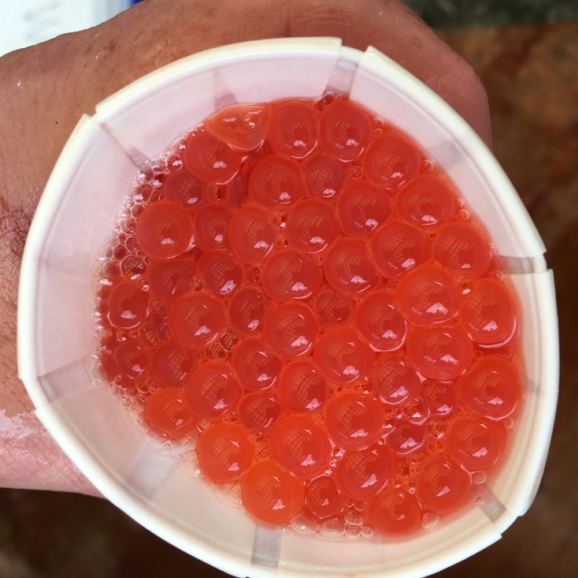
The salmon food web
As eggs they may be eaten by other fish, birds, river otters, raccoons and more.
As a fry, they may be eaten by other fish, snakes, birds, minks and more.

Slide 10
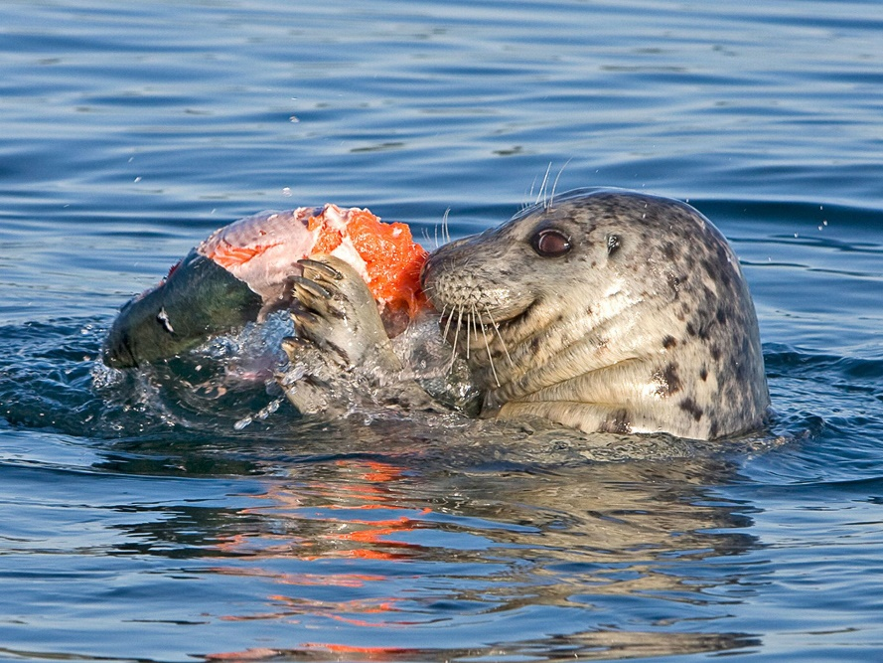
The salmon food web
In the ocean they may be eaten by other fish, dolphins, seals, sea lions, bald eagles, ospreys, sharks, eels, and more.
When back in freshwater to spawn, they may be eaten by bears, bald eagles, osprey, river otters and wolves. Scavengers like ravens, crows, coyotes and foxes will eat leftovers from other species.

Slide 11
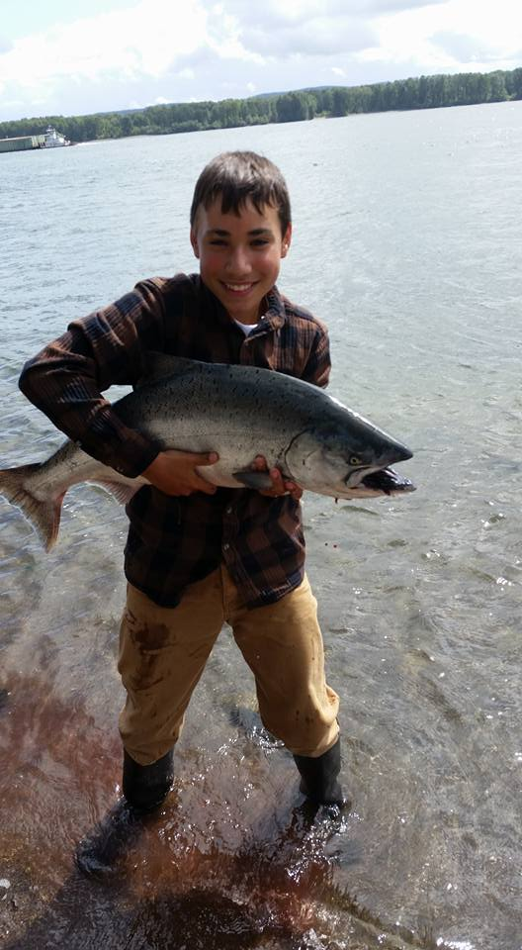
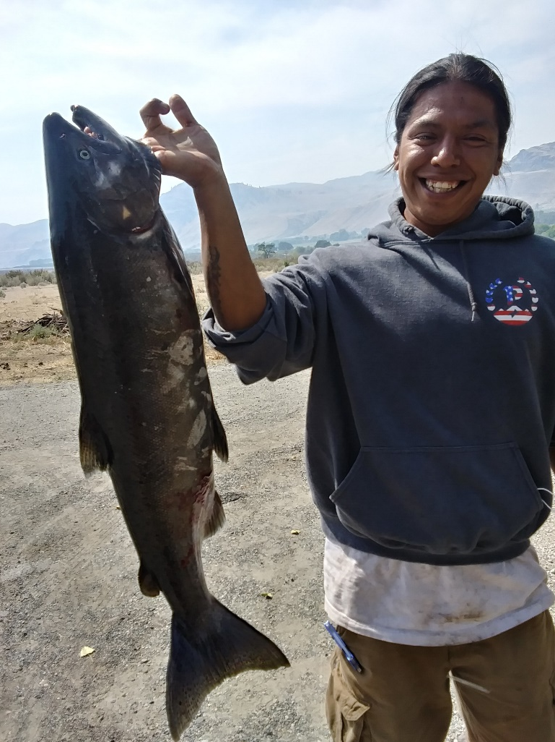
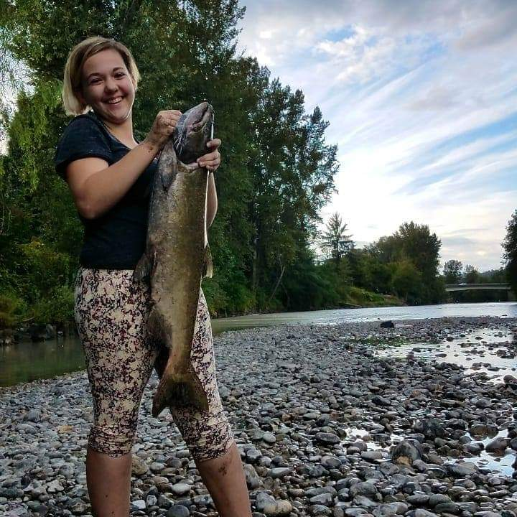
The salmon food web
Humans eat salmon at many of their life stages as well.
I am salmon
Notes:
Click on the I am salmon link to watch the video.

Slide 12
Chinook salmon
Chinook (Oncorhynchus tshawytscha) are the largest of the salmon in Salish Sea and the Pacific Ocean.
On average they are three feet long and weigh 1-12 pounds
That’s about the average size of a Shih Tzu!
Photo courtesy of akc.org
Some populations of Chinook are classified as federally endangered threatened by the United States Fish and Wildlife Service (USFWS). Threats include overfishing, overuse of water resources, passage barriers and habitat loss.
Notes:
Click on the I am salmon link to watch the video.

Slide 13
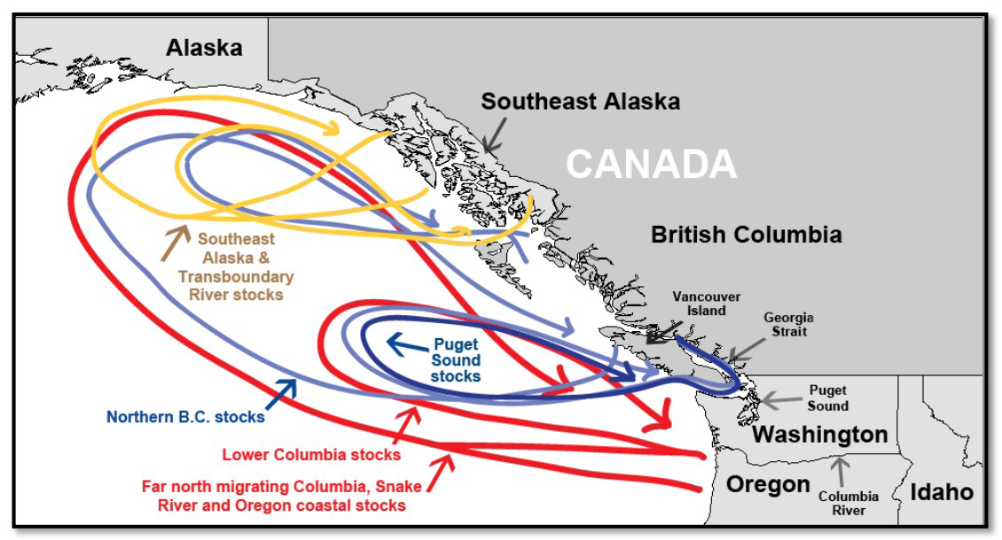
Sharing salmon
Many West Coast Chinook salmon stocks migrate far into the Pacific before returning to West Coast rivers as adults. Several of those returning stocks, such as those from the Columbia River system, overlap with the range of Southern Resident killer whales as they return to the Northwest. Graphic: NOAA Fisheries

Slide 14
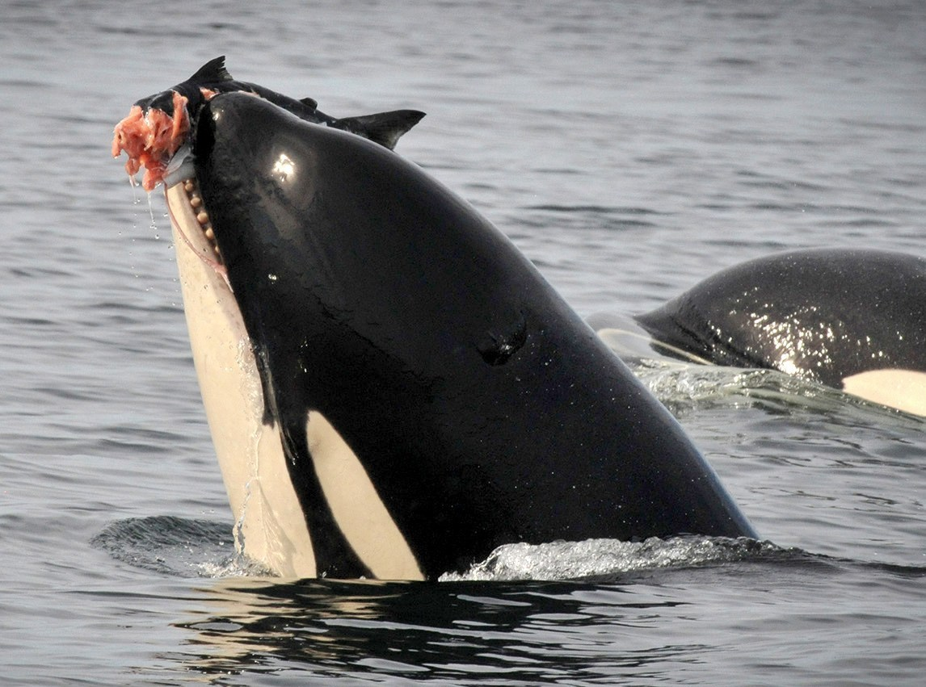
Orcas and salmon
Another species who eats salmon in the ocean are Southern Resident Killer Whales (Orcinus orca).
The name “killer whale” is misleading as orcas are the largest species in the dolphin family!
Notes:
If you want, you can introduce the term “misnomer” here. Orcas are called cetaceans and do not belong to the whale family despite their common name.

Slide 15
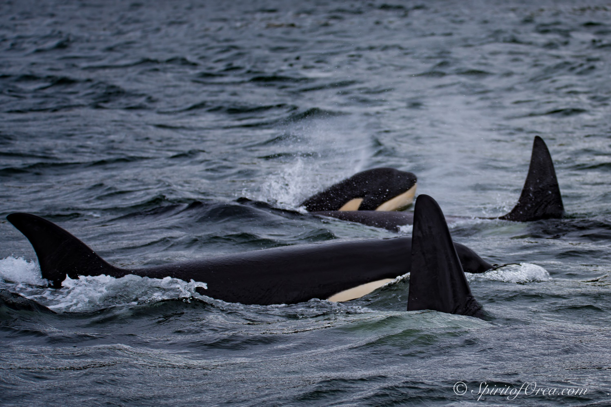
Orcas and salmon
Orcas are found in oceans throughout the globe.
They travel in pods of five to 50 members. Their pods consist of extended family members.
The population that lives most of the year in the Puget Sound are the Southern Resident Orcas.
Photo courtesy of Ken Rhea
Notes:
Click the link to play the video introducing the three different populations of orcas in Washington. Don’t forget to stop the video at 1:05!

Slide 16
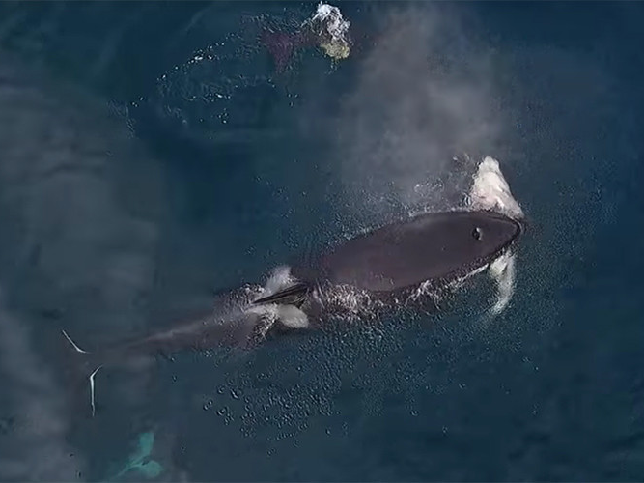
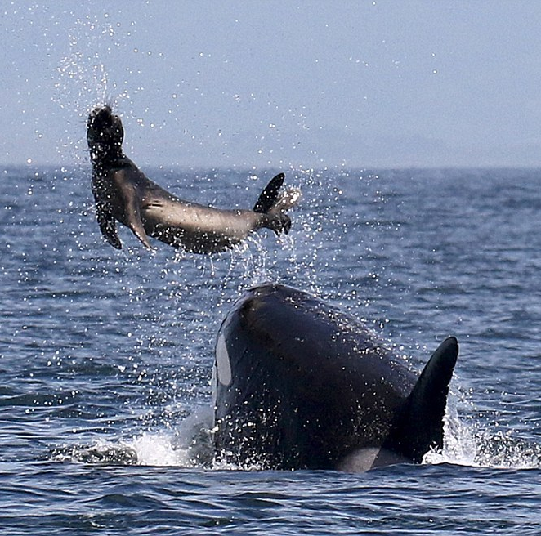
Transient orcas
Transient orcas range from Alaska to California and eat marine mammals like seals and sea lions. Transients can also be seen in the Salish Sea.
Above: Drone footage of an offshore orca with a shark.
Offshore orcas
Offshore orca populations are found farther than nine miles off the coast and eat sharks and other fish.
Notes:
Go through the following slides as the students recall the populations.

Slide 17
Southern Resident orcas
Southern Resident orcas reside along the coastline. Most of their diet (estimates vary between 70-80%) consists of Chinook and chum salmon.
This population is made of three pods, J,K and L. They are most commonly found in the waters around the San Juan Islands and the Eastern Strait of Juan de Fuca from late spring to fall. They spend the rest of the year on the outer coast.

