Slide 1
Declining Populations
Biologists have noticed a decline in Southern Resident orcas over the last 30 years.
Let’s look into what they are finding.

Slide 2
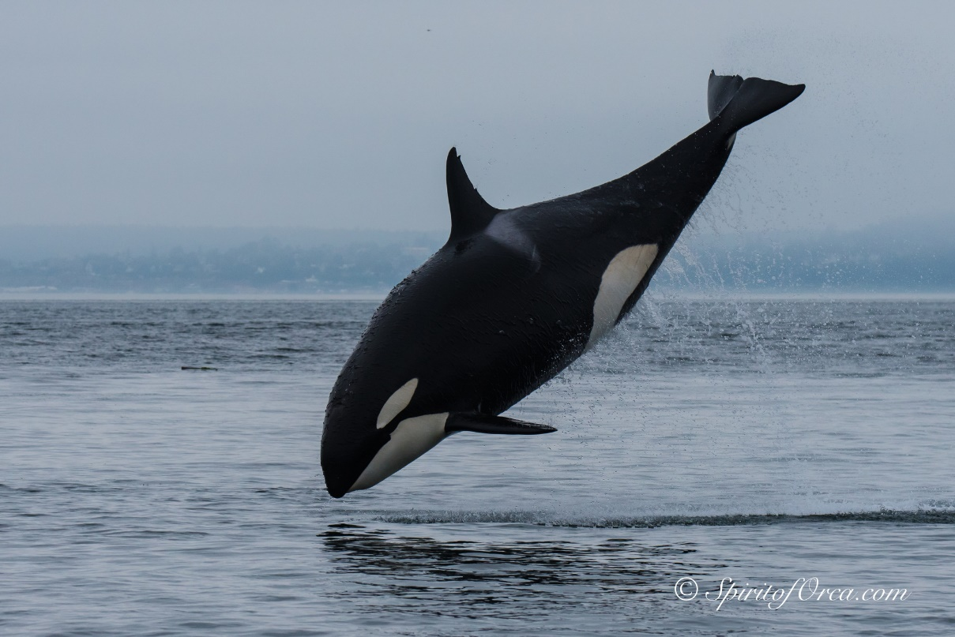
What are the top three reasons biologists think Southern Resident Orca pods are in decline?
A lack of prey
Toxic contaminants
Disturbance from noise and vessel traffic
Photo courtesy of Ken Rhea

Slide 3
What does it mean for a species to be endangered?
To be endangered means the species is at serious risk of extinction.
For a species to be considered endangered in the United States, the species must be placed on the national list of Endangered and Threatened Wildlife.
For the species to be placed on this list, United States Fish and Wildlife Service (USFWS) biologists assess the decline of that species,
OR
Members of the public can petition USFWS to put a species on the list.
Notes:
Engage students in a discussion about endangered species and extinction. Use the links provided in this slideshow and the lesson plan as further resources on the subject.

Slide 4
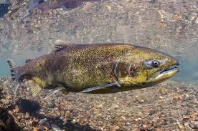
With a partner/small group
Answer the following questions:
If a species goes extinct, how does that affect the ecosystem it lives in?
How might species’ extinction affect other species who live in that ecosystem?
How might an extinction event affect humans?

Slide 5
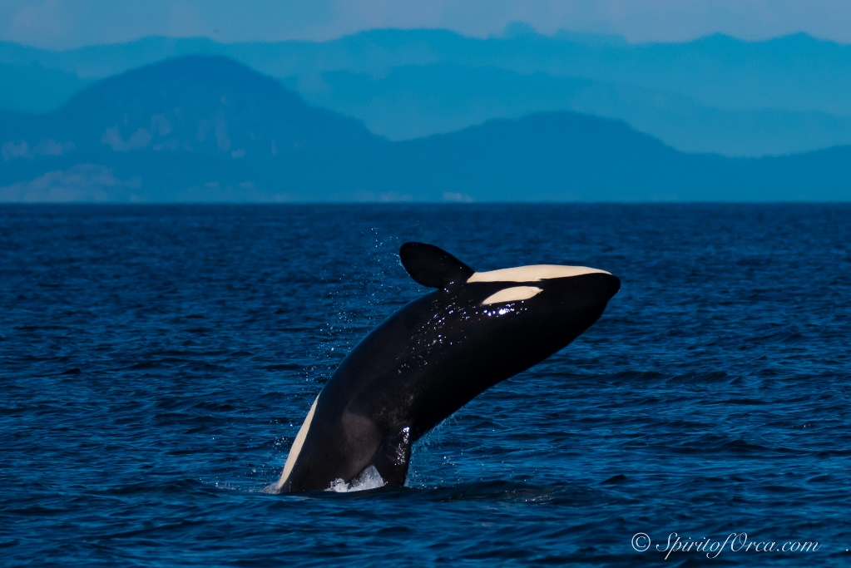
Washington’s Orcas are Hungry
Read through the story map and write down:
One thing that surprised you?
One thing you found interesting.
One thing you would like to know more about.
Photo courtesy of Ken Rhea
Notes:
After this slide, have students use evidence from the story map and from the video to hypothesize why Southern Resident Orcas are in decline (see lesson plan).

Slide 6
Washington’s Orcas are Hungry
Recall the top three reasons biologists believe Southern Resident orcas are in decline.
Photo courtesy of Ken Rhea
Notes:
Make sure students name all three, the next slide will focus on the decline of Southern Resident orca’s main prey, Chinook salmon.

Slide 7
Decline of prey
The relationship between Southern Resident orcas and Chinook salmon is known as a predator-prey relationship.
This is an interaction between two organisms in which one organism (orcas) captures and feeds on the organism that serves as prey (Chinook).

Slide 8
Describe the relationship between Southern Resident orcas and Chinook salmon
Consider:
If the orca population were to increase, what do you predict would happen to the Chinook population?
If the Chinook population were to increase, what do you predict would happen to the Southern Resident population?
Remember to cite your claims using evidence.
Graph courtesy of McGraw Hill
Notes:
If students don’t remember direct vs. inverse relationships, remind them. Look in the vocabulary section of the lesson plan. Give students the graphs that came with the lesson and ask them to describe the relationship between Chinook and Southern Resident.

