Slide 1
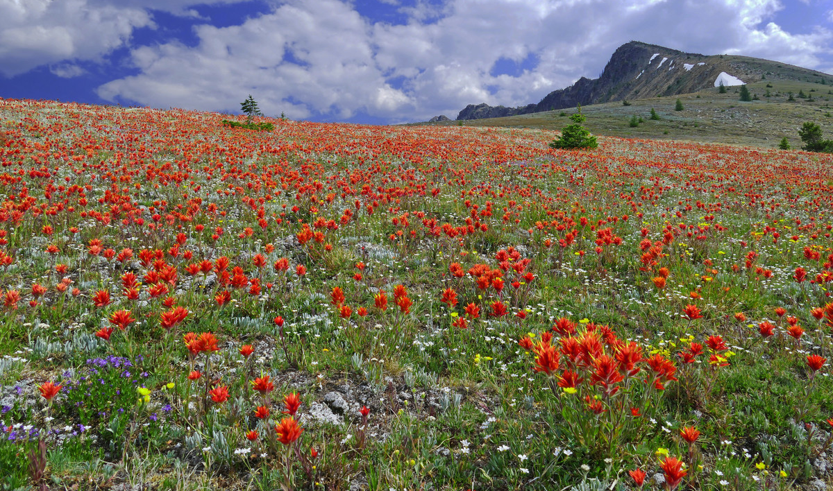
Biodiversity in Washington

Slide 2
What is biodiversity?
Biodiversity = Biological Diversity
Simply, the diversity of life on Earth.

Slide 3
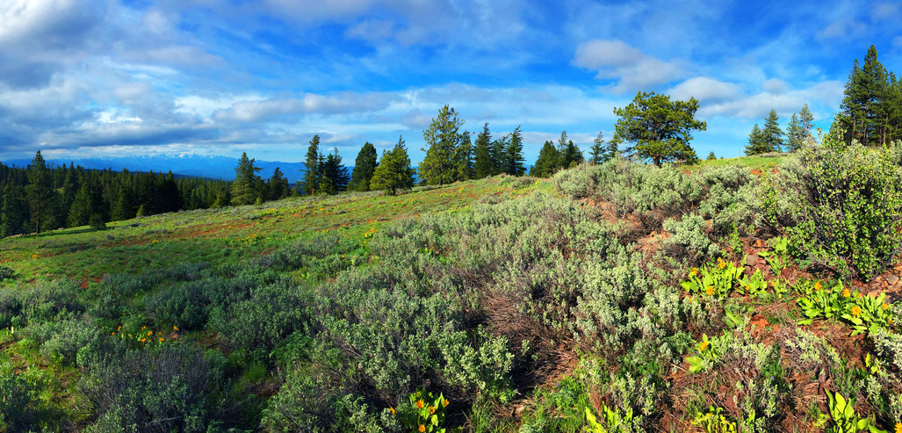
But is it that simple?
“Biodiversity is the full range of life in all its forms. This includes the habitats in which life occurs, the ways that species and habitats interact with each other, and the physical environment and the processes necessary for those interactions.”
–Washington Biodiversity Council
Notes:
Make sure to hit the play button.

Slide 4
Levels of biodiversity
Biodiversity is classified in three different areas:
Species Diversity
Genetic Diversity
Ecosystem Diversity
Notes:
Species Diversity: diversity between species.
Genetic Diversity: diversity in genes within individuals in a population.
Ecosystem Diversity: diversity of habitats, communities and ecological processes within a given area.

Slide 5
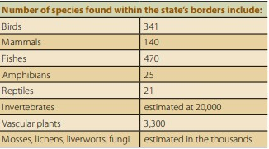
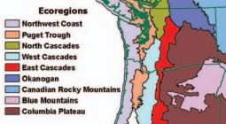
Diversity in Washington
An ecosystem is a community of organisms interacting with their surroundings.
An ecoregion is an area where ecosystems are generally similar in geology, landforms, soils, vegetation, climate, land use, wildlife, and water.
Graphs courtesy of Washington Biodiversity Council
Notes:
When showing graphs for the first time, ask students what type of diversity this is an example of.
Graph 1: species diversity
Graph 2: ecosystem diversity. Washington’s eco-regions extend past the state’s borders.

Slide 6
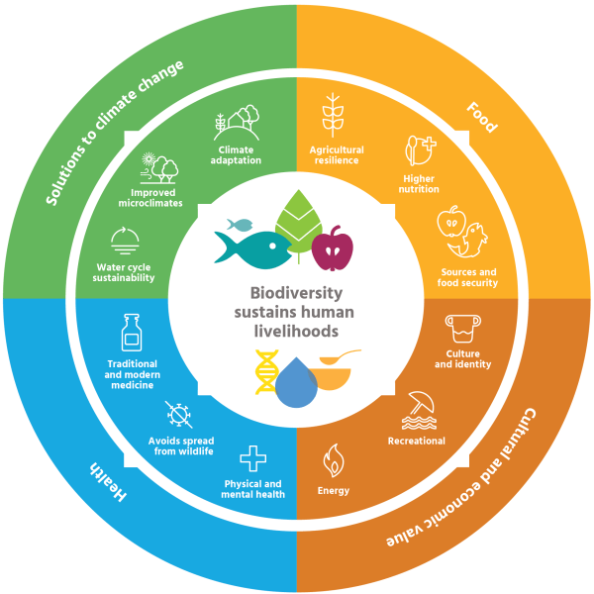
Why should we care?
Let’s find out.
How might biodiversity impact your life?
Some examples include:
Clean water, air, soil
Jobs and economy: agriculture, fishing, logging, etc.
Recreation: hunting, fishing birding, hiking, etc.
Medicines: Pacific Yew has anti-cancer properties that are used in treating ovarian cancer.
Graphic courtesy of Landscape News
Notes:
It’s hard to get excited about conserving species you may never see, but biodiversity supports human life and provides us with many ecosystem services.
After watching the video, ask students to brainstorm three ways biodiversity may impact their lives. Ask students to share after a couple seconds of brainstorming.

Slide 7
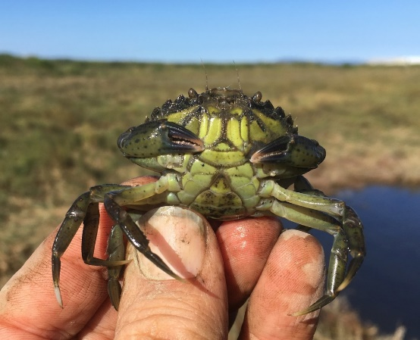
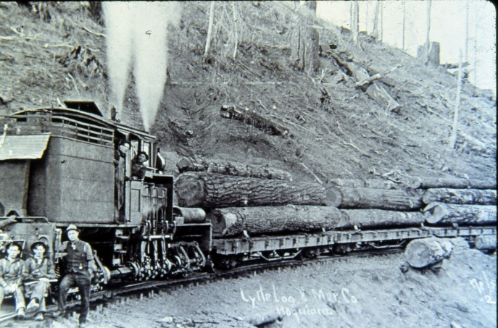
Globally, species have declined 68%*
The threats they face vary:
Invasive Species
Overexploitation
Pollution
Habitat loss
Climate change
*According to World Wildlife Fund’s 2020 State of Wildlife Report
Notes:
Invasive Species: European green crabs prey on important bivalves and other crustaceans.
Overexploitation: This can include over harvesting timber, fisheries, or other natural resources.
Pollution: Can include pollution of air, water, soil, food, etc. In this picture a mallard is covered in oil.
Habitat loss: Due to increasing urbanization of landscapes and conversion of landscapes for agricultural use. This picture shows a fragmented conifer forest in the late 1980s.
Climate change: changing patterns in weather can disrupt thousands of years of evolution.

Slide 8
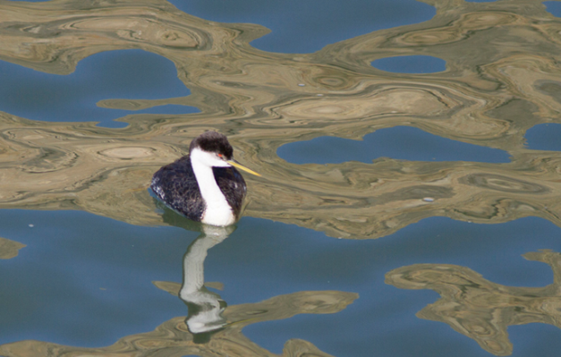
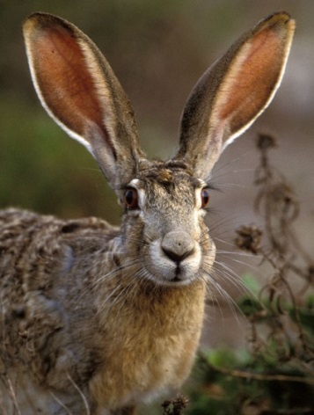
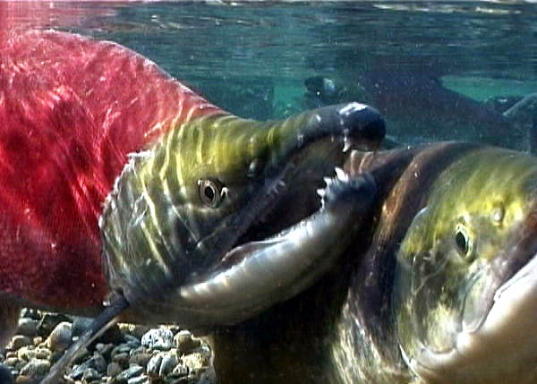
earth is heating up
fish and wildlife in trouble
got to do something
Impacts to Species and Habitat from Climate Change
Notes:
Climate change moving faster than predicted
WASHINGTON – The effects of climate change driven by human activity are spreading through the United States faster than had been predicted, increasingly threatening infrastructure, water supplies, crops and shorelines, according to a review of climate science and its effects by a federal-advisory committee.

Slide 9
Question is no longer if climate changes, but how fast and how much
All scenarios indicate warming in the 21st century
?
WA 2015
(+3F)
Annual avg. U.S. temperature has increased 1.8°F from 1901-2016.
Global 20th Century mean
Project from 2.5 to 11.9°F increase by late century (2071–2100)
National Climate Assessment, 2017

Slide 10
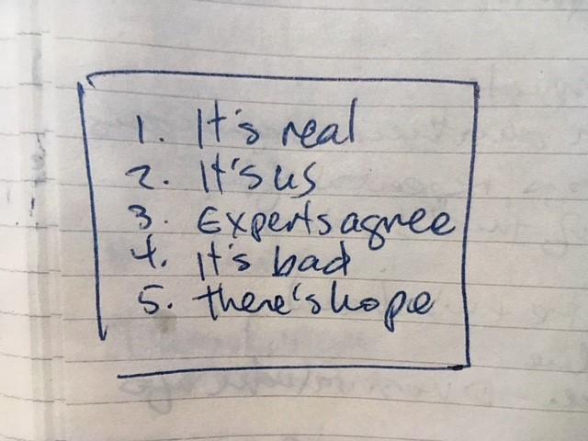
Notes:
Fortunately for all of us, Professor Ed Maibach has some tips.
The Five Climate Change Beliefs that Lead to Action
First, the research. Maibach has found that people who hold these five beliefs are much more likely to support action to solve the climate crisis:
1. Experts agree: human-caused climate change is happening. There is a consensus among scientists.
2. It’s real.
3. It’s us (human-caused).
4. It’s bad (for people).
5. It’s solvable.
And to communicate these five things, he’s created a one-sentence mantra for anyone talking about the crisis to follow: Simple, clear messages, repeated often, by a variety of trusted sources.

Slide 11
Biodiversity and Climate Change
Projected Impacts of Climate Change in Washington
Sea level rise will result in the erosion and loss of nearshore habitats.
Changes in temperature and nutrient availability may lead to declines in salt marsh and coastal wetland habitats.
Lower summer flows and warmer waters may negatively affect salmon.
Warmer water temperatures will impact plankton, which form the foundation of the marine food web.
Increased algal productivity in surface waters of Puget Sound would lead to a further depletion of oxygen at depth.
Frequency, severity, and duration of natural disturbances, such as fire and pest outbreaks, will likely change.
Department of Fish and Wildlife

Slide 12
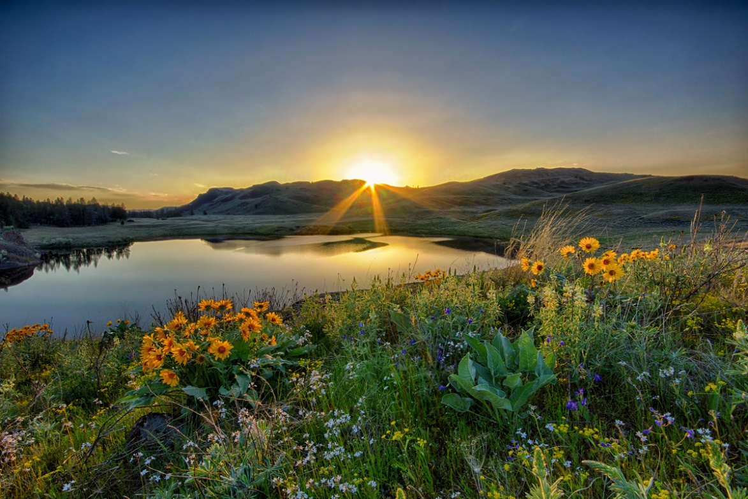
Biodiversity and Climate Change
How might these impacts effect biodiversity?
Range shifts (altitudinal/poleward)
Changing food/water availability
Increase in pests, disease, and natural disturbances
Changes in phenology
Extinction- Climate change as a driver of threats.
Notes:
Ask students to think about how the previous slide could effect species in Washington.
Introduce new word, phenology: cyclic and seasonal natural phenomena, especially in relation to climate and plant and animal life. For example, plants fruiting in the fall provide birds with necessary food on their southern migration. If the berries were to ripen earlier or later, the birds might not have this necessary food source. This could impact the avian species.

Slide 13
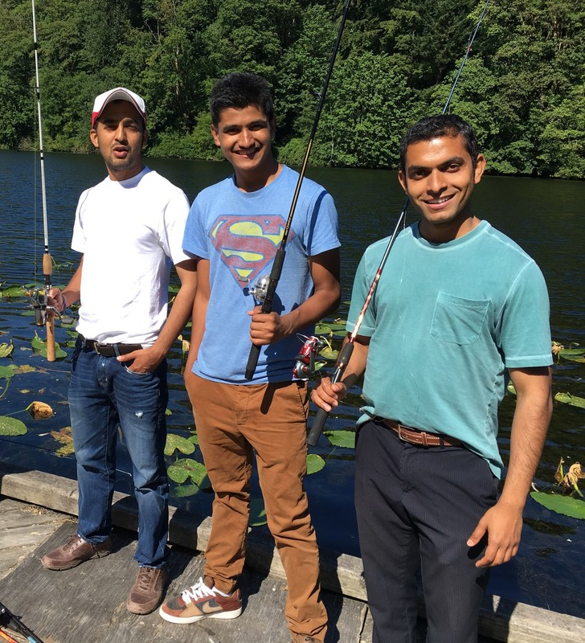
What can we do?
Identify one way that biodiversity impacts you.
It should be something specific- like an insect who pollenates your favorite type of squash or a plant that filters out heavy metals from water. You may need to do some research!
After identifying an ecosystem service you benefit from, come up with a way you, and others members of your family or community can help to preserve this ecosystem resource for generations to come.
Fishing provides important recreation and relaxation for some and provides necessary meals for others. What would happen if a popular fishery collapsed? How might you prevent this?
Notes:
Students will come up with a five to ten slide show using varied media to highlight these questions. More details are in the lesson plan.

