Slide 1
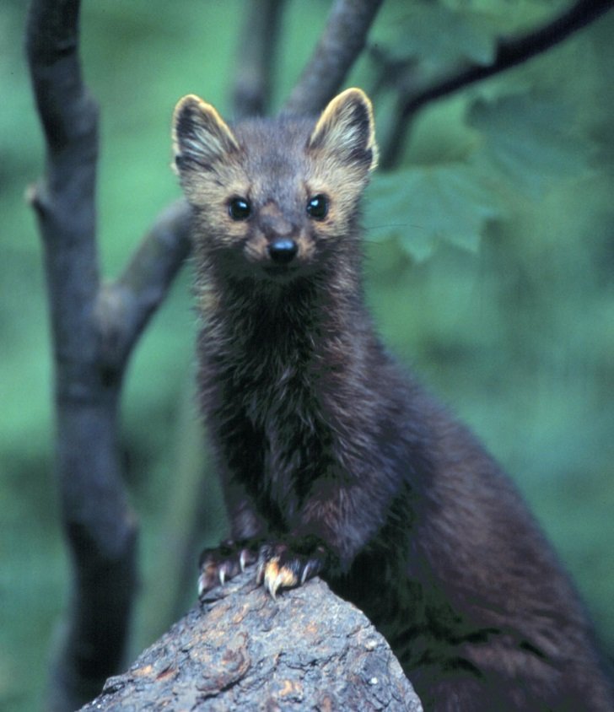
What impacts will climate change have on the species and habitats in this region?

Slide 2
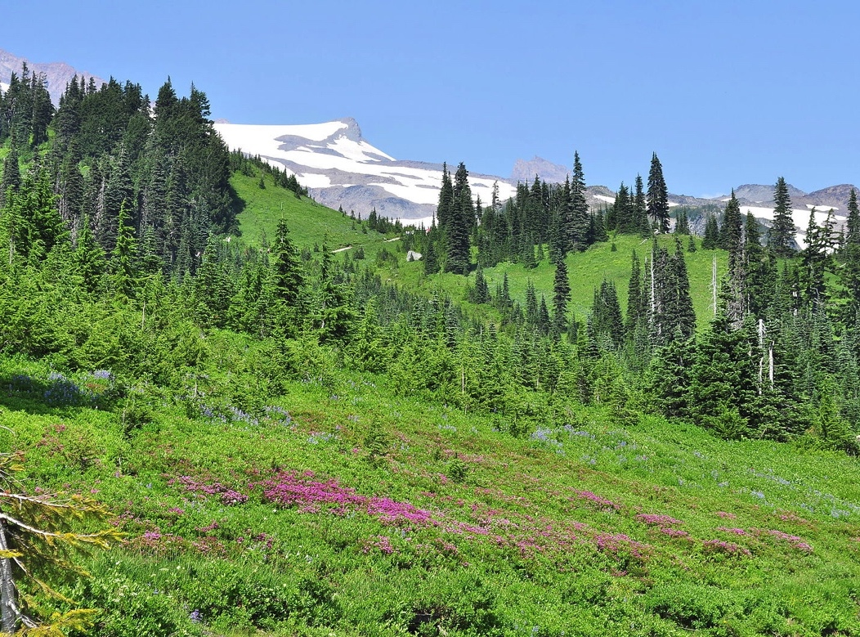
Impacts on species and ecosystems
Changes in the timing of biological events
Direct and indirect loss of habitat
Changes in species distributions (where they live)
Disease, parasites and disturbances
Changes in species interactions
Notes:
Earlier spring: 2.3 to 5.2 days per decade in the last 30 years

Slide 3
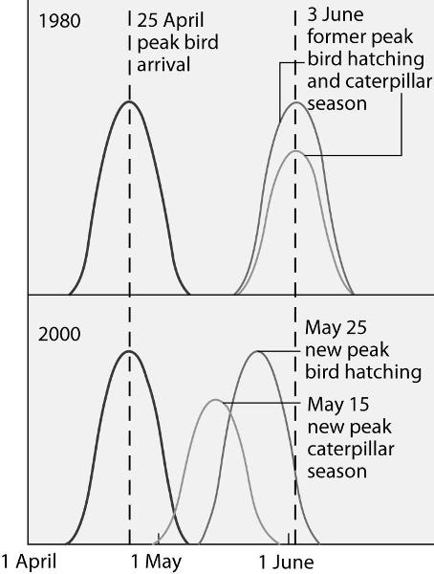
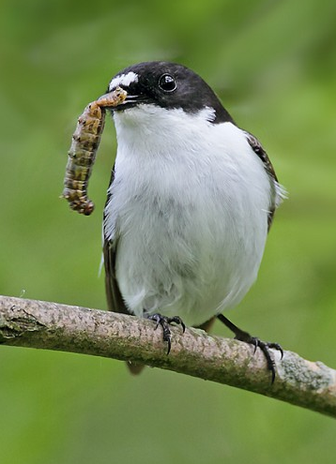
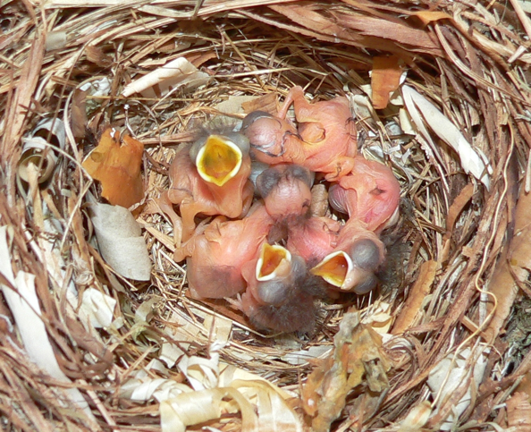
Different rates of change among interacting species raises the risk of phenological mismatches
Notes:
European pied flycatcher chicks are now born later than the caterpillars they eat.
Bird’s arrival cued by day length in their wintering grounds in Africa – daylight is obviously not changing
Caterpillars are hatching in response to temps at higher latitudes, which are warming rapidly.
Mismatch.

Slide 4
Many species will experience indirect climate-driven habitat loss, change or degradation
Notes:
For salmon and steelhead: low summer flows, high summer stream temps, scouring of nests/eggs from floods

Slide 5
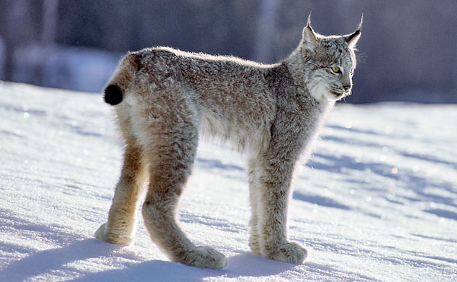
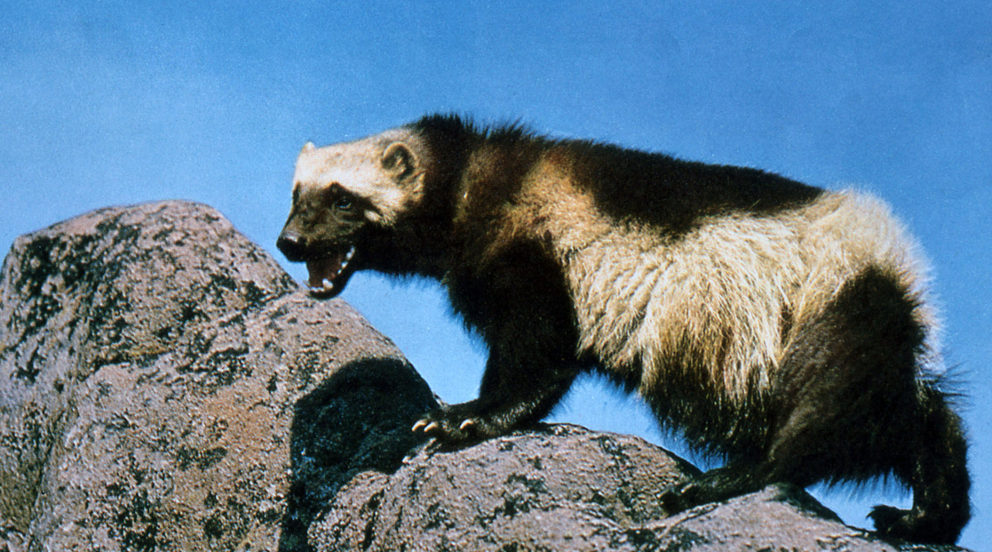
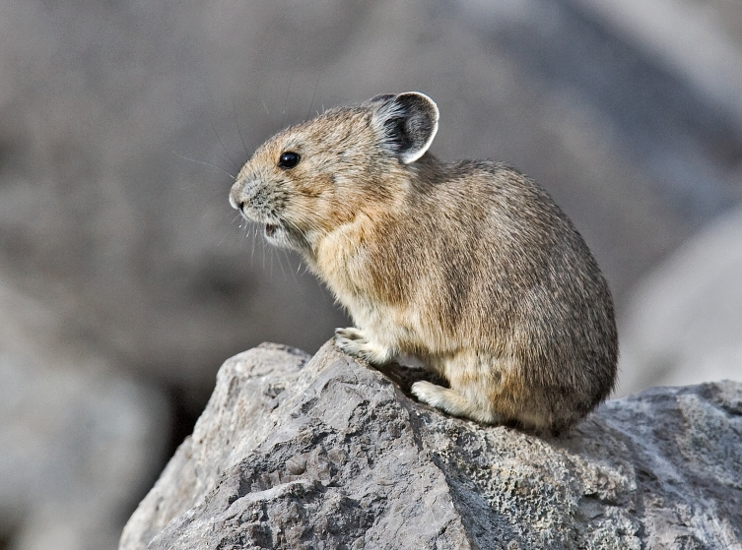
Many species will experience direct climate-driven habitat loss
Notes:
For salmon and steelhead: low summer flows, high summer stream temps, scouring of nests/eggs from floods
For wolverine: loss of spring snowpack for denning and dispersal
For pika: too hot

Slide 6
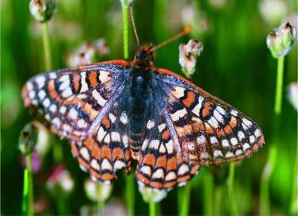
Species respond to climate change by adjusting their geographic ranges
Average range shift over past century (globally):
Upward ~11m /decade
Poleward ~17km /decade
Regional example
Edith’s checkerspot butterfly. Range has shifted northward and to higher elevations over 40+ years
Notes:
Although the individual butterflies aren’t migrating (they tend to stay in a small area their entire lives), the range for these butterflies has shifted as separate populations, one by one, go extinct—four times faster on the southern boundary of their range (Baja, Mexico) than on the northern boundary (in Canada), and nearly three times faster at lower elevations than at higher elevations.

Slide 7
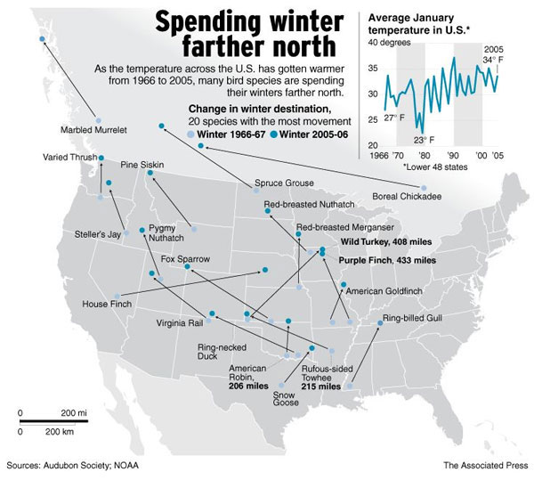
Notes:
From 40 years of Christmas Bird Count Data
177 of 305 species (58%) moved northward
60 moved more than 100 miles
Of the 305– on average moved 35 mile northward
Estimates are based on changes in the centers of abundance
Parmesan and Yohe-
6.1 km per decade
Root et al-
80% of species showing a change did so in accordance with cc

Slide 8
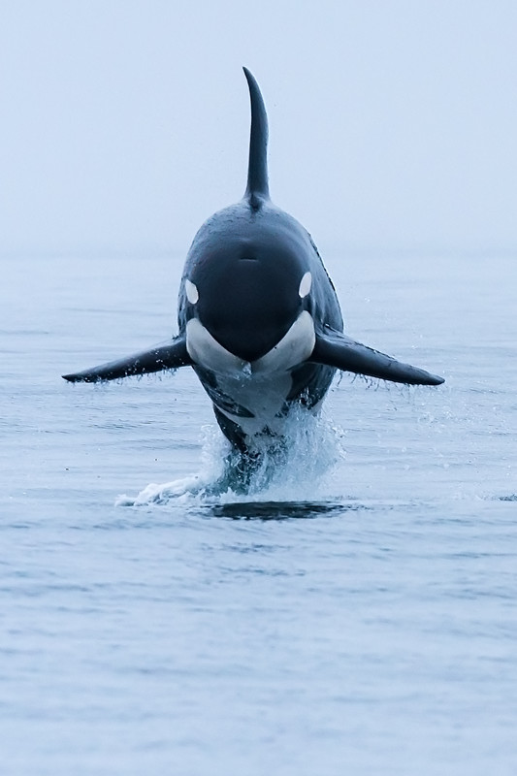
What can we do?
How should natural resource managers respond?

Slide 9
Adaptation Strategies
Resistance
Hatcheries
Resilience
Forest health treatments
Floodplain restoration (restoring side channels)
Transition
Habitat connectivity
Protecting refugia
“Preserving the stage”

Slide 10
Adaptation Strategies
Resistance
Hatcheries
Resilience
Forest health treatments
Floodplain restoration (restoring side channels)
Transition
Habitat Connectivity
Protecting Refugia
“Preserving the stage”
Reevaluate conservation priorities with a “climate lens”
Adopt forward looking goals – design for future conditions
Manage for interaction of multiple stressors
Consider broader landscape focus
Adopt strategies robust to uncertainty
Manage species specifically for climate-related stress

Slide 11
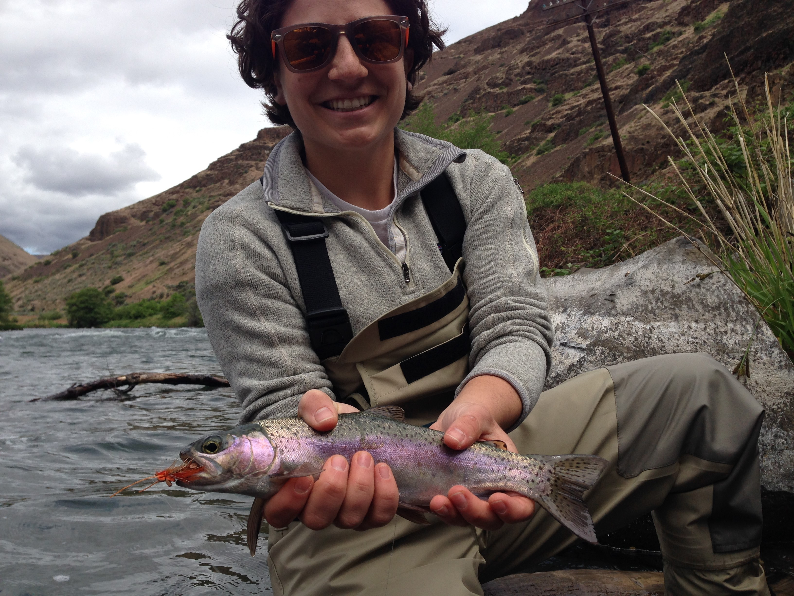
Adapting work
Meet Emelie McKain, WDFW’s Chehalis Basin Aquatic Species Restoration Plan Manager.
Emelie manages habitat restoration for the Chehalis River Basin. The work includes looking to the future to know what types of habitats are in most danger due to climate change impacts, and working to build resiliency of those habitats now.

Slide 12
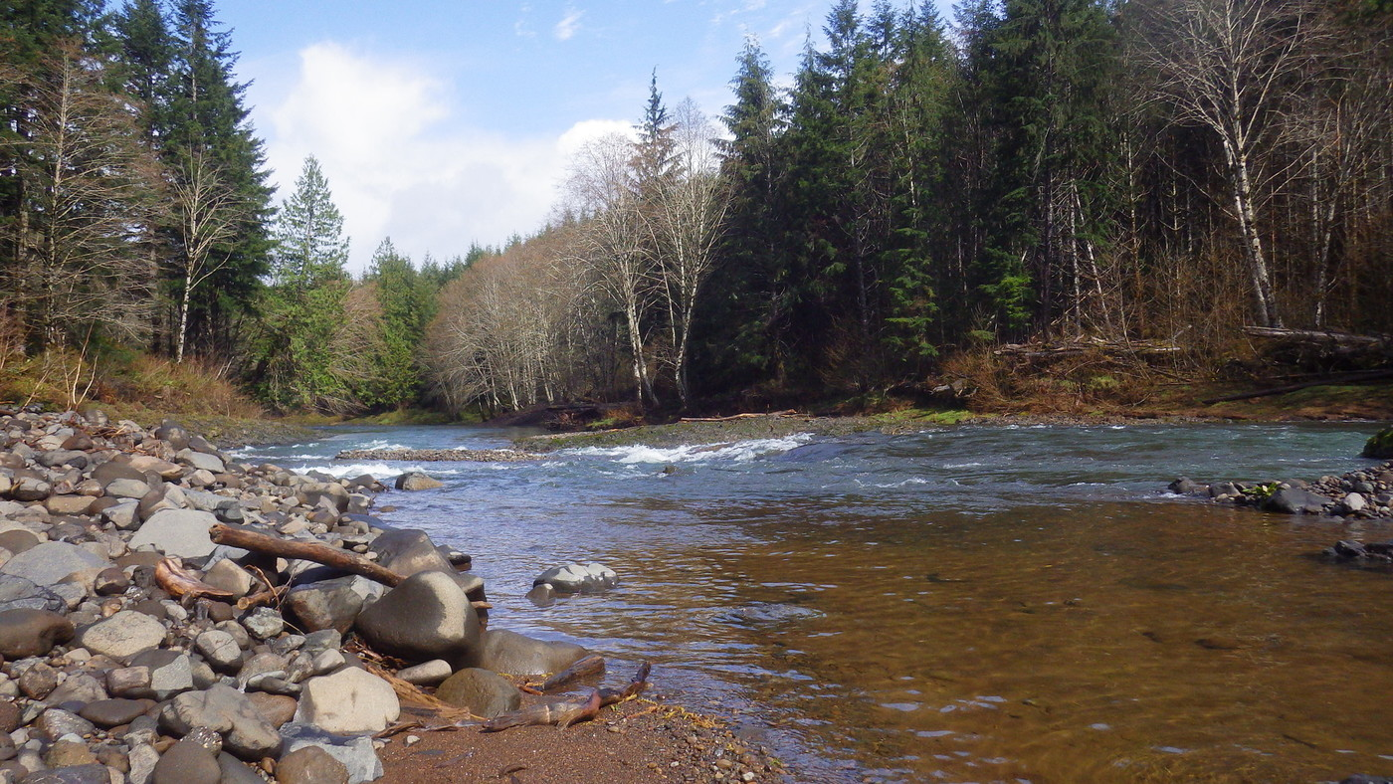
Adapting work
“By getting ahead of negative impacts to climate change we can actually restore habitats and species before they get endangered or are at risk of extinction.” –Emelie McKain

Slide 13
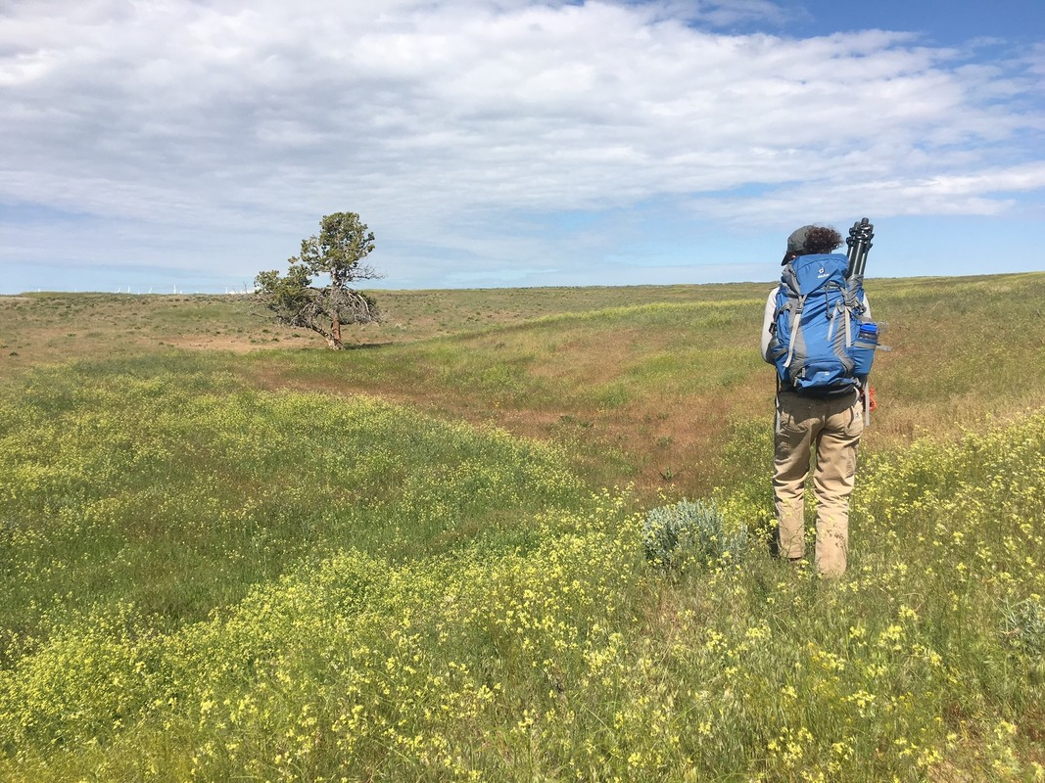
Adapting work
It’s just one of the ways that WDFW is adapting our work to preserve our state’s biodiversity.

Slide 14
Managing species for climate stress Identifying which species are most vulnerable and why.
Notes:
For salmon and steelhead: low summer flows, high summer stream temps, scouring of nests/eggs from floods

Slide 15
WDFW assessed the climate vulnerability for 268 species of conservation need
IPCC 2007
Vulnerability is the degree to which a species is susceptible to, and unable to cope with adverse impacts of climate change.
Exposure
Sensitivity
Purpose of a vulnerability assessment:
Vulnerability
Identify what resources are most vulnerable and why
Notes:
As you compare sensitivity, exposure, and adaptive capacity across different habitat types and species, vulnerability assessments become useful tools by allowing managers to identify what resources are most vulnerable and why; this critical information can then be used to develop adaptation strategies to respond to the challenges of climate change.

Slide 16
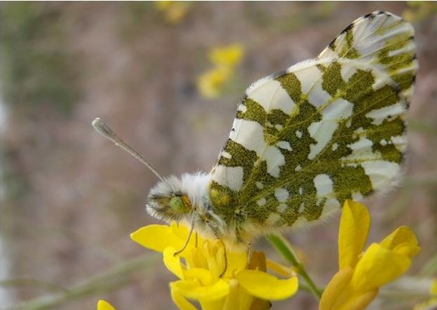
What makes some species more vulnerable to climate change than others?
Geographic range- small or large?
Population size- small or large?
Temperature tolerance- low or high?
Reliance on environmental cues for reproduction, migration, hibernation- low or high?
Diet specialization- specialist or generalist?
Freshwater requirements- low or high?
The Oregon spotted frog
The island marble butterfly
The Pacific lamprey
Notes:
Green underline denotes traits that indicate a species will be more resilient to climate change. Red without the underline denotes traits in which a species will be more vulnerable to climate change.
These are a handful of traits that scientists examine to determine the vulnerability of a species to climate change.

Slide 17
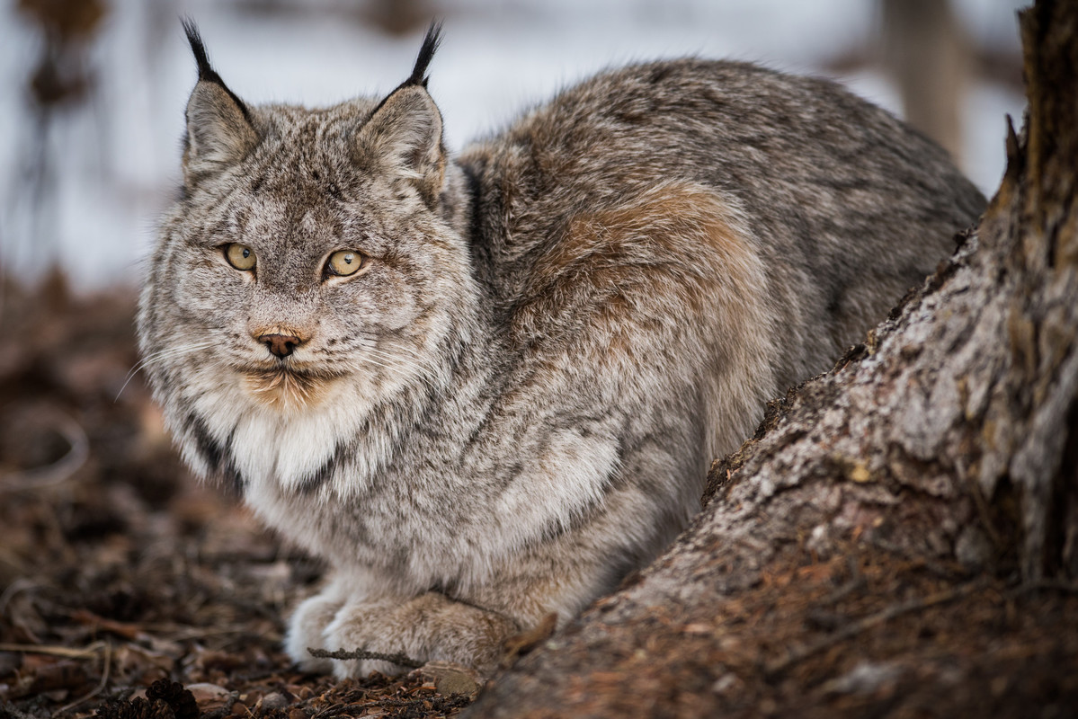
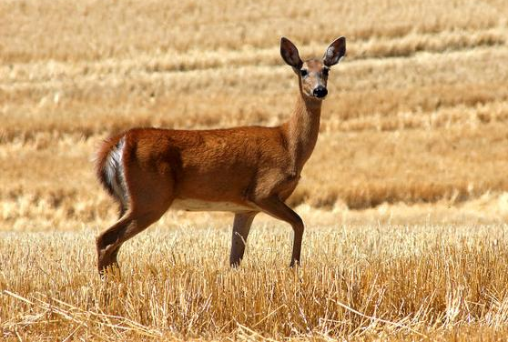
What makes some species more vulnerable to climate change than others?
Habitat specialization- low or high?
Susceptibility to disease- low or high?
Generation time- How long does it take the species to reach sexual maturity- short or long?
Reproductive rate- How many offspring/how often? More offspring or a higher frequency of reproduction vs. few offspring or infrequent reproduction.
Genetic variation- low or high?
The Canada lynx.
The marbled murrelet.
The Columbian white-tailed deer
Notes:
Green underline denotes traits that indicate a species will be more resilient to climate change. Red without the underline denotes traits in which a species will be more vulnerable to climate change.
These are a handful of traits that scientists examine to determine the vulnerability of a species to climate change.

Slide 18
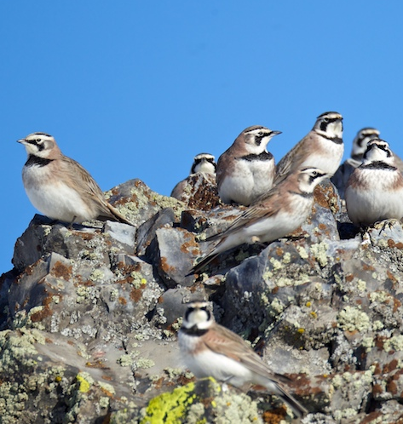
Trait based assessments
Why might it be important for natural resource managers to know the vulnerability of species to climate change?
How might they use this data?
Trait based assessments are just one way in which natural resource managers estimate how vulnerable a species is to climate change.
A group of horned larks
Notes:
Preserving biodiversity is an important job for any natural resource manager. By assessing the species who need the most help, scientists and natural resource managers may be able to put more resources to saving the species in need.

Slide 19
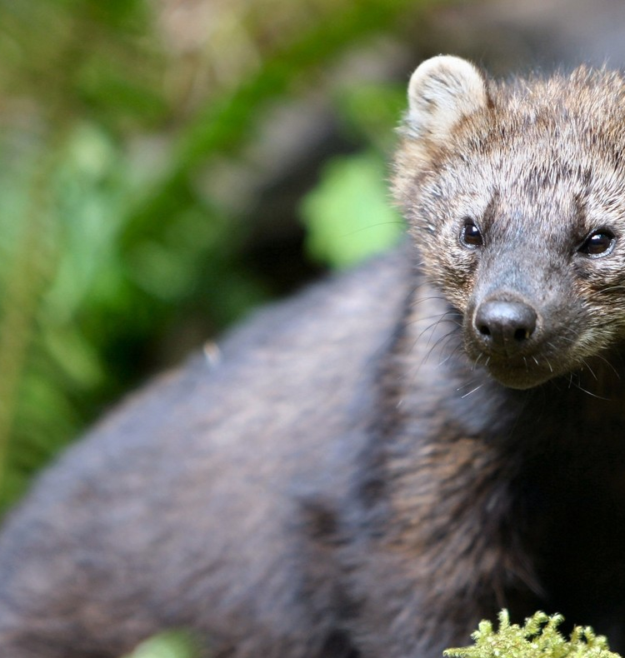
Trait based assessments measure a species’:
Exposure: How often the species is exposed to a climate-change related hazard.​
For example: species in mixed conifer forests of the West may be more exposed to climate change conditions than those in the East due to increase in frequency and severity of forest fires in the last decade.
Pacific fishers live in mixed conifer forests of the West coast and Cascades.

Slide 20
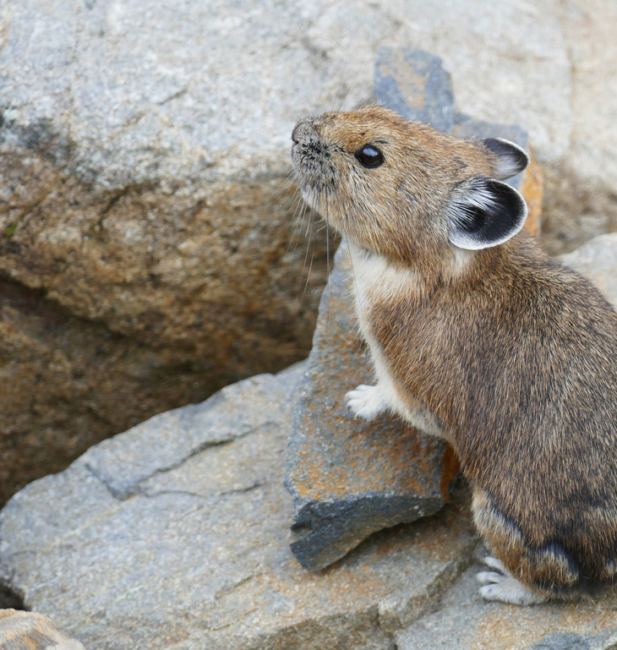
Trait based assessments measure a species’:
Sensitivity: A species’ ability/inability to persist under changing climate conditions.
For example: American Pika’s require snowpack. Because snowpack is estimated to decline dramatically with climate change, Pikas are sensitive to climate change.

Slide 21
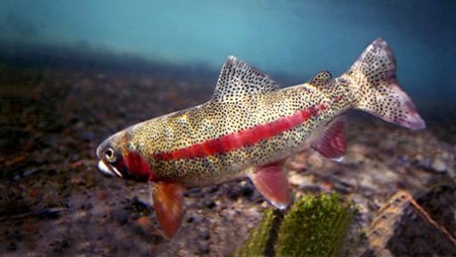
Understanding inherent sensitivity is key
Inland Redband Trout
Inland redband trout are likely sensitive to increasing water temperatures and altered flow regimes. Inland redband trout spawn in the spring, thus their embryos and recently emerged fry may be sensitive to changes in the timing and magnitude of spring runoff. Lower summer flows may decrease habitat volume and access to headwater reaches for this species.

Slide 22
Understanding inherent sensitivity is key
Key Exposure Factors:
Increased freshwater temperatures
Altered timing/magnitude of spring runoff
Lower summer flows
Inland Redband Trout
Inland redband trout are likely sensitive to increasing water temperatures and altered flow regimes. Inland redband trout spawn in the spring, thus their embryos and recently emerged fry may be sensitive to changes in the timing and magnitude of spring runoff. Lower summer flows may decrease habitat volume and access to headwater reaches for this species.
Sensitivity
Exposure
Vulnerability:
MOD-HIGH
Low
High
Low
High
MOD-HIGH
MOD-HIGH
Low
High

Slide 23
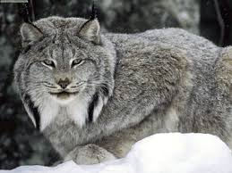
Example: Lynx
Vulnerability:
HIGH
Low
High
Exposure
Sensitivity
Low
High
Low
High
HIGH (5)
HIGH (5)
Adapted to and dependent on cold, high elevation habitats
Warmer temperatures and reduced snowpack may limit prey availability
Altered fire regimes that degrade/eliminate habitat
Air temperatures
Wildfire regimes
Snowpack
Earlier Snowmelt
Insect/disease outbreaks

Slide 24
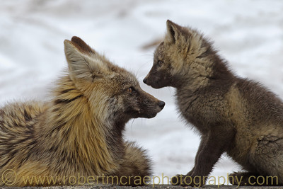
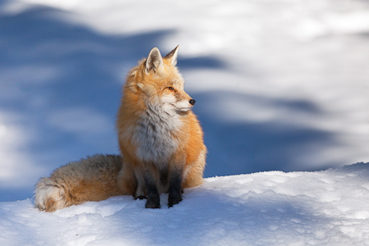
Example: Cascade Red Fox
Vulnerability:
HIGH
Low
High
Exposure
Sensitivity
Low
High
Low
High
MODERATE-HIGH (4)
HIGH (5)
Air temperatures
Wildfire regimes
Snowpack
Adapted to and dependent on cold, high elevation habitats
Warmer temperatures and reduced snowpack may further contract suitable habitat range and/or facilitate movement of coyotes
Altered fire regimes that degrade/eliminate habitat

Slide 25
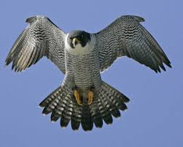
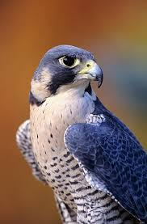
Example: Peregrine Falcon
Vulnerability:
LOW
Low
High
Exposure
Sensitivity
Low
High
Low
High
LOW (1)
LOW (1)
No specific factors identified as this is a generalist species
Utilizes a variety of habitat types
Forages on a diversity of species

Slide 26
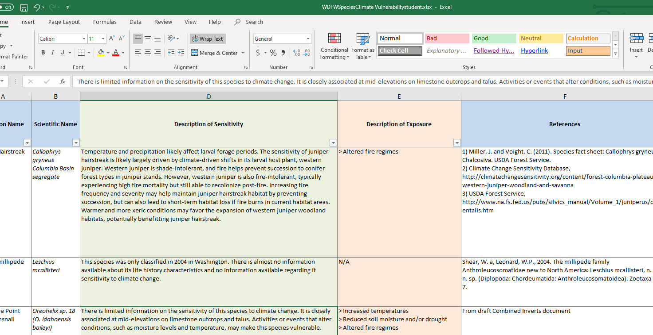
Assessing a species
You will assess a species just like a biologist.
Notes:
Students will be given two Excel documents that Washington Department of Fish and Wildlife scientists and natural resource managers use when assessing the vulnerability of a species and an ecosystem.

Slide 27
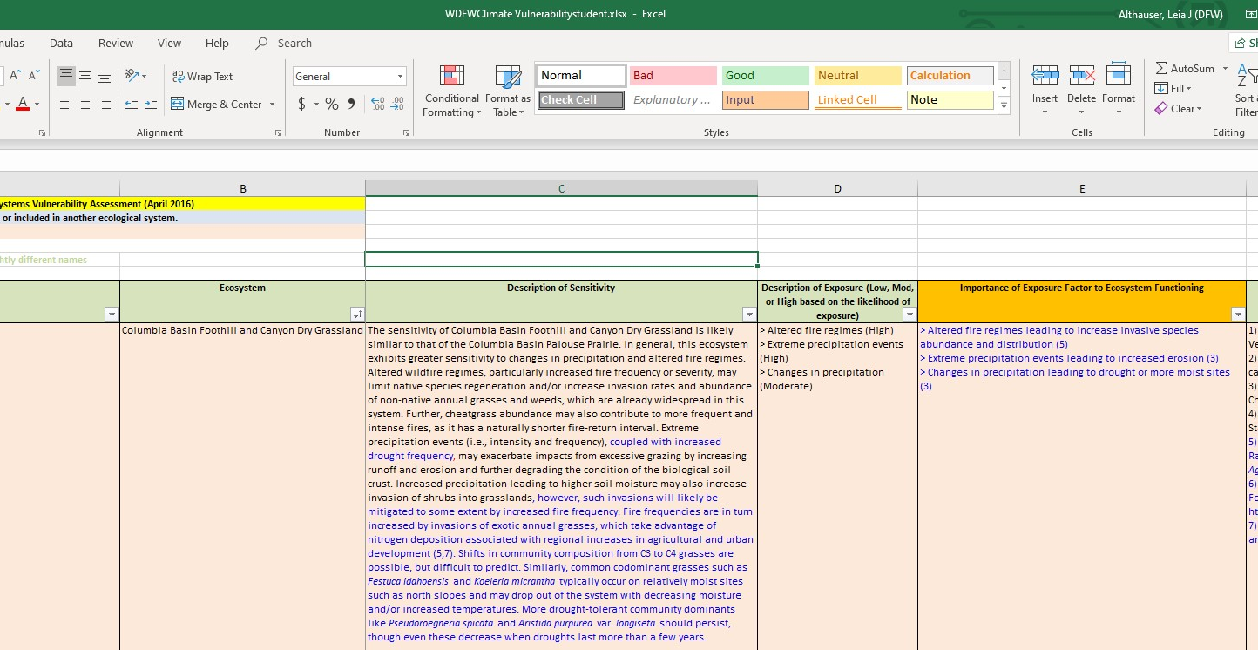
Assessing an ecosystem
You will assess an ecosystem just like a natural resource manager.

Slide 28
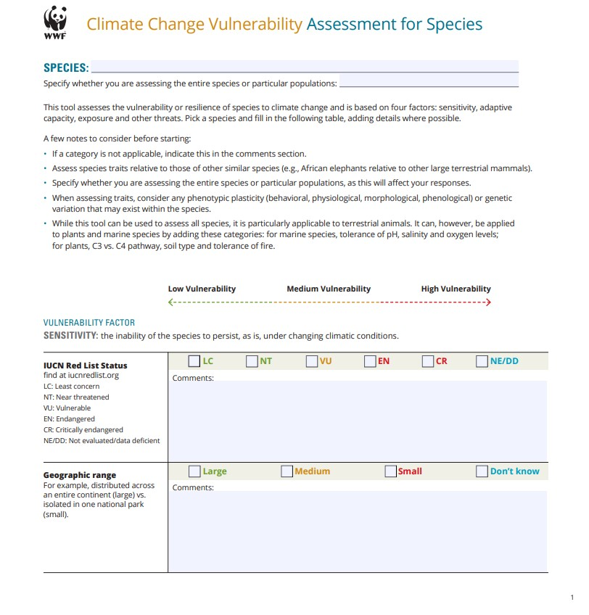
Notes:
Using the following form, students will go through the WDFW graph and find out a species vulnerability assessment for the species and ecosystem of their choice.

