Slide 1
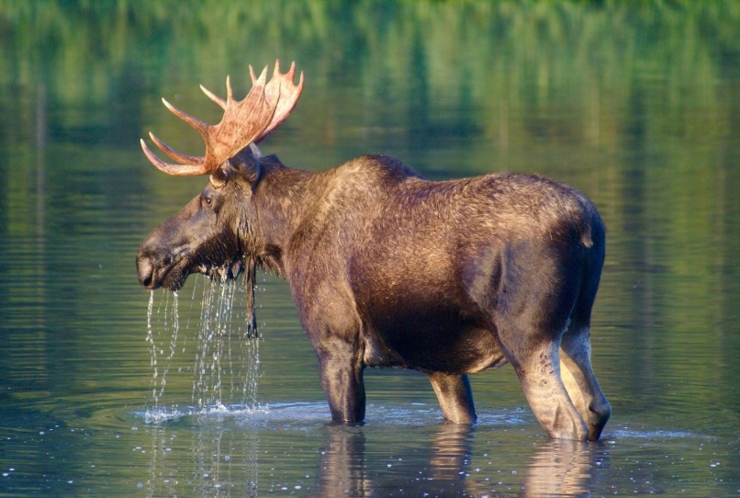
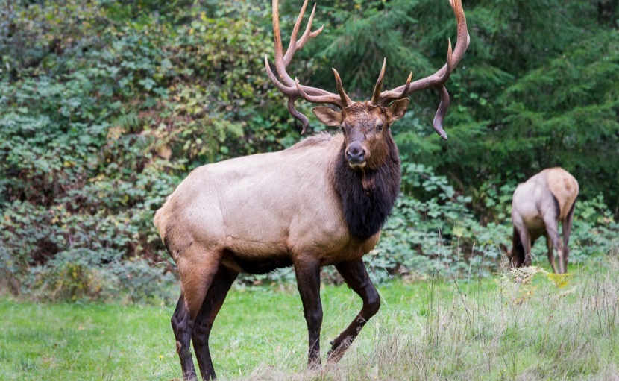
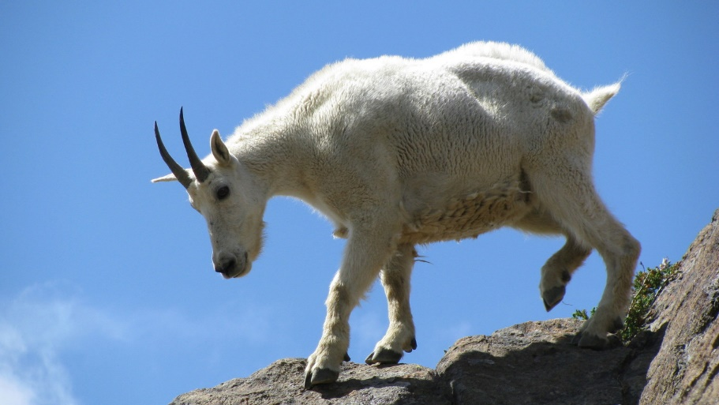
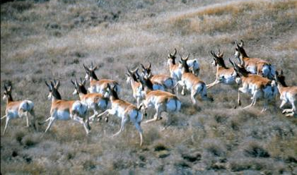
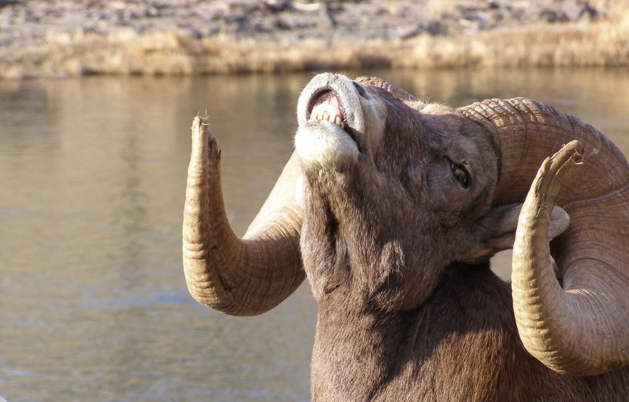
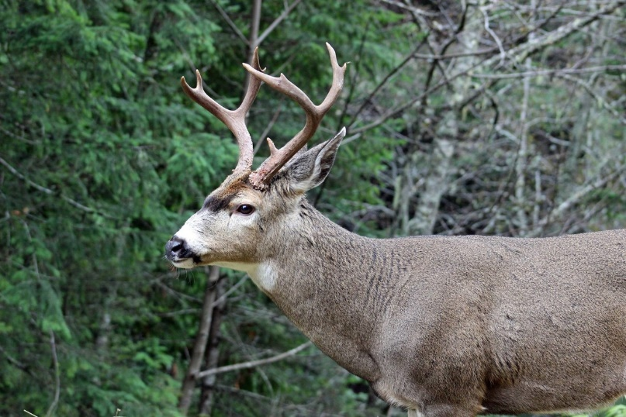
Ungulates in Washington

Slide 2
What is an ungulate?
A mammal
With hooves
All of Washington’s ungulates are even-toed, meaning they walk on two of their five toes.
Worldwide, there are about 270 land-based, even-toed ungulate species.
Humans have significant relationships with many of these animals for food, economics, and culture.
All Washington ungulates are also ruminants.
Notes:
Bullet One:
Ask students to define mammal
Mammals are: animals with a backbone, young receive milk from mothers with mammary glands, special ear bone, and have hair (except for some marine mammals –where it has disappeared except in the fetal stage).
Then follow up with asking students to give examples of mammals
Bullet Two:
Other examples of mammals with even toed hooves: including pigs, hippopotamuses, antelopes, deer, giraffes, camels, llamas, alpacas, sheep, goats, and cattle.
Have students give examples of ungulates that are considered sources of food and have economic value
Ruminant is a vocabulary word and it will be defined in the next slide.

Slide 3
What does it mean to be a ruminant?
Ruminants have stomachs that are divided into compartments.
Food is first stored in a stomach called the “rumen.”
Then, food is regurgitated (now called the cud), then re-chewed before being swallowed again.
Photo courtesy of Northwest Trek

Slide 4
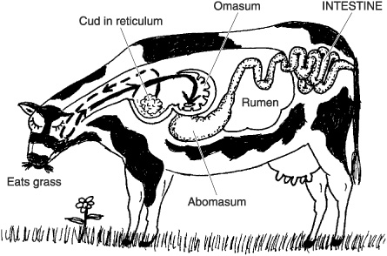
What does it mean to be a ruminant?
After being re-swallowed, food enters a second stomach where digestion begins.​
Finally, food passes into third and fourth stomachs before entering the intestine.​
This process makes plant matter easier to digest and provides more nutrient absorption.

Slide 5
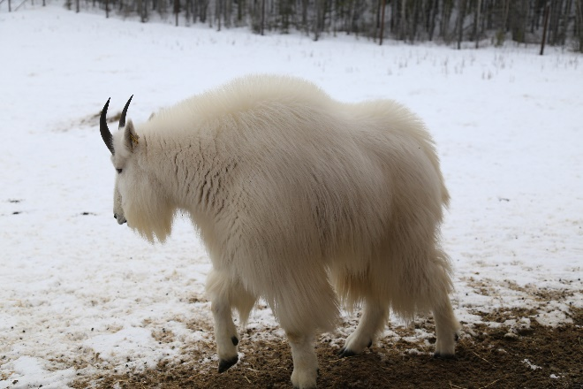
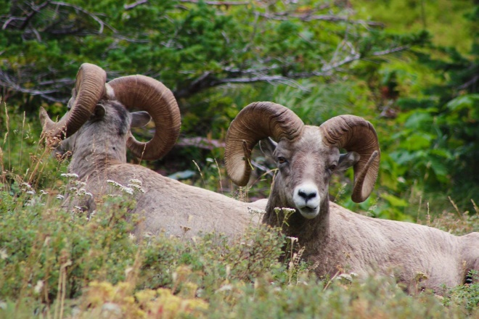
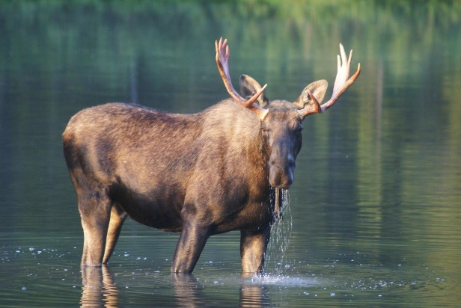
Review: What is an ungulate?
A mammal
With hooves
Even-toes
In Washington, all are ruminants (stomach with compartments)
Photo courtesy of Matt Davidson

Slide 6
Ungulates in Washington
Moose (Alces alces)
Adults can be nearly six feet at the shoulder.
Bulls (males) weigh 850-1,100 pounds.
Cows (females) weigh 600-800 pounds.
Moose are herbivores (plant eaters) and browsers, eating leaves, bark, and twigs from trees and shrubs. They also like aquatic vegetation.
Solitary, except cows with calves (young moose).

Slide 7
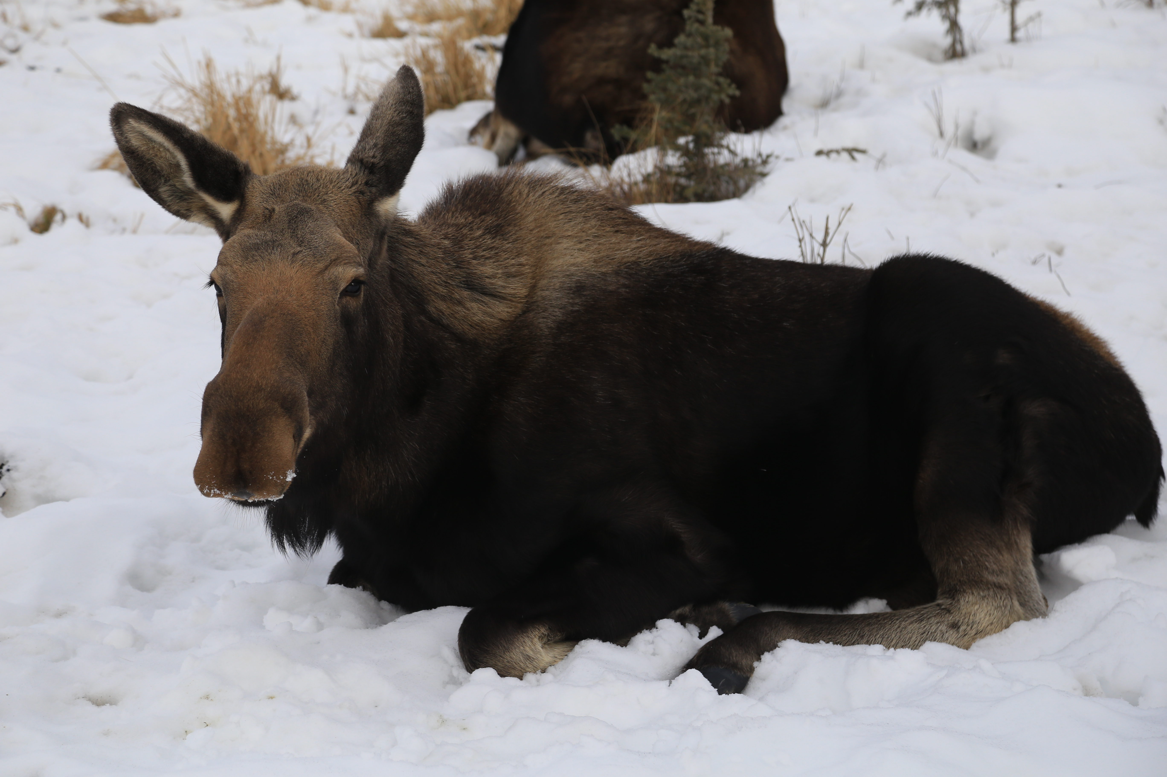
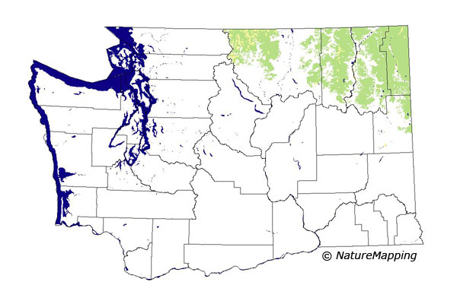
Ungulates in Washington
Moose (Alces alces)
Average lifespan is 8-12 years.
A flap of skin called a bell or dewlap hangs from the throat.
Cervidae family (antlers).
There are approximately 5,000 moose living in Washington.
The majority are found in the Selkirk Mountains with smaller populations in the North Cascades, Okanogan, and Blue Mountains.
Moose habitat

Slide 8
Ungulates in Washington
Elk (Cervus canadensis)
Bulls (males) weigh 600-800 pounds.
Cows (females) weigh 400-500 pounds.
Bulls have large, spreading antlers.
Life span is 12-16 years.
Can run up to 35 miles per hour.

Slide 9
Ungulates in Washington
Elk (Cervus canadensis)
In spring and summer, elk mainly graze. They eat grasses, sedges, and a variety of flowering plants.
In fall, elk increasingly become browsers, feeding on sprouts and branches of shrubs and trees.
During fall and winter, elk continue to eat grasses when these are available and not covered by deep snow.

Slide 10
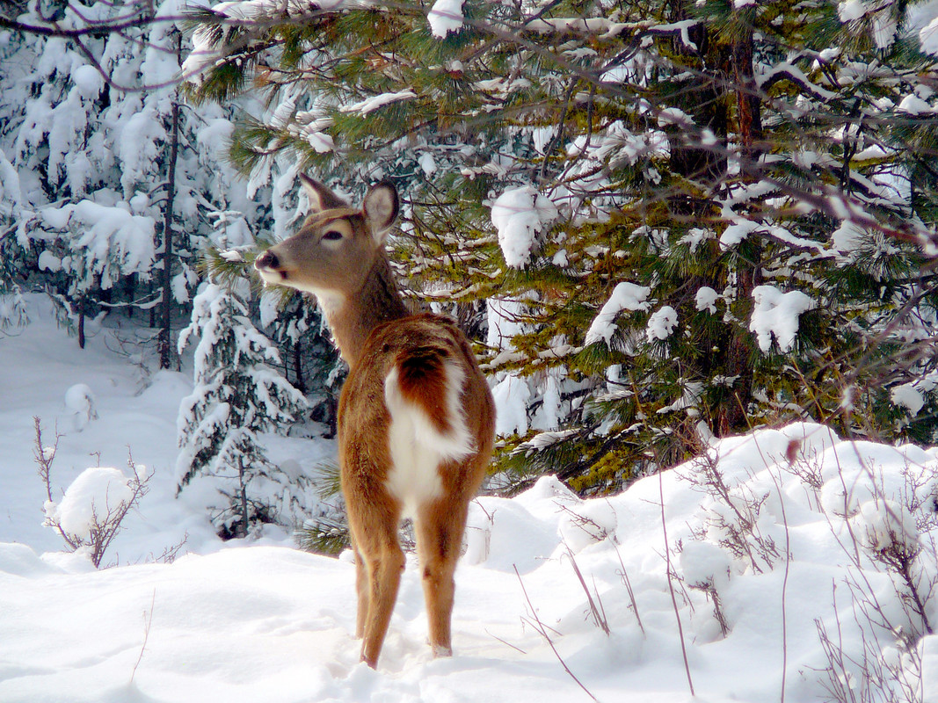
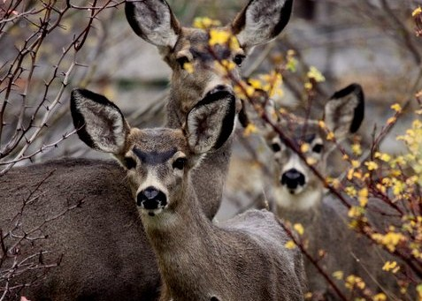
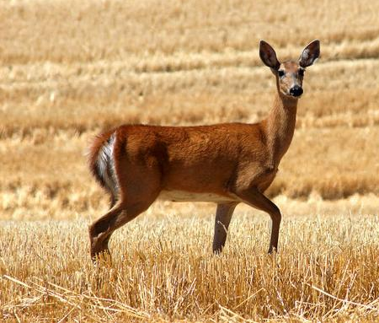
Ungulates in Washington
Four Species of Deer
Black-tailed deer Odocoileus hemionus columbianus
Most common species in Washington
White-tailed deer Odocoileus virginianus
Rocky Mountain mule deer Odocoileus hemionus hemionus
Largest deer in Washington
Columbian white-tailed deer Odocoileus virginianus leucurus
Federally listed as an endangered species in Washington and Oregon in 1967.
White-tailed deer
Black-tailed deer
Rocky Mountain mule deer
Columbian white-tailed deer

Slide 11
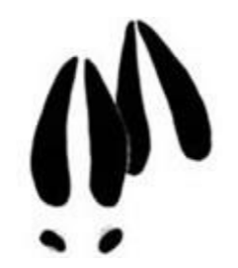
Ungulates in Washington
General Deer Info
Bucks (males) weigh up to 250 pounds.
Does (females) weigh up to 170 pounds.
Antlers have a main beam that forks.
Deer eat a wide variety of plants, but their main food item is browse -the growing tips of trees and shrubs.
In late winter and early spring, deer eat grass, clover, and other herbaceous plants.
.

Slide 12
Ungulates in Washington
Bighorn Sheep (Ovis canadensis)
Rams (males) weigh over 250 pounds, with the horns alone weighing 30 pounds.
Rams have large brown horns that curl back over their ears and spiral up past their cheeks.
Rams have double-layered skulls for protection.
Horn size can be a symbol of dominance among rams.
Ewes (females) are smaller than rams and their horns average 9-12 inches with a slight curve backwards.
Bovids (horns).

Slide 13
Ungulates in Washington
Bighorn Sheep
(Ovis canadensis)
An ewe’s average lifespan is 10-14 years.
Rams typically live 9-12 years.
Bighorns less than one year of age are referred to as lambs.
Largest wild sheep in North America.
Specialized split hooves help with balance and rough hoof bottoms, allowing them to move easily across rugged terrain.

Slide 14
Ungulates in Washington
Mountain goat
(Oreamnos americanus)
Male and female mountain goats look very similar, but males are larger.
At birth, kids (juveniles) weigh 5-7 pounds.
Nannies (adult females) weigh 125-155 pounds.
Billies (adult males) weigh 135-180 pounds.
The goat's age can be determined by counting annual growth rings, which are formed each winter.
The male's horns have a wider base and curve back in a greater, more uniform arc. The female's horns tend to curve more toward the tip.

Slide 15
Ungulates in Washington
Pronghorn
(Antilocapra americana)
Pronghorns are rather small ungulates, and measure 2.5-3 feet at shoulder height.
Adults weigh between 77-154 pounds.
Males have black horns made of a keratin sheath over a permanent, boney core. Sharp tip and forward prong. The horn sheaths of males are shed and regrown each year.
Most females have horns that are shorter and straighter than males.
Notes:
Often called “pronghorn antelope” or just “antelope”, but these are not a true antelope, which is found in Africa and southeast Asia.
The use of the term “antelope” seems to have originated when the first written description of the animal was made during the 1804–1806 Lewis and Clark Expedition.

Slide 16
Ungulates in Washington
Pronghorn
(Antilocapra americana)
Pronghorn are found in the open grassland.
They are grazing animals that eat the shrubs, grasses, and forbs that grow on the plains.
They also use the open space of the prairie to evade predators.
Can run over 55 miles per hour.
Live 7-10 years.
Photo courtesy of NPS

Slide 17
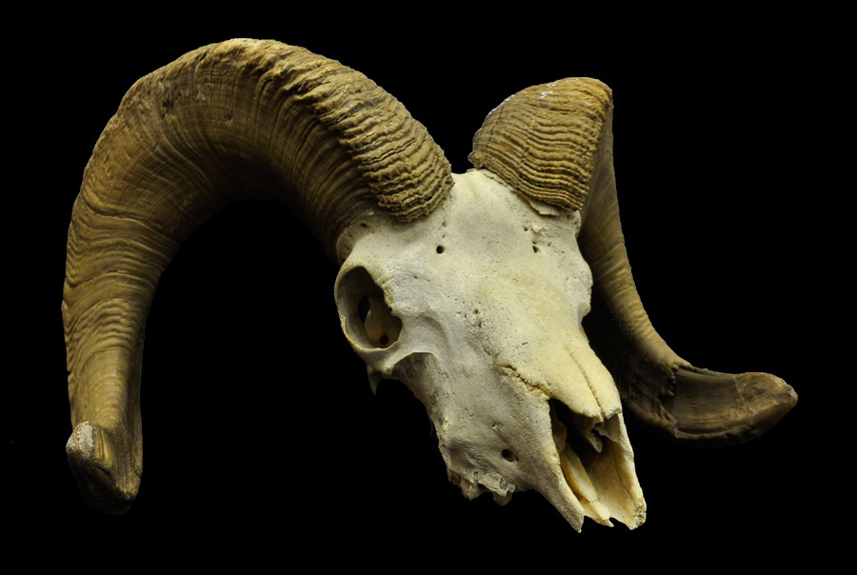
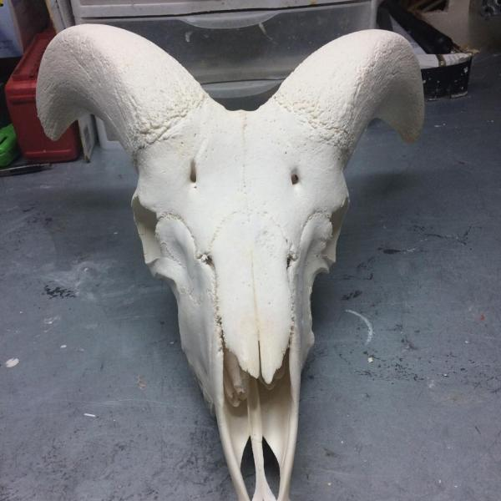
Horns
Bovids (family Bovidae).
Continuously grow, they are never shed.
Two-part structure. An interior portion of bone (an extension of the skull) is covered by an exterior sheath grown by specialized hair follicles (similar to human fingernails).
Horns are usually found on both males and females.
Horns are often used by males in fights and displays during breeding.
Photo courtesy of Museum of Natural and Cultural History
Photo courtesy of coueswhitetail.com

Slide 18
Antlers
Cervids (family Cervidae)
Regrow every year.
Grow as an extension of the animal’s skull.
They are true bone, are a single structure.
Generally, are found only on males.
Shed and regrown yearly.

Slide 19
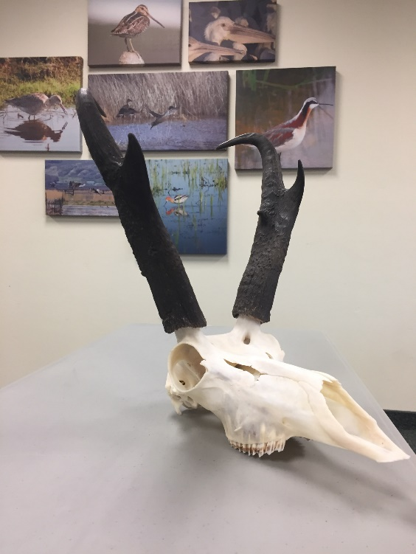
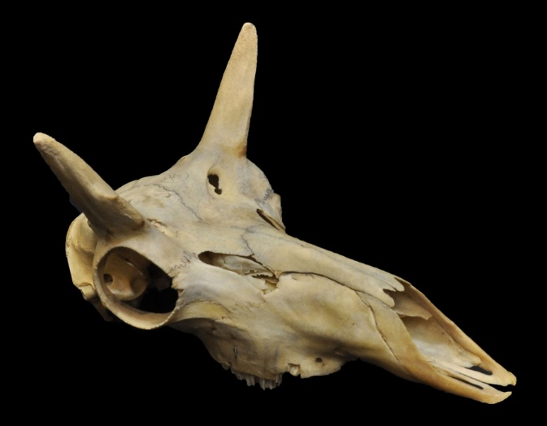
Pronghorn are blend of horns & antlers
The black sheath falls off and regrows every year, but there is a permanent horn underneath.
Photo courtesy of NPS
Photo courtesy of Idaho Game & Fish Dept
Photo courtesy of University of Oregon
Notes:
Interesting fact about the pronghorn: It is the only member of it’s family, Antilocapridae, and it’s closest living relative is the giraffe.
Pronghorn differ from bovids in two ways: their horns are branched and the keratinous sheath are shed every year.

Slide 20
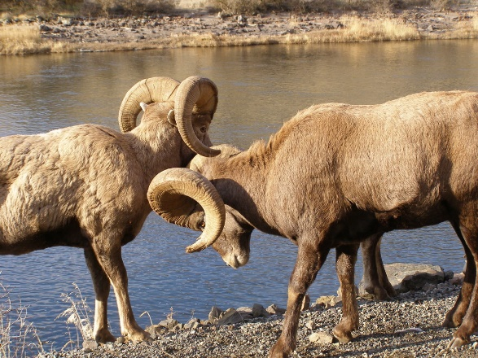
Cervids or Bovids?
Notes:
Ask students to identify if each animal is a Cervid (with horns that fall off and regrow) or Bovid (that are permanent and continue to grow for lifetime)
Cervids: moose, elk, and deer
Bovids: mountain goat and bighorn sheep

Slide 21
What are antlers and horns good for?
Establish dominance over other males.
A male who has large antlers or horns shows that the individual has survived many years and is healthy.
This is for females who want to pass on the best genes to their offspring.
Defense against predators.
Digging wallows (muddy or shallow ponds used to attract mates during rut) and beds.
Reaching high food sources.

Slide 22
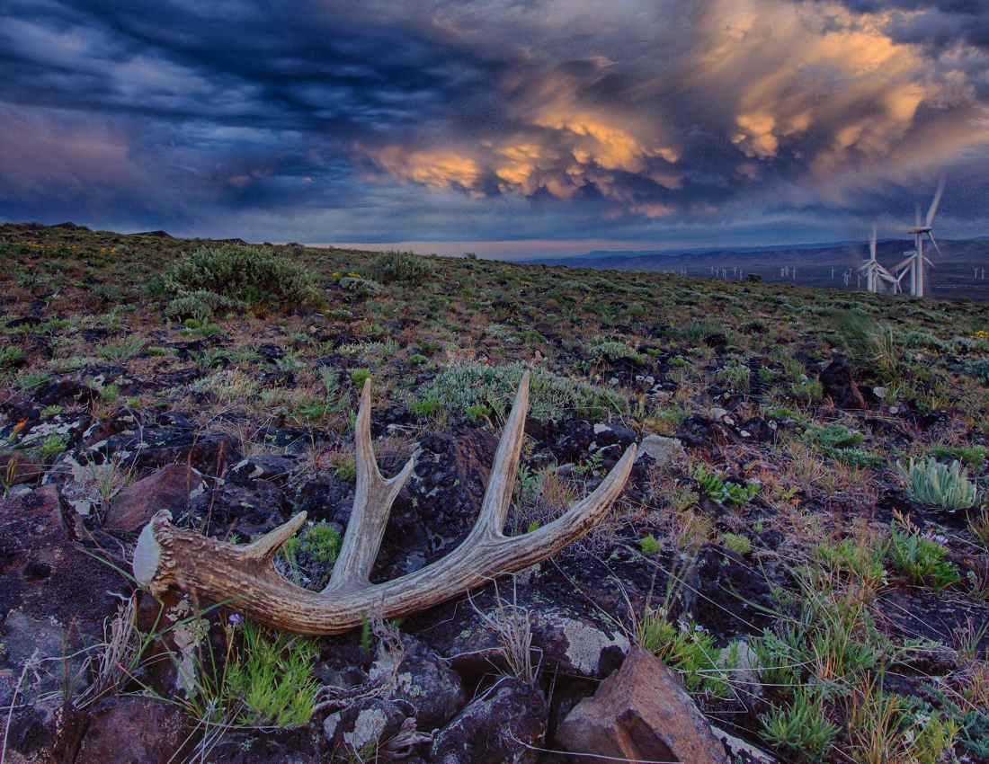
Department of Fish and Wildlife

