Slide 1
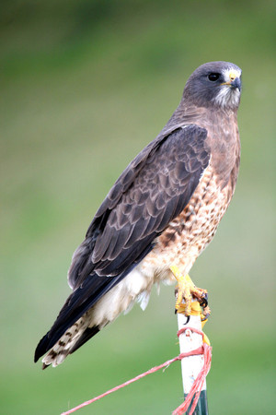
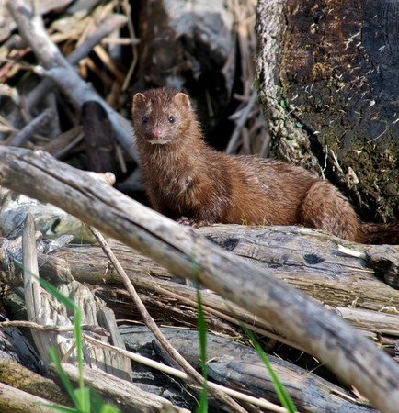
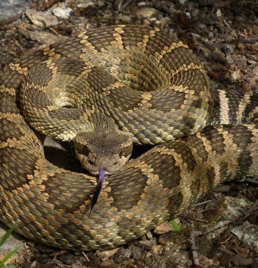
Carnivores in Washington

Slide 2
Which of the following is a carnivore?
Sea otter
Mallard (duck)
Pygmy rabbit
Notes:
Have students guess. After they are done guessing, click and the correct answer will be circled. The next slide will explain what a carnivore is.

Slide 3
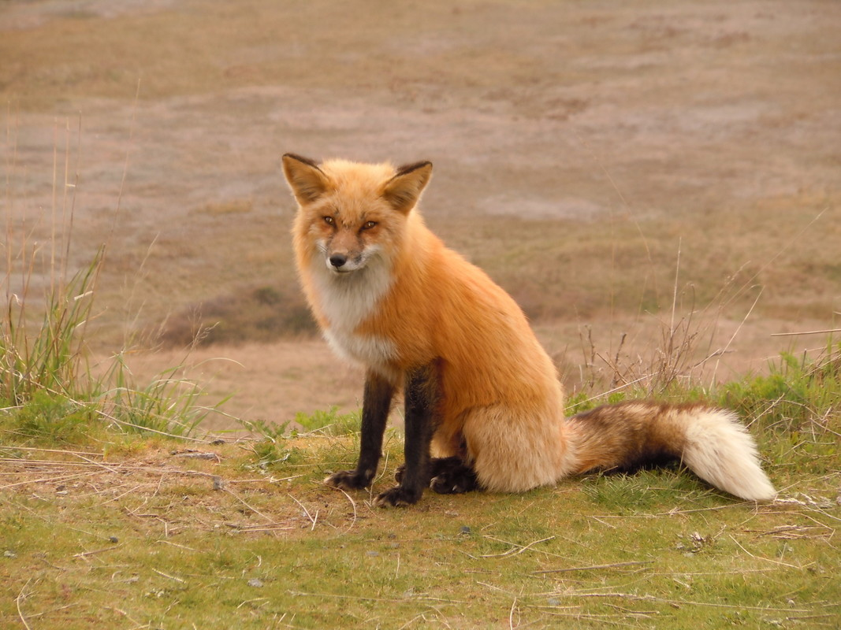
What is a carnivore?
A carnivore is an animal that eats a diet consisting mainly of other animals. This includes live and/or dead animals (scavenging).

Slide 4
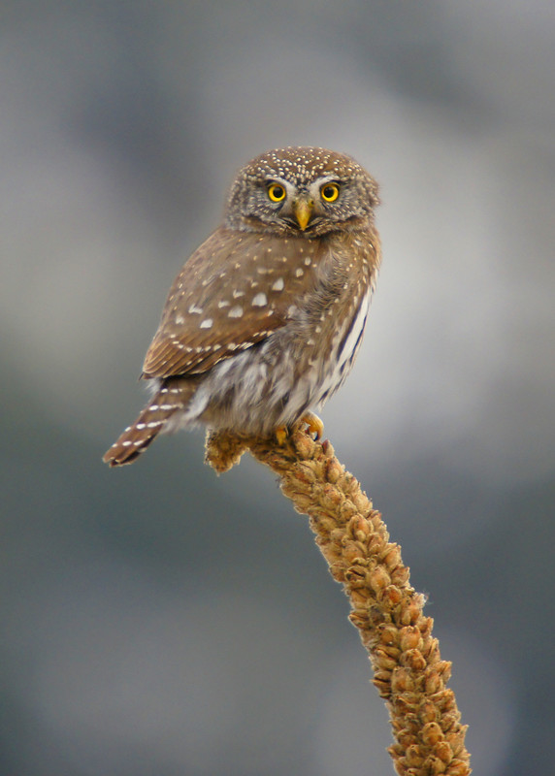
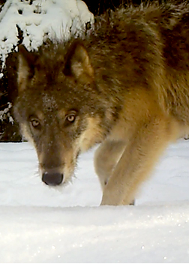
Examples of Washington carnivores:
Pygmy owl
Bobcat
Gopher snake
Gray wolf
Pine marten
Notes:
Ask students if they can think of other examples of carnivores who live Washington.

Slide 5
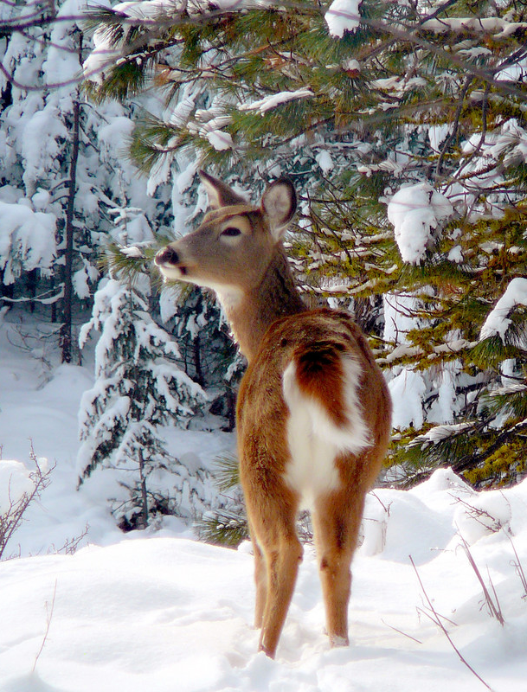
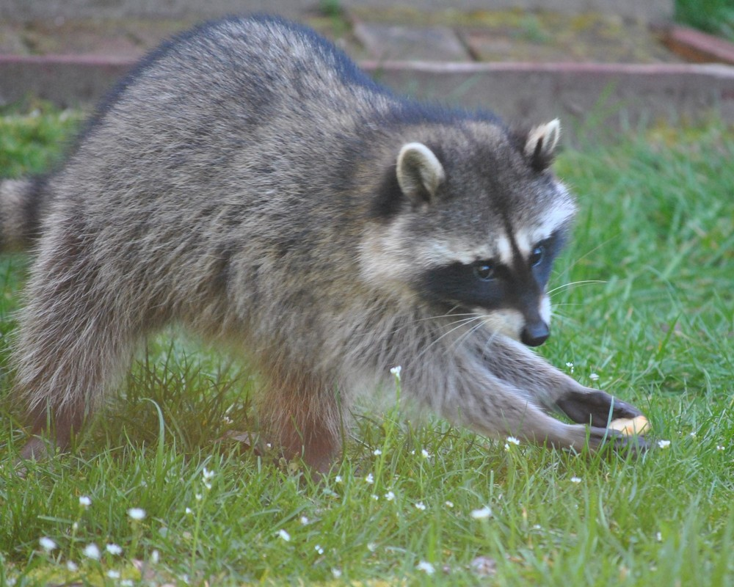
How are carnivores different?
From herbivores?
From omnivores?
Let’s find out!

Slide 6
How are carnivores different?
From herbivores?
From omnivores?
Carnivores
Animal eaters
Speed
Strength
Keen senses for hunting
Sharp teeth
Venom
Eyes in front of head
Scavenge
Plant eaters
Teeth that easily grind vegetables
Digestive systems which can handle large amounts of plant material
Eyes on side of head
Animal and plant eaters
Eggs, insects, algae, fungi
Teeth that allow them to eat both animals and plants.
Eyes usually forward facing.
Notes:
After watching the video from the previous slide, have students give reasons how the three types of animals are different. You can write their answers on a whiteboard and then compare their answers with the correct answers on this slide.

Slide 7
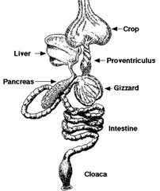
Adaptations of Carnivores
Forward facing eyes for locating prey.
Sharp, curved beak for ripping and tearing prey.
An adaptation is how a species may change over time to become better suited to its environment.
Look at the picture of the Swainson’s hawk.
What adaptations does it have that help it catch and eat its prey?
Specialized digestive system for processing bones, feathers, fur, organs, muscle, etc.
Sharp talons and strong feet for catching prey.
Long broad wings for soaring while searching for prey.
Notes:
Have students spend two minutes guessing what adaptations the hawk has. When students are done, continue the PowerPoint. This will give four adaptations of the hawk.

Slide 8
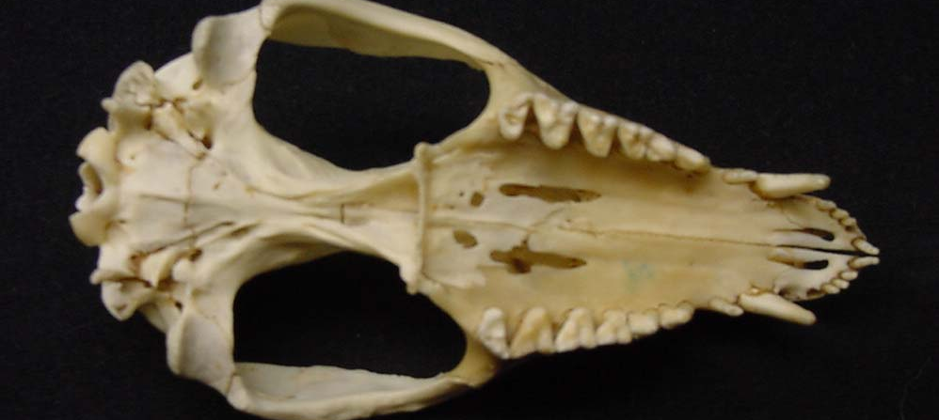
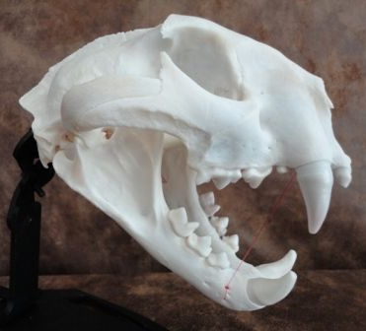
Omnivore
Carnivore
Flatter molars for grinding plant material
Forward facing eye
Forward facing eye
Canine teeth for biting prey
Herbivore
Wide, flat teeth for grinding plant material.
Canine teeth for biting prey
Sharp molars for cutting and shredding flesh and bone.
Side facing eye
Learn more here

Slide 9
Carnivore or Herbivore?
Notes:
Have students guess. Ask why they believe the species is a carnivore or herbivore.
Herbivore: eyes on side of head.

Slide 10
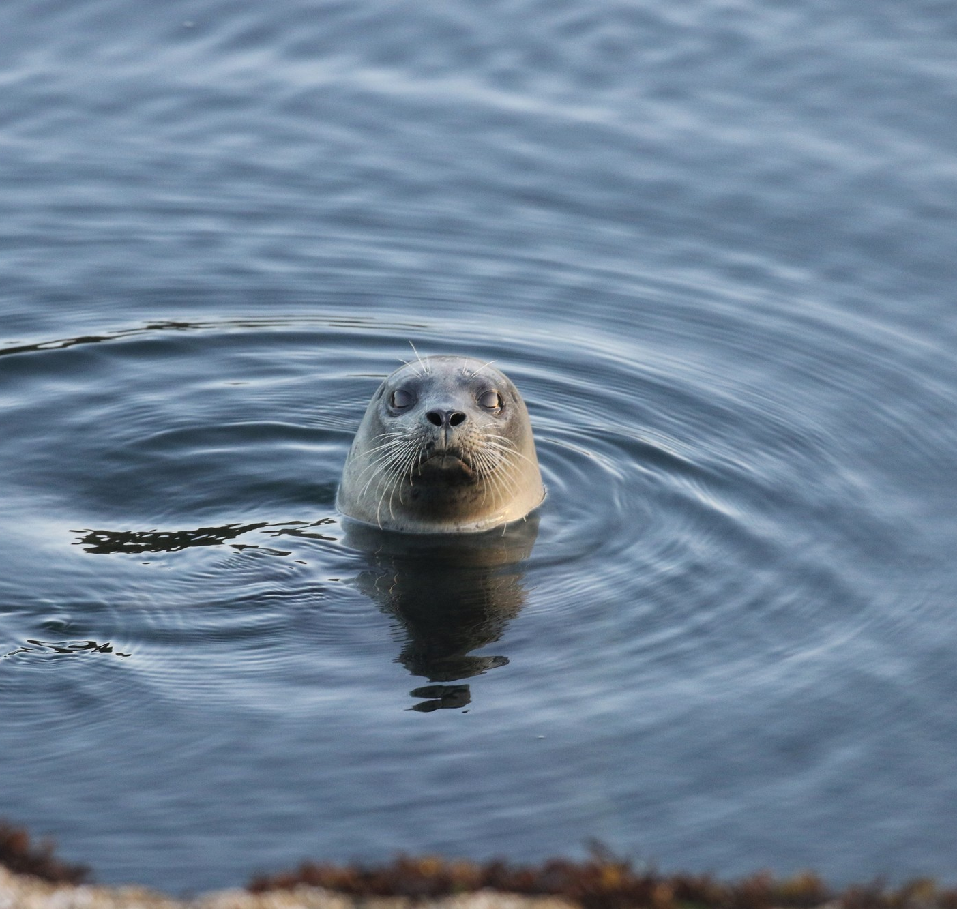
Carnivore or Herbivore?
Notes:
Have students guess. Ask why they believe the species is a carnivore or herbivore.
Carnivore: harbor seals eat fish, crustaceans, birds, etc. Forward facing eyes.

Slide 11
Carnivore or Herbivore?
Notes:
Have students guess. Ask why they believe the species is a carnivore or herbivore.
Herbivore: Moths eat sap, nectar, rotting fruit, etc. Eyes on side of the head.

Slide 12
Carnivore or Herbivore?
Notes:
Have students guess. Ask why they believe the species is a carnivore or herbivore.
Carnivore: bats eat insects (commonly moths) Forward facing eyes.

Slide 13
carnivore or herbivore?
Notes:
Have students guess. Ask why they believe the species is a carnivore or herbivore.
Carnivore! All snakes are carnivores, even though some have eyes on the sides of their head.

Slide 14
What are common traits of carnivores?
Write down student responses in this box.
Notes:
Write down traits in the box as students recall them to you.
Traits can vary from sharp teeth, to digestive systems to forward facing eyes, talons, claws, etc.

Slide 15
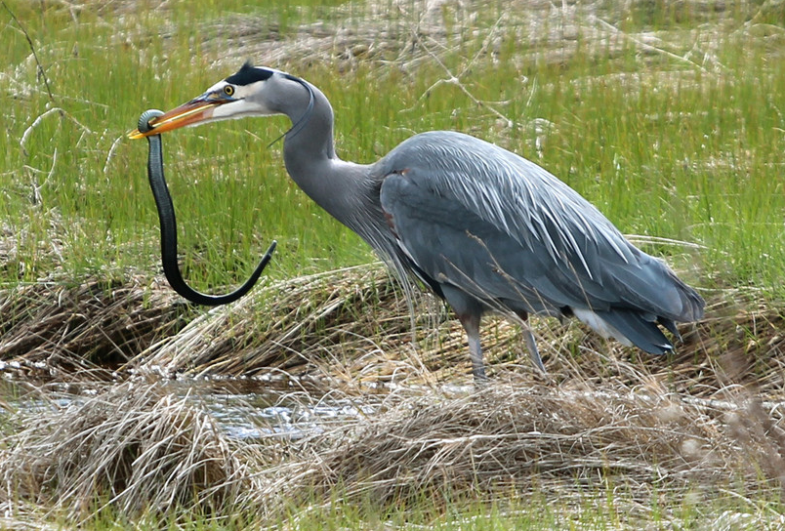
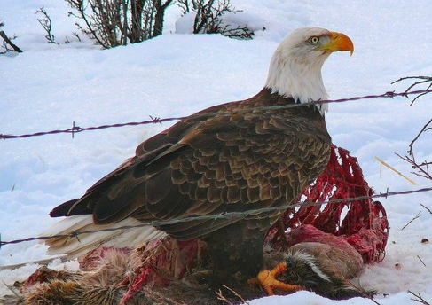
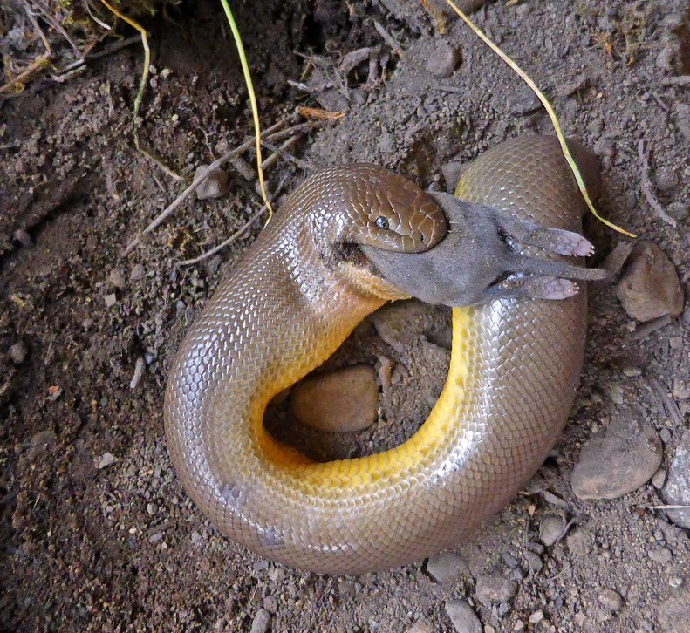
Carnivores
Some eat insects
Some eat fish
Some eat mammals
Some eat birds
Some eat reptiles
Some eat amphibians
Some eat dead animals
Some eat them all!

Slide 16
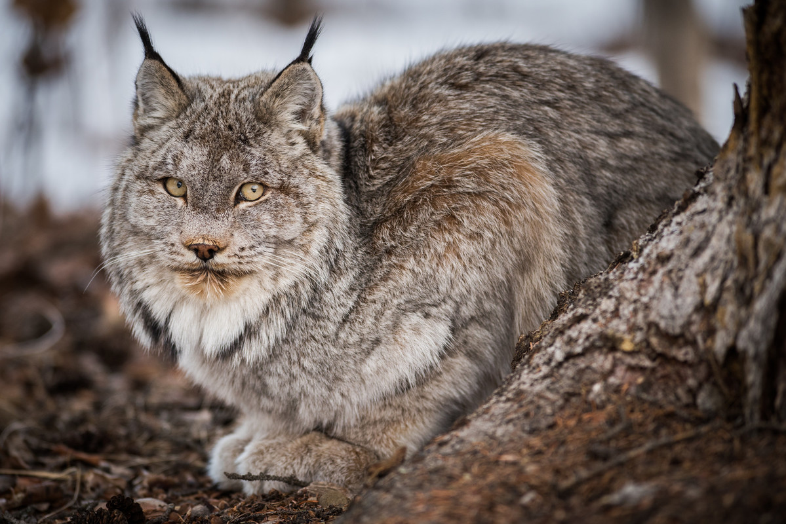
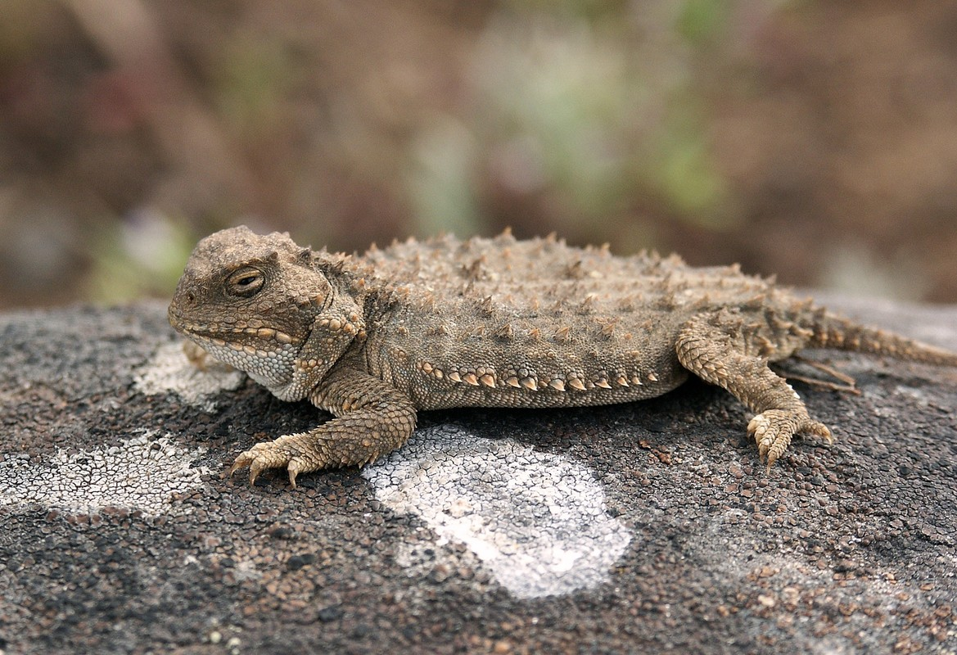
Diversity of Carnivores
Live in every type of ecosystem.
Some eat many types of prey.
Some only eat one type of prey.
Come in all shapes and sizes.
Have different adaptations depending on their environment/ecosystem.

Slide 17
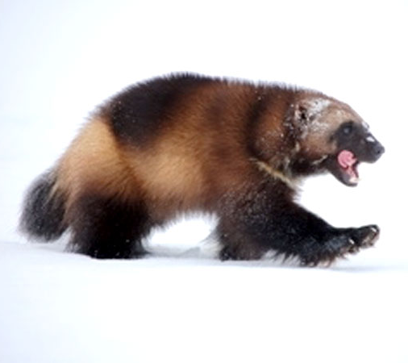
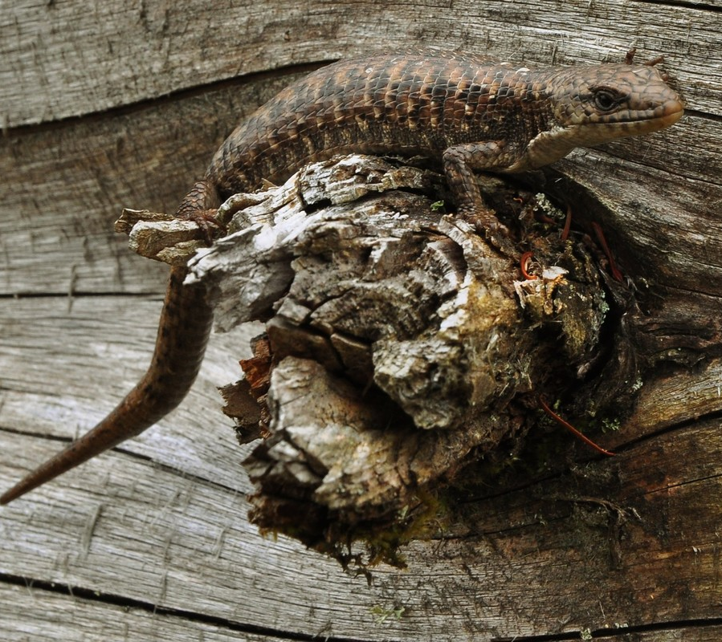
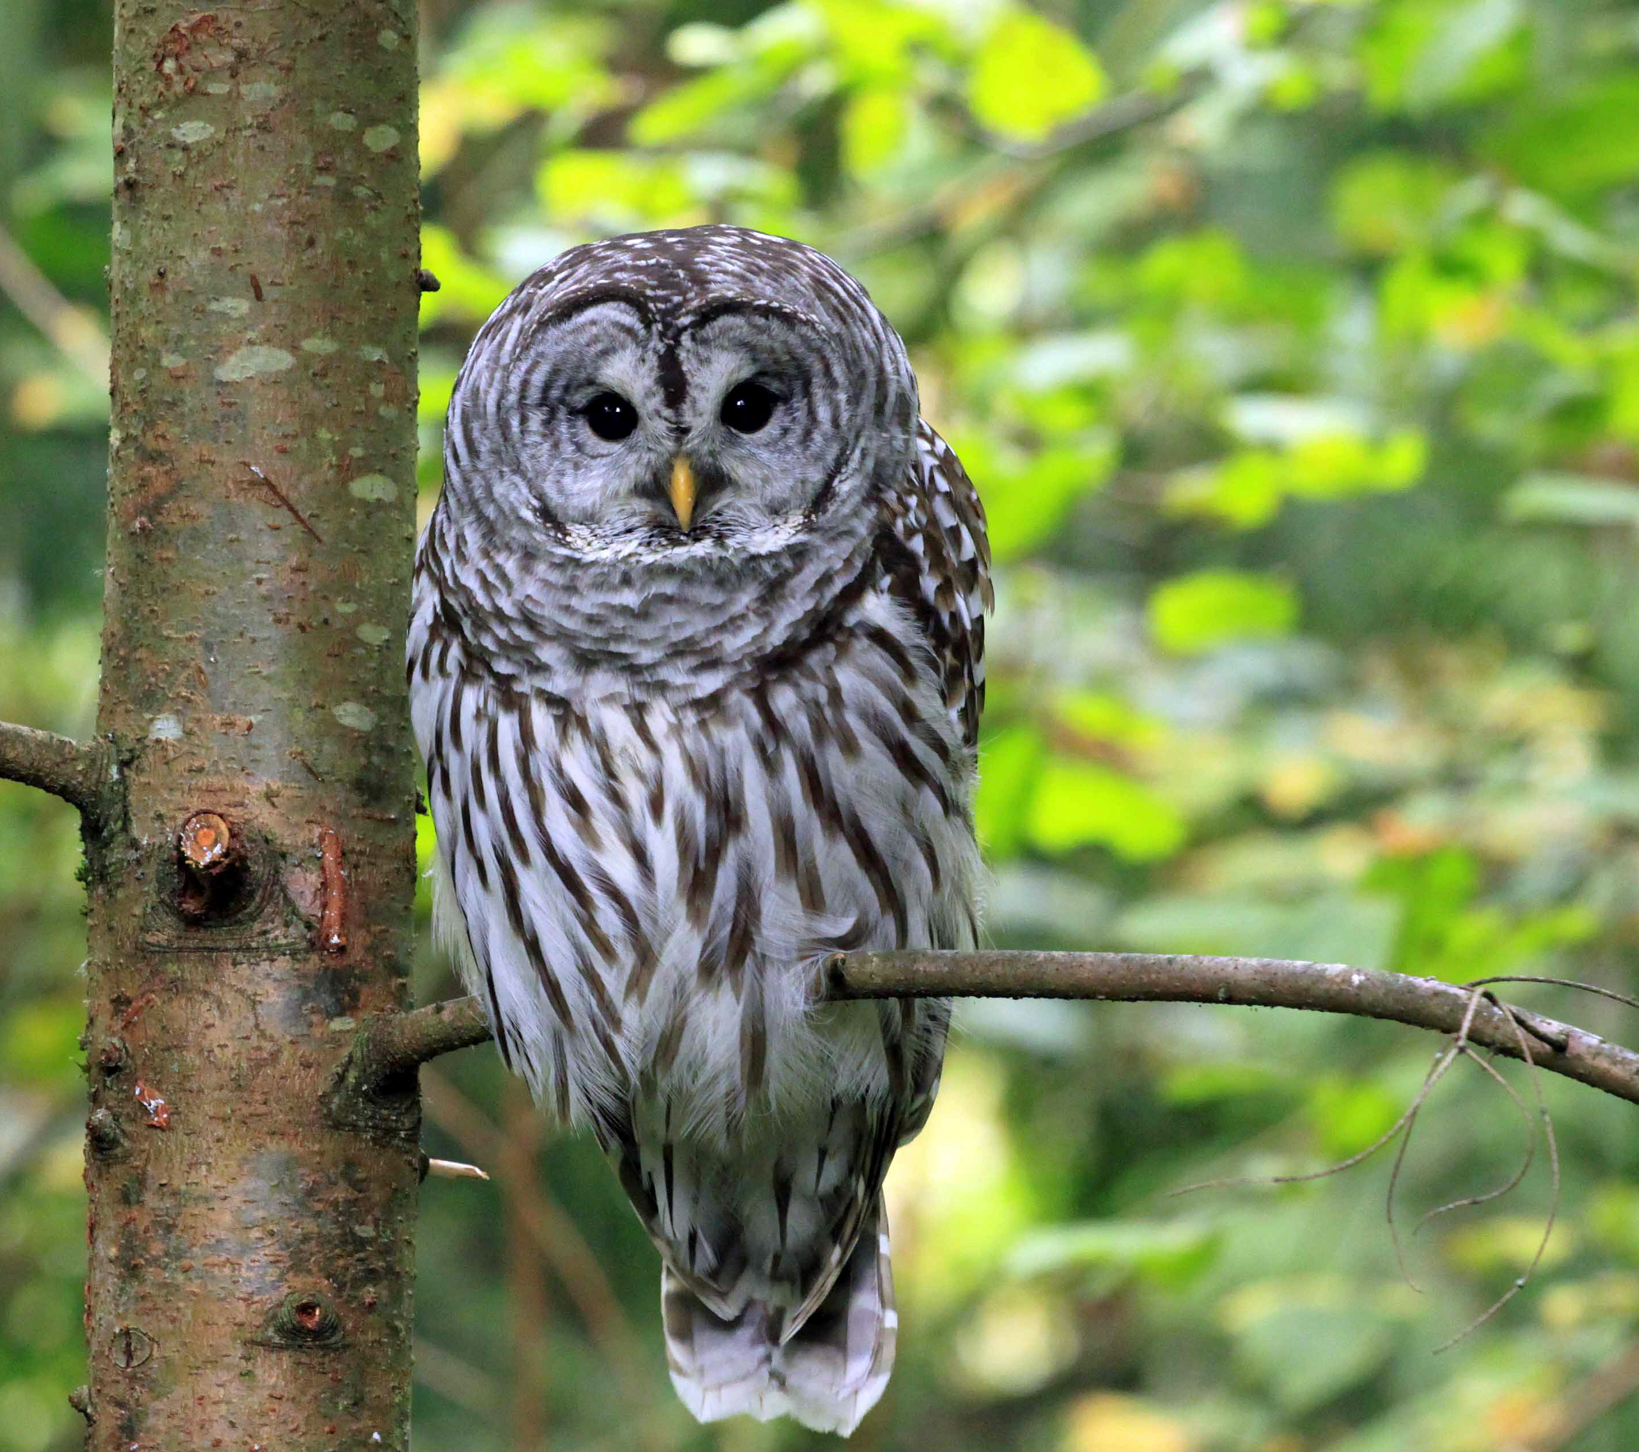
Carnivores are important because….
They remove smaller and diseased individuals.
Scavenging carnivores help control disease in ecosystems.
They prevent prey from over-populating and over-grazing.
Smaller carnivores remove “pest” species like mosquitos, mice, rats, etc.
Notes:
Carnivores are important to the health of Washington’s ecosystems. Without carnivores, we would have more disease in our ecosystems.

