Slide 1
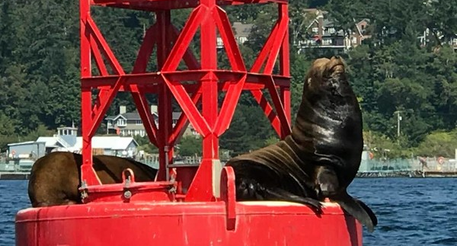
Adaptations in Marine Mammals

Slide 2
What is a marine mammal?
Notes:
Ask students to think about what a marine mammal is. Guiding question: what physical features do marine mammals have in common?

Slide 3
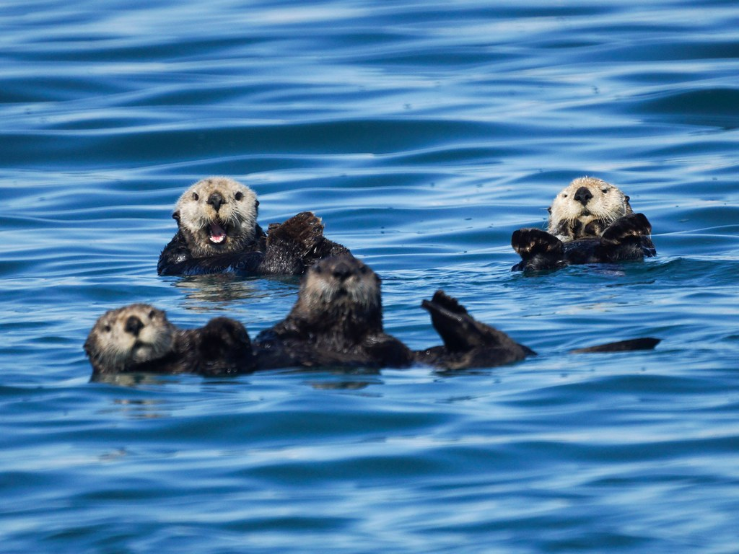
"Sea Otters" by Mike's Birds is licensed under CC BY-SA 2.0
Breathe air
Give birth to live young
Nurse their young
Warm blooded
Have hair
Marine Mammals are animals who…
Live in the ocean!
Notes:
#5 have hair: whales, porpoises, and dolphins are born with hair and then shed. The hair follicles remain, however.
After clicking through the traits, ask students to raise their hands and think of examples of marine mammals. They may come up with mammals who do not live in Washington like manatees.
After students are done giving examples, tell them we are going to learn about marine mammals who live in Washington.

Slide 4
Types of marine mammals in Washington
Whales
Porpoises
Dolphins
Orcas
Sea lions
Seals
Otters

Slide 5
Life in the ocean
Notes:
Washington has a diversity of marine mammals. This means we have many different types.
Although they are all mammals, different species use different senses and have different lifestyles that allow them to live in cold water.
We will learn the marine mammals who live in Washington and then you will study one more.

Slide 6
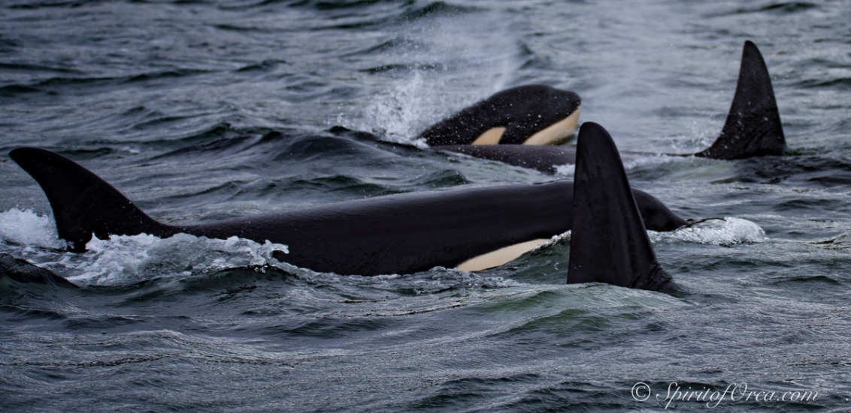
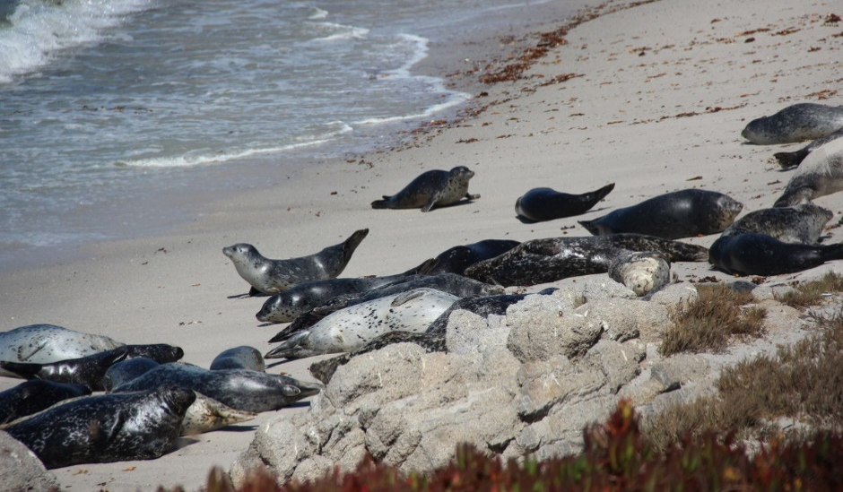
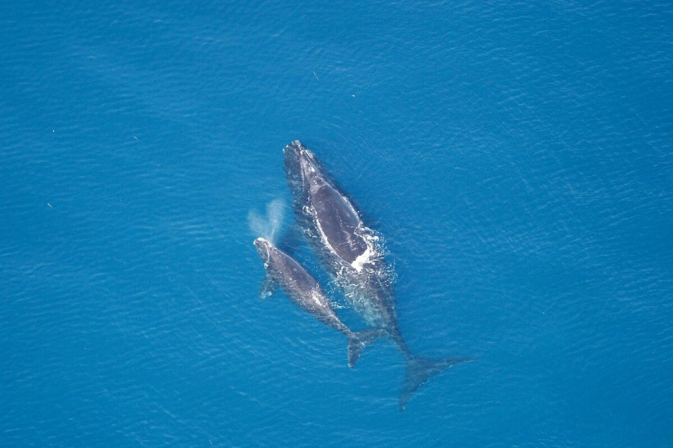
Life in the ocean
Swim
Dive
Breathe air (hold breath/
must surface for air)
Stay warm
Find food
Raise young
Notes:
Mammals have adapted to life in the ocean. This means their physical and behavioral features allow them to spend a lot of time in and under water.

Slide 7
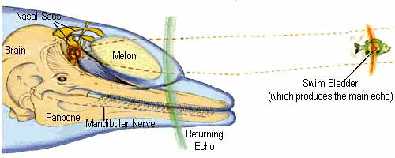
Marine mammal adaptations
Some dolphins and whales use echolocation to find their food.
"echolocation" by ManilaRyce is licensed under CC BY-NC-SA 2.0
Notes:
The link takes you to a two minute video about how mammals use echolocation.

Slide 8
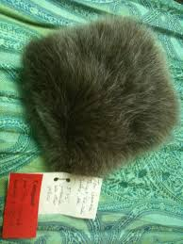
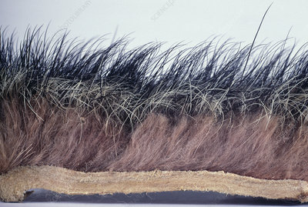
Marine mammal adaptations
Sea otters, river otters, seals, and sea lions have a dense coat of fur that keeps them warm, and mostly dry.
Left: Sea otter pelt from Alaska Wildlife ID
Right: Seal pelt from side view from Science Photo Library
Notes:
Fun note: Sea otters blow bubbles into their fur for insulation and floatation!

Slide 9
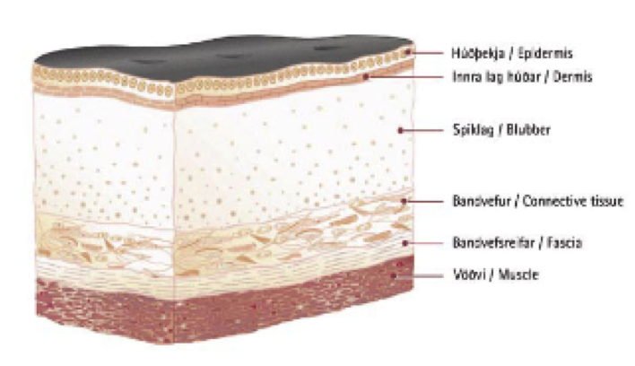
Marine mammal adaptations
Whale, dolphins, porpoises, seals and sea lions use blubber (a thick layer of fat) to keep warm.
Epidermis
Dermis
Blubber
Connective Tissue
Fascia
Muscle
Graphic courtesy of Whale and Dolphin Conservation Center

Slide 10
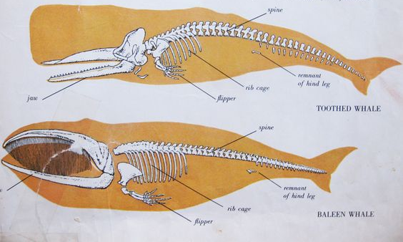
Marine mammal adaptations
Mammals eat different types of food. They have different shapes and sizes of teeth or baleen.
Notes:
The link takes you to a seven-minute NOAA video where a Seattle-based scientist uses microscopes to find out what seals and sea lions eat.

Slide 11
Marine mammal adaptations
Some mammals come on shore to have babies and to rest and others do not.

Slide 12
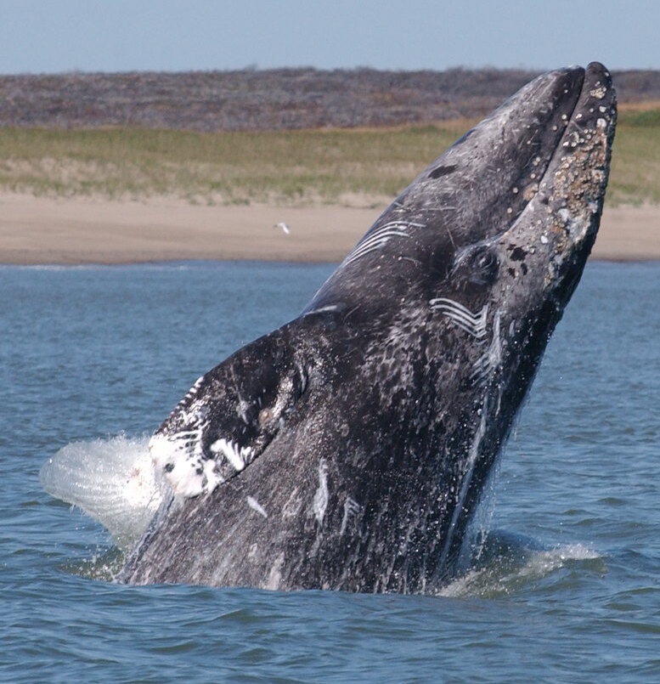
Marine mammal adaptations
Some mammals form groups while others are solitary.

Slide 13
Marine mammal adaptations
What do you think is an interesting marine mammal adaption?

