Slide 1
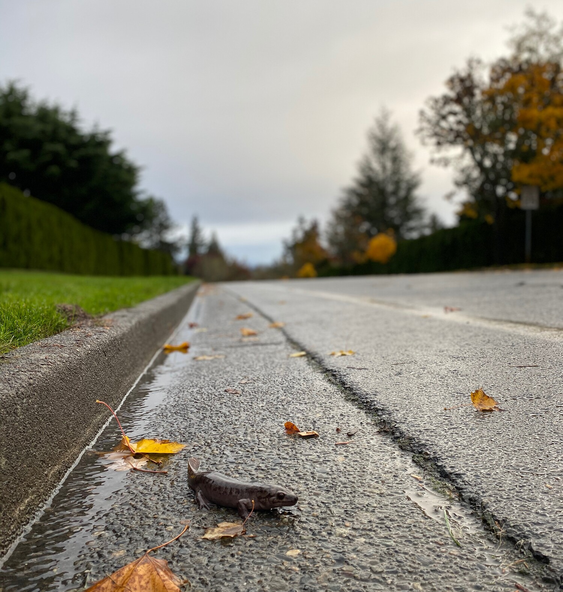
Animal Crossings
How can the built environment support movement for animals?
The Science of Corridors

Slide 2
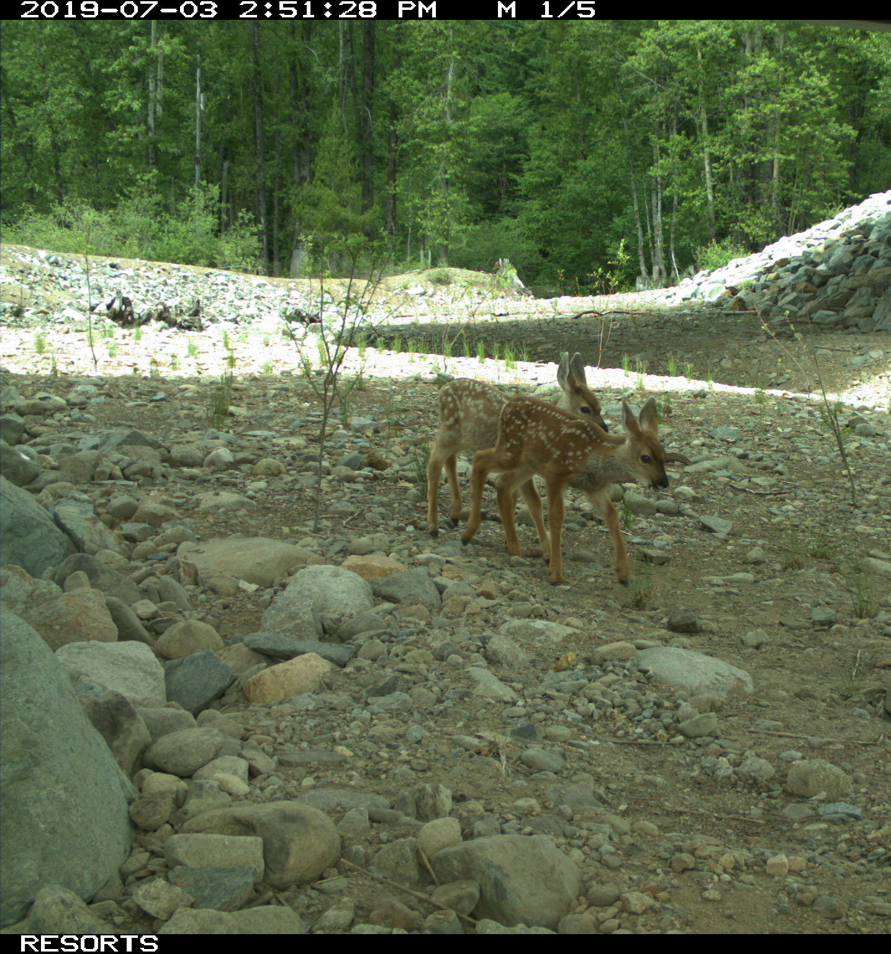
What is connectivity and why is it important?
From Ants to Grizzlies: A General Rule for Saving Biodiversity

Slide 3
A
B

Slide 4
Is it important for animals to have the ability to disperse or migrate? Why or why not?
Type student answers here

Slide 5
What actions could be taken to help increase awareness of animals crossing the road?
Type student answers here

Slide 6
What actions could be taken to help the deer move more safely to and from the two parts of the park?
Type student answers here

Slide 7
What, if any, complications might arise from these actions (differing viewpoints, funding, etc.).
Type student answers here

