Slide 1
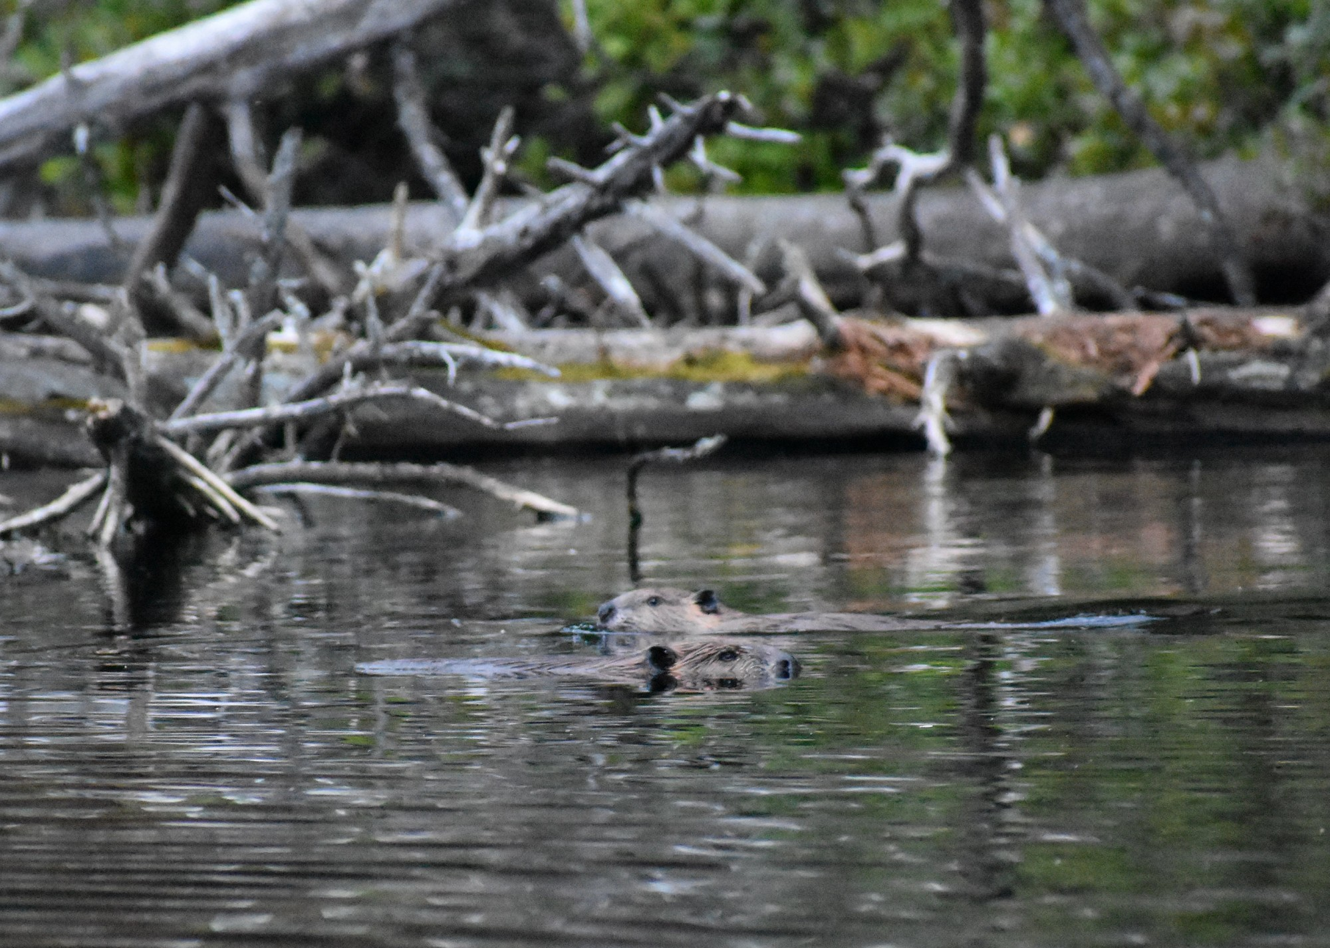
Co-Existing with Beavers

Slide 2
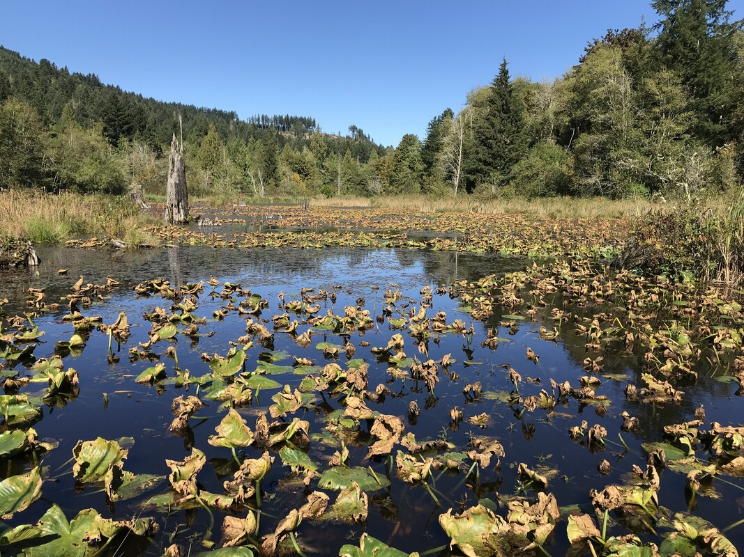
How do beavers alter ecosystems?
By creating riparian areas, pools, ponds, and more

Slide 3
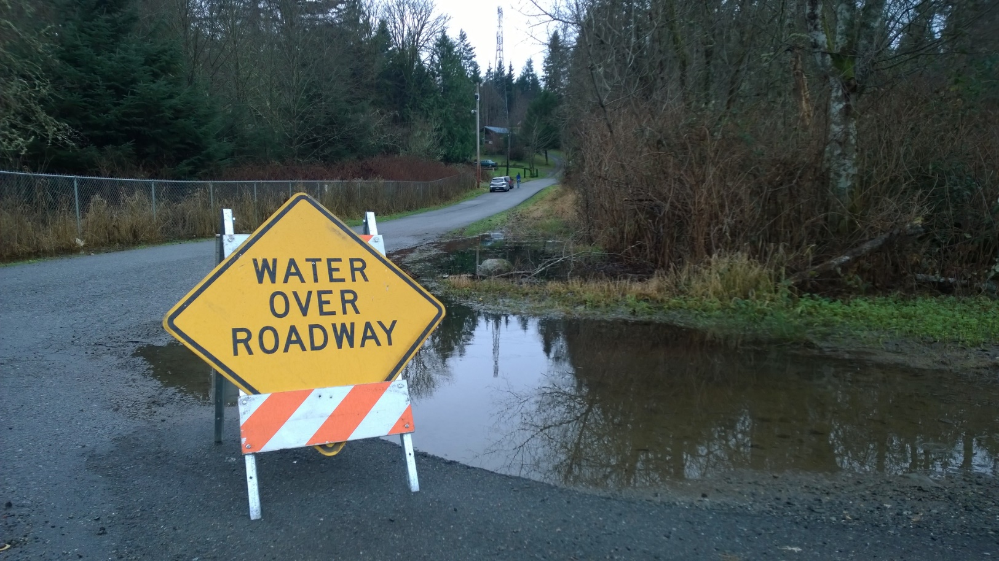
Ecosystem engineers
Sometimes beavers’ crafty engineering can cause conflict with people.
For example, when dams are built near human environments, they can cause flooding on roads, pastures, and on people’s property.
Photo courtesy of Beavers Northwest

Slide 4
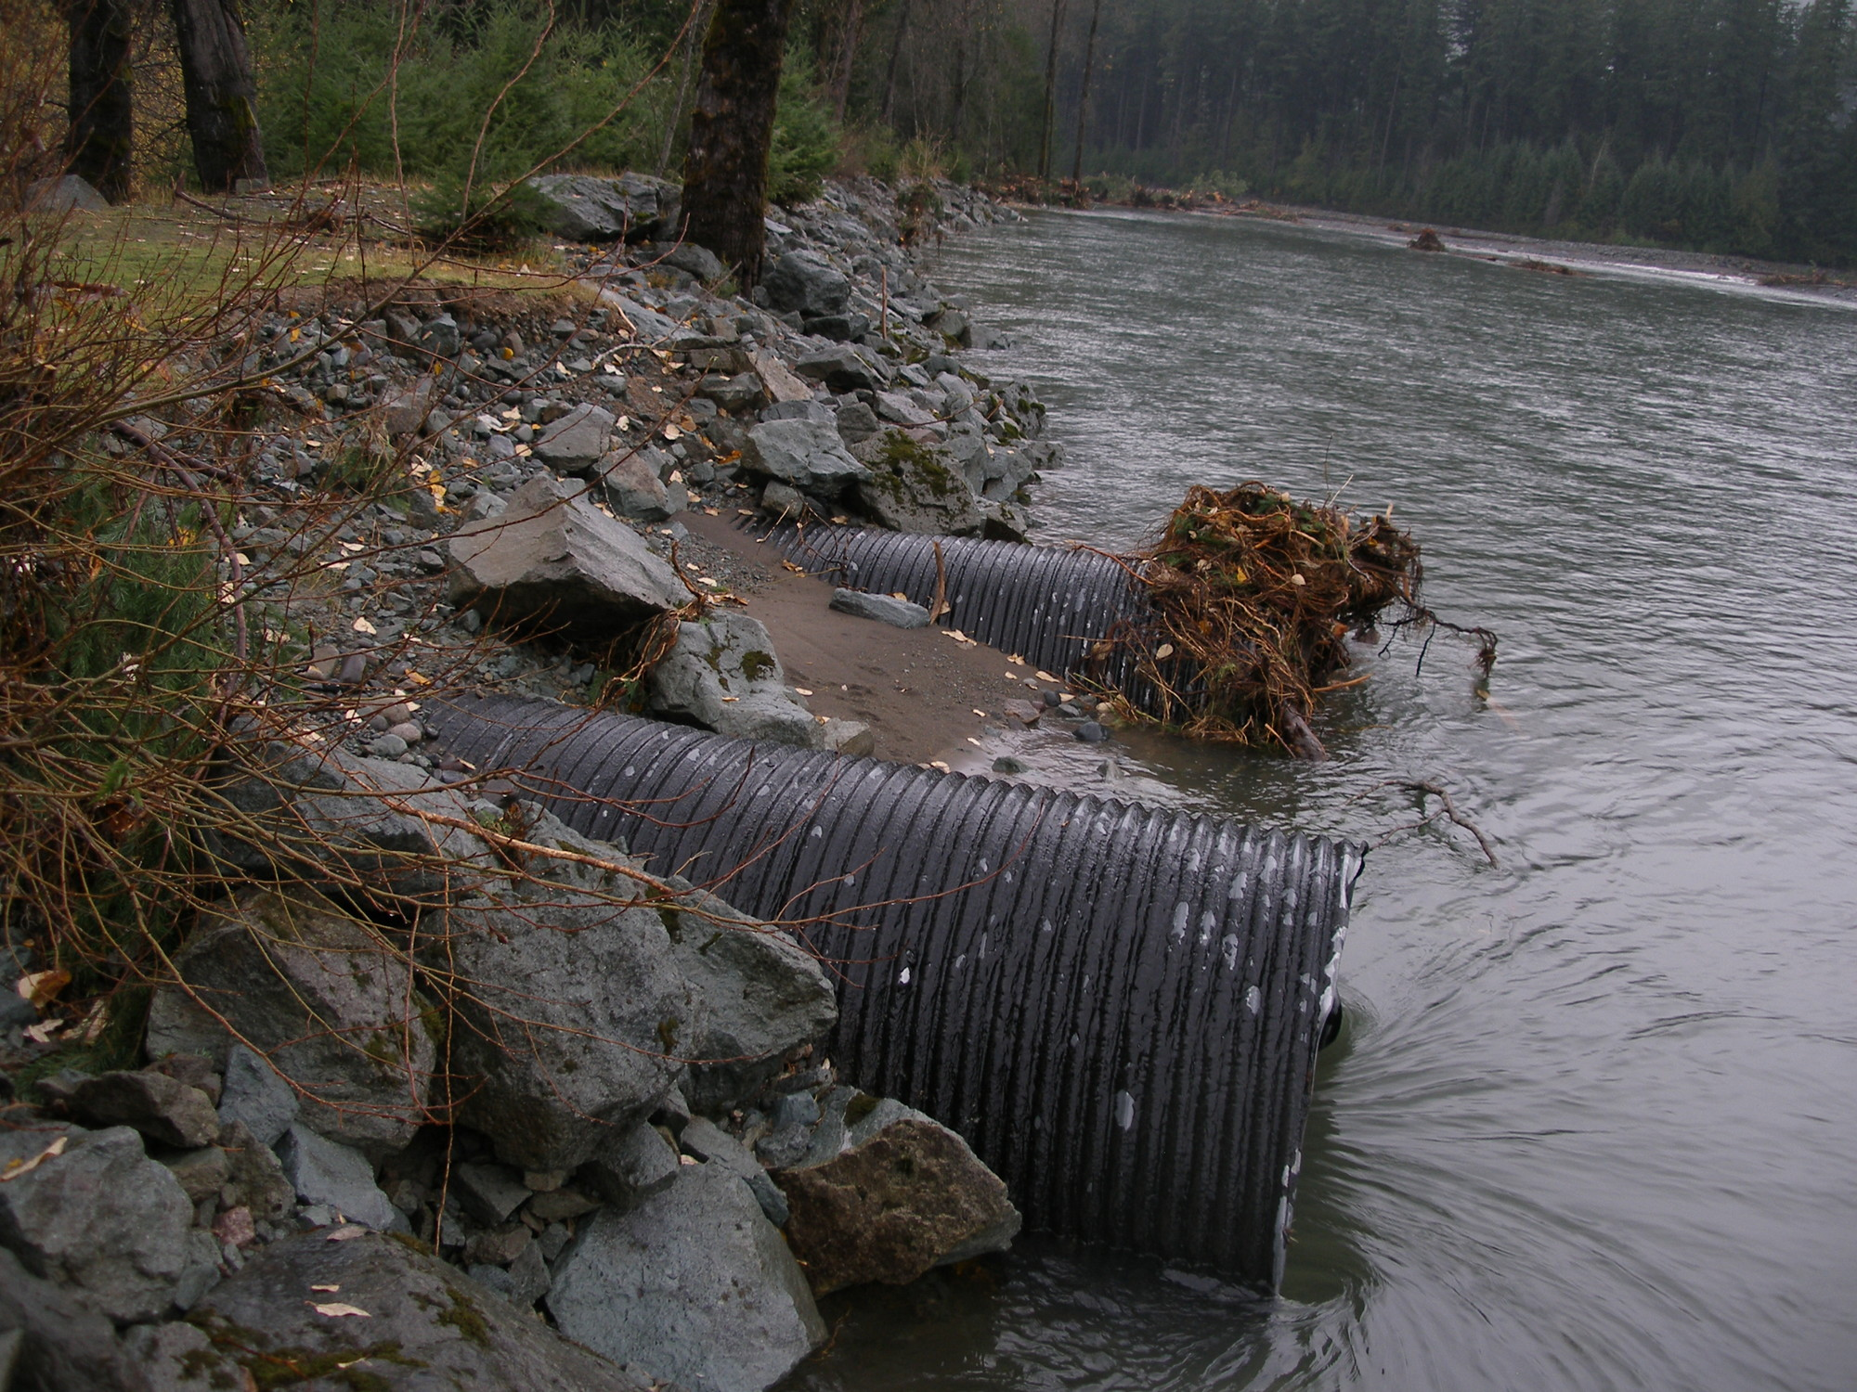
Beavers will sometimes even block culverts (they see it as a hole in a dam).

Slide 5
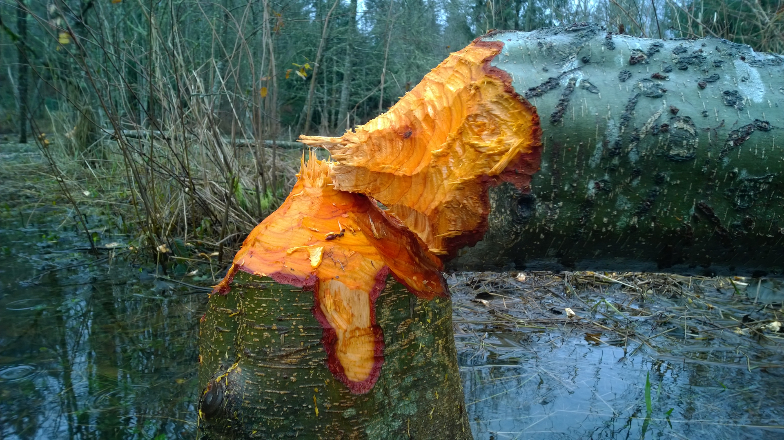
Beavers may also chew through trees that people value or create hazardous conditions by chewing through trees.
Photo courtesy of Beavers Northwest

Slide 6
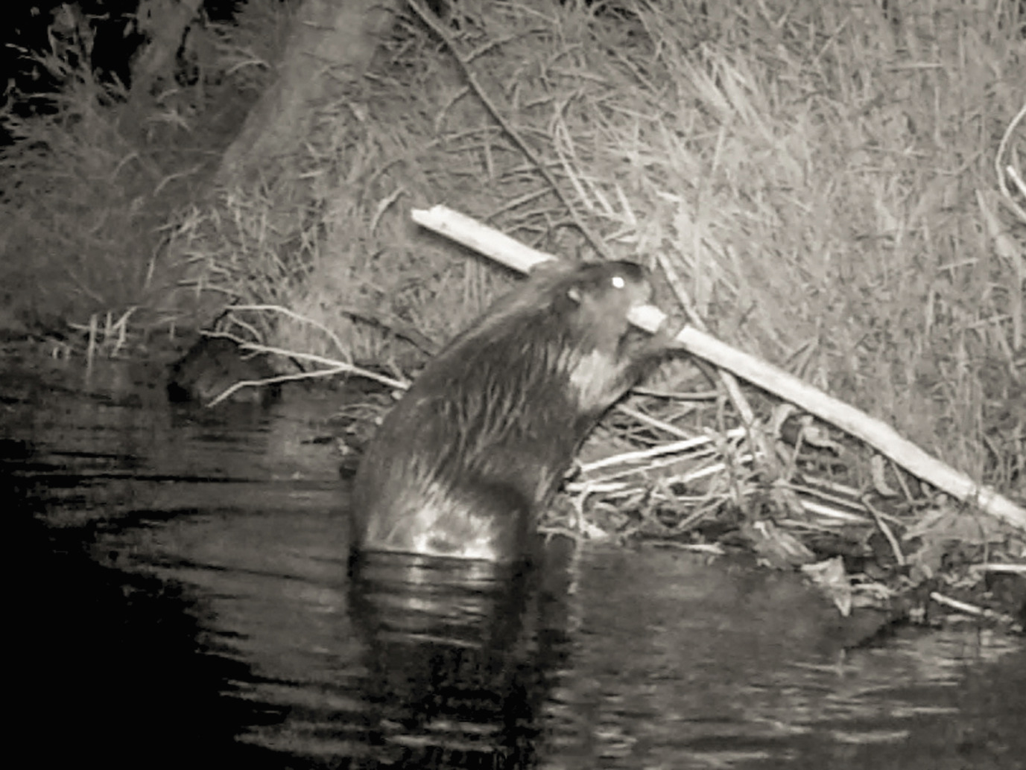
Is co-existence possible?
We know that beavers are important for many reasons, so how can we co-exist with them?
With a partner, brainstorm three ways we could solve some of the problems beavers cause.
New technology? Education? Re-location? Don’t be afraid to get creative!
Notes:
After giving students about three minutes, have them share their ideas as a class.

Slide 7
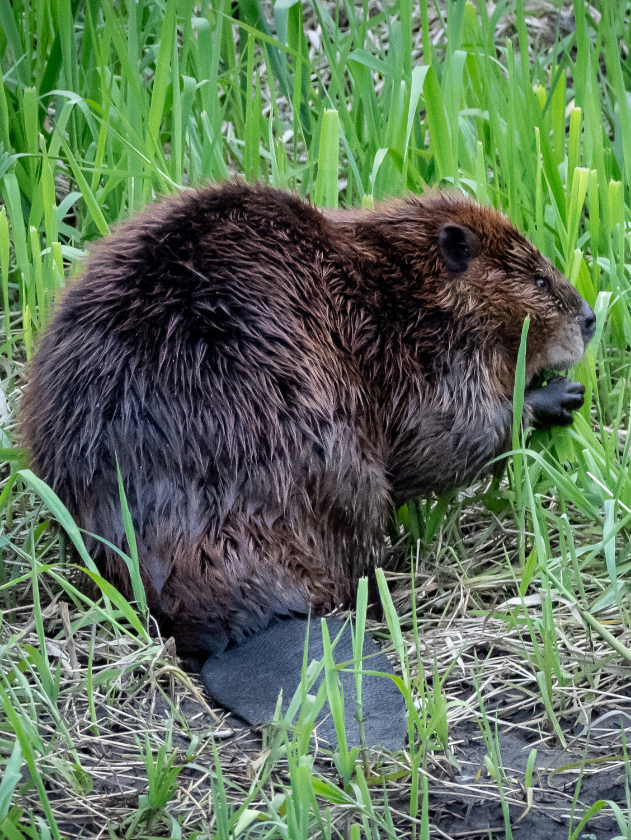
Practicing co-existence
Washington Department of Fish and Wildlife, Beavers Northwest, Methow Valley Beaver Project, and other organizations are working to solve these problems.
Statewide, these organizations help support co-existence in a handful of ways.

Slide 8
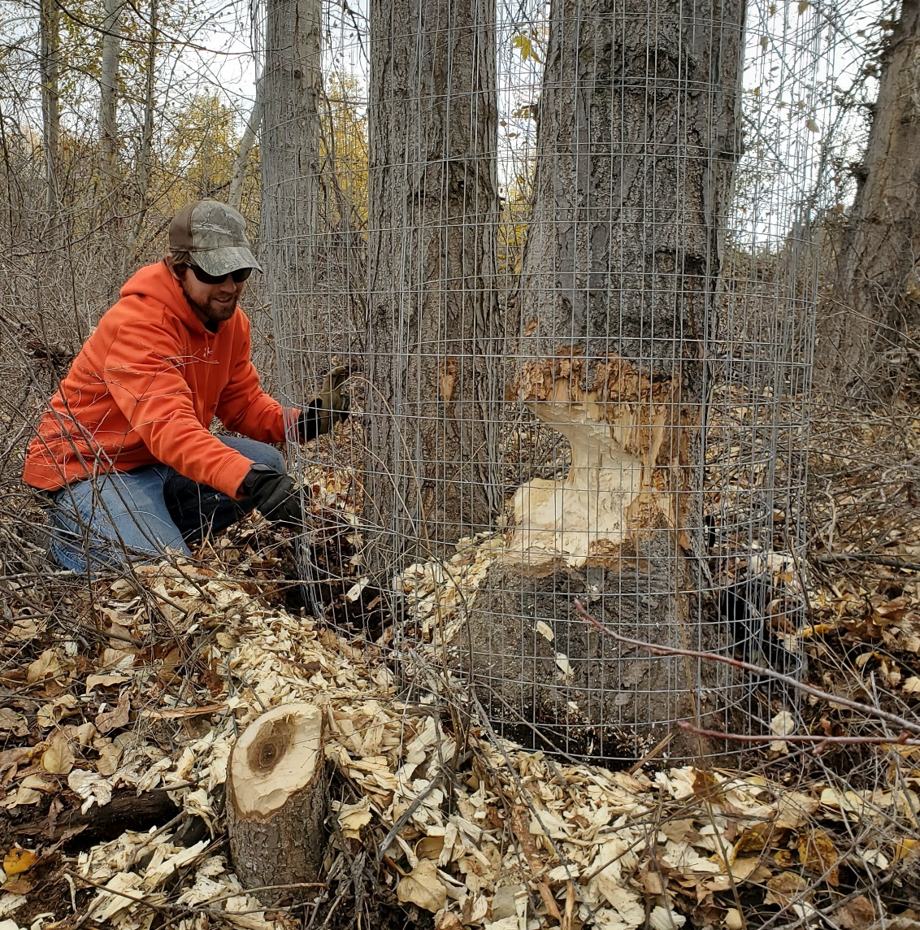
Practicing co-existence
Protecting trees.
By fencing trees with tough wire, it prevents beavers from chewing.
Trees can also be painted with latex paint and sand (no one likes sand in their mouth!).
Photo courtesy of Methow Valley Beaver Project

Slide 9
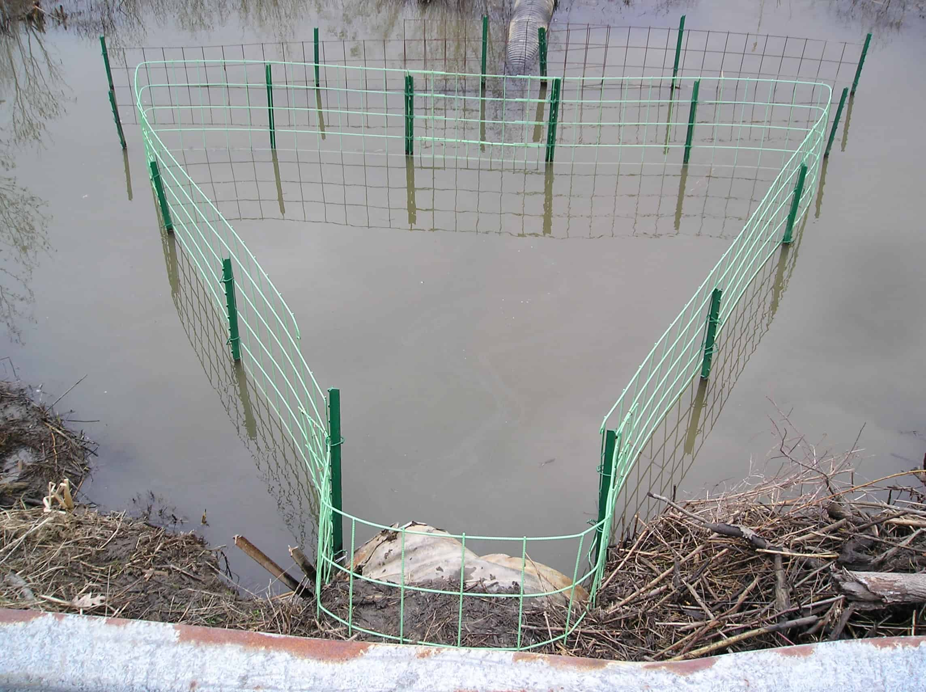
Practicing co-existence
Keeping culverts clear.
“Beaver Deceivers” fence off culverts to prevent beavers from damming them.
Photo courtesy of Beaver Solutions

Slide 10
Practicing co-existence
Leveling ponds.
Beavers Northwest helps landowners install devices that help level beaver ponds to prevent flooding.
Let’s see how one is installed.
Video courtesy of Beavers Northwest

Slide 11
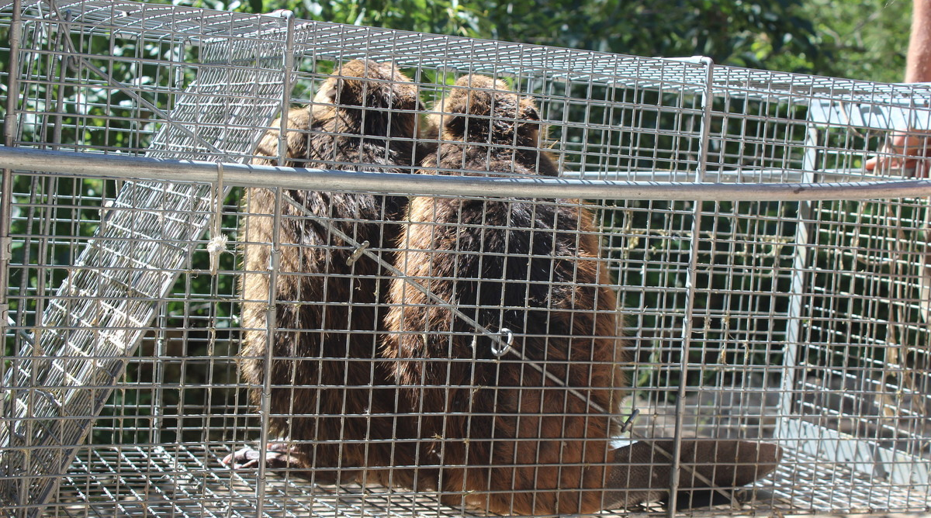
Practicing co-existence
Re-locating.
WDFW works with land owners to live-trap and relocate beavers that are causing damage to parts of the state where beavers can help improve ecosystems!

Slide 12
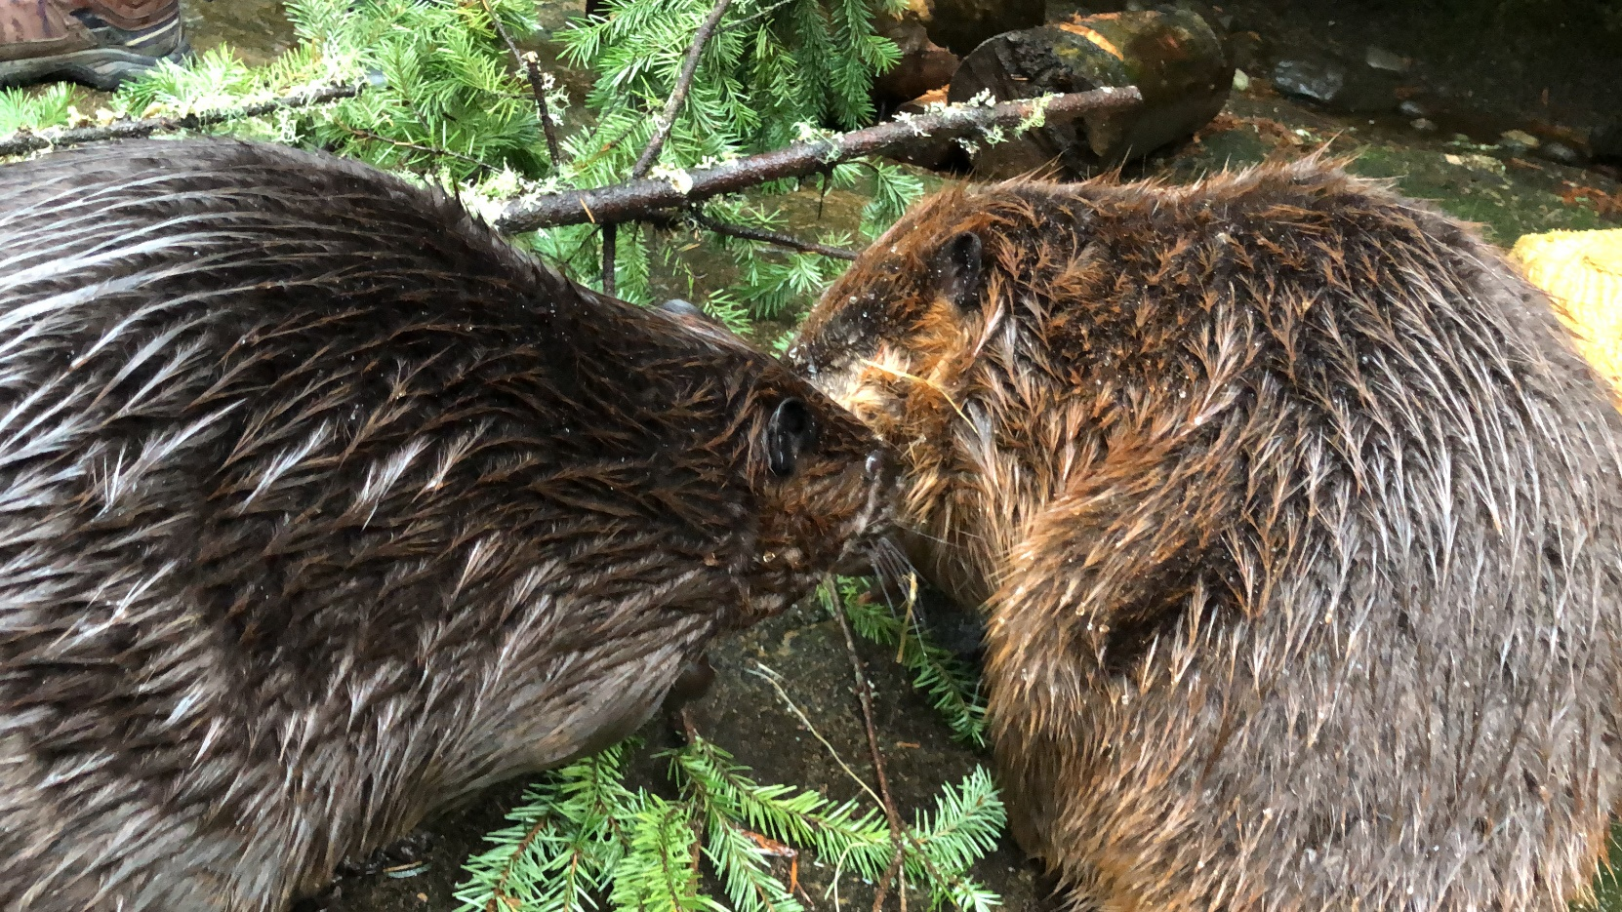
Collaboration
By working with a diverse group of individuals and organizations, Washingtonians have the opportunity to reap the benefits of beavers while preventing costly and sometimes dangerous damage.
Photo taken at Northwest Trek Wildlife Park

