Slide 1
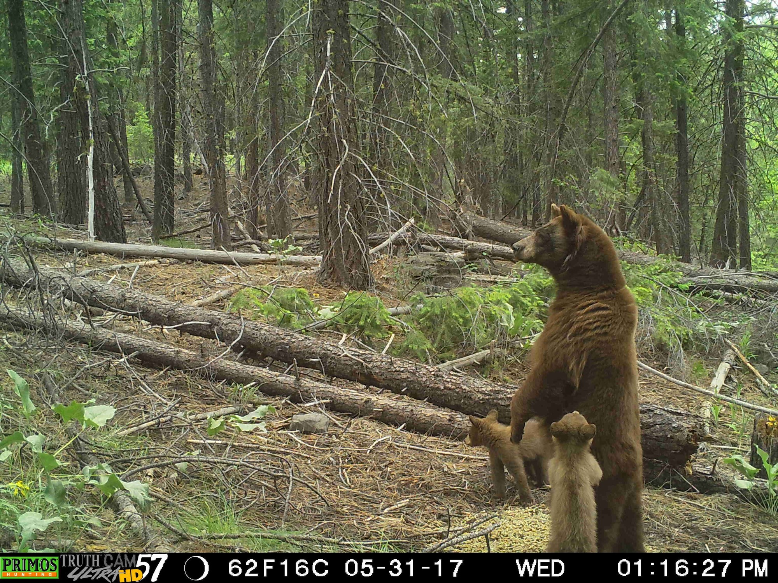
Habitat Connections

Slide 2
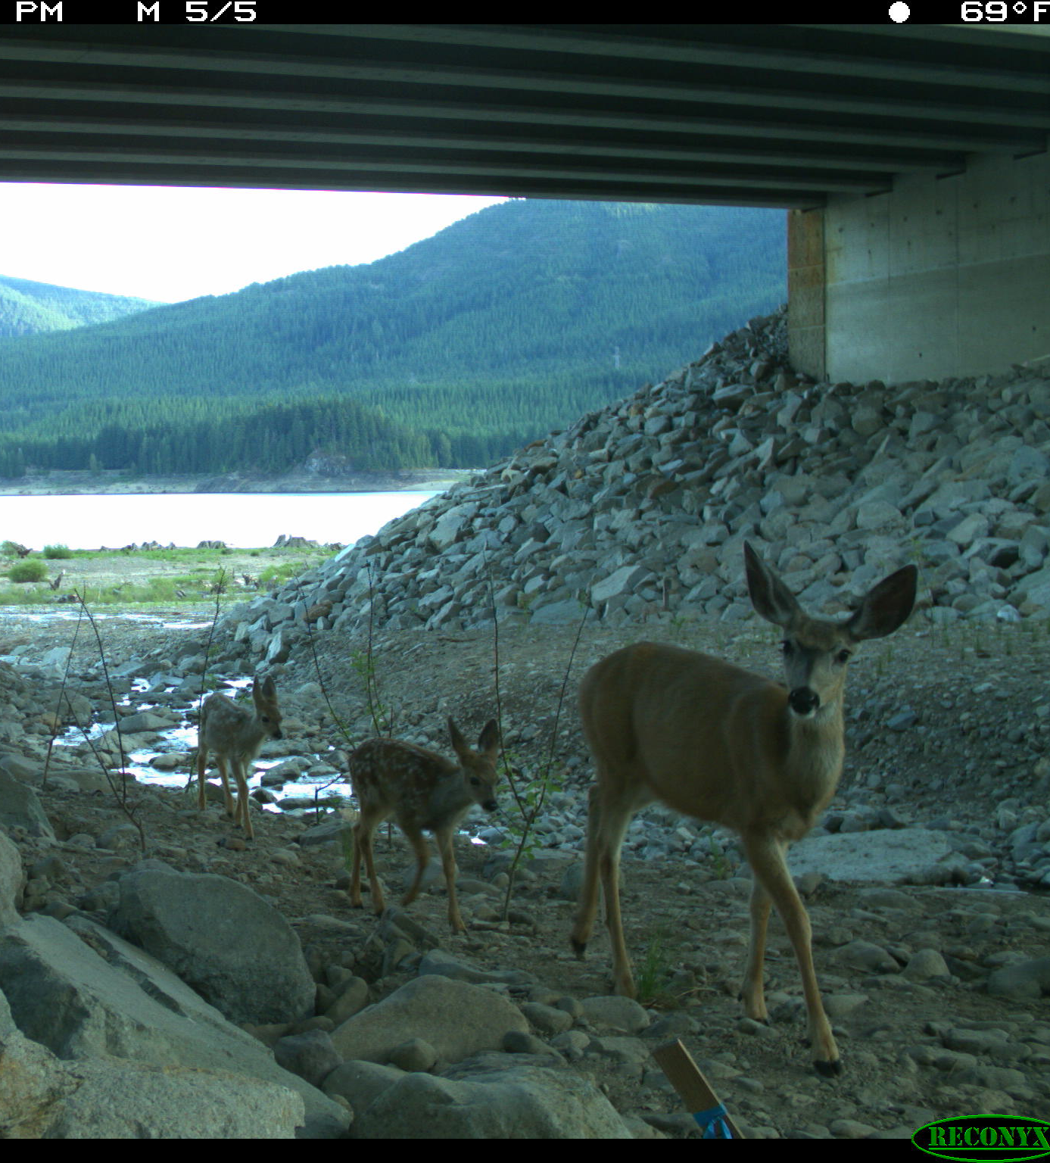
Why is wildlife connectivity important to biodiversity?
Biodiversity occurs at three different levels.
Diversity between species (how many species exist)
Diversity within species (genetic variability in a species)
Ecosystem diversity
In order to preserve biodiversity, conservation at all three levels must occur.

Slide 3
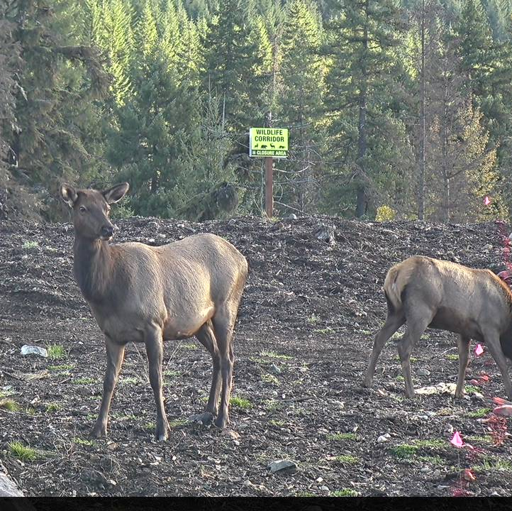
Why is wildlife connectivity important to biodiversity?
Allows for gene flow in a species’ population.
Diversity in genes of a population help increase resilience to environmental changes (whether anthropogenic or natural).
Gene flow also prevents inbreeding.

Slide 4
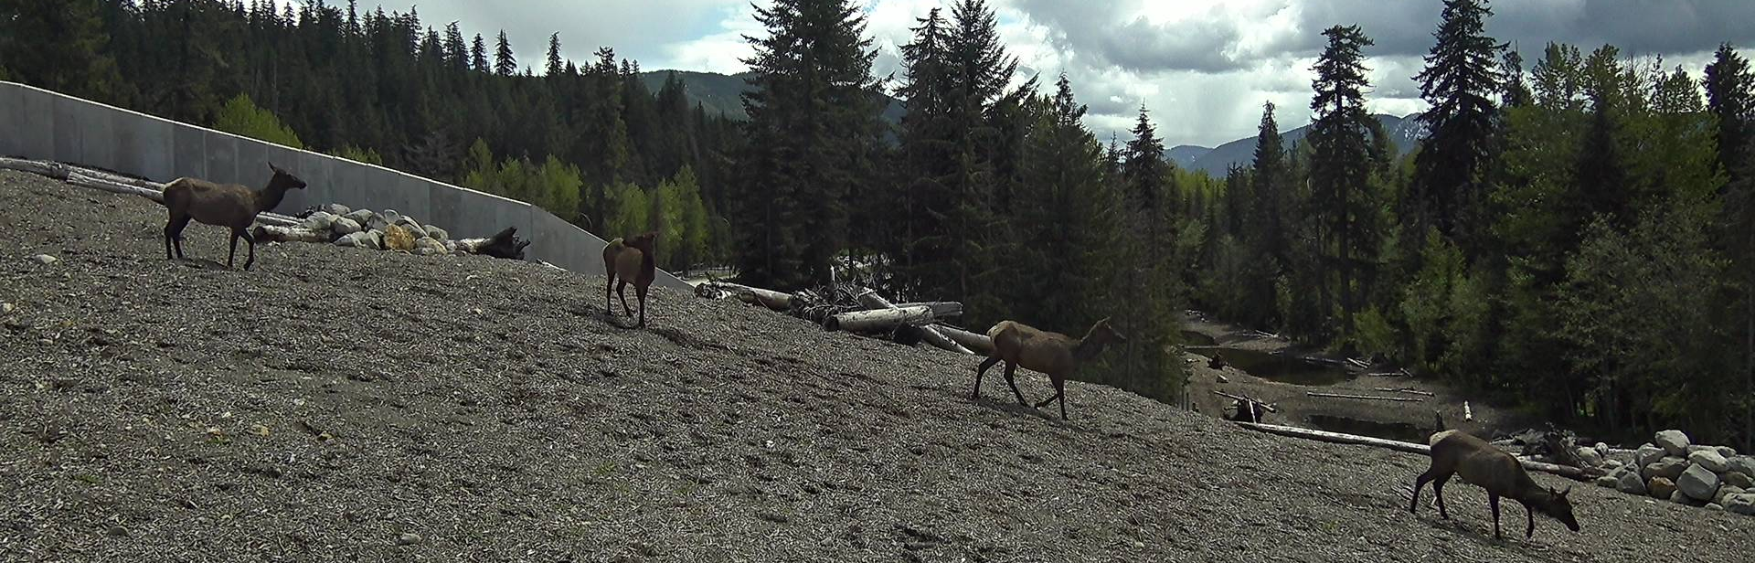
Why is wildlife connectivity important to biodiversity?
If habitat loss or fragmentation occurs, connectivity allows species to shift habitat to other suitable habitat areas.

Slide 5
Why is wildlife connectivity important to biodiversity?
Large mammals, birds, and other migratory and dispersing animals often require large areas to travel.
Connectivity helps give these species space they need to survive.

Slide 6
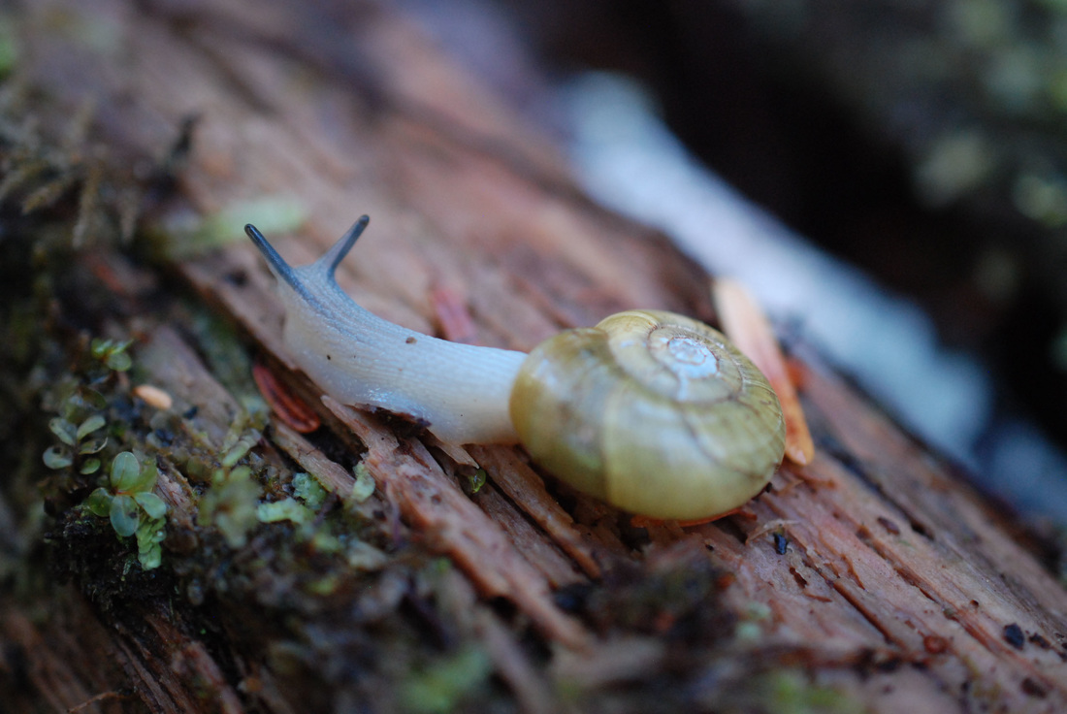
Why is wildlife connectivity important to biodiversity?
Low mobility wildlife also need connectivity.
For example, reptiles, amphibians and even terrestrial mollusks (snails, slugs).
A beaded lancetooth snail is a terrestrial mollusk that resides in Washington. Photo by Kelly Fretwell, Central Coast Biodiversity

Slide 7
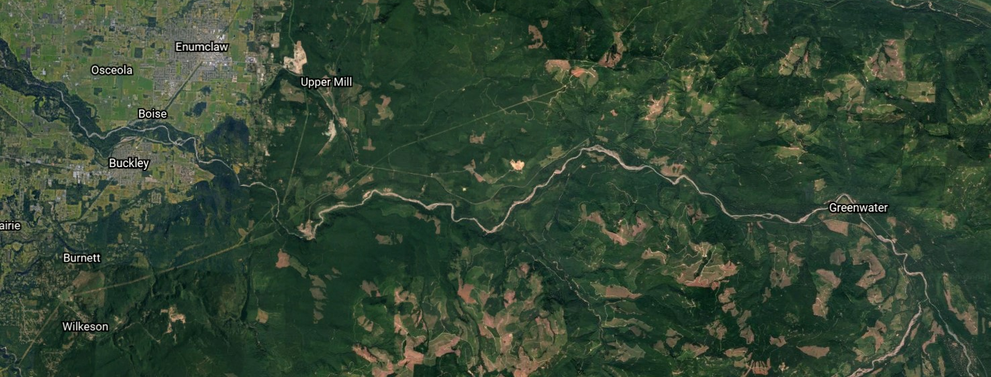
What fragments habitat?
As the human-growth boundary continues to expand, wildlife habitat continues to shrink.
Housing and commercial developments, industrial areas, conversion into agricultural lands, roadways, etc. are all contributors to habitat fragmentation.

Slide 8
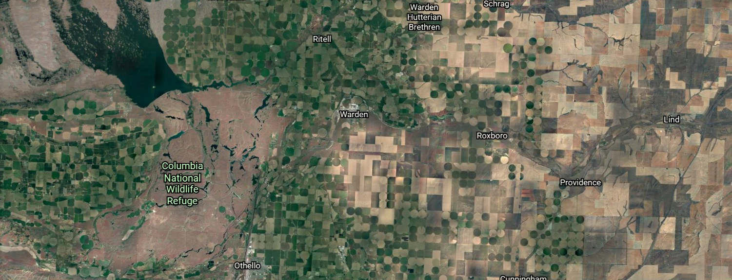
Fragmented habitat patches typically have lower species biodiversity.
The ecosystems also become more susceptible to natural fragmentation caused by extreme weather, fires and glacial retreat.
Anthropogenic fragmentation typically occurs at faster rates and over larger areas than natural fragmentations.

Slide 9
Creating connections and corridors
Graphic from https://y2y.net/resources/educational-materials/
Notes:
Biologists and land-use planners use different types of corridors to help connect species to “core” habitat patches. What do you think are the pros and cons of using a stepping stone vs. a continuous corridor? What factors would you have to take into consideration?

Slide 10
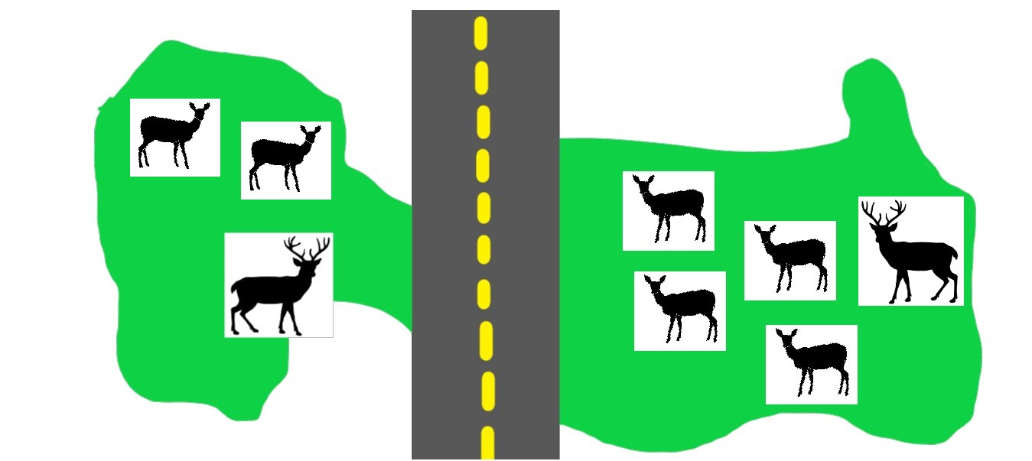
A
Core habitat zone
B
Core habitat zone
Notes:
Looking back at our original example of Deer State Park. Identify the core habitat zones. What type of corridor would you use to connect deer from one part of the park to the other? Would you use overpasses, under passes, Why?

Slide 11
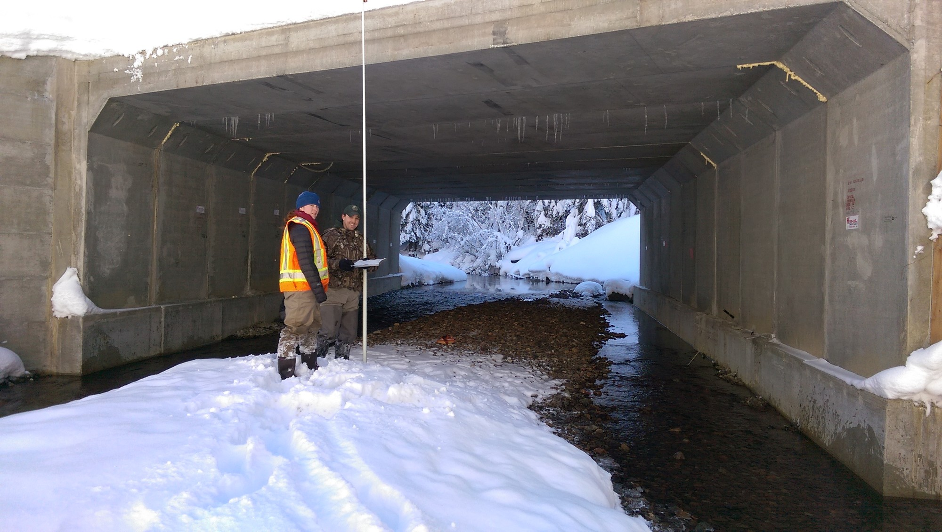
Knowing about an area’s connectivity potential is essential for habitat managers and biologists.

Slide 12
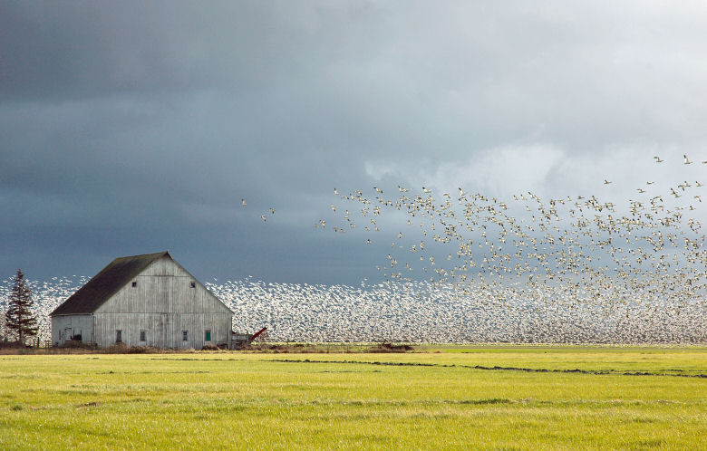
WDFW habitat mangers and biologists use connectivity information for:
Land use proposals
Where should future connectivity be ensured and how can areas surrounding the habitat be preserved or restored?

Slide 13
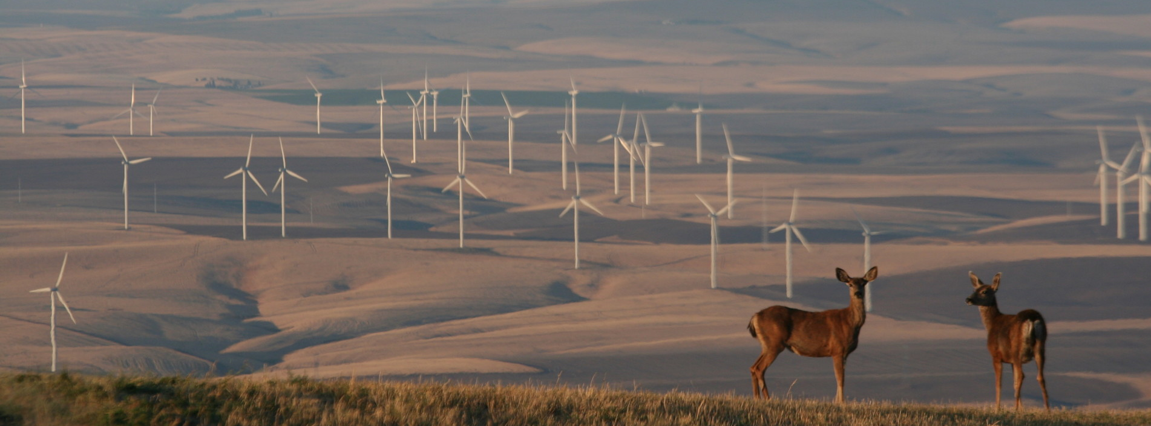
WDFW habitat mangers and biologists use connectivity information for:
Land use proposals
This allows habitat managers to:
suggest locations for development in areas that are away from potentially sensitive areas
advocate for habitat preservation (such as conservation easements, public lands creation, etc.

Slide 14
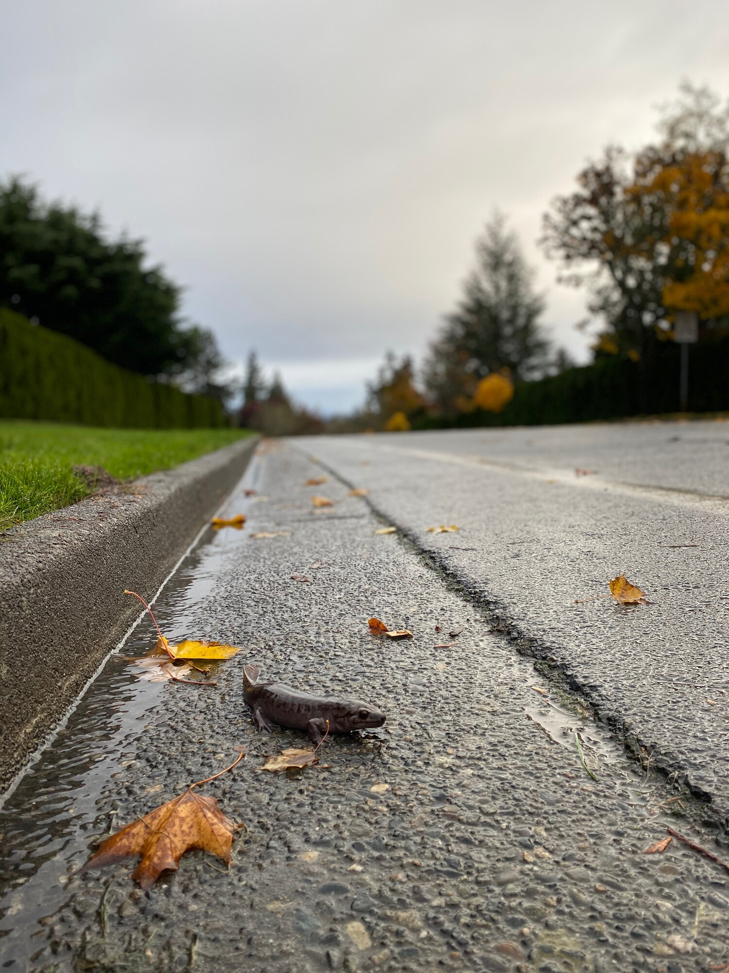
WDFW habitat mangers and biologists use connectivity information for:
Highway and road connectivity structures
Where is the most effective place to create wildlife connectivity through a roadway?

