Slide 1
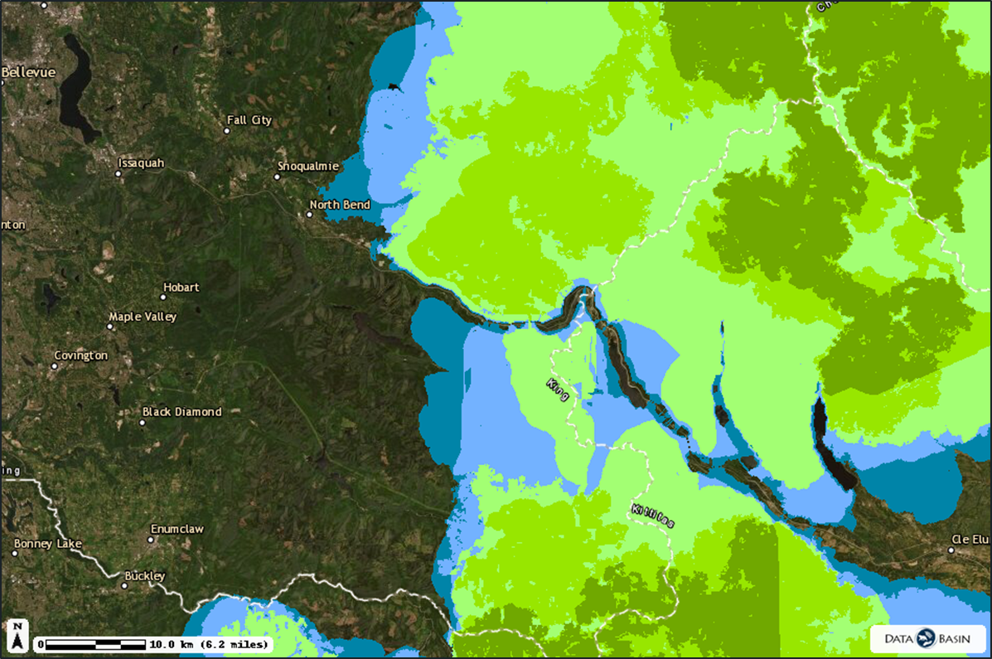
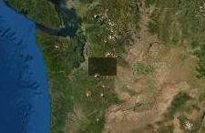
Legend
Narrow Network Montane Species Guild
Displaying: MONTANE
1 Number of Montane Species
2 Number of Montane Species
3 Number of Montane Species
4 Number of Montane Species
5 Number of Montane Species
6 Number of Montane Species
Notes:
“In this graphic, the movement of six different species’ groups were tracked (see legend). Habitat managers use this data to determine where the best place to add crossing structures would be.
Looking at the graph, if you were a habitat manager, where would you build wildlife crossing structures?”

Slide 2
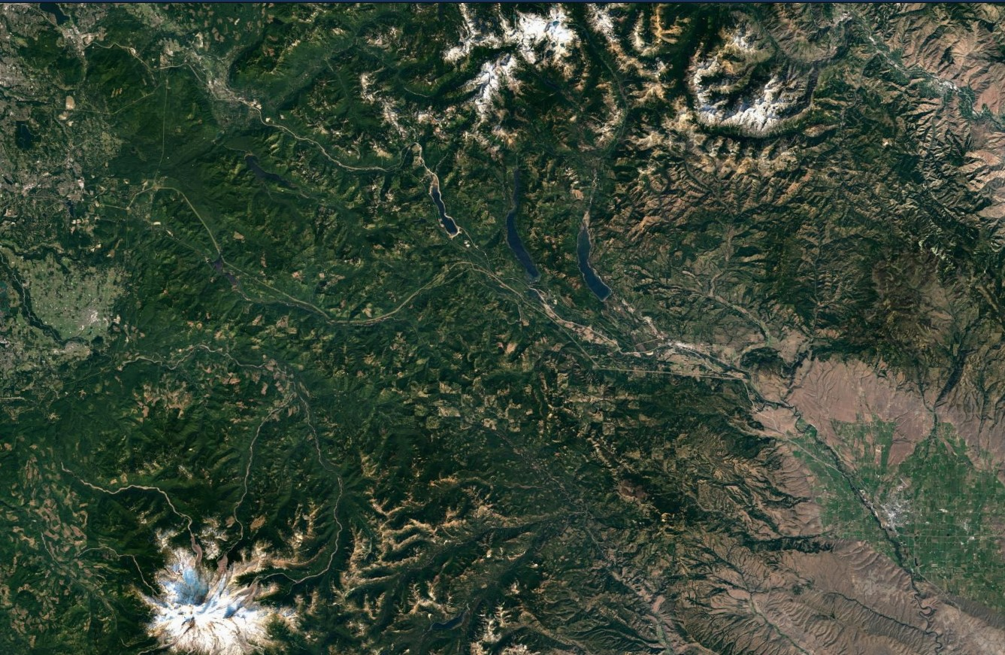
Notes:
You want species to be able to move from North Cascades into the Mt. Rainier area.
You may choose to keep or remove city and road features.

Slide 3
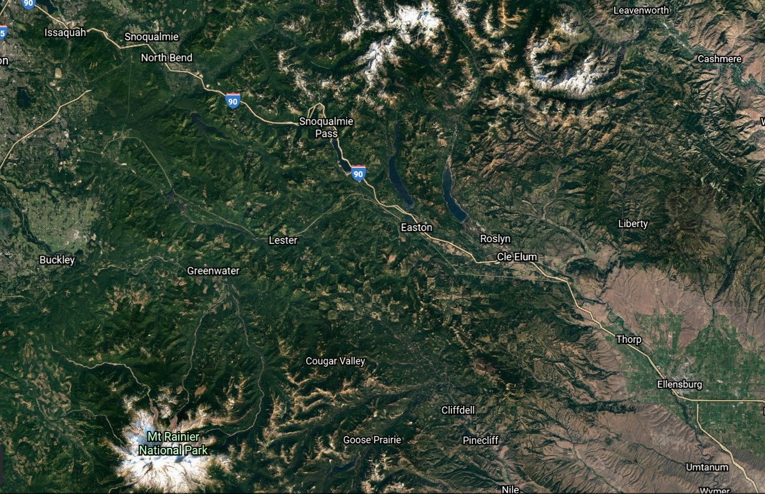
Notes:
You want species to be able to move from North Cascades into the Mt. Rainier area. You may choose to keep or remove city and road features.

Slide 4
Notes:
Edit this map with your 1st species information. You should also screen shot your map from Google Earth to get a closer view of your designated 10 miles.

Slide 5
Notes:
Edit this map with your 2nd species information. You should also screen shot your map from Google Earth to get a closer view of your designated 10 miles.

Slide 6
Notes:
Edit this map with your 3rd species information. You should also screen shot your map from Google Earth to get a closer view of your designated 10 miles.

