Slide 1
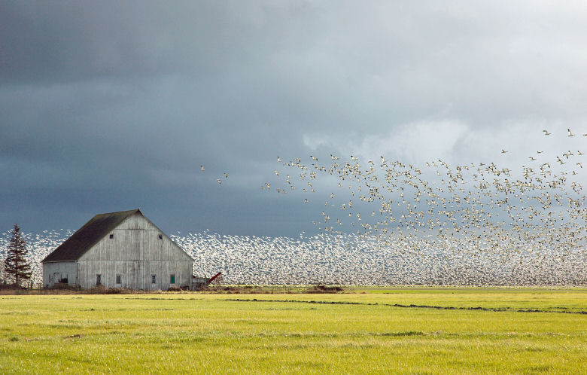
What is migration?
Notes:
Migration is the seasonal movement behavior when animals seek habitat (food, water, shelter, space) in different regions. For many bird species these regions are located on different continents or hemispheres of the Earth.

Slide 2
Insert answers here
(You can use or delete this slide if using a (virtual) whiteboard).

Slide 3
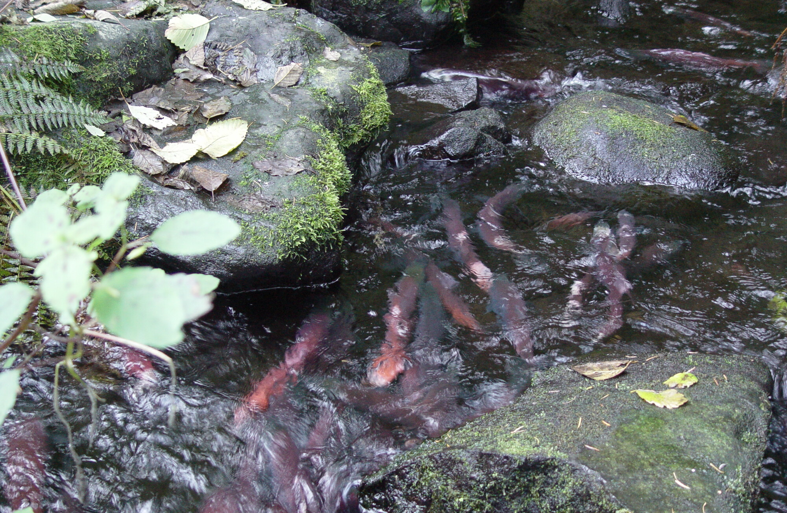
Notes:
Salmon are an example of a migrating fish species.

Slide 4
Insert answers here
(You can use or delete this slide if using a (virtual) whiteboard)

Slide 5
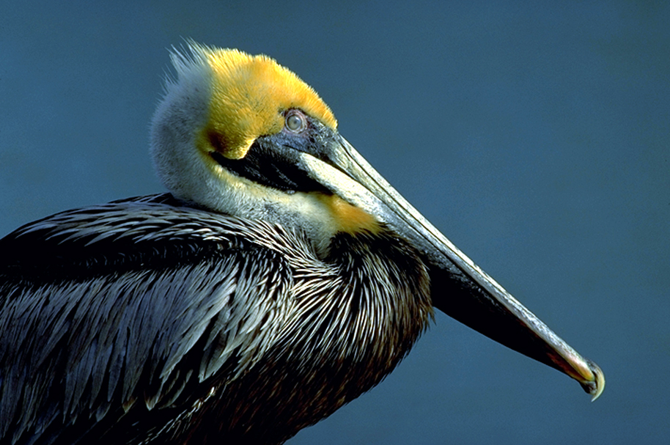
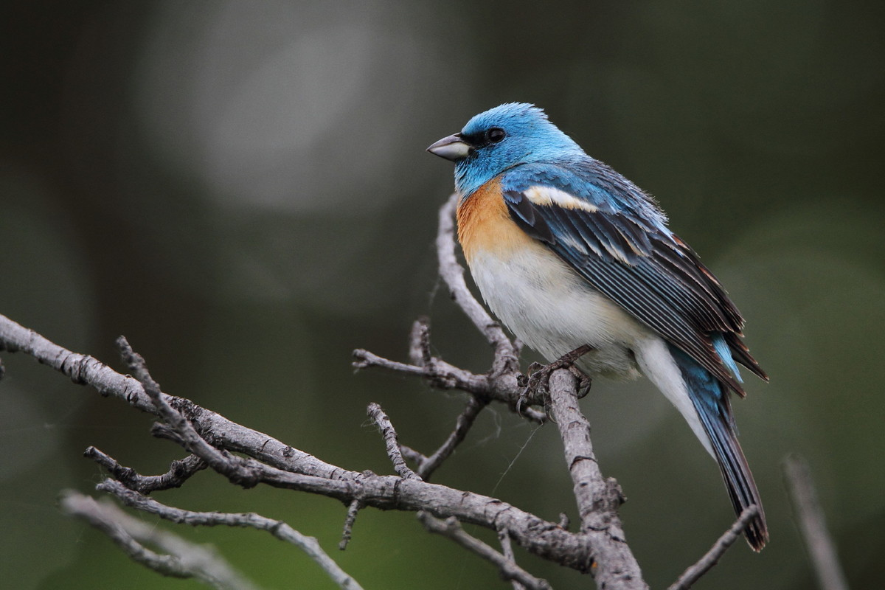
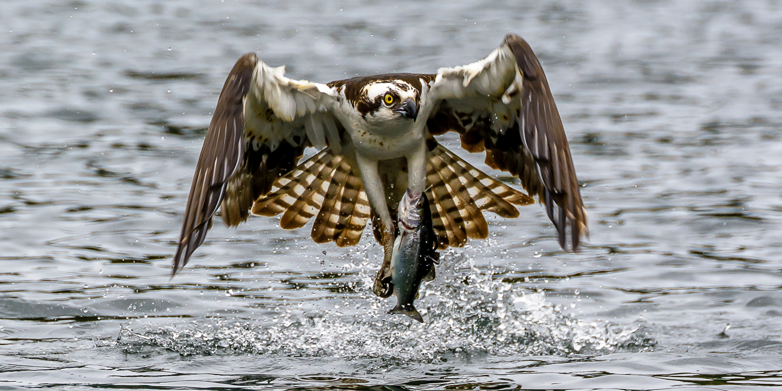
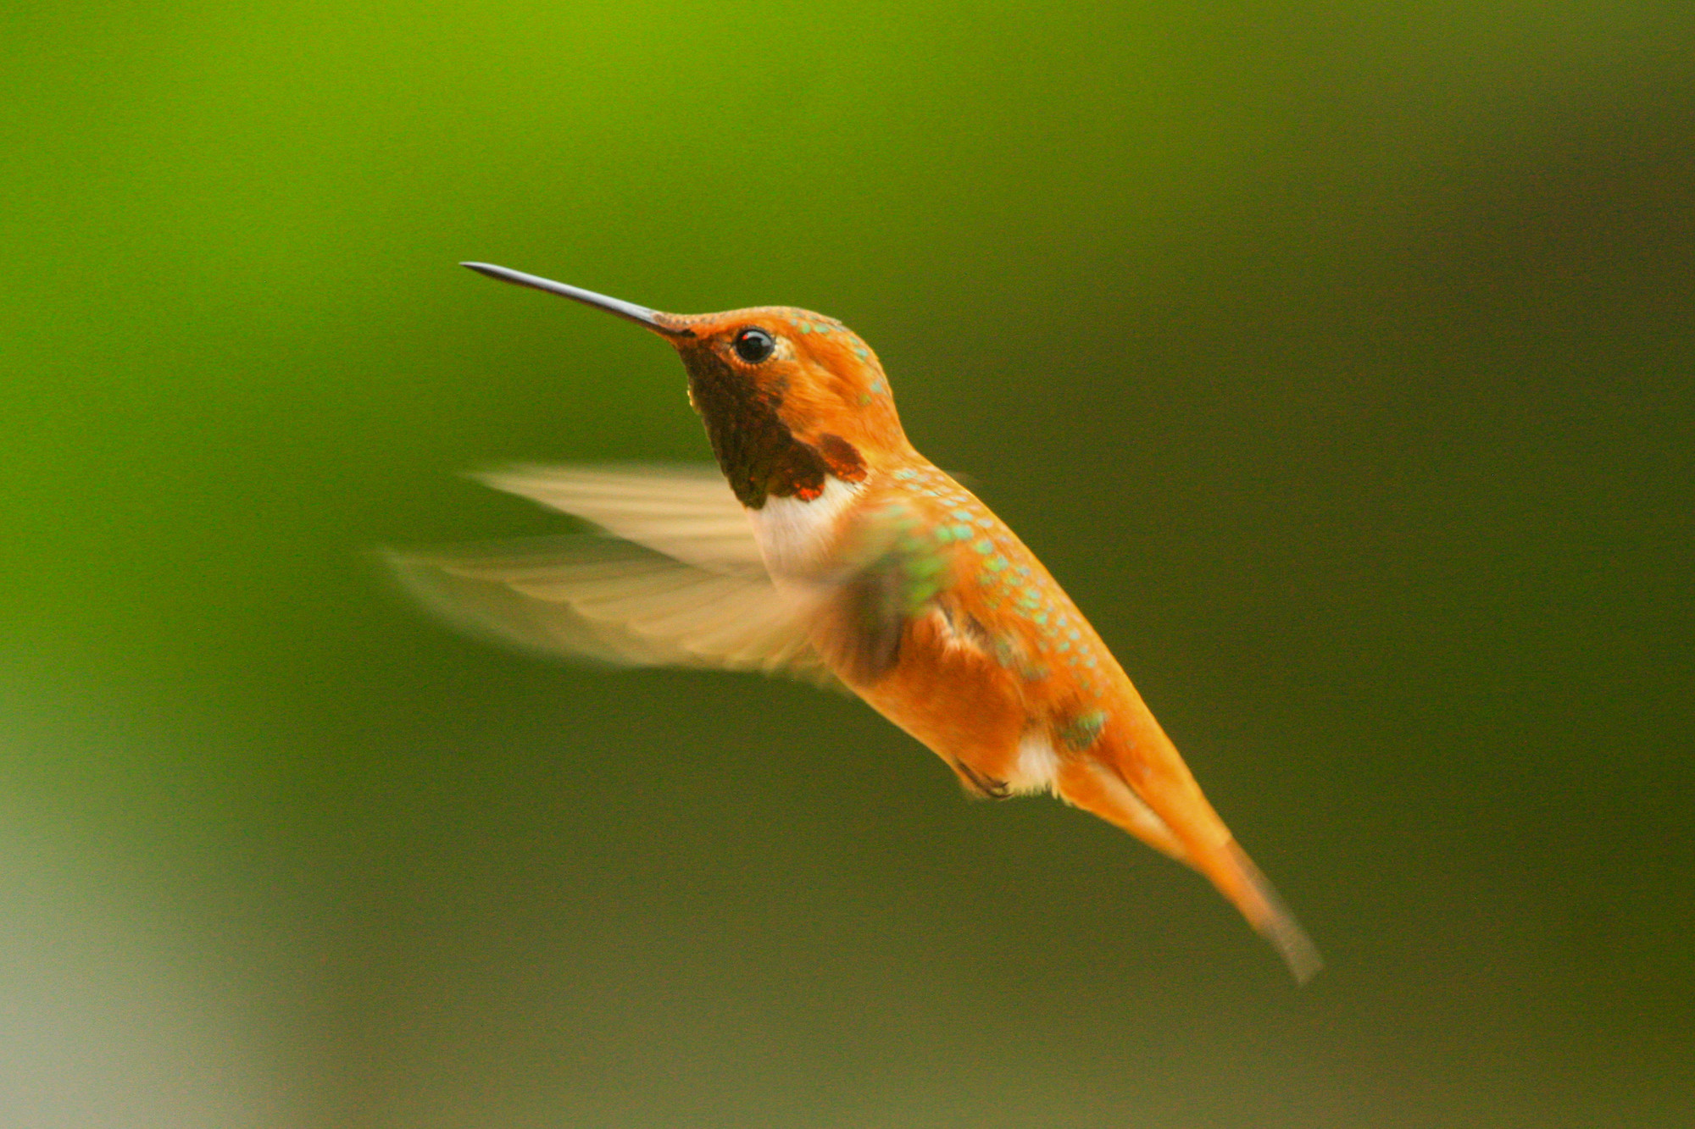
Notes:
Migratory birds include over 1,000+ species of bird that spend parts of their annual life cycle in different regions.
(Clockwise, brown pelican, lazuli bunting, osprey, rufous hummingbird).

Slide 6
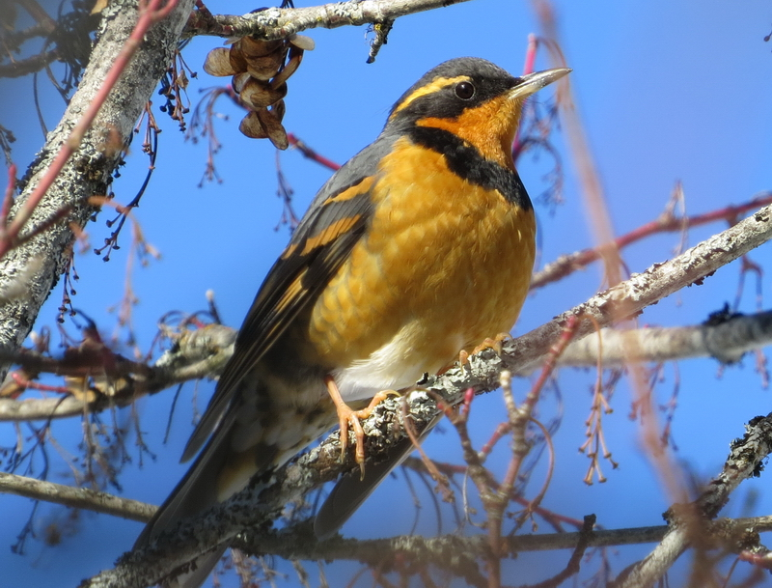
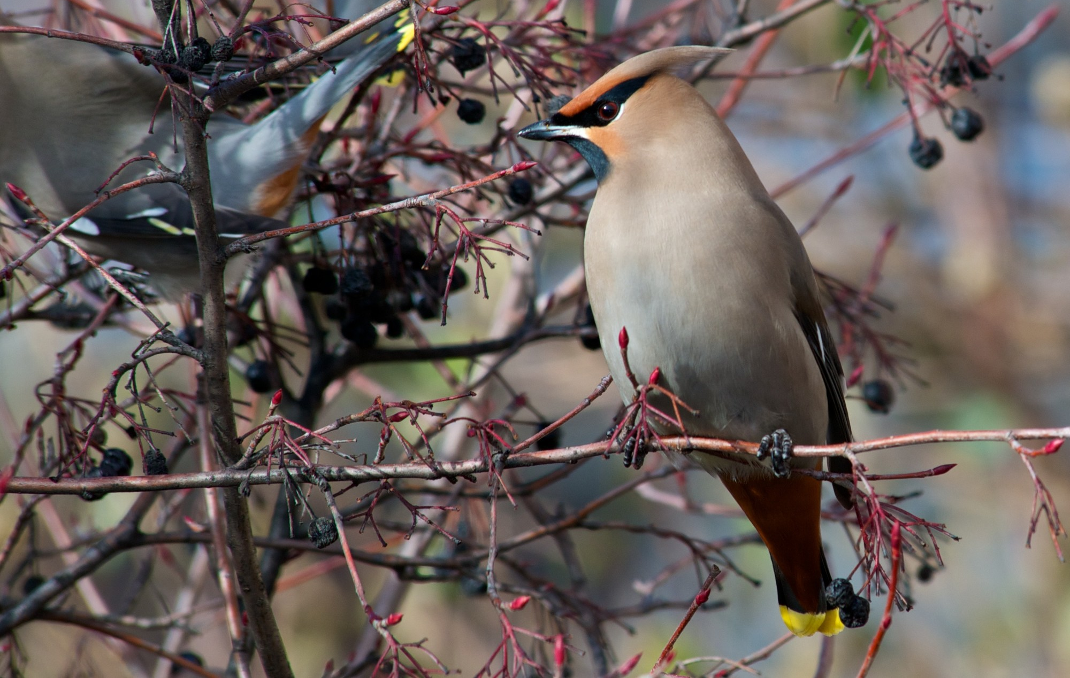
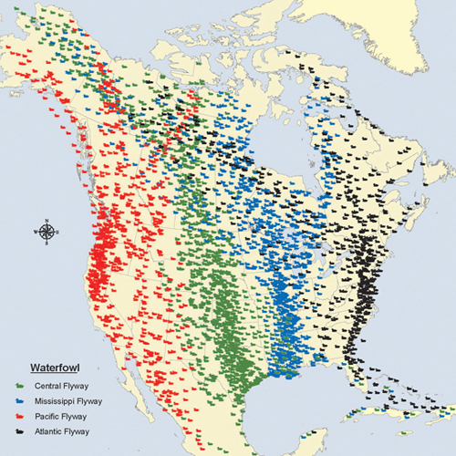
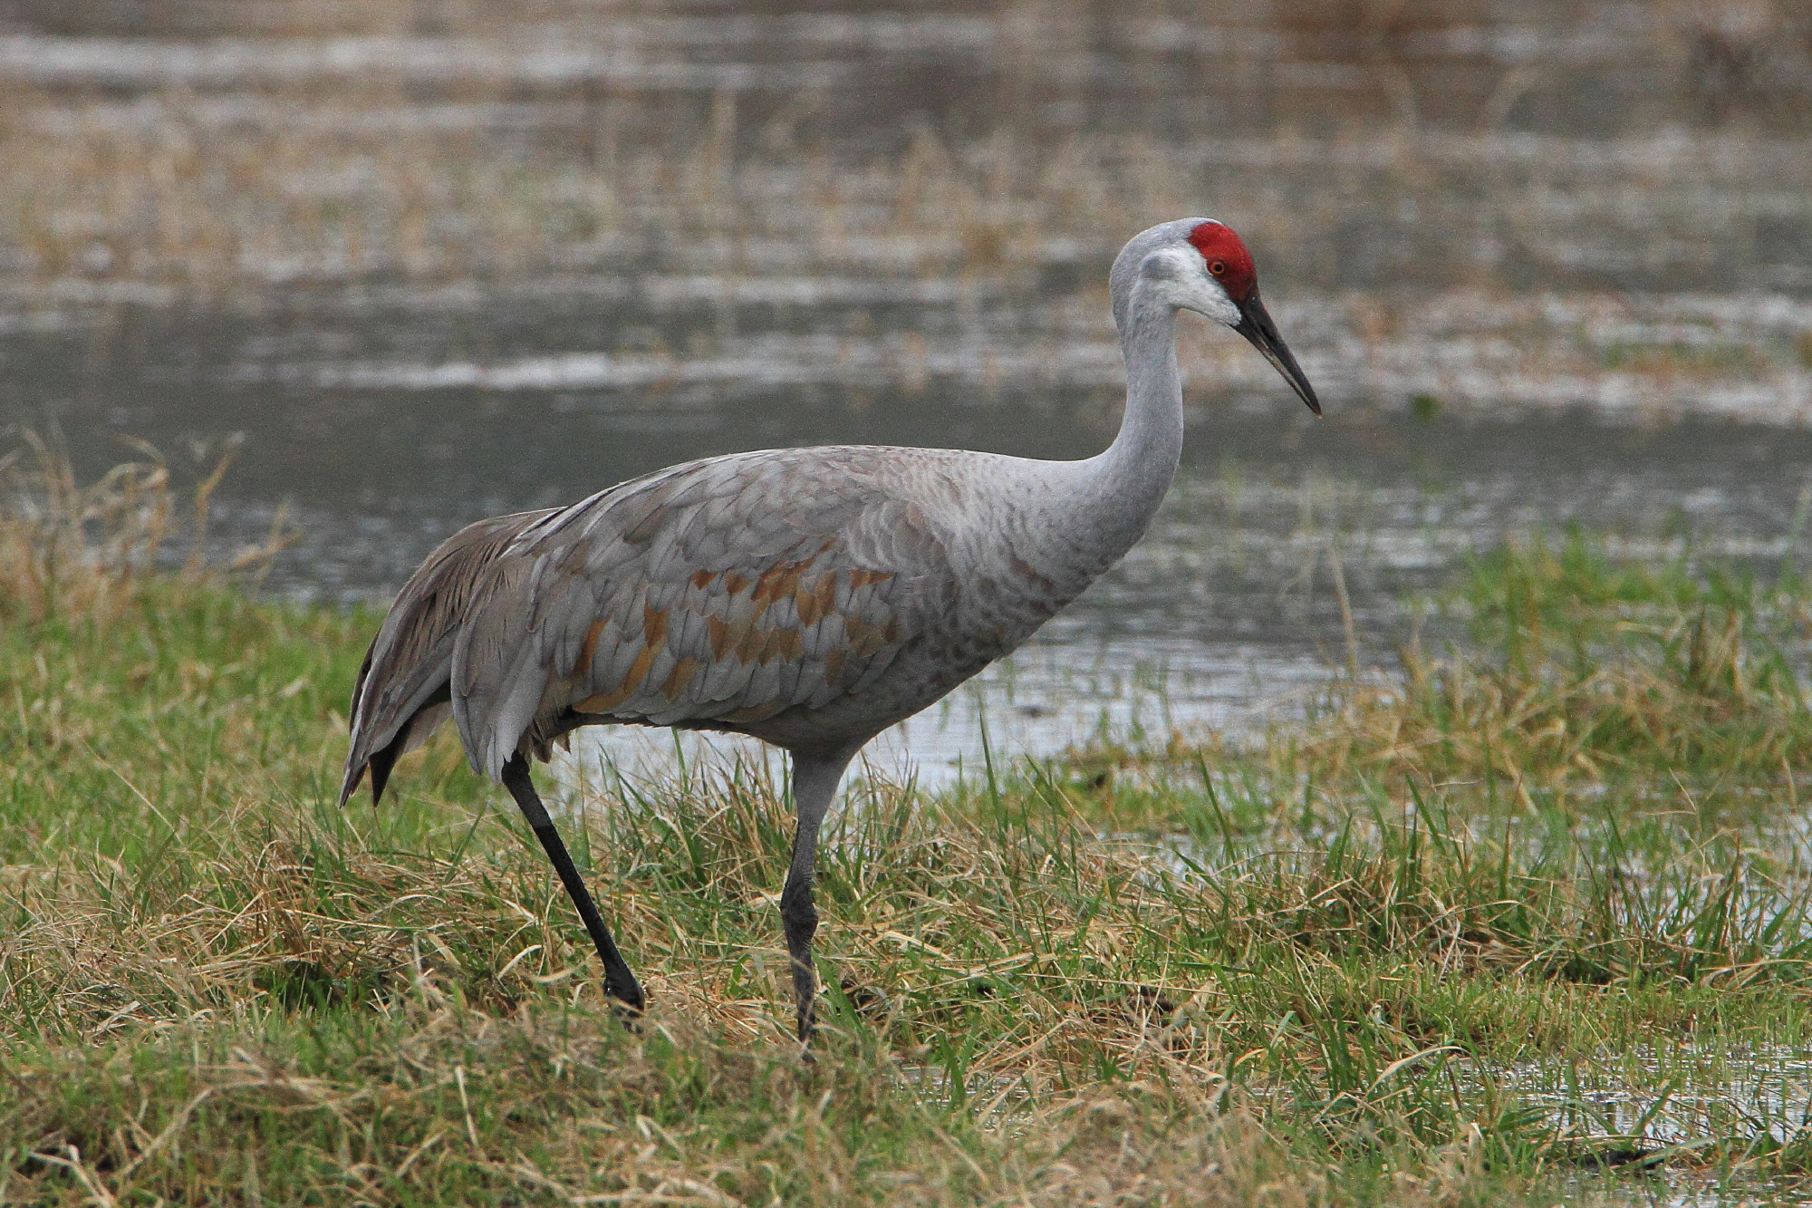
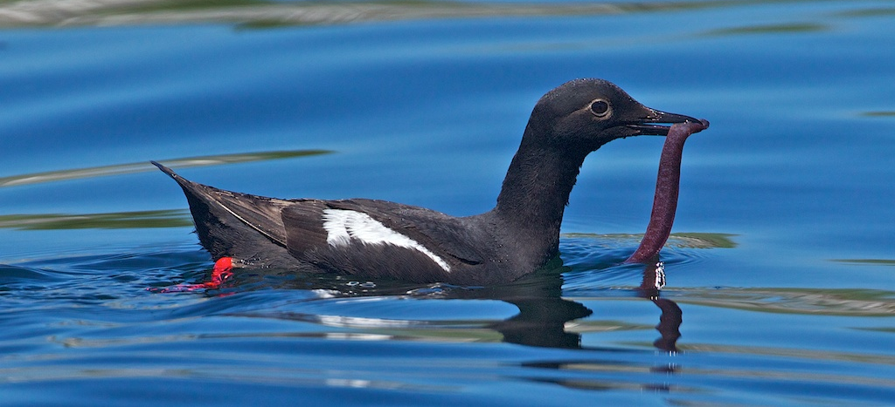
Notes:
Birds most commonly migrate north and south following weather and food availability.
(Clockwise, varied thrush, bohemian waxwing, pigeon guillemot, sandhill crane).

Slide 7
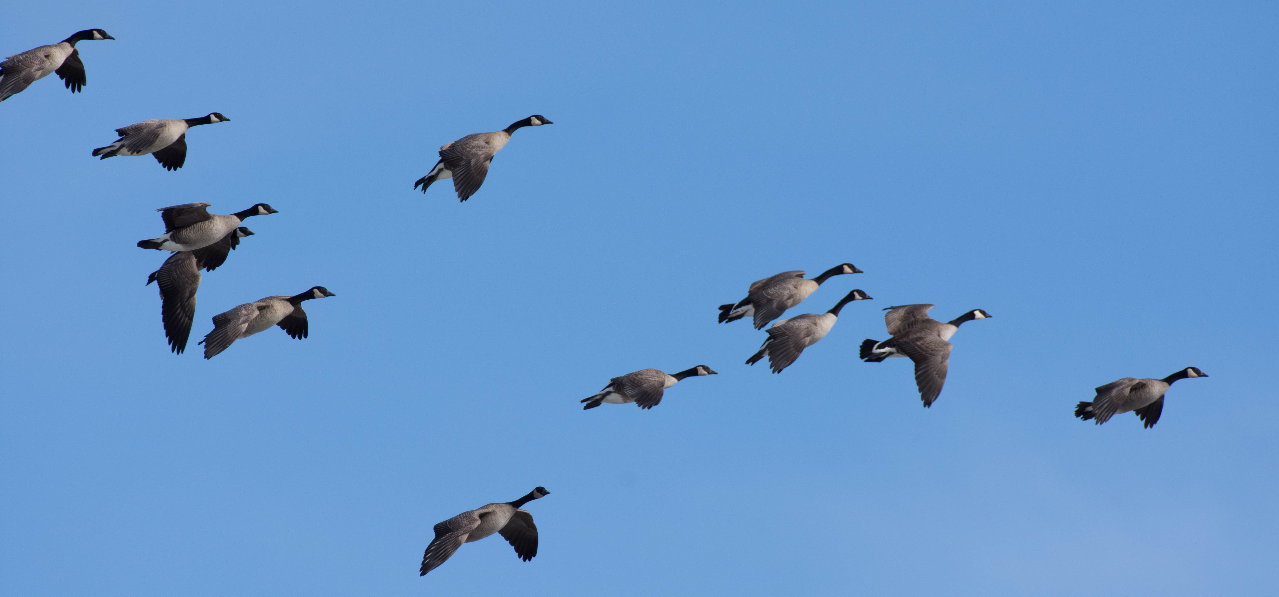
Why migrate?
Let’s see some migration patterns
Notes:
Reasons animals migrate include:
Find food,
Find suitable breeding sites,
To avoid unsuitable weather.
The link will take you to a site where students can see the paths birds take in migration throughout a year.

Slide 8
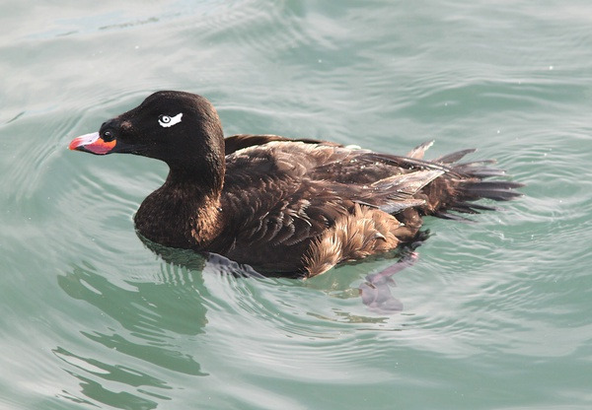
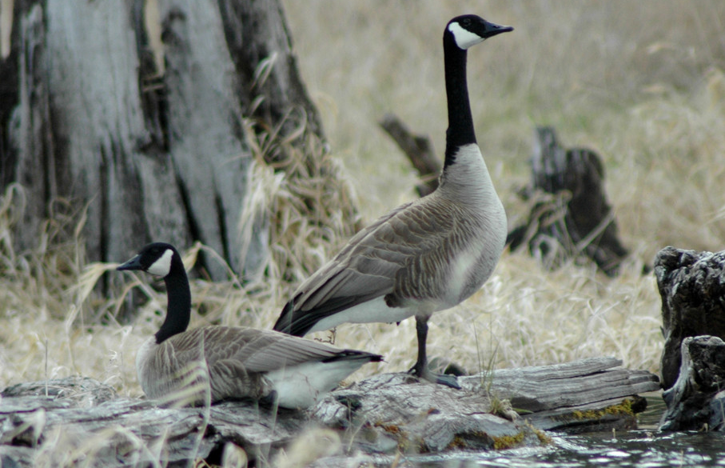
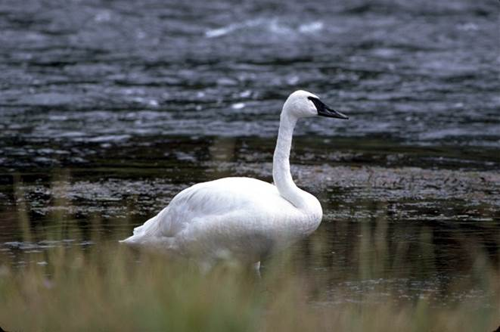
Migratory Waterfowl
Notes:
Waterfowl is a general term for waterbirds like ducks, swans, and geese. Some live in lakes and rivers while others live in ponds.

Slide 9
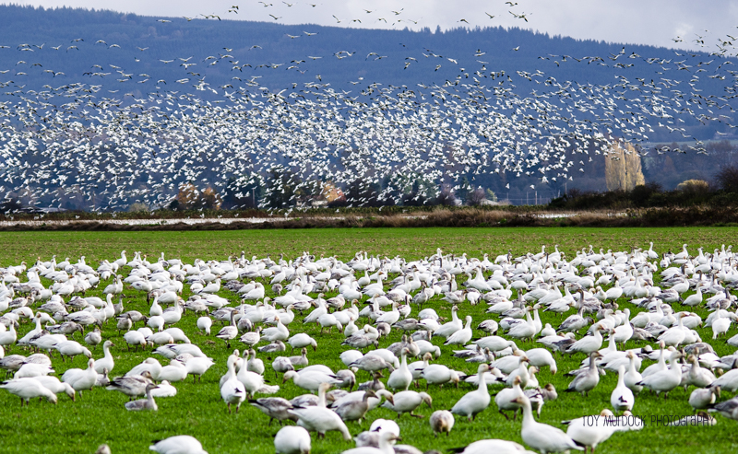
Notes:
Many northern-breeding ducks, geese, and swans also are migrants, but need only to move from their northern breeding grounds far enough south to escape frozen waters.

Slide 10
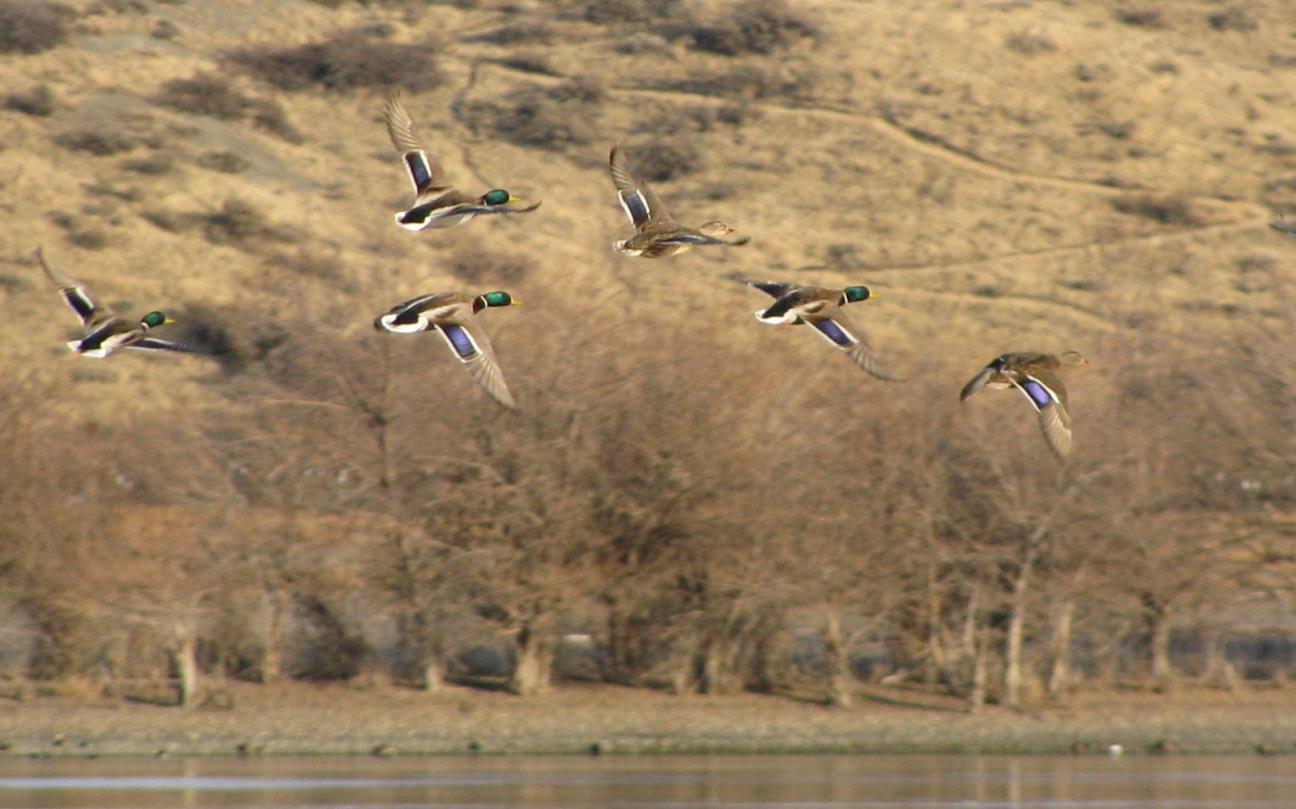
Notes:
Longer days and abundant food of northern summers provides greater opportunities for waterfowl to feed their young.
When days begin to shorten in the fall, birds will fly again to warmer regions where food and shelter available.
As a class read the article: https://www.ducks.org/conservation/waterfowl-research-science/understanding-waterfowl-migration-navigation

Slide 11
Insert answers here
(You can use or delete this slide if using a (virtual) whiteboard).

Slide 12
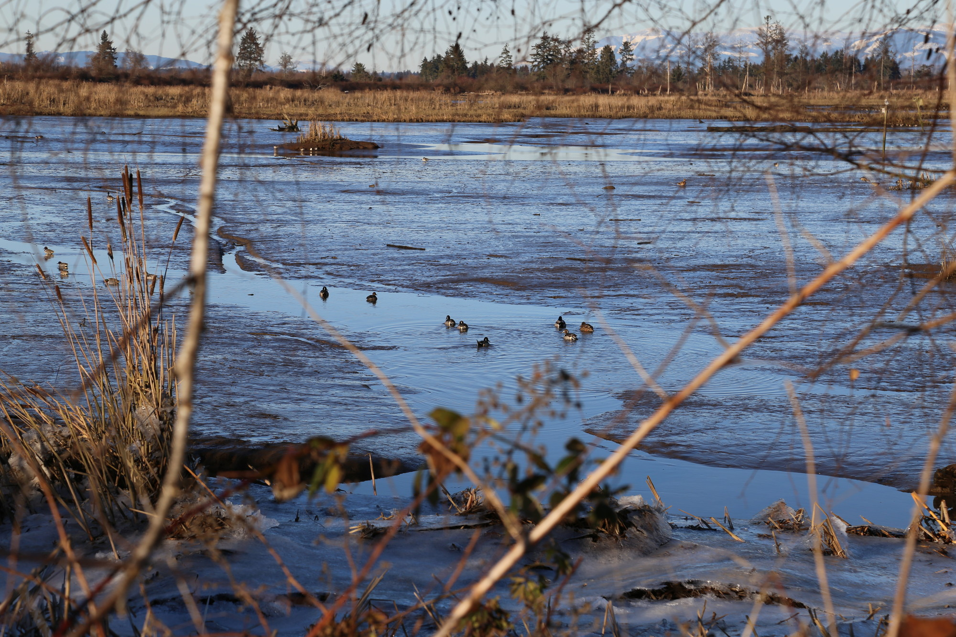
What factors affect waterfowl migration?
Notes:
-Photoperiod (amount of daylight).
- Seasonal changes in habitat conditions. (frozen in northern part of waterfowl’s range).
- Precipitation (Declining water levels are not favorable).
-Wind direction and velocity. (Birds migrate more efficiently when they have a tailwind).

Slide 13
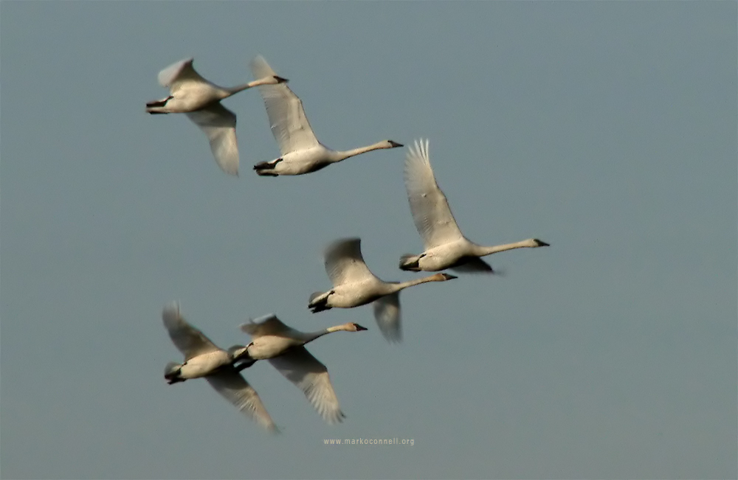
Let’s learn more
Notes:
This link takes you to a CBS video clip of migrating waterfowl in Central California in 2020.

Slide 14
Notes:
There are four major North American flyways: the Atlantic, the Mississippi, the Central and the Pacific.
Flyway boundaries are not sharply defined, and in the breeding areas in the north and in the wintering areas in the south there is overlapping of the four flyways.
The terms "migration route" and "flyway" are theoretical concepts. Flyways are wide highways, broad areas in which migration routes are found. Migration routes, on the other hand, are the lanes of travel from a particular breeding ground to the winter quarters used by specific bird populations.

Slide 15
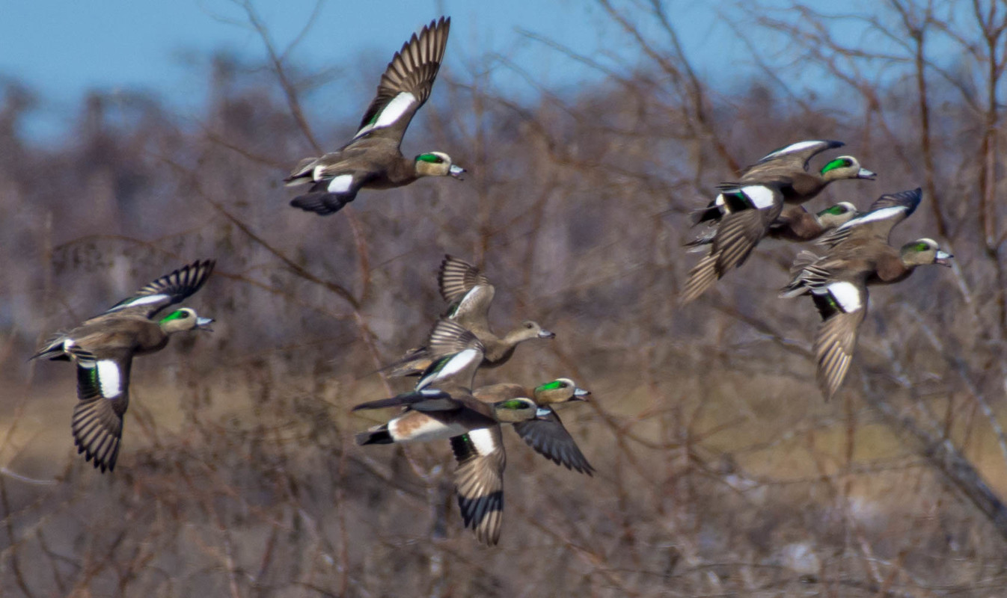
How do Waterfowl know where to go?
When migrating, birds follow features such as rivers, coastlines, and mountain ranges.
They respond to the earth’s magnetic poles with very tiny bits of metal in their heads.
They observe stars at night.
They use the sun positioning for guidance.
Notes:
See if students can guess before giving them answers.

Slide 16
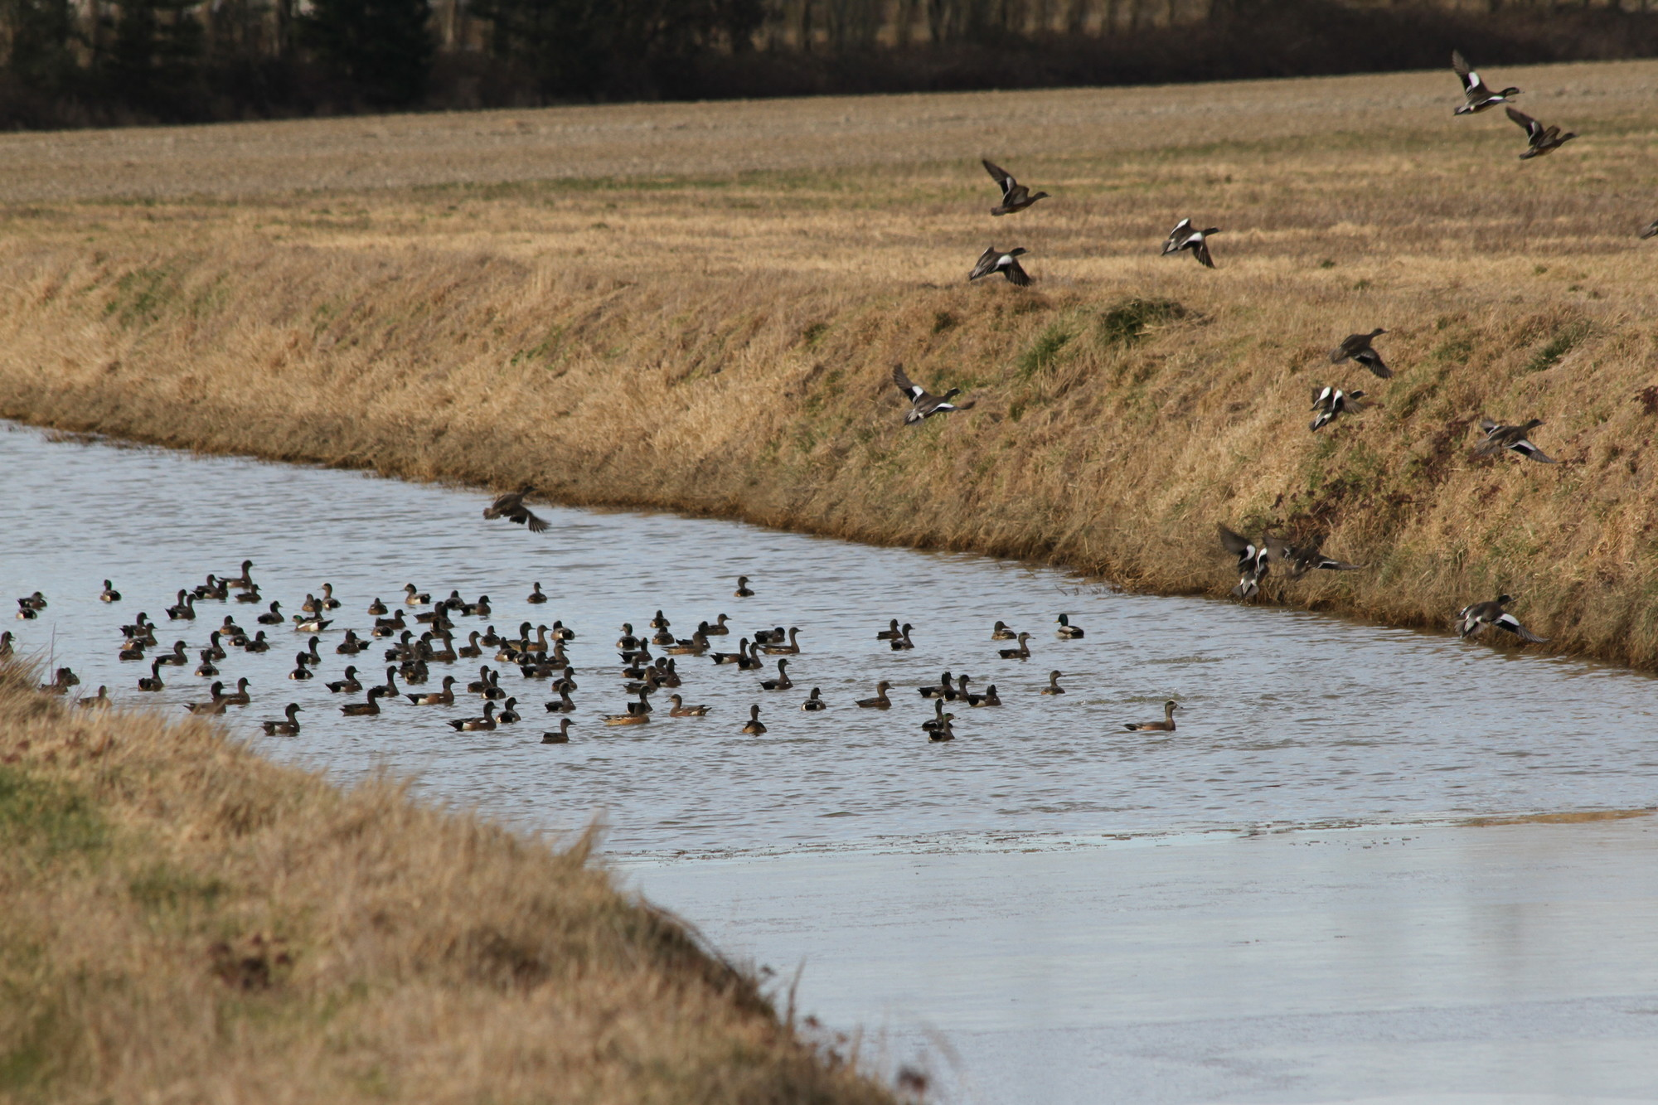
Stopover Sites and Refugia
Notes:
Because flying is so energetically taxing for birds (think of running 4,000 + miles) it’s imperative for waterfowl to have refugia during migration. If they can’t find the habitat to rest and forage, they will likely succumb to starvation.
Wetlands are a good example of refugia for waterfowl.

Slide 17
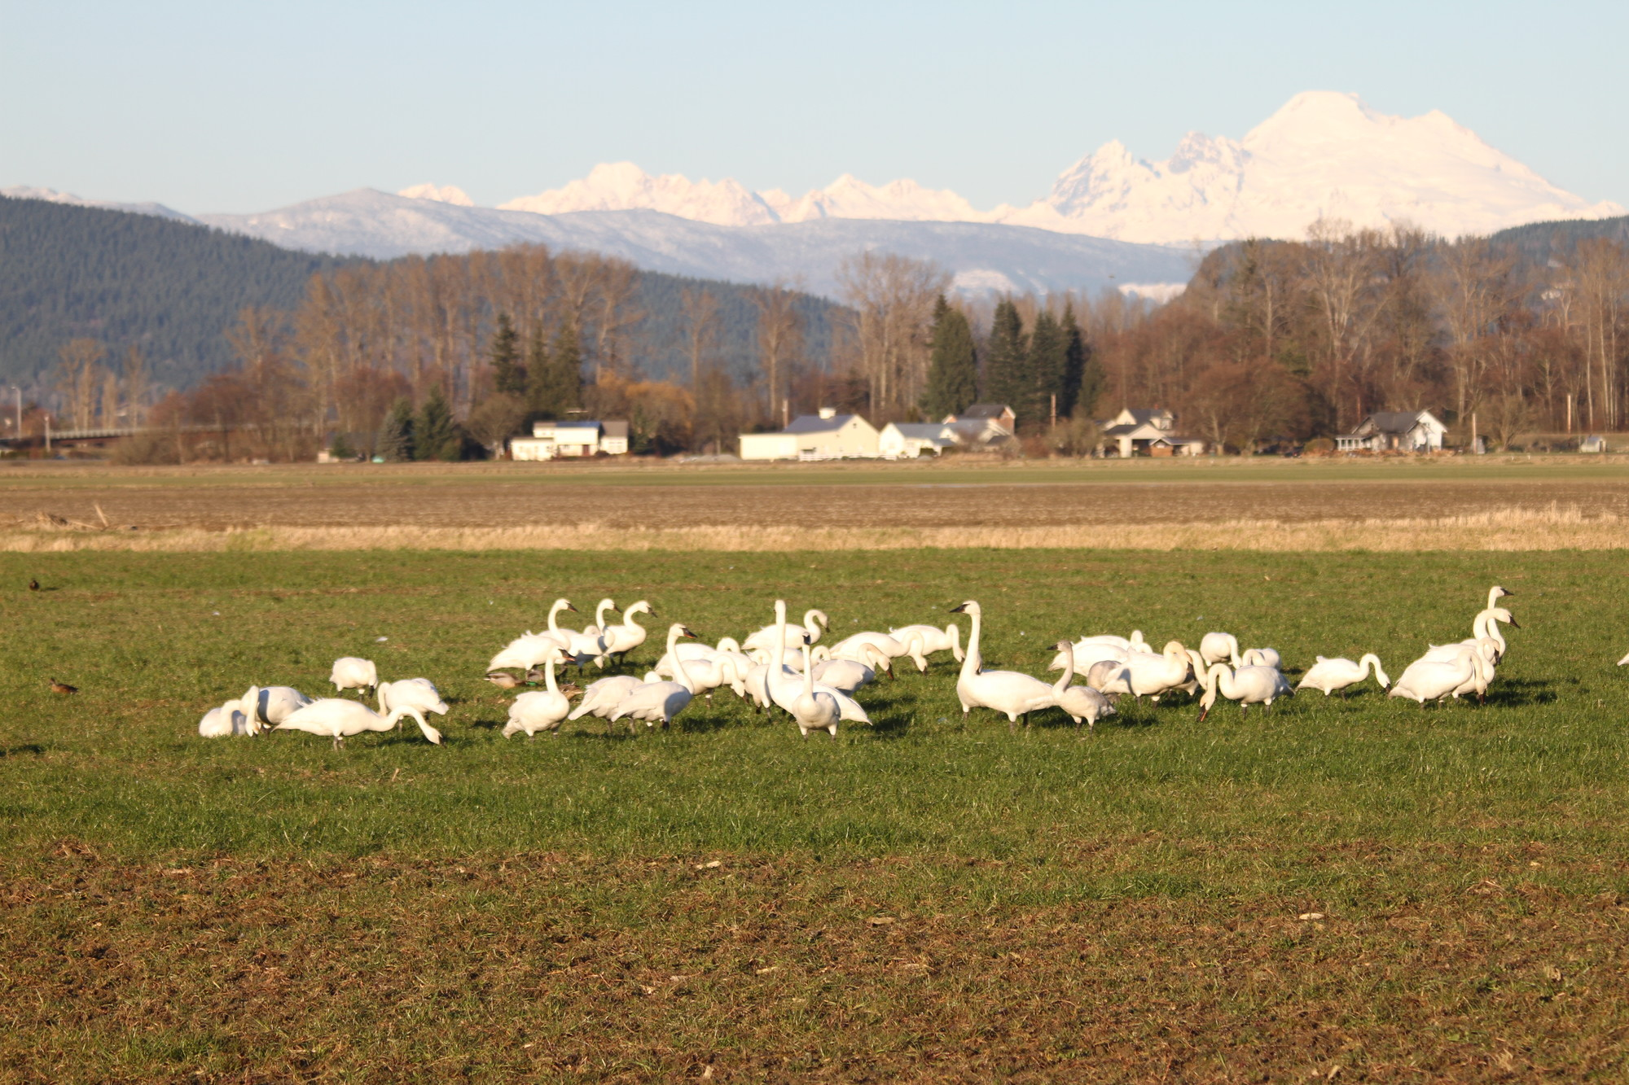
Notes:
Stopover sites are often located in agricultural areas where farmers flood fields, giving birds access to water.
Migration is very difficult for birds and many flooded agricultural areas come as a welcome sign for birds in need of temporary habitat.

Slide 18
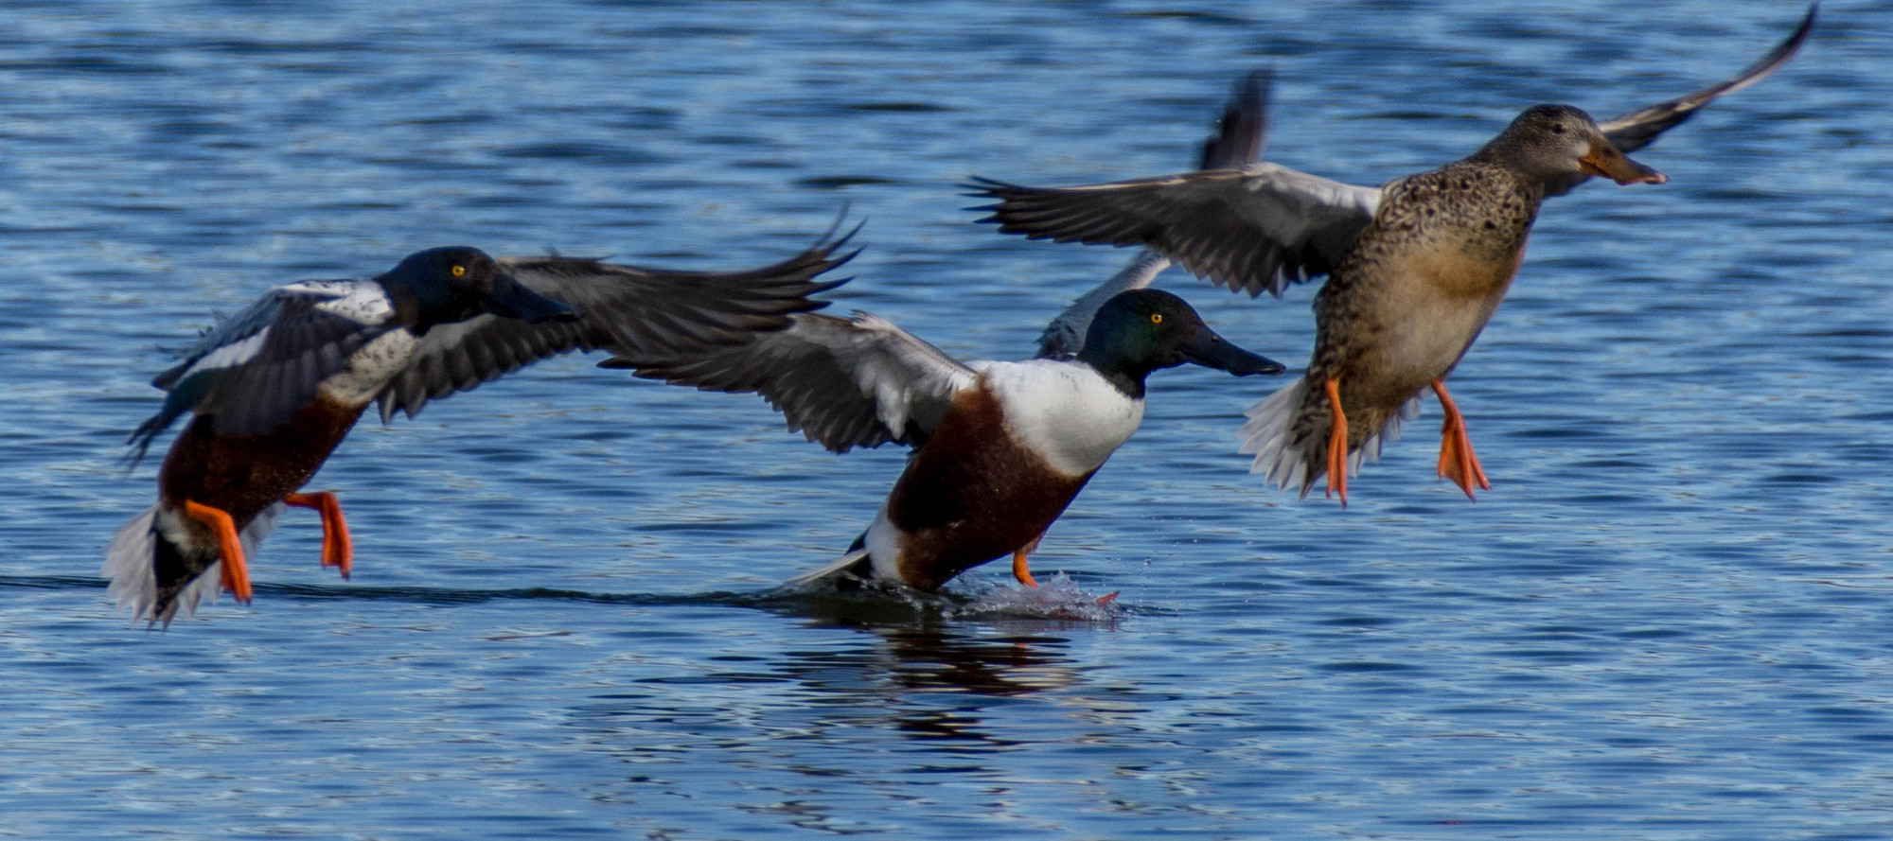
Notes:
The “water” in waterfowl is important. These species require water to survive. Stopover sites that can provide these birds with water help make migration successful.
Waterfowl must have connectivity (A network of stopover sites throughout a flyway that meet their habitat requirements) in order to survive migration.

Slide 19
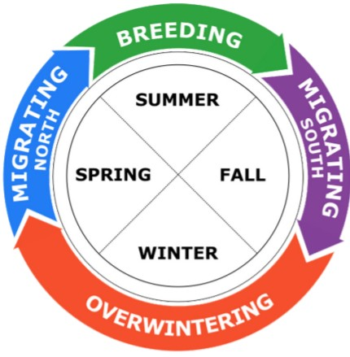
Full Annual
Cycle
The pattern of moving throughout the year is called the full annual cycle.
Depending on where the bird is in its cycle, it may have different habitat and energy requirements.
Why do you think this information could be important?
Notes:
Have students take three minutes and think-pair-share with a partner about how know a bird’s full annual cycle could be important.
Have a handful of partners share.

Slide 20
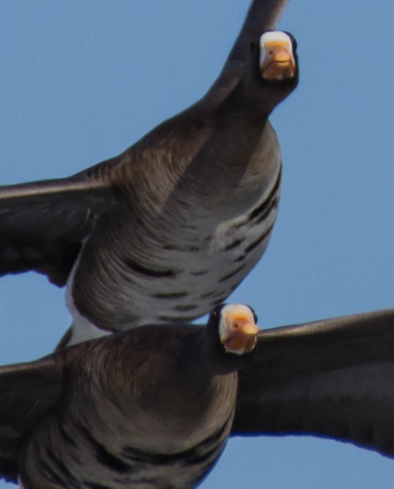
WDFW uses information about the full annual cycle to help make the best informed decisions for waterfowl hunting and conservation management.
This information helps keep sustain healthy waterfowl populations.

Slide 21
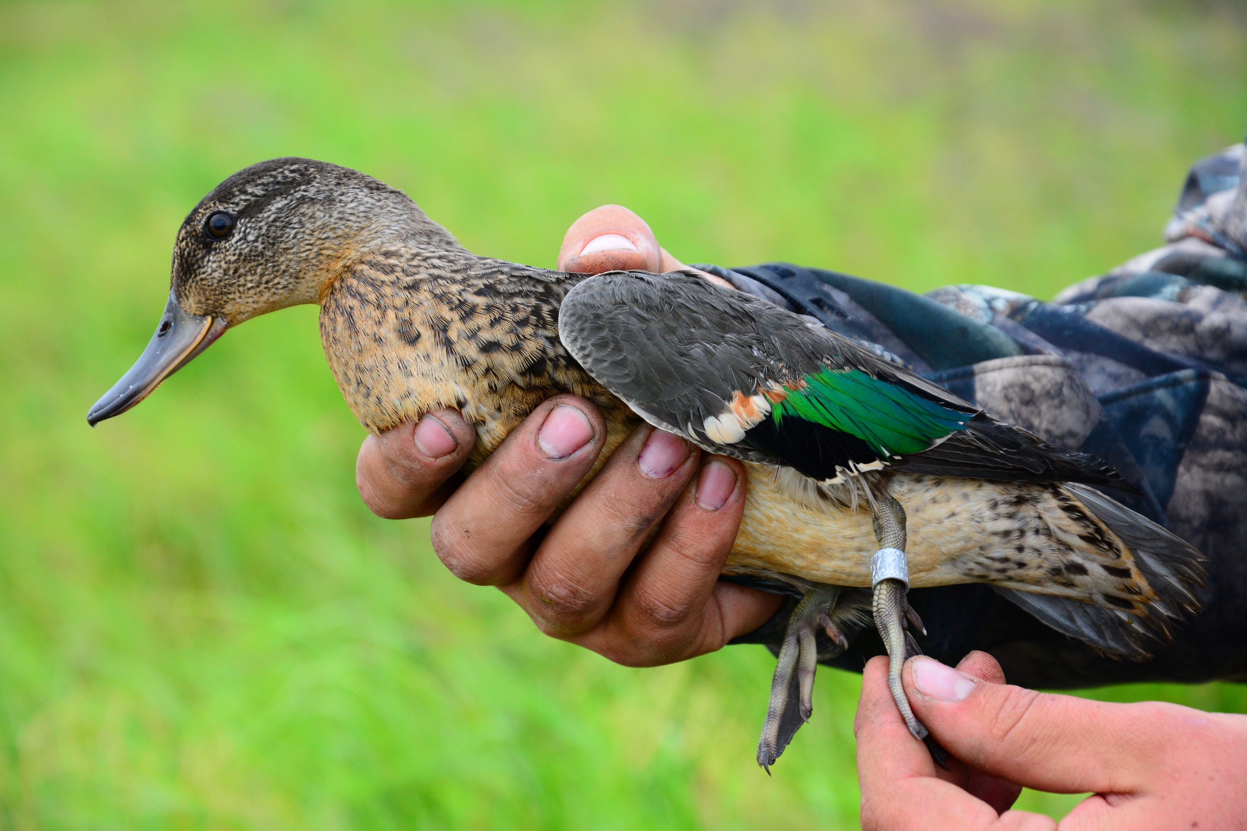
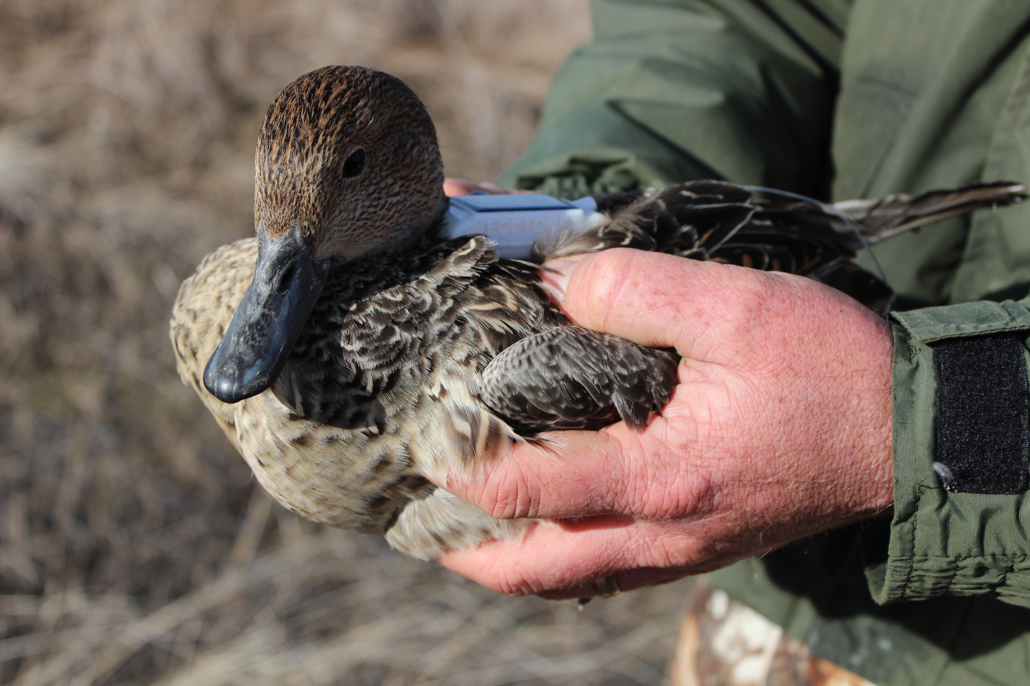
Tagging waterfowl
Notes:
First Picture:This Northern pintail has a GPS tracking device on her back.
Second picture: Biologists also track birds by attaching metal bands on their legs and then reading the numbers during annual counts.

Slide 22
Tagging waterfowl
Notes:
Because birds migrate and cross different state and country borders, WDFW biologists and waterfowl managers work with various state, national, and international agencies to sustainably manage and track waterfowl populations.
In this picture, scientists tracked 7 different individual birds of the same species. You can see how even individual birds take very different migration routes.

