Slide 1
Adaptations in Temperate Rainforest Organisms

Slide 2
What is an adaptation?
An adaptation is a physical or behavioral trait an organism has to live in its habitat.
Notes:
See if students can produce a definition before revealing on slide.

Slide 3
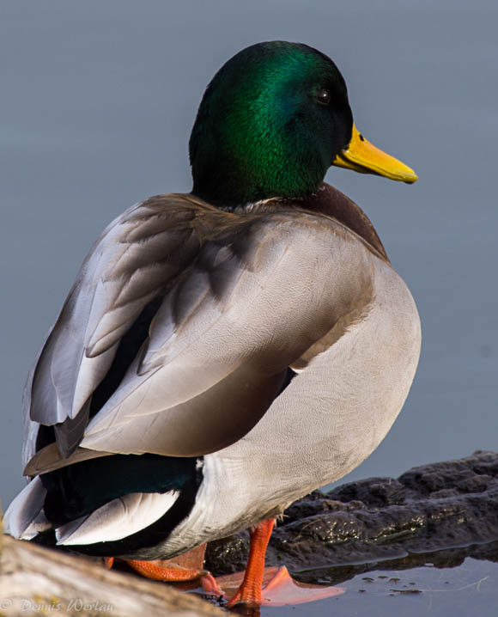
Let’s look at some examples of well adapted birds!
What adaptations do these birds have that help them thrive in their habitats?
Mallard Duck
Waterproof feathers to stay dry and warm.
Webbed feet for swimming.
Great Horned Owl
Large eyes to see in the dark.
Strong feet to catch prey.
Piliated Woodpecker
Beak for pecking wood for insects.
Special skull to handle pecking power.
Notes:
Go through the birds one at a time, having students suggest what they think each bird has that helps it within its habitat.

Slide 4
When we think about animal adaptations, it is important to think about the role the 5 senses play
How do sight, hearing, smell, taste, and touch help creatures of the temperate rainforest?

Slide 5
How do we use our senses?
We’re going to go outside and think about what you can see, hear, smell, taste, and feel. Try to answer these questions to help!
What can you smell that would tell you about your surroundings?
Can you hear running water? How close is it to where you’re standing?
Are you scanning the ground with your eyes to look for animals?
Can you imagine what the tree bark around you would feel like?
Notes:
You can copy and paste these questions onto a Word document and print it out if you want students to write their answers down. Or you can use journals.

Slide 6
Let’s look at some plants and animals that have adapted to the temperate rainforest environment!
Notes:
Have students remind you what adapted means.

Slide 7
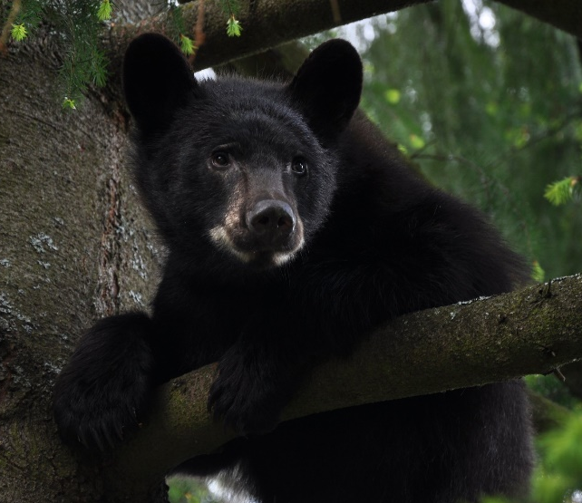
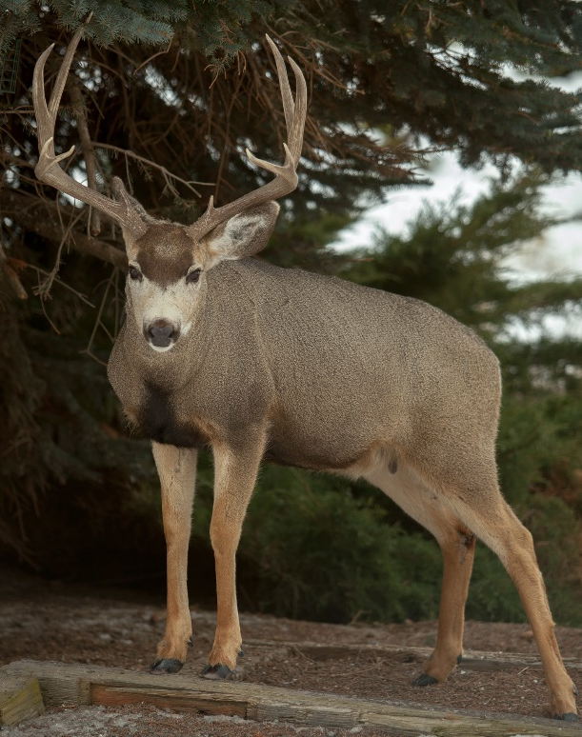
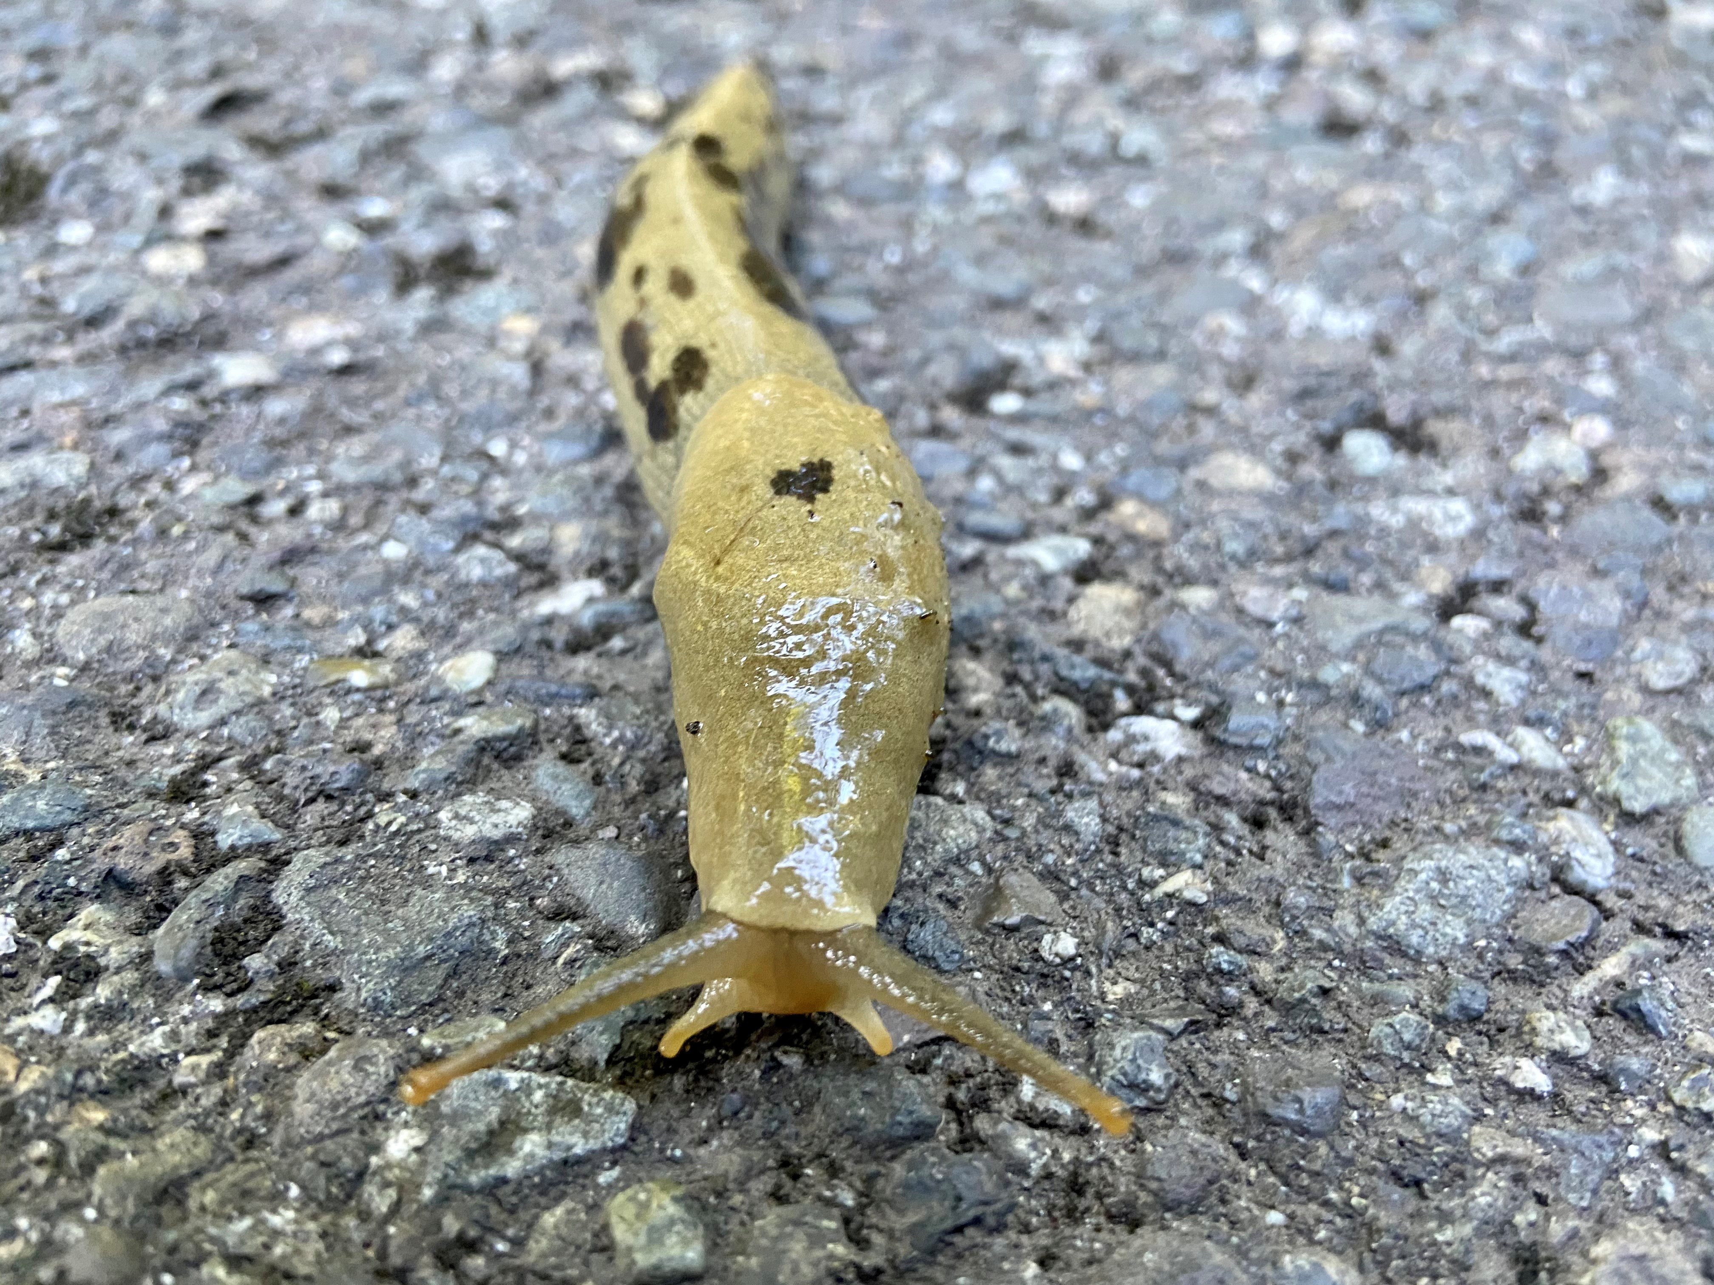
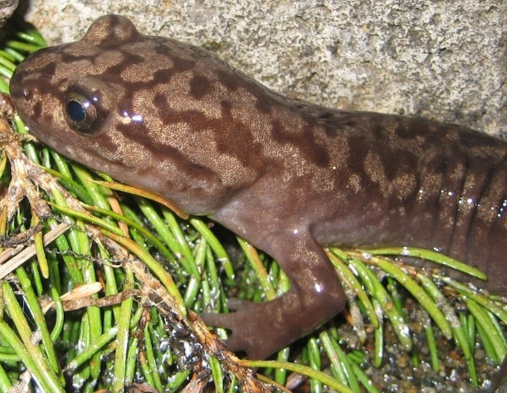
On this slide, let's look at five temperate rainforest animals and try to guess the sense or senses they use the most.
Black bear
Bald Eagle
Mule deer
Pacific salamander
Banana slug
Notes:
Round-robin through the animals and have students guess what senses these animals use.
Eagle- sight, touch; Black Bear- smell, hearing, sight; Mule Deer- smell, hearing, sight; Salamander- smell, taste, sight; Banana Slug- touch, smell through their antenna

Slide 8
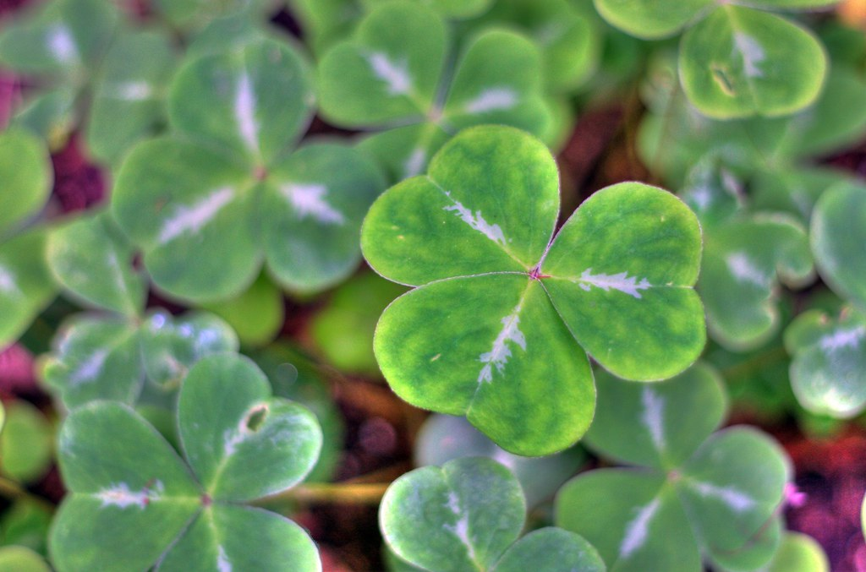
Redwood Sorrel adaptations
Thrives in low sunlight on the forest floor.
Leaves can tilt to face towards or away from the sun to keep moisture.
Leaves will curl during rain so they are not damaged.
Only grows 2 inches – 8 inches tall.
"Redwood Sorrel" by Sinéad McKeown is licensed under CC BY-NC-SA 2.0

Slide 9
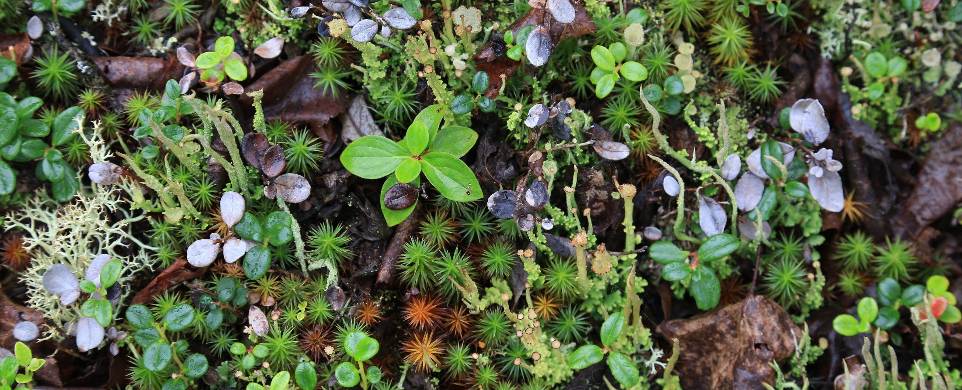
Epiphyte adaptations
Epiphytes grow on other plants and do not need to have roots in the soil.
This group includes ferns, lichens, and mosses that are common in temperate rainforests.
They use photosynthesis to get energy and take water from the air as rain or fog.
Notes:
See if students can recall what an epiphyte is before revealing the bullets.
Epiphytes are plants that grow on other plants without hurting them, such as moss on a tree branch.

Slide 10
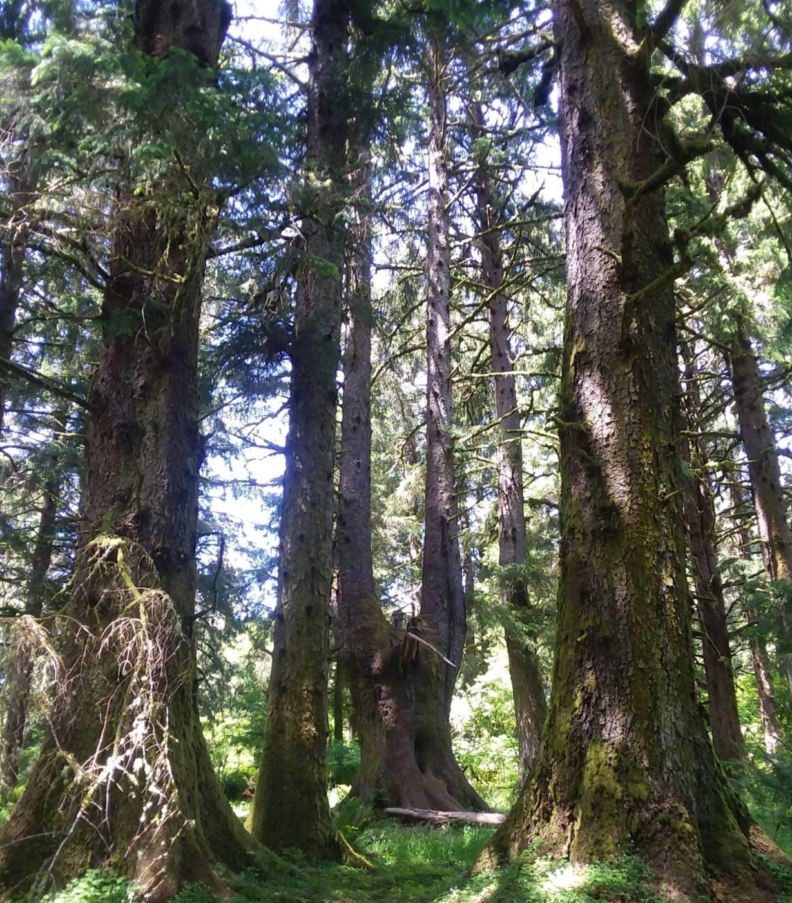
Sitka spruce adaptations
Grows very large to compete for sunlight.
Thrives in cool, wet weather.
Thin needles that are encased in wax to protect from cold and to trap in water.
Photo courtesy of Native Plants PNW

Slide 11
Pacific giant salamander adaptations
Young salamanders live in the water and adult salamanders are also found on land.
They have an excellent sense of smell, taste, and sight.
How would you describe the coloring of this animal?
Notes:
This salamander utilizes camouflage to help blend in with its habitat. This species will hide in leaf litter on the forest floor to avoid predators.

Slide 12
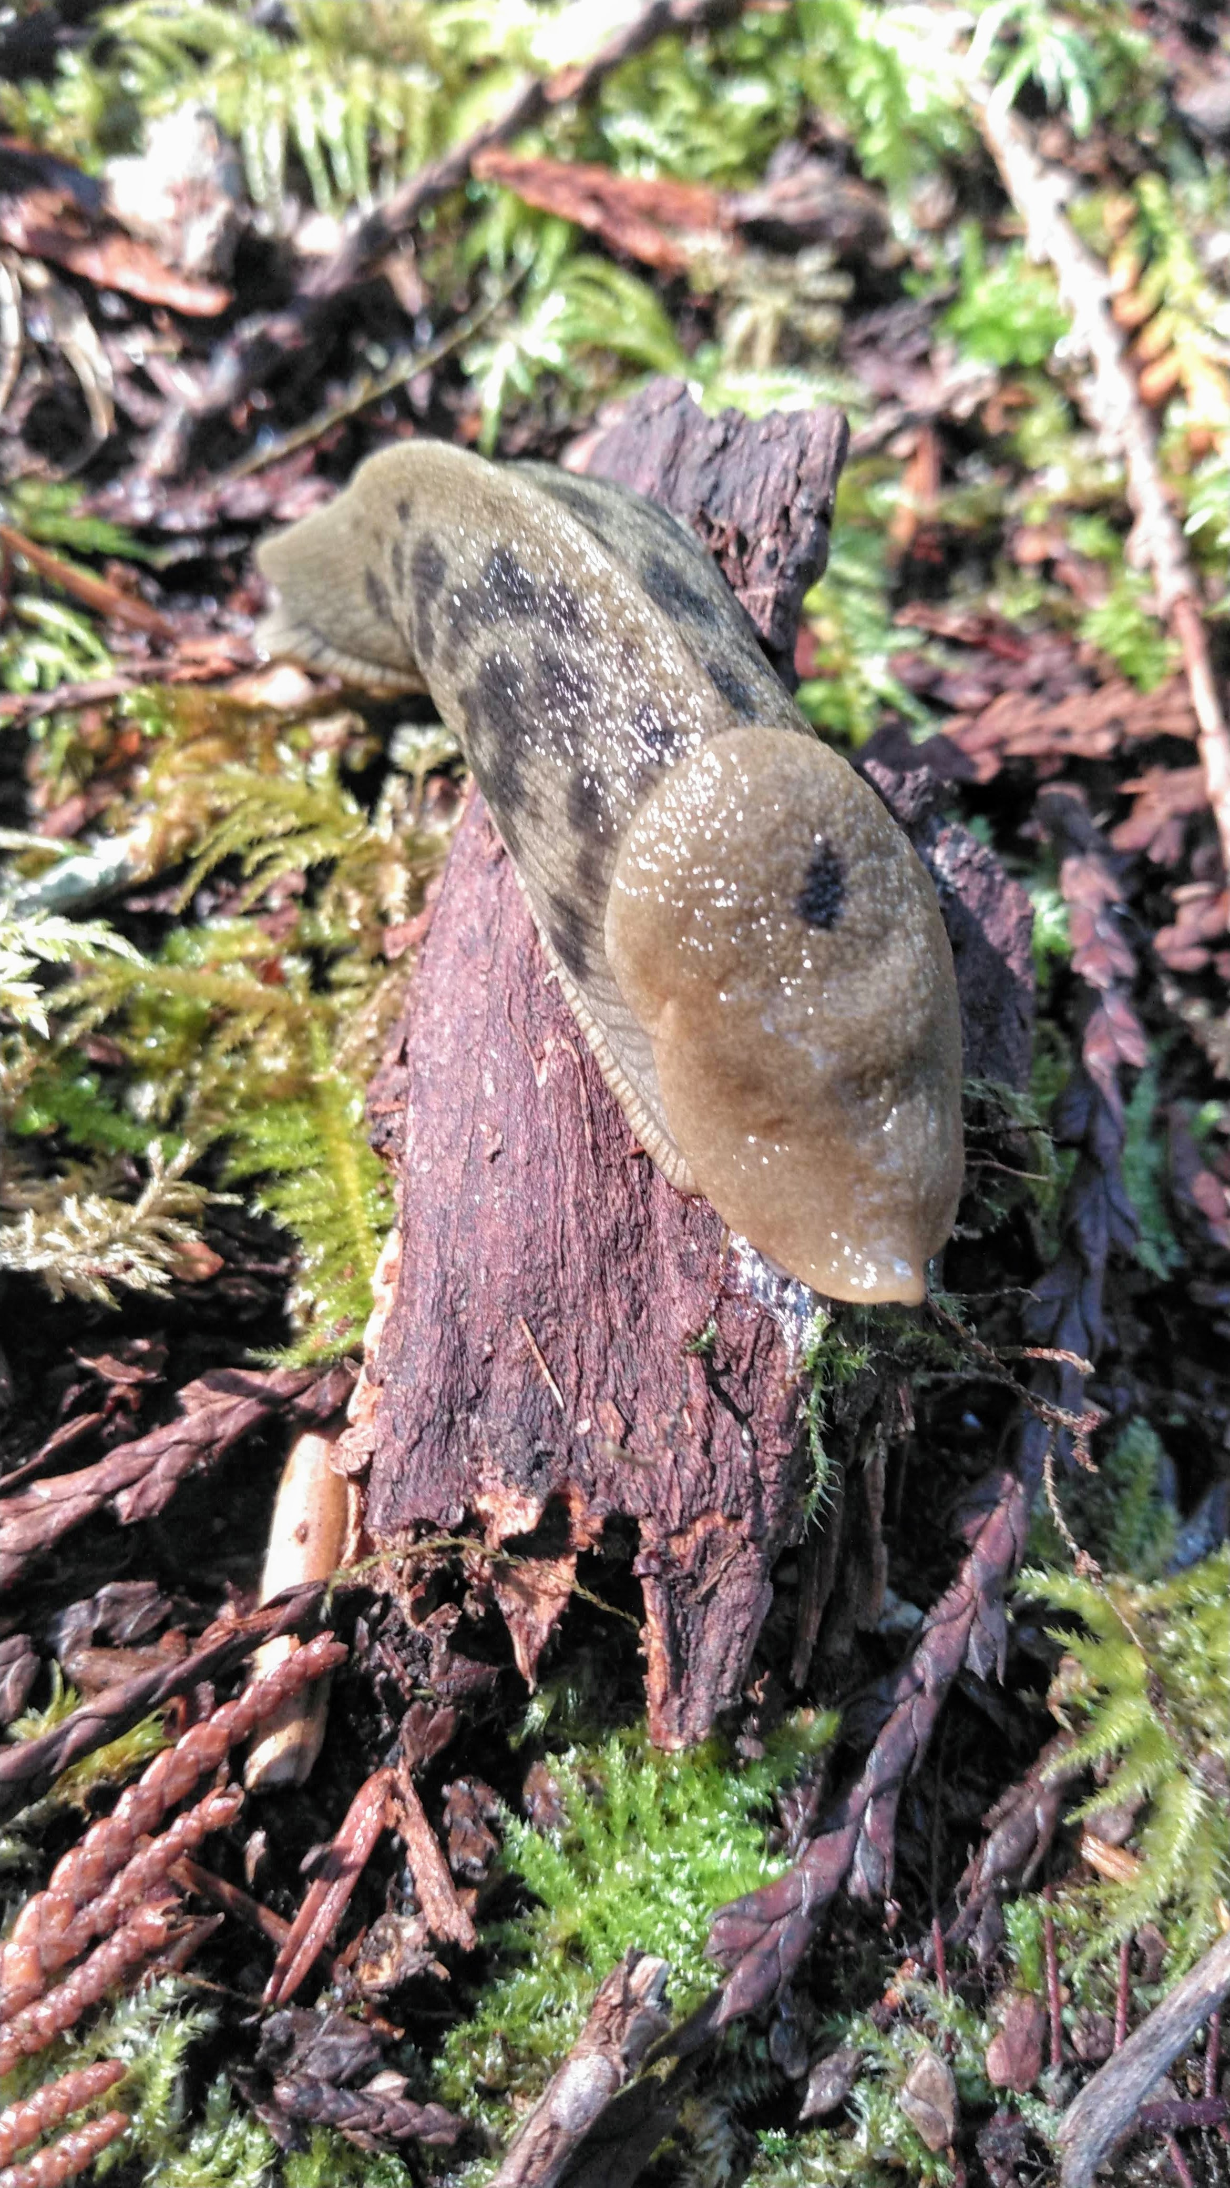
Banana Slug adaptations
Eats fallen leaves, mushrooms, and dead materials.
Hibernates in cooler seasons.
Excellent sense of smell for food and predators.
Why do you think this slug covers its body in slime?
Notes:
Slime to keep it moist in warmer weather and to keep away predators.

Slide 13
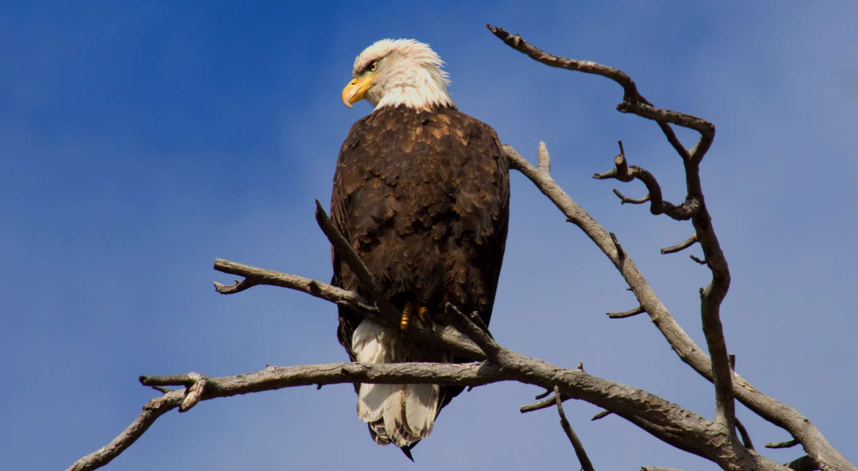
Bald eagle adaptations
Eats small mammals, birds, and fish that it spots from above.
Has large talons to grip tree branches.
Waterproof feathers on the outside, and soft, warm feathers close to the eagle's body keeps it warm and dry.

Slide 14
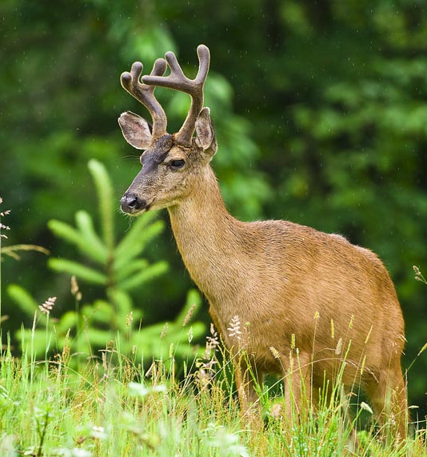
Mule Deer adaptations
Excellent sense of smell and hearing for predators.
Eats leaves, twigs, ferns, lichen, and can adapt to other plants when food is limited.
How do you think a deer stays warm in cold, wet weather?
Notes:
Deer stays warm by sheltering underneath large trees to avoid wind and rain. Specialized fur that traps warm air also helps to keep deer warm.

Slide 15
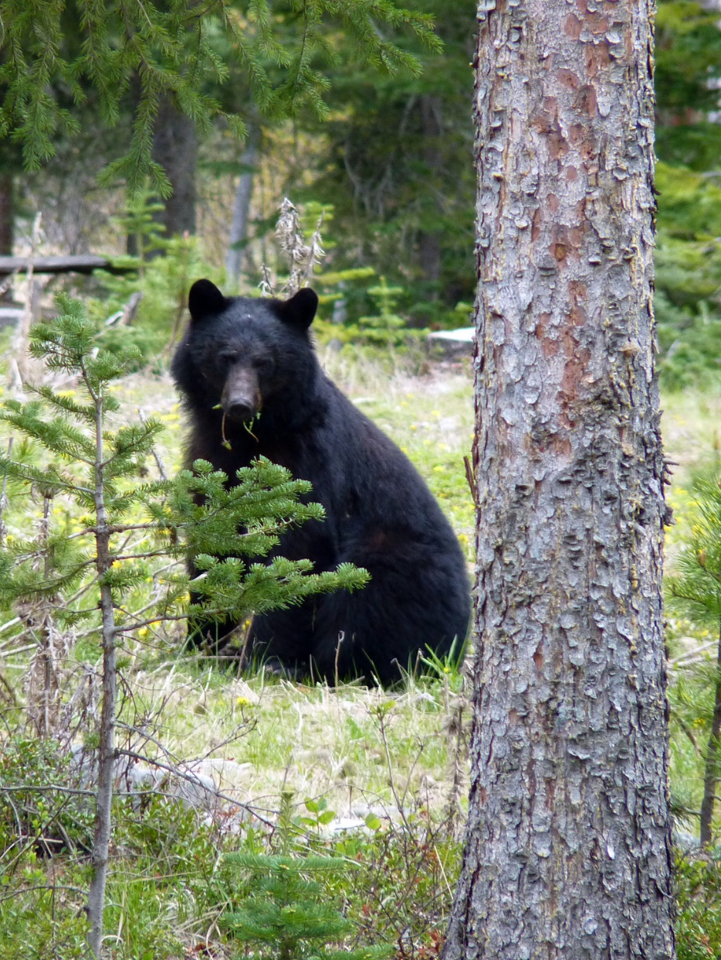
Black bear adaptations
Thick fur and fat keep the bear warm and dry during the winter and heavy rains.
Excellent sense of smell for food.
Fur color helps with camouflage.
What layers of the rainforest do you think the black bear lives in? Canopy? Understory? Forest floor? All three?
Notes:
Black bear utilizes the understory and forest floor but is equipped with strong limbs and long claws for climbing trees so all three answers could be correct.

Slide 16
Look at the animal on the slide and with a partner answer these questions:
How do they stay warm?
What might they eat?
How do they find shelter?
How do they blend into their environment?
How are they adapted to be able to survive in the rainforest?
What senses do they need to survive?
How will they walk through dense vegetation?
Notes:
For the next slides, there are no wrong answers as long as students can justify their answer.

Slide 17
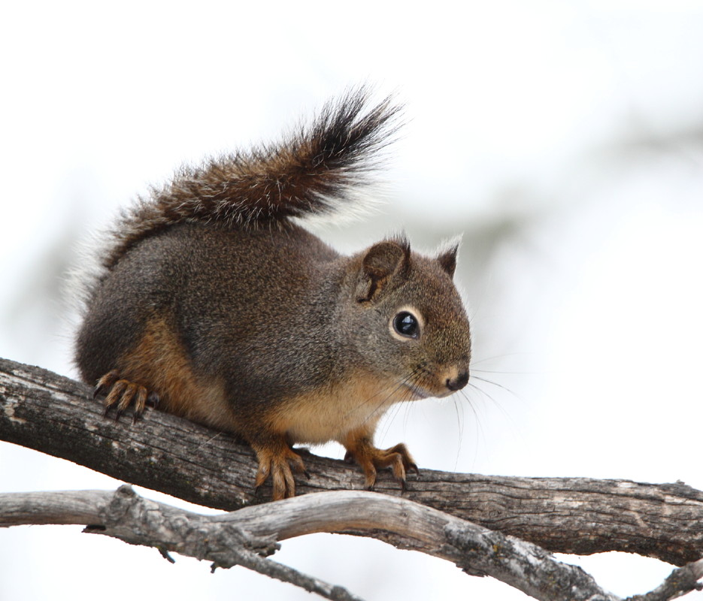
Douglas squirrel
How do they stay warm?
What might they eat?
How do they find shelter?
How do they blend into their environment?
How are they adapted to be able to survive in the rainforest?
What senses do they need to survive?
How will they walk through dense vegetation?
Notes:
List of adaptations: coloring that provides camouflage, fur that provides warmth, hibernation during colder months or storms, uses hollows of trees to nest and shelter, uses hearing and sight to watch for predators, small size allows for easy movement through the canopy and understory.

Slide 18
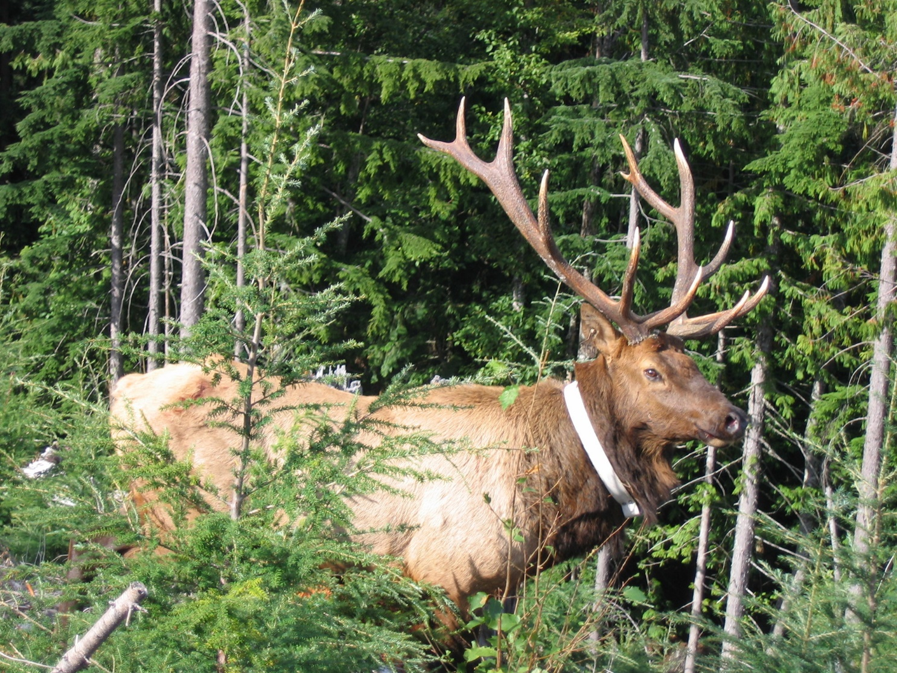
Roosevelt elk
How do they stay warm?
What might they eat?
How do they find shelter?
How do they blend into their environment?
How are they adapted to be able to survive in the rainforest?
What senses do they need to survive?
How will they walk through dense vegetation?
Notes:
List of adaptations: camouflage in dark coloring; travel in herds for protection and warmth; unlike other species of elk, temperate rainforest elk do not migrate because the climate stays mild; uses hearing and smell to watch for potential dangers; eats ferns, shrubs, and lichen of the temperate rainforest.

Slide 19
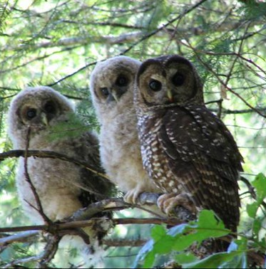
Northern Spotted Owl
How do they stay warm?
What might they eat?
How do they find shelter?
How do they blend into their environment?
How are they adapted to be able to survive in the rainforest?
What senses do they need to survive?
How will they walk through dense vegetation?
Notes:
List of adaptations: Layers of feathers that trap warm air and keep the bird warm; eats flying squirrels, voles, and other small rodents; uses hearing to find prey; shelters in trees;

