Slide 1
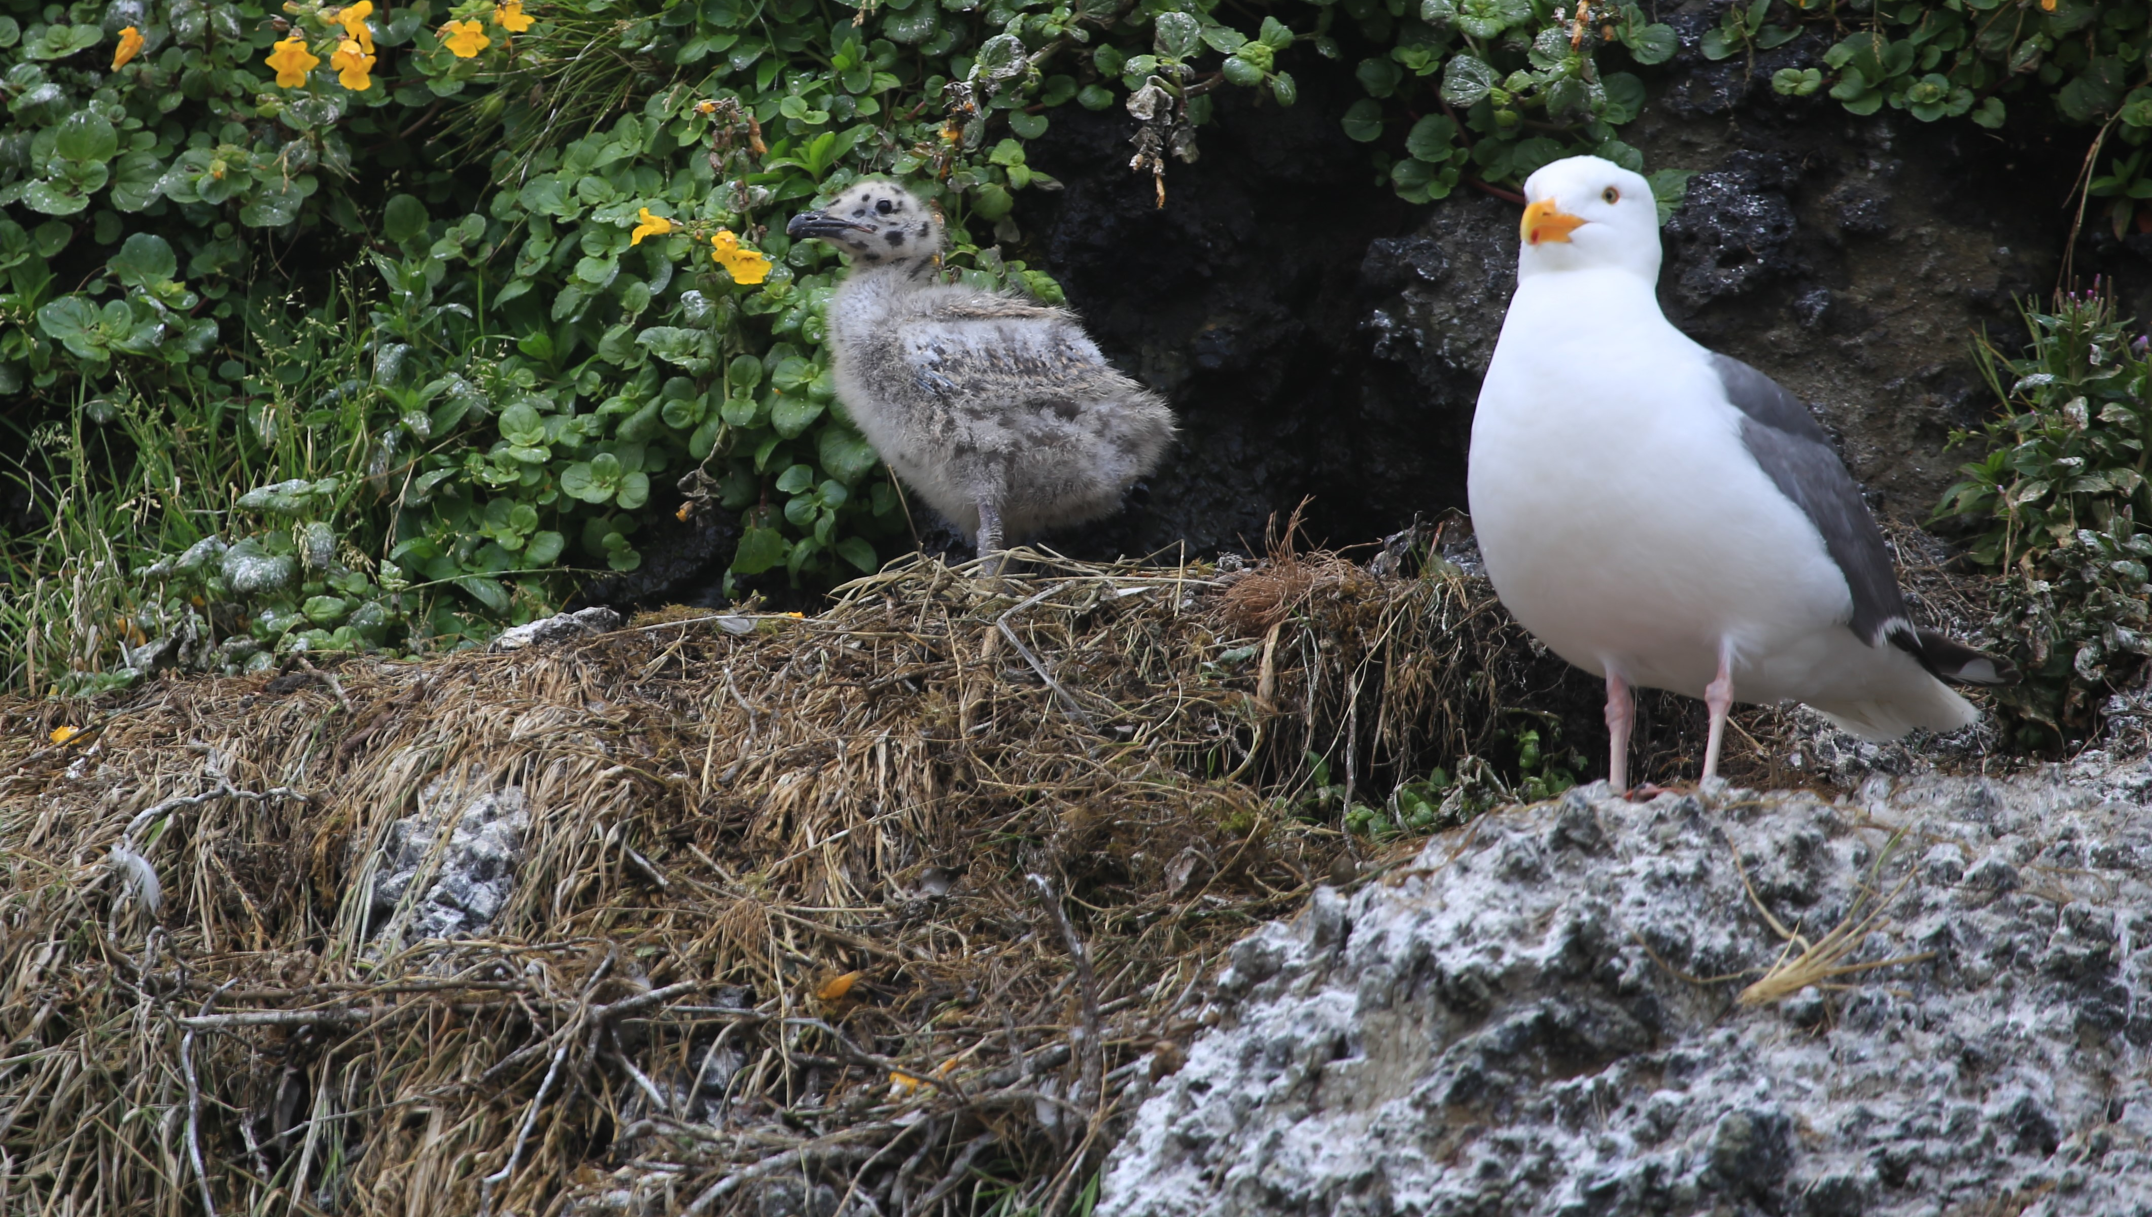
How do these babies look different from their parents?
Gull

Slide 2
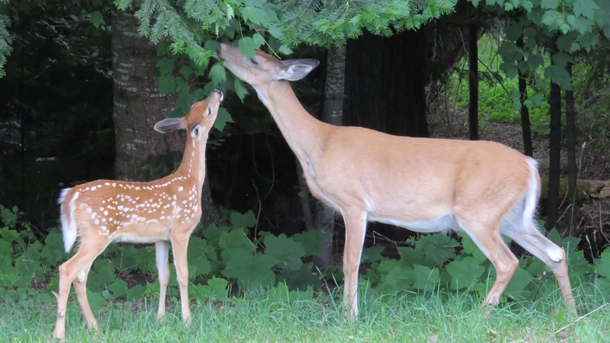
How do these babies look different from their parents?
Deer

Slide 3
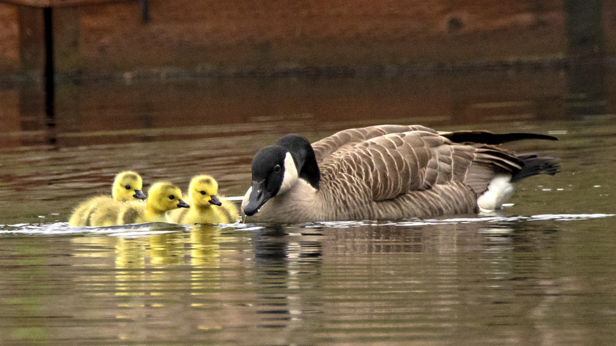
How do these babies look different from their parents?
Goose

Slide 4
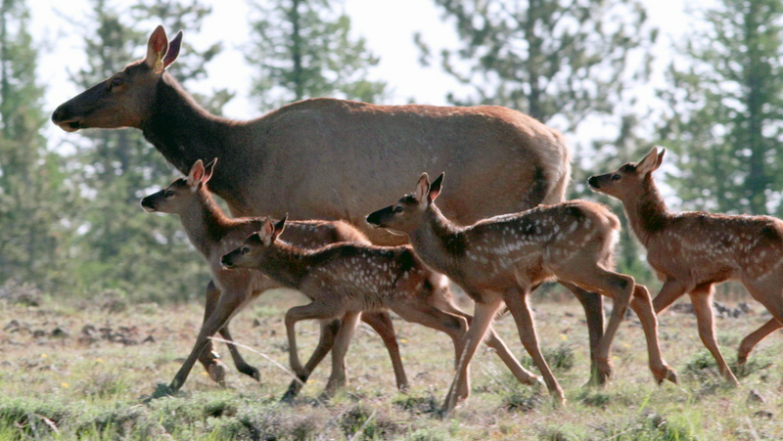
How do these babies look different from their parents?
Elk

Slide 5
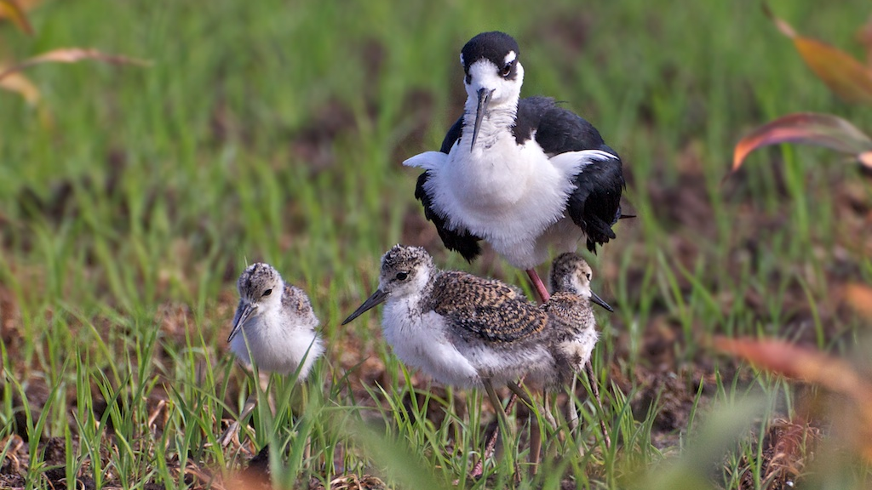
How do these babies look different from their parents?
Black-Necked Stilt

Slide 6
1. Describe differences you notice between babies and their parents.
2. Describe similarities you notice between babies and their parents.
3. Do you notice anything similar with the different the baby animals?
4. Do you think all baby animals stay with their parents?
5. What’s another baby animal that looks different from its parents?

