Slide 1
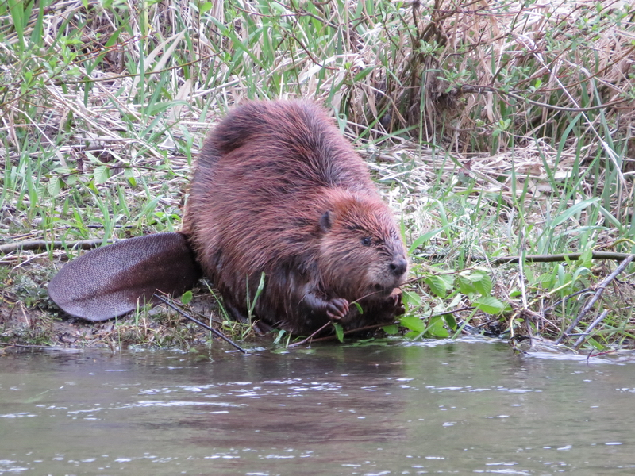
Beavers, Nature’s Engineers

Slide 2
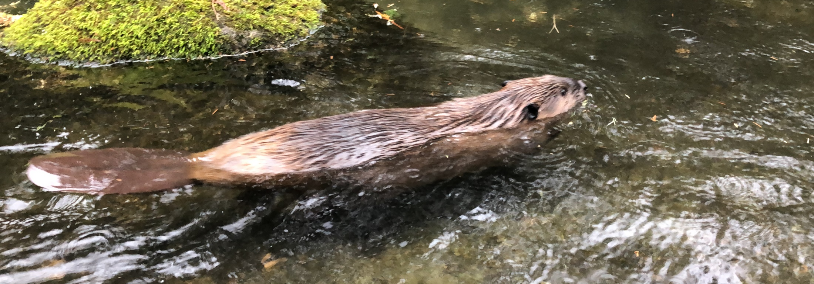
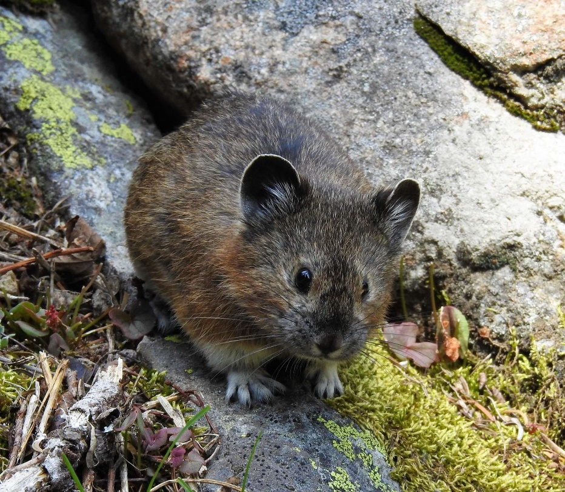
What is a beaver?
A beaver is a rodent. Other rodents include mice, rats, chipmunks, squirrels, pikas, and more.
Northern Pika
Photo taken at Northwest Trek Wildlife Park
But unlike most other rodents, beavers are semi-aquatic, meaning they also live in water.

Slide 3
Ecosystem engineers
What’s the first thing you think of when you hear the word, “beaver”?
Student answers here
Beavers are commonly associated with the dams they build. Dams are structures that hold water.
Notes:
Ask students to think for a moment. When you ask them to respond you can write answers on a whiteboard or create a new textbox in this slide.

Slide 4
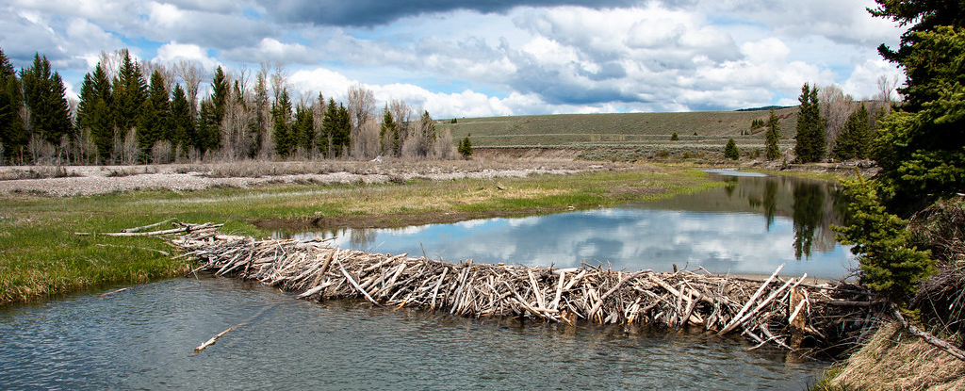
Beavers build dams to create ponds because beavers move more easily in water than on land.
Ponds allow them to escape from predators, and increasing the size of the pond allows them more access to vegetation for foraging around the pond.
Notes:
Ask students to think-pair-share about what they think it means to be an ecosystem engineer. You can introduce the terms ecosystem and engineer here.

Slide 5
Because of their building abilities, beavers are commonly referred to as “ecosystem engineers”.
Beaver dams alter ecosystems by raising water levels and creating wetlands.
Beavers create their own habitat, and habitat for many other species!
Notes:
Ask students to think-pair-share about what they think it means to be an ecosystem engineer. You can introduce the terms ecosystem and engineer here.

Slide 6
Beaver Dams
Beaver dams are built from mud, sticks, small trees, grasses, and leaf litter.
Let’s watch how they build now!
Notes:
After watching ask students to recall three things they learned about beavers and some materials they saw beavers use in making a dam.

Slide 7
Beaver Dams
But why are these dams important? Here are just a few reasons:
Dams slow streams and rivers while also creating ponds that slowly release water during hot summer months when stream flows are low.
This allows for better habitat for aquatic (water) species such as fish, amphibians, invertebrates, birds, and plants to live year-round.
Dams help increase ground water and increase riparian (river/stream) habitat.

Slide 8
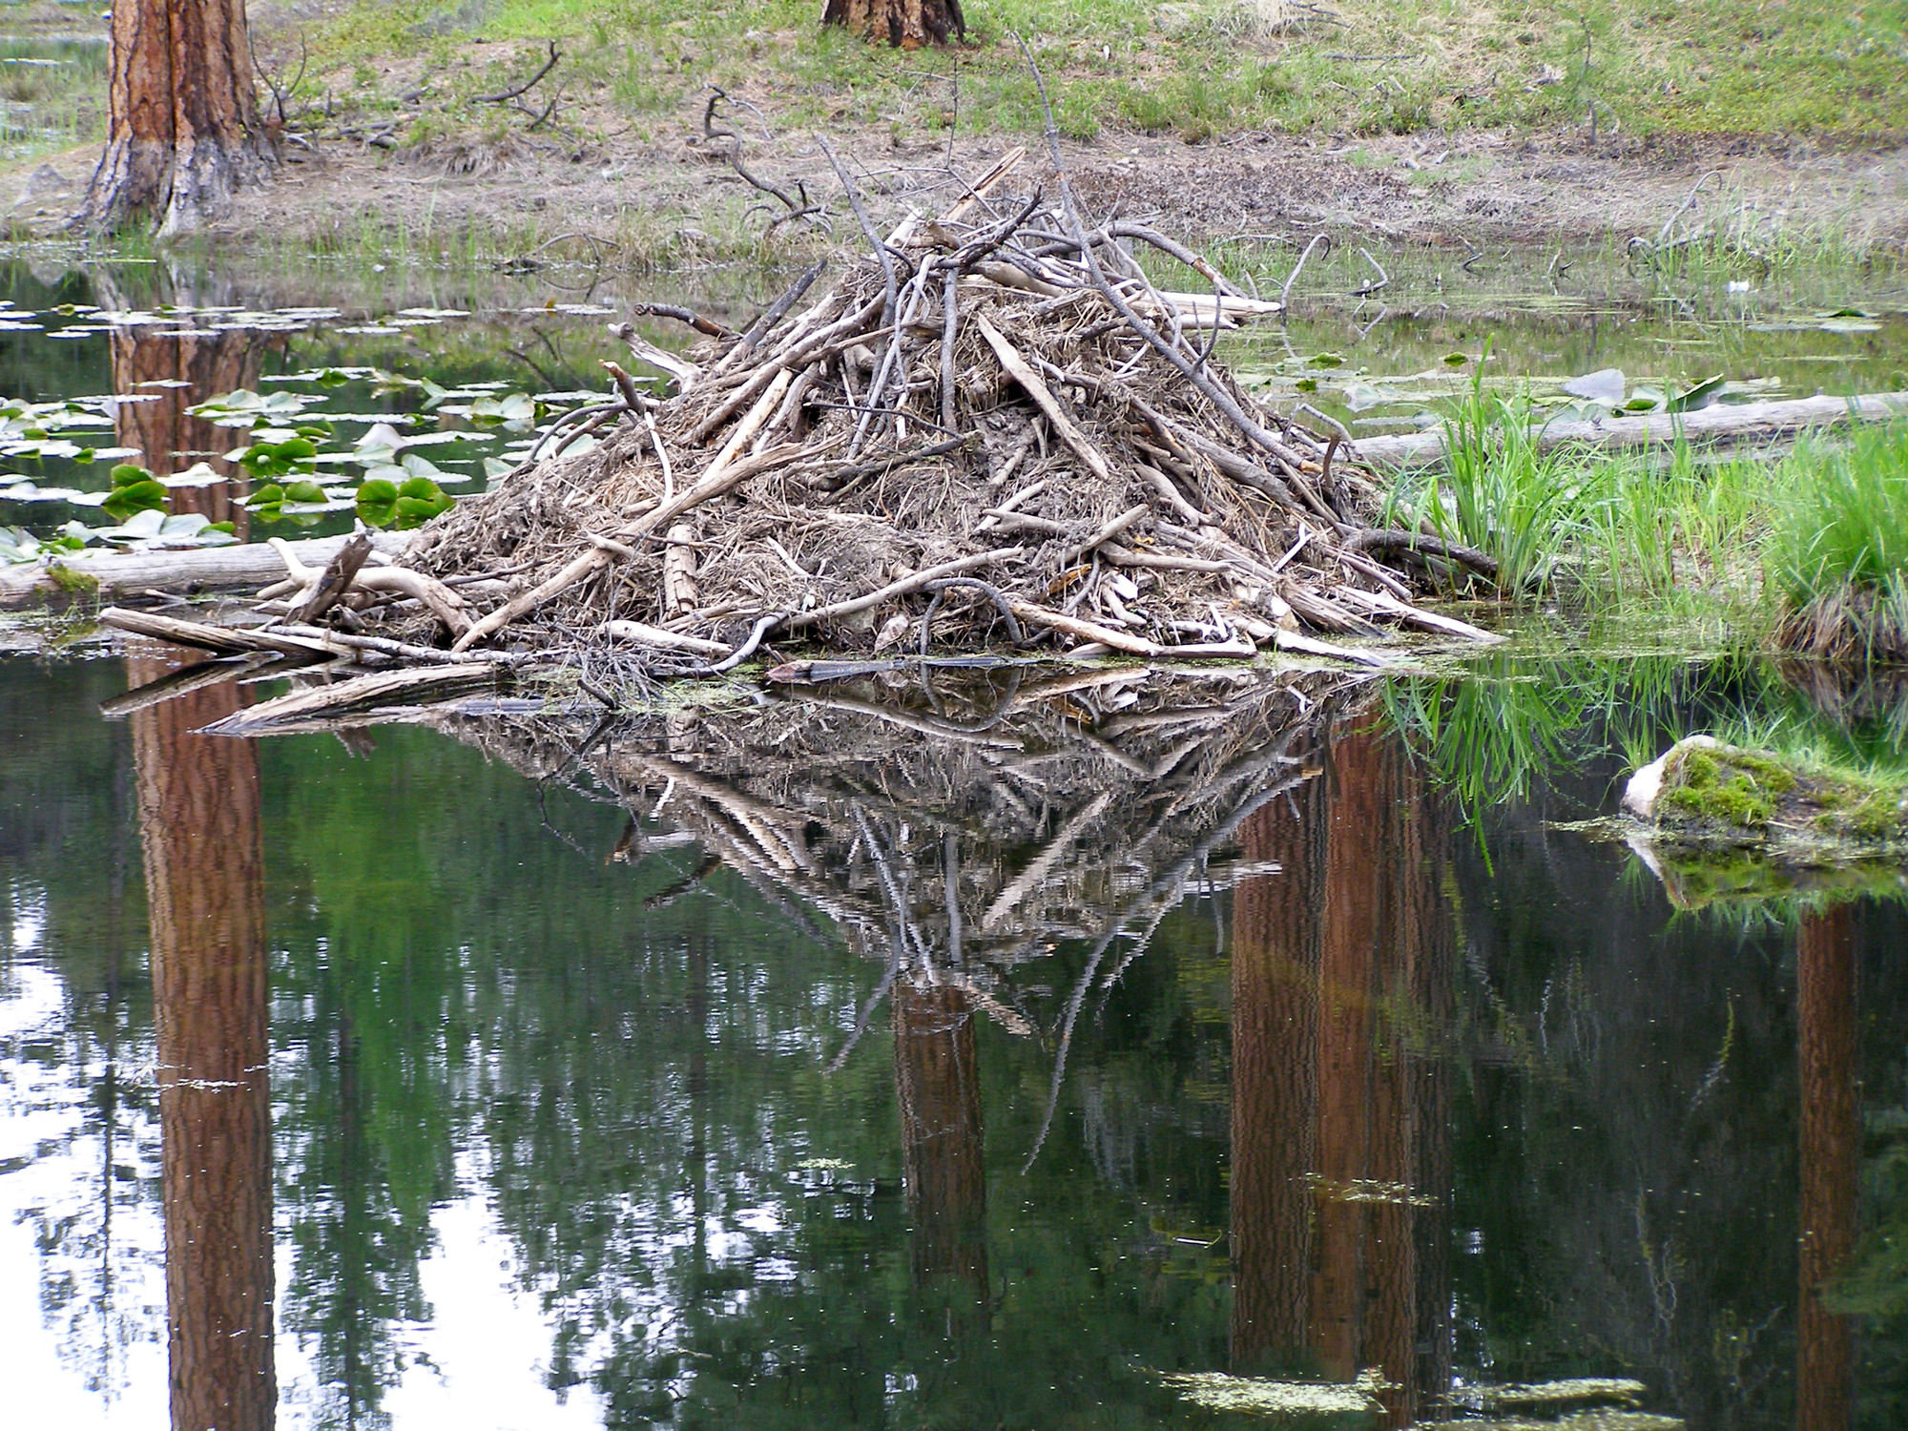
After dams are built and a pond is created, beaver will then build a lodge. Lodges are where beavers sleep and raise young. Lodges, like dams, are made of mud, sticks, and other nearby materials.
Let’s learn more
Notes:
The link will take you to an interactive webpage where students can popcorn read and learn more about how beavers make their ecosystems.

Slide 9
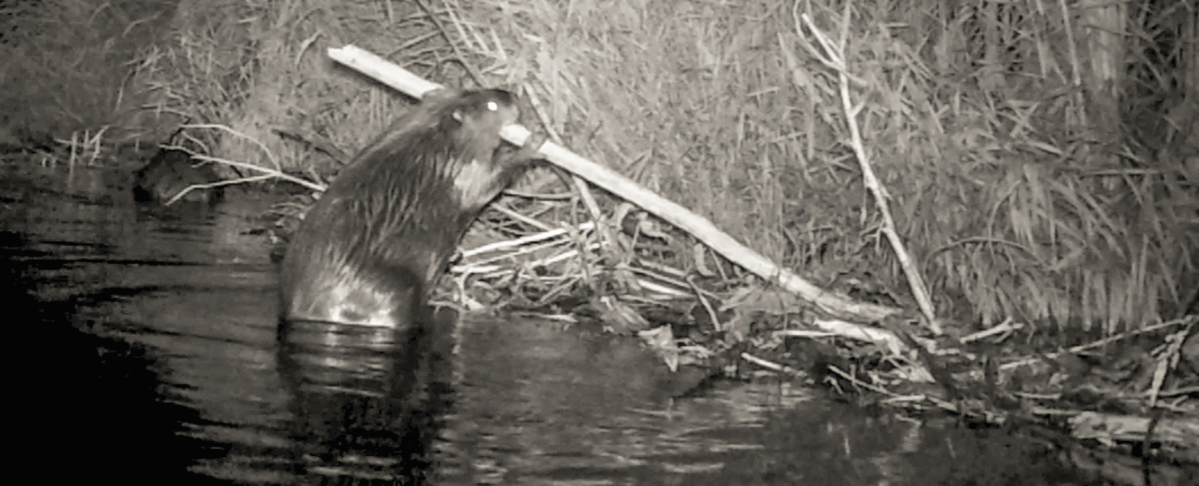
Beavers continue to work on their dams and lodges throughout their life.
Like true engineers, they spend a lot of time to maintain these structures once they are built.
Even with all their hard work, sometimes their dams fail.

Slide 10
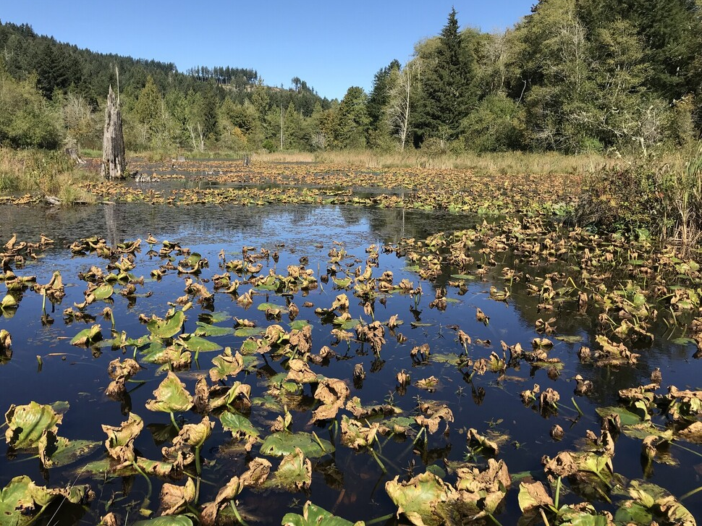
Beaver Ponds
Beaver dams slow sediment (small rocks, mud, sand) and allow water to slowly trickle through.
This slows streams and creates wetland habitats.
Scientists have found that beaver dams can also create small pools that help juvenile salmon migrate.
Can you think of other species that may benefit from wetlands?
Notes:
Species who may benefit include other waterfowl, frogs, salamanders, birds, humans (wetlands create clean water), mammals, and more!

Slide 11
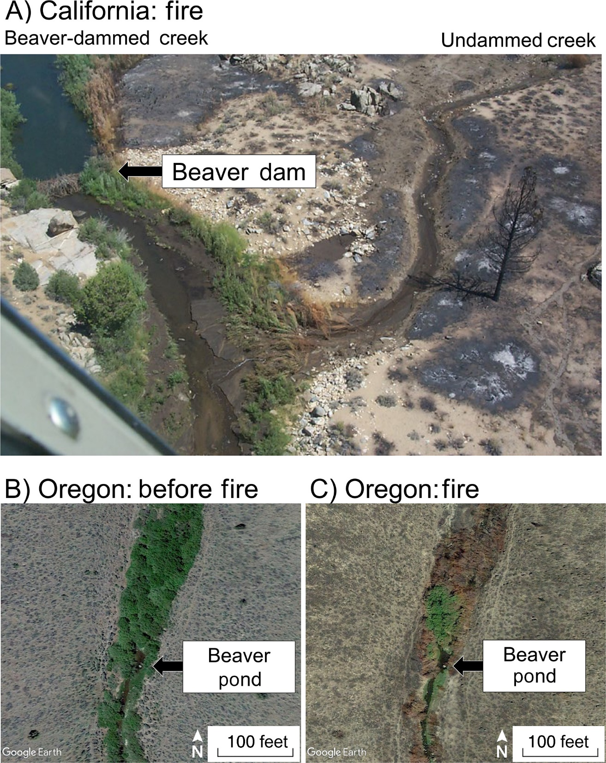
Tougher Ecosystems
Beaver dams also increase groundwater (water under the ground).
Scientists are finding as wildfires increase, areas where beavers build dams are protected because of increased ground and surface water.
Watch this video to see how it works!
Photo from: “Smokey the Beaver: beaver‐dammed riparian corridors stay green during wildfire throughout the western United States”
Notes:
The link takes you to a one-minute video where students can see how beaver dams prevent fires from spreading.

Slide 12
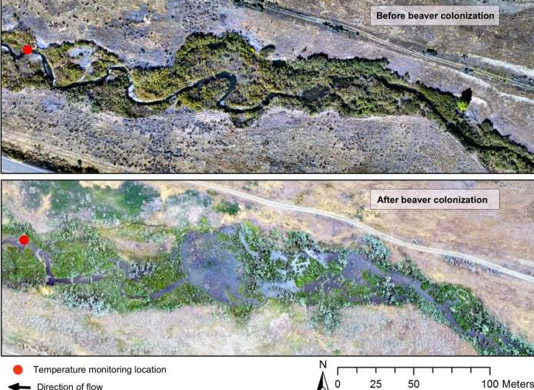
Tougher Ecosystems
Dams and ponds also help reduce temperatures of water, making riparian areas more suitable for species like salmon.
Photo from: Library of Public Sciences
Notes:
Species who may benefit include other waterfowl, frogs, salamanders, birds, humans (wetlands create clean water), mammals, and more!

Slide 13
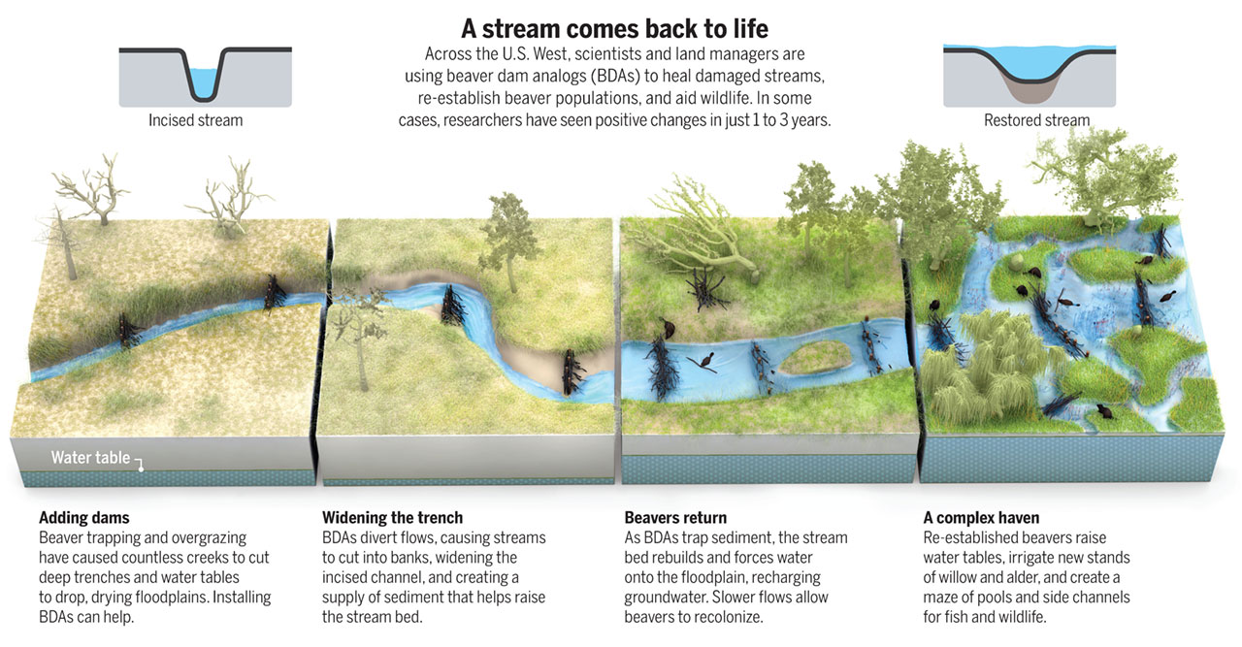
Photo from: Science Magazine
Notes:
You can have students popcorn read the text on this slide.

Slide 14
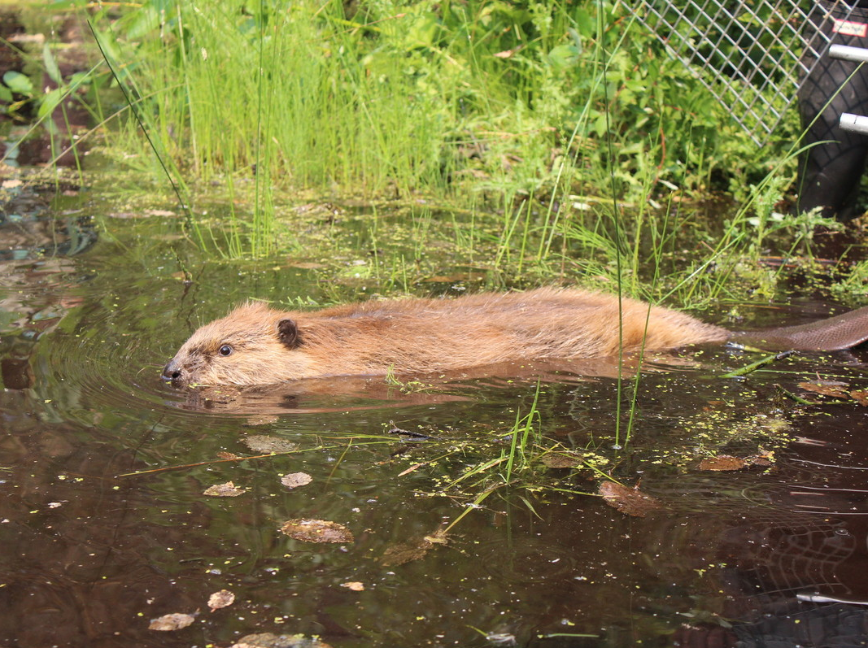
Reflect
First, think of three ways beavers change ecosystems (you can write it down if you want).
Then, share with a partner.
Notes:
After sharing with a partner, write answers on physical or virtual whiteboard for students to remember. You can share this document with students for their “build a dam” project.

