Slide 1
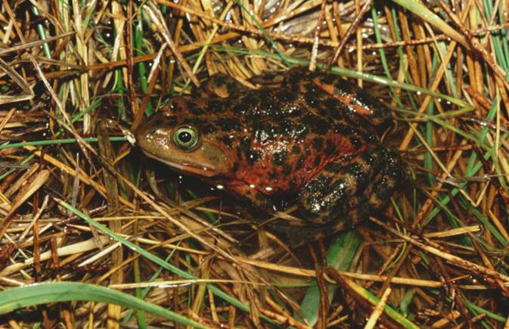
Endangered Species
Notes:
Oregon spotted frog

Slide 2
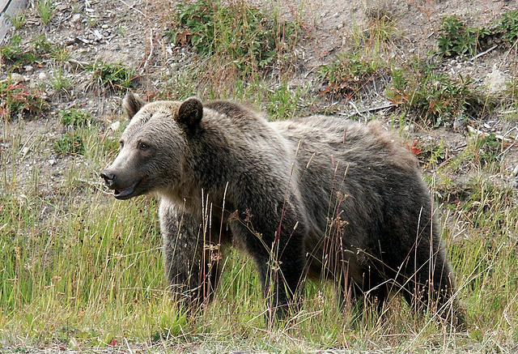
What are endangered species?
Department of Fish and Wildlife
Notes:
Grizzly bear

Slide 3
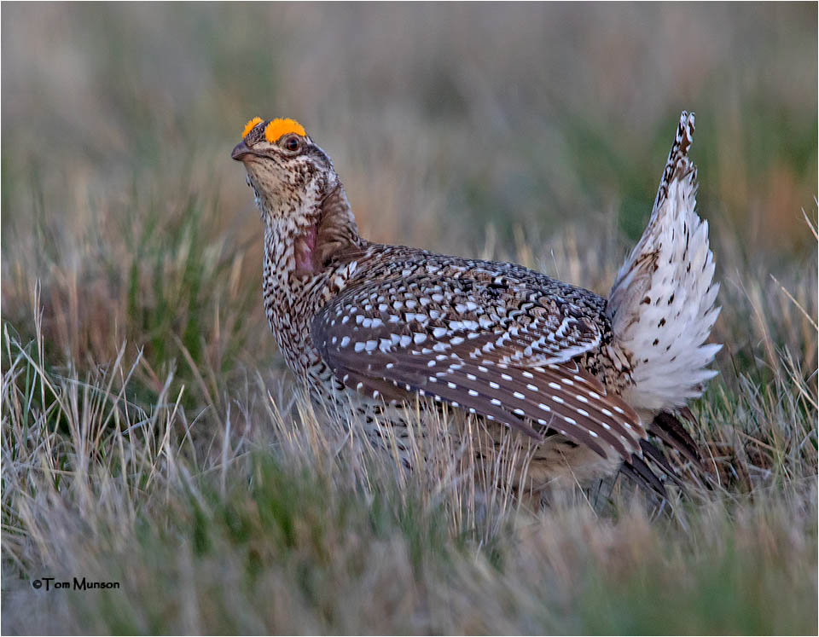
Species that are threatened with extinction
Department of Fish and Wildlife
Notes:
Movie link: https://www.pbs.org/video/d4k-endangered-species-video-short-8ahfww/
Sharp-Tailed Grouse
Extinction means gone forever.

Slide 4
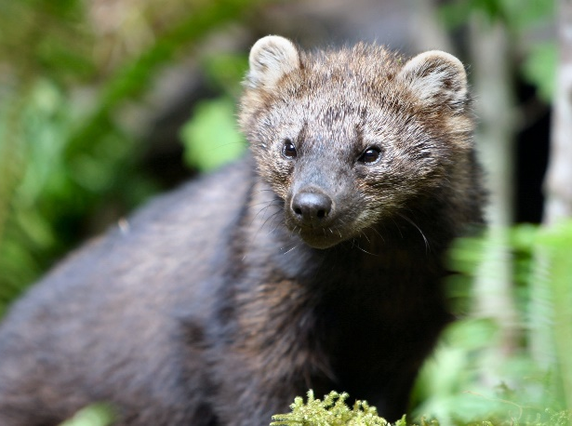
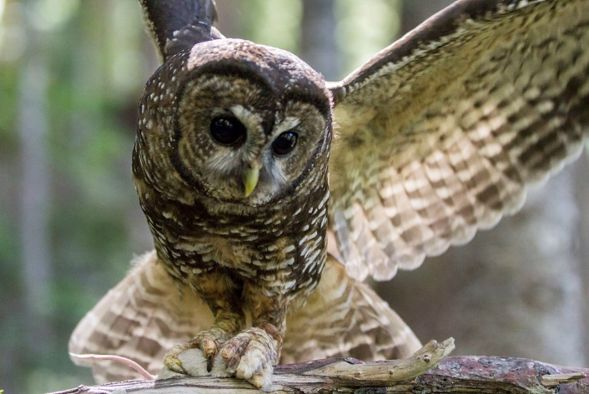
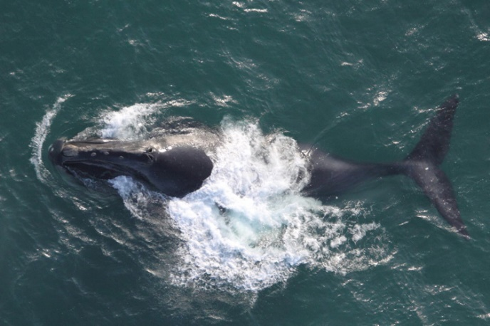
What endangered species are found in Washington?
You can type answers here or on a whiteboard.
Fishers are a state-listed endangered species.
Northern spotted owls are both federally and state-listed.
North Pacific Right Whales are state, federally and internationally listed as endangered.
Department of Fish and Wildlife
Notes:
Ask students why they think an animal may be endangered in Washington, but not nationally/federally.

Slide 5
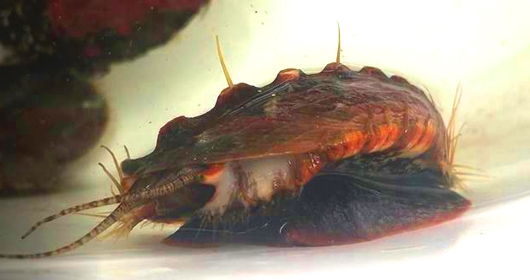
What endangered species are found in Washington?
Washington has 46 listed species including mammals, fish, birds, reptiles, amphibians, and invertebrates.
Let’s meet one species and see what WDFW and partners are doing to help protect it.
Department of Fish and Wildlife
Notes:
After watching the video ask students why populations numbers were so low? Overharvest
What is being done to restore populations?

Slide 6
Why do species become endangered?
You can type answers here or on a whiteboard.
Department of Fish and Wildlife
Notes:
Solicit student ideas. Write them down on this slide or on a whiteboard.

Slide 7
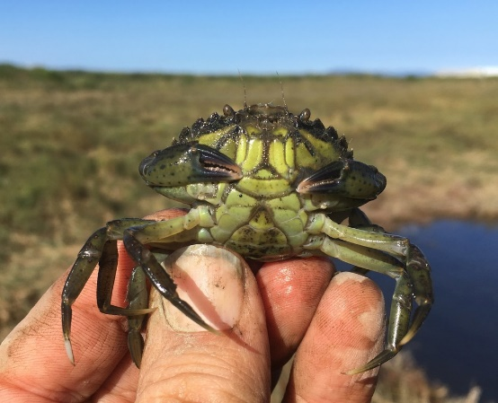
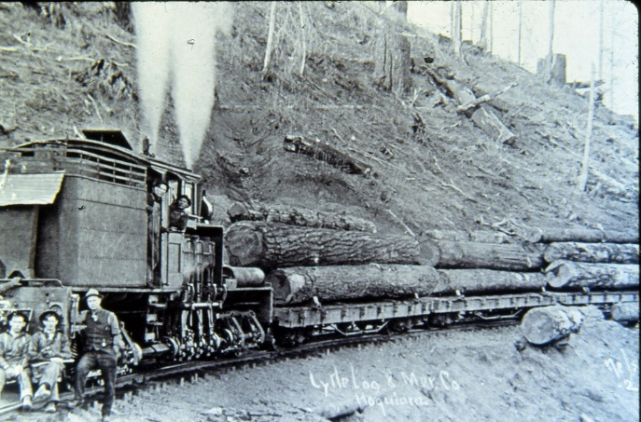
Globally, species have declined 68%*
The threats they face vary:
Invasive Species
Overexploitation
Pollution
Habitat loss
Climate change
*According to World Wildlife Fund’s 2020 State of Wildlife Report
Notes:
Invasive Species: European green crabs prey on important bivalves and other crustaceans.
Overexploitation: This can include over harvesting timber, fisheries, or other natural resources.
Pollution: Can include pollution of air, water, soil, food, etc. In this picture a mallard is covered in oil.
Habitat loss: Due to increasing urbanization of landscapes and conversion of landscapes for agricultural use. This picture shows a fragmented conifer forest in the late 1980s.
Climate change: changing patterns in weather can disrupt thousands of years of evolution.

Slide 8
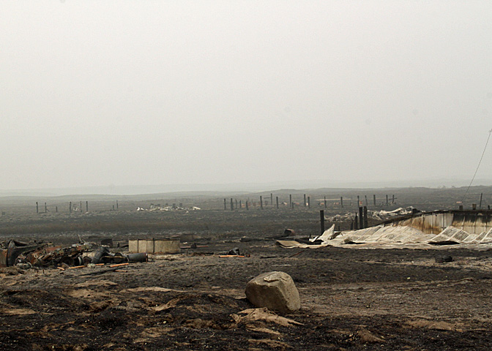
Habitat loss, the driving factor of extinction
Lack of disturbance may also impact ecosystems or species who have evolved to live with disturbance.
For example, many Pacific Northwestern landscapes have evolved to need frequent, small fires. Fire suppression has led to larger, more intense fires than historically occurred.
Notes:
Although all threats play a role in species loss, most of these threats ultimately cause habitat loss which can lead to extinction.
For example, climate change increases fire intensity and frequency, burning through forests and prairie and decimating habitat. Invasive species can take over habitat from native species, and overharvest of natural resources and human development can also reduce habitat for species.
Many of these issues are complex and interconnected.

Slide 9
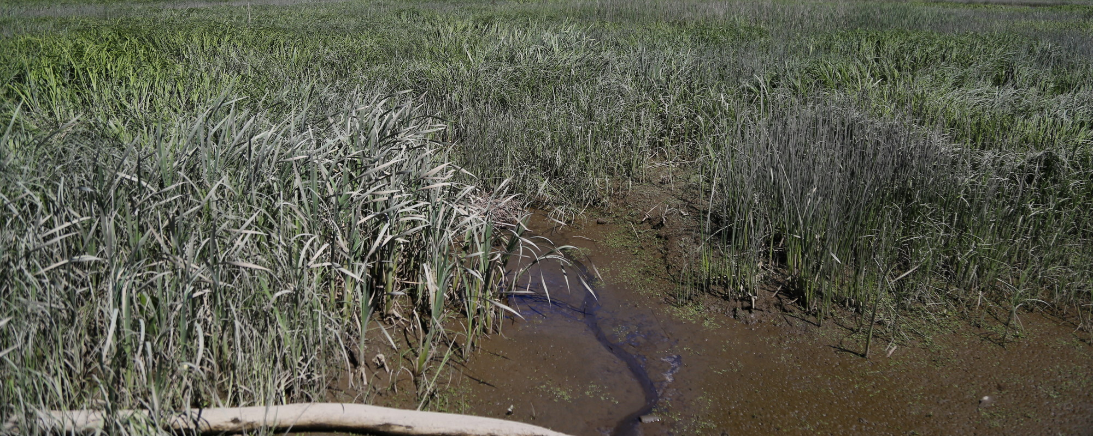
Additionally, loss of habitat may not directly harm species.
For example, disease could be more prevalent due to warming as a result of tree loss or drier wetlands.
Notes:
Loss of habitat may not directly harm species, but the compounding effects may.
Ask students if they can think of another way in which habitat loss indirectly impacts species or ecosystems.

Slide 10
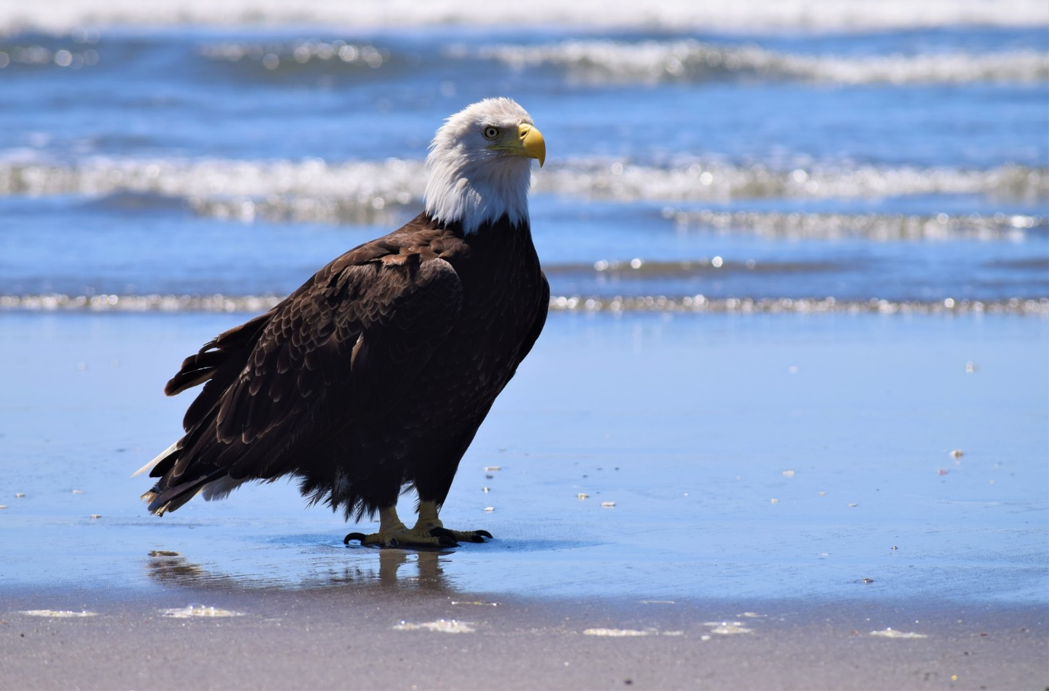
How do we help?
The U.S. Endangered Species Act, establishes protections for endangered and threatened species and identifies critical habitat important to their recovery.
Federal, state, and tribal wildlife managers develop recovery plans for listed species and then work together to prevent extinction.
It’s recovered many species including the bald eagle and Stellar sea lion.
The Oregon spotted frog is both a federally and state protected species. WDFW and U.S. Fish and Wildlife work with landowners to help protect critical habitat for the species. Let’s see how.

Slide 11
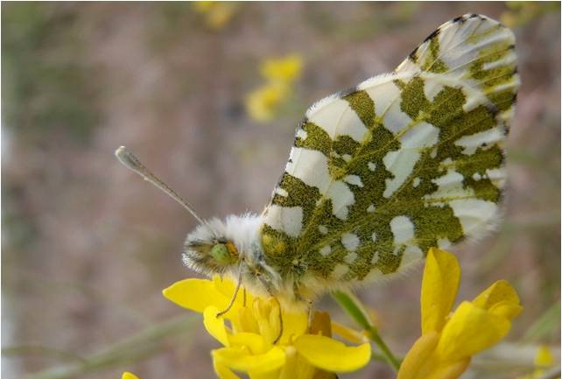
Case Study
Some species like the Island Marble Butterfly, are endemic to Washington. This means they are found no where else in the world. Let’s find out their story.
Department of Fish and Wildlife
Notes:
After watching the video ask students what threatened the Island Marble Butterfly?
- Loss of habitat due to floods, which have become more common as we see more effects of anthropogenic (human caused) climate change.

Slide 12
Why are some species more vulnerable to extinction than others?
Small population size: Species with a small population have less individuals to recover if the population experiences disturbance. These populations don’t start off small but were already declining.
Specialist species: Species who specialize in one type of environment or only eat specific types of food are more likely to be vulnerable to extinction.
Department of Fish and Wildlife
Notes:
Specialist species-Northern spotted owls prefer only old growth forest and specific types of voles, making them a habitat and food specialist.
Tufted puffins in Washington have a small population.

Slide 13
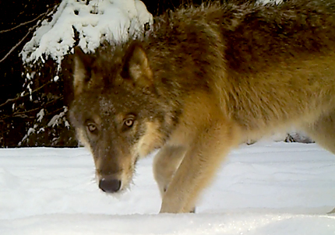
Why are some species more vulnerable to extinction than others?
Territory size: animals with larger territories are can be more disturbed by habitat loss.
Body size: larger animals typically need more space and calories to survive and have a slower reproductive rate.
Department of Fish and Wildlife
Notes:
Grizzly bear- needs large spaces to roam and lots of calories to live.
Gray wolf- wolf packs require large territories.
Ask students to think of other reasons one species might be more vulnerable than another?

Slide 14
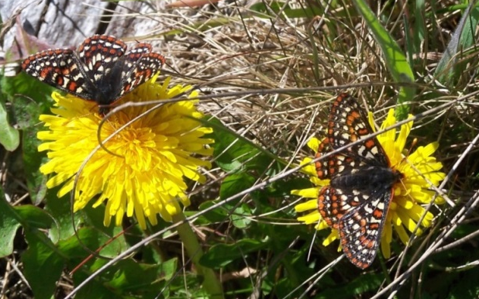
Why do we care?
The more species, the more biodiversity. Biodiversity contributes to important ecosystem services like clean air, clean water, medicine, food, etc.
Biodiversity is an interconnected web.
Loss of ecosystem resilience.
Weaker food webs and less ecosystem services.
Department of Fish and Wildlife
Notes:
Have students define biodiversity.
Losing one or two species may not harm these webs, but losing multiple species over a short period of time leads to a loss of ecosystem resilience, weakening food webs and impacting ecosystem services we benefit from.

Slide 15
Why do we care?
Think of it like a sports team. If you have multiple players who play the same position and one gets injured, it’s okay because your team has a backup.
But if all the players who play that position are injured, your team is now weakened and won’t play well.
Department of Fish and Wildlife
"Women's Soccer Team Practice" by SupportPDX is licensed under CC BY 2.0

Slide 16
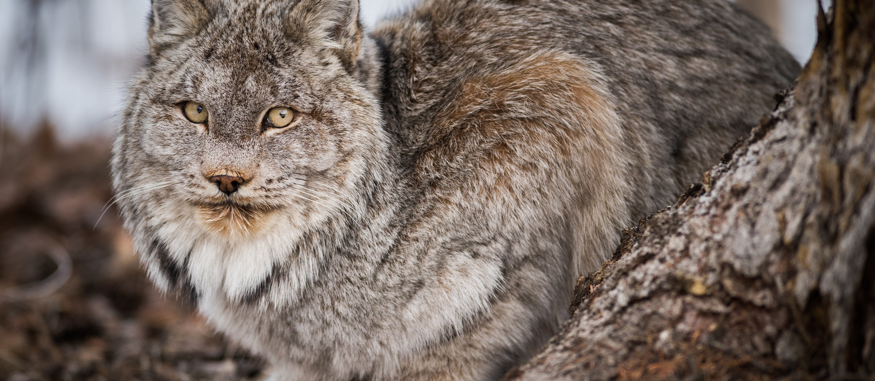
When we lose species, we also lose knowledge that we could gain by learning more about them.
We can’t find a new medicine or ways of interacting with the world if a species goes extinct.
Department of Fish and Wildlife

