Slide 1
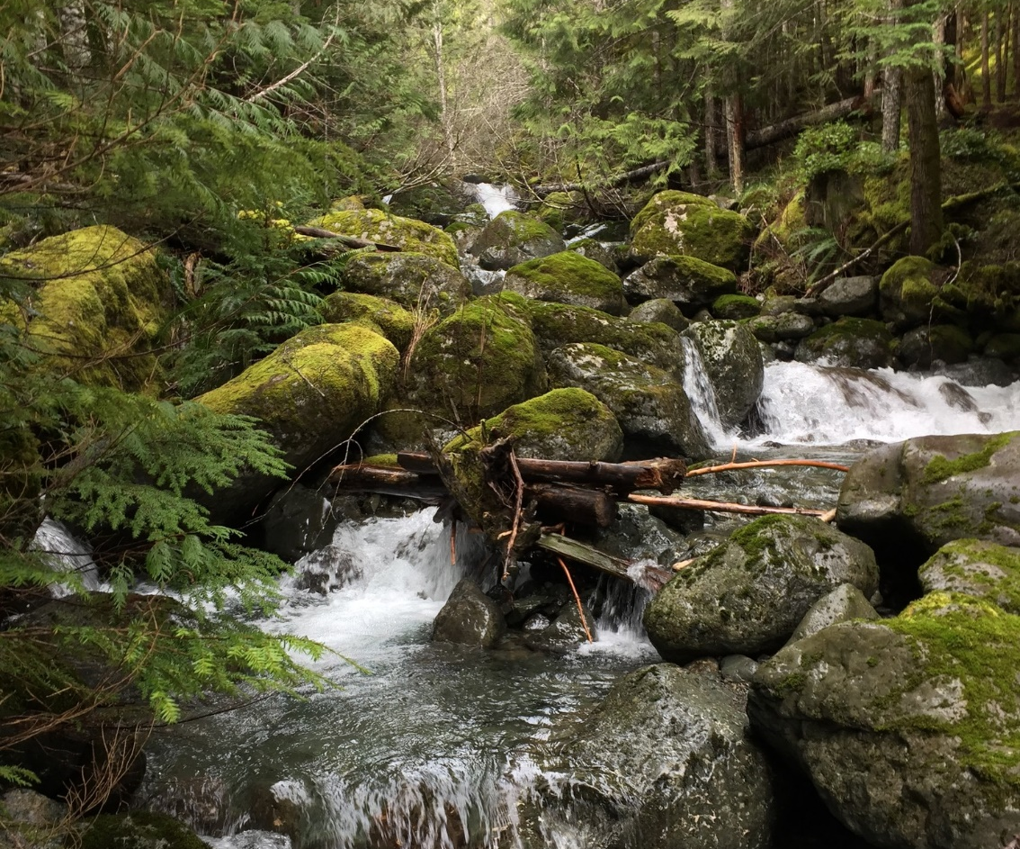
Temperate Rainforests of Washington

Slide 2
What comes to mind when you think of a rainforest?
What animals?
What plants?
What weather?
Notes:
Ask each category of what comes to mind when students think of the word rainforest.

Slide 3
What is a temperate rainforest?
An area with a temperate climate means it has mild temperatures (no extreme heat or cold).
Rainforests are an area of tall, mostly evergreen trees with large amounts of precipitation.
Using these definitions, what do you think a temperate rainforest looks like?
Notes:
Define temperate and then rainforest.
Have students think-pair-share and describe what a temperate rainforest looks like. Have them describe the trees, plants, animals, etc.

Slide 4
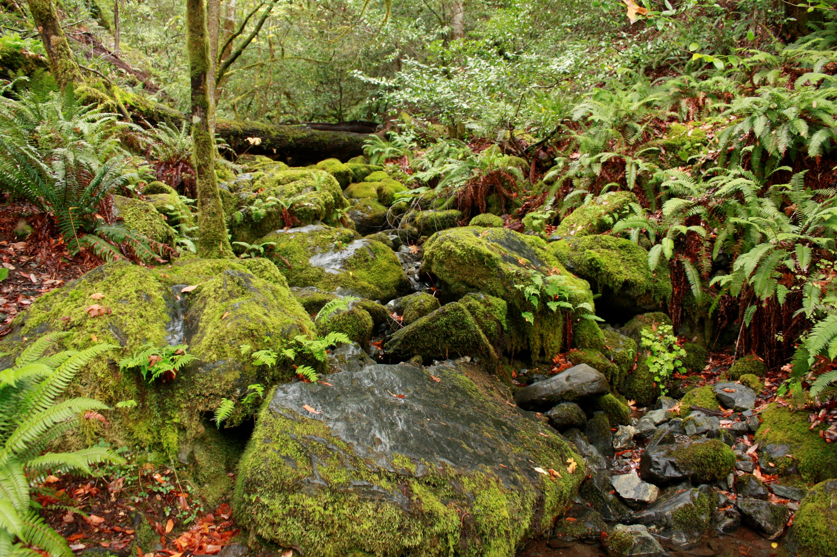
Did you think of this?
evergreen trees
lichen
shrubs
dead logs
ferns
mushrooms
moss
creek

Slide 5
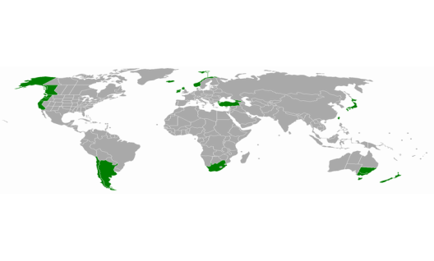
Where are Temperate Rainforests?
Temperate rainforests are on 6 out of the 7 continents!
Of the world's temperate rainforests, let's look at the one in our neck of the woods!
Map Credit: Maphobbyist / Wikimedia*

Slide 6
This map shows the Pacific Temperate Rainforest
It’s also the largest temperate rainforest in the world!
Let’s take an even closer look at the temperate rainforests of Washington State.
Map Credit: Analisa Fenix @ Ecotrust

Slide 7
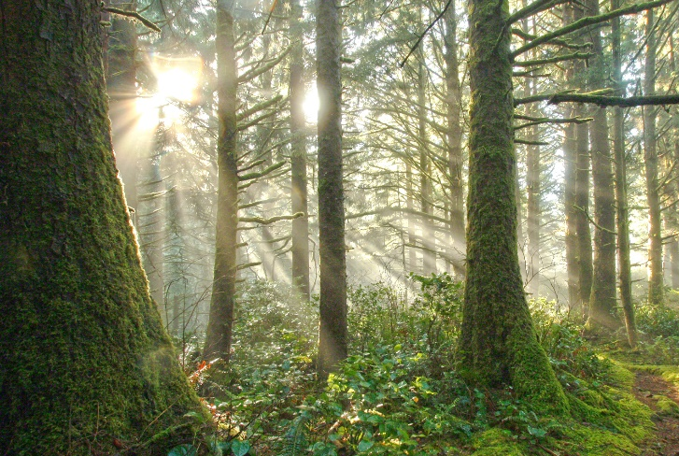
Here are some of the temperate rainforests of Washington!
Moran State Park, San Juan Islands
Larrabee State Park,
Bellingham
Hoh Rainforest, Olympic National Park
Notes:
.

Slide 8
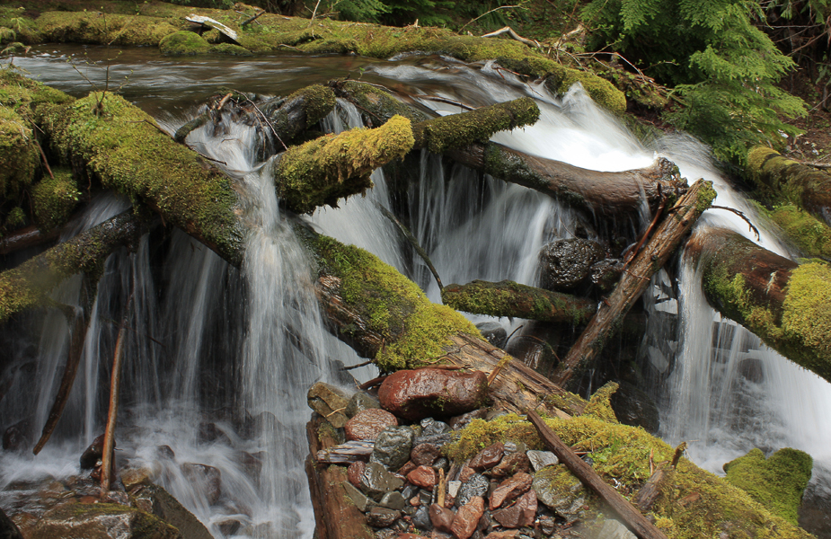
Ingredients for a temperate rainforest: 1. 2. 3. 4. 5. 6.
What are the key characteristics of temperate rainforest?
Rain
Moderate temperatures
Evergreen trees
Epiphytes
Nurse logs
Decomposers
Notes:
Have students guess some of the characteristics.

Slide 9
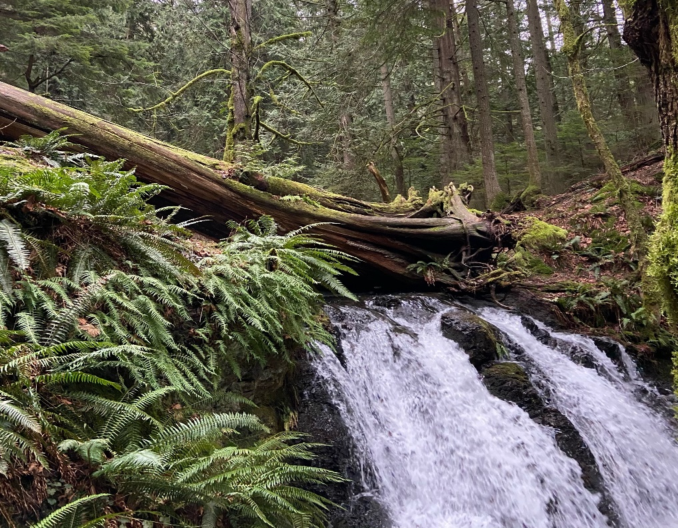
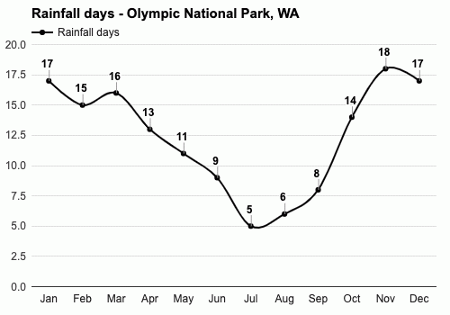
Rainfall
The amount of rain a forest receives is the difference between a temperate forest and a temperate rainforest.
Which months do you think receive the most rainfall?
Which months receive the least?
Graph from: Weather Atlas
Notes:
Allow for students to answer questions with graph.

Slide 10
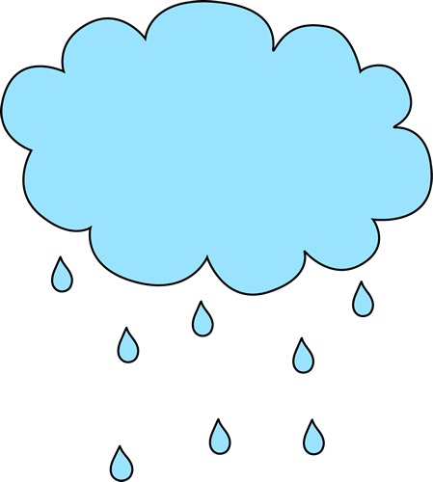
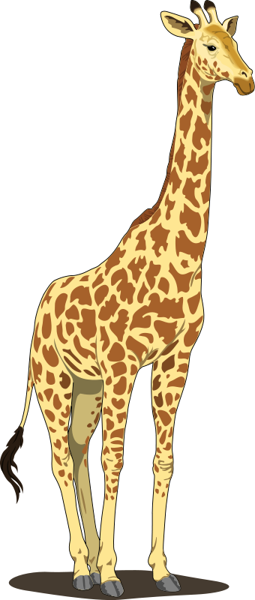
How much rainfall do temperate rainforests receive?
Temperate rainforests receive anywhere from 55 to 200 inches of rain every year. That’s over 16 feet of rain!
Let’s look at how tall 16 feet of rain really is. For example, a full-grown giraffe is 16 feet!
If the person on the graph is 4 feet tall, how many people do we need to stack to add up to 16 feet?

Slide 11
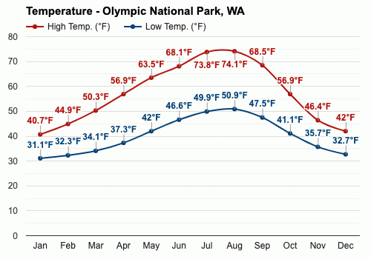
Moderate temperatures
The moderate temperatures of this habitat rarely dip below freezing at 32°F or above 80°F.
How hot does it get where you live? How cold does it get?
How does the climate where you live compare to the temperate rainforest climate?
Graph Credit: Weather Atlas

Slide 12
Evergreen trees
Evergreen trees keep their leaves, also known as needles, year-round and are always green!
Some of the most common evergreen trees in the temperate rainforests of Washington include:
Sitka spruce
Douglas fir
Western red cedar
Western hemlock
Photo Credit: Keele University
Photo Credit: Canada Plants

Slide 13
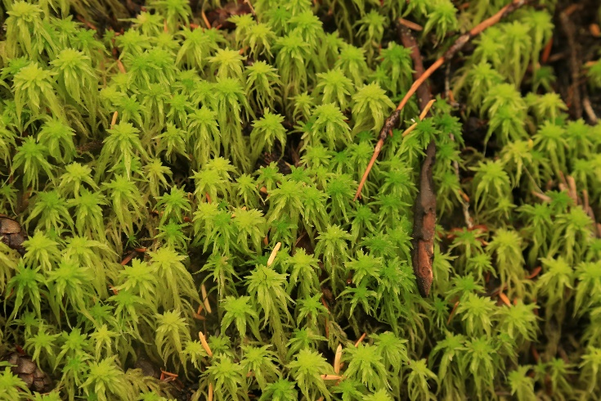
Epiphytes
Epiphytes are plants that grow on other plants without hurting them, such as moss on a tree branch.
Devil’s matchstick lichen
Small red peat moss
Lungwort lichen
Licorice fern

Slide 14
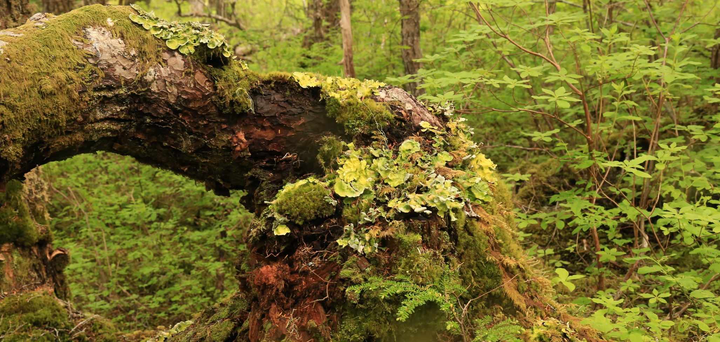
Nurse logs
Nurse logs are fallen trees that provide a nursery for seedlings, another name for young plants, as the tree decomposes.
This helpful video will explain more!
Notes:
Play the linked video to further explain what a nurse log is and how it supports the temperate rainforest.

Slide 15
Decomposers
Temperate rainforests rely on these organisms to break down natural materials such as fallen trees, dead plants, and other products of the forest.
Decomposers can be fungus, bacteria, insects, slugs.
Banana slugs!
In Washington’s temperate rainforests, one decomposer is very important… can you guess who?
Hint: who’s in this photo?
Photo by Matt Gunter

Slide 16
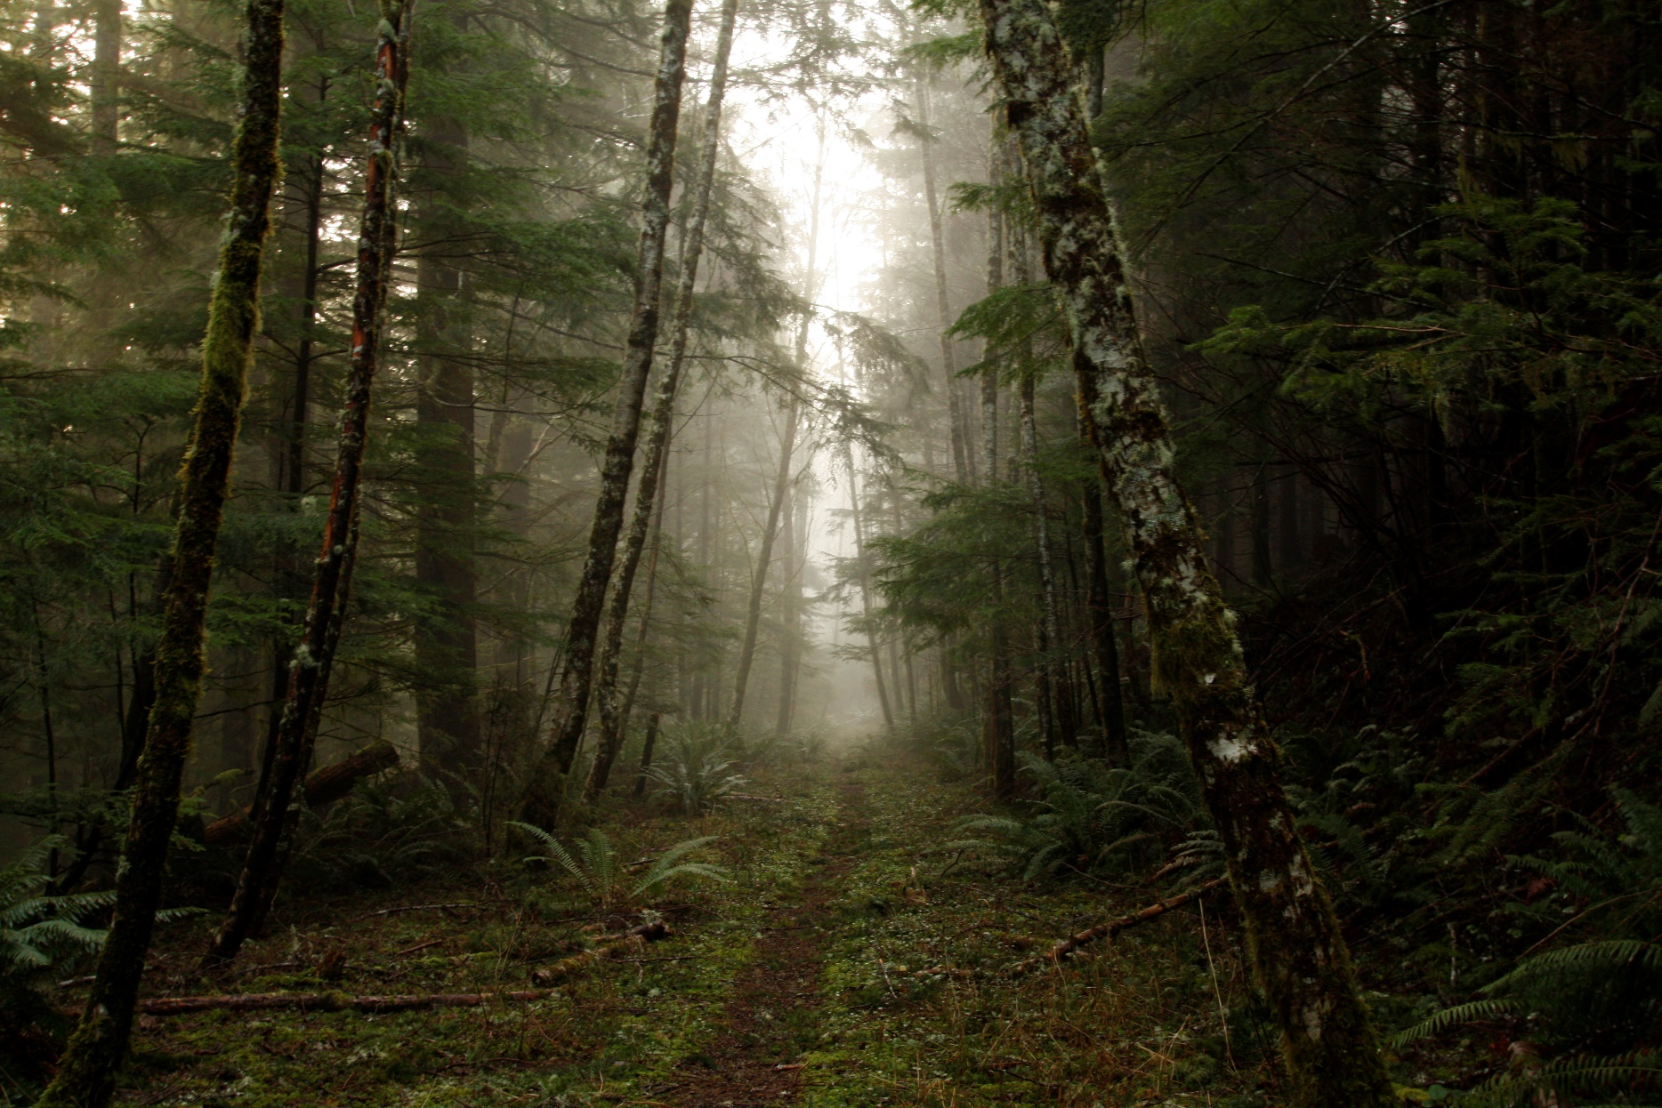
Layers of the Temperate Rainforest
Notes:
Forests have three layers, the canopy, the understory and the forest floor.

Slide 17
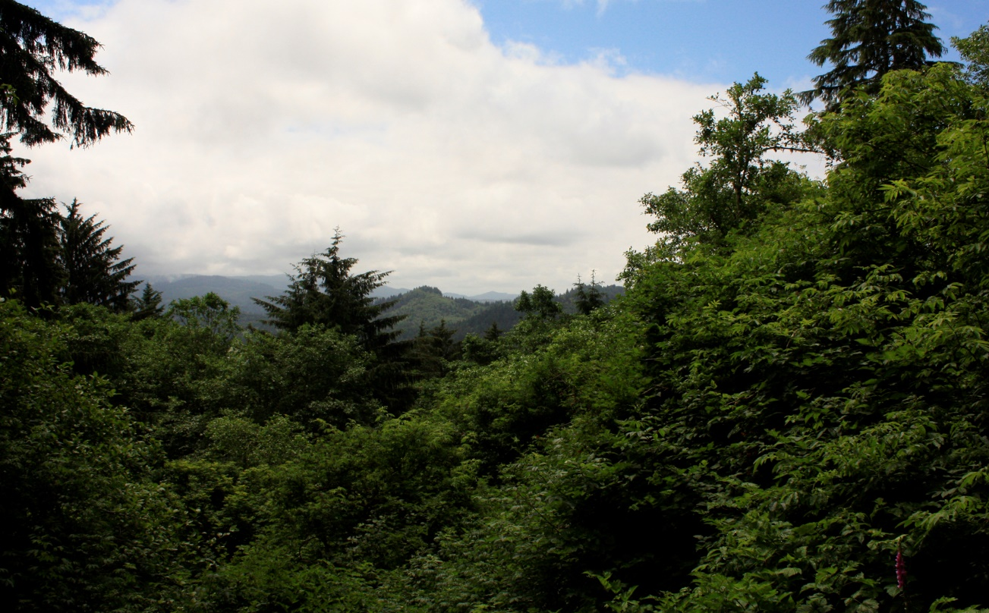
1. Canopy
The canopy is the top layer.
It is dominated by trees competing for sunlight.
Many birds, like the bald eagle, utilize this layer.
This image shows some of the tree species and how tall they can get!
Why would a tree want to be the tallest?
Notes:
Have students guess why a tree would want to be the tallest.

Slide 18
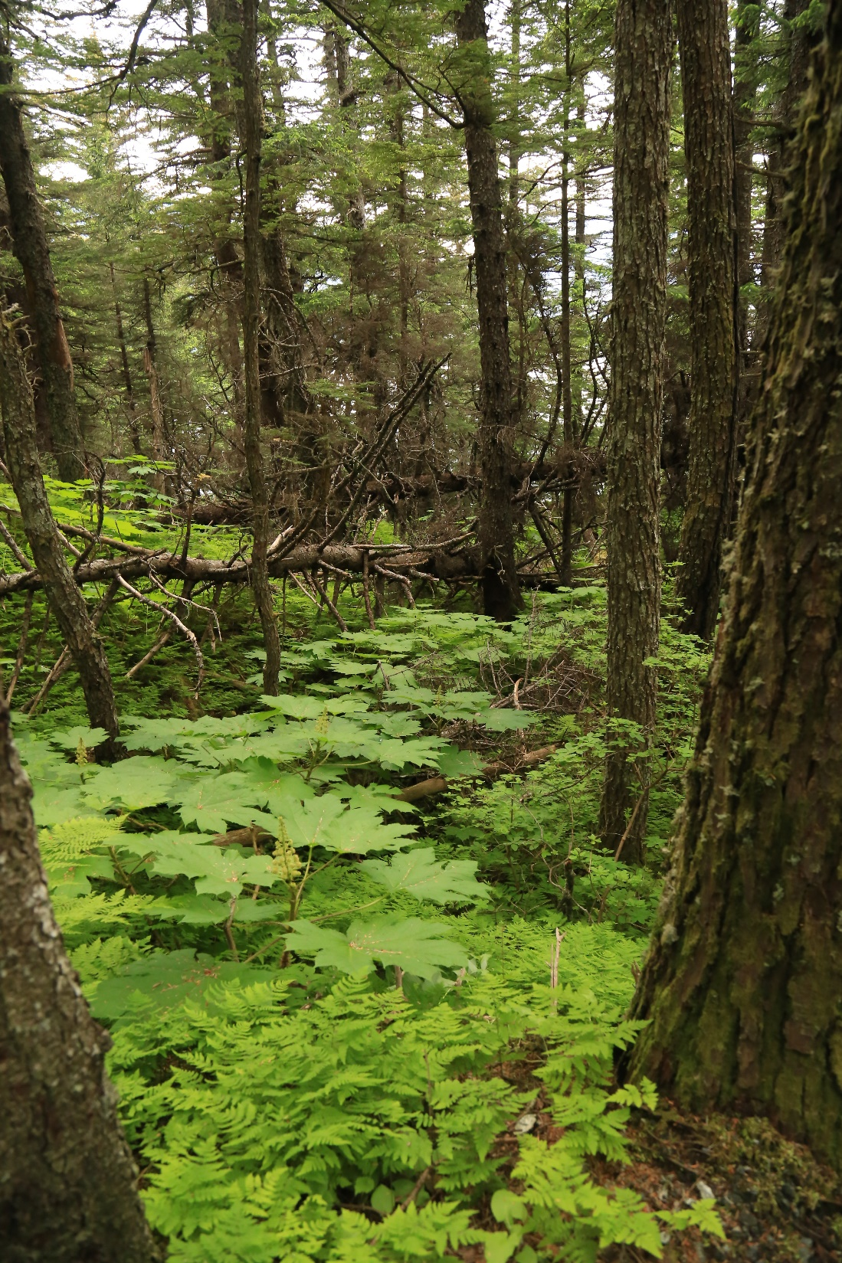
2. Understory
The understory is the middle layer.
The understory is home to many shrubs, vines, mosses, and smaller trees.
Birds, mammals, and insects can be found here.

Slide 19
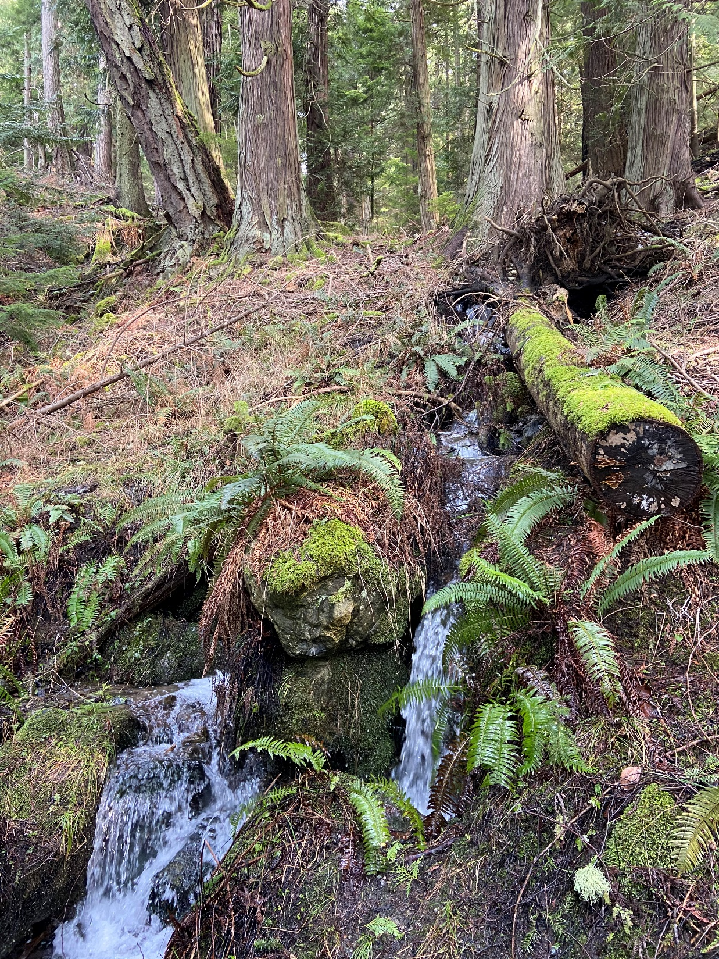
3. Forest floor
The forest floor is the bottom layer.
The floor is covered in lichens, mosses, and small plants.
Many decomposers live in this layer.
Do you remember which decomposer lives here?
Notes:
See if students can recall the banana slug before playing the animation.

Slide 20
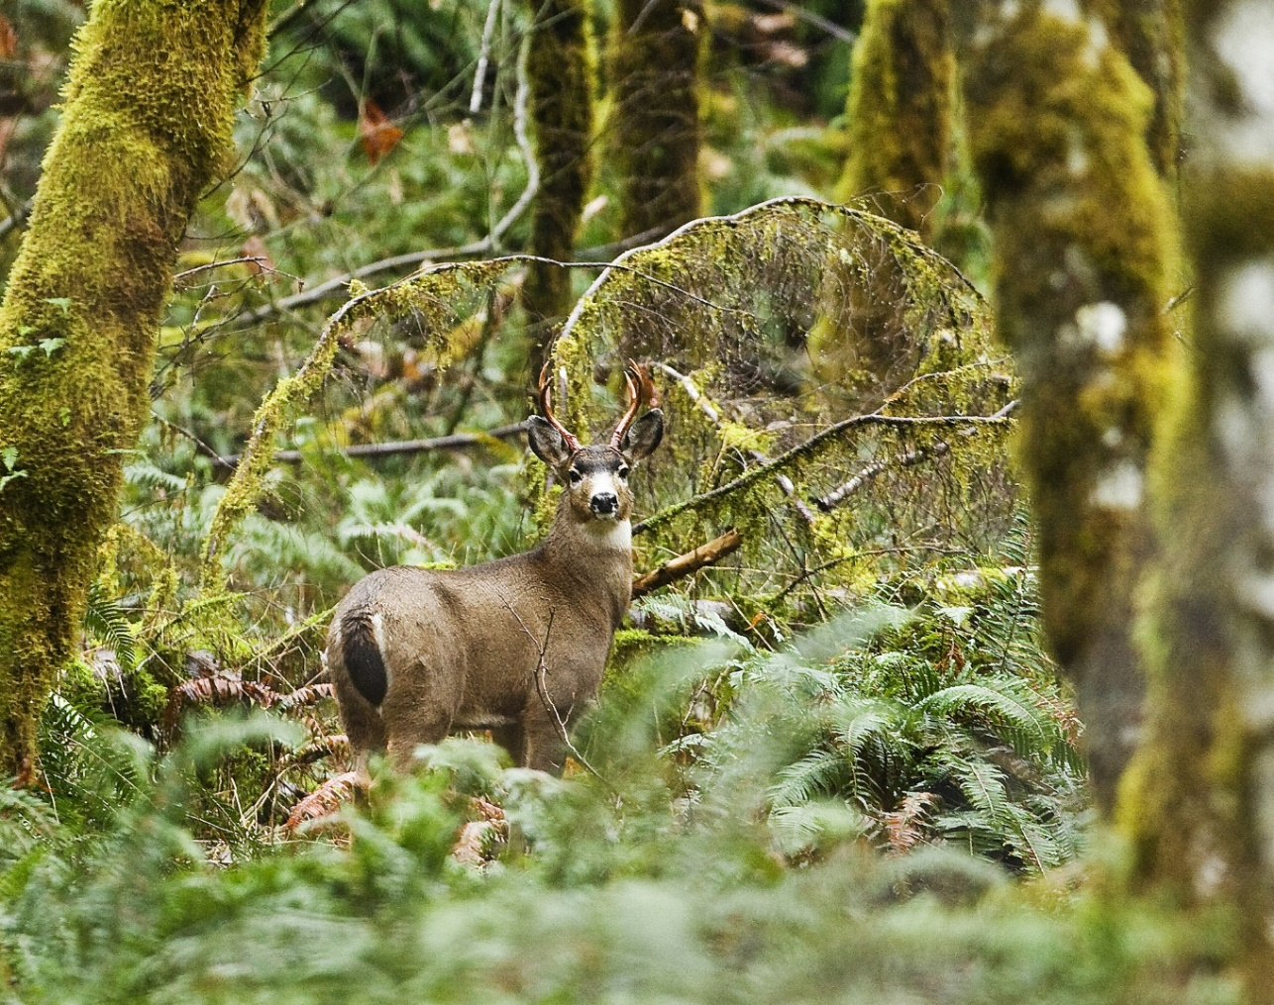
Now that you know this habitat, what do you think plants and animals who live here need to survive?
Notes:
Have students think-pair-share.

