Slide 1
Healthy Forests

Slide 2
What makes a forest healthy? Do healthy forests matter? Why or why not?
Notes:
Have students think-pair-share with a partner. You can write answers down on a empty slide, use a whiteboard or virtual whiteboard.

Slide 3
Write answers from previous slide here.
Notes:
Delete this slide if using a whiteboard or virtual whiteboard.

Slide 4
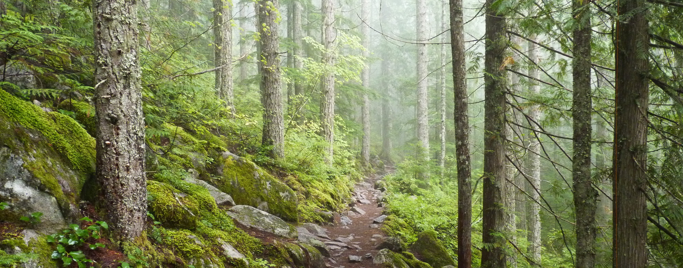
According to the U.S. Forest Service,
“Forest health has been defined by the production of forest conditions which directly satisfy human needs and by resilience, recurrence, persistence, and biophysical processes which lead to sustainable ecological conditions.”
But what does this mean?
Healthy forests are ones that deliver ecosystem services such as:
Clean air,
Water cycling,
Nutrient cycling,
Timber for harvest,
Biodiversity,
Habitat for wildlife,
and more.
Notes:
Give students a minute to discuss as a class what their interpretation of the definition means. Afterward you can click through the definition.

Slide 5
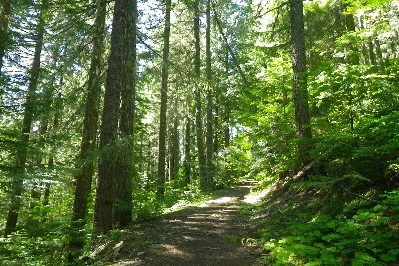
What’s a healthy forest look like?
Healthy forests are resilient, persistent, and recurring.
Notes:
Healthy forests are those which provide these services while staying resilient, persistent, and recurring throughout their historical range.

Slide 6
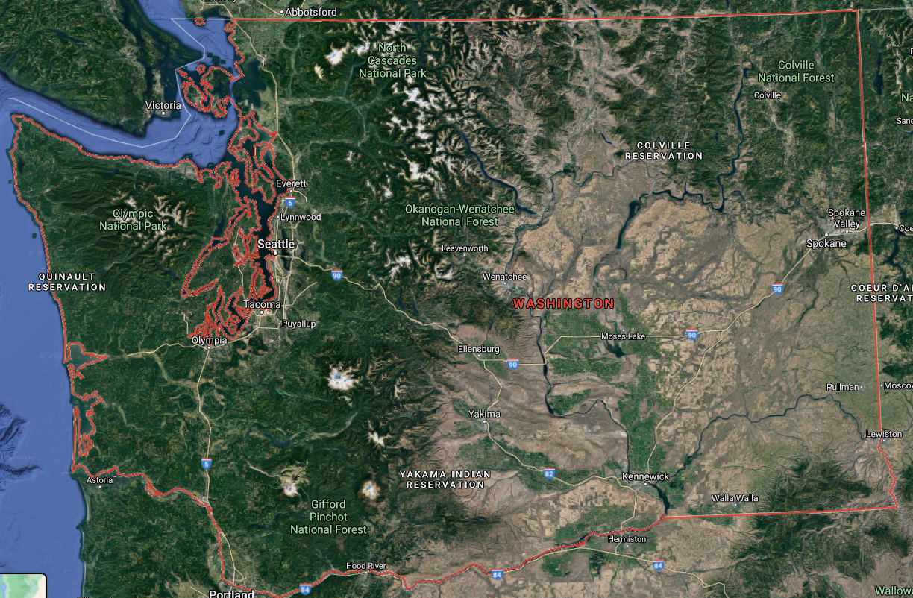
Washington Forests
Eastside: Dry ponderosa pine forests
Westside: Temperate rainforests
Notes:
Washington has two very different forest types.
The Westside of Washington is characterized by wet, cool climates and adapted species. (Douglas Fir, Western hemlock, Western red cedar)
The Eastside has warmer, drier climates and species (Ponderosa Pine)
Because these forests have evolved to such different climates, they have different definitions of healthy and slightly different threats and methods of restoration.

Slide 7
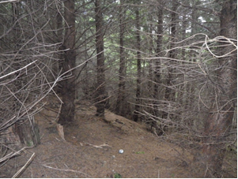
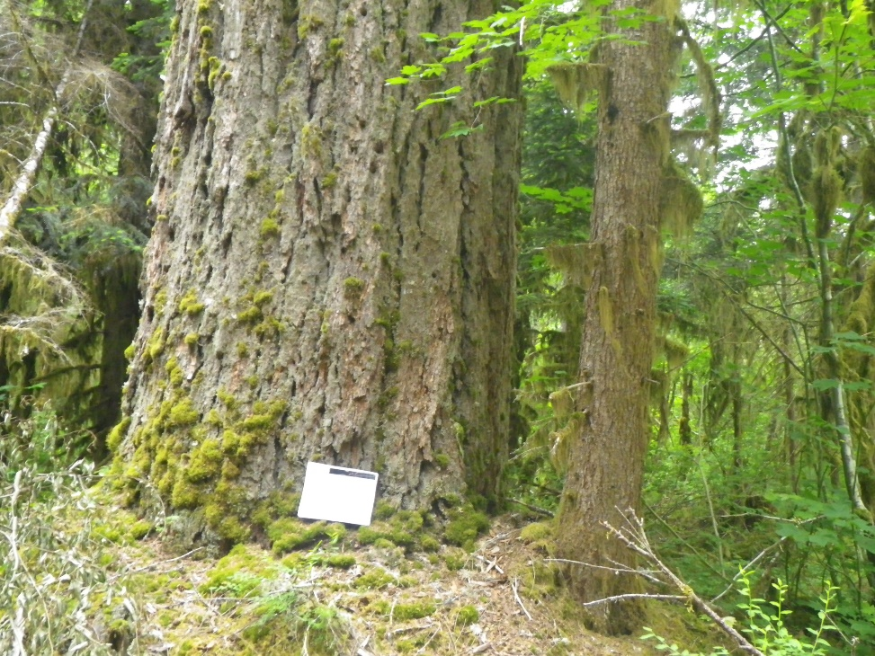
Westside Forests
Notes:
First photo: Many Westside (wet) forests have been converted into Douglas Fir tree plantations to be used for timber harvest, Unfortunately, the lack of diversity and overcrowded conditions risk disease, pests, and lack of habitat for other plants and wildlife species.
Second photo: A healthy, and diverse temperate rainforest ecosystem.
Ask students to note three differences between the photos.

Slide 8
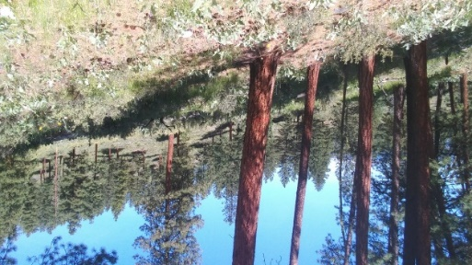
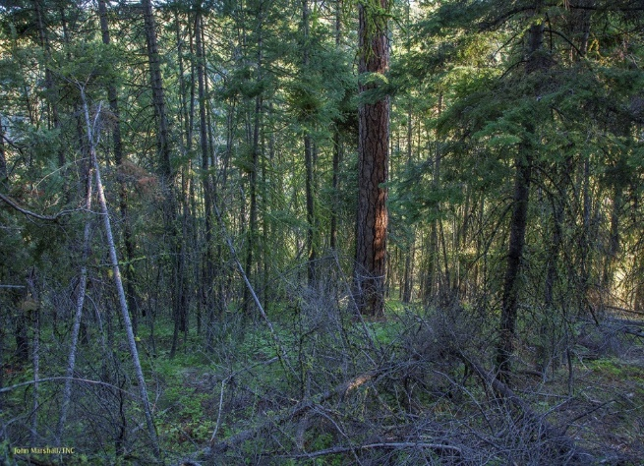
Eastside Forests
Notes:
The first picture shows an “unhealthy” stand of dry Eastside ponderosa pine forest.
Issues of overcrowding occur due to a century of fire suppression. Overcrowded stands cause pests, disease, and fire to spread more rapidly than thinned out stands. Thus, overcrowding can put the whole stand at risk.
Second photo is a “healthy” forest.
Ask students to note three differences between the photos.

Slide 9
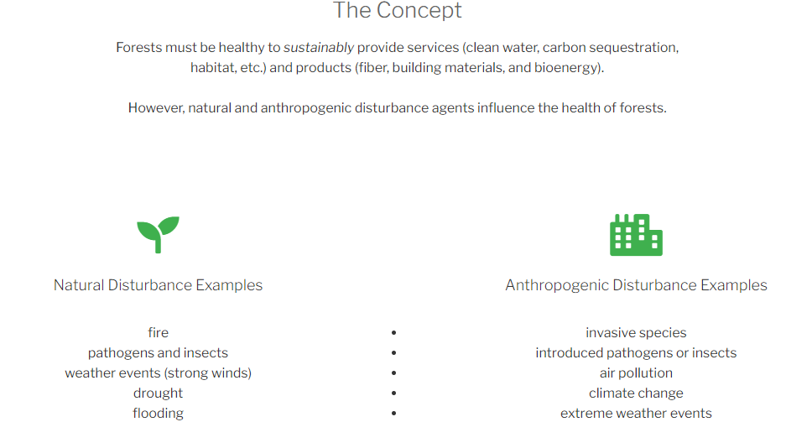
What factors influence the health of a forest?
Graphic from: https://foresthealth.org
Notes:
All landscapes and ecosystems are subject to disturbance

Slide 10
Disturbance
Disturbance is not always bad.
Anthropogenic disturbance is cause for concern.
Notes:
In fact, many of our species have evolved in response to disturbance, building resilience against it. Poor forest management techniques (such as fire suppression) over the last century is a large reason for major wildfires.
Because climate change, invasive species, introduced diseases, and extreme weather events are occurring at such a (geologically) quick rate, species do not have time to evolve resilience to these types of disturbances.

Slide 11
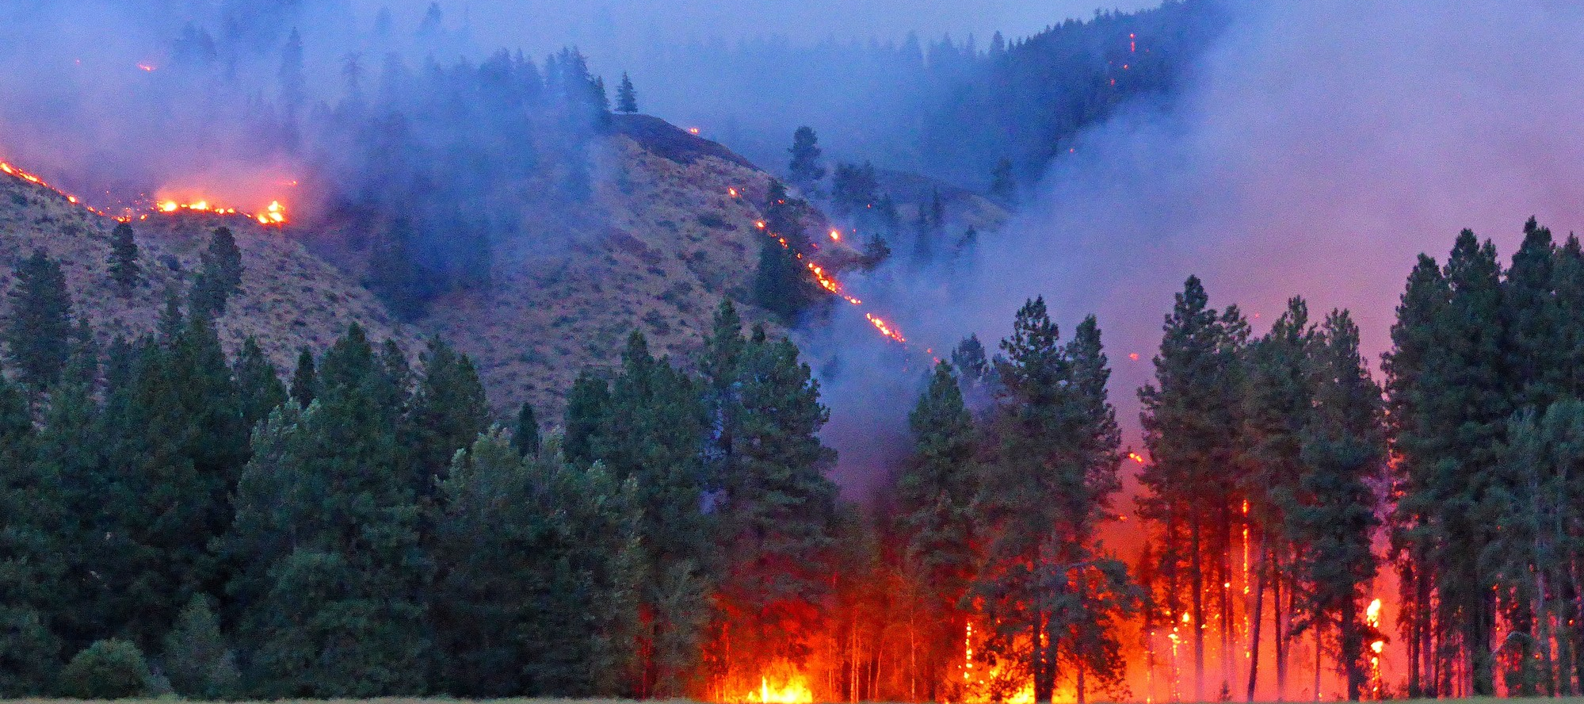
Lack of Disturbance
Disturbance is not always bad.
Since the early 1900s we’ve suppressed a natural disturbance in our forests.
Notes:
Text to go with the photo (third click): Fire suppression (lack of disturbance), compounded with anthropogenic climate change has led to more frequent, and severe wildfires than historically occurred.

Slide 12
Adding back disturbance
Indigenous peoples burned landscapes for thousands of years.
Meadows and prairies.
Conifer encroachment and undergrowth build up.
Notes:
It’s important to note that Indigenous peoples of Washington, and across the West had been burning landscapes for thousands of years before European settlement.
This created meadows and prairies and different kinds of habitat for wildlife.
Without fires weeding out undergrowth and smaller trees, conifers grow too thick or encroach on meadowed areas.

Slide 13
What features make a forest healthy?
Let’s find out.
Notes:
The link will take you to a 5:30 video. Have students take notes. After the video ask (alternatively, you could hand out these questions beforehand):
Why do you think an overcrowded stand in the forest is more susceptible to insect damage and disease?
What three factors are important in creating healthy forests (individuals, clumps and openings).
Hypothesize what do you think would happen to the forests if fires, thinning and the ICO management system was not introduced to this forest?

Slide 14
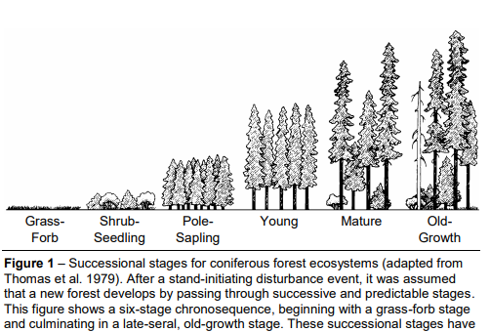
Forest succession
Illustration from https://www.fs.usda.gov/
Notes:
Just as animals have lifecycles, so do forests. This can be called forest succession. Forests begin in the grass/forb (think wildflowers) phase and then may steadily grow trees if conditions allow. Forests have evolved with disturbance as a natural part of their lifecycles. However due to mismanagement of forests, we now have to manage forests so they cycle through these phases.

Slide 15
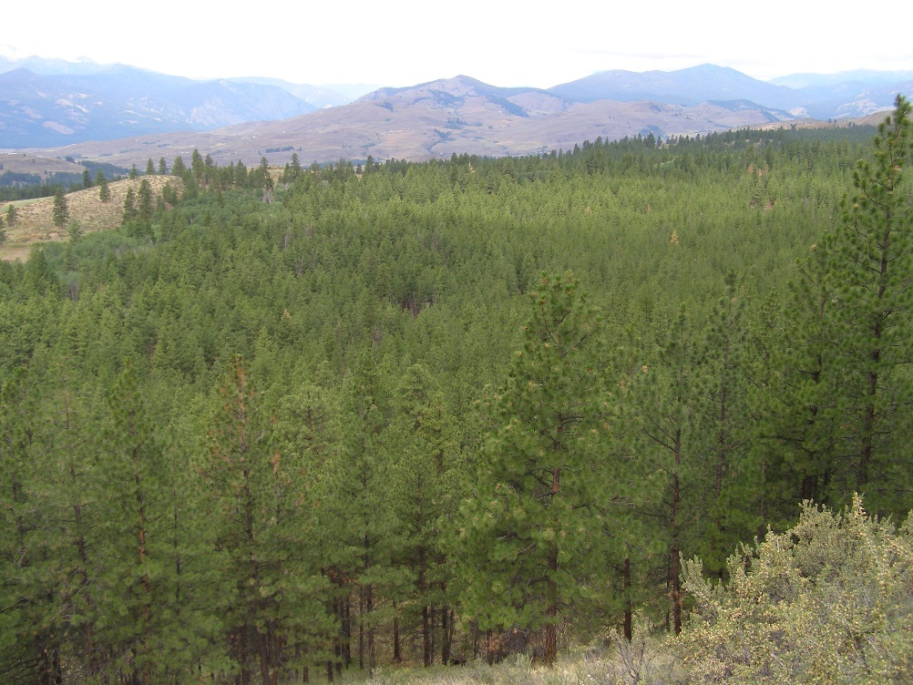
Only 5% of a ponderosa pine forest should include dense stands like these. (Currently at 35%).
Notes:
What might be some effects of having 30% more densely populated stands?

Slide 16
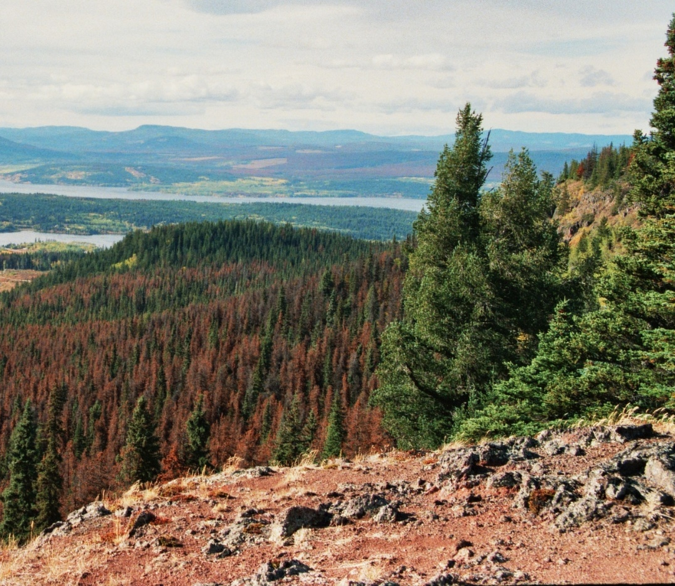
Impacts on forest health
Larger, hotter, and more severe wildfires.
Larger, and more intense pest outbreaks.
Larger, and more intense pathogen outbreaks.
Notes:
These dense stands have been aggregating fuels over the last century and thus become more susceptible to the rapid spread of disturbance.

Slide 17
What should a healthy forest look like?
A healthy forest has a specific ratio of the different forest stages
(early, mid-open, mid-closed, late-open, late-closed)
Currently, this ratio is different from the desired ratio.
Notes:
Ask students what they notice about the differences in the two graphs.

Slide 18
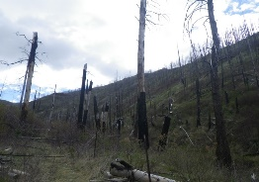
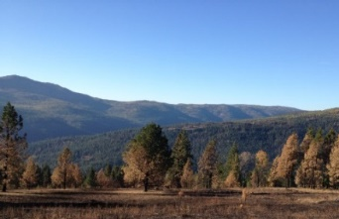
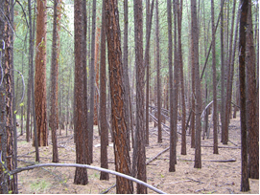
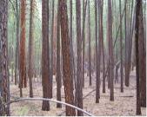
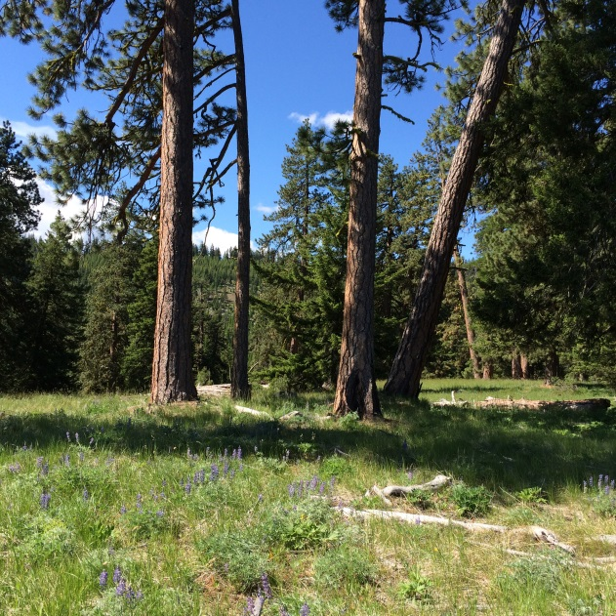
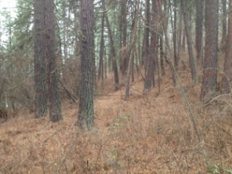
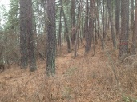
What these stages look like in dry ponderosa pine forests
Current Stage Ratio
Desired Stage Ratio
Early 15%
10%
Mid-open 19%
25-35%
Mid-closed 35%
5%
40-45%
Late-open 16%
Late -closed 35%
5%
Notes:
The balance of stages has been thrown off and we currently have more densely populated stands than desired. A higher percentage of dense stands in the forest make it easy for disturbance to wipe out an entire stand, spread to multiple stands.

Slide 19
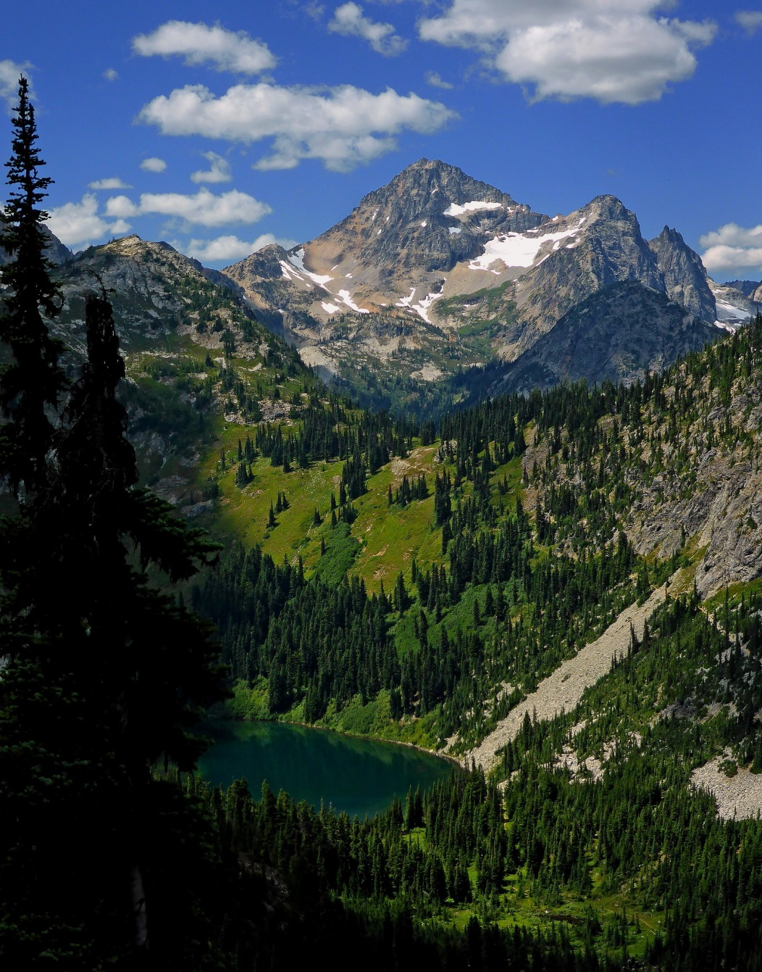
A mosaic of patches, clumps and gaps for wildlife diversity
Notes:
Forest health is all about balance. Historically, Northwestern forests were a mosaic of dense stands mixed with open stands and meadows.
This creates a diversity of habitats and species. It also creates fuel breaks, or areas where fire, disease, and pests cannot spread as well because the “fuel” is physically distanced.

Slide 20
Do you think these various stages of forest are important for wildlife?
Why or why not?
Notes:
Give students one minute to look at this photo and see if they can identify the different stages of forest. Afterward have them guess and then click through the different stages,
Grassy meadows
Dense forest
Patchy “closed” forest
Patchy “open” forest
Alpine (treeless)
Afterward, ask students to think-pair-share about why the different forest stages may be important for wildlife.

Slide 21
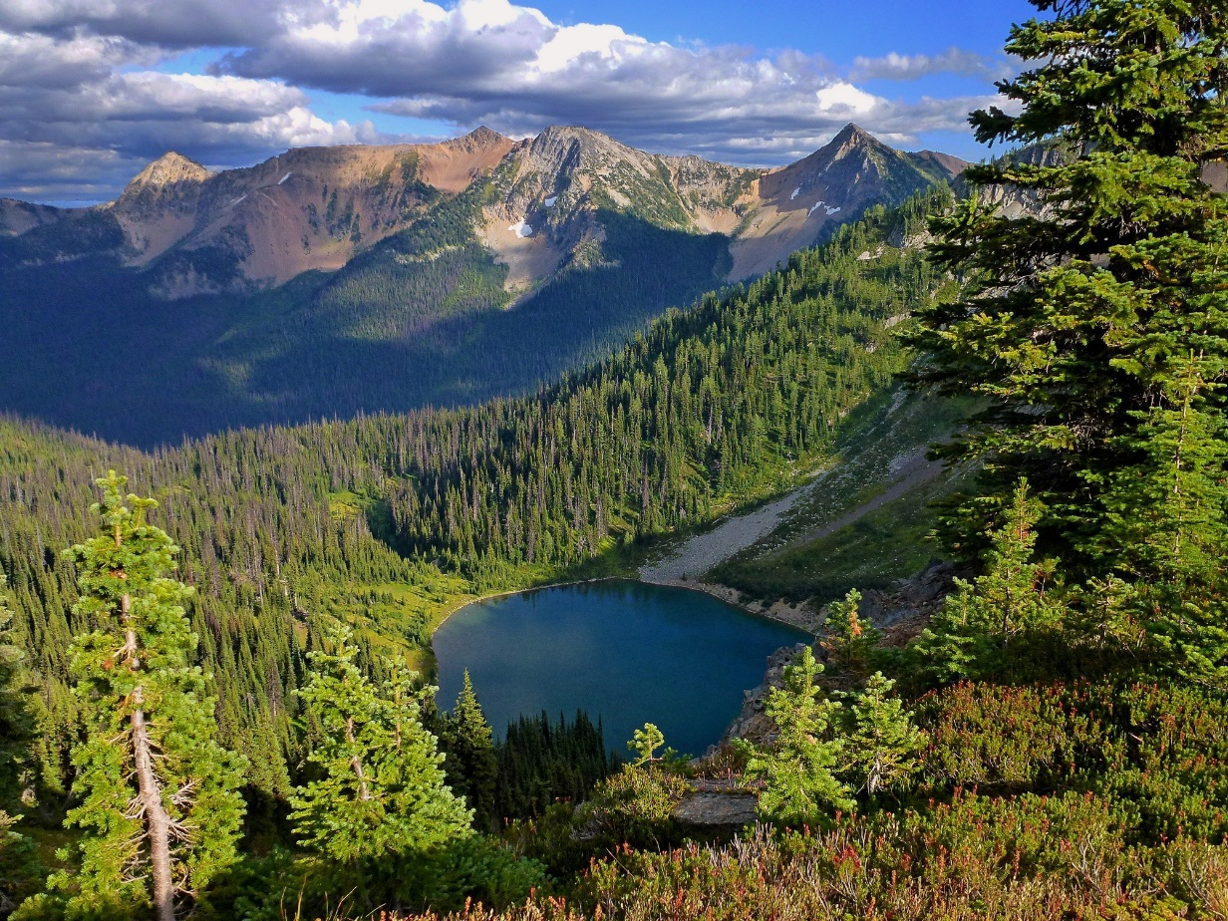
Managing for wildlife
Different animals require different forest structures.
Dead wood like logs, snags, and piles can provide a needed home or resting space for many species.
Let’s see
Notes:
Maintaining habitat for wildlife is an important part of forest restoration and health.
The link will take you to a six-minute video where a Washington DNR wildlife forester talks about important forest structures.

Slide 22
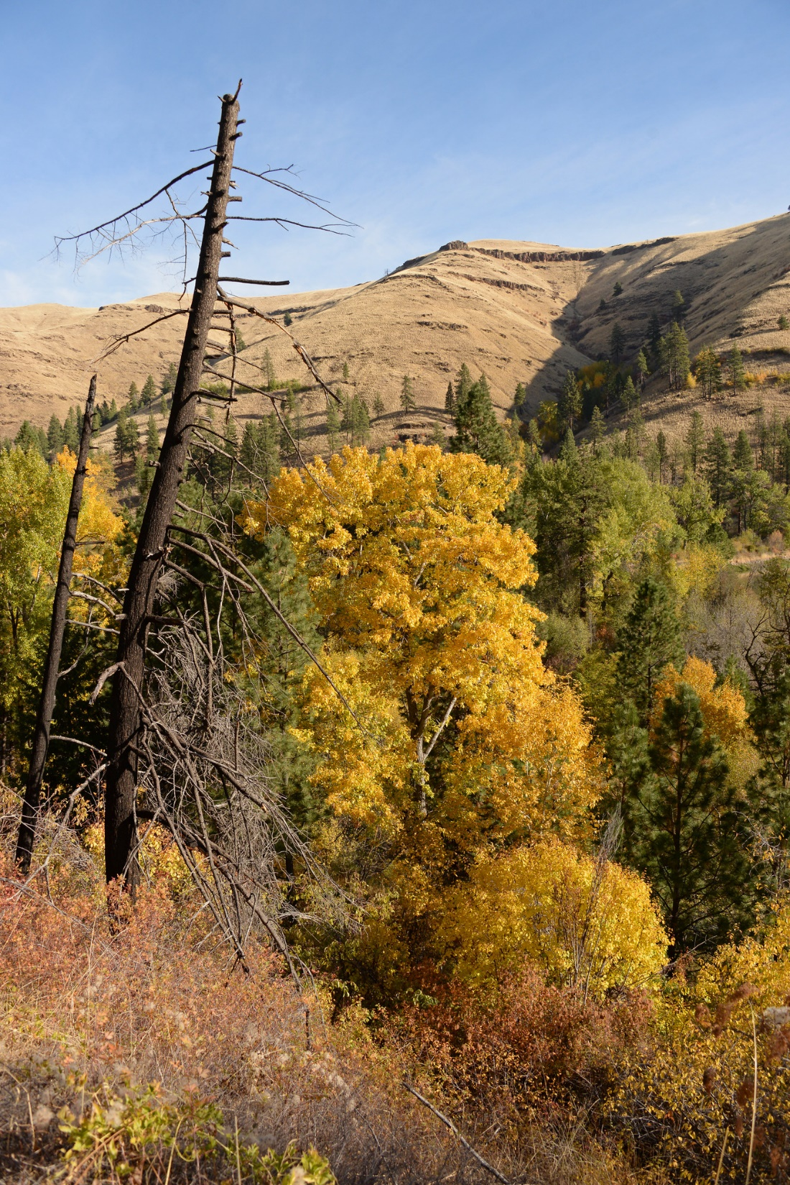
Dead Wood and Snags
Standing dead or dying trees are called snags.
More than 100 species of birds, mammals, reptiles and amphibians use snags.
Snags enhance natural areas by attracting wildlife species that may not otherwise be there.
Notes:
Snags are used for nesting, roosting, shelter, denning and feeding. Over 45 species in Washington forage for food in them!

Slide 23
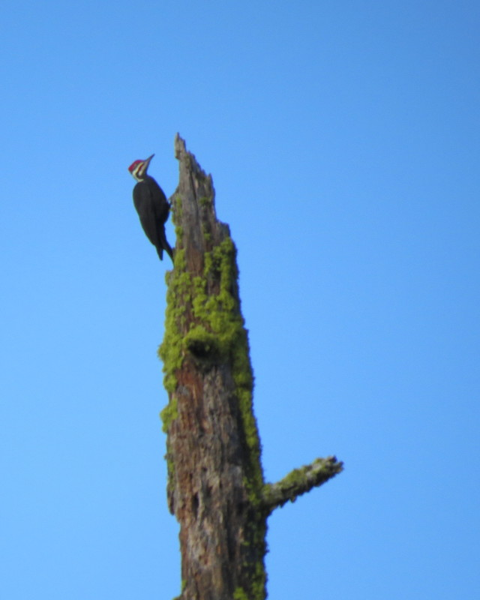
Dead Wood and Snags
How to identify snags
Notes:
This will take you to a 6:30 video that teaches students how to find snags, what role snags play in ecosystems and what species utilize snags.

Slide 24
Restoring forests for wildlife
Forests that look like this are beneficial to some species.
However a forest with mostly dense stands reduces biodiversity at an ecosystem level.
Forests with individuals, clumps, openings and other diverse features allow for more species.

Slide 25
Only 5% of a ponderosa pine forest should include dense stands like these. (Currently at 35%).
Notes:
What might be some effects of having 30% more densely populated stands?

Slide 26
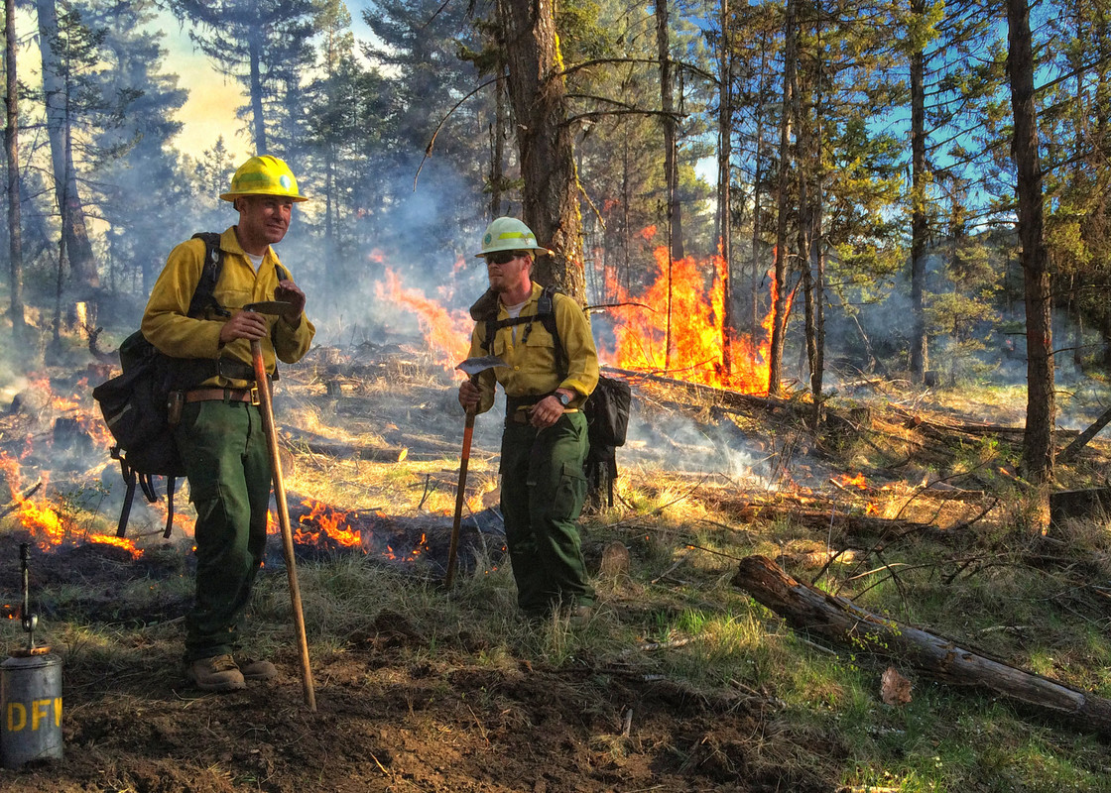
What can we do to restore the forest?
Let’s find out what federal, state, tribal, and private organizations do to help re-create resilient forests.
Notes:
The link will take you to a Washington DNR blog about what a healthy forest looks like. It will review concepts with students and introduce students to methods used by restoration foresters. The end of the article has a 15-minute TED video about why wildfires have gotten worse and methods of forest restoration.

Slide 27
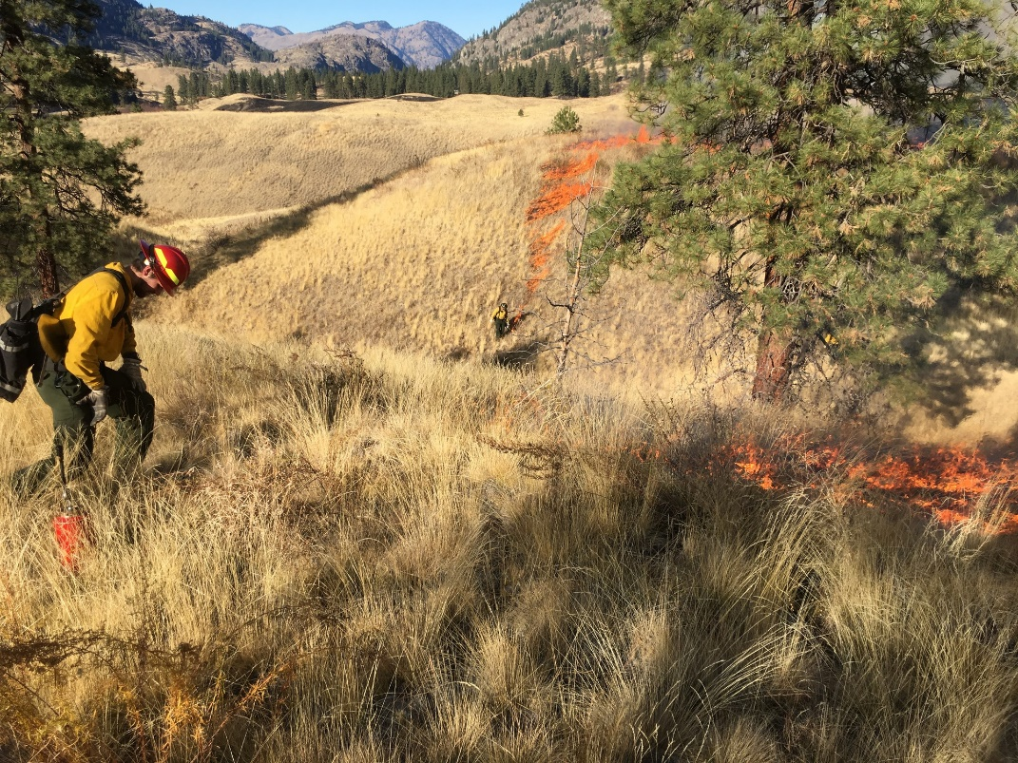
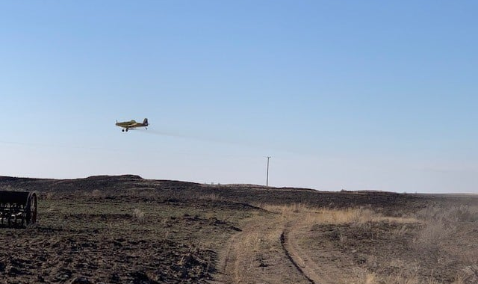
Not Thinned Thinned
Methods
Thinning
Prescribed fire
Fuel breaks
Planting
A plane drops seeds for replanting on a WDFW wildlife area after a large wildfire
Fuel breaks are lines in the “fuel” which help prevent the rapid spread of wildfire.
Notes:
WDFW foresters work with other state as well as federal and tribal agencies to implement forest restoration practices such as thinning, prescribed fire, fuel breaks and planting on WDFW-managed wildlife areas.

Slide 28
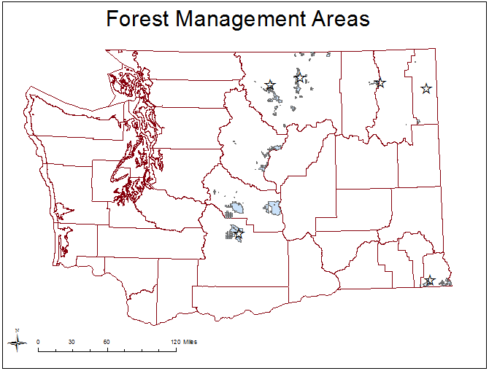
What can we do to restore the forest?
Thinned over 12,000 acres in wildlife areas throughout the state.
Notes:
Since 2014, WDFW has thinned over 12,000 acres on wildlife areas throughout the state. That’s like a football field extending from Seattle, Washington to Sacramento, California! Or about the same as 9,075 football fields.

Slide 29
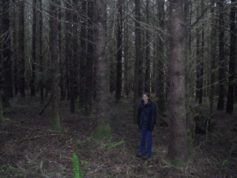
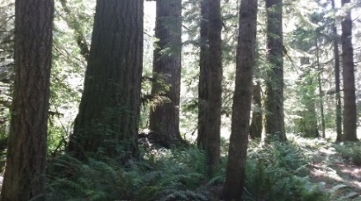
Untreated Treated Desired future condition
What does restoration look like?
Notes:
2018-2019: Mount Saint Helens Wildlife Area thinning project.
Ask students to note what differences they notice.

Slide 30
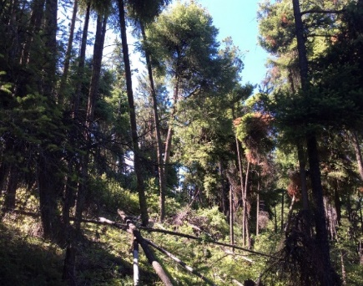
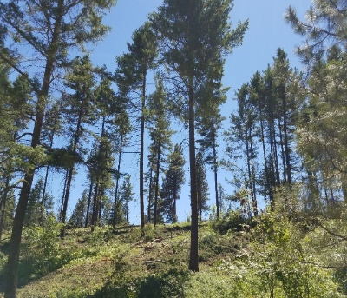
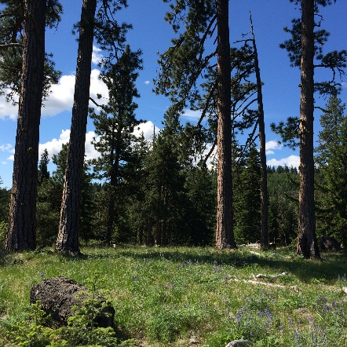
Untreated Treated Desired future condition
What does restoration look like?
Notes:
October 2017: An 805-acre thinning project on the LT Murray Wildlife Area near Ellensburg.
Ask students to note what differences they notice.

Slide 31
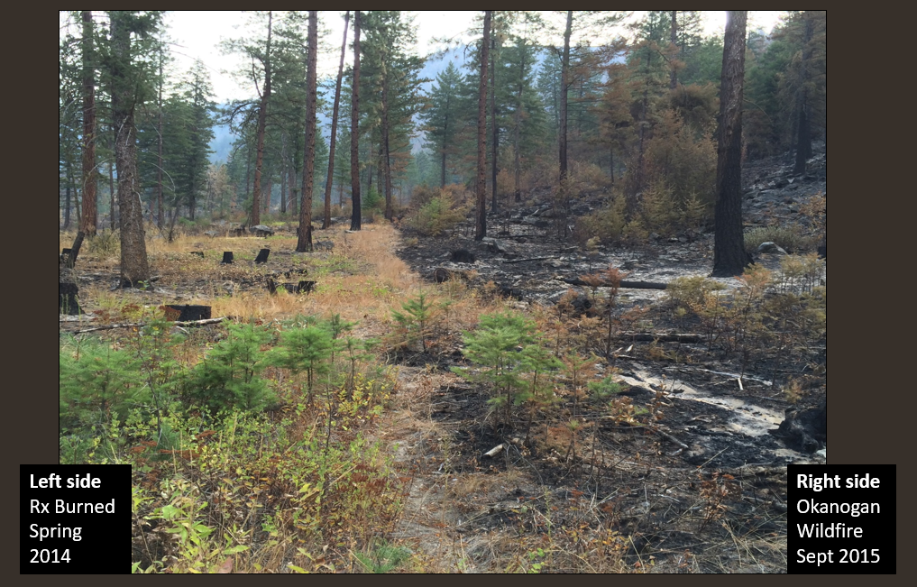
How treatments can impact disturbance
Notes:
In 2011, the Sinlahekin Wildlife area was mechanically thinned and prescribed fire was also used. In 2015 the Okanogan Wildfire came through the wildlife area. You can see how the treated vs. untreated parts of the wildlife area were impacted.

Slide 32
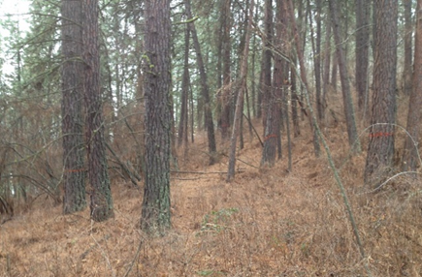
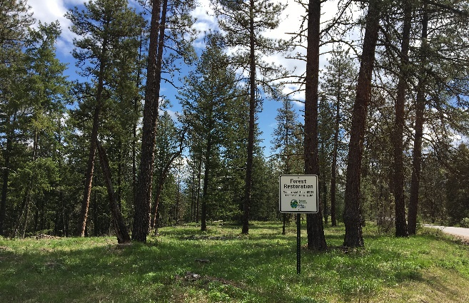
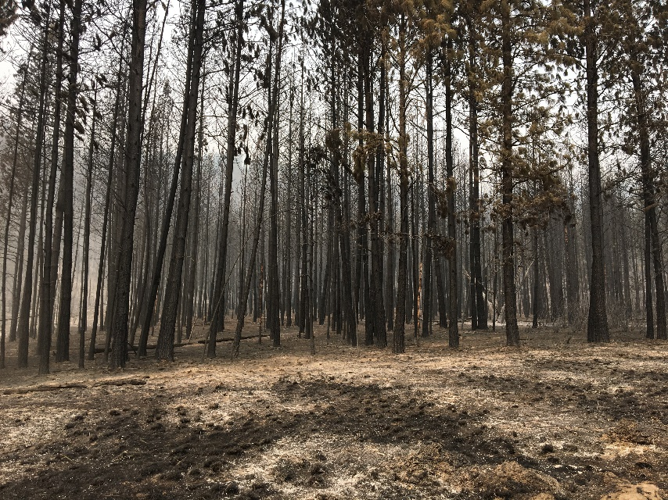
How treatments can impact disturbance
Boyd’s Fire - 2018
Untreated
After restoration (Thin + Rx burn)
Notes:
These treatments also help protect buildings and other structures, minimizing the cost of wildfire damage.
It’s important to note that treatments don’t fireproof forests.

Slide 33
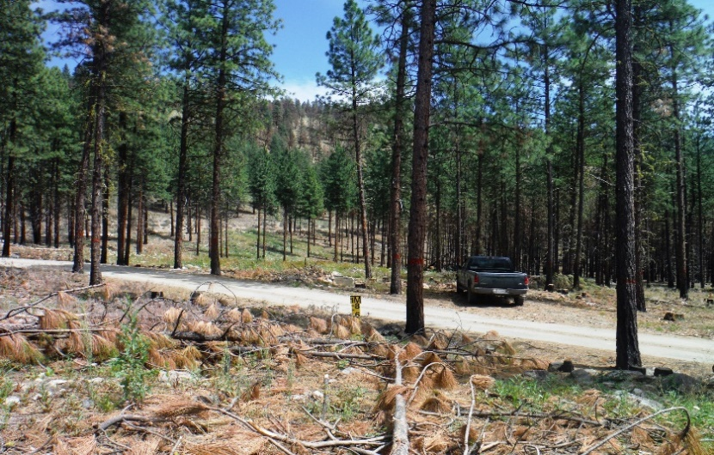
Which side looks more resilient?
Notes:
Have students look at picture and ask if they can spot any differences between the right and left side of the photo.
After giving them a couple of minutes share answers as a class. Students should be able to point out that the forest in the left side of the photo is much more dense than the forest in the right hand side.

