Slide 1
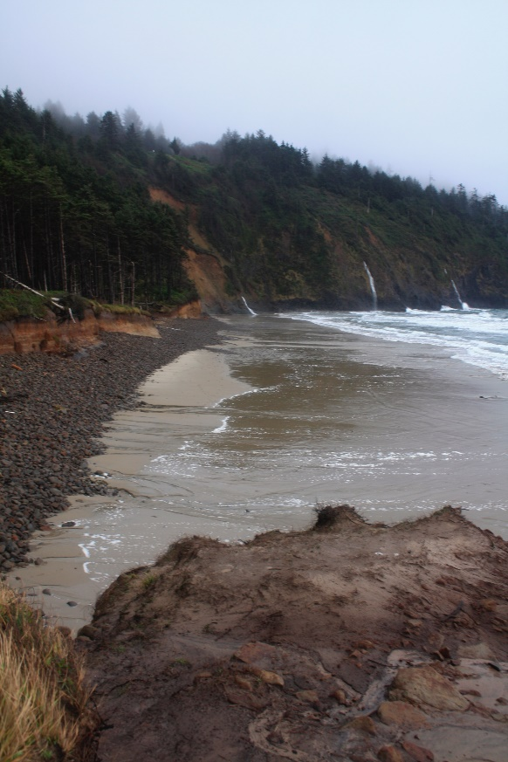
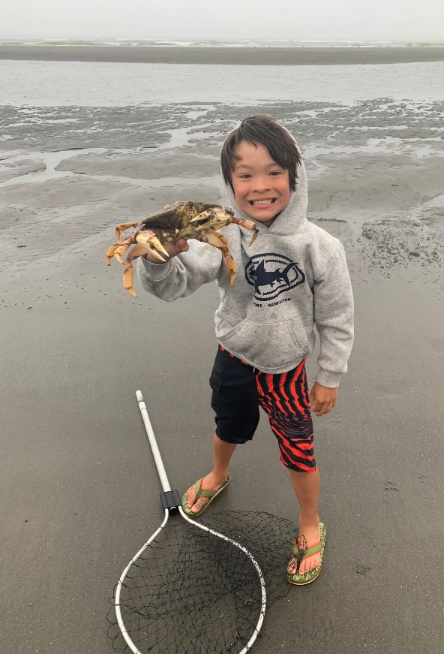
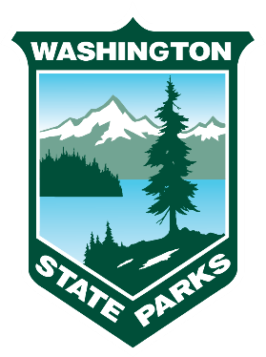
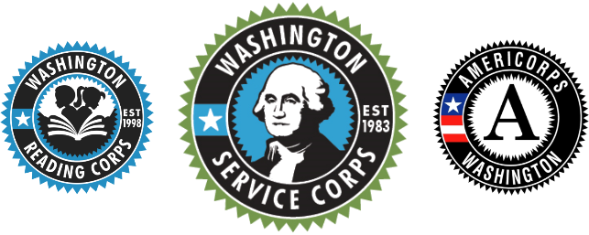
Coastal Ecosystems of Washington

Slide 2
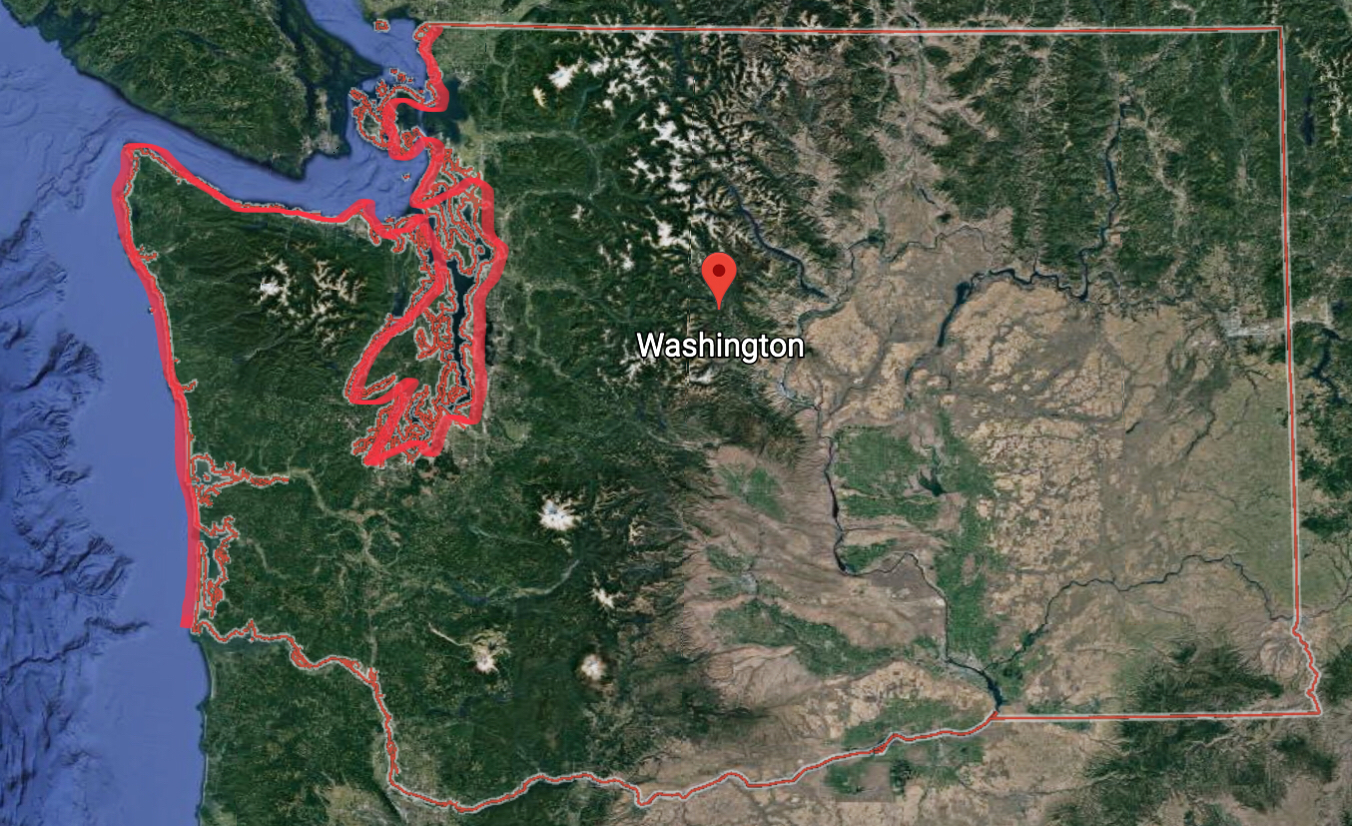
Washington has over 3,000 miles of coast!
Notes:
Explain that Washington has over 3,000 miles of coastline with all of its islands and channels of water.

Slide 3
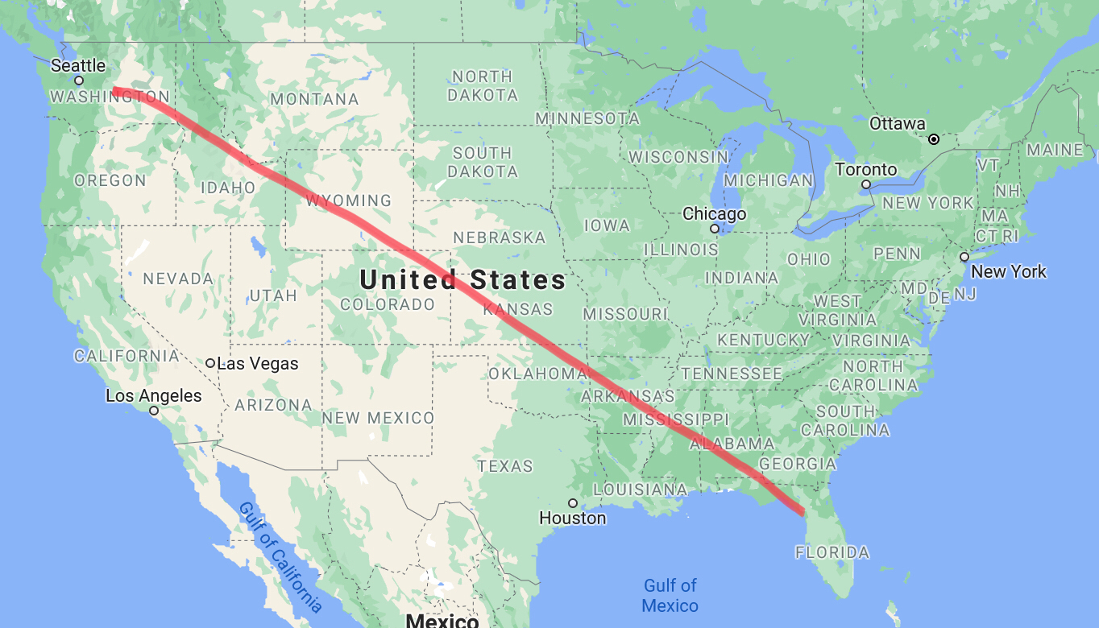
3,000 miles is the same distance as driving from Seattle to Disney World
Seattle, WA
If you wanted to walk 3,000 miles, it would take 43 days, a month and a half, to complete!
Disney World, FL
Notes:
3,000 miles is the same distance as driving from Seattle to Disney World in Orlando, FL. If you were to walk nonstop 24hr/day, it would take 43 days, a month and a half, to walk that distance! People can spend their whole lives living near the coast in Washington and still not visit it all.

Slide 4
What are some of the ways we use coastal ecosystems?
Notes:
Ask students to provide examples of ways they have used coastal ecosystems and/or ways we use coastal ecosystems.
You can choose to have them think-pair-share or share out as a class.

Slide 5
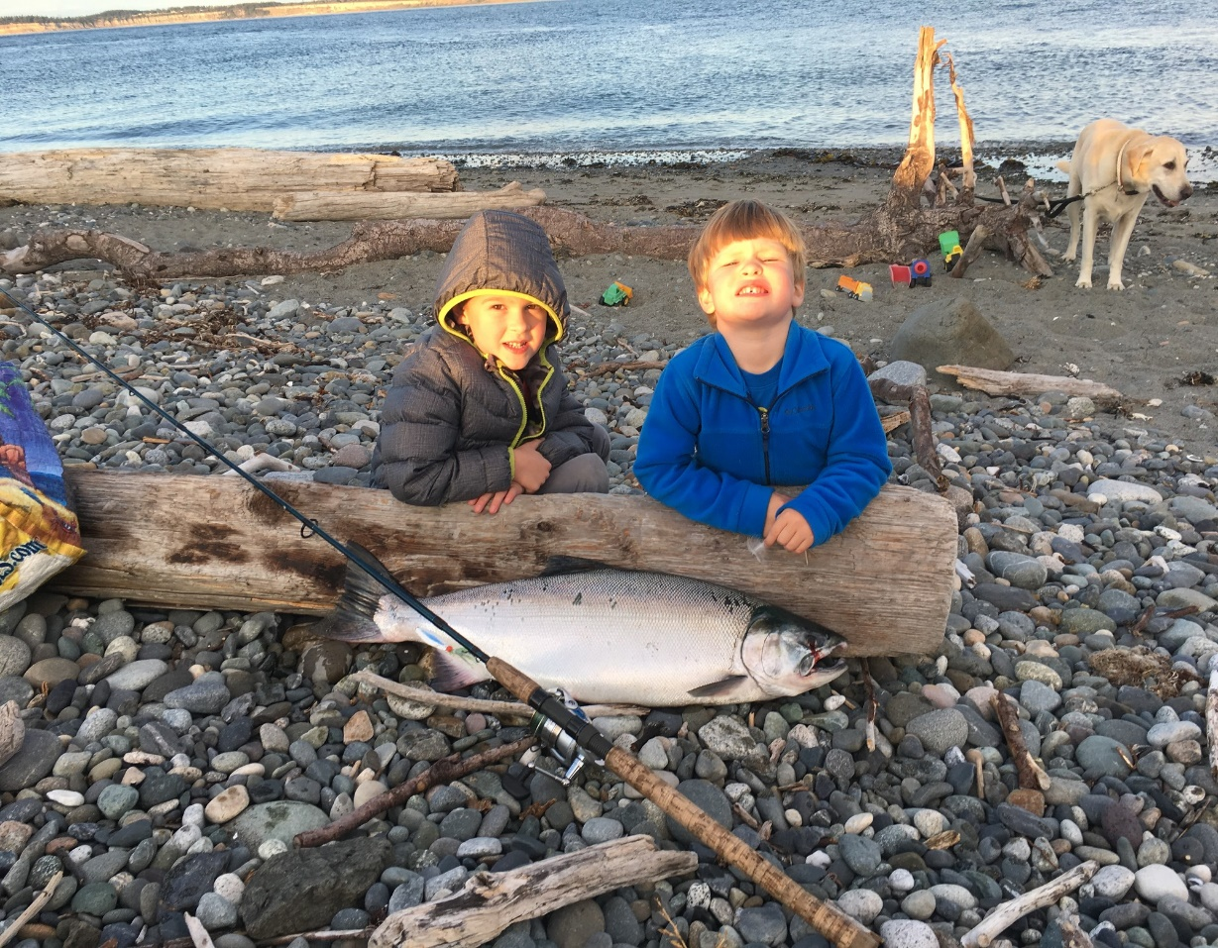
We use coastal ecosystems for food
Foods we get from coasts:
-Salmon
-Tuna
-Trout
-Shellfish
-Crabs
-Shrimp
-Clams
-Scallops
-Mussels
-Prawns
Notes:
Students will probably guess this as one of the ways we utilize coastal ecosystems. List off some of the popular foods we get from coasts, both along the ocean and along rivers and lakes.
Ask students if there is anything on the list they have eaten.

Slide 6
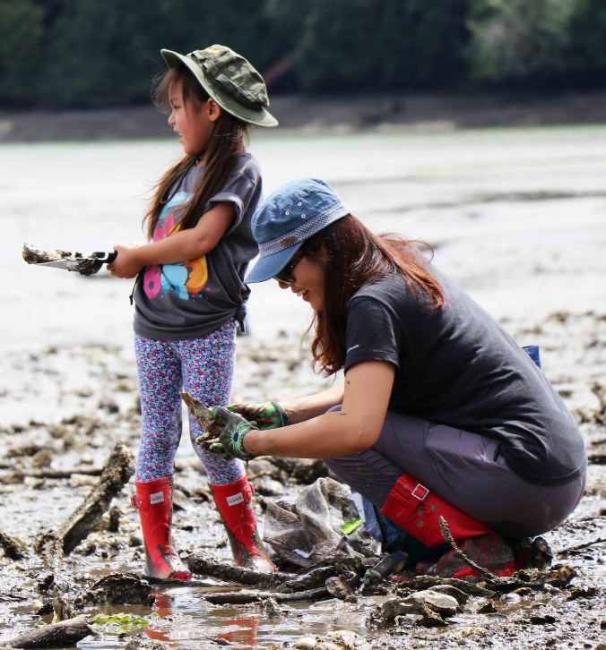
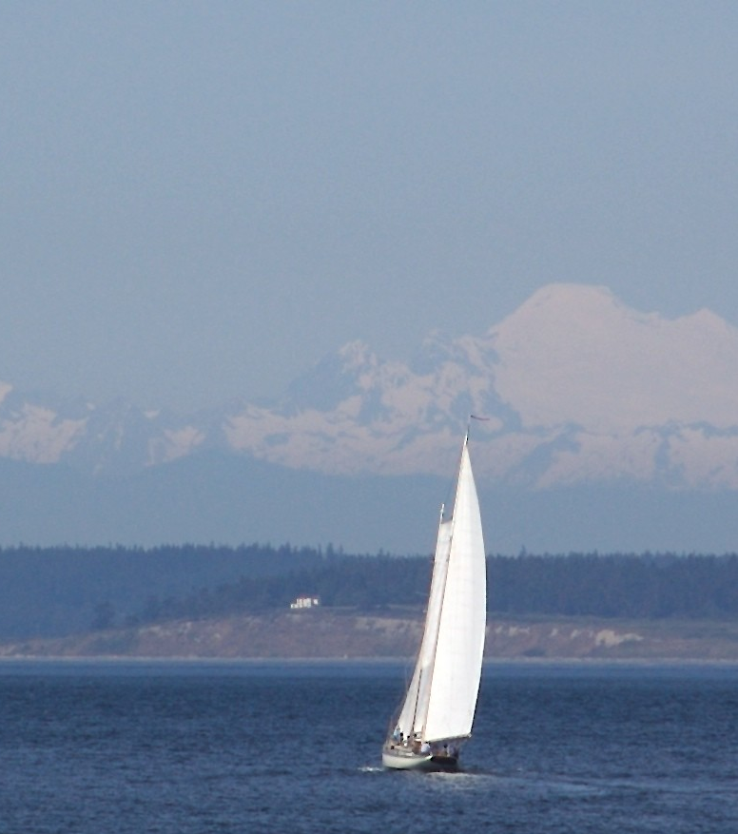
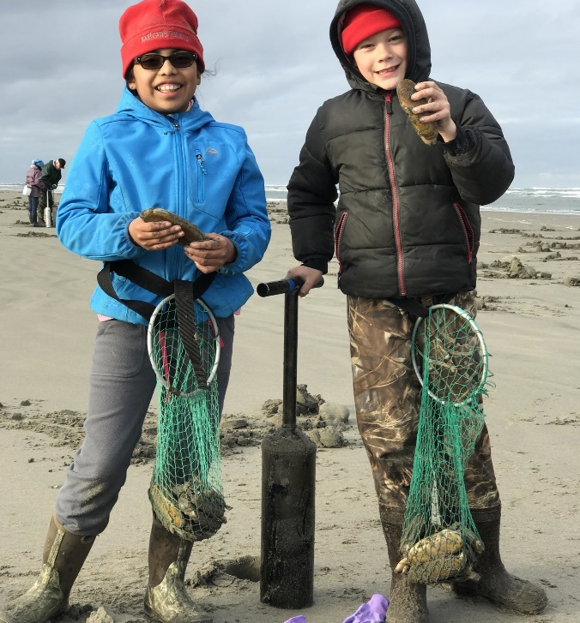
We use coastal ecosystems for recreation
Recreation is what we do just for fun, like walking on the beach, playing in the water, and enjoying boat rides.
"Pacific Northwest Sailing Idyll" by A.Davey is licensed under CC BY 2.0
Notes:
Explain that recreation is the term for the activities we do for fun.
Ask students if they have ever recreated in a coastal area. If so, what have they done?

Slide 7
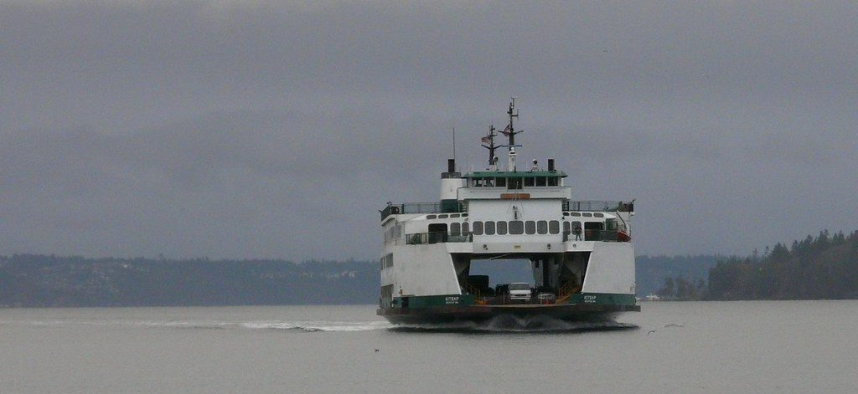
We use coastal ecosystems for transportation
Washington has the largest ferry system in the country to help access the 3,000 miles of coastline and surrounding islands.
Image courtesy of "kitsap ferry washington" by Diamond Brooke is licensed under CC BY-NC-ND 2.0
Notes:
Ask students why they think transportation might be important.
Ideas: people traveling for work, recreation, to visit friends and family members, what else?

Slide 8
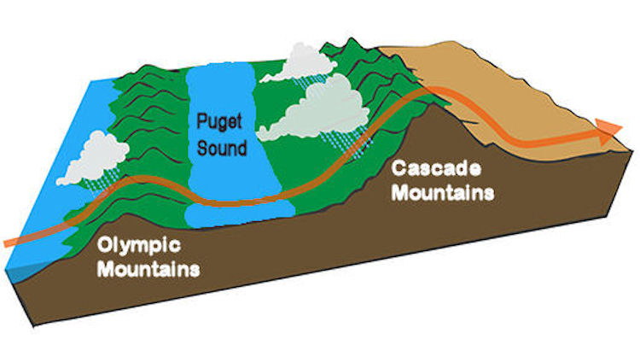
Coastal ecosystems help control our weather
Coastal Washington is known for its cool, wet weather.
Western Washington
Notes:
The ocean has colder air than the land, and when cold air meets warm air, clouds form. These wet and heavy clouds travel over the Olympic and Cascade Mountains Cascades, dumping water (as rain) so they can travel over the mountain ranges. This is why Western Washington has a lot more rainy days than Eastern Washington.

Slide 9
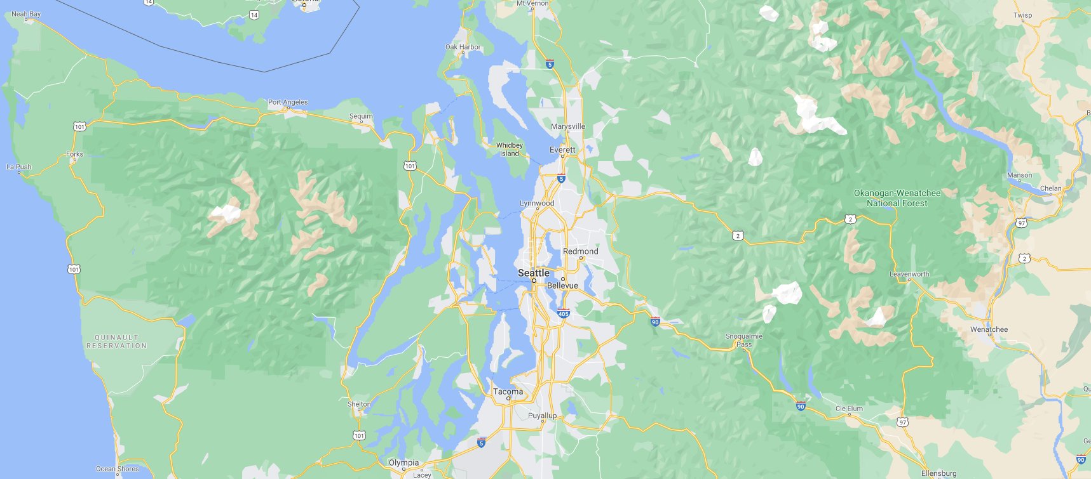
Washington is famous for Puget Sound, the second biggest estuary in the United States.
An estuary is where freshwater and saltwater meet, like when a river meets the ocean.
Notes:
Puget Sound is the coastal area in northwestern Washington where saltwater from the Pacific Ocean meets freshwater from rivers around a collection of islands.
All of the water (blue) in the circled area is considered the Puget Sound.

Slide 10
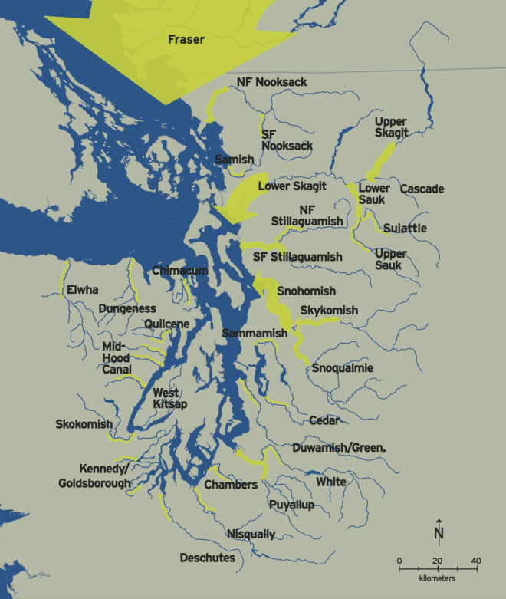
Estuaries are full of biodiversity
An estimated 2,800 rivers and streams flow into Puget Sound!
Image courtesy of The Encyclopedia of Puget Sound
Notes:
Estuaries are full of biodiversity from the mixing of freshwater and saltwater, and are a great place for lots of plants and animals to live.
This picture shows major rivers that flow into Puget Sound.

Slide 11
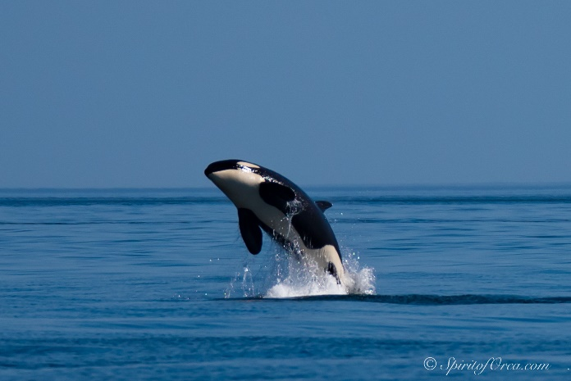
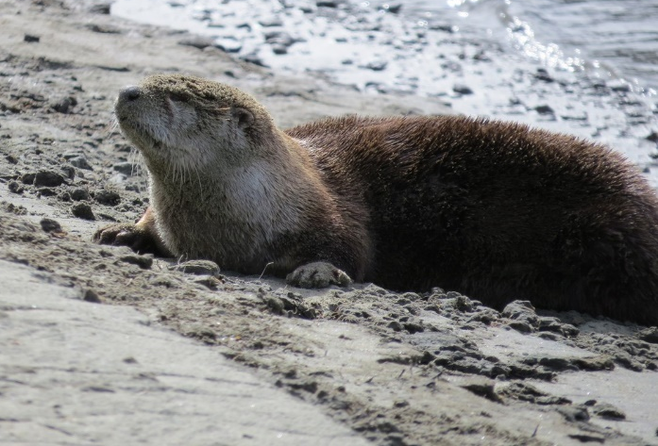
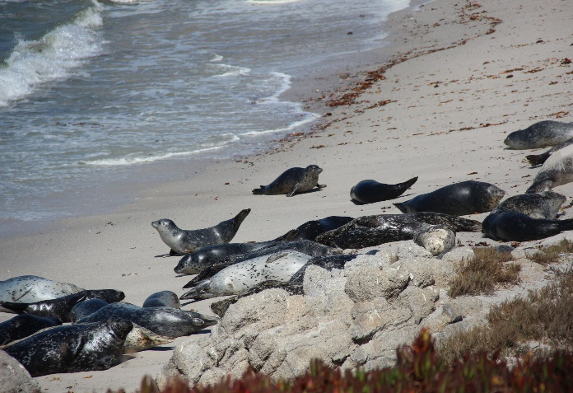
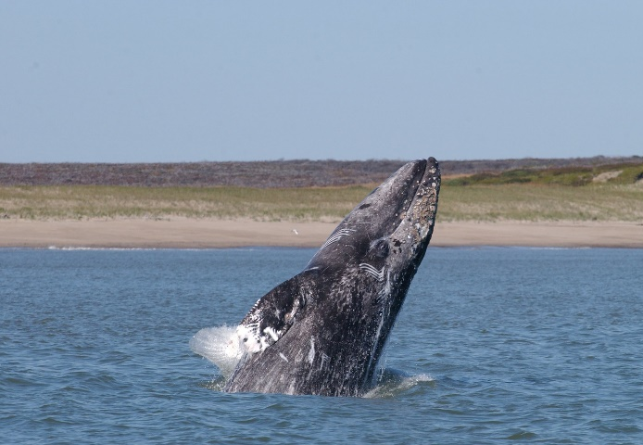
Coastal ecosystems are important habitats for a lot of Washington’s marine mammals.
Orca
River Otter
Harbor Seals
Gray whale
Notes:
Ask students if they recognize any of these animals and have ever seen them in Washington.
What are other coastal animals they can think of?

Slide 12
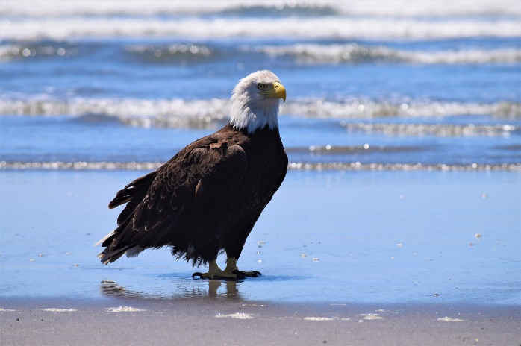
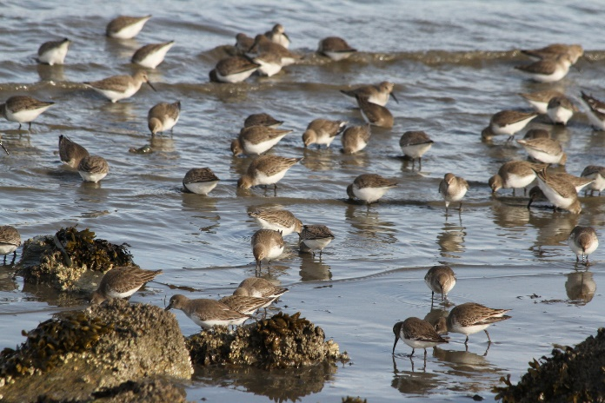
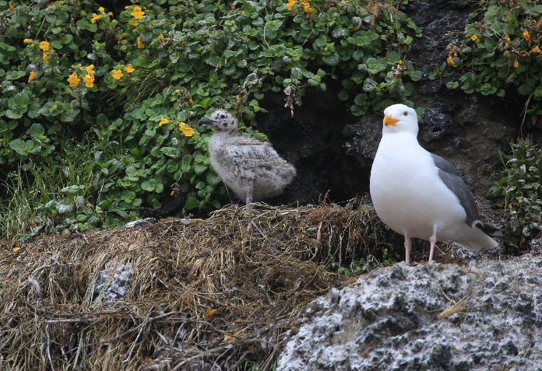
Coastal ecosystems are also important habitats for a lot of Washington’s bird species.
Bald eagle
Dunlins
Black
oystercatcher
Western gull and chick
Notes:
Ask students if they recognize any of these animals and have ever seen them in Washington.
Ask students if they have ever seen a coastal bird or a bird that lives in or near water.

Slide 13
Think to yourself, have you ever…
Been to an area where land and water meet, like a beach or river?
Been on a boat?
Eaten seafood?
Enjoyed a cool breeze near water?
Watched wildlife near water?
Been fishing, clamming, or crabbing?
Eaten fish from a lake or river?
Notes:
Before reading each question aloud, tell students to think quietly to themselves without raising their hands or nodding for any questions to prevent anyone from feeling left out if they haven’t done certain activities.

Slide 14
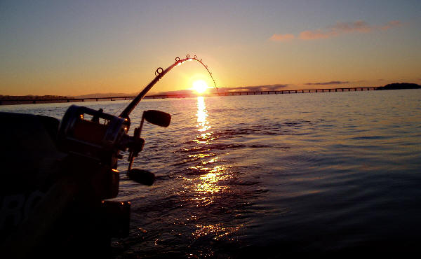
We can all find a connection to coastal ecosystems, even if we live hours away from the coast.
Notes:
Explain that we can all find a connection to coastal ecosystems and resources no matter where we live.

Slide 15
Extended Activity:
Compare and Contrast a Coast
Notes:
Introduce the extended activity of comparing/contrasting coastal ecosystems on separate worksheet.

