Slide 1
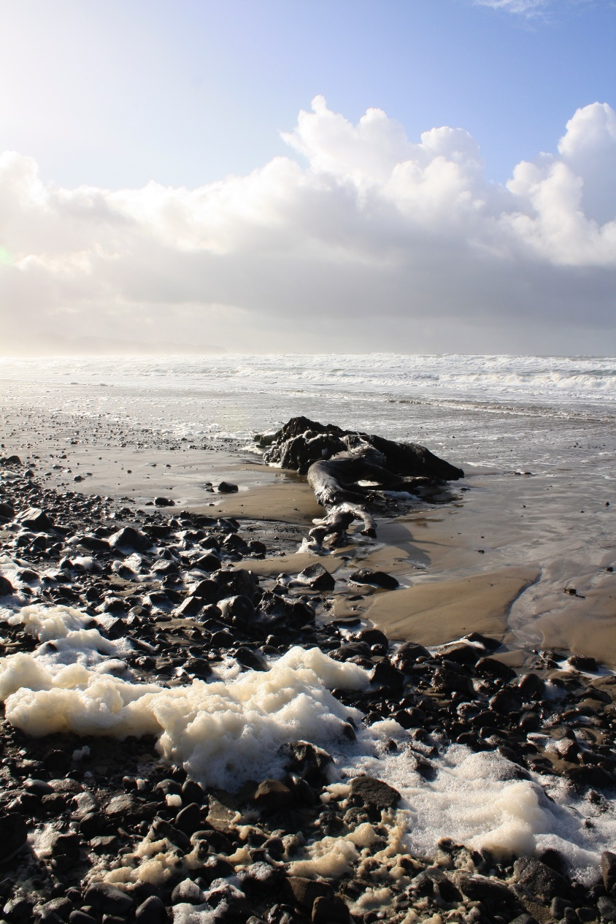
What are coastal ecosystems?
Notes:
Image courtesy of WDFW

Slide 2
What are coastal ecosystems?
The coast is the area where land and water meet.
An ecosystem is an area where all living and nonliving things work together to form a community. Plants, animals, weather, and landscape are all parts of ecosystems.
Examples of coastal ecosystems are beaches, bays, estuaries, and salt marshes.
Notes:
Define coast and ecosystems so students understand the concept of a coastal ecosystem.

Slide 3
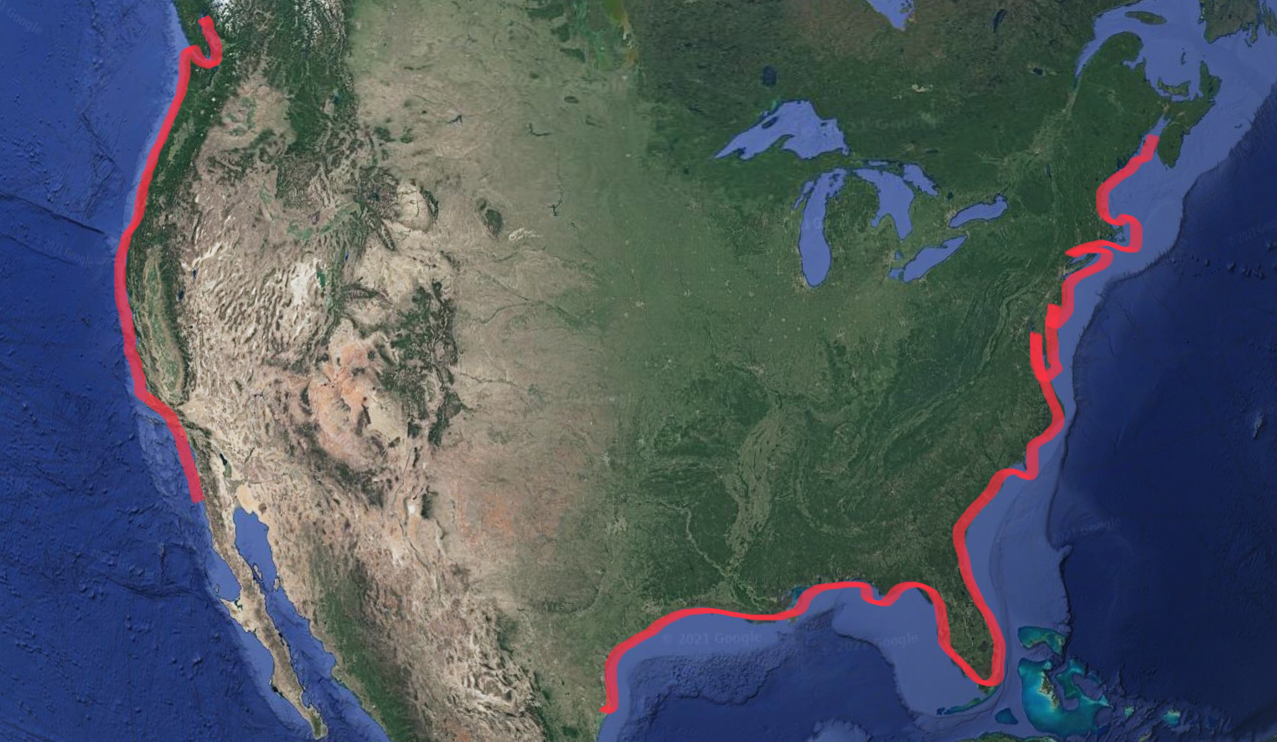
Coasts in the USA
Notes:
Explain that this is a map of the United States highlighting the coasts, where the Eastern US meets the Atlantic Ocean and the western U.S. meets the Pacific Ocean.

Slide 4
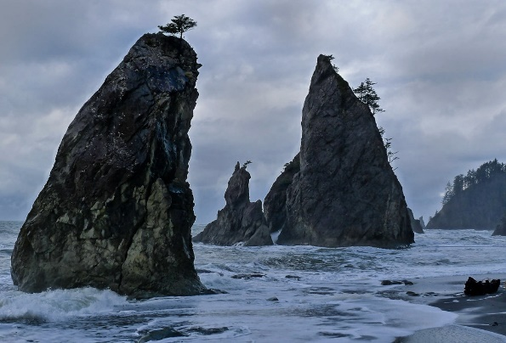
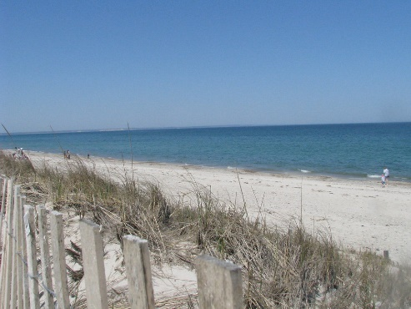
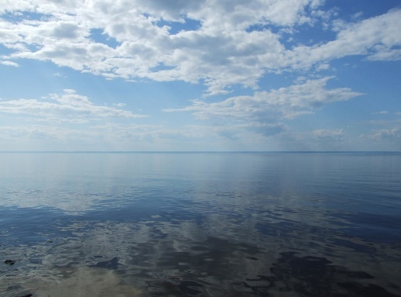
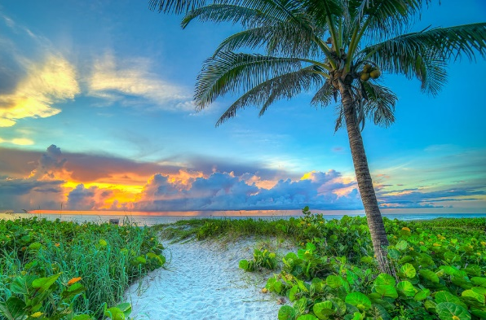
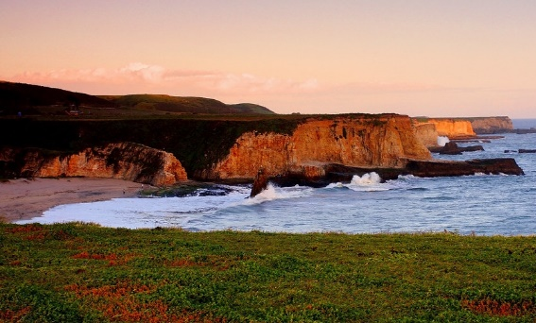
Coasts can look very different:
Massachusetts
Washington
"Washington coast´s rugged and wild beauty - Part 2"is licensed under CC BY-NC-ND 2.0,
Cape Cod Sandy Neck Beach" is licensed under CC BY-NC 2.0
Wisconsin
Background: Lake Superior 1“ is licensed under CC BY-NC 2.0
California
"California Coast Panorama" is licensed under CC BY 2.0
Delray Beach Florida Sunrise at Beach is licensed under CC BY-NC-ND 2.0
Florida
Notes:
In the US alone, there is a vast diversity in coastal ecosystems. Even though they look different, they’re all coasts, where land and water meet.
23 states have coastline along the Pacific and Atlantic oceans, and 8 states have coastlines along the Great Lakes in the midwestern US.

Slide 5
Coasts are where land and water meet
Where Washington and the Pacific Ocean meet
Where Wisconsin and Lake Superior meet
Wisconsin
"Washington coast´s rugged and wild beauty - Part 2"is licensed under CC BY-NC-ND 2.0,
Background: Lake Superior 1“ is licensed under CC BY-NC 2.0
Notes:
Coastlines exists where the land and ocean meet, and where the land and large lakes meet, like at the Great Lakes in the midwestern US, where Wisconsin is.

Slide 6
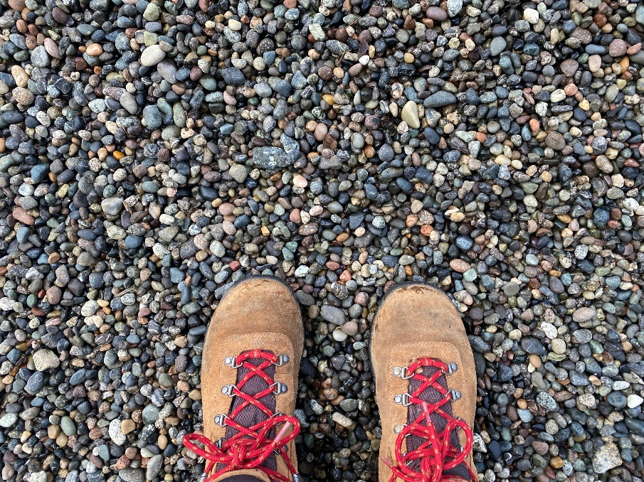
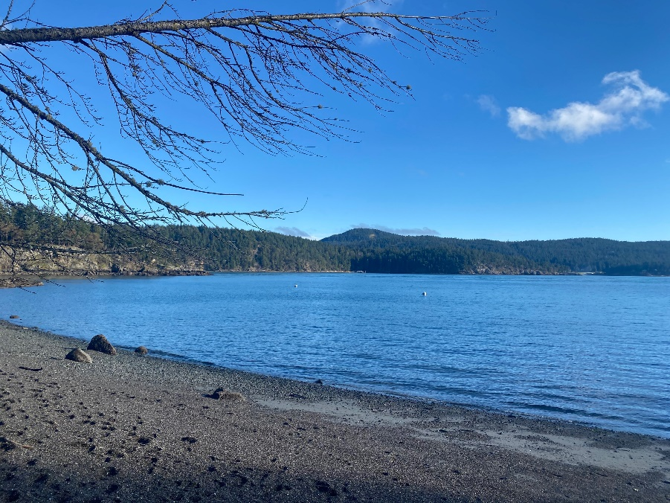
Most coastal ecosystems have beaches
Beaches are the sandy or rocky areas between land and water.
The beach at Obstruction Pass State Park, Orcas Island, WA
Notes:
Here in Washington, many of our beaches have rocky shores instead of white sandy beaches.

Slide 7
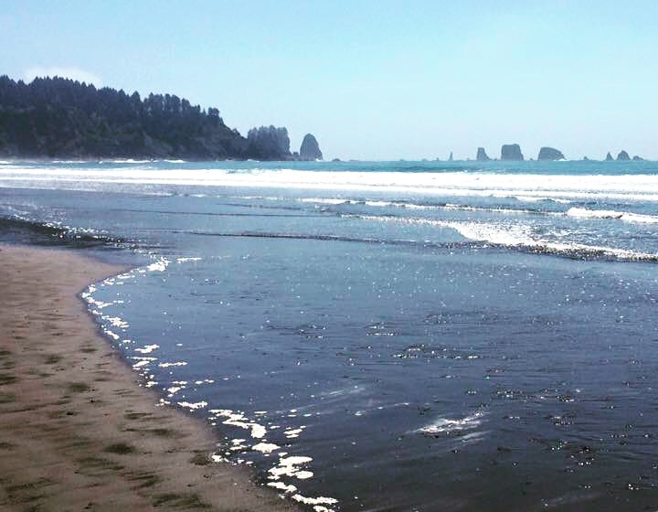
Tides are the rising and falling of the ocean, caused by the gravitational pull of the moon.
All beaches have tides
Gravity is the invisible force that pulls objects towards each other.
Notes:
Depending on the students’ understanding of gravity, an explanation may be necessary.
Earth’s gravity is what keeps us from floating off into space. When we jump in the air, we come back down to the ground instead of floating away because of Earth’s gravity.

Slide 8
Tides are caused by the moon
Just like the Earth, the moon has its own gravitational pull.
Because the moon is smaller than the Earth, it’s gravitational pull is weaker than ours.
It pulls on large bodies of water when it’s close to the Earth, causing high tide.
Notes:
The moon has its own gravity and pulls on large bodies of water on the earth, creating high and low tides. High tides are when the moon is closer to the beach and low tide is when the moon is further away from the beach.

Slide 9
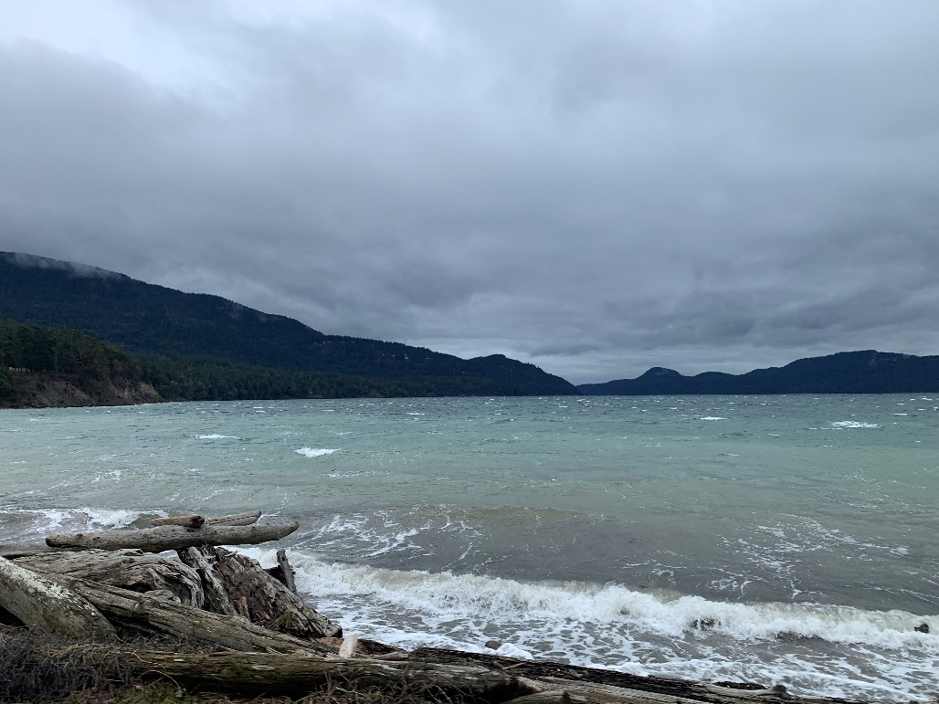
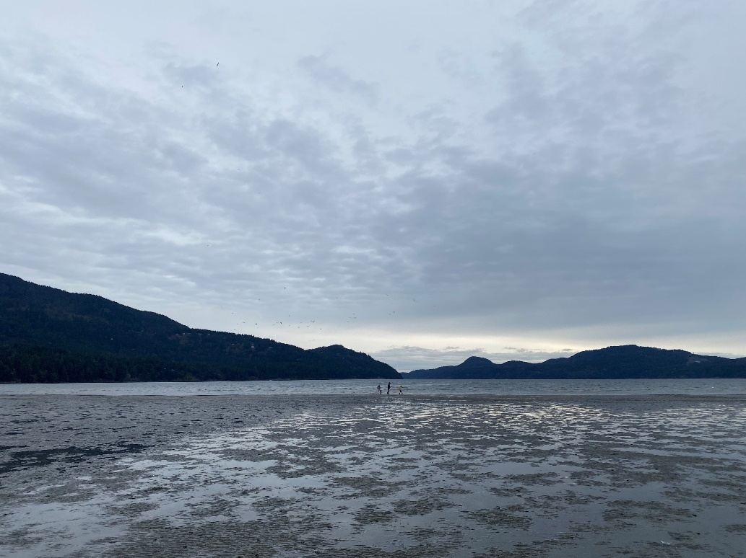
All coasts experience high tide and low tide
High Tide
Low Tide
Crescent Beach, Orcas Island, WA
Notes:
These two pictures show the exact same view at Crescent Beach on Orcas Island, located in the San Juan Islands. You can tell it’s the same place from looking at the mountains in the background which are the same in each photo. The area looks completely different at high tide vs low tide.

Slide 10
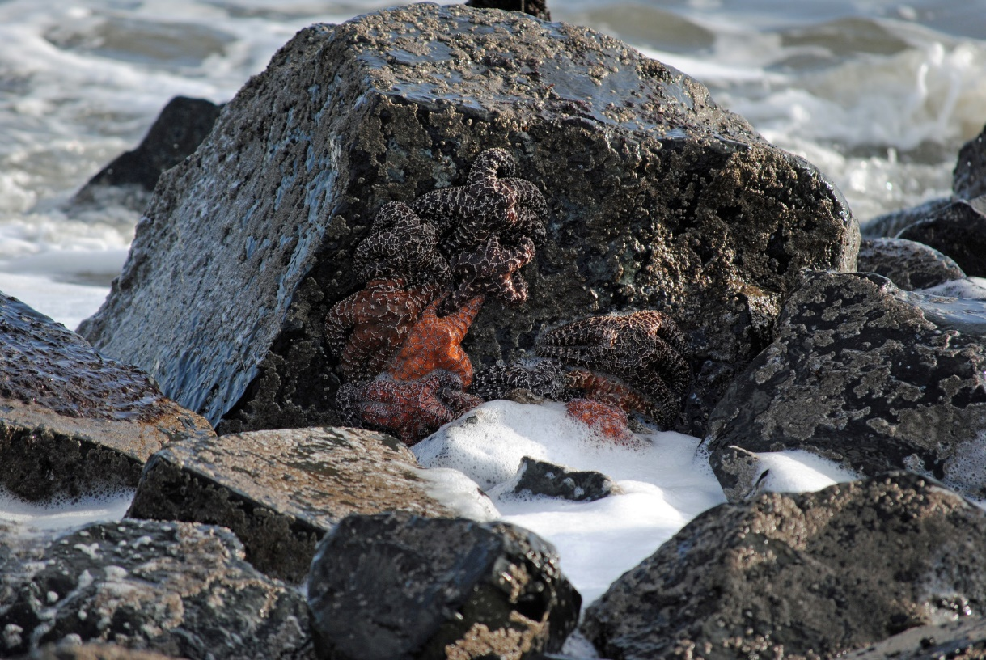
When it’s low tide, water gets trapped in between rocks, creating tidepools.
Tidepools hold entire ecosystems in their water and on their rocks.
How many sea stars can you count on this rock?
Notes:
Ask students to take a moment and see how many sea stars they can count on this rock. There’s at least 8!

Slide 11
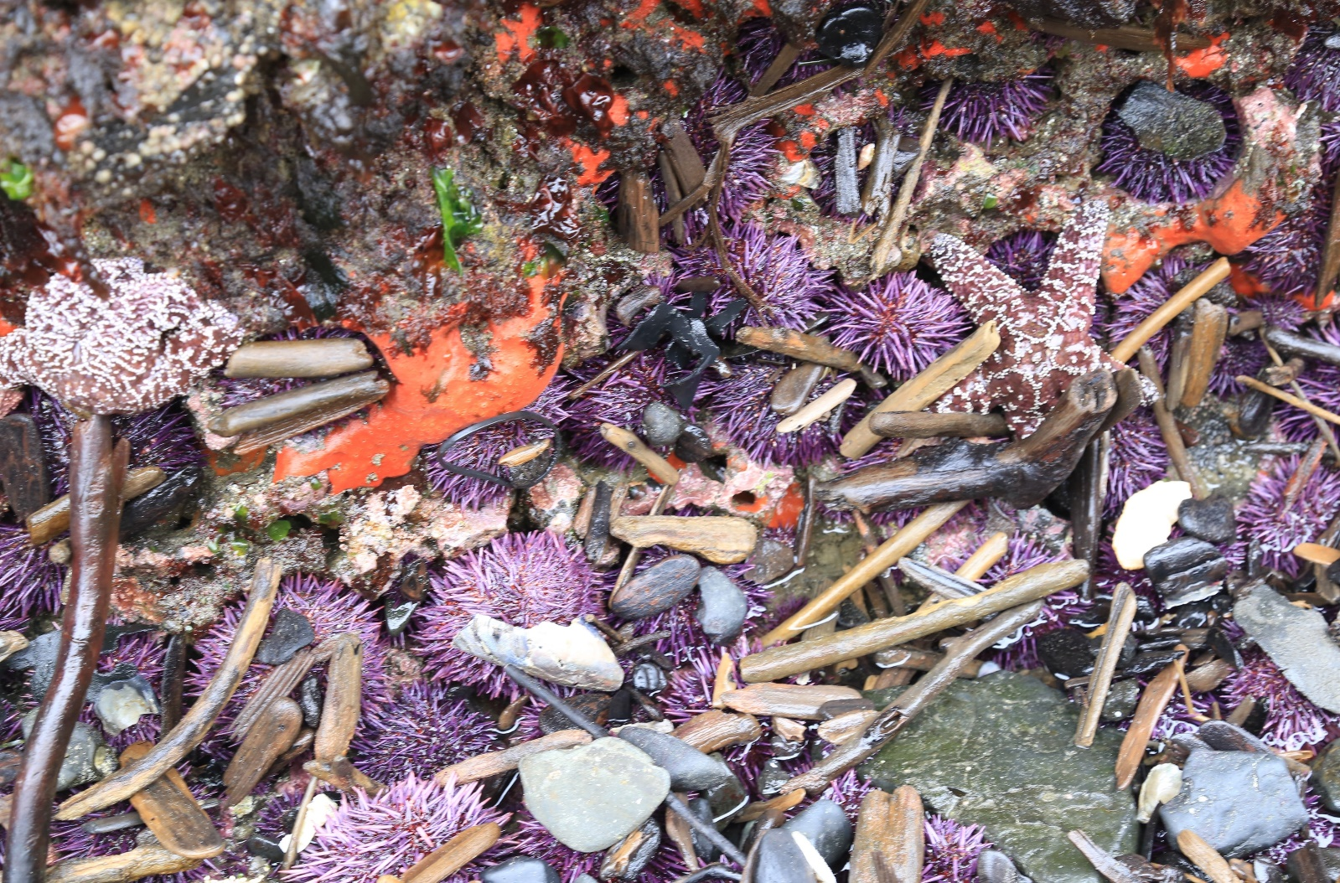
Tidepools have a lot of biodiversity.
What do you think biodiversity means?
Notes:
Ask students to think about what biodiversity means and to use this picture as a hint. Have them suggest their guesses if time permits.
Bio=life diversity=many things
Biodiversity is the many different types of life and the habitats on Earth!

Slide 12
Biodiversity is the amount of life in an ecosystem. Ecosystems with high biodiversity have a lot of different life forms.
Ochre Sea Star
Sea Lettuce
Orange Sponge
Purple Urchin

Slide 13
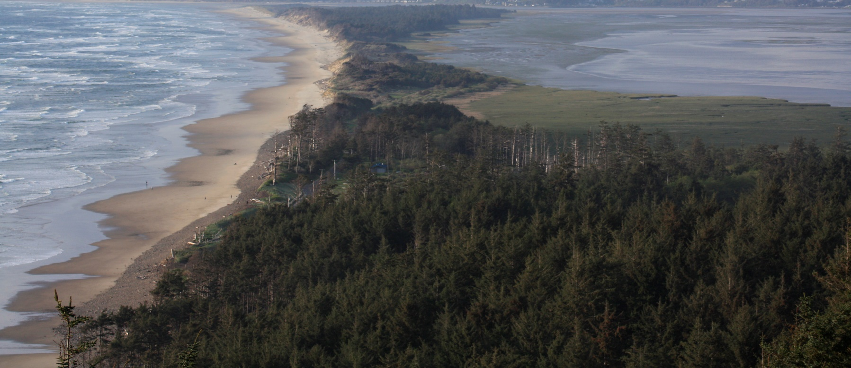
Why is biodiversity important?
Why is it important to have many different types of plants, animals and other living things?
Why is it important to have many different types of ecosystems?
Notes:
Have students think-pair-share with a partner for these two questions. Then come back as a class and have students share what they thought,

Slide 14
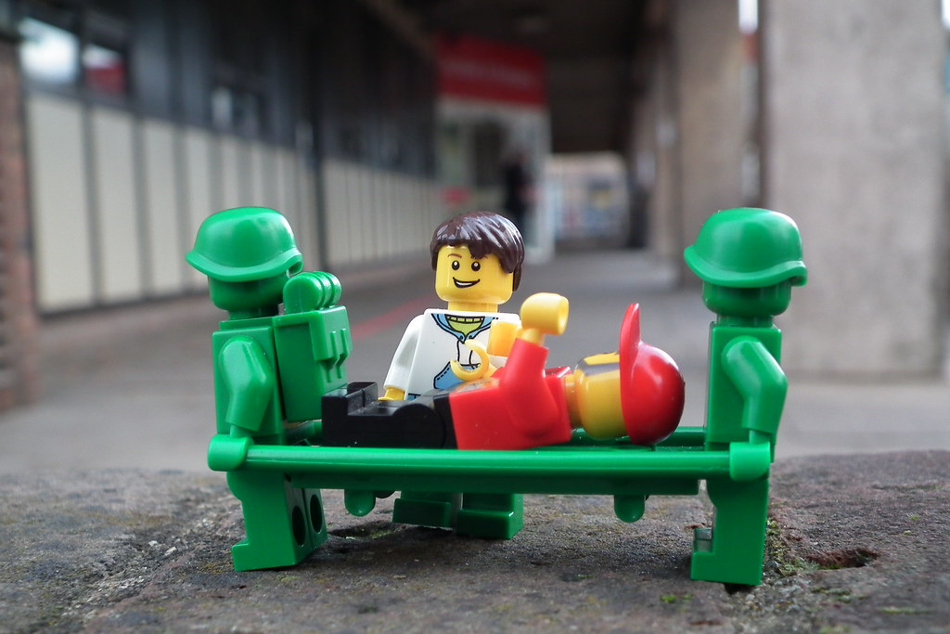
Think of biodiversity like a sports team that supports life on Earth.
If you have multiple players who play the same position and one gets injured, it’s okay because your team has a backup.
But if all the players who play that position are injured, your team is now weakened and won’t play well.
Notes:
The same thing goes for the health of Earth. If we have many different types of lifeforms and ecosystems, and a few get sick or die, it’s okay because there are others to fill their role. But if too many get sick or die, then Earth and all the lifeforms it supports might also get sick.

Slide 15
When teams have multiple players for each role, they have a higher level of “biodiversity”, and have a ”healthier” team.
2 catchers
2 batters
"In 2015, the first woman coach was hired by a Major League Baseball team." is licensed under CC BY-NC-ND 2.0
Notes:
If there are multiple players for each role, the team is “healthier” because it has a higher amount of biodiversity within it, aka a higher number of species present.

Slide 16
Each of these species has a specific role in this tide pool ecosystem.
Ochre Sea Star
Sea Lettuce
Orange Sponge
Purple Urchin

Slide 17
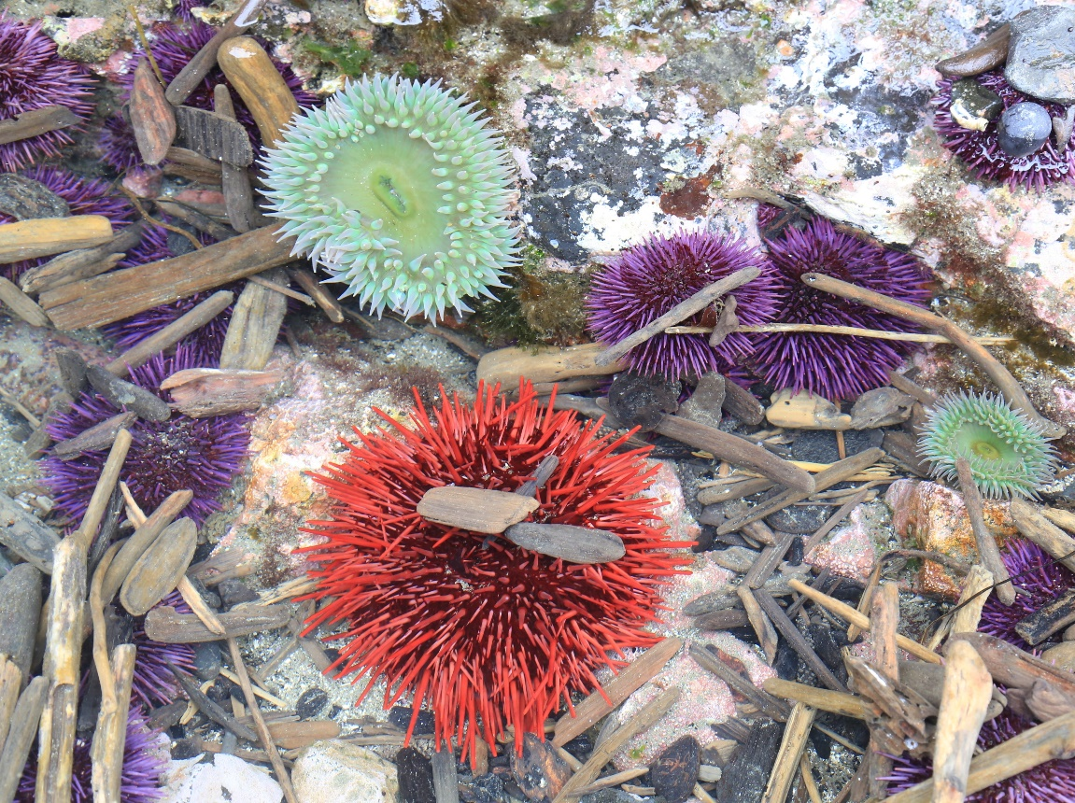
Ecosystems with high biodiversity are healthier than ecosystems with low biodiversity.
Green Sea Anemone
Purple Urchin
Every plant and animal plays a role in their ecosystem.
The more biodiversity there is, the more roles are filled, and the healthier the ecosystem is.
Red Urchin

Slide 18
Sea urchins are important tide pool herbivores, meaning they eat plants.
Green Sea Anemone
Algae
Purple Urchin
Purple Urchin
Red Urchin
Notes:
Sea urchin’s role in the ecosystem is to eat algae and they are also food for a lot of different tide pool animals.
Explain that sea urchins, the purple and red spiky balls in the photo eat different types of algae that grows in tide pools and is brought in with the tides, and they’re a food source for animals like otters, birds, and sea stars.
(Algae are plant-like living things that make their food from sunlight. They are neither plant, nor animal.)

Slide 19
What do you think would happen if sea urchins were removed from tide pools?
Notes:
Ask students to take a moment to think about what would happen to this tide pool community if sea urchins, the herbivores, were removed from this ecosystem.

Slide 20
If sea urchins were removed from this, the algae may grow take over the ecosystem!
If there are too many algae or plants in the water, they absorb all the nutrients.
This doesn’t leave enough for the rest of the animals in the tide pool, which results in an unhealthy ecosystem.
Notes:
Explain that by removing the sea urchins, the algae no longer has a predator and will grow out of control because there’s nothing around to eat it.
A lot of algae will absorb a lot of nutrients out of the water so that other things living in the tide pool won’t get enough nutrients, meaning the ecosystem will be unbalanced and unhealthy.

Slide 21
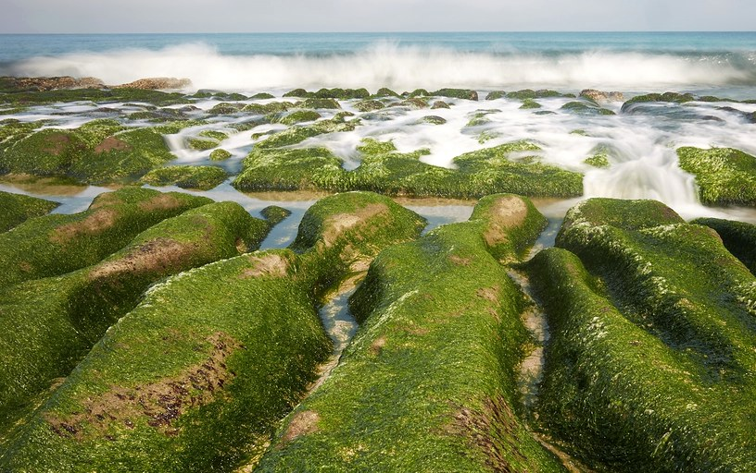
If not enough roles in the ecosystem are filled and biodiversity is low, it can result in too many of one species which usually leads to an unhealthy ecosystem.
This ecosystem has too much algae and not enough biodiversity.
"Sea lettuce" by arcaswiss is licensed under CC BY-NC-SA 2.0
Notes:
Explain that an overabundance of any organism is usually a harmful thing for ecosystems and throws everything out of balance. In this photo, too much algae is dominating the landscape.

Slide 22
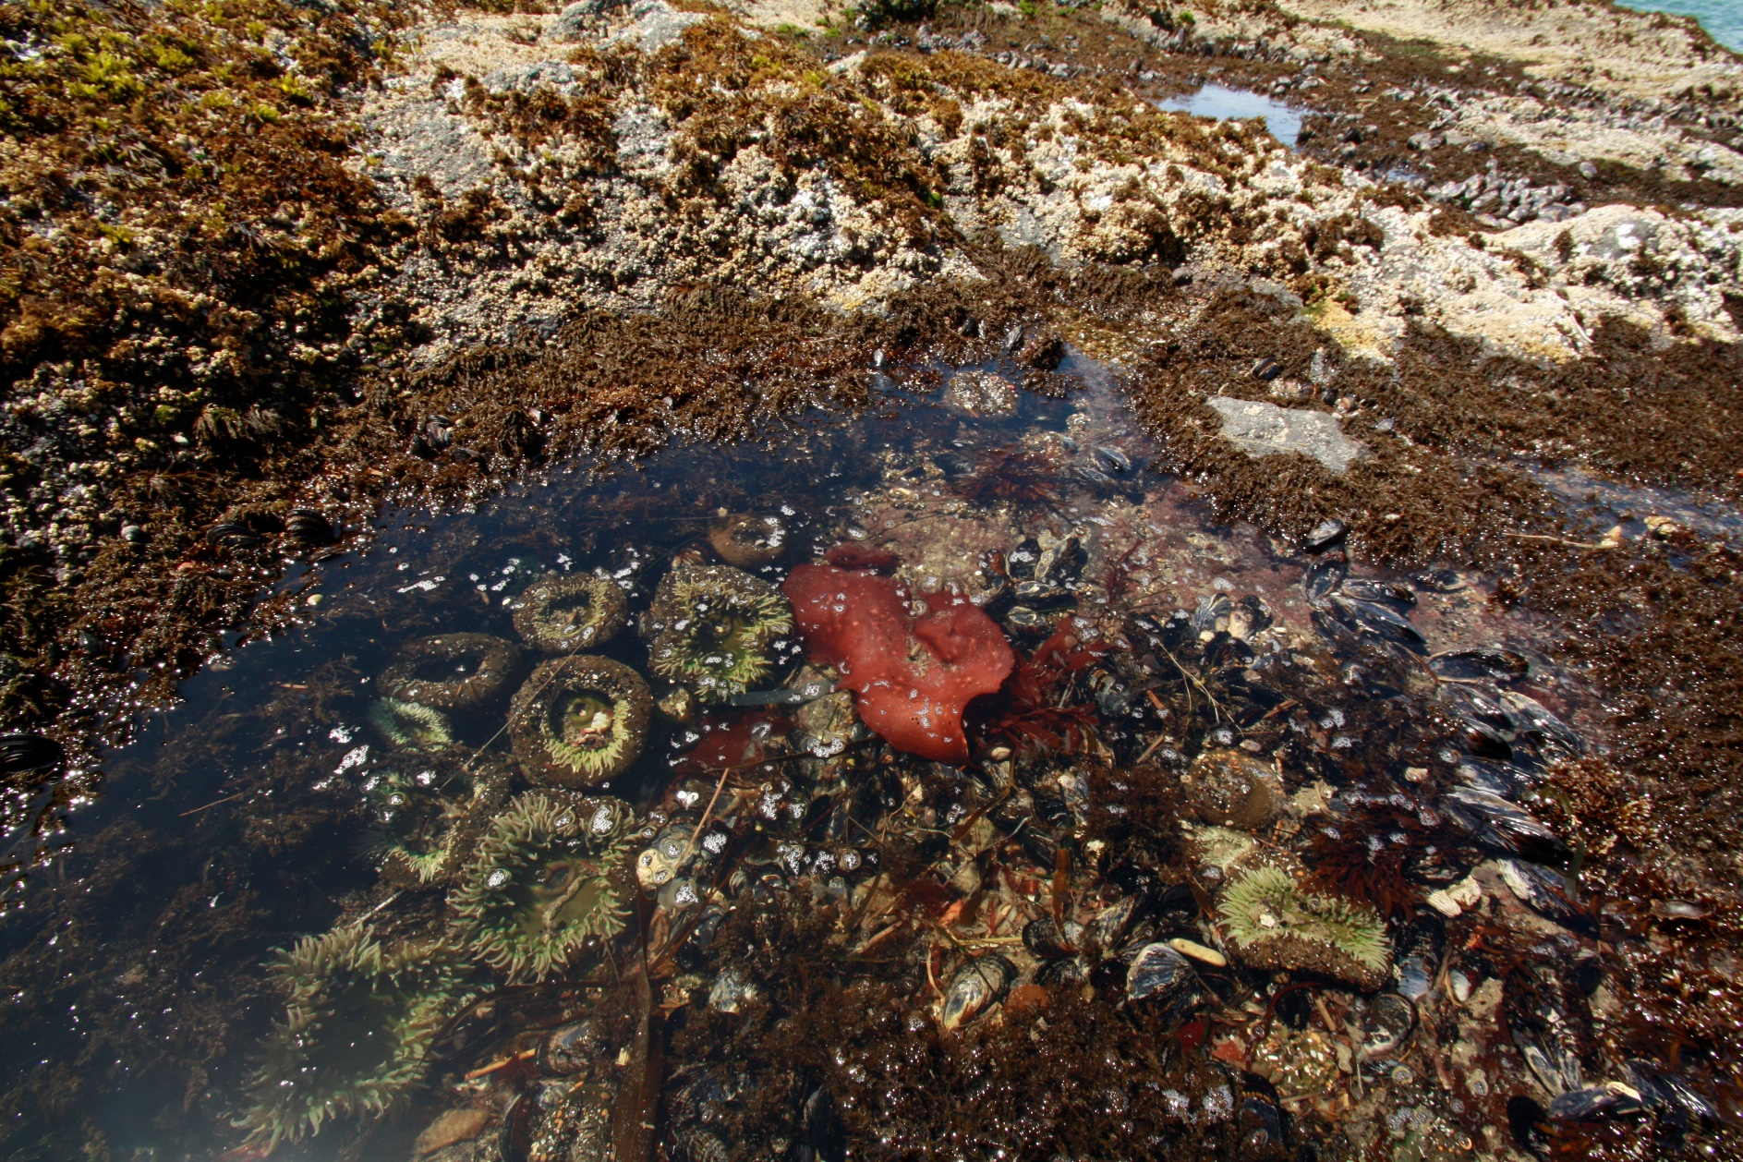
Biodiversity helps create a healthy, balanced ecosystem.

Slide 23
Thinking about everything we’ve just learned…

Slide 24
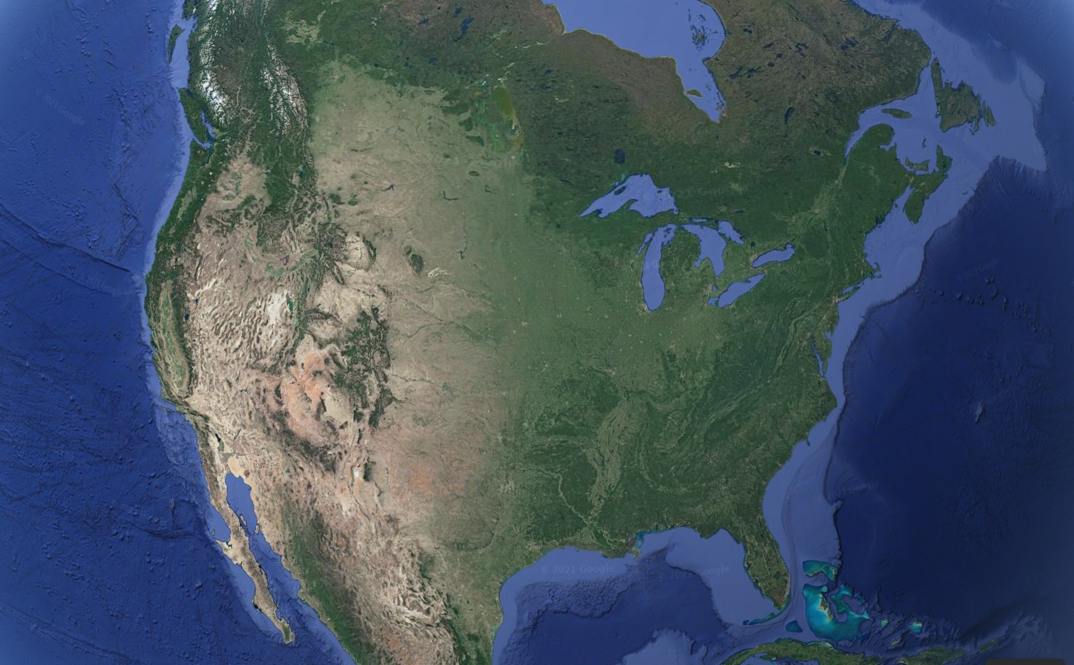
Where are the coastal ecosystems in Washington?
Notes:
Ask students where the coastal ecosystems in Washington are. Open up the Coastal Ecosystems of Washington PP after this slide is finished, or start on the next PowerPoint in your next science period.

