Slide 1
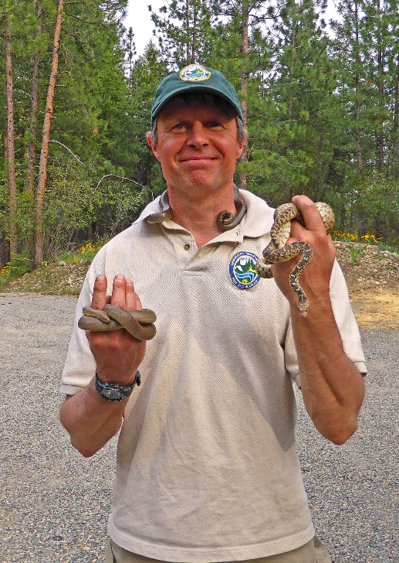
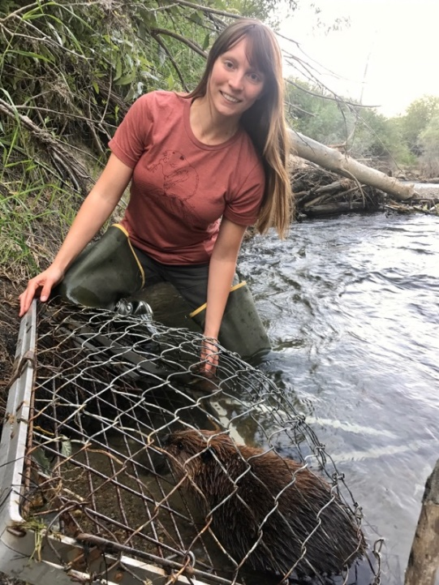
Why manage wildlife?
Notes:
Ask students for reasons they think wildlife should be managed. You can write their reasons on a board, or a whiteboard.

Slide 2
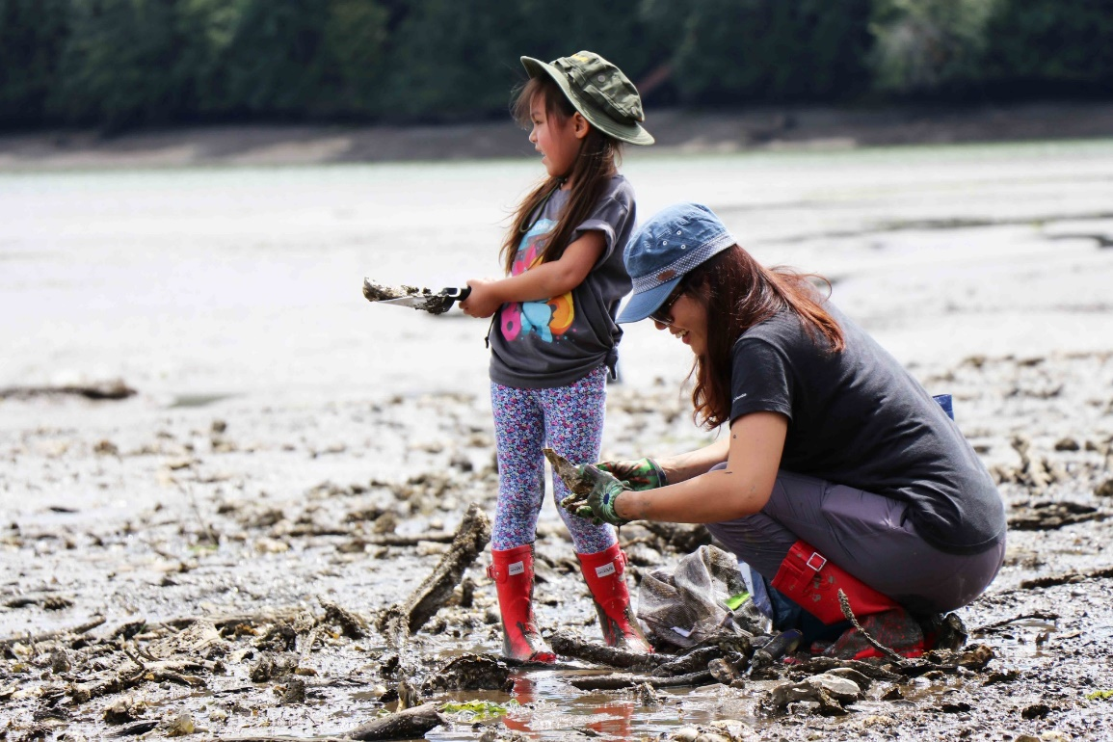
Human interaction with wildlife
Humans appreciate and use wildlife in a variety of ways.
Intrinsic value and appreciation
Fishing
Viewing
Medicines and beauty products (both traditional and modern)
Pollination
Artwork
Hunting
Pest management
Fertilizer (i.e., guano)
Cultural importance
Trapping
???

Slide 3
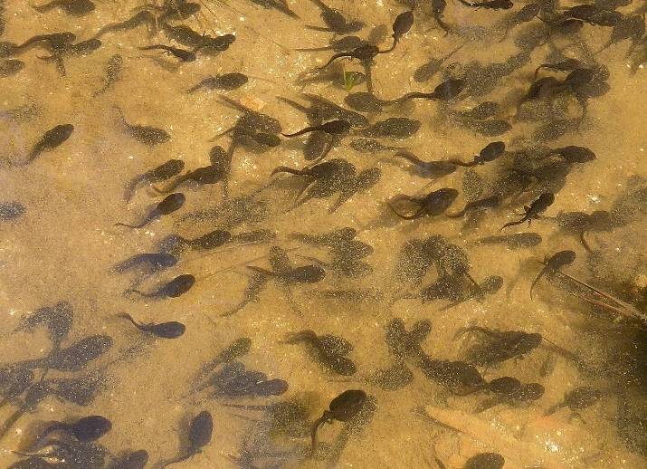
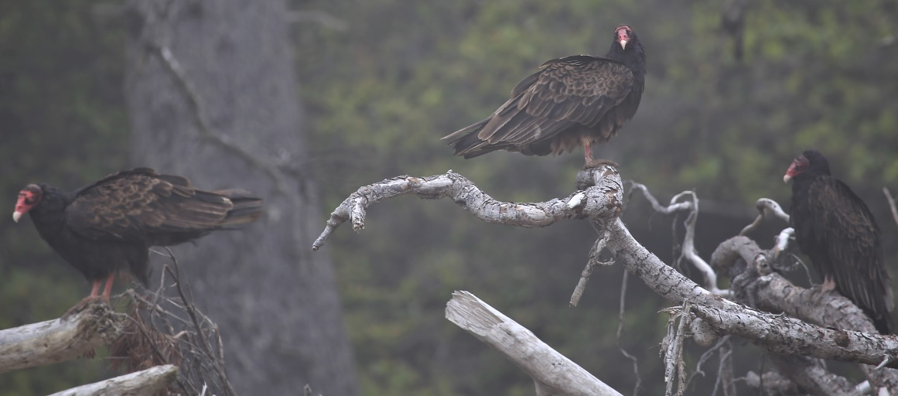
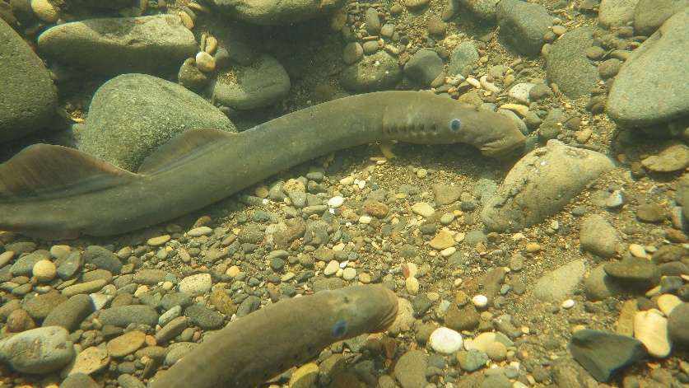
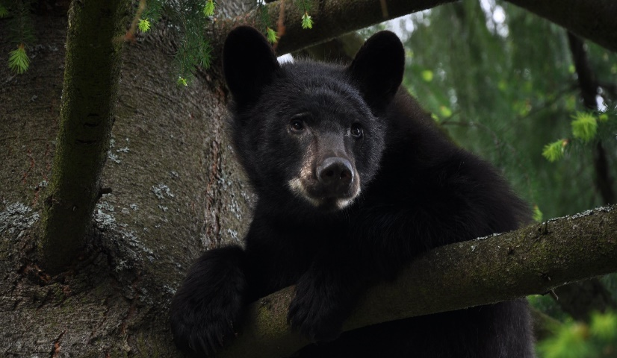
Ecosystem Services
All of the previously mentioned interactions are considered ecosystem services-- Benefits that people obtain from wildlife and ecosystems.

Slide 4
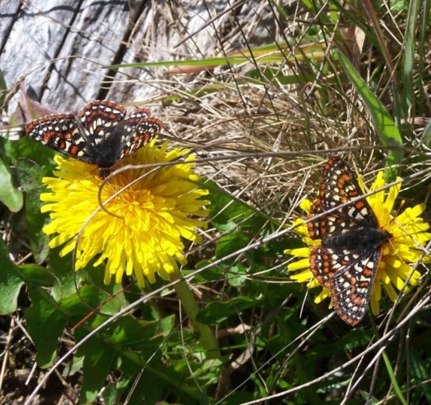
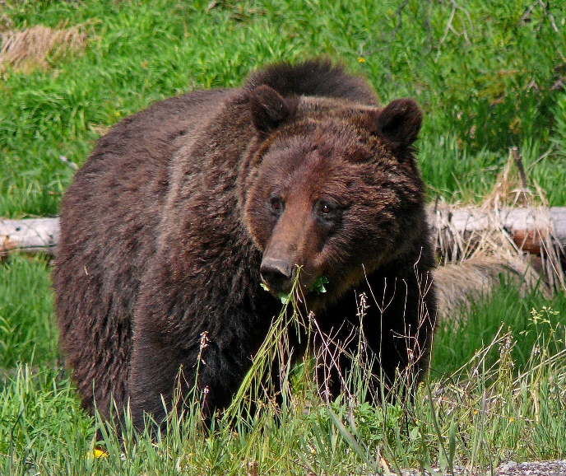
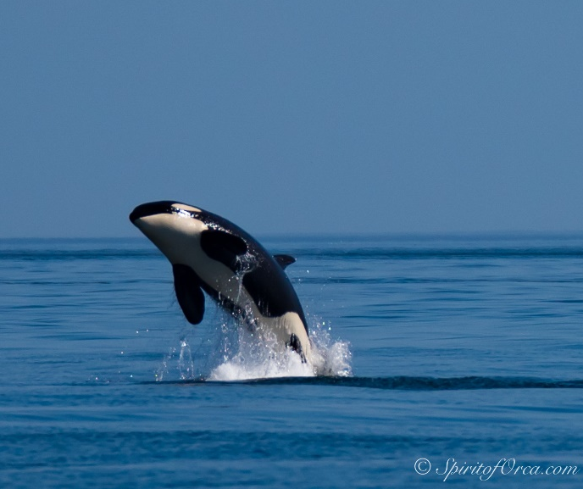
Biodiversity
The diversity of species and habitats in the world provide a plethora of ecosystem services.
Loss of biodiversity and mass extinction is a real threat to ecosystem services and our way of life.
According to the United Nations, 1 million species are at risk of extinction globally.
By 2070, 1/3 of species (all kingdoms) may be extinct.

Slide 5
How to preserve biodiversity and balance our needs?
With a partner, brainstorm:
What are ways you think wildlife managers address this global challenge?
In the state?
In the U.S.?
On an international scale?

Slide 6
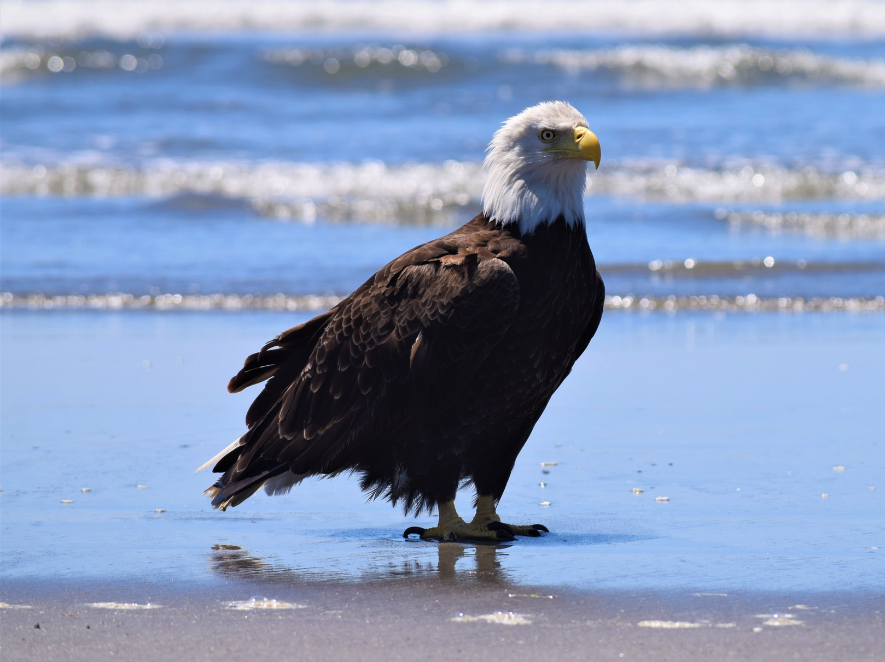
In the U.S., state agencies are tasked with wildlife management. They follow the North American Model of Wildlife Conservation.

Slide 7
Under the North American Model, wildlife managers follow seven principles of wildlife management.
Wildlife resources are conserved and held in trust for all people.
Markets for game are eliminated, preventing commercial decimations of species.
Wildlife is allocated according to democratic rule of law.
Wildlife may only be killed for a legitimate, non-frivolous purpose.
Wildlife is an international resource.
Every person has an equal opportunity under the law to participate in hunting and fishing.
Scientific management is the proper means for wildlife conservation.
Notes:
See if students can remember any of the seven principles from their reading before revealing them.

Slide 8
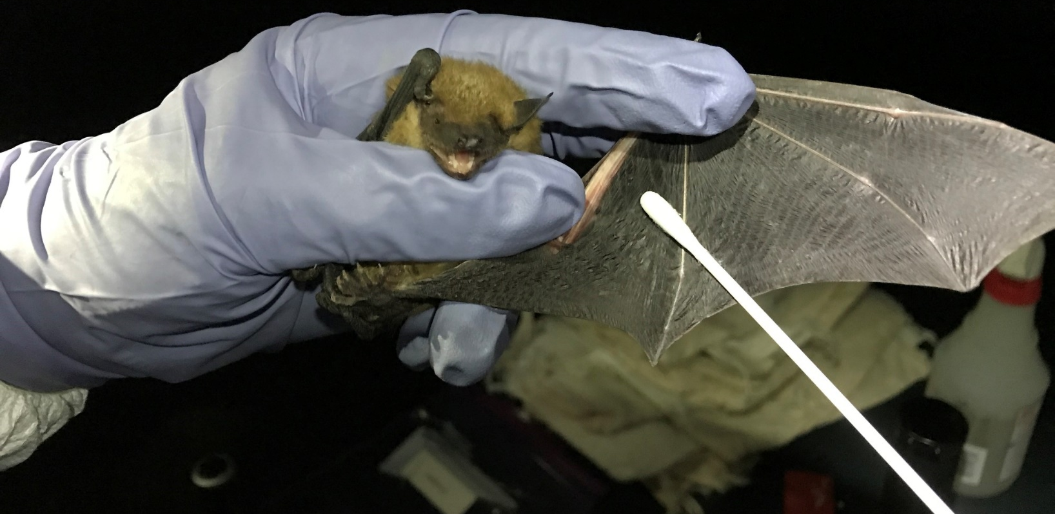
Washington Department of Fish and Wildlife
Mission: To preserve, protect ,and perpetuate fish, wildlife, and ecosystems while providing sustainable fish and wildlife recreational and commercial opportunities.
From habitat recovery to monitoring fisheries, the Department addresses emerging fish, wildlife, and natural resource needs while balancing public interests.
Notes:
WDFW is Washington’s state fish and wildlife management agency. The Department manages and co-manages fish, wildlife, and wildlife areas with other state, tribal, and federal agencies.

Slide 9
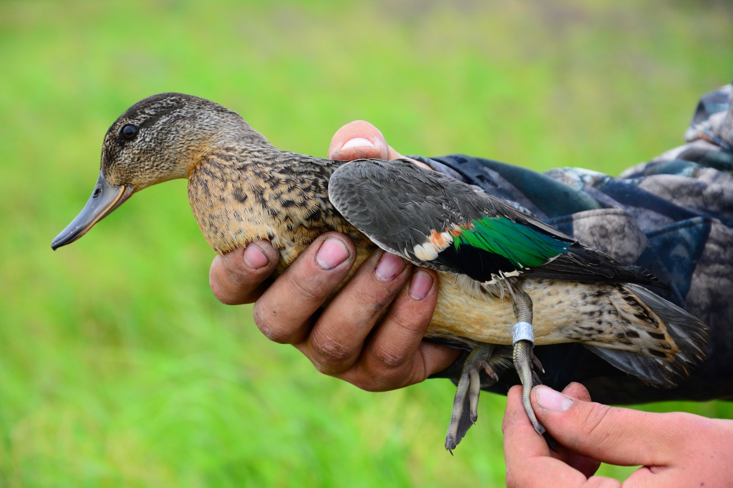
Sustainability of Resources
Wildlife biologists and natural resource scientists study species and their habitats.
Notes:
Studying wildlife and their habitats gives us a better idea of how various species impact their ecosystems and what a healthy population of each species looks like.

Slide 10
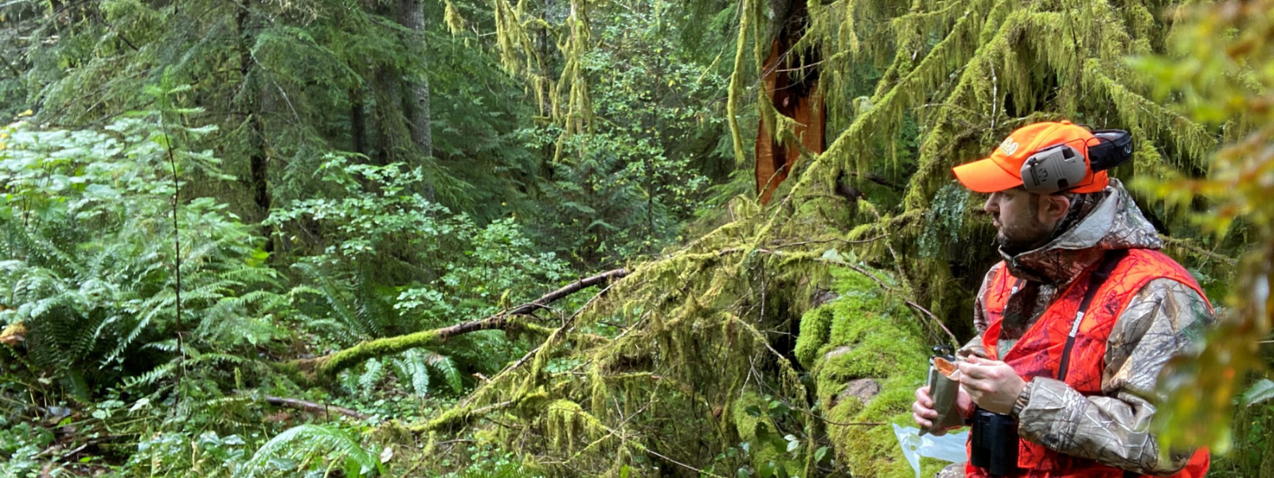
Sustainability of Resources
The data scientists collect inform management decisions which help protect the health of a species’ population.
This helps us make decisions that allow for sustainable populations of wildlife for hunters, trappers, anglers, and viewers.

Slide 11
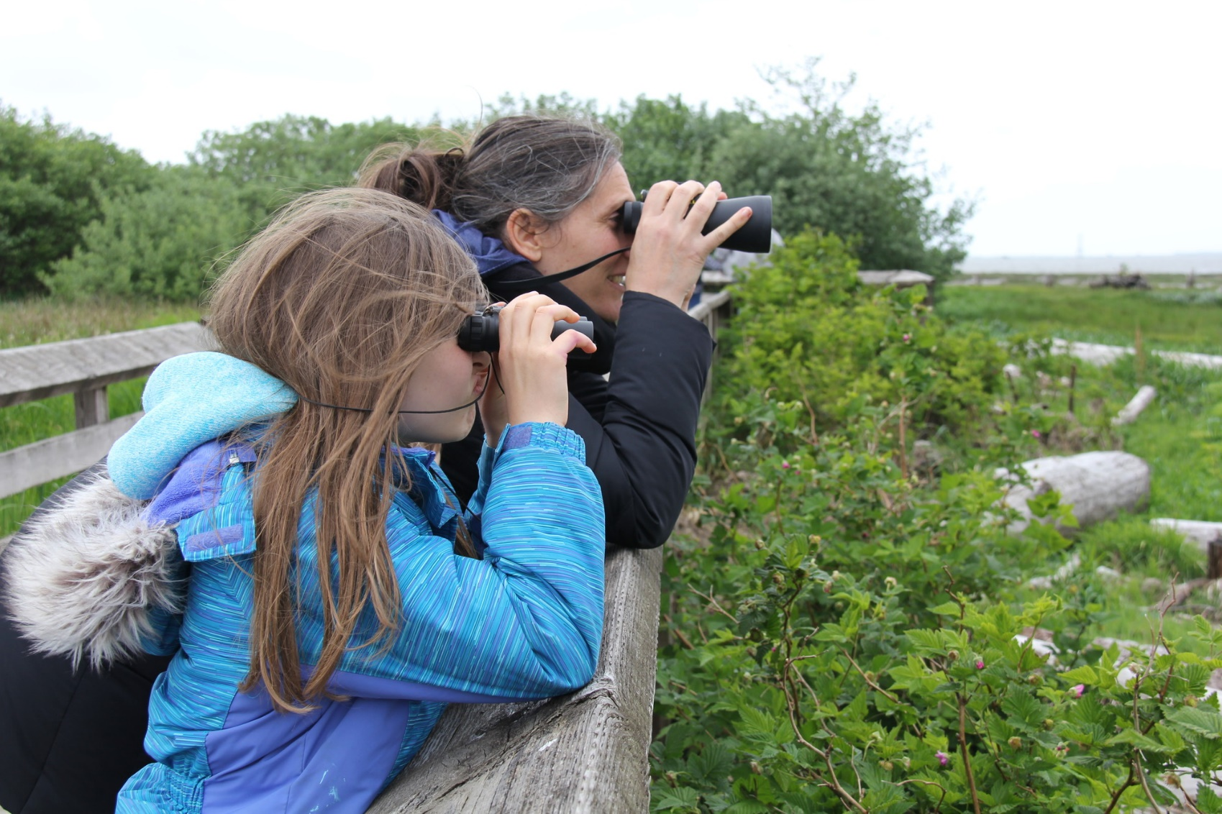
Balancing Public Values
Notes:
Because there are many ways that humans interact with wildlife, people have varying ideologies of how to manage wildlife. Wildlife managers use data from the best available science and public input to help inform decisions about wildlife management.

Slide 12
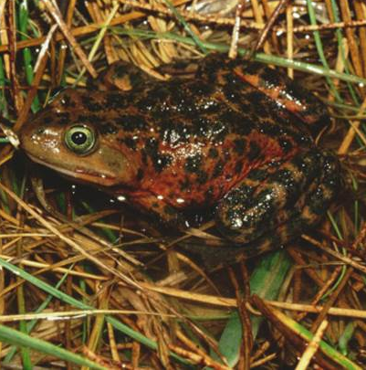
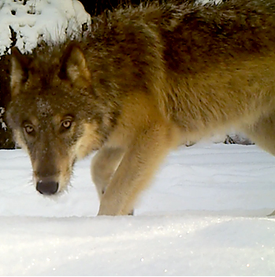
Balancing Public Interests
Because of the diverse ways communities interact with wildlife, management agencies balance competing interests of wildlife issues.
Examples include:
Predator management
Commercial fishing management
Recreational hunting, fishing, and trapping management
Endangered species management
Notes:
Ask students to think of other ways that wildlife may have conflicting interests on different groups.
Some examples include:
Wildlife conflict: Deer/elk eating agriculture crops, beavers flooding roads

Slide 13
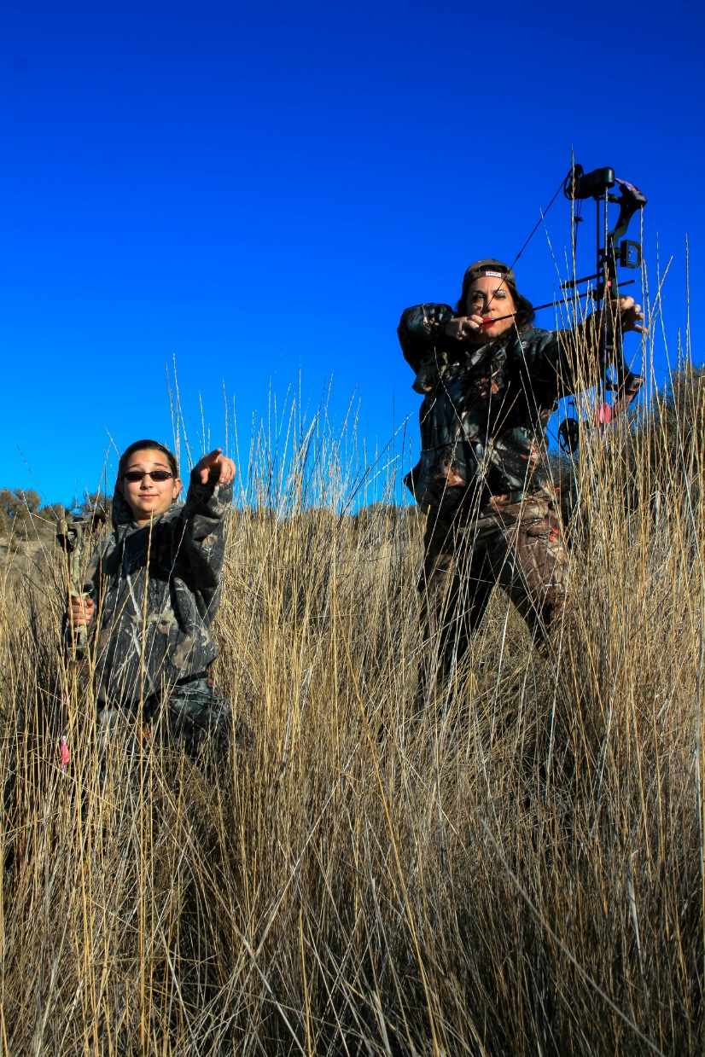
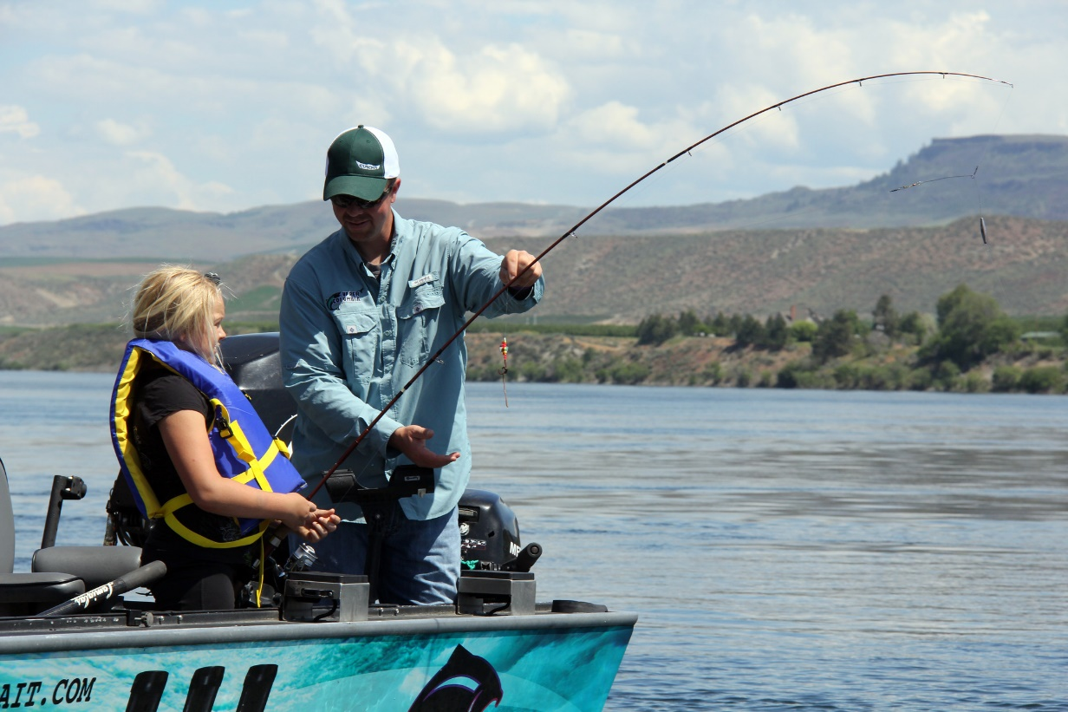
How is wildlife conservation funded?
Conservation Funding in the U.S.
Notes:
Traditionally, conservation funding has come from a sales tax on hunting and fishing equipment and license revenues. However, as these activities decline in popularity and threats to fish, wildlife, and habitats increase, funding to manage species may decrease.
The link will take you to a four-minute video on the history of conservation funding and its current challenges.
After viewing, ask students to share their ideas on how conservation should be funded in the U.S. Should it continue through the current system with hunters playing a vital role? Or, should it change ny taxing items associated with outdoor recreation (like tents or camping stoves)? By raising taxes on everyone?

Slide 14
How is wildlife conservation funded?
WDFW receives funding through a variety of ways.
Notes:
The State Wildlife Account is funding from Washington hunting and fishing licenses.
State General Fund is the 1% of general tax in Washington split between all Washington natural resource agencies. These funds support programs with statewide benefits such as salmon production, marine enforcement, environmental permitting, and habitat and species conservation.
The Federal General fund is revenue from the Pittman-Robertson and Dingell-Johnson Act.
Other funding can include revenue from license plates, grants, etc.

Slide 15
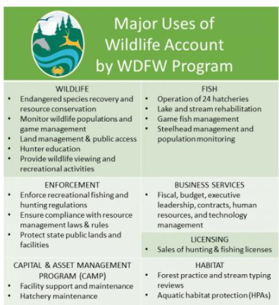
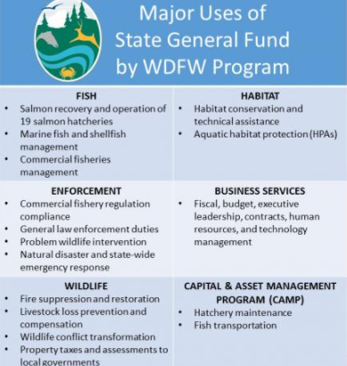
How funding is used
Notes:
Ask students to popcorn read through the different sections.
Remember:
Wildlife account=revenue from hunting/angling licenses
State general fund=general tax dollars

Slide 16
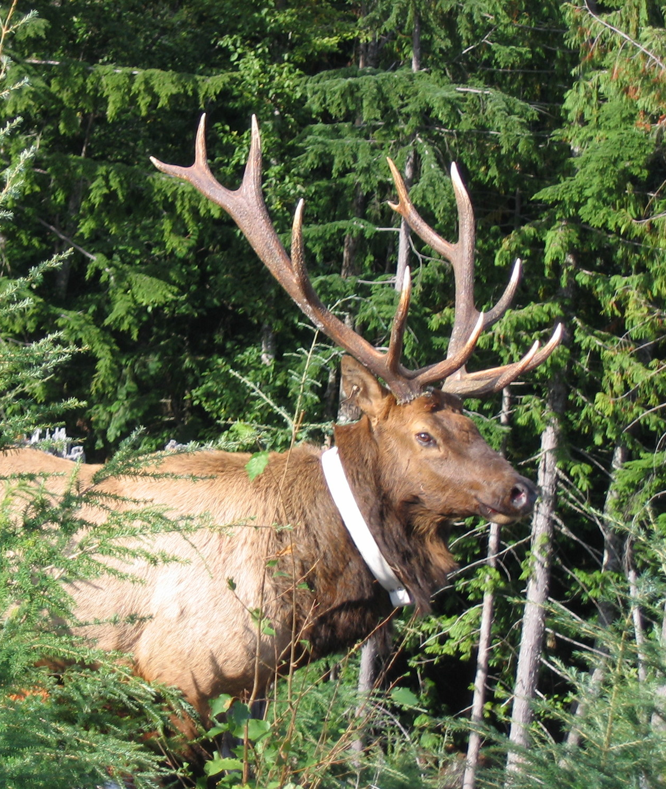
What else?
Why do you think it’s important to know how our wildlife agencies are funded and how money is spent?
Notes:
Have students think-pair-share for three minutes. Write student answers on a whiteboard or create a new textbox in this slide.

