Slide 1
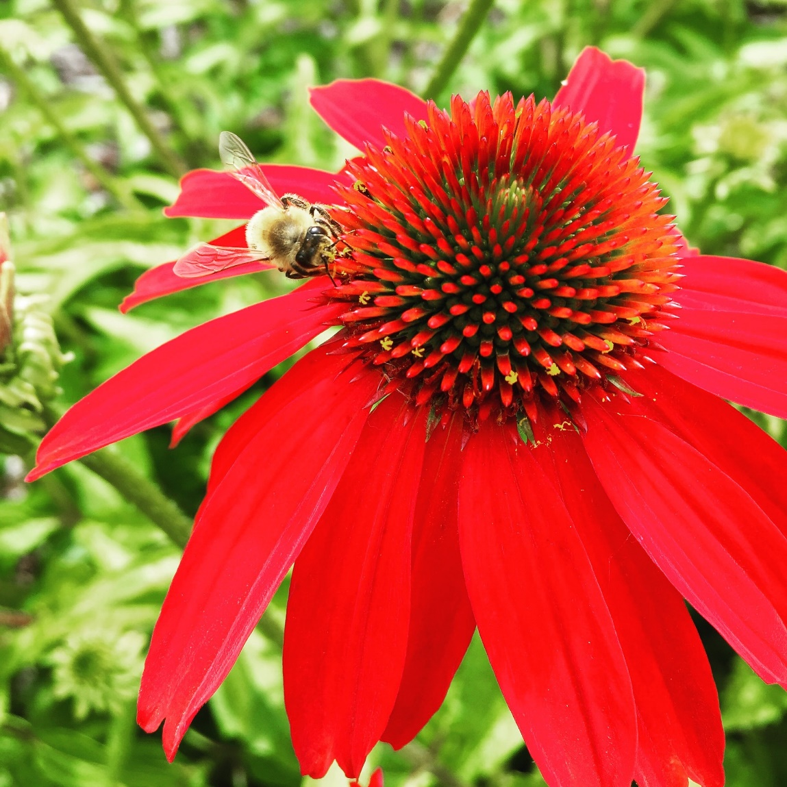
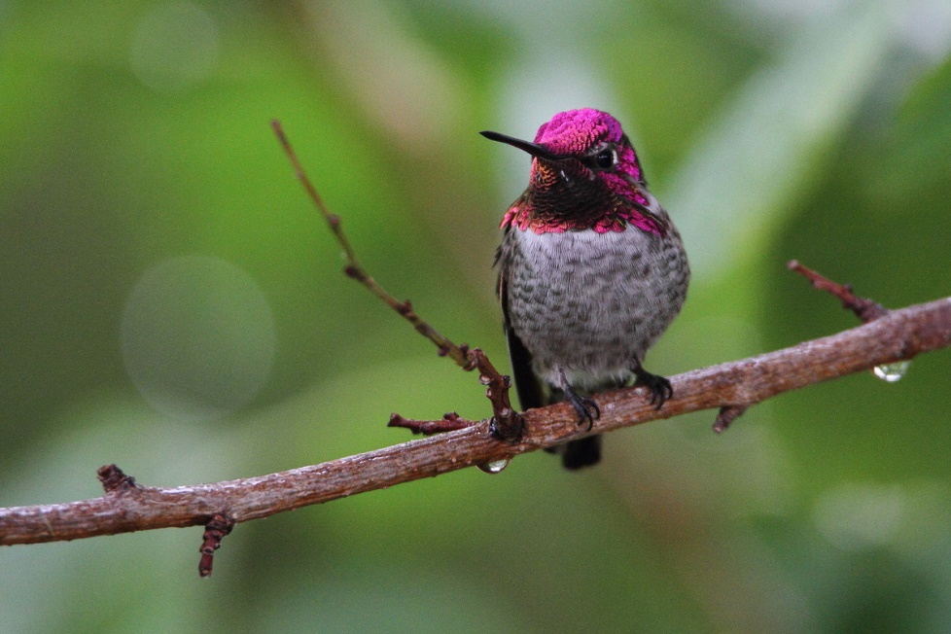
Pollinators

Slide 2
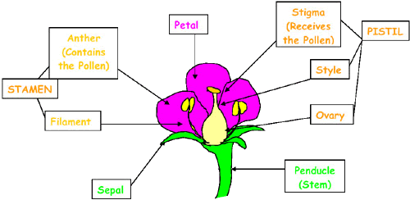
What is pollination?
Pollination is when pollen (male fertilizing agent) is moved from the anther of a flower to the female stigma. This process makes a seed.
Graphic courtesy of United States Forest Service
Notes:
Ask students if they know what pollination is before clicking to show the information.

Slide 3
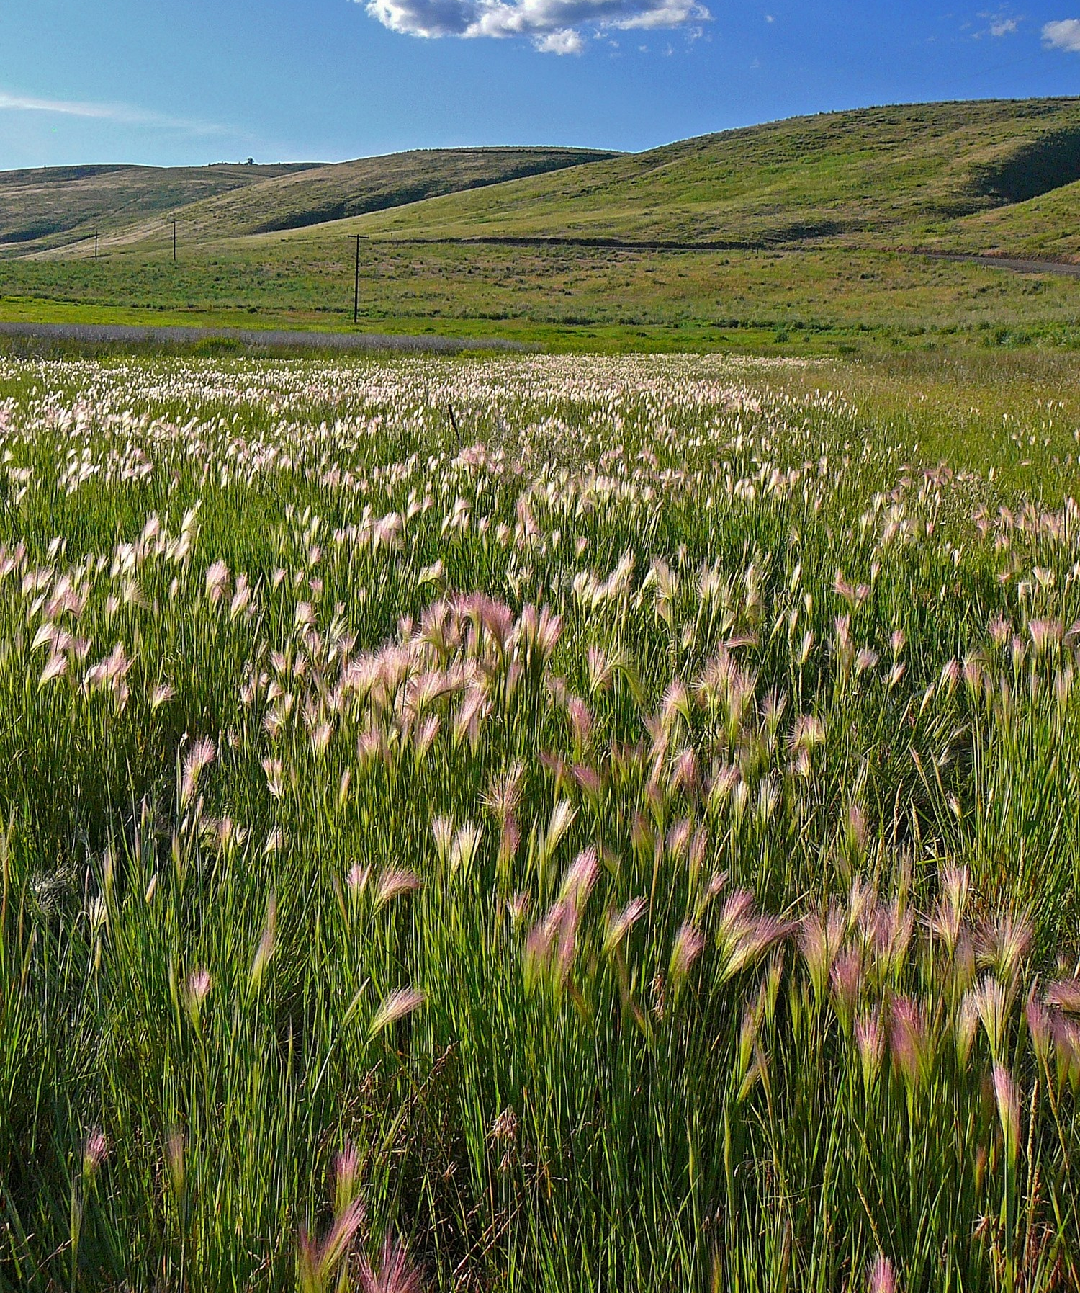
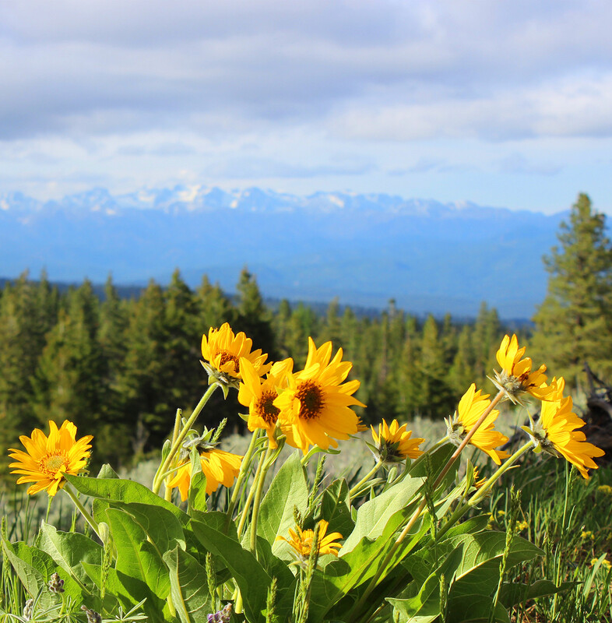
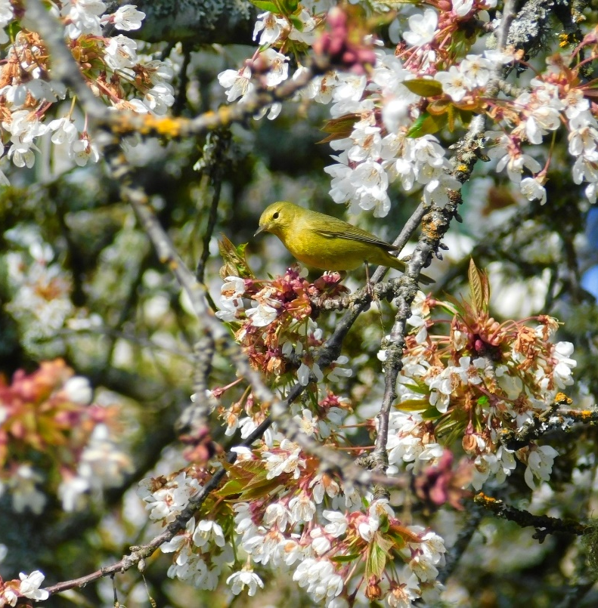
What types of plants need pollination?
Any flowering species. This includes trees, grasses and flowers.

Slide 4
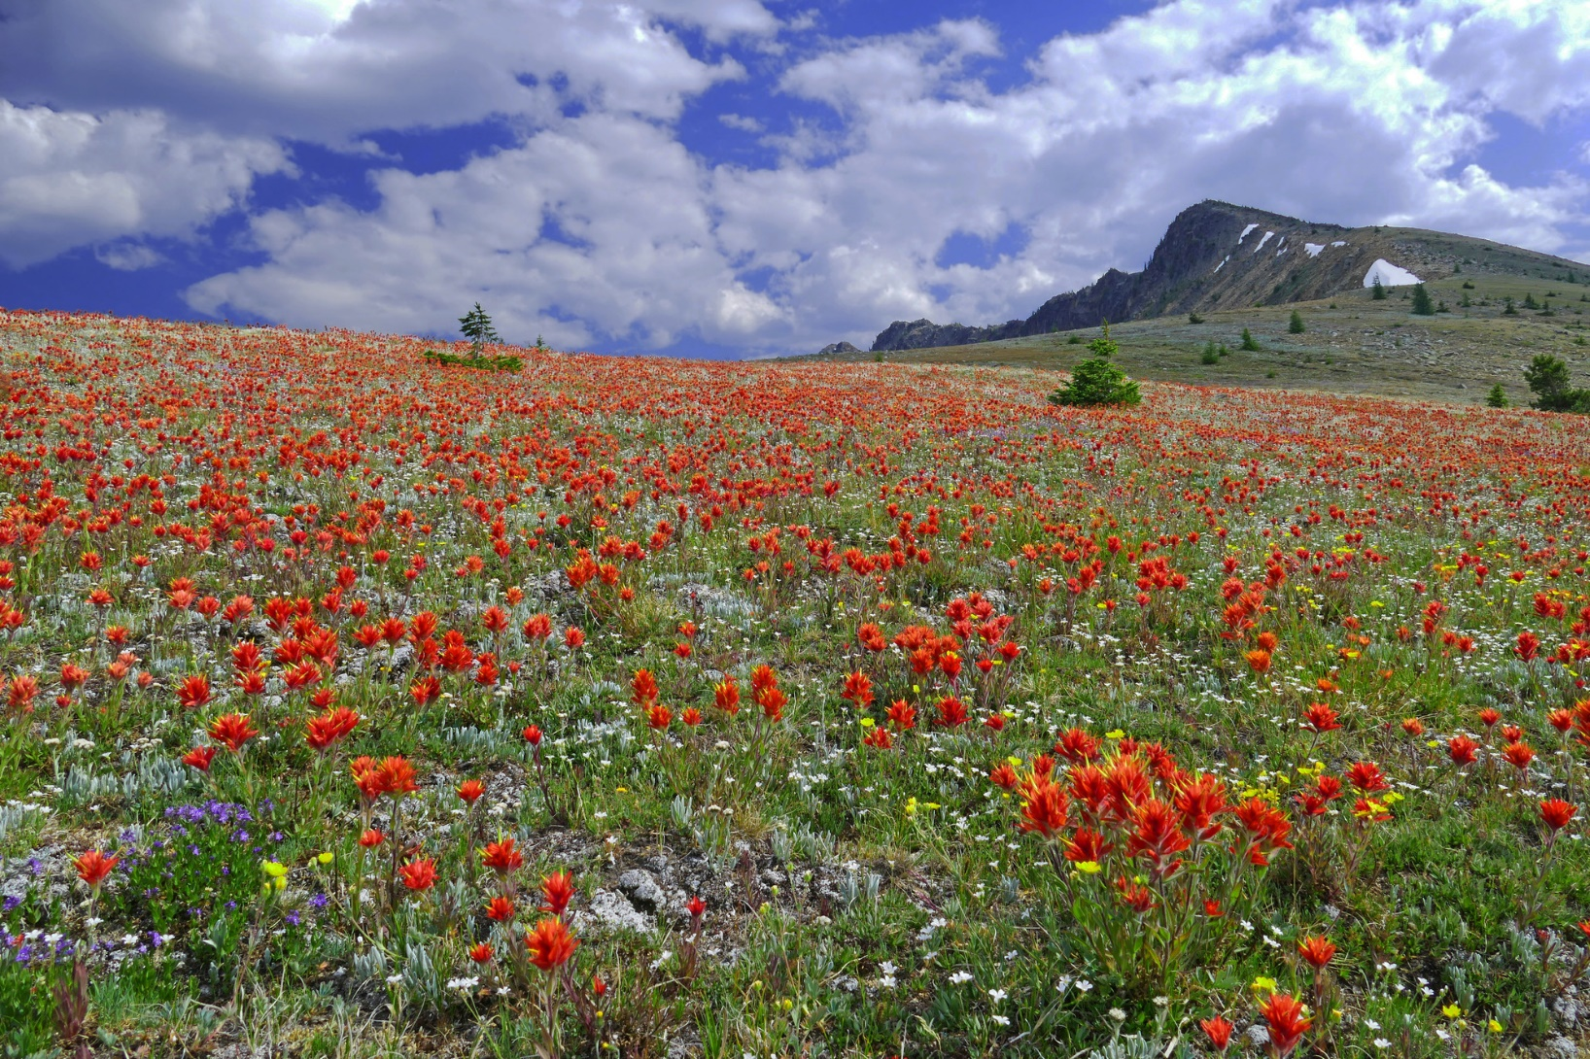
How does pollination occur?
Cross pollination can occur when wind, water, insects, and animals transfer pollen from one flower to another.
Notes:
Self pollination is when a stigma is fertilized by its own pollen.
Cross Pollination- when a plant is pollinated by a vector (wind, water, animal) to get the pollen from one plant to another plant of the same species.

Slide 5
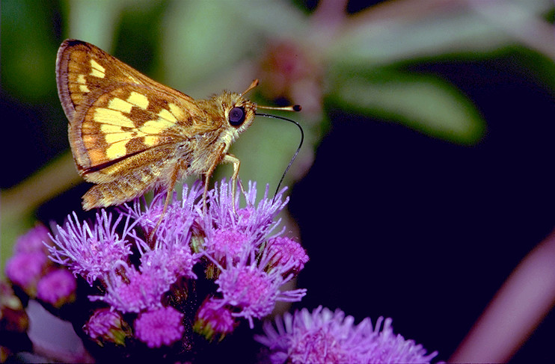
How does pollination occur?
Insects and animals who help pollinate are called pollinators. Pollinators land on flowers to eat, drink nectar, and collect pollen (a source of protein). Check it out
Notes:
When the animal visits another flower of the same species, this sticky pollen may fall off onto the stigma, resulting in fertilization.
The link takes you to a two-minute video of slow-motion footage of a bee collecting pollen.

Slide 6
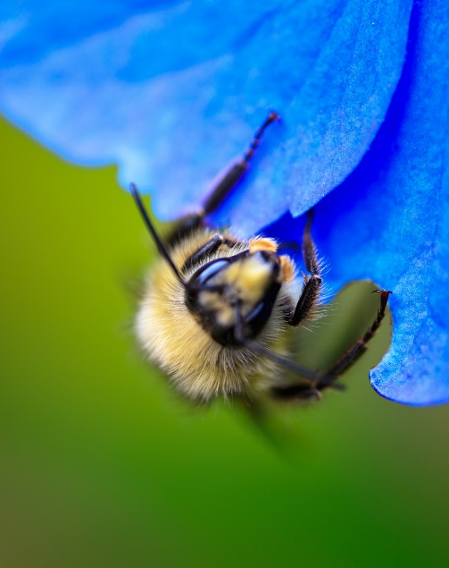
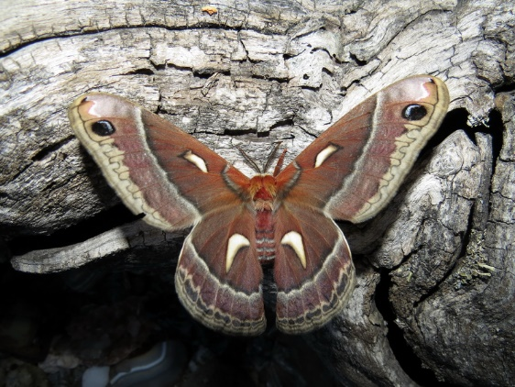
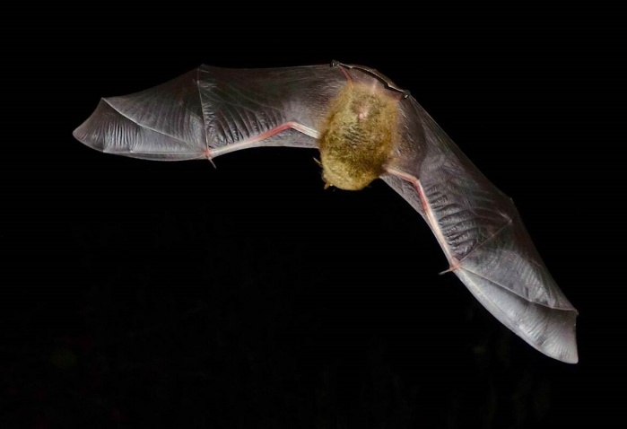
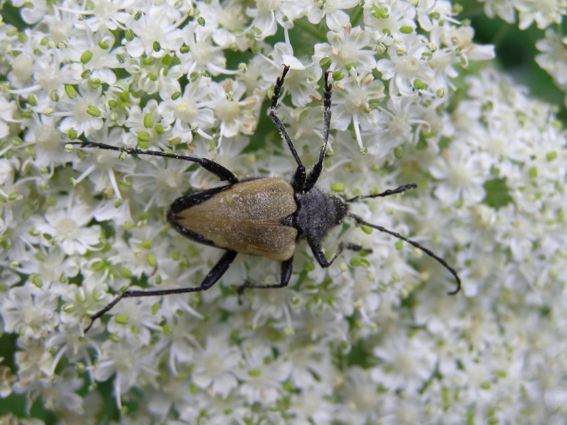
What types of species are pollinators?
Ants
Bats
Bees
Beetles
Birds
Butterflies
Flies
Moths
Wasps
And in some parts of the world:
Monkeys, reptiles, marsupials, and rodents.
Notes:
Ask students to give some ideas of what species may pollinate flowers.

Slide 7
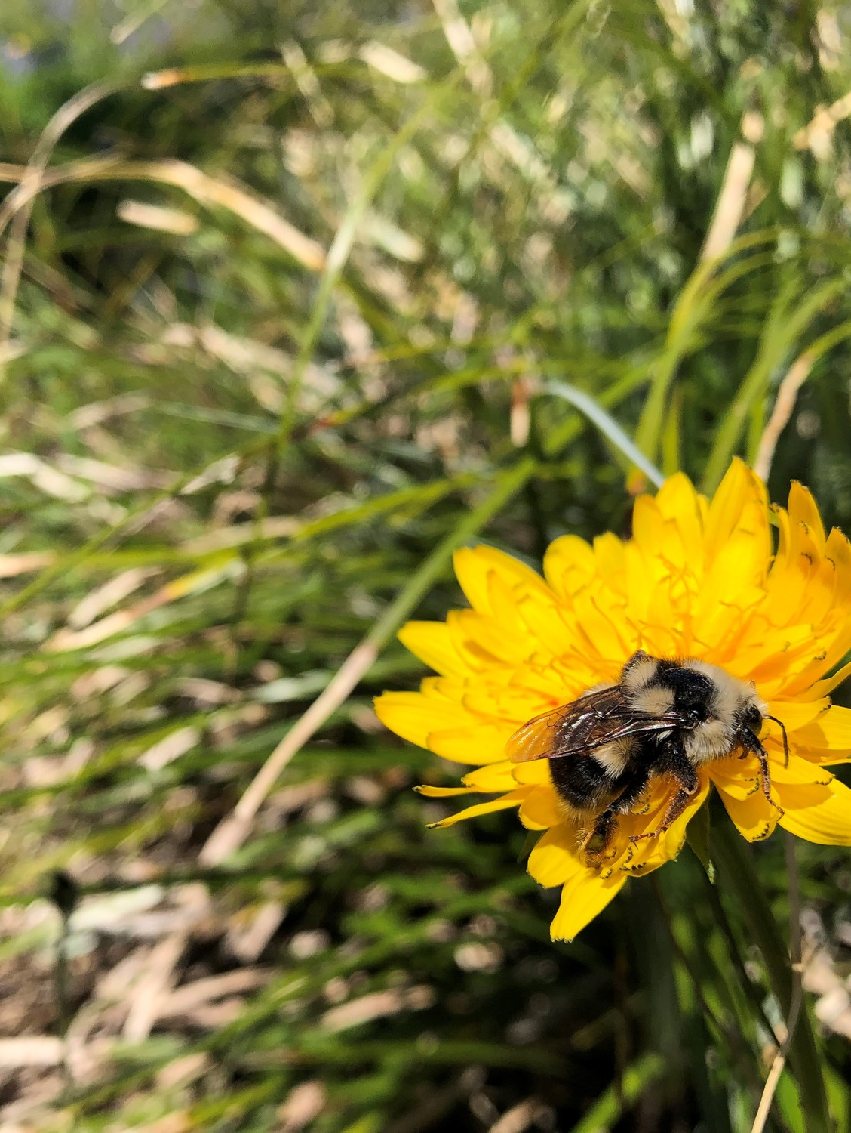
Pollination Syndrome
Plants, animals, and insects have evolved physical characteristics together that make them more likely to interact.
Notes:
This is called pollination syndrome. It means that specific types of plants attract specific types of pollinators.

Slide 8
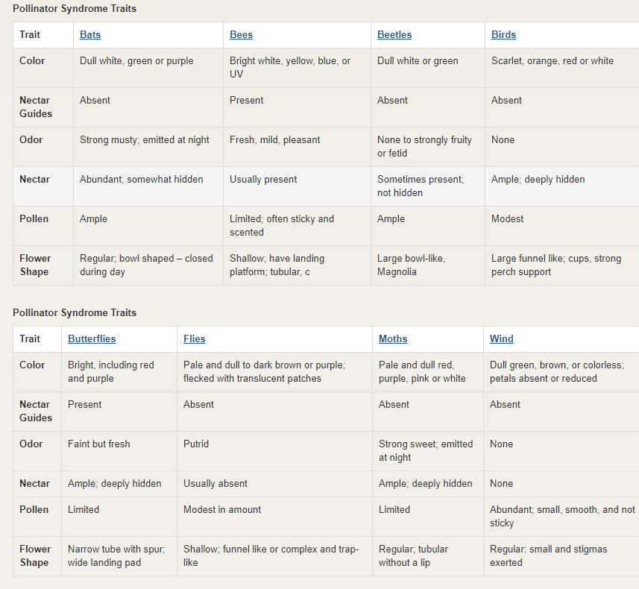
Graphic courtesy of United States Forest Service
Notes:
Ask students to work with a partner and answer the following questions:
What color are wind pollinated flowers?
Describe the shape of flowers that bees pollinate.
What flower odor are flies attracted to?
What color flowers do bats pollinate?
Describe the flower odor that moths are attracted to.

Slide 9
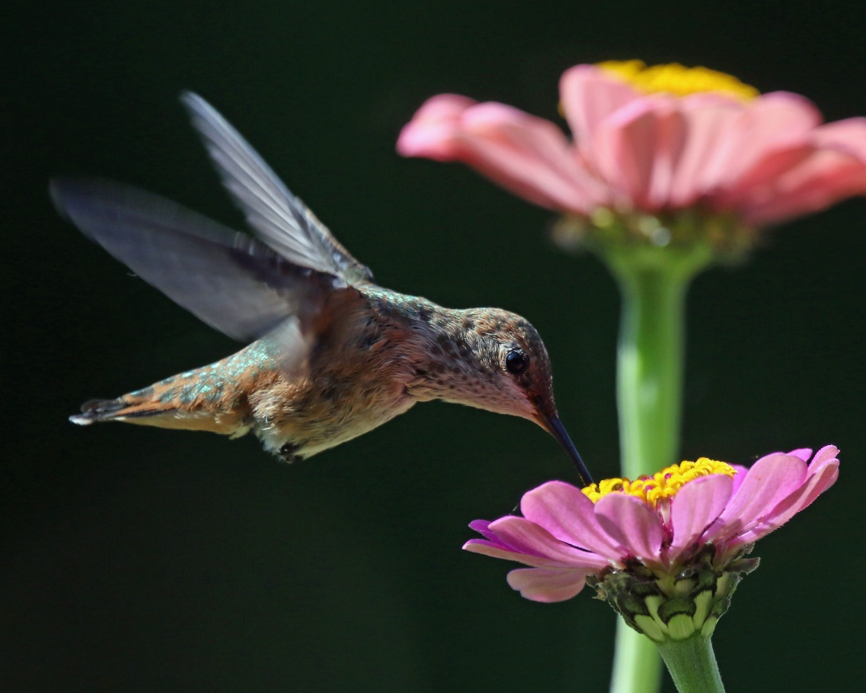
Why are pollinators important?
Almost 80% of the 1,400 crop species around the world require pollination.
At least 1/3 of the foods you eat depend on pollinators.
Between 75-95% of all flowering plants need pollinators to survive.
Notes:
This includes foods like coffee and chocolate, bananas, mangoes, and so much more.
In the U.S. pollination produces nearly $20 billion worth of products each year.

Slide 10
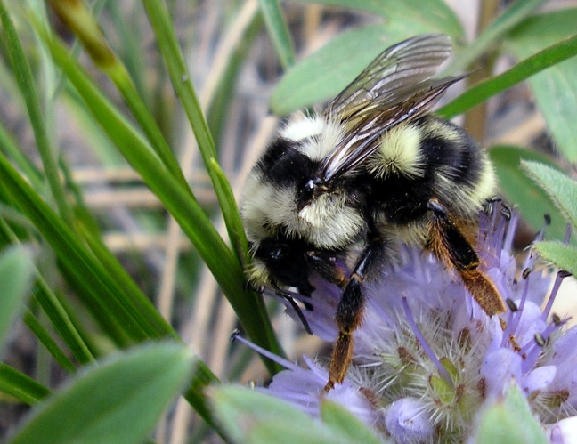
Pollinators in decline
In the last 20 years, monarch butterflies have declined by 90%.
Bumblebees (pollinator superstars) are in decline by 25%
Notes:
Unfortunately, many pollinator species are in decline.
This is largely due to a loss in feeding and nesting habitats.

Slide 11
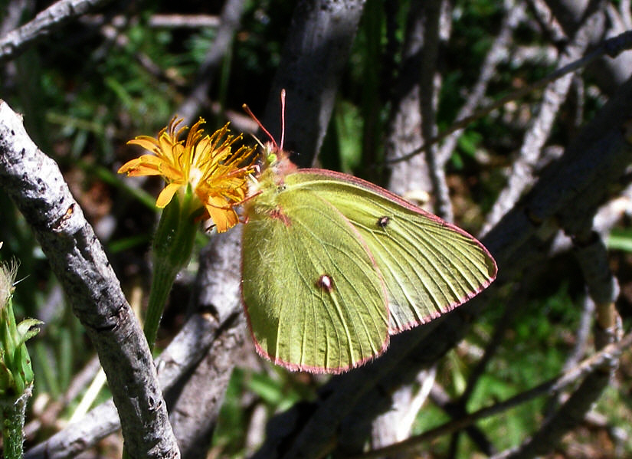
What’s driving decline?
Loss of feeding and nesting habitat,
Pesticides
Disease,
Anthropogenic global warming
(changes in phenology)
Let’s learn more
Department of Fish and Wildlife
Notes:
Phenology: Cyclic and seasonal natural phenomena, especially in relation to climate and plant and animal life.
The link takes you to a five-minute video about the importance of pollinators and bees.

Slide 12
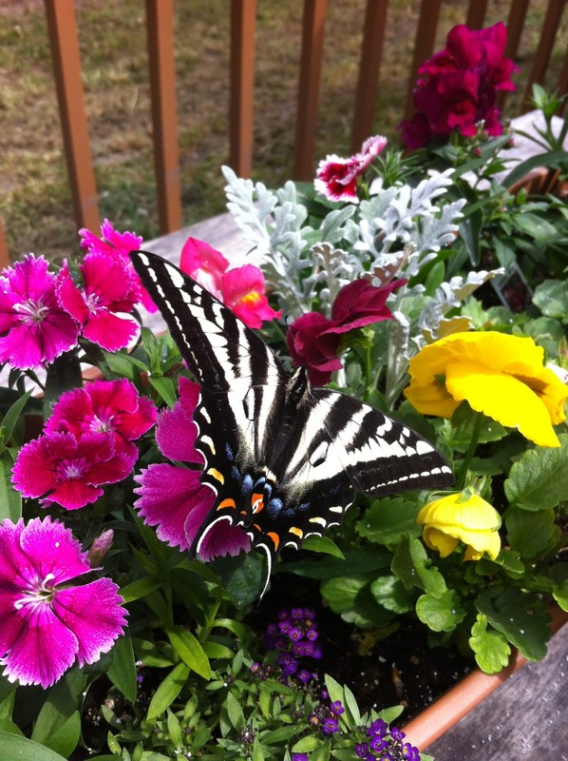
What can we do to help?
Plant flowers– this adds habitat.
Get involved with community science
Talk to people about pollinators
Reduce or eliminate pesticide use.
Notes:
Ask students if they remember what the video suggested for ways to help pollinators before clicking on some answers. Add other answers that are not listed that students come up with.

Slide 13
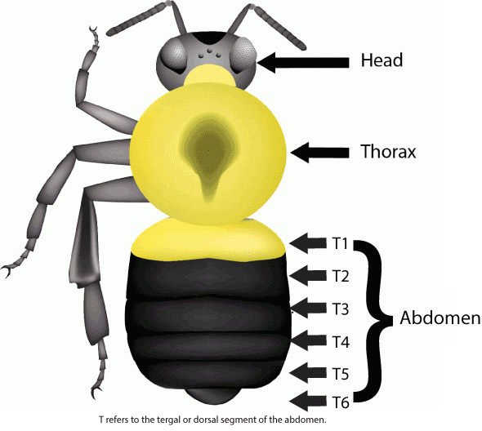
How to Identify a bumble bee
When you think of a bumble bee, do you picture the iconic yellow and black stripes?
Most bumble bees have those black and white stripes, but can also vary in coloration.
Graphic courtesy of Bumble Bee Watch
Notes:
They can also have white, red, and orange coloring. Like all insects, bumble bees have three main body parts: head, thorax, and abdomen.

Slide 14
How to Identify a bumble bee
The coloration of these parts is used to identify bumble bee species.
With careful observation, you can learn to identify the different species of bumble bees in your backyard or schoolyard.
Graphic courtesy of Bumble Bee Watch
Notes:
They can also have white, red, and orange coloring. Like all insects, bumble bees have three main body parts: head, thorax, and abdomen.

Slide 15
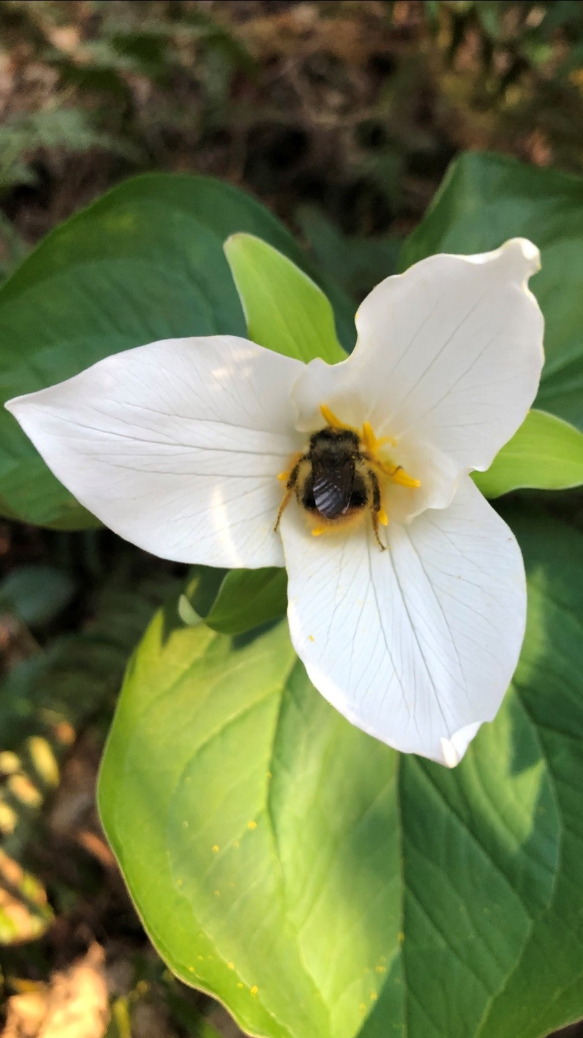
Helping Scientists
Scientists across North America are working together to study nearly 50 species of bumble bees and why their populations are declining. Causes likely include loss of habitat, pesticide use, climate change, and competition with honey bees.
Notes:
They can also have white, red, and orange coloring. Like all insects, bumble bees have three main body parts: head, thorax, and abdomen.

Slide 16
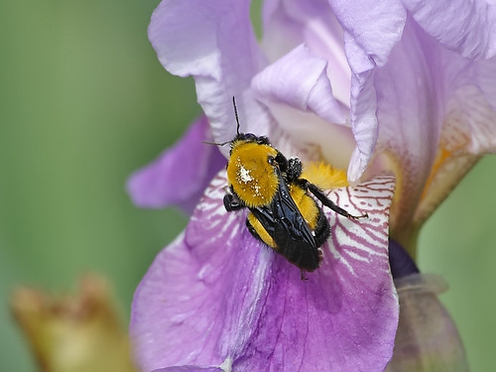
Helping Scientists
Scientists need a better understanding of where bumble bees are to help protect them. You will help them by sharing photos of bumble bees you find in your schoolyard and neighborhood.
Notes:
After this slide, explain to students they are going to go into their school yard in small groups and look for bees. This data will then be used to help scientists better understand where bees are in Washington. Pass out the students instruction sheet.

