Slide 1
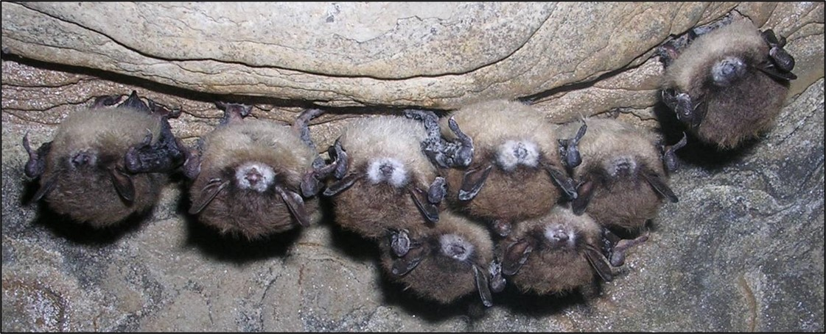
Wildlife Disease

Slide 2
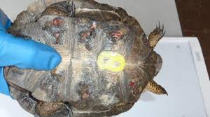
What is Wildlife Disease?
Disease is the change in the normal function of any part or organ of the body.
Western Pond Turtle with shell disease which forms deep pitting lesions in the turtles’ shells.
Disease can impact an individual, or a populations’ ability to reproduce and survive– Especially threatened and endangered species like Western pond turtles.

Slide 3
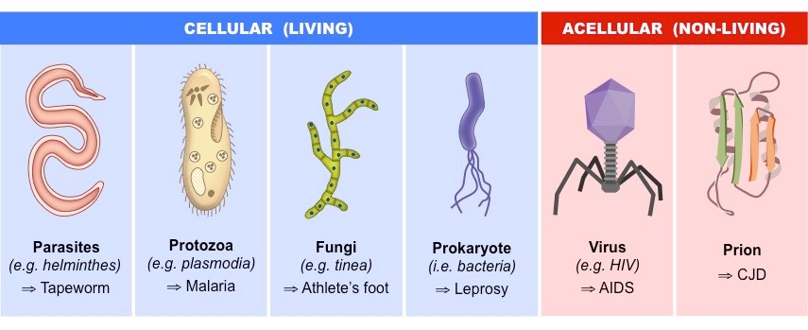
What Causes Disease?
Disease is caused by a pathogen; a parasite, bacteria, fungi, virus, or prion.
Photo from: https://ib.bioninja.com.au/
Notes:
Pathogens are an infectious agent that carries disease.
Prions are an infectious protein that has folded abnormally into a structure capable of causing disease, i.e., Chronic Wasting Disease in ungulates.
To learn more about pathogens please follow this link. https://ib.bioninja.com.au/standard-level/topic-6-human-physiology/63-defence-against-infectio/pathogens.html

Slide 4
What Spreads Disease?
Disease is typically a normal part of ecosystems.
However drivers such as:
changes in land use (i.e., forest to farmland),
anthropogenic climate change,
increased interactions between humans, domestic animals, and wildlife (i.e., urbanization)
illegal wildlife trade, and
introduced and invasive species,
are increasing both the rate and intensity of disease.

Slide 5
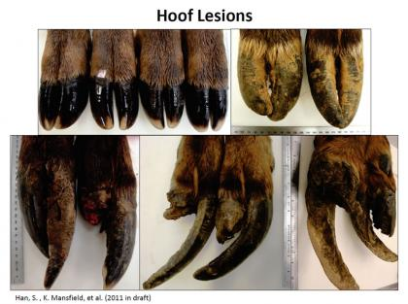
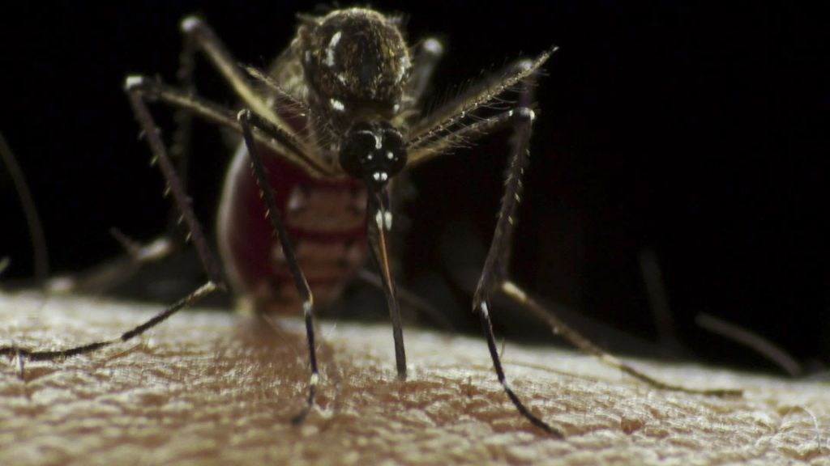
What Spreads Disease?
Disease is commonly spread among the environment or through a vector species.
Elk hoof disease- through the environment
West Nile Virus- through a vector
"Aedes aegypti mosquito" by Sanofi Pasteur is licensed under CC BY-NC-ND 2.0
Notes:
Vectors are species that carry and spread disease to other organisms (i.e., ticks and Lyme disease).
For example, elk hoof disease causes elk to have deformed hooves and lesions and often results in mortality. This disease is caused by a bacteria that spreads in cool, damp environments. Because elk congregate in meadows and pastures, one infected elk could spread the disease to many in the heard.
West Nile virus is a blood-borne disease that is transmitted by mosquitos. Thousands of wild birds and fewer wild mammals have died of West Nile in the U.S. since 1999. There are still active cases of West Nile virus in both humans and birds.

Slide 6
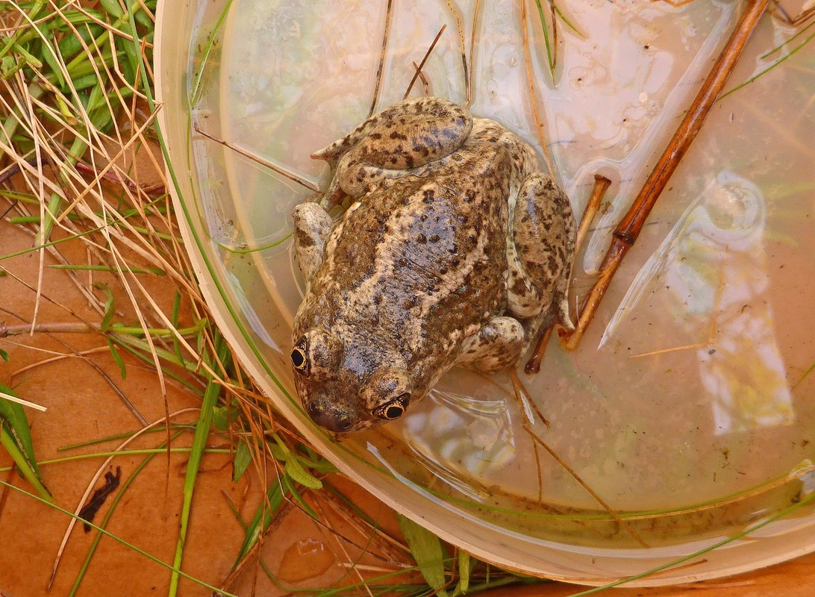
Why should I care about wildlife disease?
Zoonoses
Impacts to ecosystems services
Impacts to populations, reduction in biodiversity
Notes:
Before revealing definitions, ask students if they know what the bolded vocabulary words mean.
Zoonoses are diseases that can be transmitted between humans and animals, some examples include rabies, West Nile, Lyme, just to name a few. 60% of infectious diseases in humans are zoonoses.
Ecosystem services: Benefits people obtain from ecosystems, plants, and wildlife.
Biodiversity: The full range of life in all its forms. This includes the habitats in which life occurs, the ways that species and habitats interact with each other, and the physical environment and the processes necessary for those interactions.

Slide 7
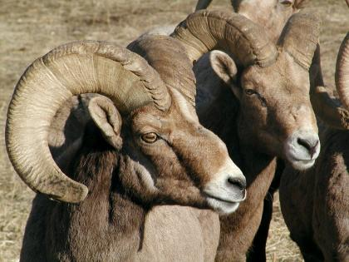
Zoonoses
When humans come into contact with wildlife, the risk for zoonoses increase.
Many types of pathogens can transfer from wildlife to humans.
Unfortunately, new zoonoses are on the rise.
Notes:
The link takes you to a 1:30 video that explains the increase in zoonoses, how zoonoses transfer and what is being done.
Other zoonoses include: SARS, Ebola, Zika, Swine Flu.

Slide 8
Ecosystem Services
Biodiversity provides us with many ecosystem services.
Increase occurrence and rate of diseases threatens many species that provide with ecosystem services.
For example, bats (insect eaters and pollinators).
Notes:
Ask students if they can think about wildlife diseases they have heard of that impact species. Some examples could be, white-nose syndrome in bats, elk hoof disease, pneumonia in bighorn sheep.
Link takes you to a seven-minute video featuring work around white-nose syndrome (a fungus) in bats.

Slide 9
Populations and Biodiversity
Biodiversity helps build ecosystem resilience.
If a species or population is wiped out from disease, biodiversity and overall ecosystem health is reduced .
Notes:
Increase in disease types and occurrences may reduce a species ability to recover from disturbance.
For example, a new study shows that white-nose syndrome killed over 90% of three bat species in less than 10 years. https://www.usgs.gov/news/white-nose-syndrome-killed-over-90-three-north-american-bat-species

Slide 10
Diseases in Washington
Wildlife in Washington face many diseases. Some pose more of a threat to species’ populations than others. Some of these include:
White nose syndrome
Elk hoof disease
Salmonella
Pneumonia (bighorn sheep)
Turtle shell disease
Chytrid fungus and ranaviruses (amphibians)

Slide 11
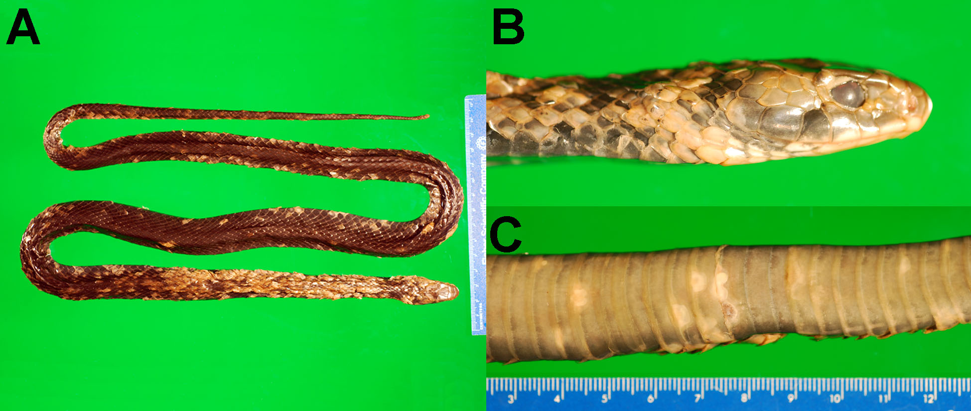
Emerging threats
Other diseases like chronic wasting disease and snake fungal disease have not entered Washington yet, but have been diagnosed in animals in nearby states.

Slide 12
Disease management
So how do wildlife managers, biologists, and veterinarians help whole populations of recover from disease?
Each disease, and each species has a different management strategy.
Notes:
For example, with elk hoof disease managers don’t move elk from infected populations. They research to learn more and rely on community science to help them monitor the spread of the disease.

Slide 13
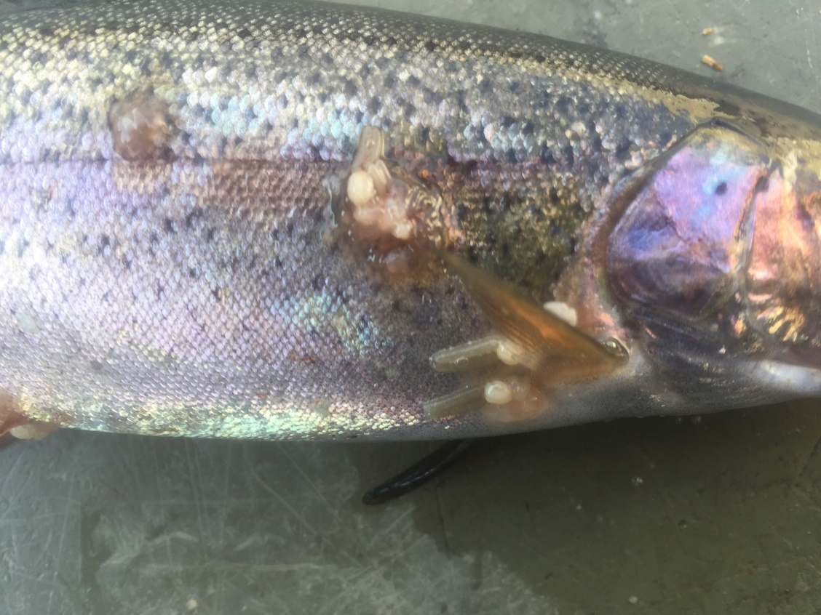
Disease management
Often, wildlife veterinarians and biologists work together to research the disease and attempt to prevent the spread among the population.

Slide 14
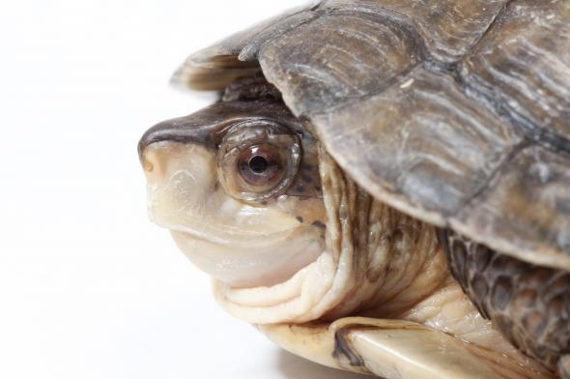
Disease Management.
For threatened and endangered species, like the Western pond turtle, more action might be taken.
Notes:
The link takes you to a short, two-page article about how the WDFW and partners are helping Western pond turtles and managing shell disease within the population.

Slide 15
Turtle Shell Disease
According to the reading:
- Describe why WDFW and partners “head-start” Western Pond turtles.
- What do we know about the disease?
Notes:
Have students think-pair and then share answers as a class.
Type student answers into the text box.

Slide 16
Turtle Shell Disease
According to the reading:
-What are we trying to research and learn about the disease?
Do you think head-starting is worth the risk of shell disease? Why or why not?
Notes:
Have students think-pair and then share answers as a class.
Type student answers into the text box.
Afterward have students watch this short video about how WDFW help recover turtles with shell disease: https://www.king5.com/article/tech/science/environment/turtle-shell-disease-scans-show-alarming-lesions/281-330253351

