Slide 1
This slide deck contains three habitats. Each habitat contains a different set of five herps. You will choose which three herps are most likely to be found in each habitat.
For this activity, you will look at the photograph of the habitat and use the Amphibians and Reptiles of Washington guide to help you decide which herps might be found in each habitat photo.
Please answer all questions in complete sentences.

Slide 2
Describe the habitat. Does it look wet or dry? What types of plants do you see?
Think about the colors in this habitat. For herps to camouflage themselves, what colors do you think they would need to be?
Look on slide 3. Which of the species from slide 3 do you think would live in this habitat? You will cut and paste the picture of the herp from slide three onto slide one (habitat photograph).
Identify each species (all five) as a reptile or amphibian.
5. Why do you think this species belongs here? What adaptations do they have that help them live in this habitat?

Slide 3
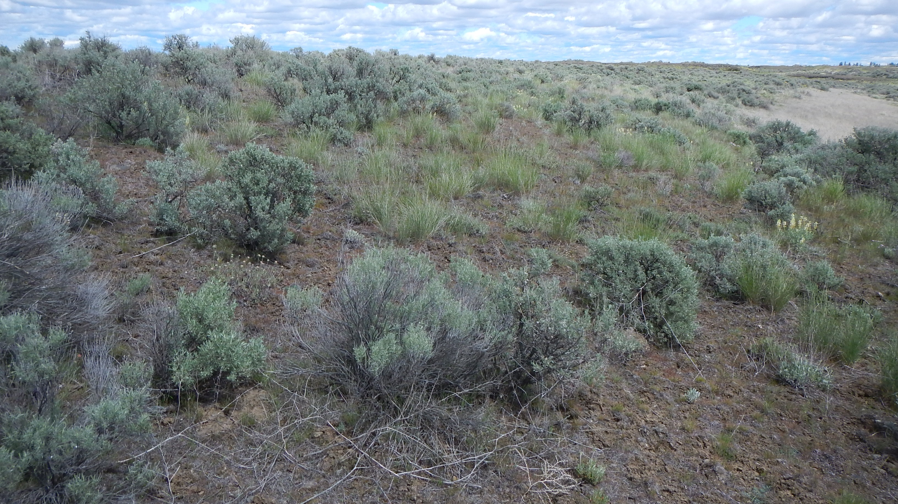
Eastern Washington

Slide 4
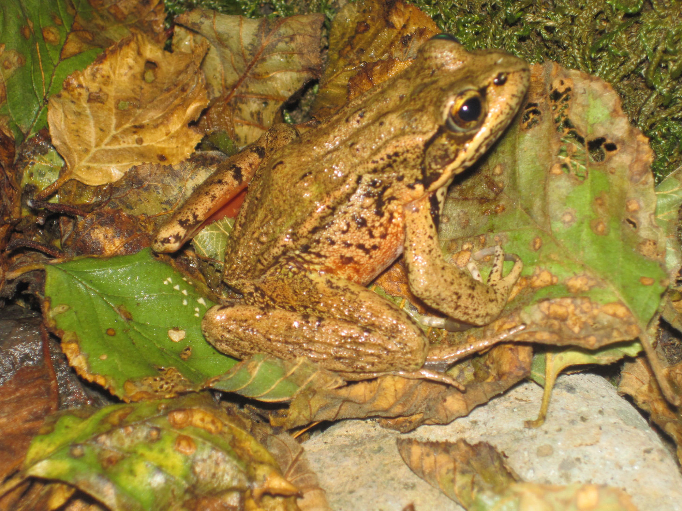
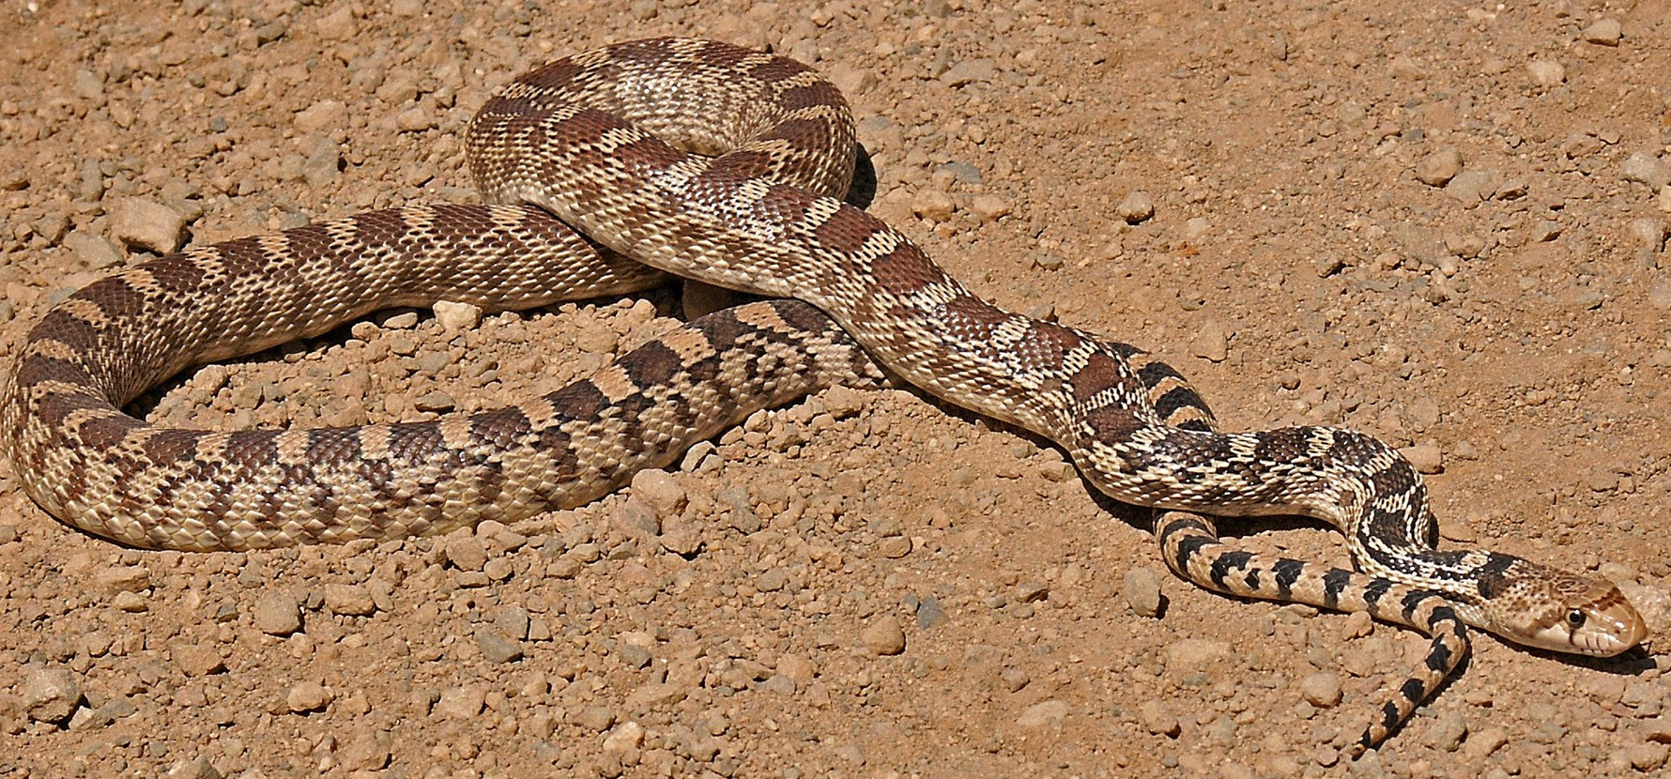
Western Pond Turtle
Gopher Snake
Northern red-legged frog
Spadefoot toad
Pygmy short-horned lizard

Slide 5
Describe the habitat. Does it look wet or dry? What types of plants do you see?
Think about the colors in this habitat. For herps to camouflage themselves, what colors do you think they would need to be?
Look on slide 3. Which of the species from slide 3 do you think would live in this habitat? You will cut and paste the picture of the herp from slide three onto slide one (habitat photograph).
Identify each species (all five) as a reptile or amphibian.
Why do you think this species belongs here? What adaptations do they have that help them live in this habitat?

Slide 6
Central Washington

Slide 7
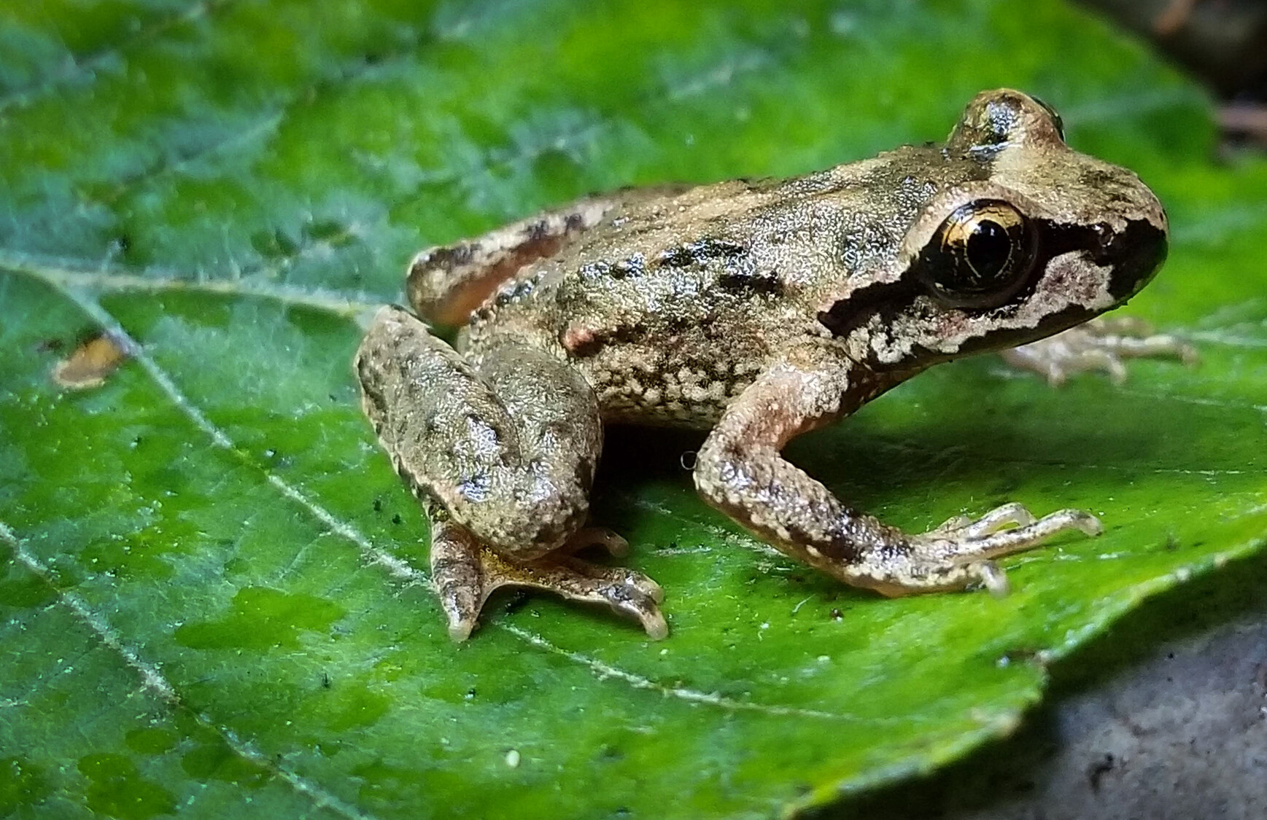
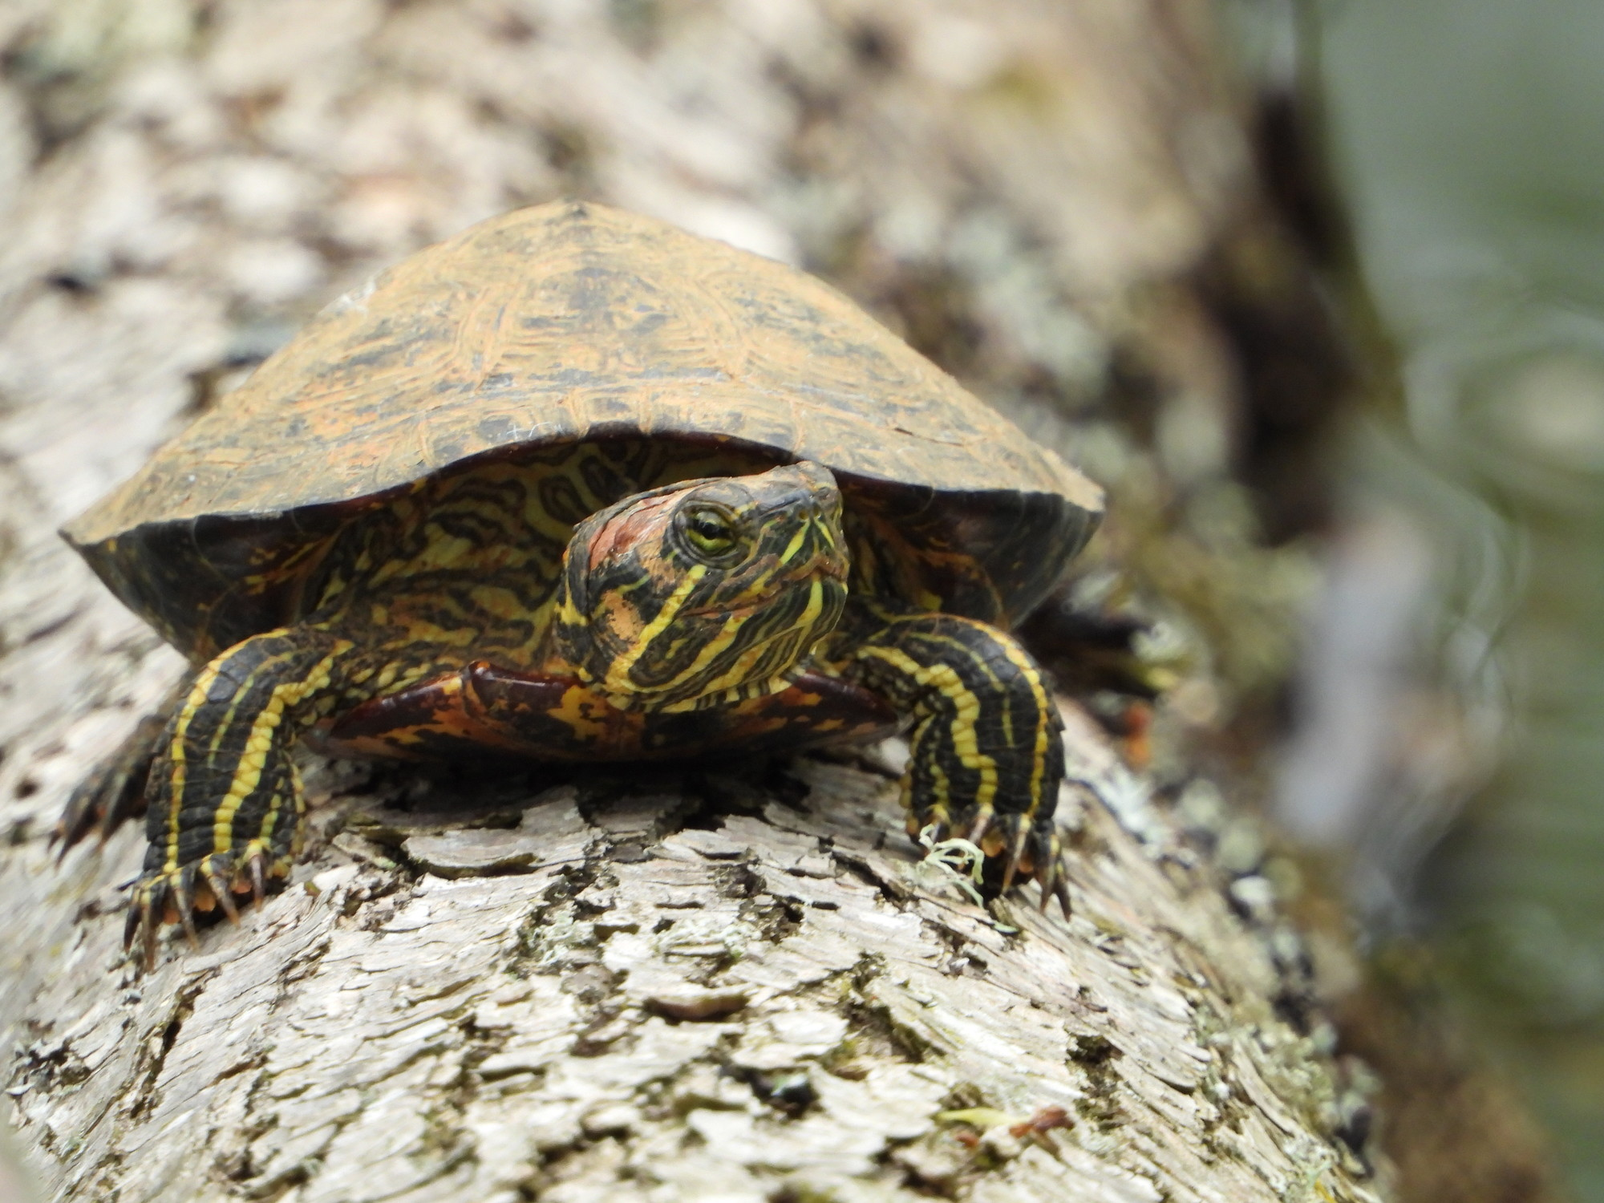
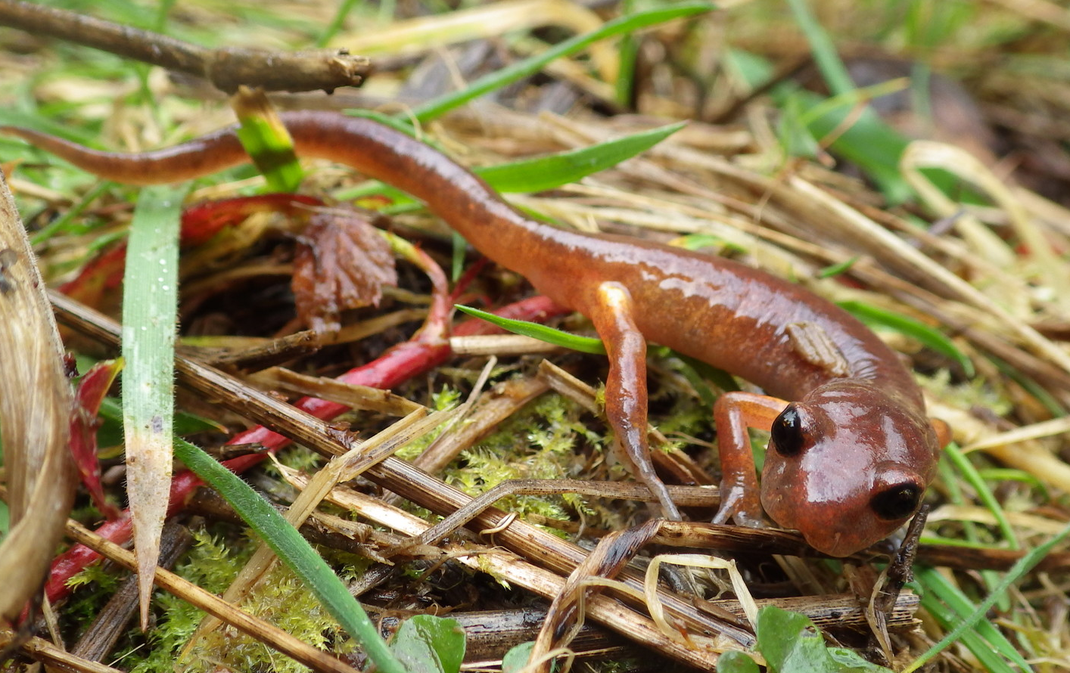
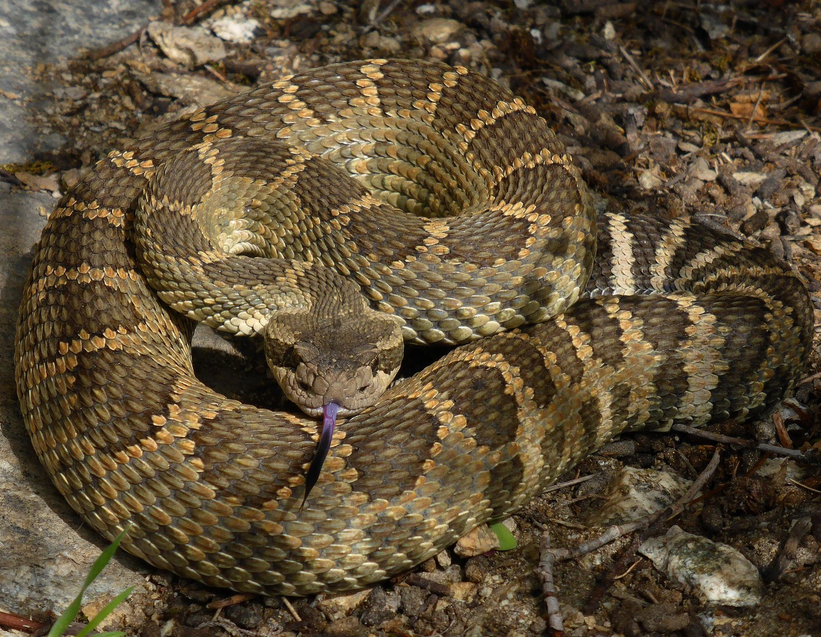
Coastal tailed frog
Painted turtle
Side blotched lizard
Ensatina salamander
Pacific rattlesnake

Slide 8
Describe the habitat. Does it look wet or dry? What types of plants do you see?
Think about the colors in this habitat. For herps to camouflage themselves, what colors do you think they would need to be?
Look on slide 3. Which of the species from slide 3 do you think would live in this habitat? You will cut and paste the picture of the herp from slide three onto slide one (habitat photograph).
Identify each species (all five) as a reptile or amphibian.
Why do you think this species belongs here? What adaptations do they have that help them live in this habitat?

Slide 9
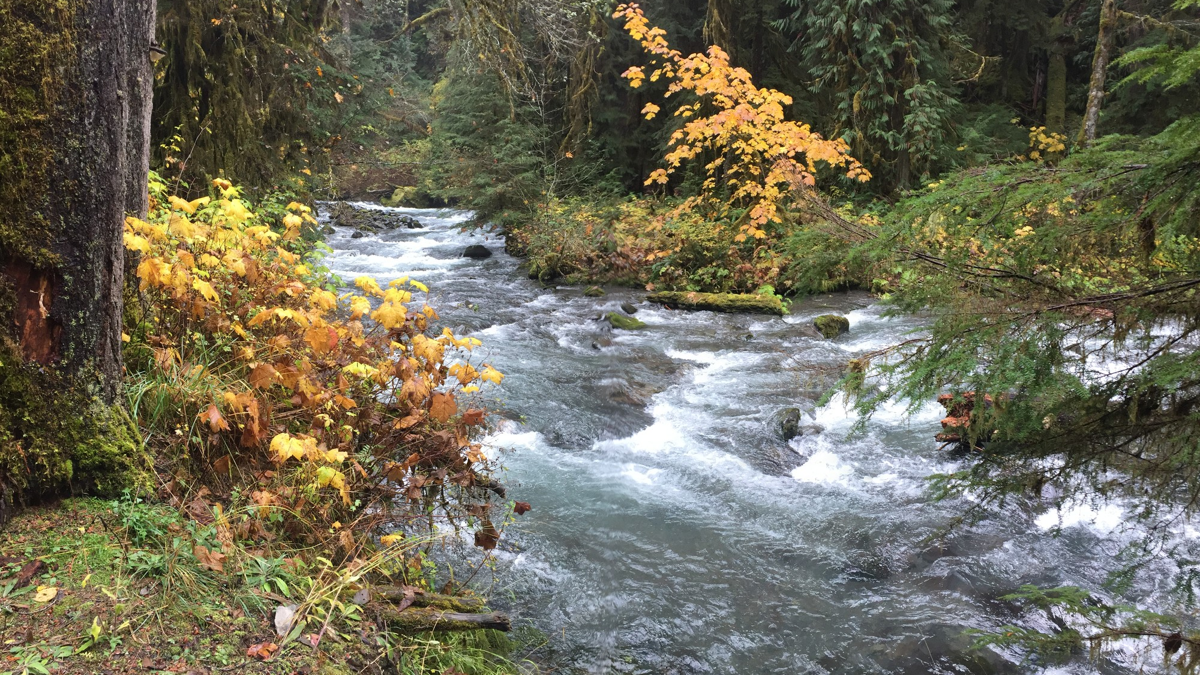
Western Washington

Slide 10
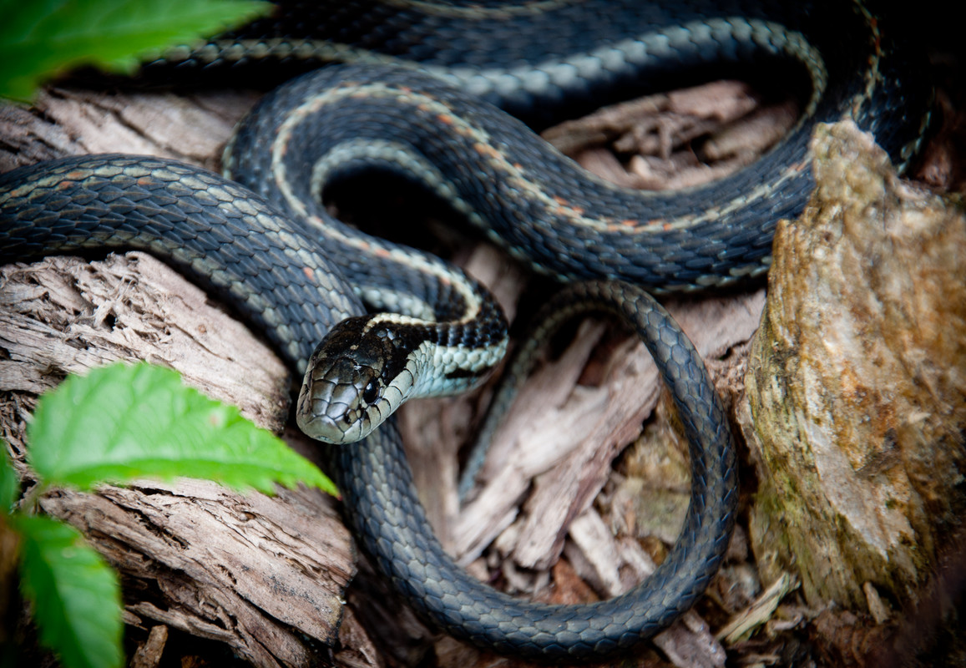
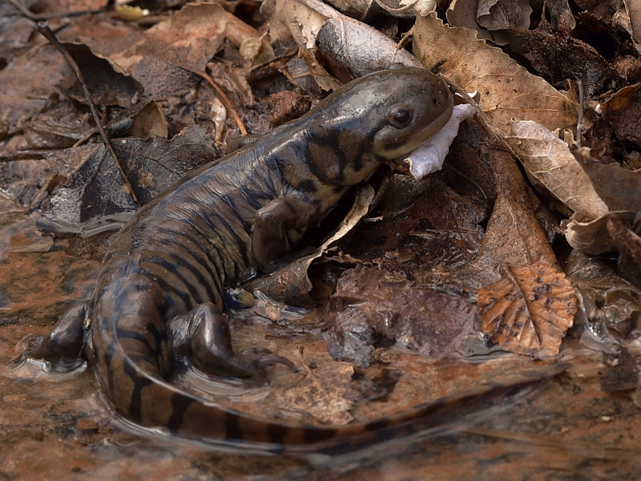
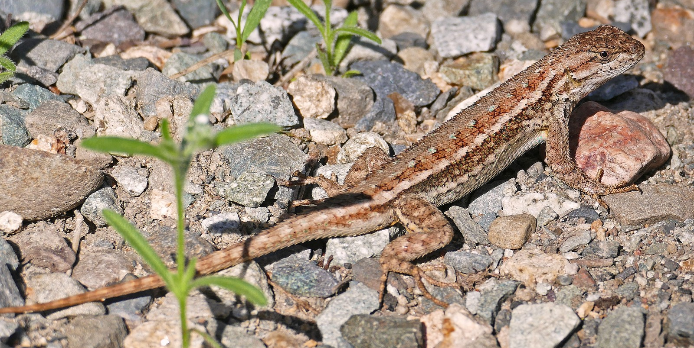
Pacific tree frog
Gartersnake
Western toad
Tiger salamander
Western fence lizard

