Slide 1
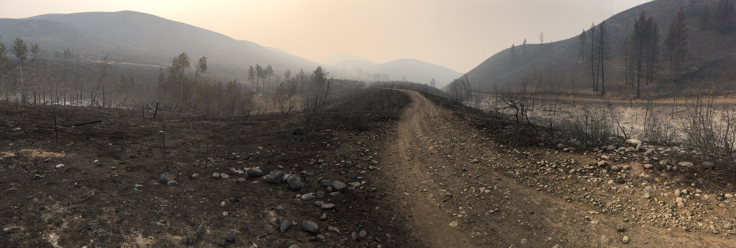
Wildfires in Washington

Slide 2
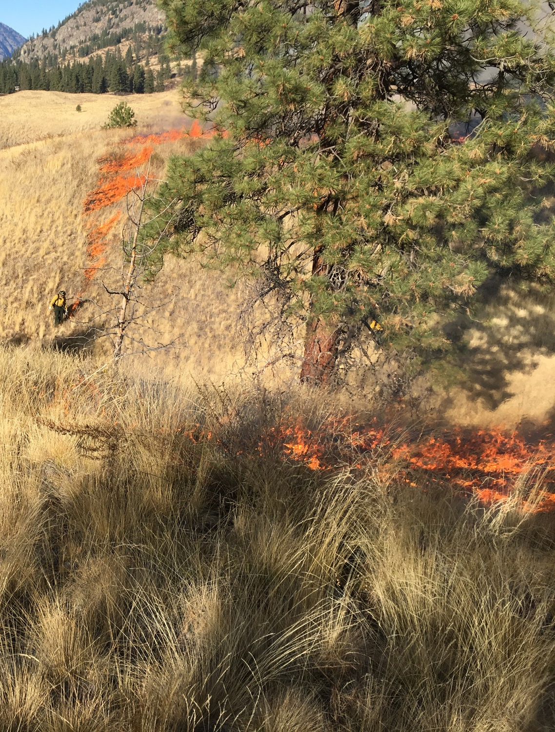
Fire is a part of Northwest landscapes
Before Europeans arrived, smaller, more frequent fires occurred.
Depending on the ecosystem these small fires occurred between 2-100 years.
Notes:
Smaller fires thinned out smaller trees and brush, making large-scale fires like we see today unlikely to occur. These smaller fires were unable to reach the limbs and tops of big trees, however.
Grassland and shrubsteppe fires occurred more frequently than fires in temperate rainforests of Washington.

Slide 3
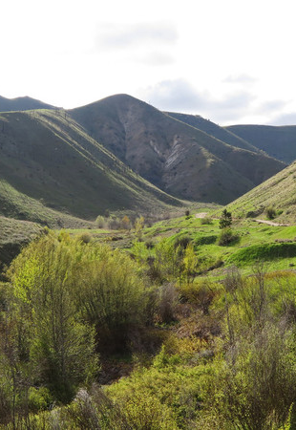
Indigenous Fire Practices
Indigenous peoples managed lands by setting smaller fires.
This created a diversity of habitats that included forests, meadows, and prairies.
It allowed for a variety of plant and animal species to thrive.
Notes:
When Europeans settled the indigenous land, they had no idea the patch-work landscapes were managed by tribes. They noticed the significant spacing between trees and the “park like” meadows.
It’s important to note that Indigenous peoples of Washington, and across the West had been burning landscapes for thousands of years before European settlement.
This created meadows and prairies and different kinds of habitat for wildlife.
Without fires weeding out undergrowth and smaller trees, conifers grow too thick or encroach on meadowed areas.

Slide 4
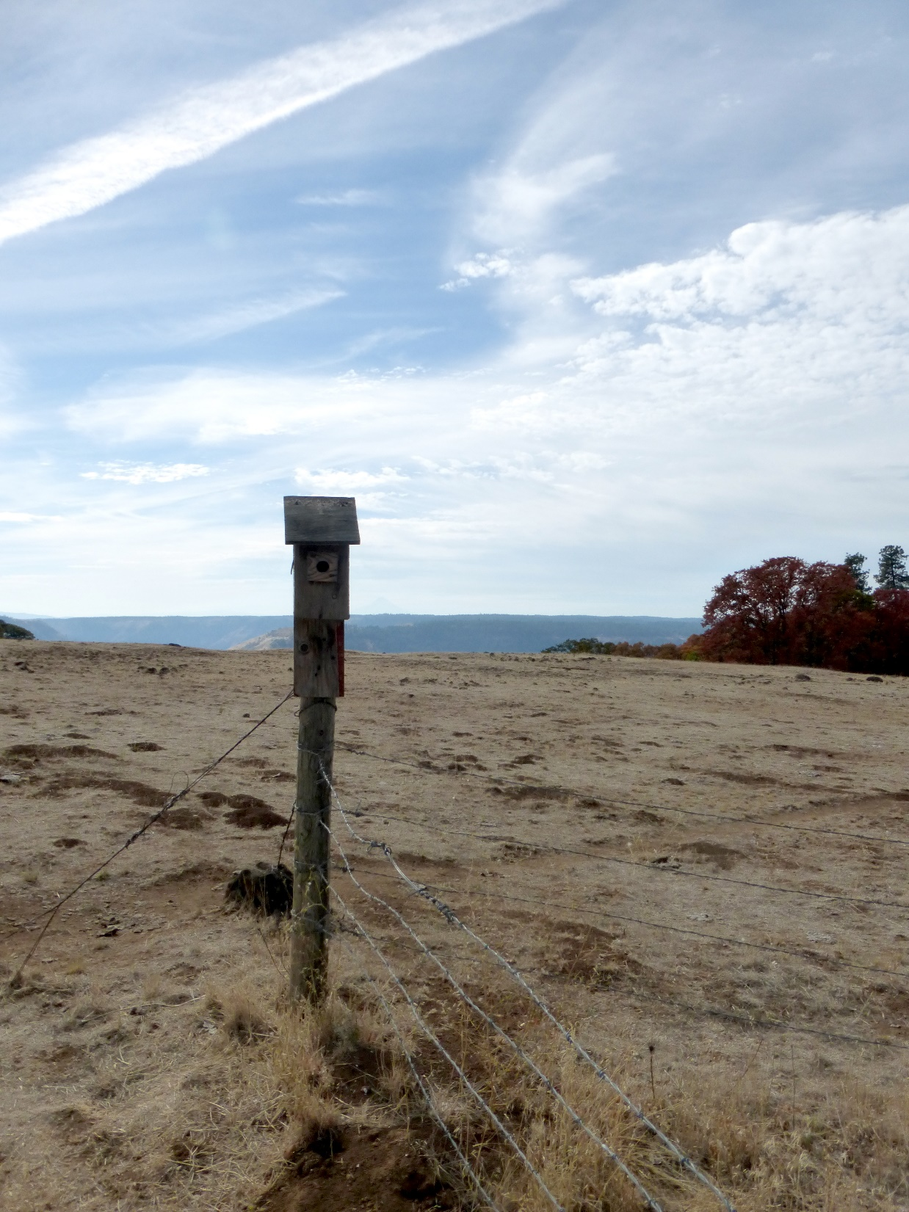
Fire Suppression
In the late 1800s, heavy and unregulated grazing reduced grass cover that carried fires.
Poor timber harvest management created dense forests of Douglas Fir only stands.
Fires were immediately put out.
Notes:
Fires that did get started were immediately put out.

Slide 5
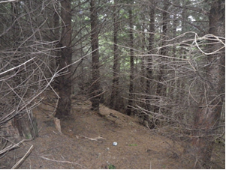
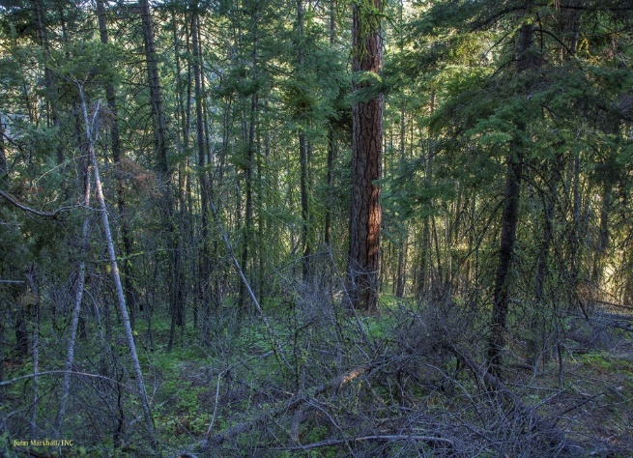
Overcrowded conditions
Fear of fire led to fire exclusion, or suppression policies in 1911.
This led to dense, overgrown forests with little to no diversity.
Notes:
Fires were suppressed throughout North America. Only within the last few decades have scientists and land managers learning the benefits of wildfire on ecosystems.
Unfortunately, the lack of diversity and overcrowded conditions risk disease, pests, and lack of habitat for other plants and wildlife species.

Slide 6
Notes:
Ask students to predict what would happen if a wildfire were to start in this forest.
Answer: The small trees would form a ladder, carrying the flames into the tops of the large trees. Flames would quickly spread across the tree tops and would likely cause a high intensity wildfire that might burn down the entire forest instead of thinning out the small trees and grasses.

Slide 7
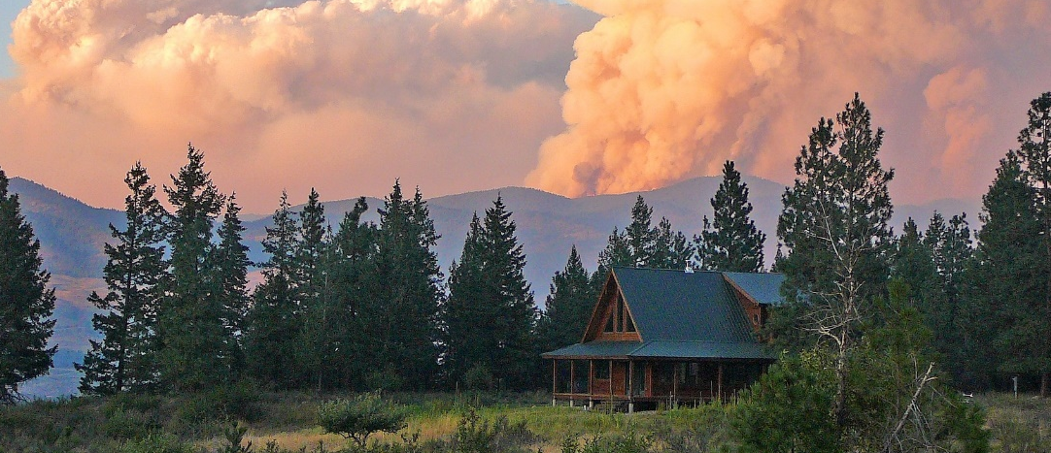

Fire suppression’s impacts on ecosystems
Larger, hotter, and more severe wildfires
More frequent wildfires
Notes:
Fire suppression policies over the last century have led to larger, hotter, more frequent and severe wildfires in the last 20 years. Coupled with climate change and drought, high intensity fires have become too regular.

Slide 8
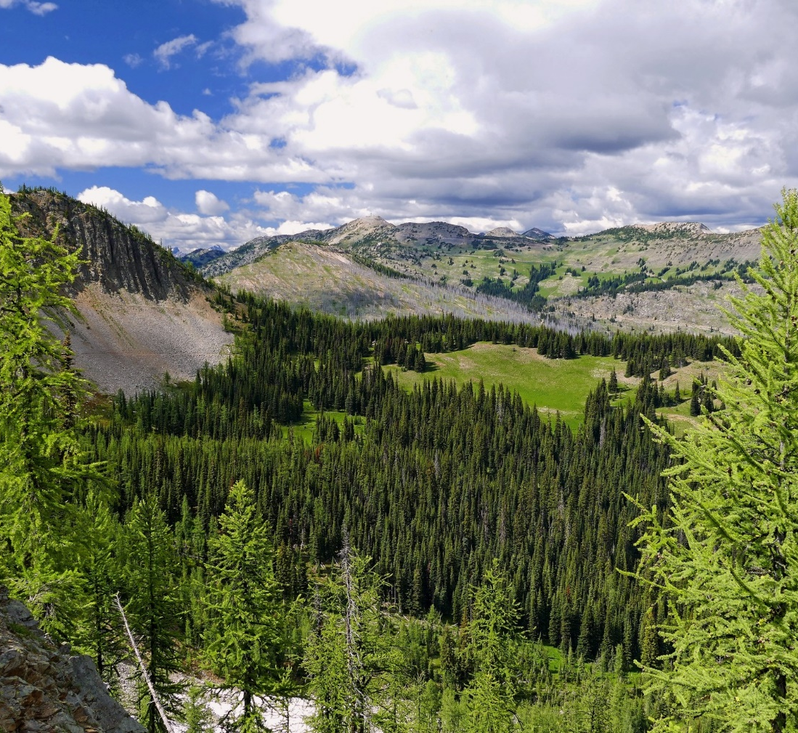
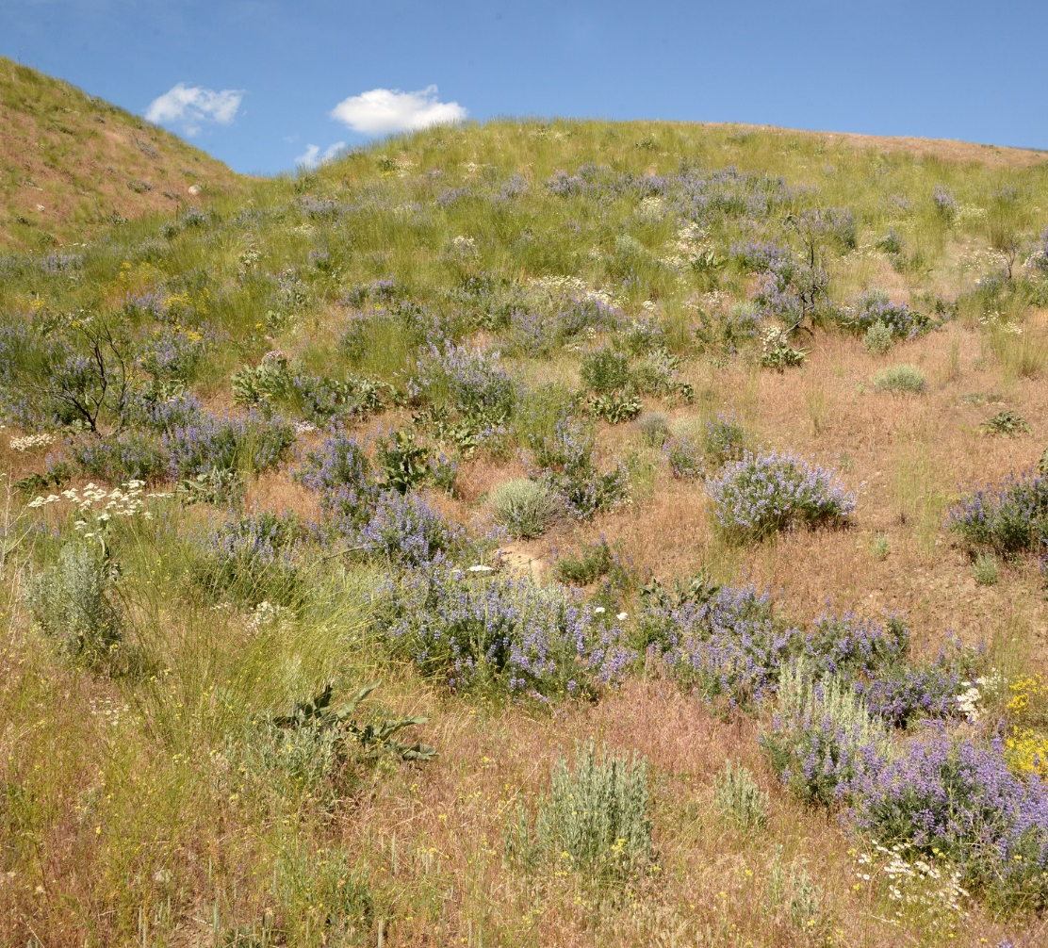
A mosaic of patches, clumps and gaps for wildlife diversity
Notes:
Ecosystem health is all about balance. Historically, Northwestern landscapes were a mosaic of dense stands mixed with open stands and meadows.
This creates a diversity of habitats and species. It also creates fuel breaks, or areas where fire cannot spread as well because the “fuel” is physically distanced.

Slide 9
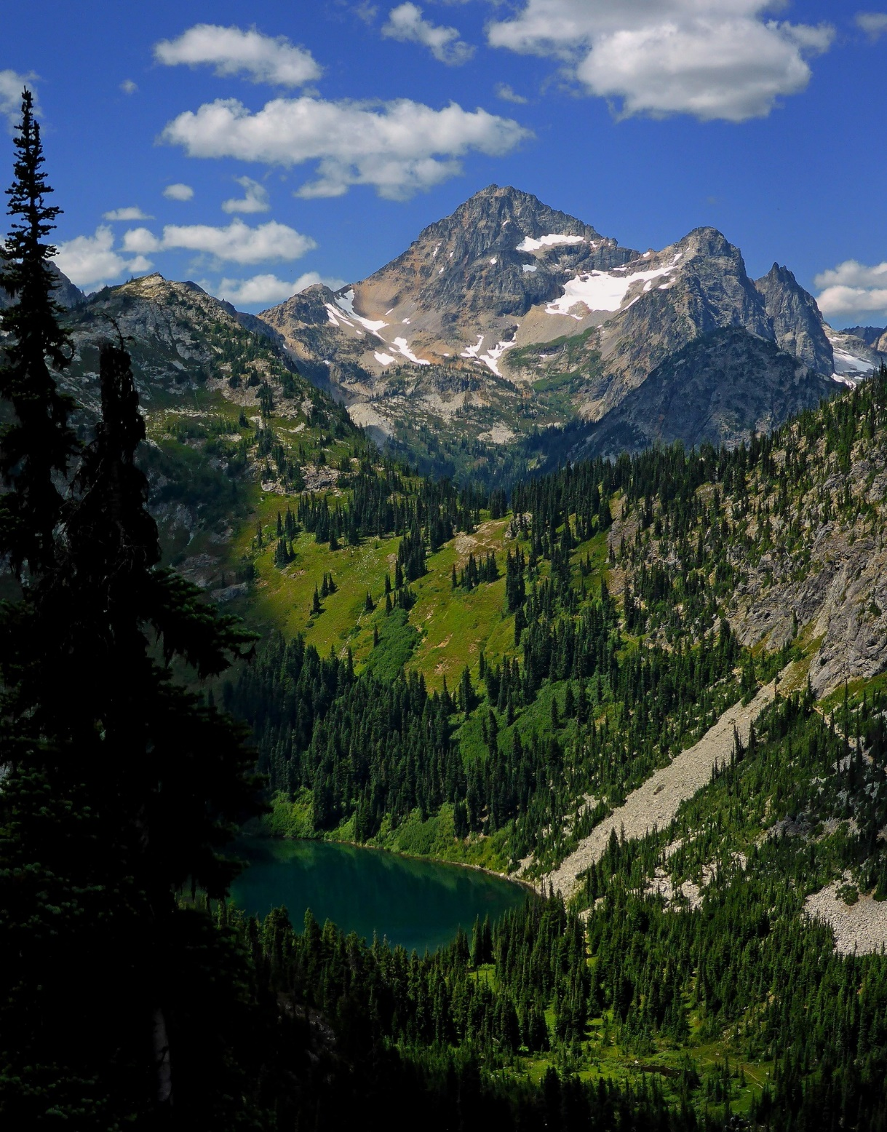
Do you think these various stages of forest are important for wildlife?
Why or why not?
Notes:
Give students one minute to look at this photo and see if they can identify the different stages of forest. Afterward have them guess and then click through the different stages,
Grassy meadows
Dense forest
Patchy “closed” forest
Patchy “open” forest
Alpine (treeless)
Afterward, ask students to think-pair-share about why the different forest stages may be important for wildlife.

Slide 10
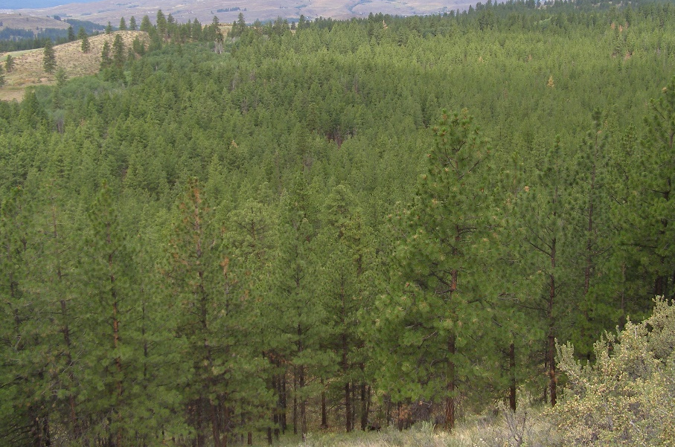
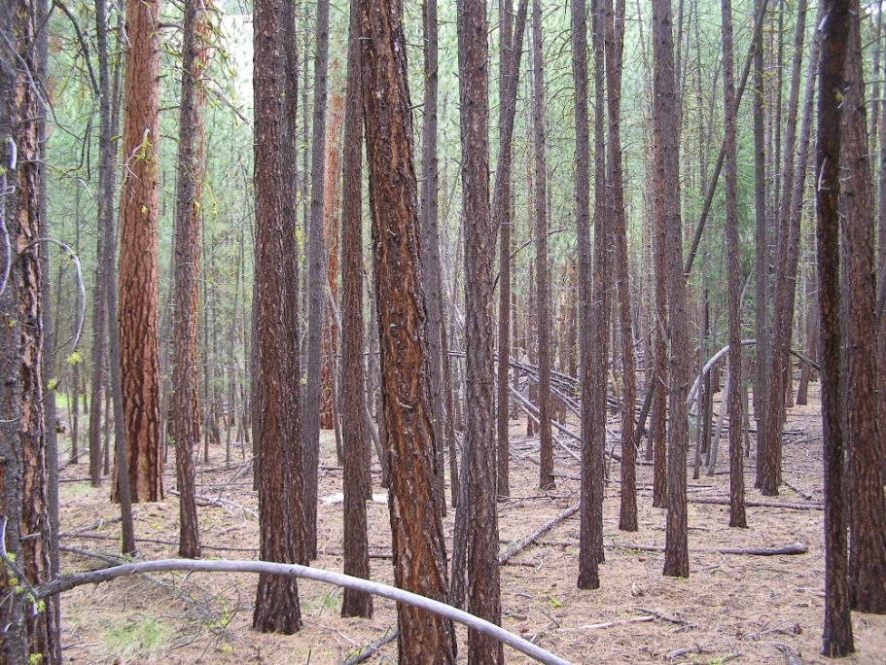
Restoring forests for wildlife
Forests that look like this are beneficial to some species.
However a forest with mostly dense stands reduces plant and wildlife diversity.
Landscapes with individual (trees or shrubs), clumps, openings, and other diverse features allow for more species.

Slide 11
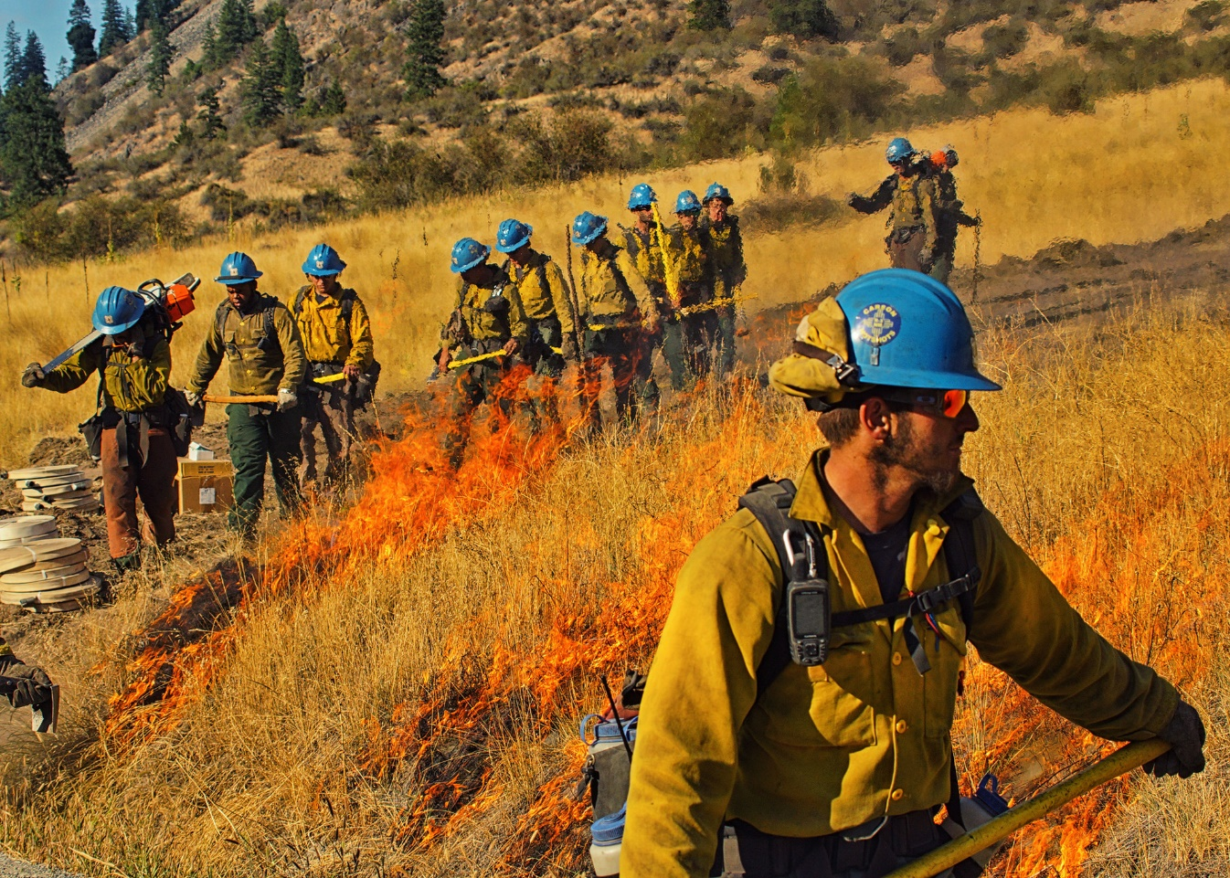
Prescribed burns
Land managers have begun to add fire back into our ecosystems via prescribed burns.
Prescribed fires reduce fuels and high intensity fires and create a mosaic on the landscape.
Moasic or patchwork forests and grasslands provide a variety of habitat for different types of plants and animals.
Notes:
A prescribed burn is the planned application of fire to natural fuels, including logging debris, grasslands and/or understory vegetation, with the intent to confine the fire to a predetermined area.
A prescribed natural fire refers to allowing naturally ignited fires, such as those started by lightning, to burn under specific management prescriptions without initial fire suppression.
Fuel: Any dead or living material that will burn. This includes grasses, dead branches and pine needles on the ground, as well as standing live and dead trees.

Slide 12
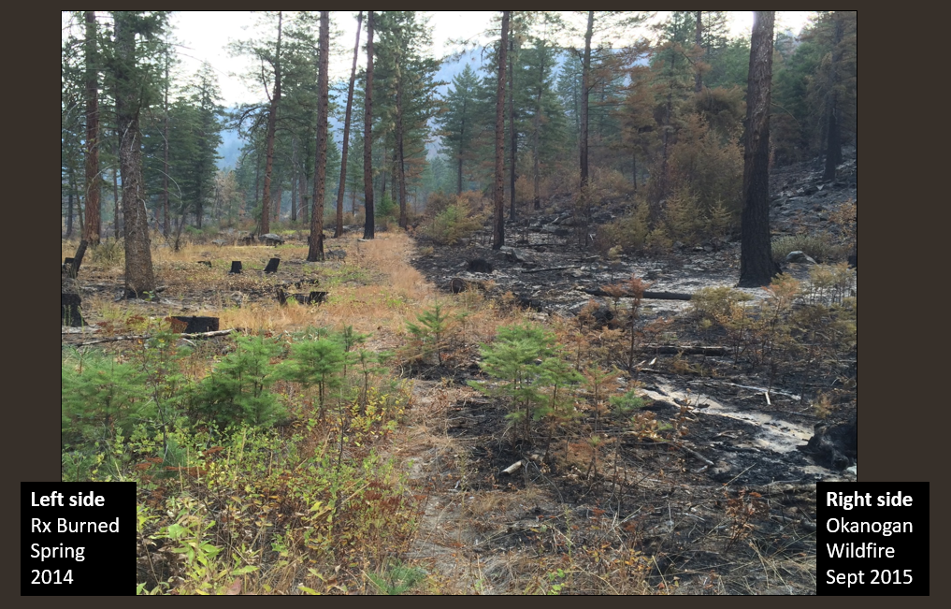
How treatments can impact disturbance
Notes:
In 2011, the Sinlahekin Wildlife area was mechanically thinned and prescribed fire was also used. In 2015 the Okanogan Wildfire came through the wildlife area. You can see how the treated vs. untreated parts of the wildlife area were impacted.
Ask students to identify differences between the right and left side. Which looks like it’s in better condition?
Large, dead tree.
Smaller dead trees and shrubs (may have carried fire to crown (top) of tree.
Thinned stumps and patch of burn where fire came in, but did not spread because there was not enough fuel.
Smaller, more spread out trees survived.
Even though some of the tree’s limb was burned, the tree is still alive because fuels reduction prevented fire from reaching the top.

Slide 13
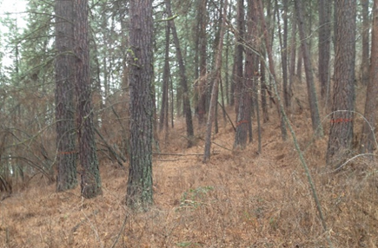
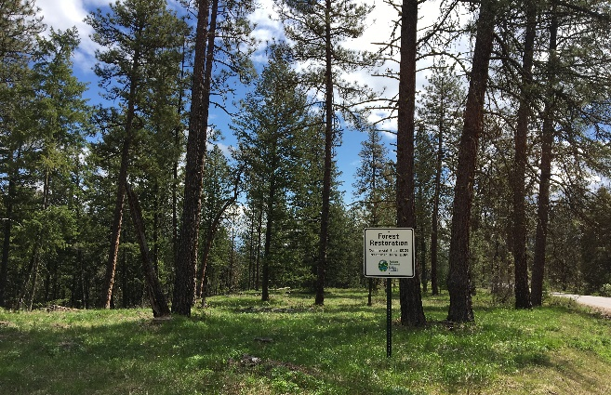
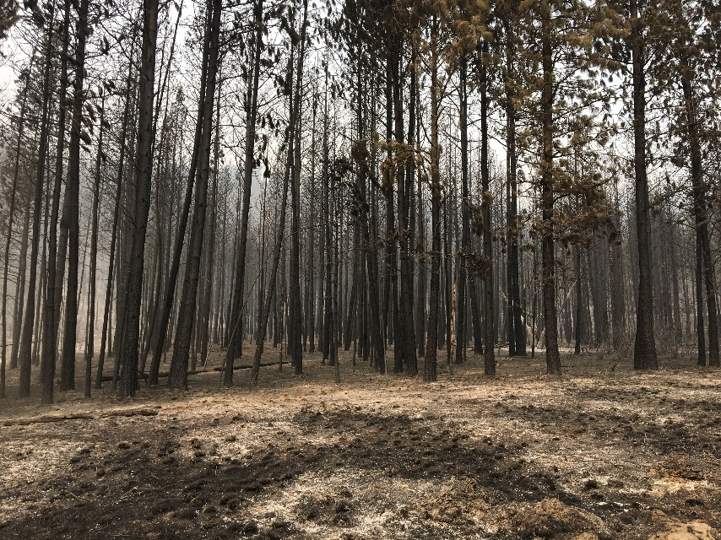
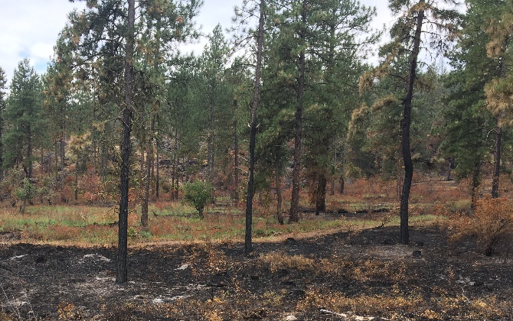
How treatments can help forests
Boyd’s Fire - 2018
Untreated
After restoration (Thin + Rx burn)
Notes:
These treatments also help protect buildings and other structures, minimizing the cost of wildfire damage.
It’s important to note that treatments don’t fireproof forests.

Slide 14
Fires mean better habitat
Notes:
Have students pair with a partner and list three reasons they think the picture on the right would be better habitat for wildlife than the picture on the right. Share answers with the class.

