Slide 1
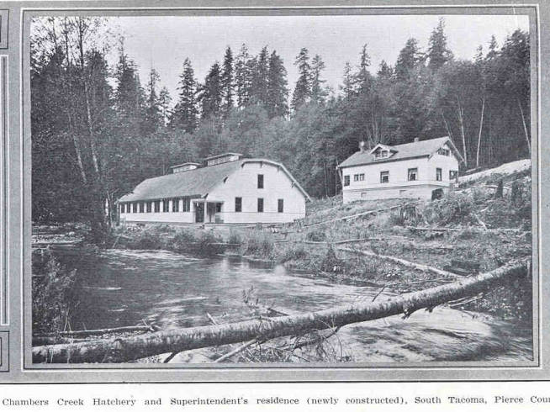
History of fish hatcheries in Washington

Slide 2
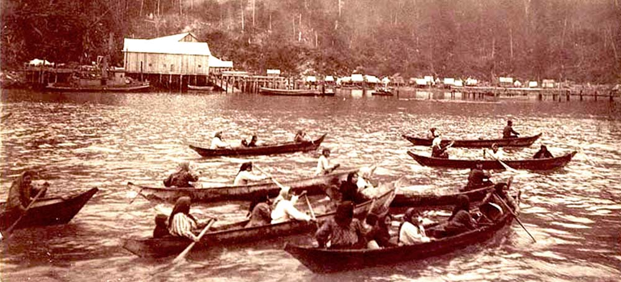
Photo courtesy of Olympia.wa.gov

Slide 3
Type text here. Bullet points are not always necessary
Remove bullets if it is more impactful
Simplify text, convey concepts
Place your talking points in the notes section
Carry the stage with your presence

Slide 4
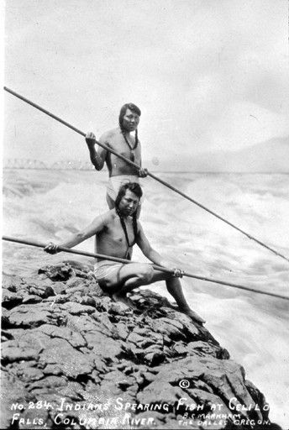
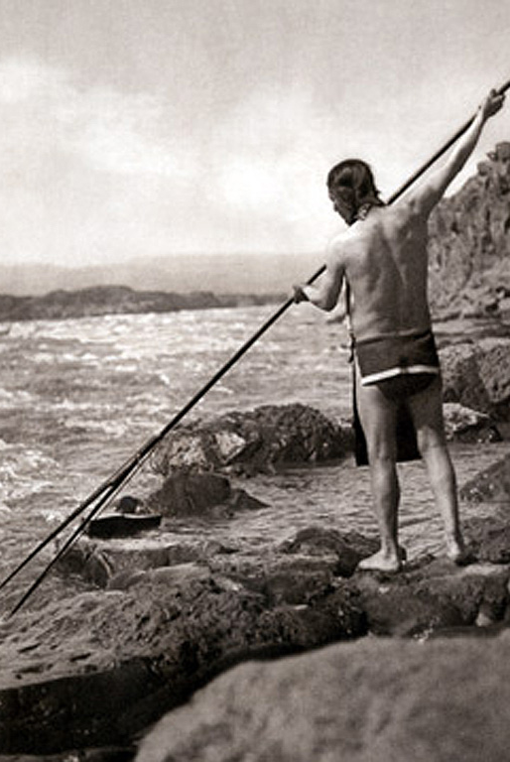
IMPACTFUL STATEMENT/ key findings or quote
Important topic or attraction
Photos courtesy of Columbia River Inter-tribal fish commission

Slide 5
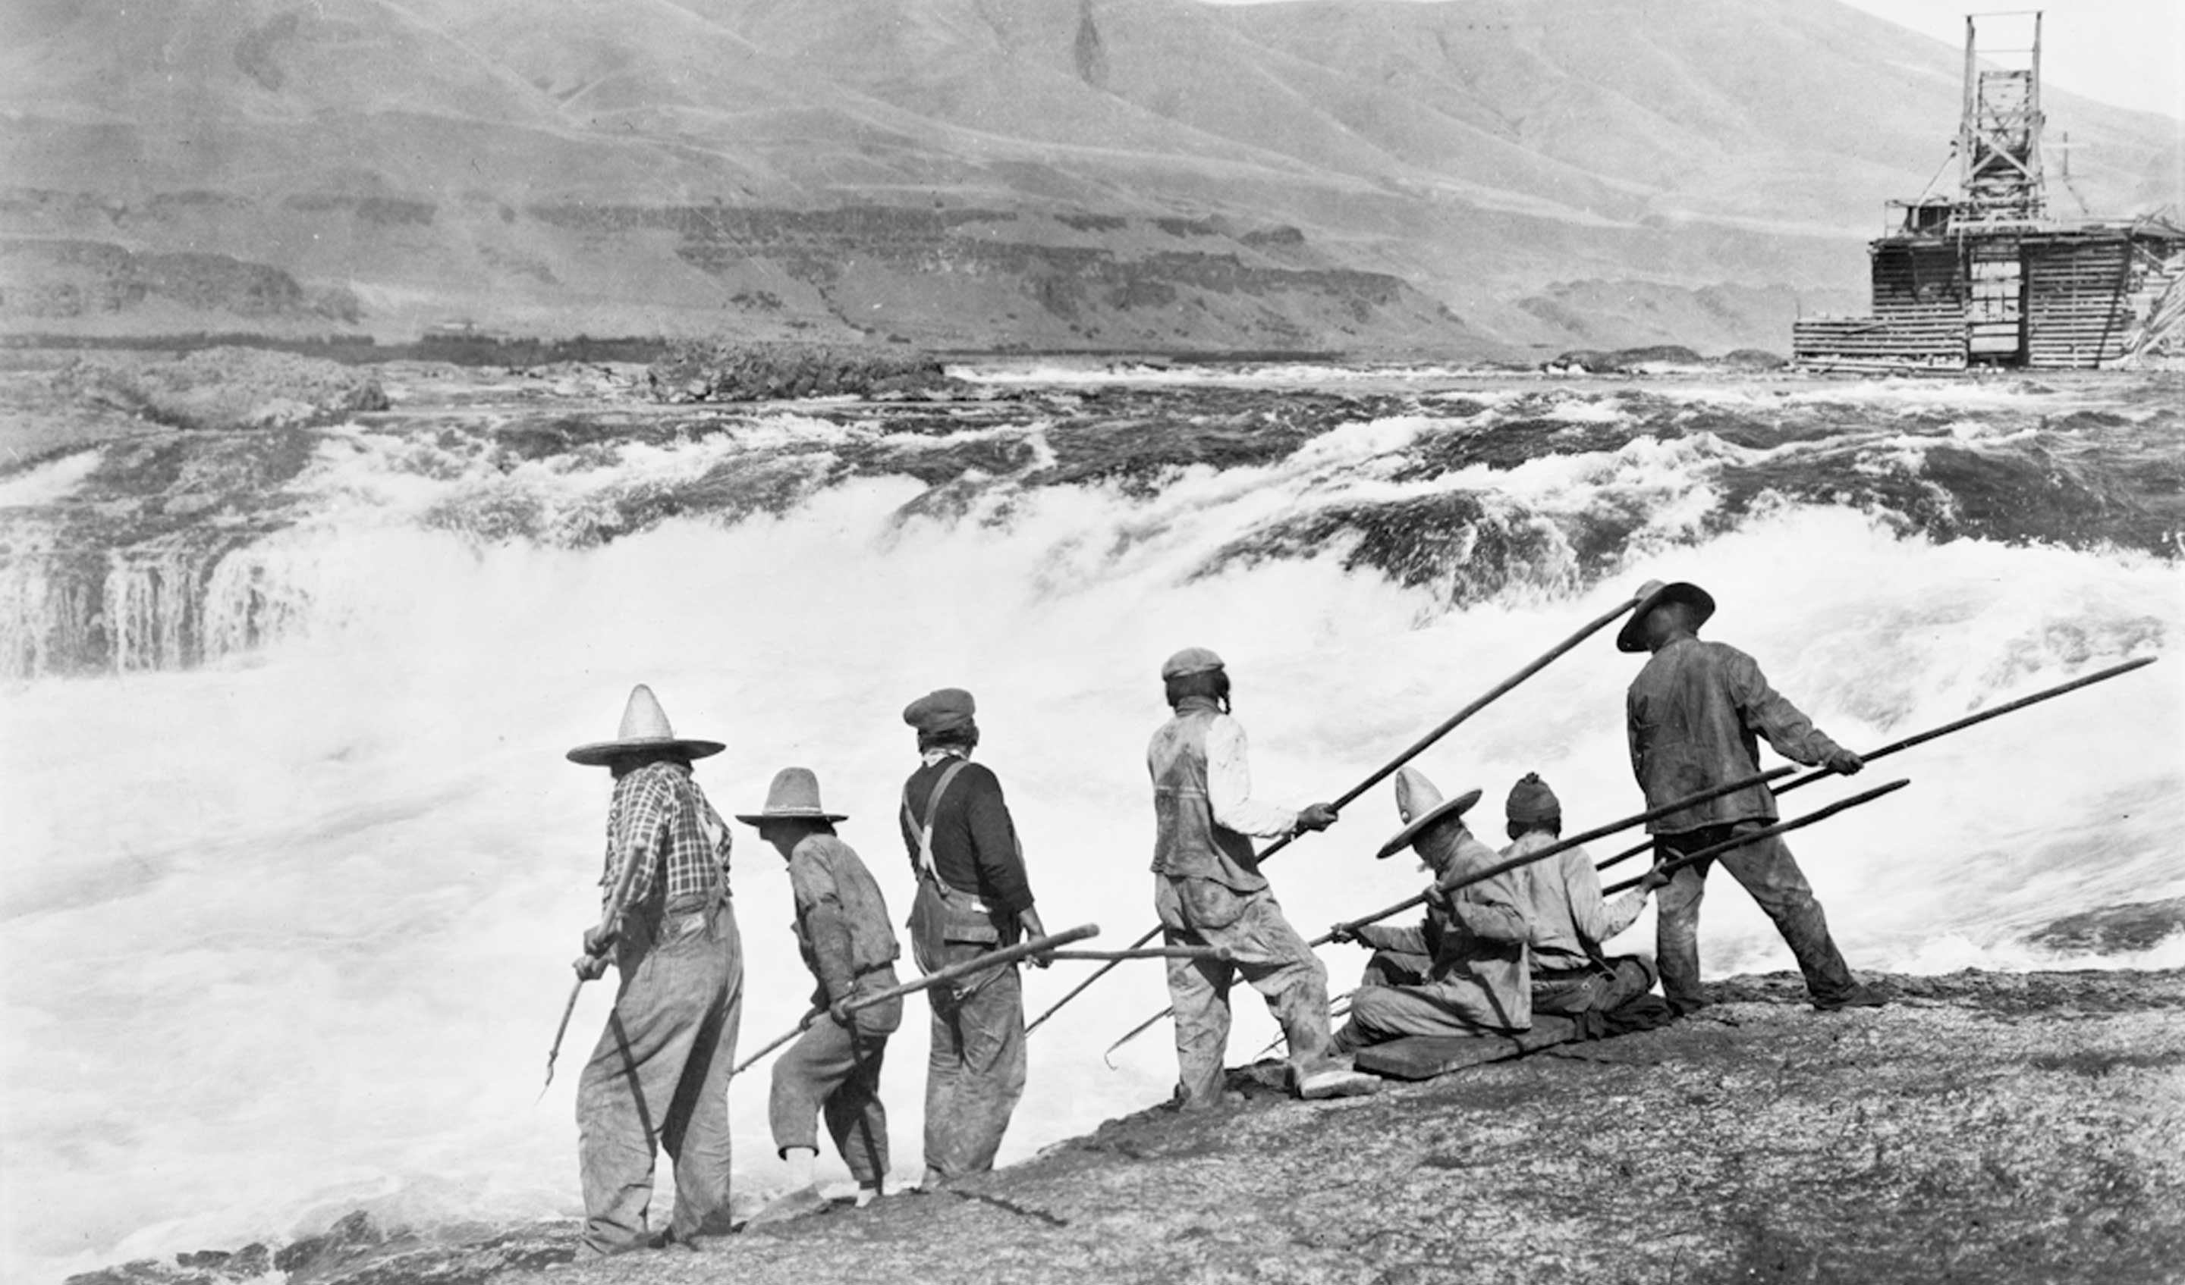
Transition slide title

Slide 6
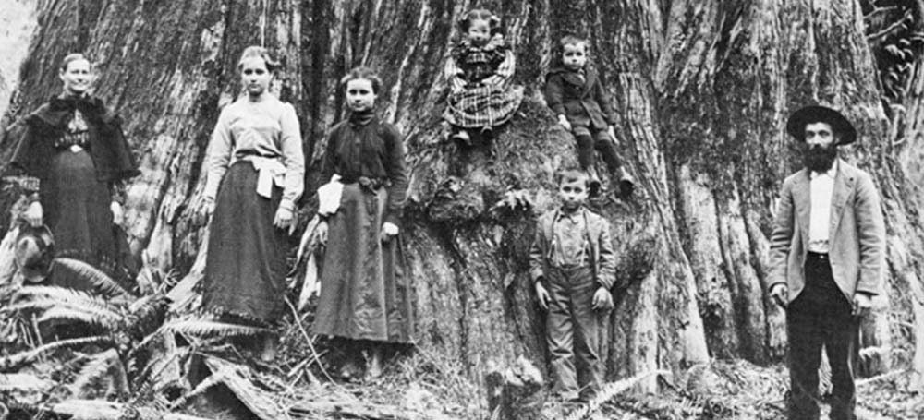
Photo courtesy of Olympia.wa.gov

Slide 7
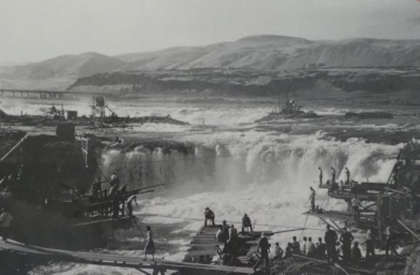
Photo courtesy of education.blogs.archives.gov

Slide 8
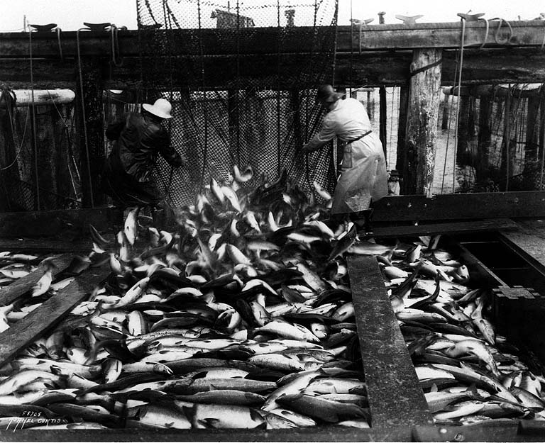
Photo courtesy of University of Washington

Slide 9
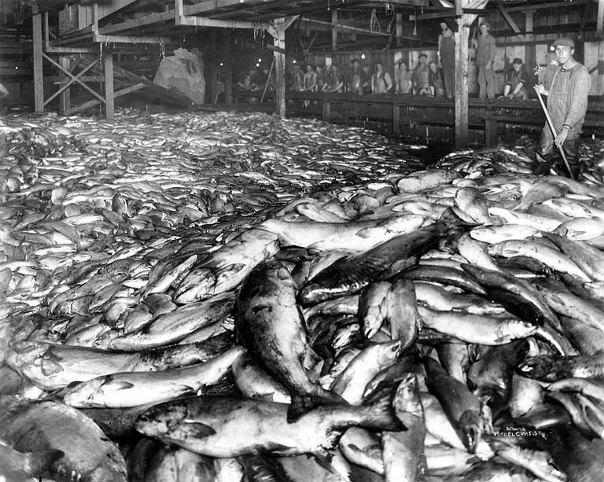
Photo courtesy of University of Washington

Slide 11
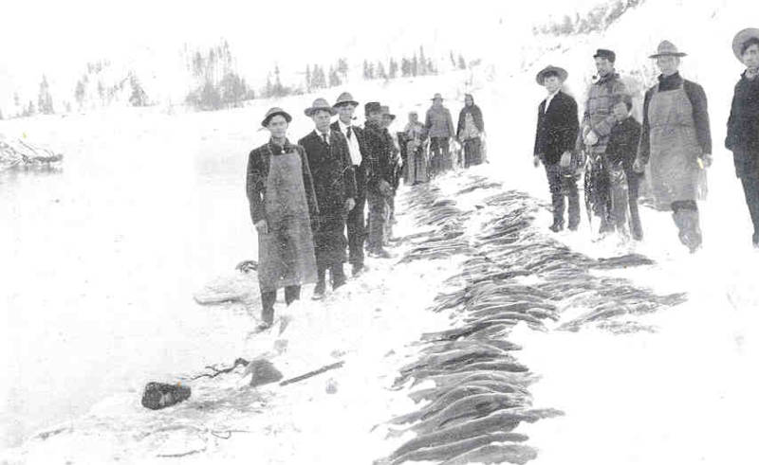

Slide 12
A man carrying salmon eggs

Slide 13
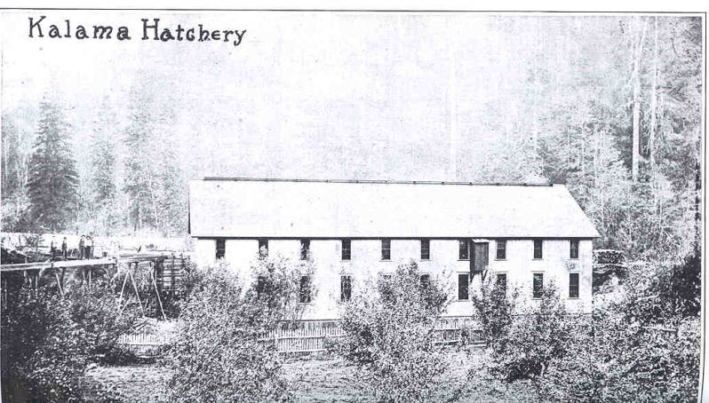

Slide 15
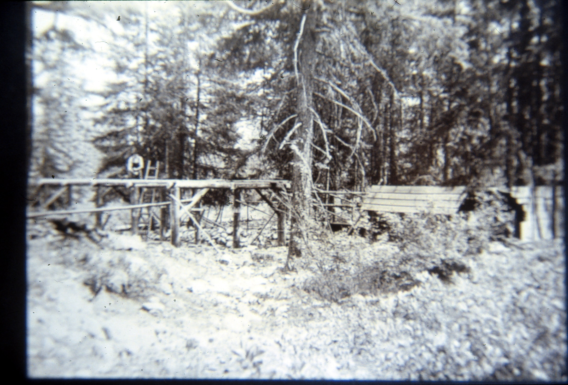
Lake Chelan trout hatchery 1903

Slide 16
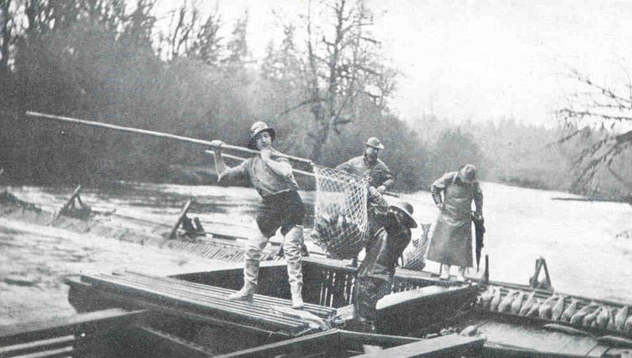
Catching fish for the Chehalis salmon hatchery 1916

Slide 17
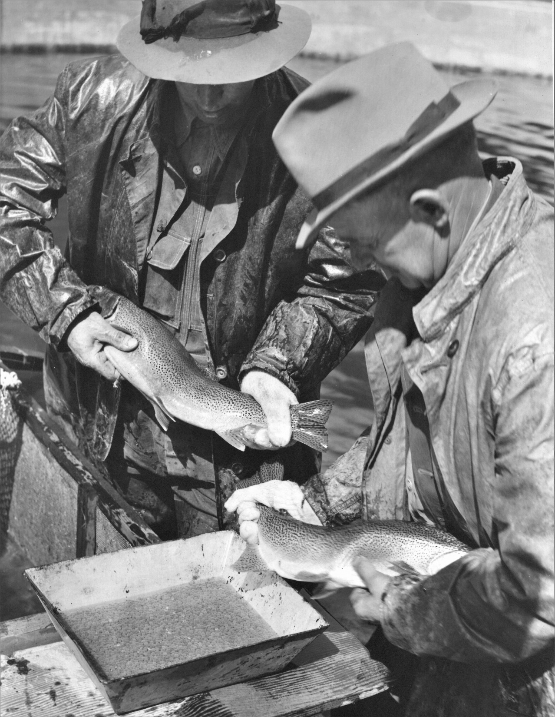
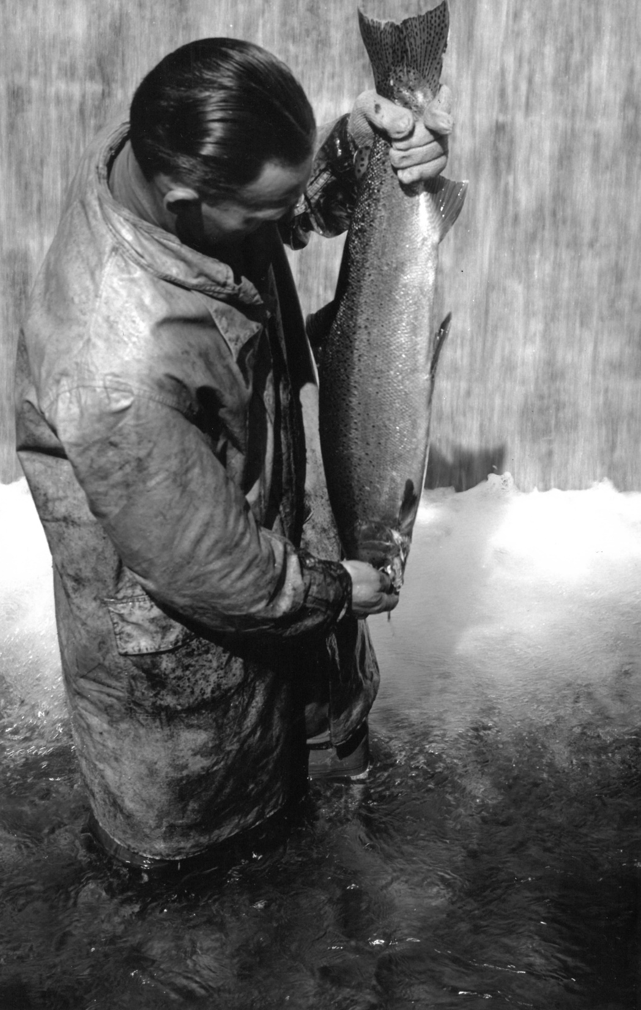
Lake Chelan trout hatchery 1903
Spawning trout

Slide 18
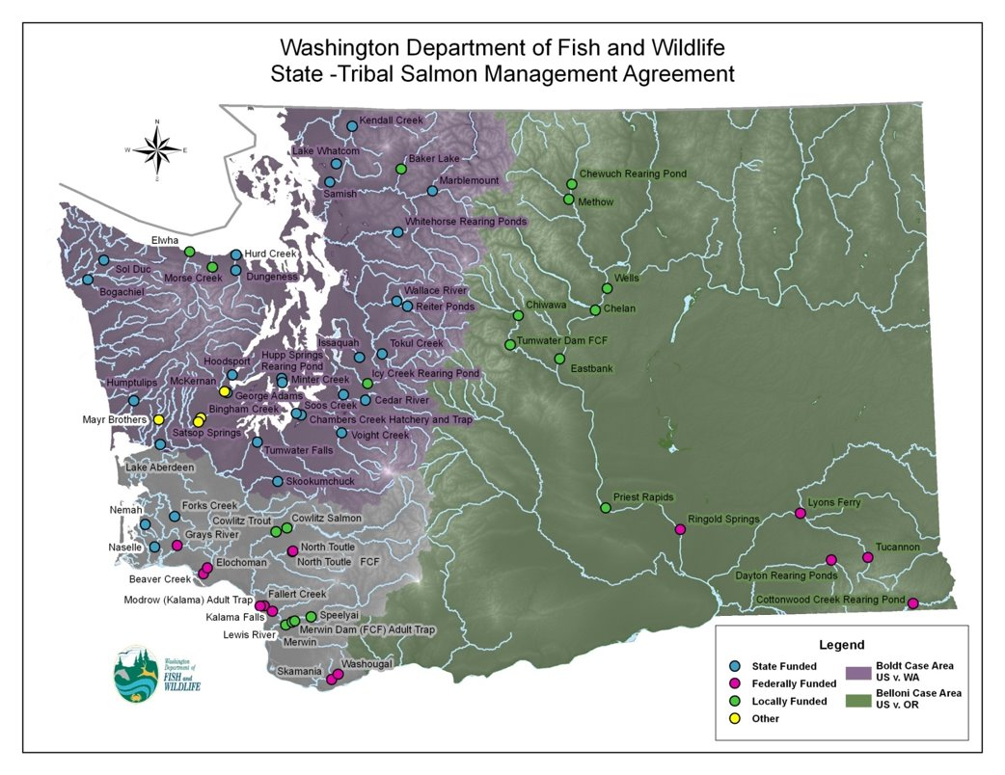
Notes:
This map shows all of the state, federal, tribal, co-run, and other hatcheries in Washington.

Slide 20
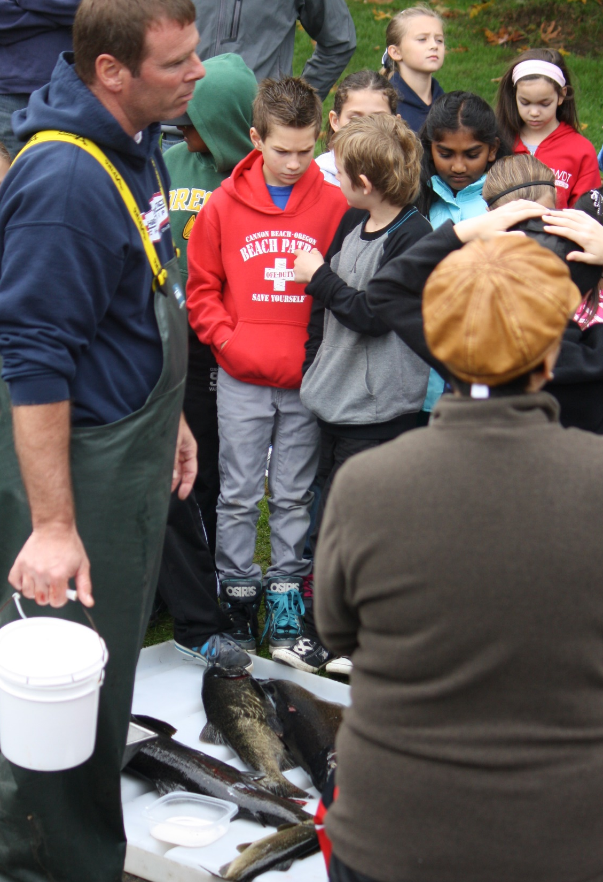
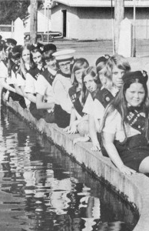
Education- Hatcheries provide the public a chance to see spawning fish and learn about fish and habitat.

Slide 21
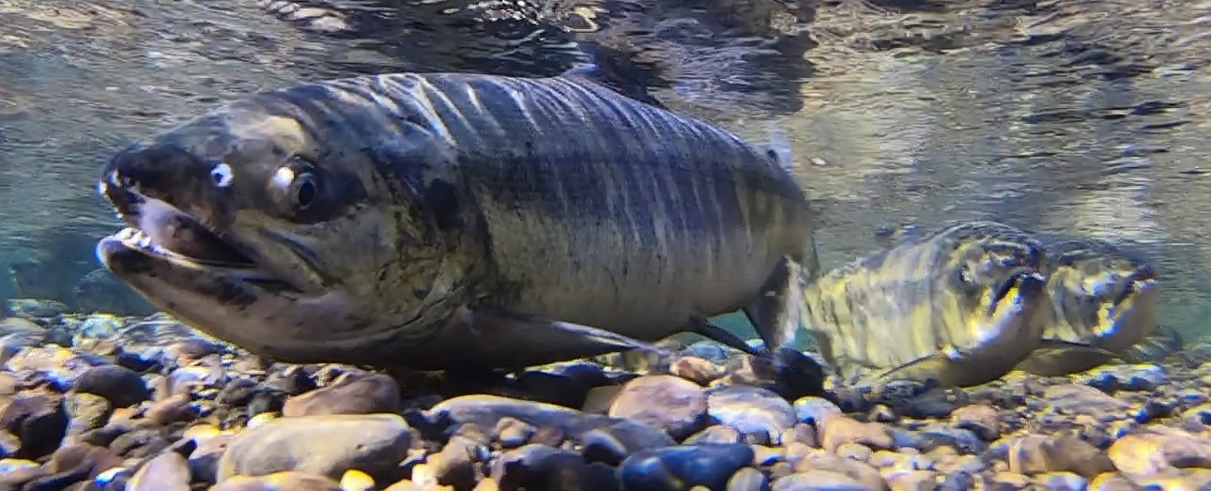
With the need for recreational and commercial fish and the need to protect wild fish, hatcheries work in partnership with wild stocks.
This allows us to maintain healthy supplies of native and local stocks. .

