Slide 1
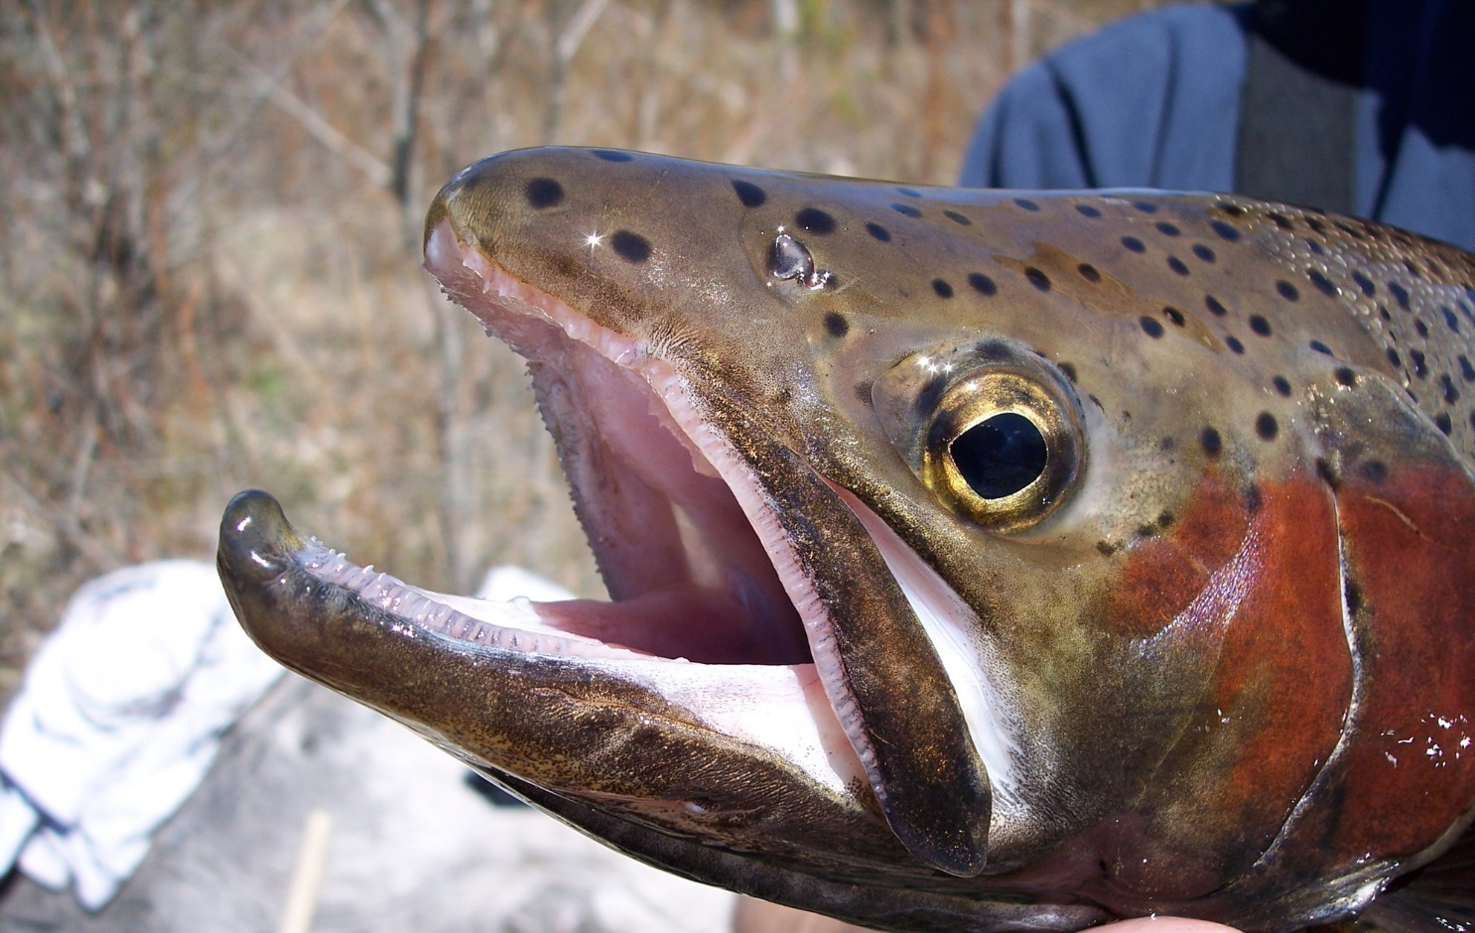
Redband Trout

Slide 2
What are redband trout?
Redband trout are a type of rainbow trout.
They have a shiny rainbow down each side.
Both rainbow trout and redband trout are salmonids. This means they are related to salmon!
Notes:
Ask students to raise their hands if they have ever heard of redband trout. If anyone has, ask them what they know about them. The answer may vary depending on where you live geographically.
After showing the picture, ask students if they can guess why they are called rainbow trout.
Redband trout are subspecies of rainbow trout. Subspecies are typically a geographically isolated species and may become somewhat physically and genetically different from other subspecies.

Slide 3
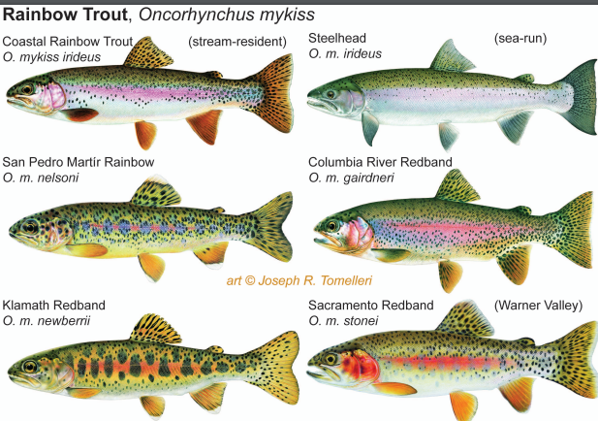
There are six different types of rainbow trout!
Graphic courtesy of United States Fish and Wildlife Service.
This is the type of redband/rainbow trout we have in Washington.
Notes:
In Washington we have the Columbia River/ Interior/ Great Basin redband trout (the names are often used interchangeably but all are classified as O.m. gairdneri)

Slide 4
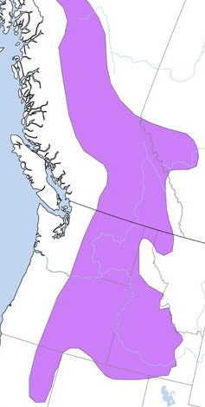
Where are redband trout found?
They are found throughout Washington, Idaho, Montana, Oregon, and Northern California).
In Washington, they are found dry climates in the East.
Graphic courtesy of Montana Field Guide.

Slide 5
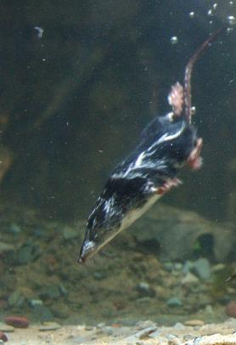
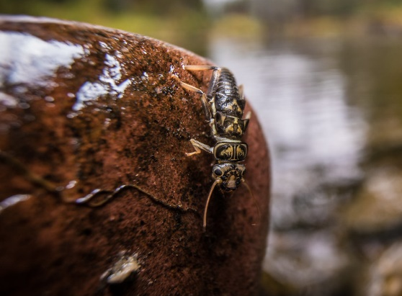
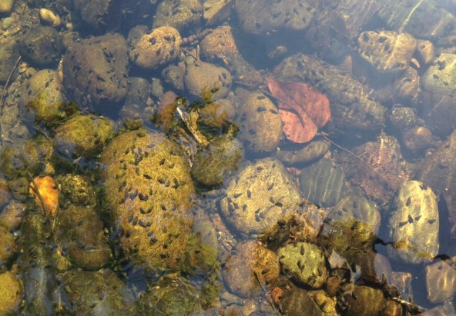
What do they eat?
Redband trout are opportunistic feeders.
They will eat macroinvertebrates like: stoneflies, dragonfly nymphs, mayflies, beetles, snails, and worms and small fish, crayfish, small aquatic mammals, and more.
Stonefly courtesy of National Park Service
Northern Crayfish
Aquatic snails
Water shrew by Robert A. MacArthur
Notes:
Introduce the term opportunistic: When animals (consumers) east or consume any prey they can catch.
Macroinvertebrates are small aquatic animals without backbones that can be seen without a microscope.

Slide 6
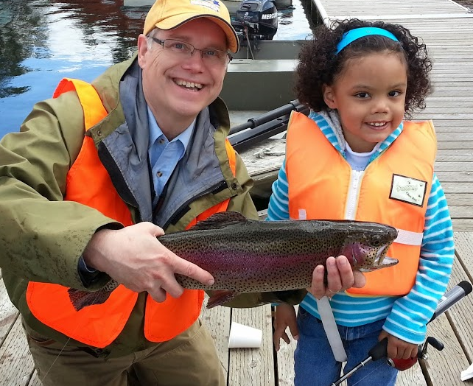
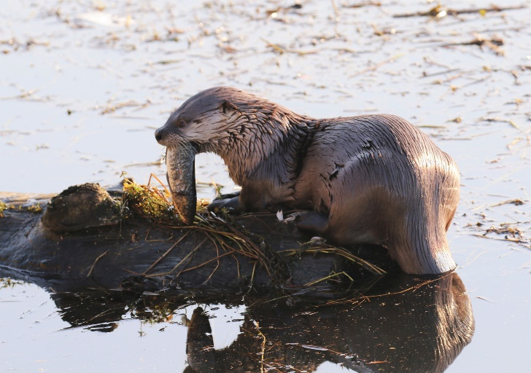
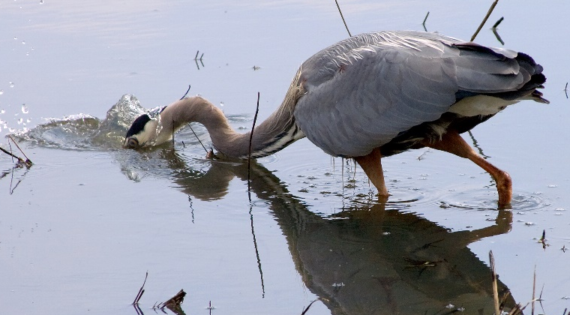
What eats them?
Bears, birds, raccoons, bobcats, river otters, and humans!

Slide 7
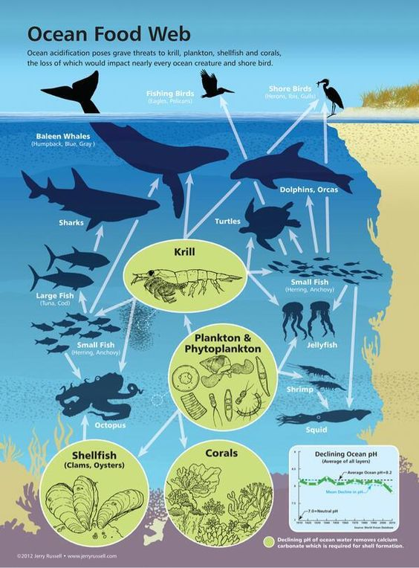
Food webs
Redband trout are an important part of the food web.
Consider:
What eats krill?
What does krill eat?
How would removing krill from this ecosystem impact other animals?
With a partner, describe some of the relationships of marine animals in this food web.
Food web graphic courtesy of NOAA
Notes:
Before introducing the concepts of food webs, ask students what they think a food web is. Have them share with a partner.
Food webs describe the feeding relationships or connections among species in an ecosystem. They show how species engage with one another.

Slide 8
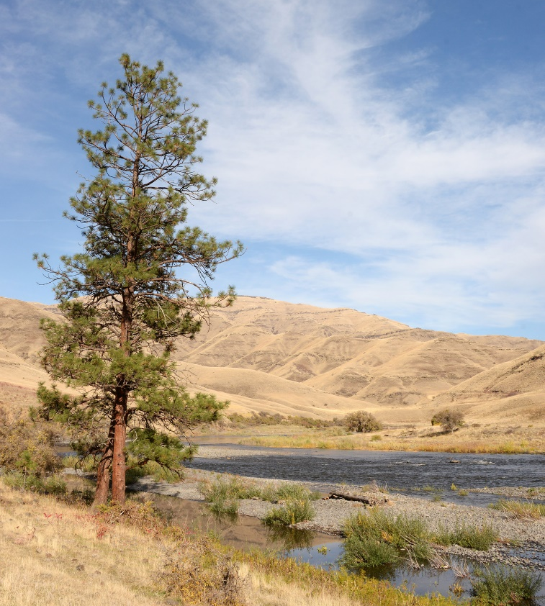
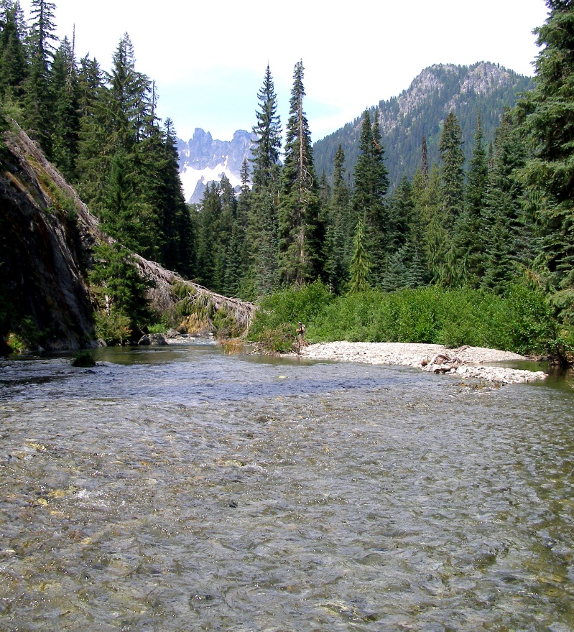
What’s their habitat like?
Redband trout are adaptable.
They have evolved to live in everything from mountain forest to high desert streams.
Notes:
You may want to introduce the term adaptable– the ability to adjust to new conditions.

Slide 9
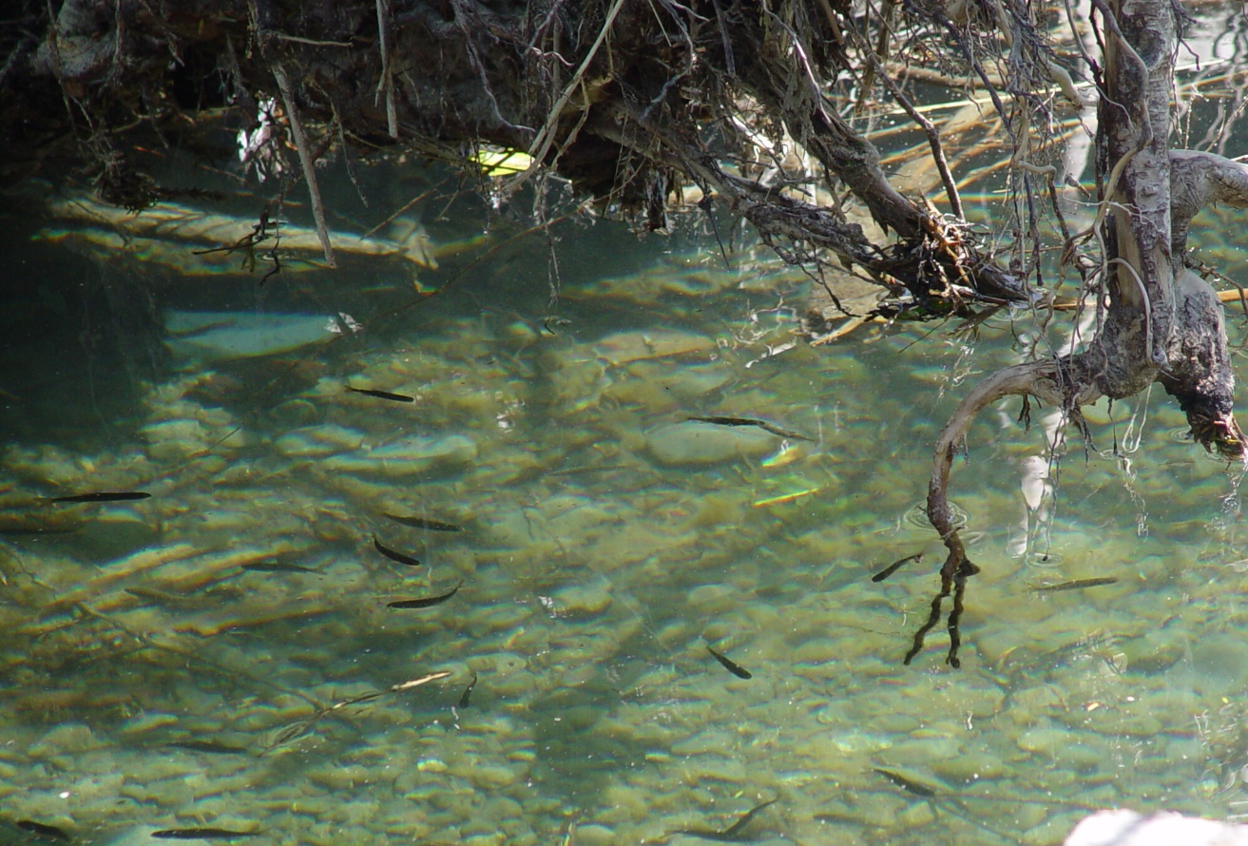
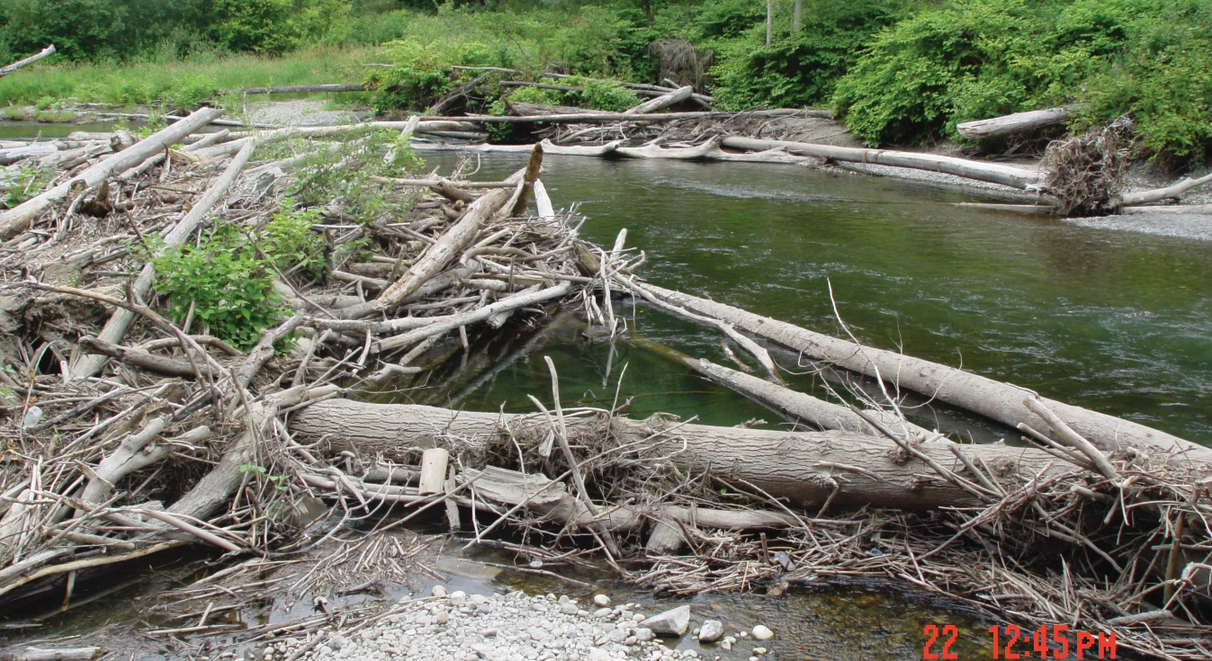
Redband trout like to live in areas with…
Large woody debris
Notes:
Woody debris provides protection from predators, hiding places for juvenile and small fish and shade for cooler water temperatures.

Slide 10
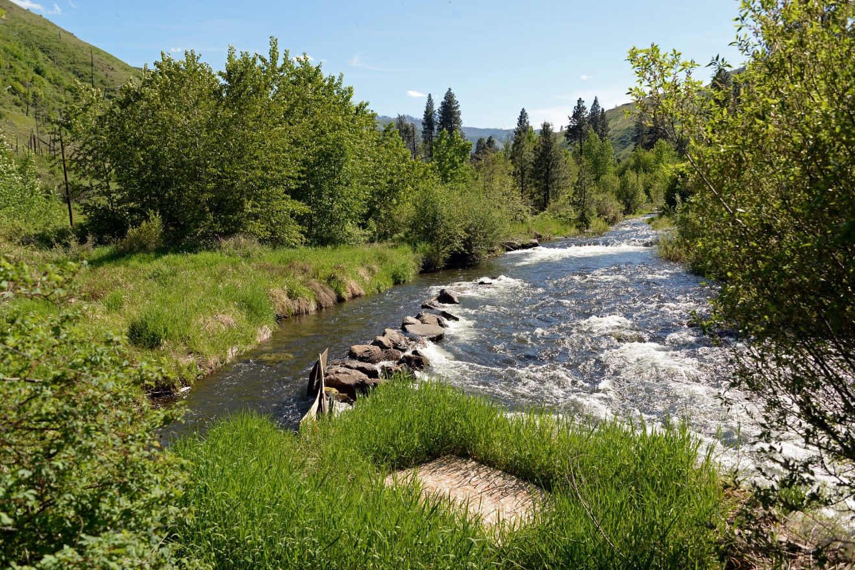
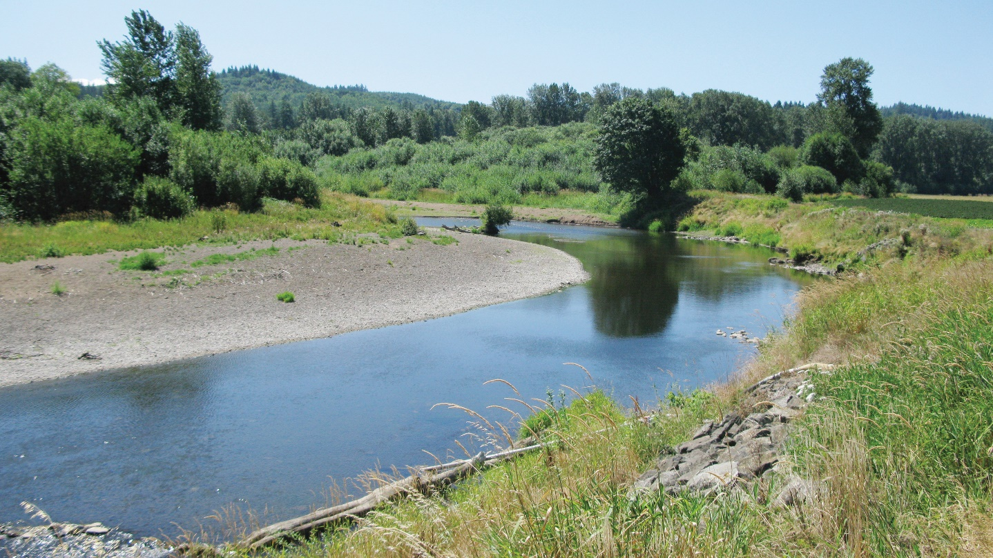
Redband trout like to live in areas with…
Overhanging vegetation
Notes:
Ask students to compare and contrast the two different parts of the river. Ask them to think-pair-share about why having overhanging vegetation is so important.

Slide 11
Redband trout like to live in areas with…
Gradual channels
High movement water
Notes:
Redband trout utilize both steep and gradual channels. Gradual channels are important for laying eggs. Quick moving water keeps the water cool, and helps oxygenate the water as well.

Slide 12
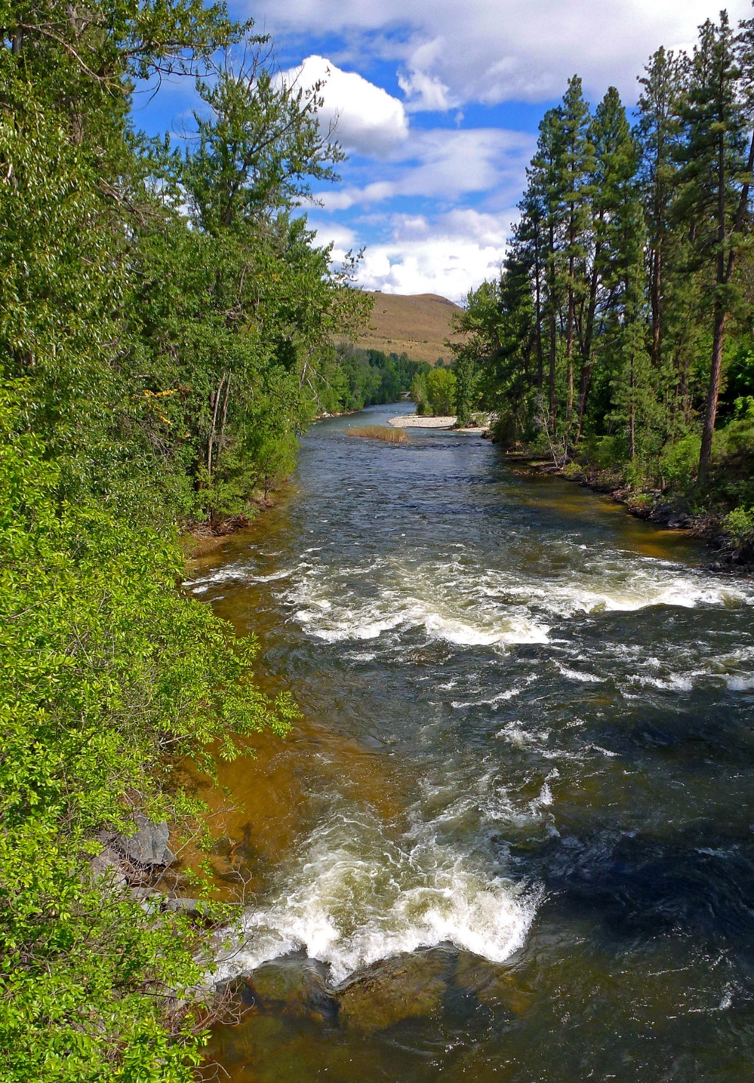
Redband trout like to live in areas with…
Areas with boulders, cobbles, and pebbles.
Pocket water- water with lots of big rocks and tumbling currents.
Notes:
Loose gravel and cobbles help provide habitat for redds (fish nests) and moving water helps provide oxygen in the water for fish to breathe.

Slide 13
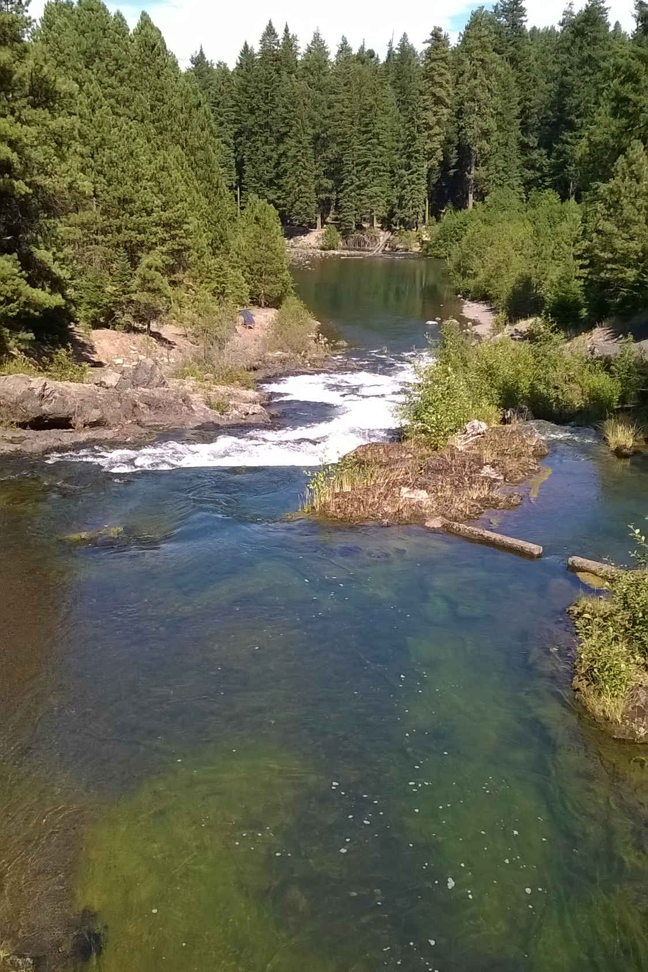
Redband trout like to live in areas with…
Pools
Notes:
Ask students if they can identify any pools in the picture before clicking to reveal the circles that highlight a couple.
Pools provide important resting and raising habitat for redband trout. Additionally, rivers and streams with many pools act as refuge from floods, drought, and extreme temperatures.

Slide 14
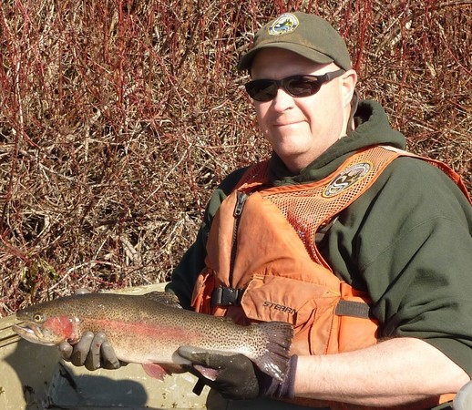
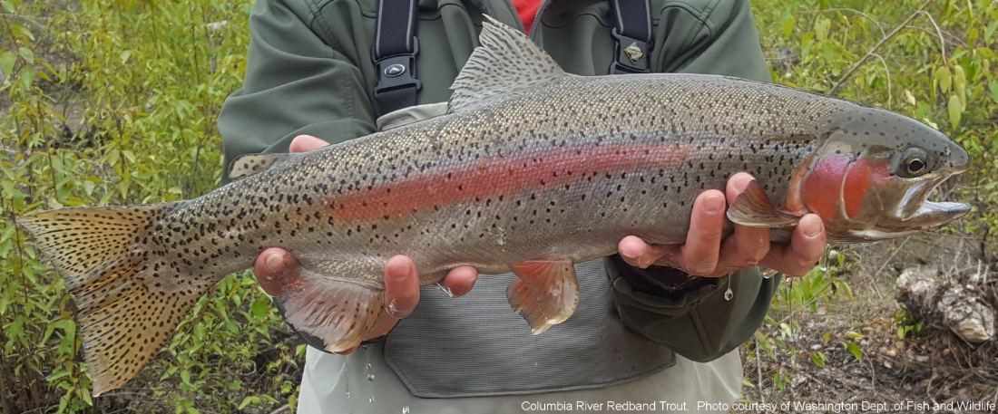
Why are redband trout important?
They are important for people’s subsistence, culture, and recreation.
Scientists are still learning more about their role in our ecosystems. If we lose them, we may be losing our next scientific breakthrough!

Slide 15
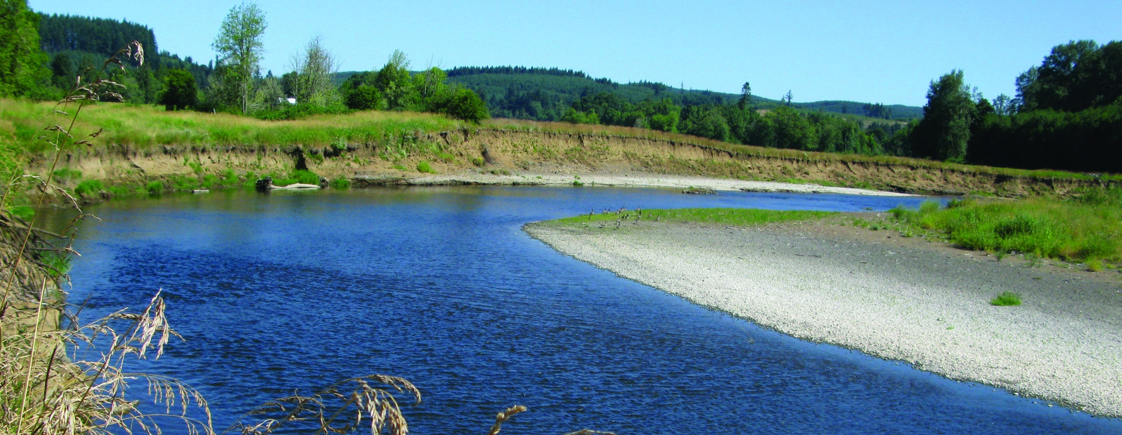
Decline in redband trout
Threats to redband trout include:
Loss of habitat.
Pollution like garbage in recreation areas.
Pesticide and fertilizer run off in water.
Stream bank breaking down.

Slide 16
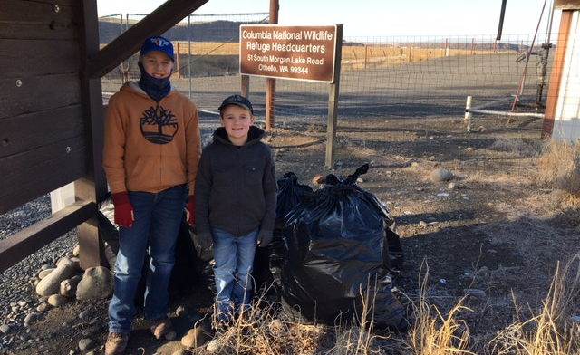
What can we do?
Clean up garbage and practice Leave No Trace Principles when enjoying the outdoors.
Notes:
Because the fish are sensitive to pollution, there are many things you and your family can do to help redband trout like cleaning up garbage and making sure you leave no trace when exploring.

Slide 17
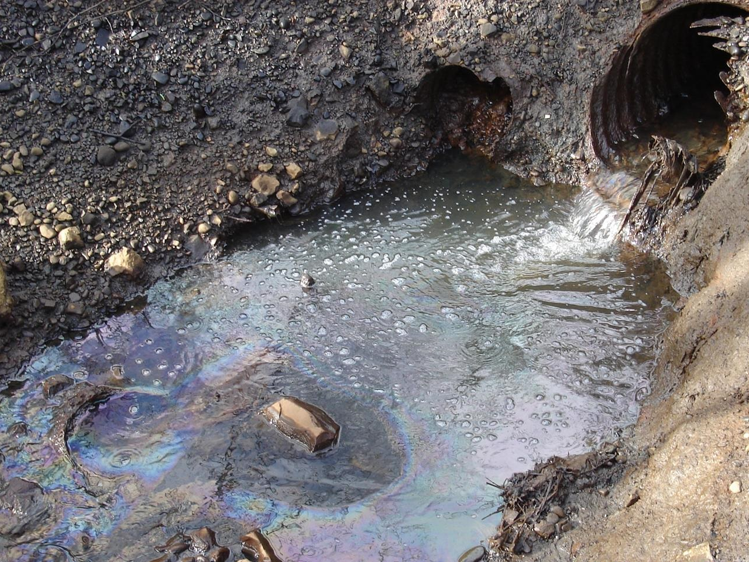
What can we do?
Don’t pollute water!
Never put anything in storm drains, rivers, lakes, streams, etc.
Photo courtesy of Washington Department of Ecology
Notes:
Redband trout need clean water to survive. Water pollution threatens the health of the trout, the species they prey on and the species that preys on trout!

Slide 18
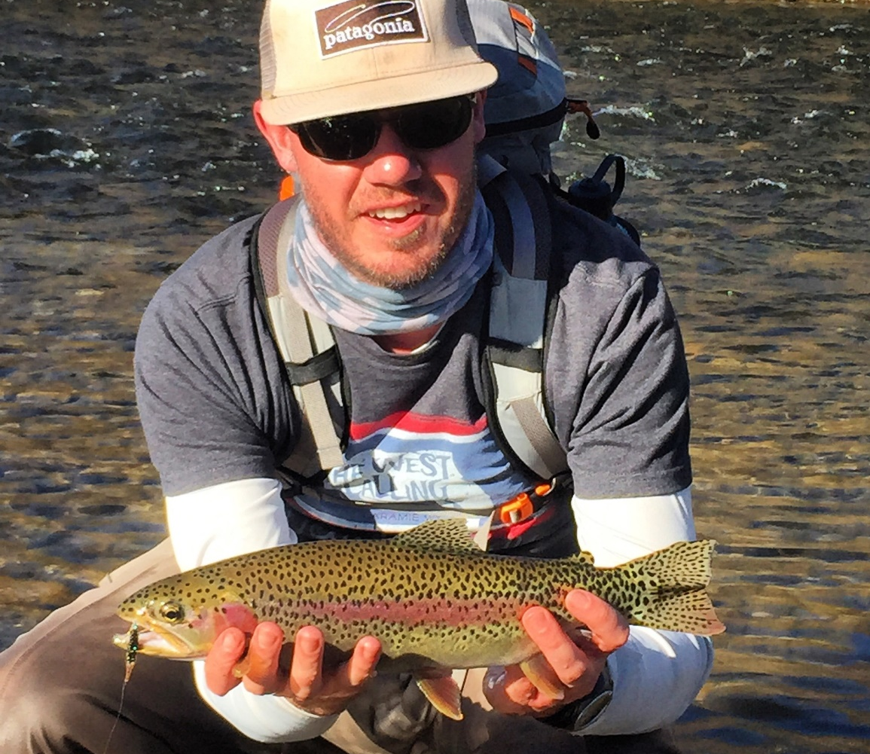
What can we do?
Find and enjoy redband trout!
Notes:
Students can use this link: https://wdfw.wa.gov/species-habitats/species/oncorhynchus-mykiss#locations to find rainbow or redband trout.

