Slide 1
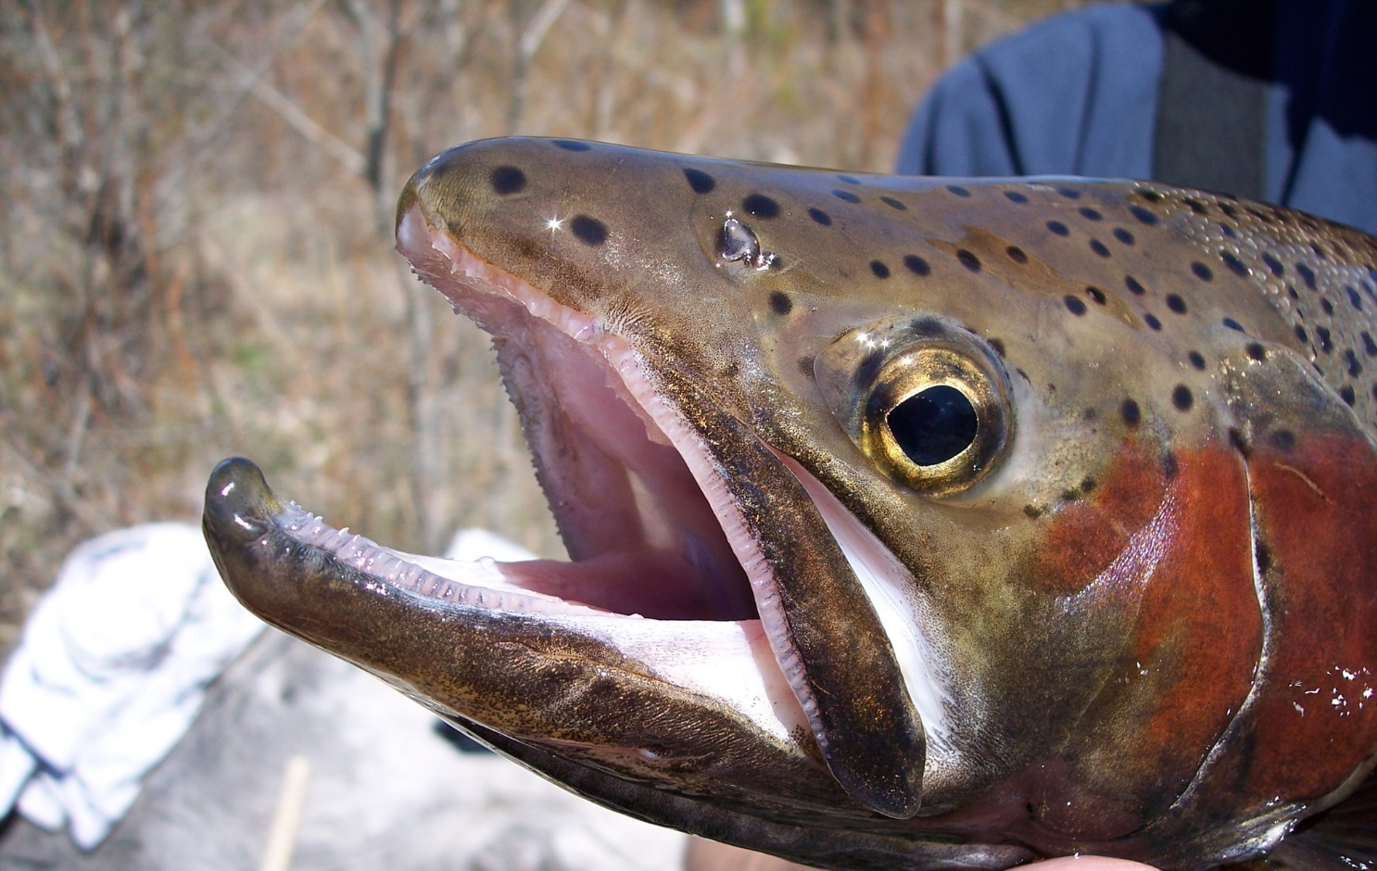
Redband Trout

Slide 2
What are redband trout?
Redband trout are a unique type of rainbow trout.
They have a shiny rainbow down each side.
Both rainbow trout and redband trout are salmonids. This means they are related to salmon!
Notes:
Ask students to raise their hands if they have ever heard of redband trout. If anyone has, ask them what they know about them. The answer may vary depending on where you live geographically.
After showing the picture, ask students if they can guess why they are called rainbow trout.
Redband trout are subspecies of rainbow trout. Subspecies are typically a geographically isolated species and may become somewhat physically and genetically different from other subspecies.

Slide 3
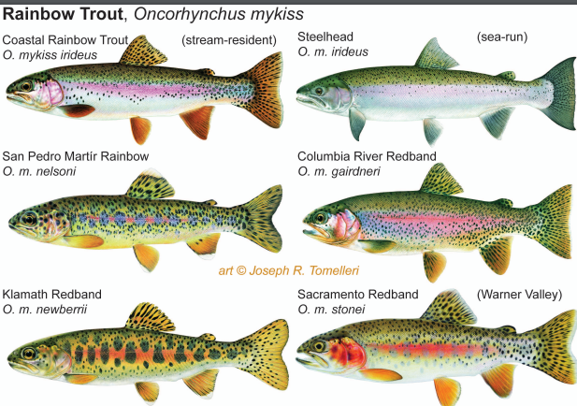
On the West Coast, there are six different types of rainbow trout! (Not all of them are found in Washington)
Graphic courtesy of United States Fish and Wildlife Service.
This is the type of redband/rainbow trout we have in Washington.
Notes:
In Washington we have the Columbia River/ Interior/ Great Basin redband trout (the names are often used interchangeably but all are classified as O.m. gairdneri)

Slide 4
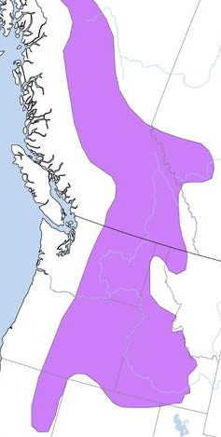
Where are redband trout found?
They are found throughout the western states (Washington, Idaho, Montana, Oregon, and Northern California).
In Washington, they are found in more arid (dry) climates east of the Cascade Mountains.
Graphic courtesy of Montana Field Guide.

Slide 5
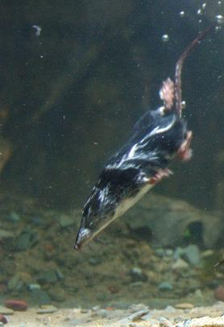
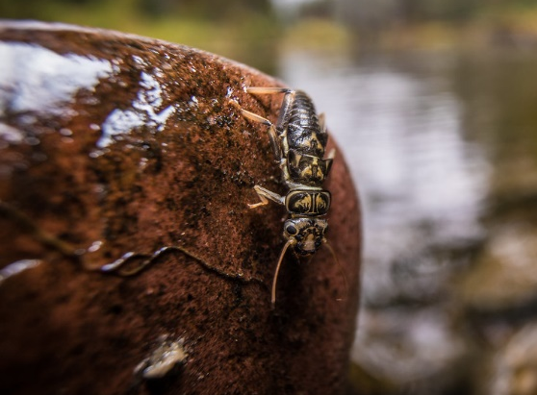
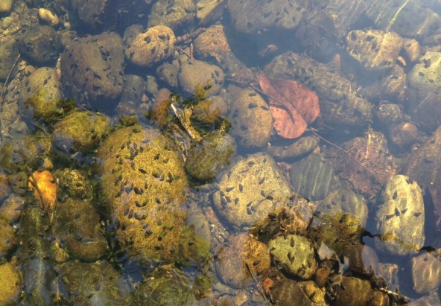
What do they eat?
Redband trout are opportunistic feeders.
They will eat macroinvertebrates like: stoneflies, dragonfly nymphs, mayflies, beetles, snails, and worms and small fish, crayfish, small aquatic mammals, and more.
Stonefly courtesy of National Park Service
Northern Crayfish
Aquatic snails
Water shrew by Robert A. MacArthur
Notes:
Introduce the term opportunistic.
Macroinvertebrates are small aquatic animals without backbones that can be seen without a microscope.

Slide 6
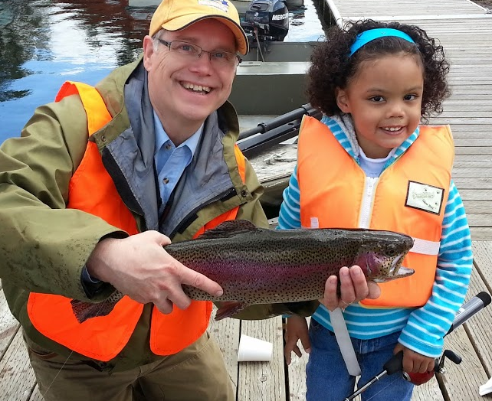
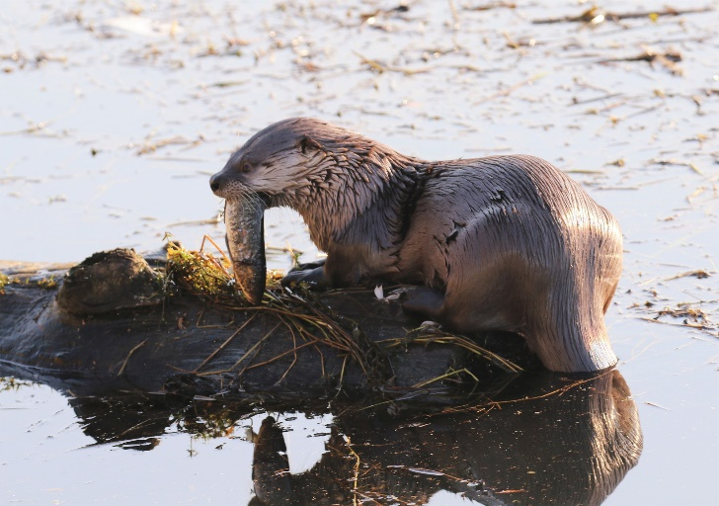
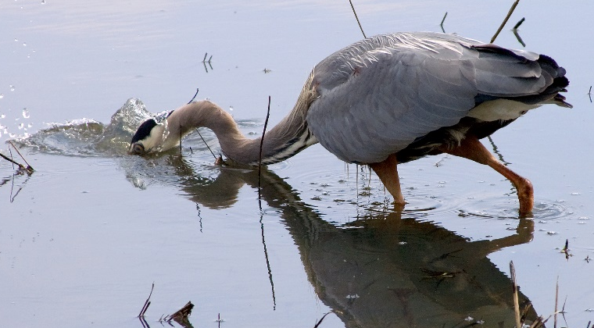
What eats them?
Bears, many species of birds (like kingfisher and herons), raccoons, bobcats, river otters, and humans!

Slide 7
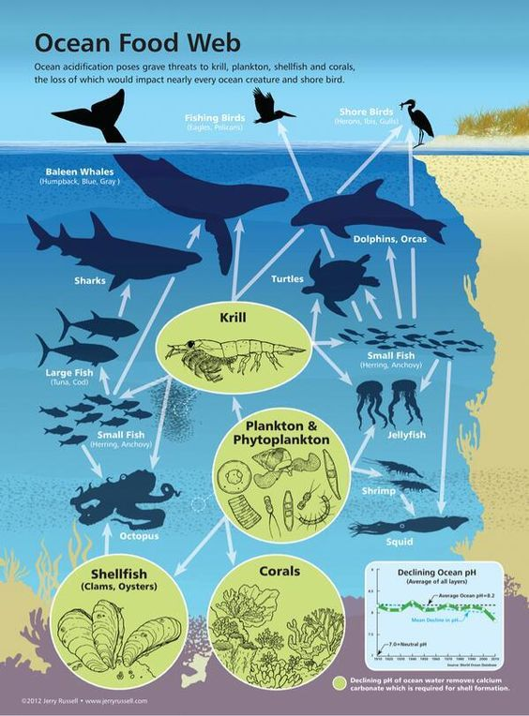
Food webs
Redband trout are an important part of the food web.
Consider:
What eats krill?
What does krill eat?
How would removing krill from this ecosystem impact other animals?
With a partner, describe some of the relationships of marine animals in this food web.
Food web graphic courtesy of NOAA
Notes:
Before introducing the concepts of food webs, ask students what they think a food web is. Have them share with a partner and the
Food webs describe the feeding relationships or connections among species in an ecosystem. They show how species engage with one another.

Slide 8
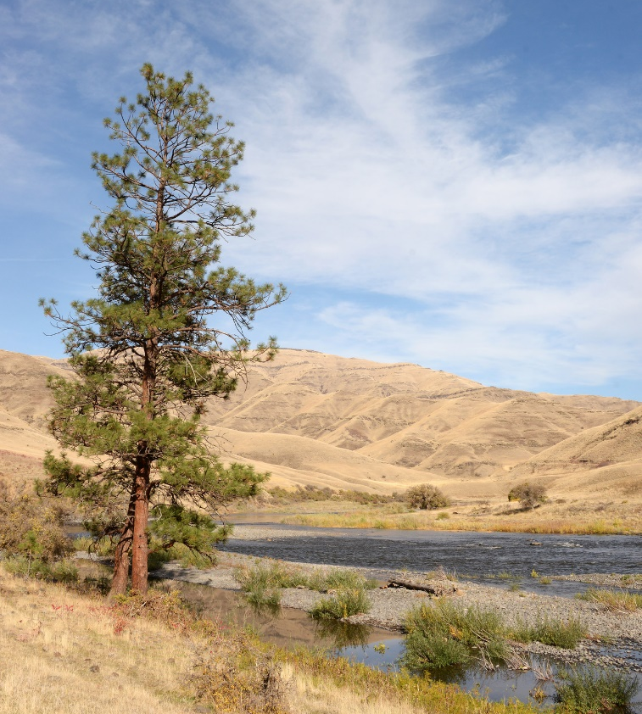
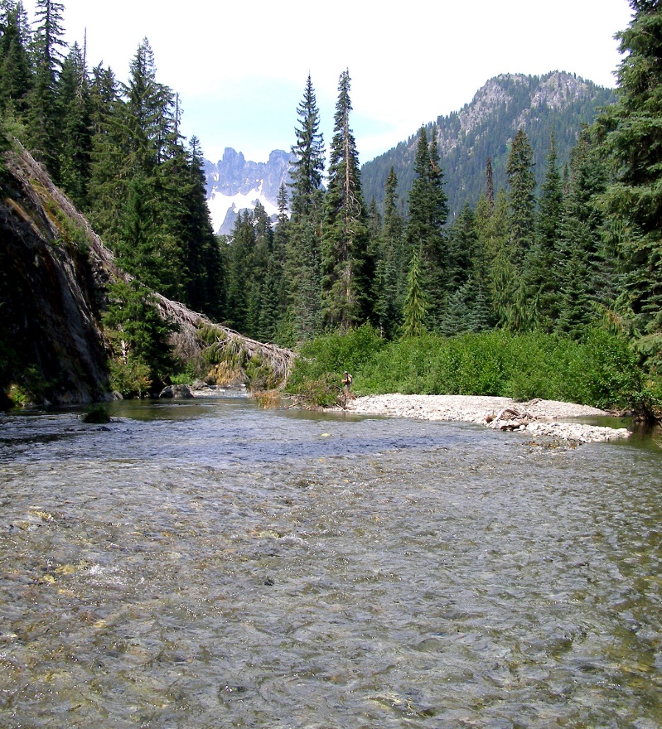
What’s their habitat like?
Redband trout are adaptable.
They have evolved to live in everything from mountain forest to high desert streams.
Notes:
You may want to introduce the term adaptable– the ability to adjust to new conditions.

Slide 9
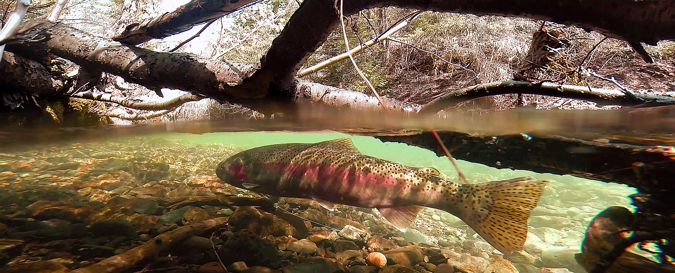
What’s their habitat like?
Redband trout are adaptable.
Areas where they live may experience drought (low water), high water temperature (rainbow trout typically like cold water), fires, and more.
Notes:
Because the habitat redband trout live in can experience such different conditions, redband trout have adapted traits that allow them to live in conditions that other rainbow trout would not be able to.
Although they are an adaptable species and can survive in less than ideal conditions, the species only thrives when they have certain habitat elements. Additionally, trout eggs must have clean, cold water to hatch.

Slide 10
Important habitat elements
Undercut stream banks
Notes:
Undercut banks provide protection for young trout from aerial predators like birds and mammals.

Slide 11
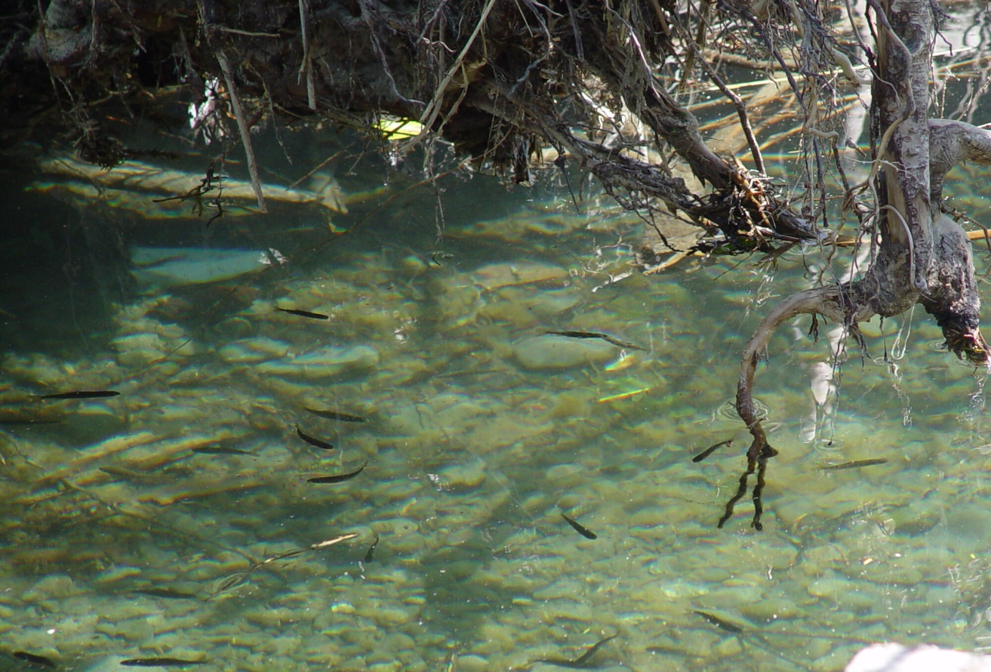
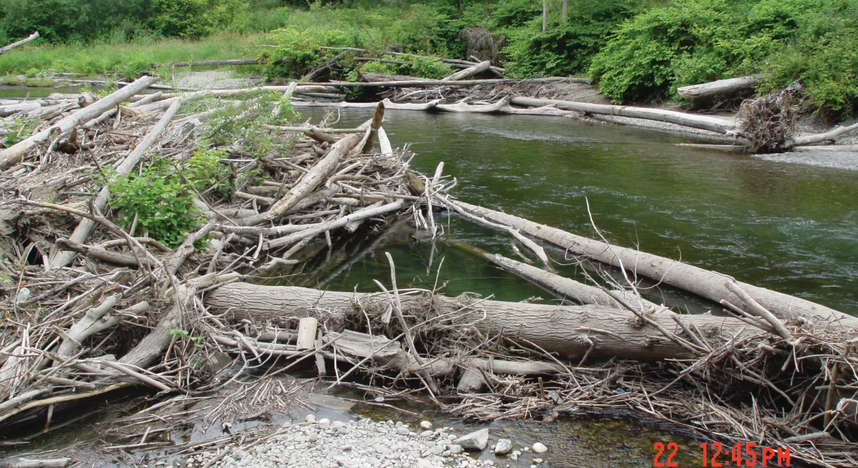
Important habitat elements
Large woody debris
Notes:
Woody debris provides protection from predators, hiding places for juvenile and small fish and shade for cooler water temperatures.

Slide 12
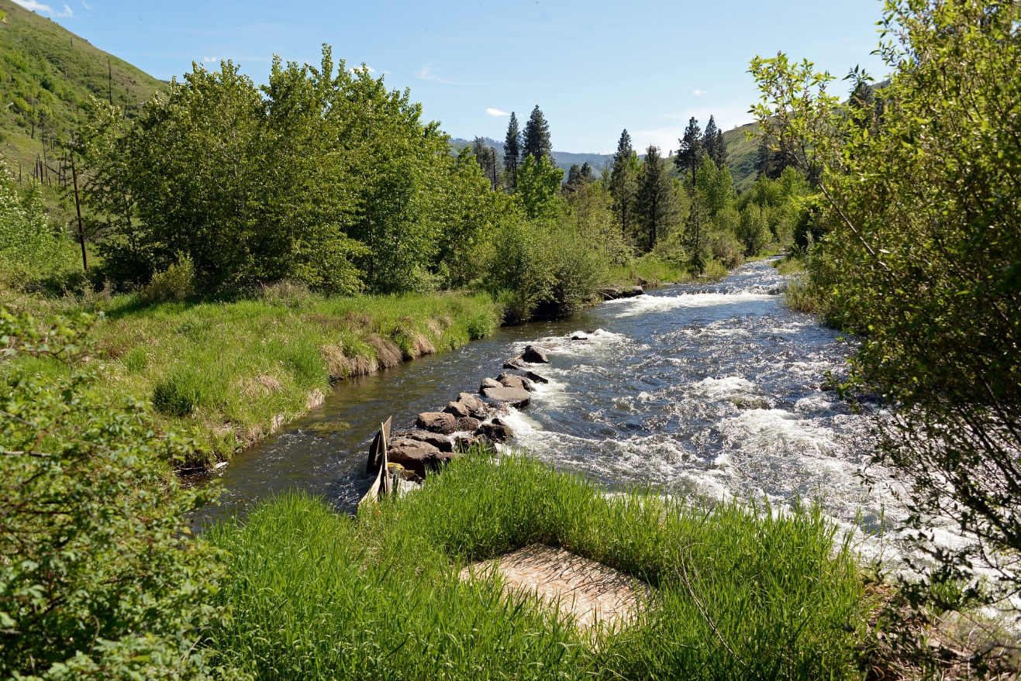
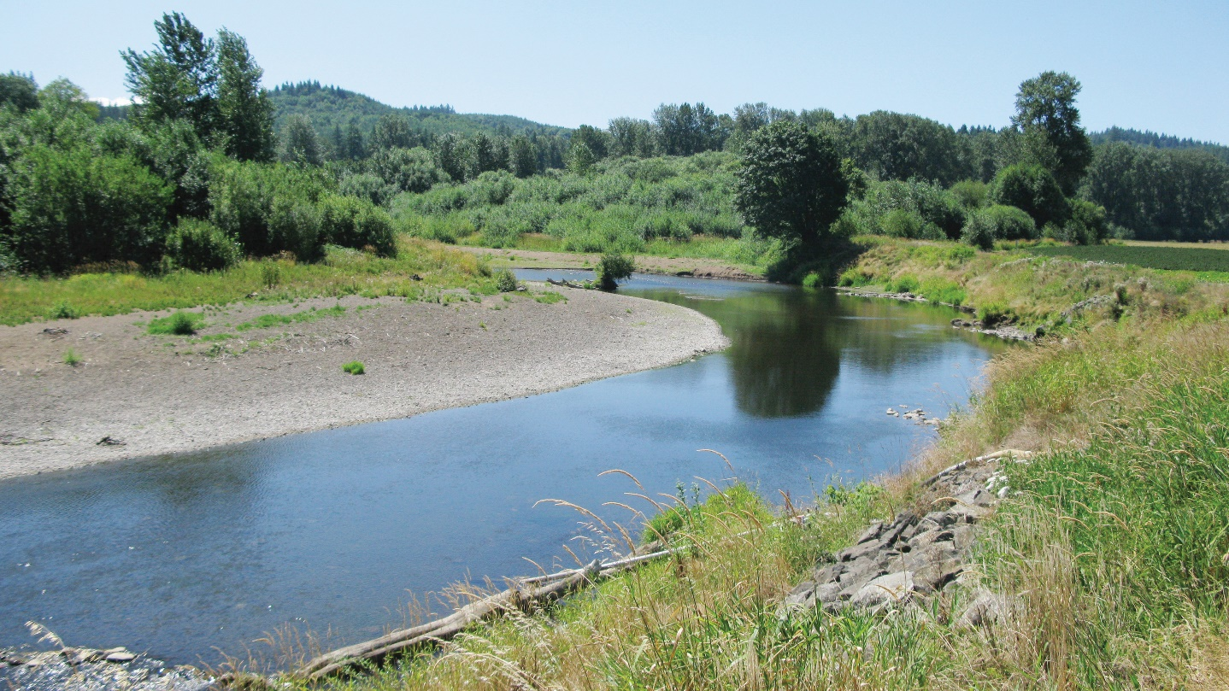
Important habitat elements
Overhanging vegetation
Notes:
Ask students to compare and contrast the two different parts of the river. Ask them to think-pair-share about why having overhanging vegetation is so important.

Slide 13
Important habitat elements
Gradual channels
High movement water
Notes:
Redband trout utilize both steep and gradual channels. Gradual channels are important for laying eggs. Quick moving water keeps the water cool, and helps oxygenate the water as well.

Slide 14
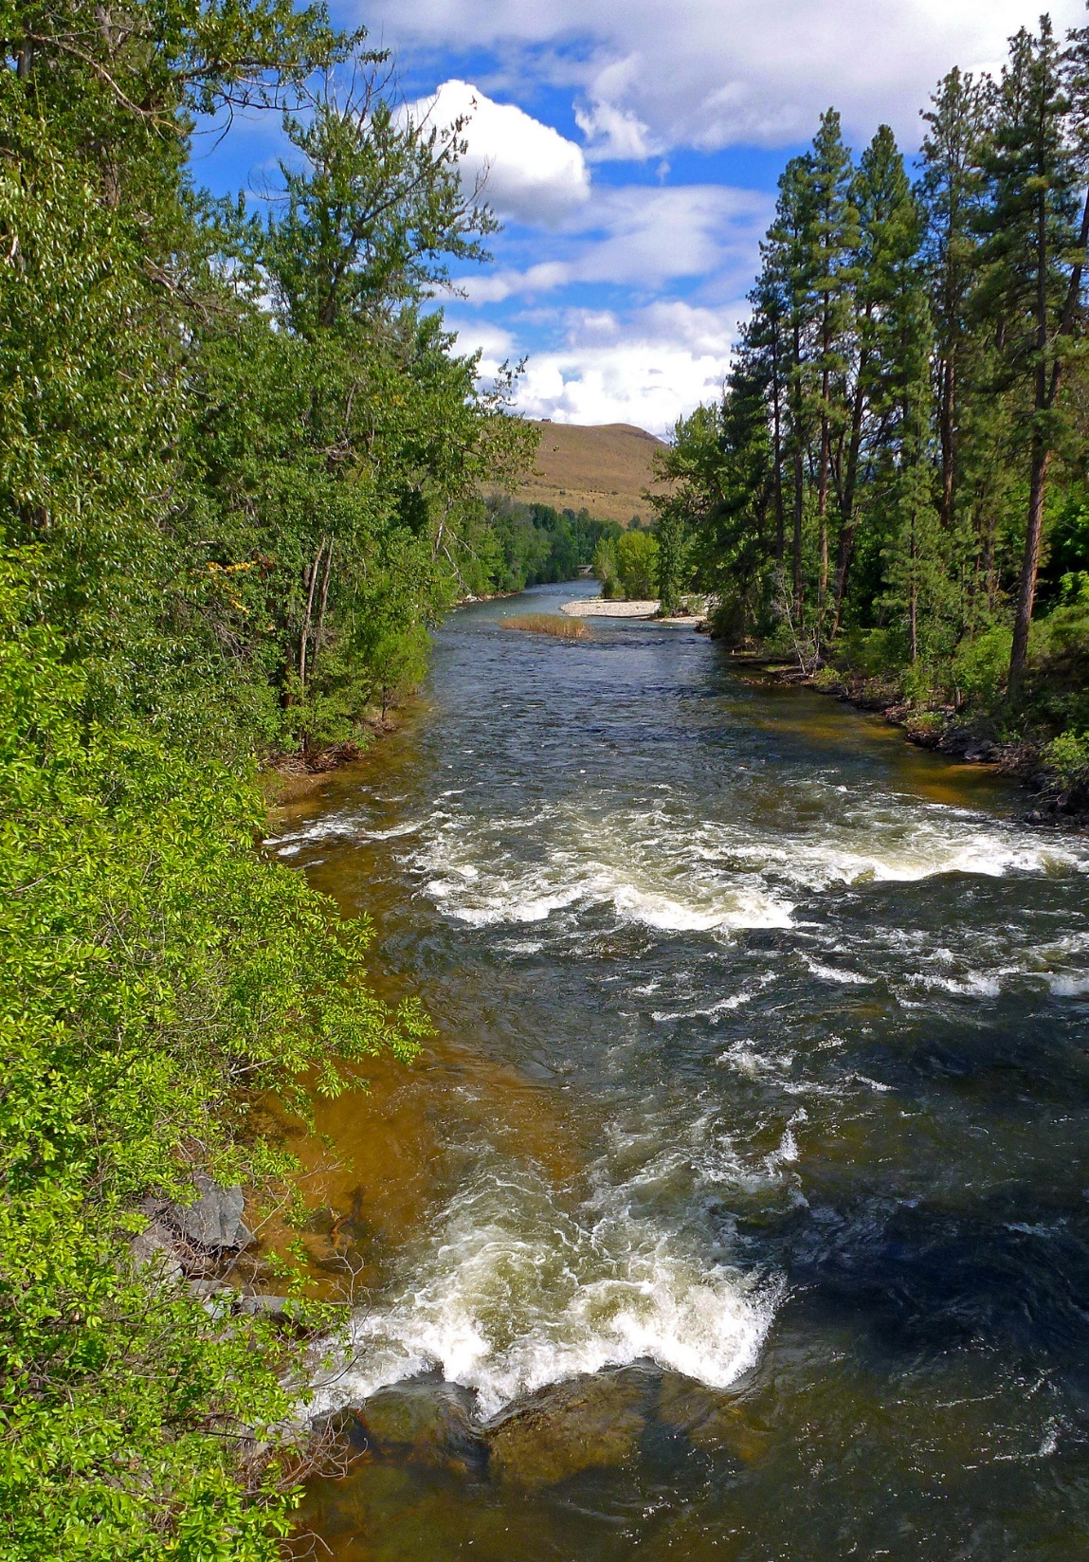
Important habitat elements
Substrates with boulders, cobbles, and pebbles.
Pocket water- water with lots of big rocks and tumbling currents.
Notes:
Loose gravel and cobbles help provide habitat for redds (fish nests) and moving water helps provide oxygen in the water for fish to breathe.

Slide 15
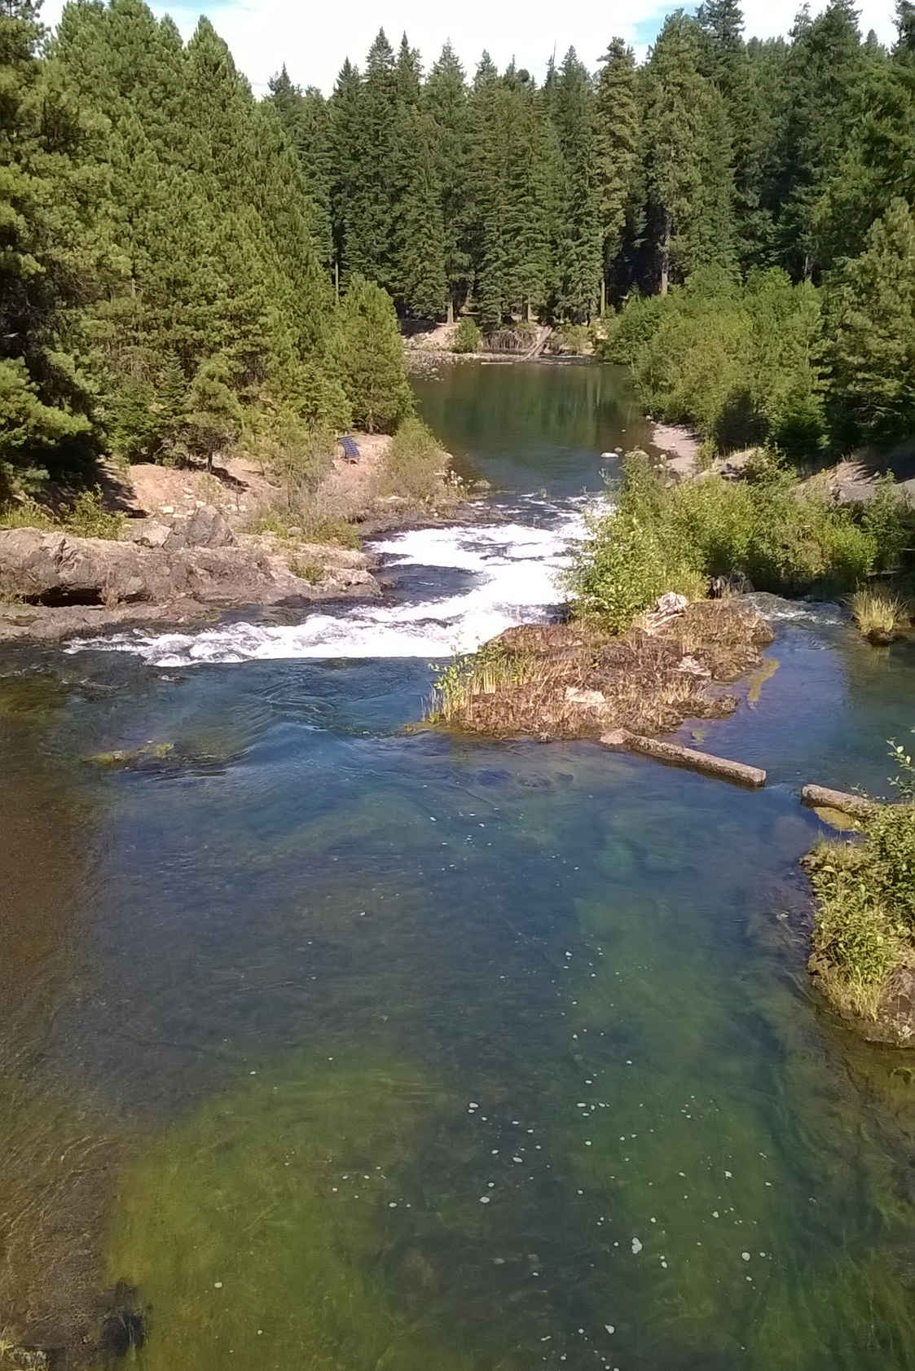
Important habitat elements
Pools
Notes:
Ask students if they can identify any pools in the picture before clicking to reveal the circles that highlight a couple.
Pools provide important resting and raising habitat for redband trout. Additionally, rivers and streams with many pools act as refuge from floods, drought, and extreme temperatures.

Slide 16
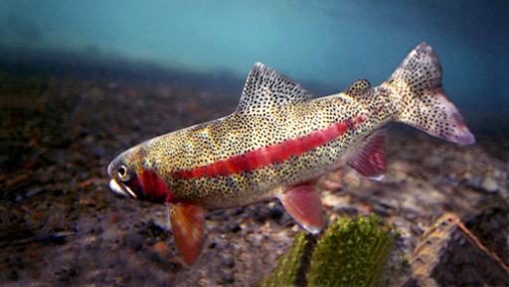
Life histories of redband trout.
Resident redband trout will spend their life small streams and river tributaries (smaller streams that stem from a larger river).
Photo courtesy of United States Fish and Wildlife Service.
Notes:
Additionally, their ability to adapt has led the fish to having different life histories. Some migrate, while others do not.
Life history is the sequence of events related to survival and reproduction that occur from birth through death.

Slide 17
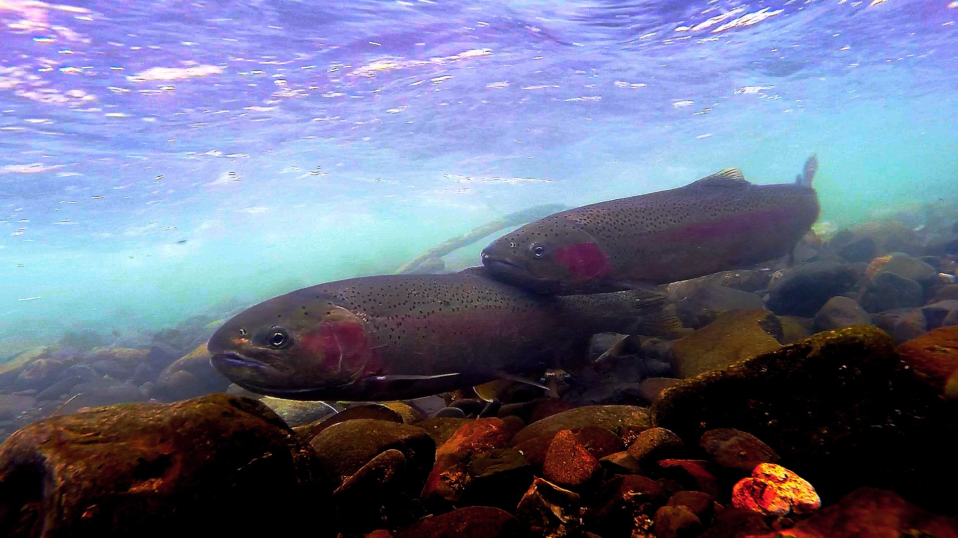
Life histories of redband trout.
Fluvial redband trout will spend their life in rivers or streams.
Notes:
Life history is the sequence of events related to survival and reproduction that occur from birth through death.
These fish spawn in steams and spend their entire lives in flowing water and return to their natal stream to spawn (the stream they were hatched in).

Slide 18
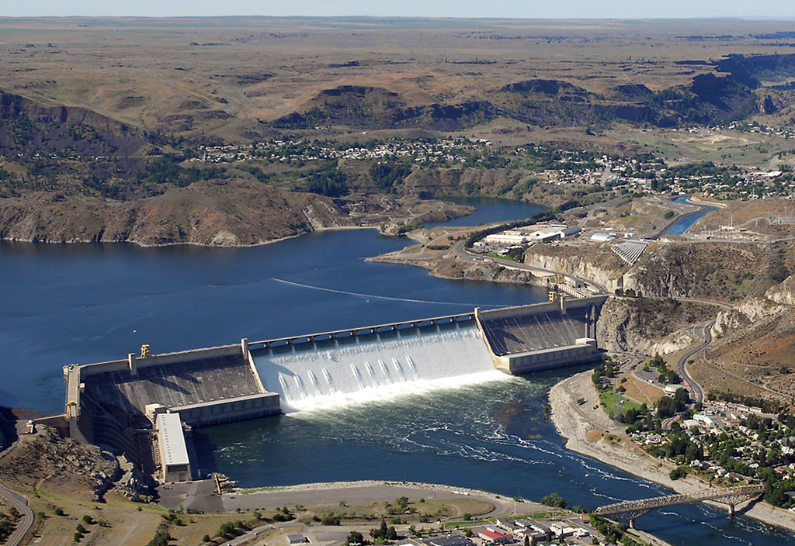
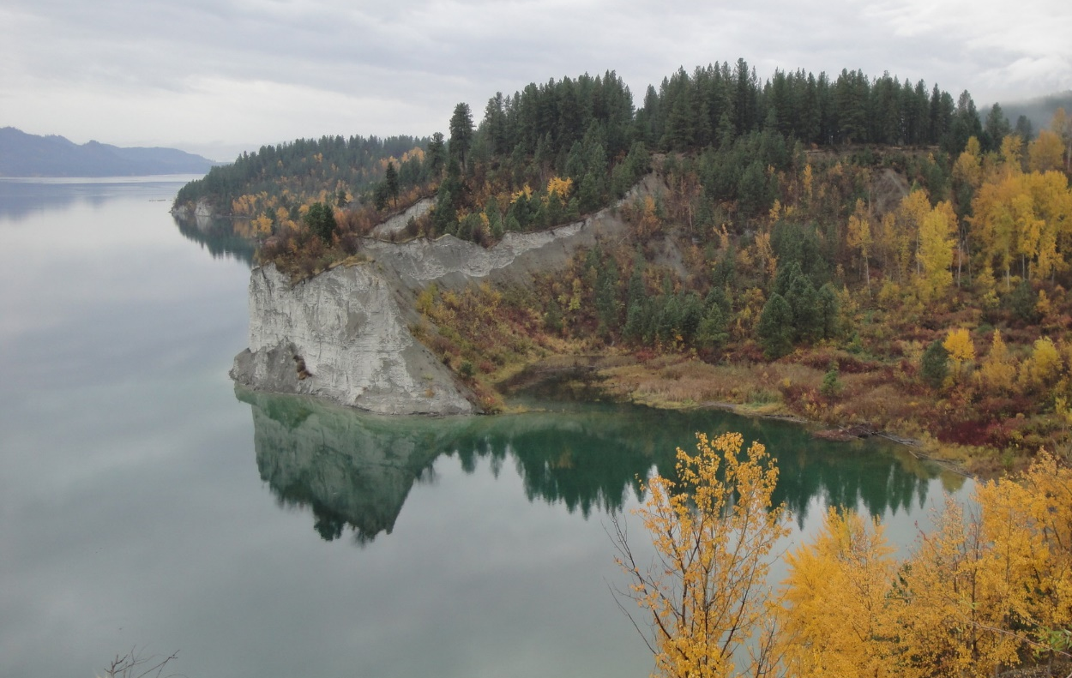
Life histories of redband trout.
Adfluvial redband trout spawn in rivers and streams, but spend most of their life in a lake marsh.
Redband Trout in the upper Columbia River used to migrate all the way to the ocean (an anadromous lifestyle)!
The Grand Coulee Dam, Photo by U.S. Bureau of Reclamation.
After construction of the Grand Coulee Dam in 1941, they could no longer migrate. The fish adapted their life history and now spend most of their lives in Lake Roosevelt.
Lake Roosevelt in the fall
Notes:
Anadromous life histories are when fish are born in rivers or steams and spend most of their life in the ocean before returning to rivers or streams to spawn. Salmon are an example of this life history.
Adfluvial redband trout typically spend one to three years in lakes to mature before returning to streams to spawn.
Lake Roosevelt is a reservoir, an artificially constructed lake created by damming the Columbia River.

Slide 19
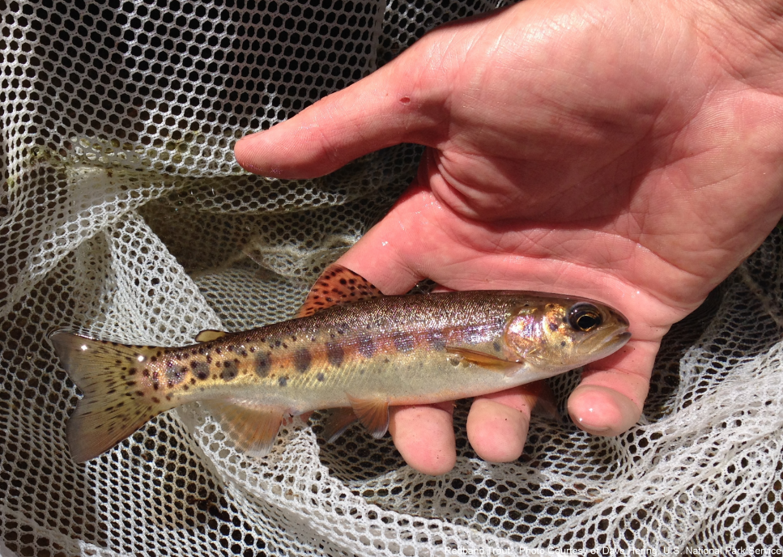
Why are redband trout important?
Redband trout are important part of the food web in Washington and other western states. Even from eggs they help support a variety of species from birds to humans!
They have been a culturally important food source for many indigenous tribes for thousands of years.

Slide 20
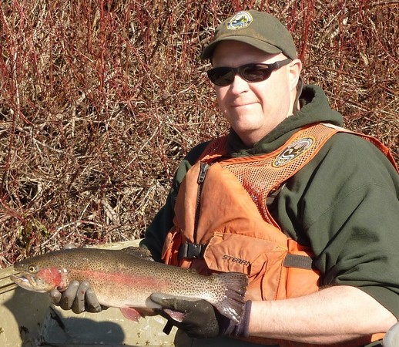
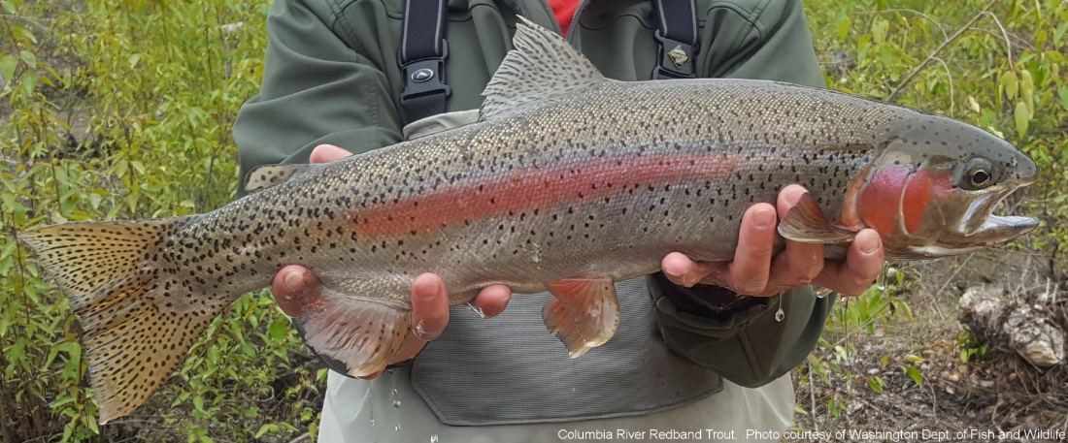
Why are redband trout important?
They are important for people’s subsistence, culture, and recreation.
Scientists are still learning more about their role in our ecosystems. If we lose them, we may be losing our next scientific breakthrough!

Slide 21
Decline in redband trout
Today, fisheries biologists in Washington (people who study fish) estimate that redband trout only have 11% of their previous habitat.

Slide 22
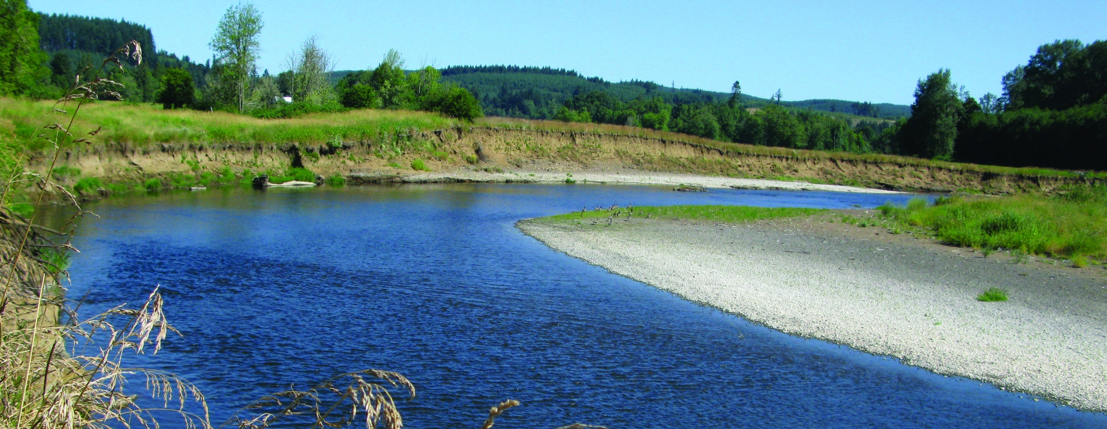
Decline in redband trout
Threats to redband trout include:
Loss or degradation of habitat
Habitat loss due to development.
Pollution like garbage in recreation areas.
Pesticide and fertilizer run off in water.
Stream bank erosion due to poor livestock grazing practices.

Slide 23
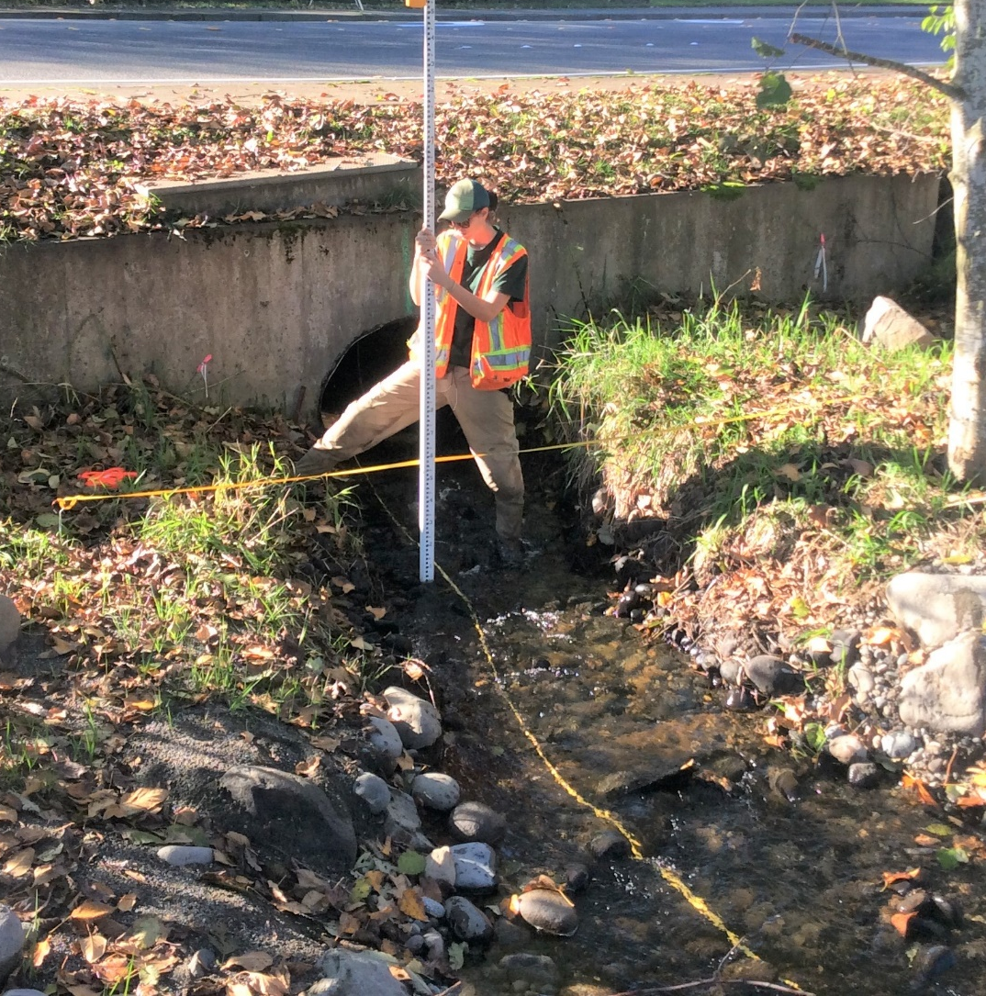
Decline in redband trout
Threats to redband trout include:
Fish passage barriers
Small barriers like undersized culverts
Dam construction (like Grand Coulee and Chief Joseph)
Hybridization (breeding with another species) with hatchery rainbow trout
A WDFW employee measures the culvert to see if fish can pass through.
Notes:
Fish passage barriers prevent fish from migrating from river to lake, or river to stream. These barriers prevent fish from moving and sometimes prevent them from spawning.

Slide 24
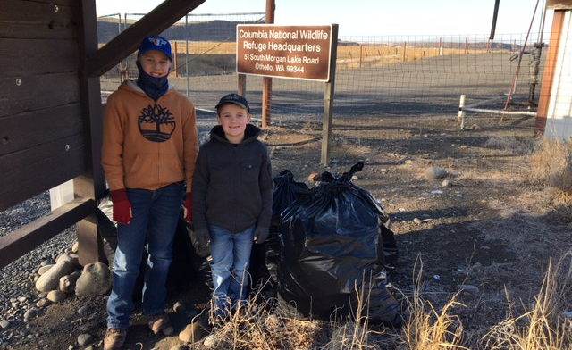
What can we do?
Clean up garbage and practice Leave No Trace Principles when enjoying the outdoors.
Notes:
Because the fish are sensitive to pollution, there are many things you and your family can do to help redband trout like cleaning up garbage and making sure you leave no trace when exploring.

Slide 25
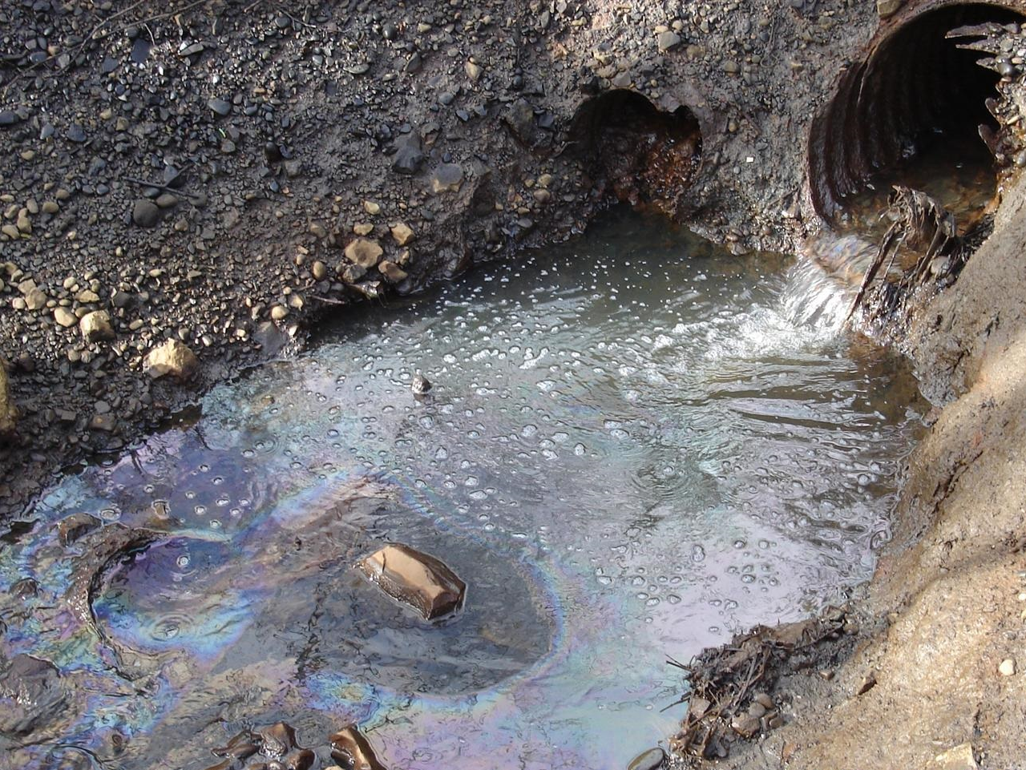
What can we do?
Don’t pollute water!
Never put anything in storm drains, rivers, lakes, streams, etc.
Photo courtesy of Washington Department of Ecology
Notes:
Redband trout need clean water to survive. Water pollution threatens the health of the trout, the species they prey on and the species that preys on trout!

Slide 26
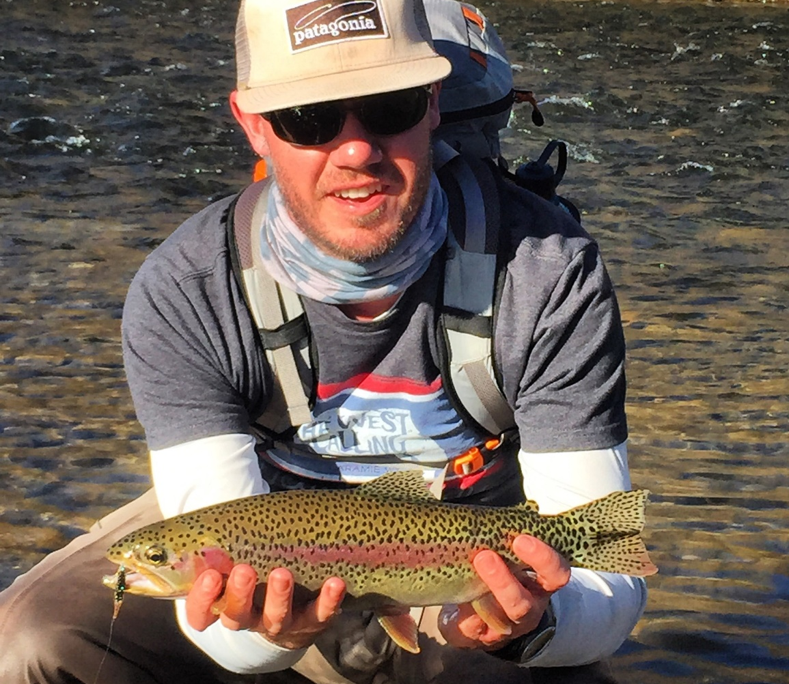
What can we do?
Find and enjoy redband trout!
Notes:
Students can use this link: https://wdfw.wa.gov/species-habitats/species/oncorhynchus-mykiss#locations to find rainbow or redband trout.

