Slide 1
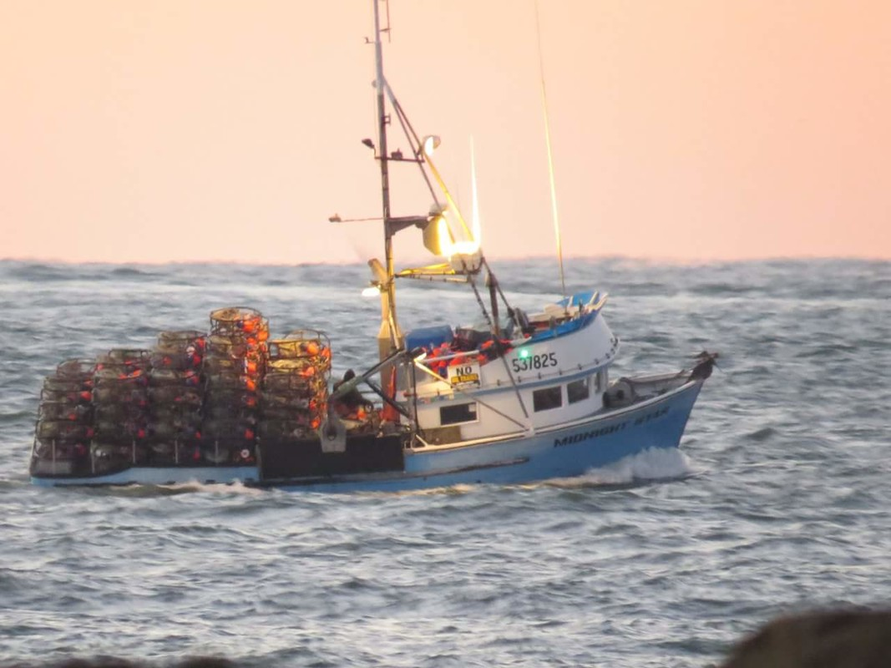
Washington Sustainable Seafood

Slide 2
How can we support sustainable fisheries?
Over 70%
97% of the world’s water is in the ocean.
Notes:
Ask students to brainstorm ways they could support sustainable fisheries.

Slide 3
Washington fisheries
Ask adults to buy local, sustainable seafood.
Both fresh and frozen can be
good choices depending on the
type of seafood.
Make sure to ask where the seafood comes from!
Do research with your family about the seafood you eat so you are more informed.
Sustainable seafood market in Ilwaco
Photo: Luke Whittaker/Chinook Observer
Notes:
The link will take you to a commercial salmon fishing family who catches their fish sustainably.

Slide 4
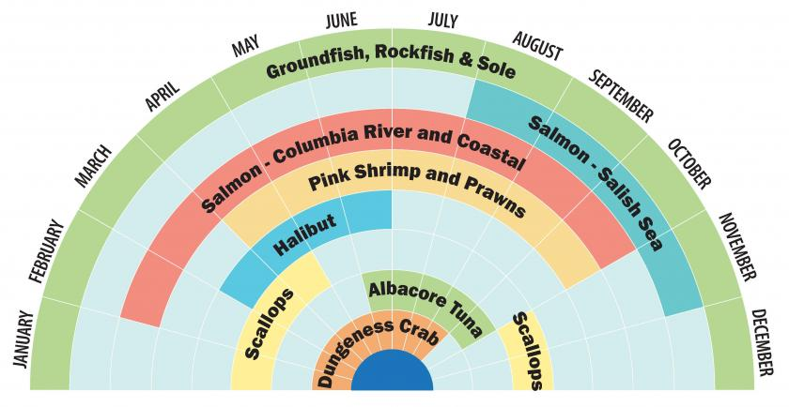
Washington fisheries
Only harvest seafood when it is in season.
Locally canned and frozen seafood may provide affordable and year-round options.

Slide 5
Washington fisheries
Support local fishers and fisheries whenever possible
Notes:
The link takes you to localcatch.org where students and adults can find local seafood in their area. The finder also has filters for fish caught with a community and ecosystem based management mindset.

Slide 6
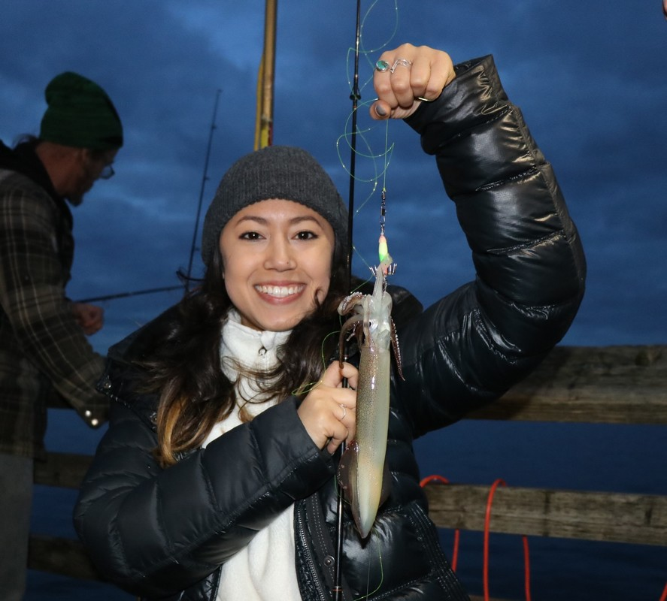
Washington fisheries
Try harvesting or purchasing seafood with your family.
Squid (Calamari is tasty!)
Kelp and seaweed (good for soups and salads)
Razor clams
Steamer clams
Marine mussels
Oysters
Arrowtooth flounder
Pacific sanddab
Starry flounder
Walleye
Kokanee
Trout
Squid jigging only requires a pole and tackle and can be done from many urban piers.
Don’t forget to make sure your family gets the right permits and/or licenses before harvesting any natural resource. This helps keep fisheries sustainable!

Slide 7
Washington fisheries
Use the Seafood Watch or FishWatch as a resource to see if the fish you purchase is sustainable!
Notes:
The link takes students to a California Academy of Science video about how they, and their families can choose more sustainable seafood at the market and in restaurants.

Slide 8
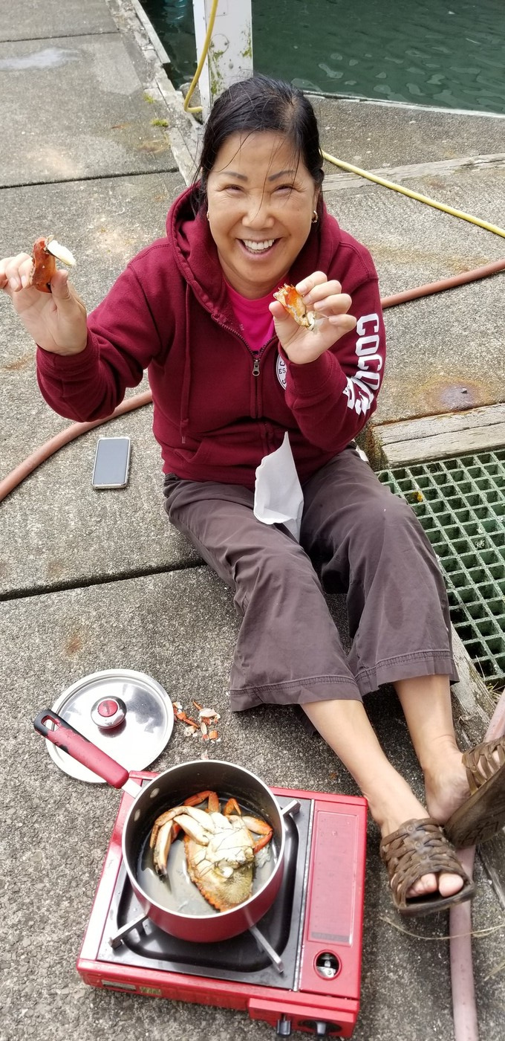
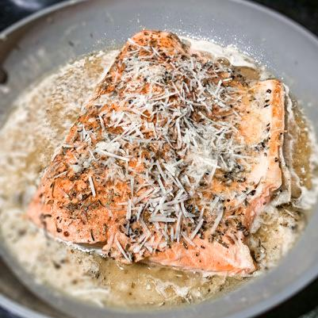
Washington fisheries
Enjoy Washington seafood and try cooking new recipes with your family.
Cajun Salmon
1 tablespoon extra-virgin olive oil
4 4-oz. salmon fillets
3 teaspoon Cajun seasoning
2 tablespoons butter
3 cloves minced garlic
1/3 cups chicken or vegetable broth
Juice of one lemon
1 tablespoon honey
1 tablespoon freshly chopped parsley
2 tablespoons grated parmesan
---------------------------------------
Heat oil in skillet over medium-high heat.
Season salmon with 2 t. Cajun seasoning and add to skillet skin-side up.
Cook about 6 minutes, then flip and cook 2 minutes or until golden color. Transfer to plate
Add all other ingredients to skillet including remaining Cajun seasoning. Bring mixture to a simmer.
Reduce heat to medium and add salmon back to skillet.
Cook 3 more minutes or until sauce has reduced and salmon is cooked through.
Notes:
You don’t have to harvest seafood to appreciate it. Take time with a family member to find a delicious seafood recipe and cook together!

Slide 9
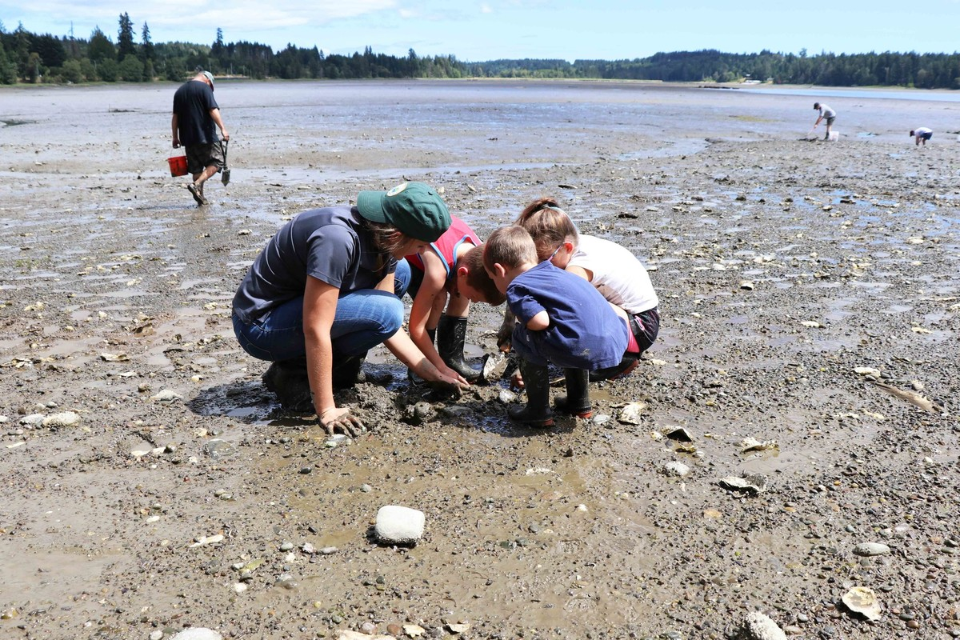
Your ideas?
Discuss the ideas you brainstormed at the beginning of the lesson with a partner. These ideas will help you with your project.

