Slide 1
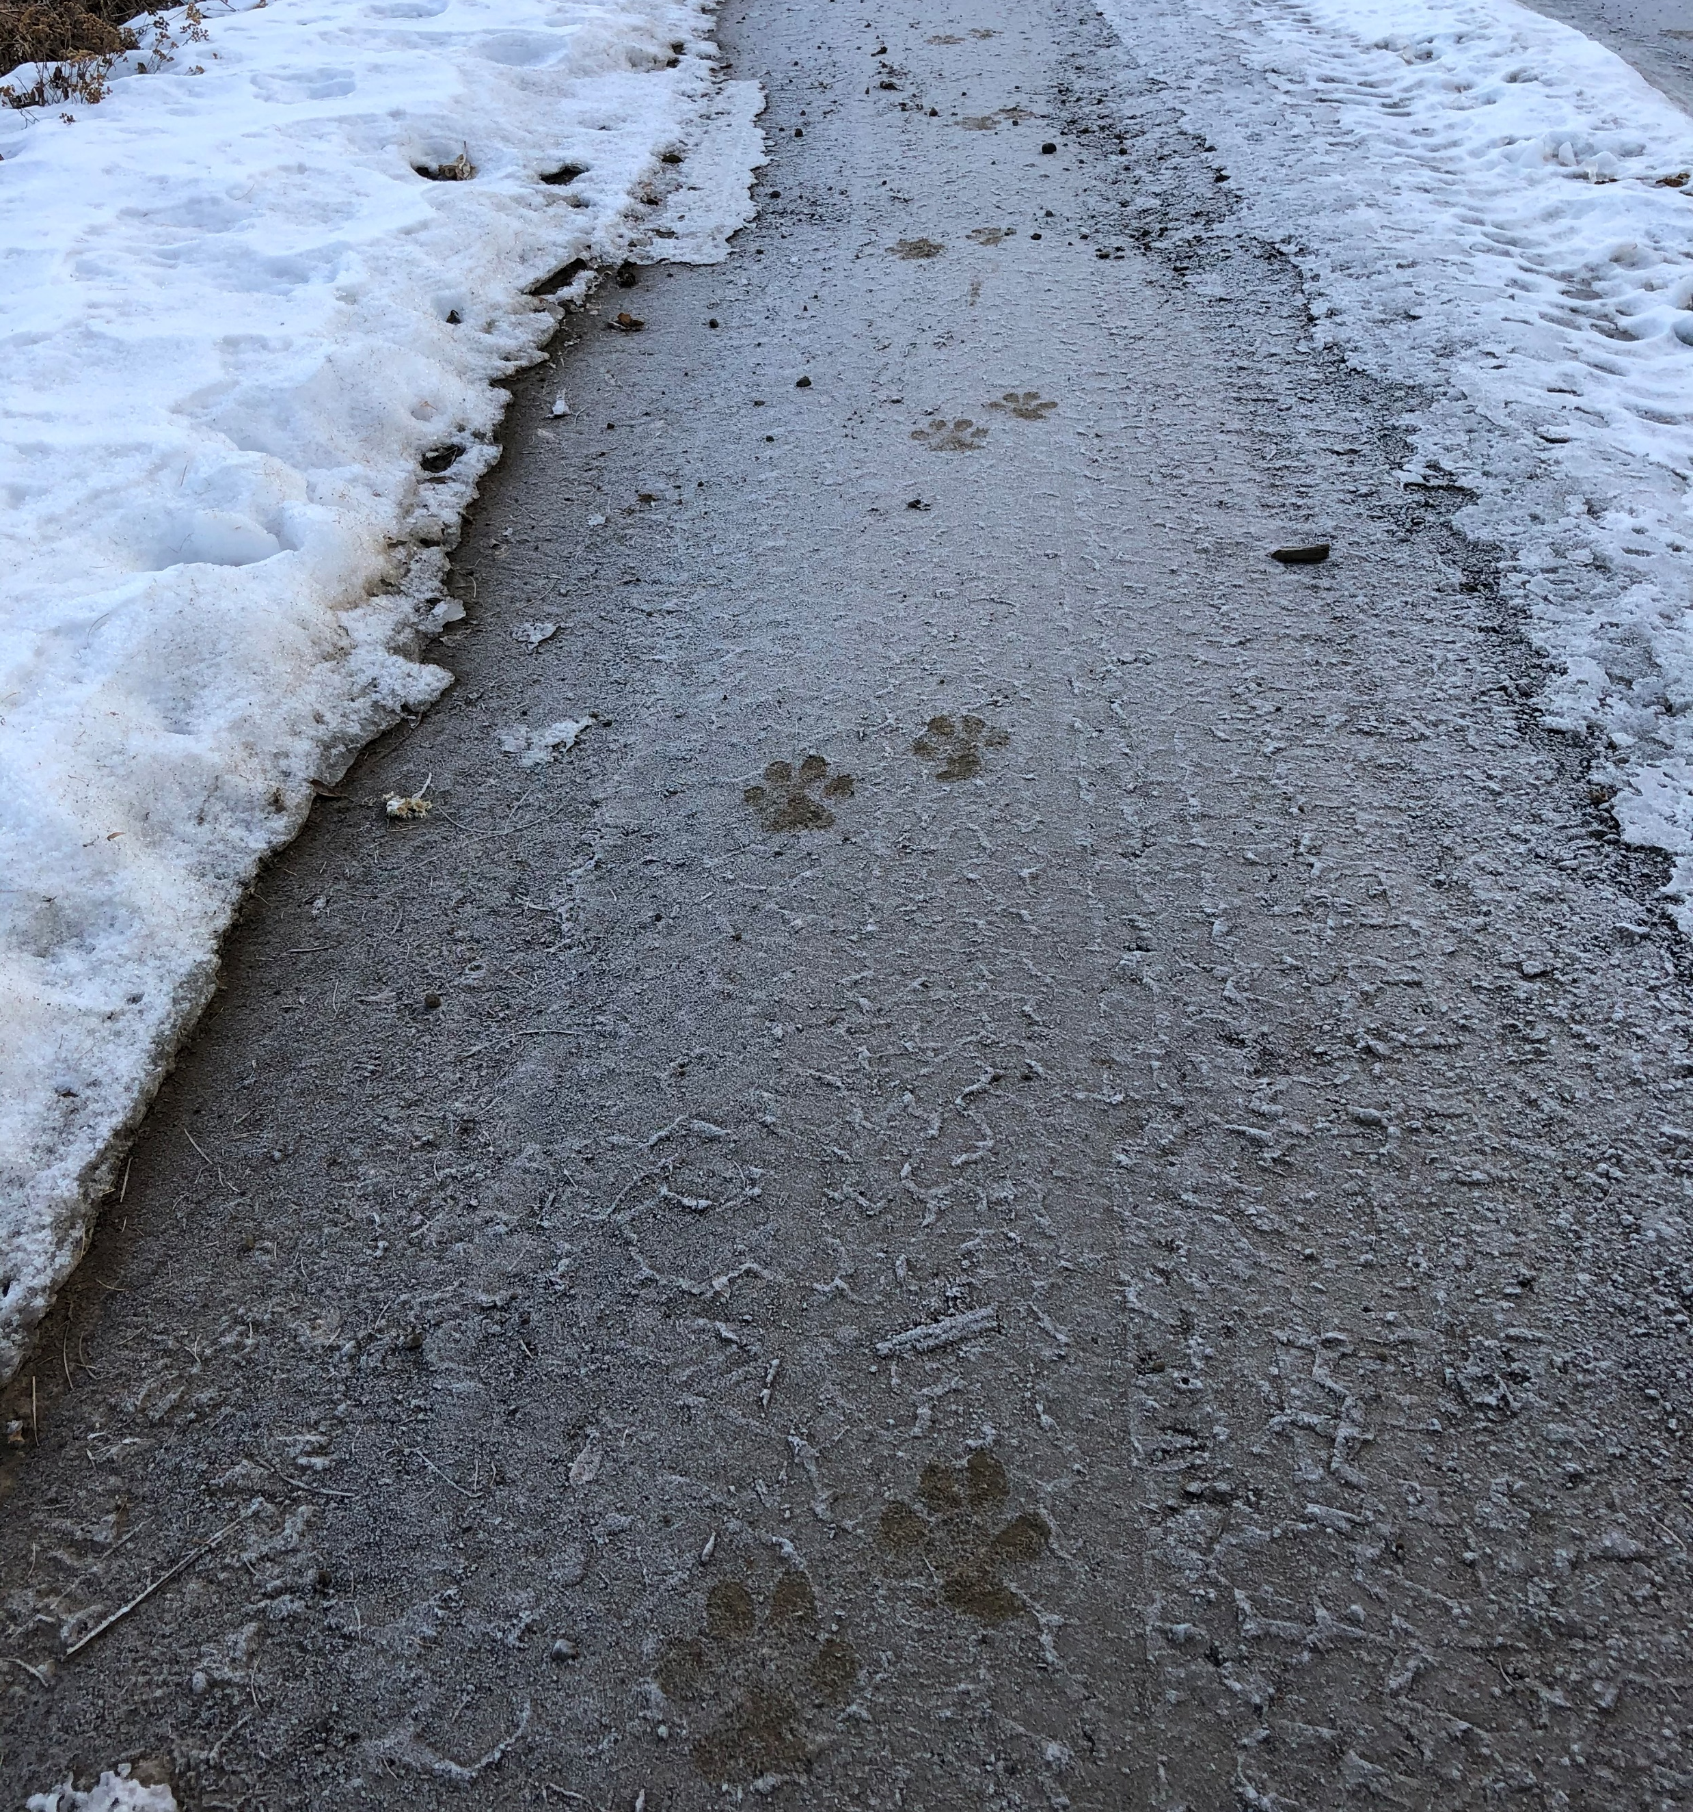
Notes:
How many wolves? What type of gait is this, why?
One wolf, a side-trot because the front and the hind foot are on the same side of the trail.

Slide 2
Notes:
Ask learners to estimate how many wolves might have created these tracks. Also, what type of gait to they think this might be?
Answer: 16! In Yellowstone National Park, Gabe observed 16 wolves using the exact same tracks to travel. This is a direct register trot.

Slide 3
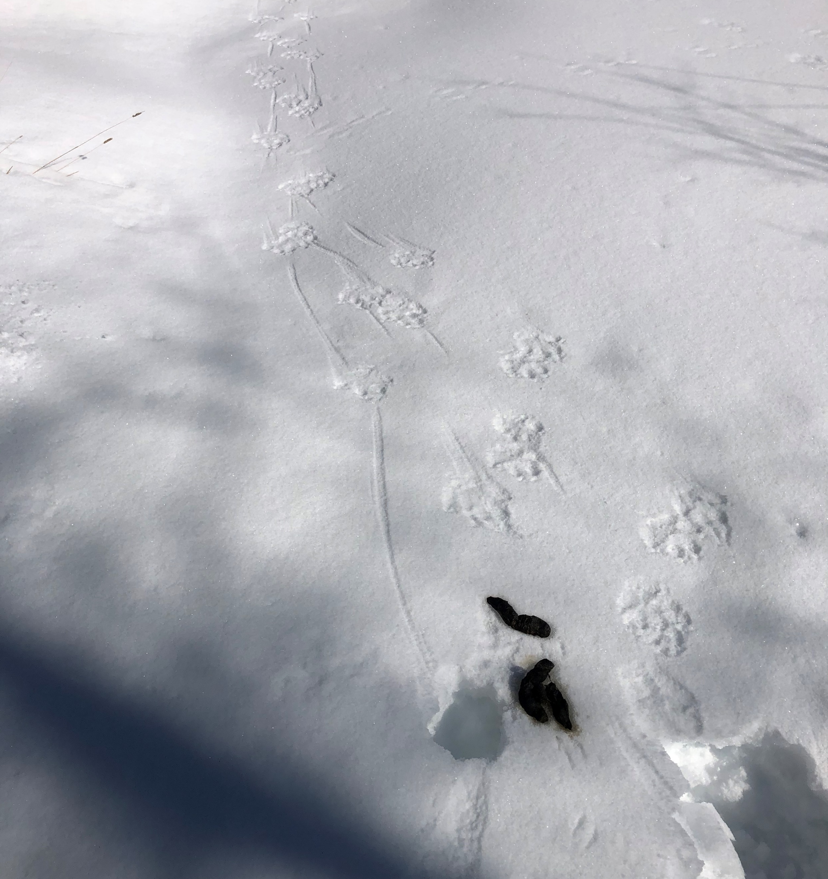
Notes:
How many wolves might be in this picture? What is another sign that wolves have been present?
Gabe estimates three wolves have been in this area. Scat is the other evidence of wolf presence.

Slide 4
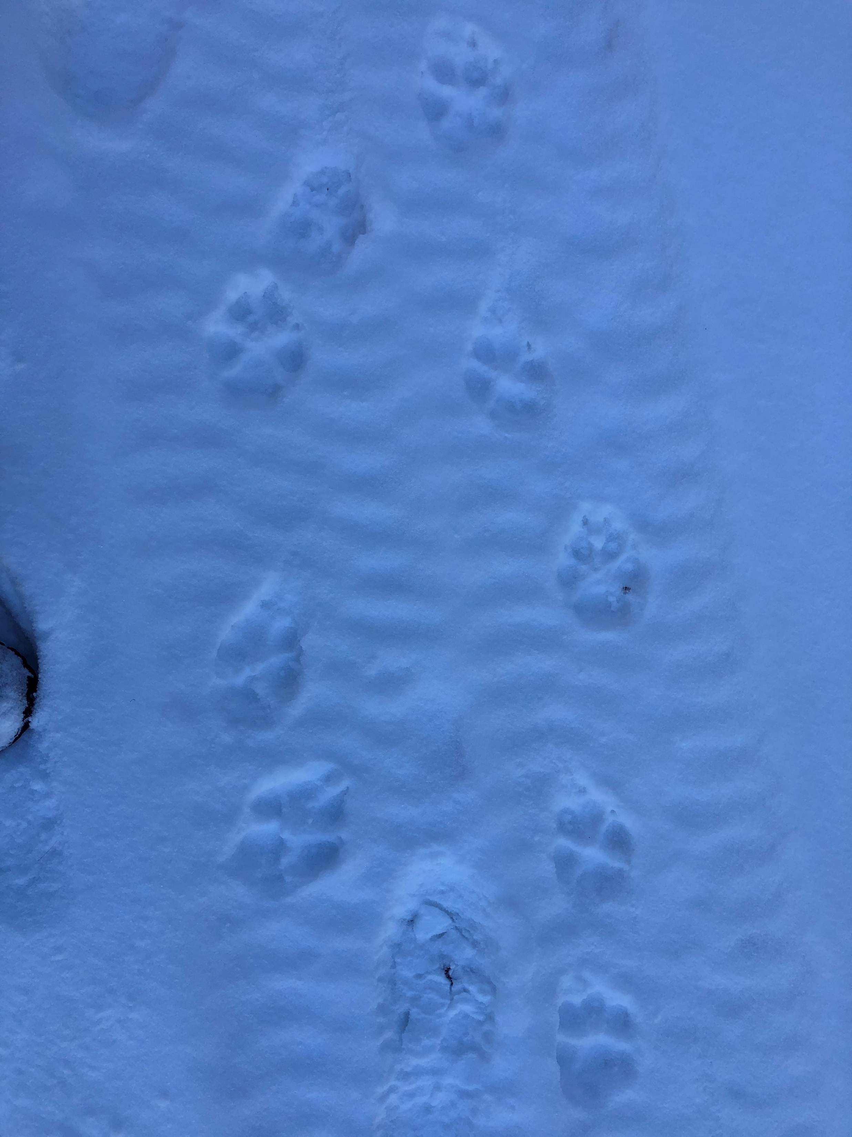
Notes:
How many wolves in this picture? Type of gait?
Two wolves, walking.

