Slide 1

Fish Friendly Workshop and Certification
Puget Sound Edition:
Marine Areas 7 and 7A, and Limited Participation Fisheries

Slide 2
Purpose
To provide information on why Fish Friendly regulations have been implemented.
To provide information to allow fishers to comply with state and federal regulations.
Help fishers strengthen fishery sustainability and opportunity by limiting their effect on ESA listed fish stocks and mitigate bycatch.

Slide 3
Module 1: General Information

Slide 4
Requirements of Management
Our fisheries must comply with the Endangered Species Act (ESA), and regulations put forth by the Pacific Salmon Treaty and the North of Falcon Process.
    ESA makes any unauthorized “take” of a listed species illegal.
    A take (death or harassment of a salmon) can be authorized by NOAA Fisheries provided they are convinced all reasonable actions are being taken to minimize “take”.
    A determination that the fishery will not jeopardize the species are the reason for these regulations.

Slide 5
ESA listed Puget Sound Fish Stocks
Puget Sound Chinook (1999)
Puget Sound Steelhead (2007)
3 Species of Rockfish (2009)
Hood Canal and Strait of Juan de Fuca Summer Chum (1999)
Release of ESA listed fish along with practices like brailing and recovery boxes are the means approved by NOAA that allow WDFW to prosecute these salmon fisheries.
Fish Friendly regulations comply with the Fraser River Panel and other Pacific Salmon Treaty.

Slide 6
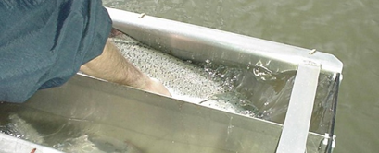
Management Goal:
Minimize release mortality on all non-target salmon species in Marine Areas 7 and 7A.

Slide 7
Before you Fish:
Ensure crew are familiar with:
    These Fish Friendly Regulations
    Fish ID cards
    Example of Recovery Box schematics
    Extra copy of the annual regulations

Slide 8
Module 2: Best Fishing Practices

Slide 9
Fish Handling and Salmon ID
Best Fishing Practices
    Proper Fish handling is essential for compliance with Fish Friendly and Best Fishing Practices.
    Improved fish handling not only improves the survival of released fish but can also improve the quality of the product for market.
    This also helps achieve our ESA goal of reducing impacts to listed and bycatch species.

Slide 10
Keep fish wet and release as quickly as possible. May use knotless dip nets
Best Fishing Practices
Keeping the fish wet minimizes slime and scale removal and improves the health and respiration of the fish.
Minimize time the fish is out of water, while also keeping hands and surfaces wet.
  Physical abrasion removes scales and slime making fish more susceptible to infection.
  Use knotless dip nets when available and keep net wet to minimize abrasion.

Slide 11
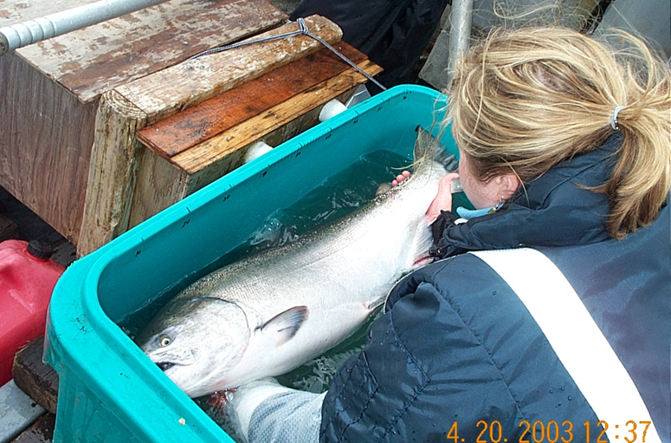
Protect gills and lift properly
Best Fishing Practices
Damaging the gills will result in high mortality. Holding by tail alone will damage vertebrae and internal organs.
  When moving, holding or carrying a fish: Support both head and tail when lifting fish.

Slide 12
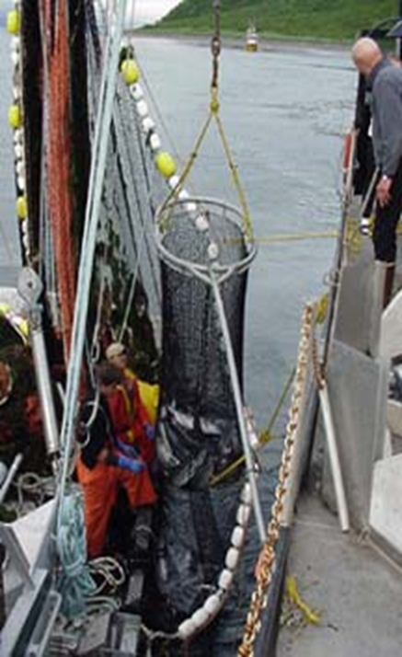
Avoid drops to hard surfaces
Best Fishing Practices
  Hard knocks can cause external and internal damage that may result in death.
  Lower the brail to the deck or very near deck before spilling fish.

Slide 13
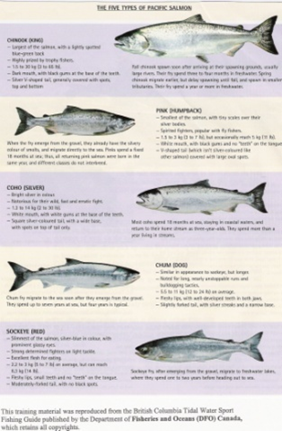
Proper Fish Identification
(through crew training)
Best Fishing Practices
Crew must be able to identify fish required to be released quickly for successful live release.
  WDFW provides salmon identification guides for you to use with your crew online at WDFW.WA.GOV
  Take time to train new crew members how to identify salmon!

Slide 14
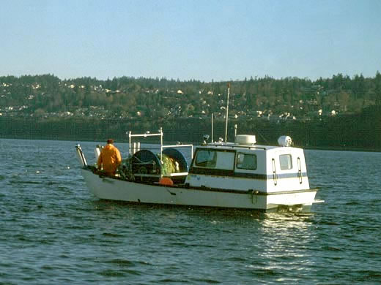
Best Fishing Practices: Gill Nets

Slide 15
Best Fishing Practices for Gillnets
Recovery Boxes
Required in Areas 7&7A chum fisheries through October 15
  Placing salmon in a stream of oxygenated water can often revive fish that are lethargic because they are injured or have been out of the water too long
  Place bleeding or lethargic salmon to be released into a recovery box head into the water flow and monitor their behavior. Release when fish are energetic and swimming.

Slide 16
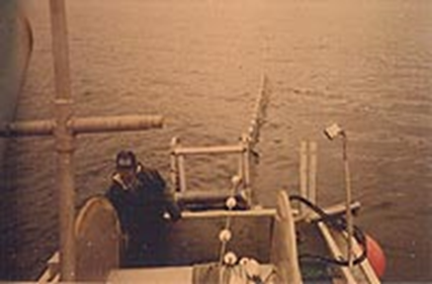
Best Fishing Practices for Gillnets
Short Soak Times (45 minutes)
Required in Areas 7&7A chum fisheries through October 15
  Soak time for each set is limited to 45 minutes, from First mesh in, to Last mesh out. This regulation is strictly enforced. Only soak ¾ or less of your net if you believe the length of your net cannot be retrieved in this amount of time.
  Gilled fish have difficulty respirating and rapidly use up oxygen while struggling.
  Short Soaks are used to mitigate mortality.

Slide 17
Best Fishing Practices for Gillnets
Releasing Fish
Required to release Chinook and Coho in Areas 7&7A chum fisheries through October 15
  Release all fish required to be released by regulations. Fish need to be released quickly, with minimal damage.
  Requirements established by the Pacific Salmon Treaty.
  May need to cut mesh that ensnares the fish. Picking station should be situated for quick release or placement in recovery box.

Slide 18
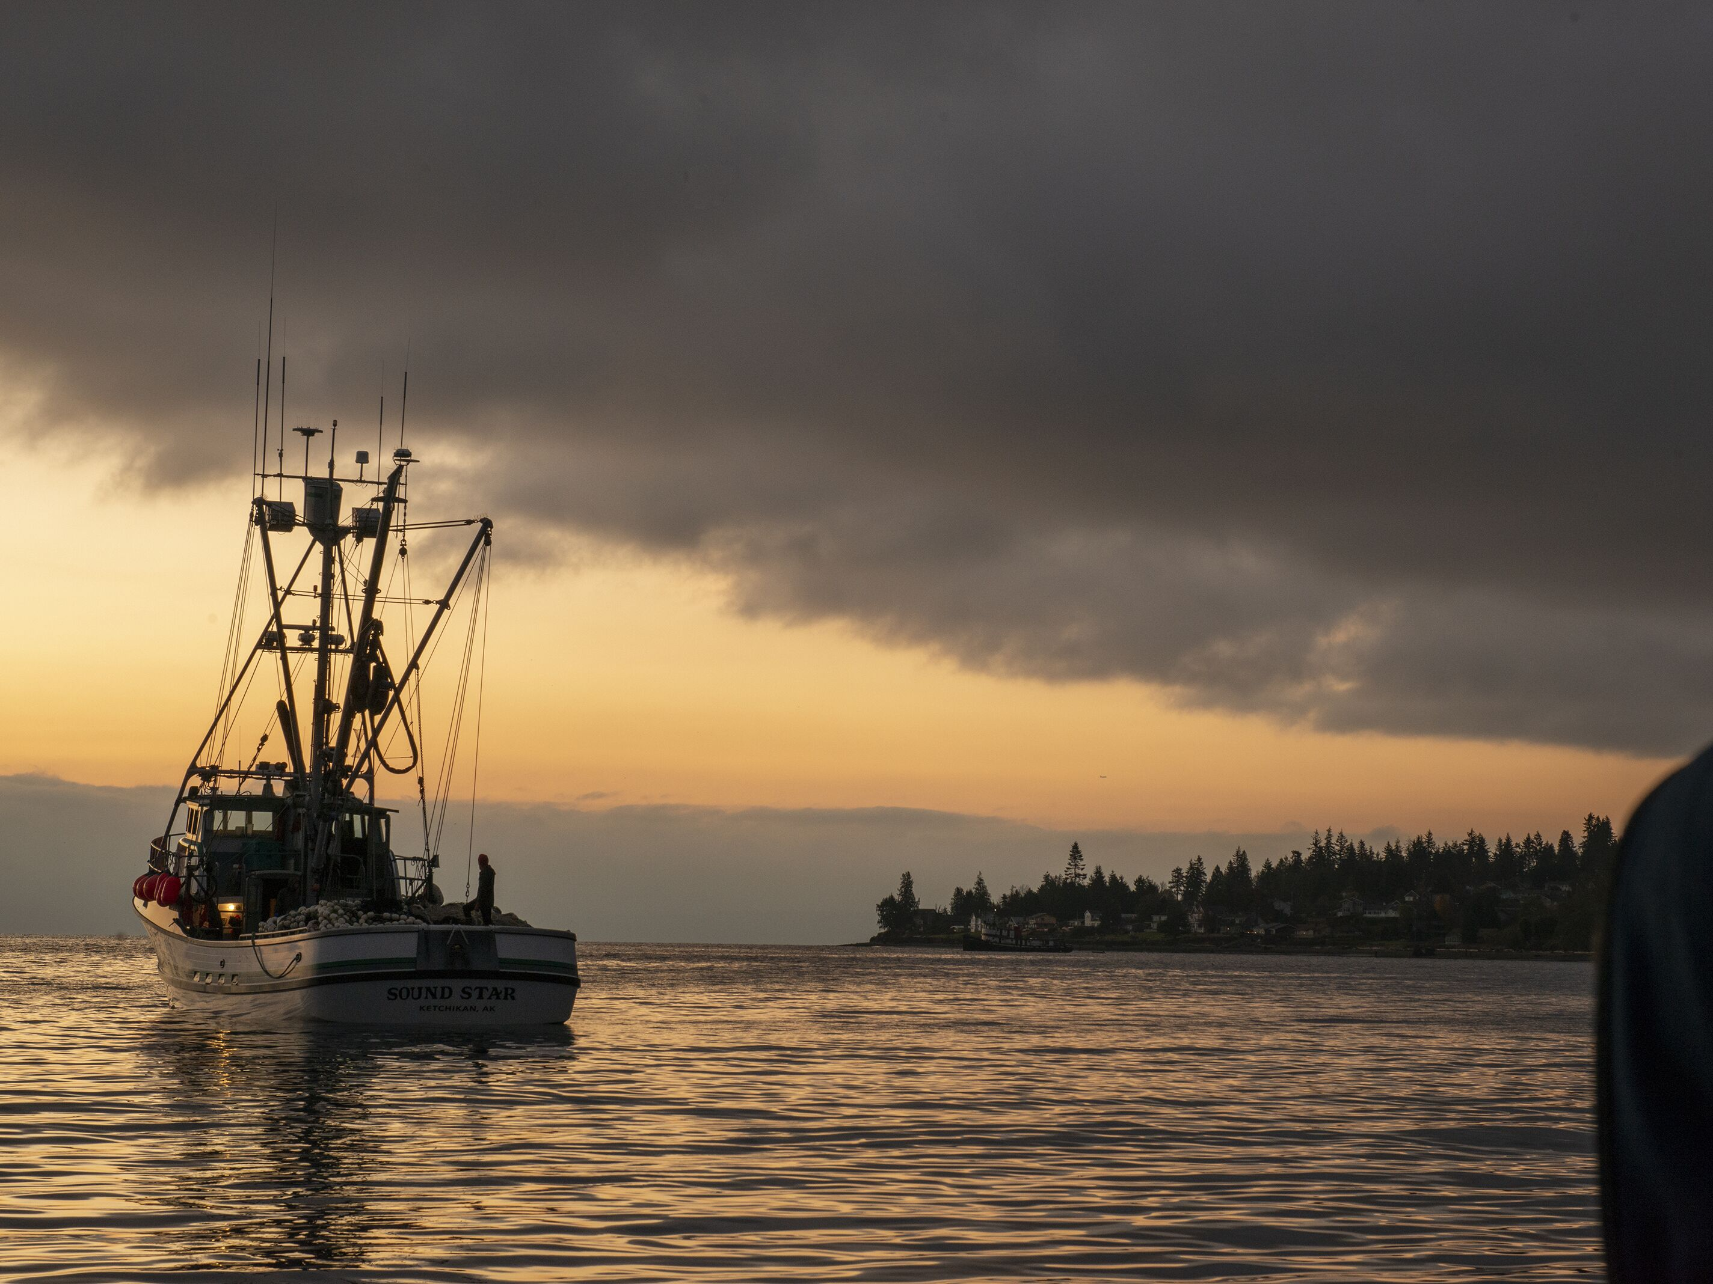
Best Fishing Practices:
Purse Seines

Slide 19
Best Fishing Practices for Purse Seines
Recovery Boxes
Required in Areas 7&7A chum fisheries through October 15
  Placing salmon in a stream of oxygenated water can often revive fish that are lethargic because they are injured or have been out of the water too long.
  Place bleeding or lethargic salmon to be released into a recovery box head into the water flow and monitor their behavior. Release when fish are energetic and swimming.

Slide 20
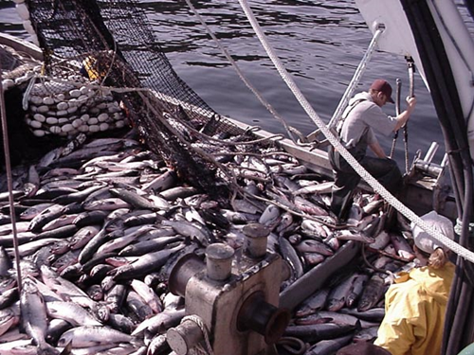
Best Fishing Practices for Purse Seines
Closed Hatch Covers and Sorting
Always required
  Maintaining a closed hatch cover prevents prohibited species from accidentally going into the hold.
  Keep the hatch closed until brail load, or hand pulled net, is deposited on deck. Promptly sort the catch and use proper handling techniques to release the bycatch. Place lethargic or bleeding fish in an operating recovery box

Slide 21
Best Fishing Practices for Purse Seines
Brailing
Always required in Areas 7&7A
  By reducing the total weight of fish being lifted out of the water at one time, the crushing and net marking of fish is reduced. Also, the smaller number of fish on deck can be quickly sorted.
  For small sets, hand lift bunt of the net over the side of the vessel. Do not over-crowd the fish in the net between brails.

Slide 22
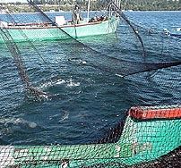
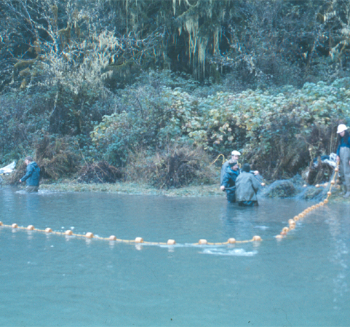
Best Fishing Practices:
Reef Nets & Beach Seine

Slide 23
Reef Net or Beach Seine gear has the potential for very high release survival if the following techniques are used
    Properly identify and release fish.
    Keep fish wet, but not over-crowded.
    Use knotless dip nets is employed.
    Use wetted gloves or wetted hands.
    Use proper lifting techniques.

Slide 24
Module 3: WDFW Monitoring Programs

Slide 25
WDFW Commercial Salmon Monitoring Program
WDFW deploys Fishery Observers during several Puget Sound fisheries:
    Puget Sound Purse Seine
    Puget Sound Gill Net
    Reef Net
    Tenders
    Puget Sound Salmon Charters

Slide 26
WDFW Commercial Salmon Monitoring Program
    Monitoring Data Collection includes:
    Fleet Distribution
    Catch Per Unit Effort (CPUE)
    Catch Composition
    Location and Effort
    Genetic Stock Identification (GSI)
    Sex, Length, Scales
    Catch Log information
    Total Landed Catch

Slide 27
What is the information used for?
    Observer data is used to estimate the incidental catch of non-target species that are required to be released. Since these fish are not recorded on fish tickets, the Federal Fishing authorization requires WDFW to estimate non-landed impacts of ESA listed stocks.
    Secondarily, Observers collect data on target species to better inform in-season management decisions. This data also include further ESA coverage data collection on marine mammal and sea bird encounters.

Slide 28
What to expect from WDFW Fishery Observers
    Fisheries Observers or a WDFW representative:
    Will inform you of intent to board.
    Will be polite, respectful, and professional.
    Will attempt to minimize effect on your fishing operations.
    Will work with your crew to collect the required data.
    Fishery data recorded is **confidential** and not released to other fishers.

Slide 29
What WDFW expects from Fishers
    Fishers should:
    Provide safe access for boarding and disembarking the vessel
    Provide access to catch, and a suitable sampling area.
    Answers observer's questions.
    Be polite, respectful, and professional.
    Work with the Observer to allow for the required data collection.

Slide 30

Derelict Fishing Gear, and Marine
Mammal Entanglements

Slide 31
Reporting Derelict or Lost Gear in Puget Sound
Regulations require any person who loses or abandons commercial fishing gear to report it to the Department of Fish and Wildlife within 24 hours of loss. See the WDFW Commercial Salmon Regulations for contact information.
“No-fault” Approach :
  The focus of the Derelict Fishing Gear Removal Project is not on assessing blame. The goals are to remove lost and abandoned gear, to help restore Puget Sound

Slide 32
Reporting Entangled Large Whales in Puget Sound
Large whales periodically become entangled in active or derelict fishing gear, or other ropes/lines/chains in the marine environment. Some whales that become entangled can shed the gear on their own. Whales that are entangled can suffer from injuries, infection, and wrapping that can impair their ability to feed or swim.
How You Can Help:
  Prompt reporting is the best way to help entangled whales. Please stay with the whale if it is safe to do so.
  Safety First! Because whales in distress may act unpredictably, do not closely approach the animal. Never attempt disentanglement or to remove any gear without training and authorization.
  Video or photos showing the entangling gear can be helpful for our efforts to reduce these entanglements in the future. Please collect and provide video or photos to NOAA Fisheries but remember to stay at least 100 yards from the whale and beware that lines in the water could snag your vessel.

Slide 33
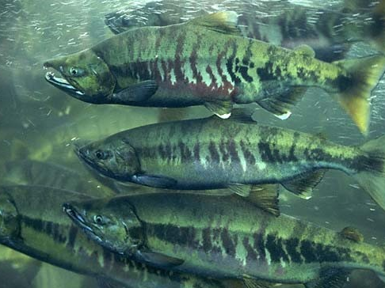
Congratulations!
You have completed the Fish Friendly course. Thank you for participating.

