Slide 1
Salmon In Washington

Slide 2
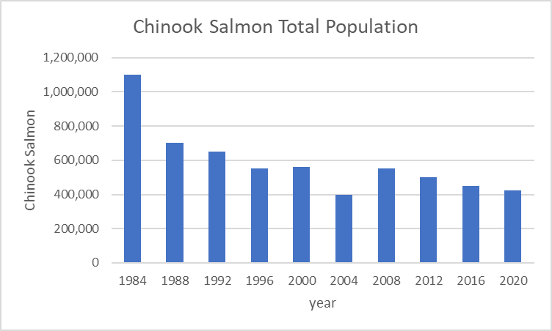

Slide 3
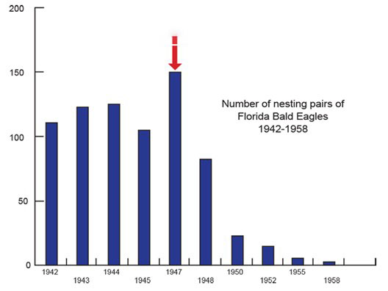

Slide 4
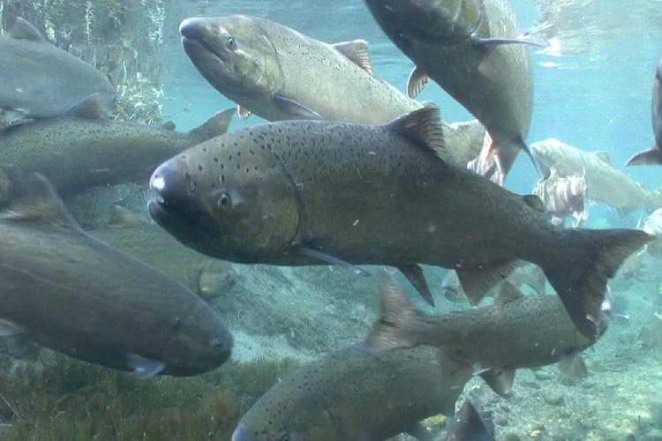
River Habitat Needs

Slide 5
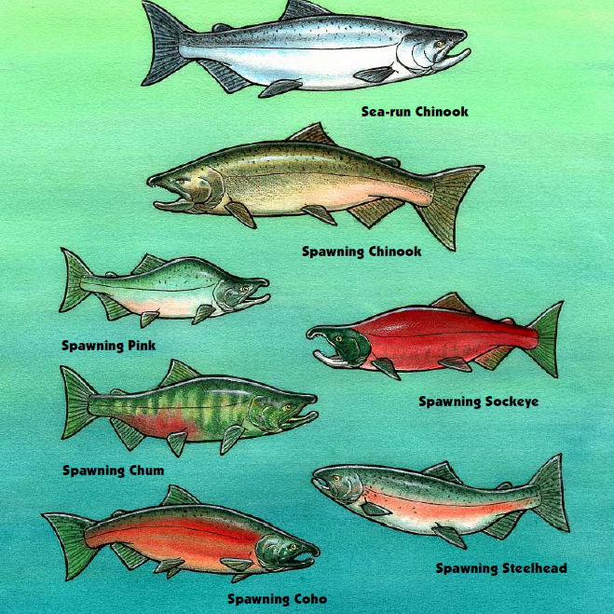
There are six different types of Pacific salmonids!
Chinook salmon
coho salmon
pink salmon
sockeye salmon
chum salmon
rainbow and steelhead trout*
All salmonids spend part of their lives in freshwater rivers
Notes:
Rainbow and steelhead trout are the same species with different lifestyles. Rainbow trout spend their lives in freshwater and steelhead trout, like salmon migrate to the oceans and back to freshwater.

Slide 6
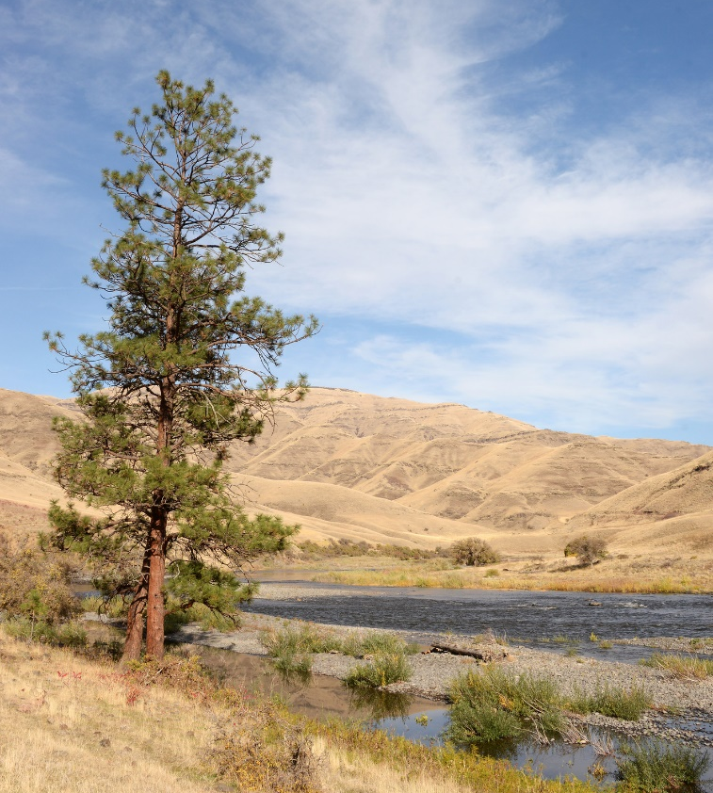
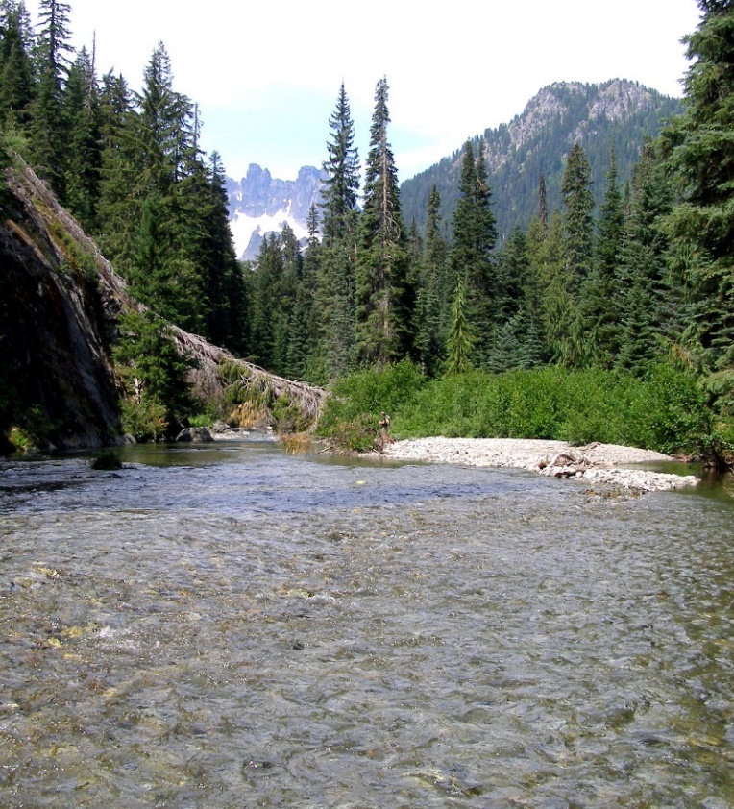
Salmon Facts
Salmon are adaptable.
They have evolved to live in everything from mountain forest to high desert streams.
Notes:
You may want to introduce the term adaptable– the ability to adjust to new conditions.

Slide 7
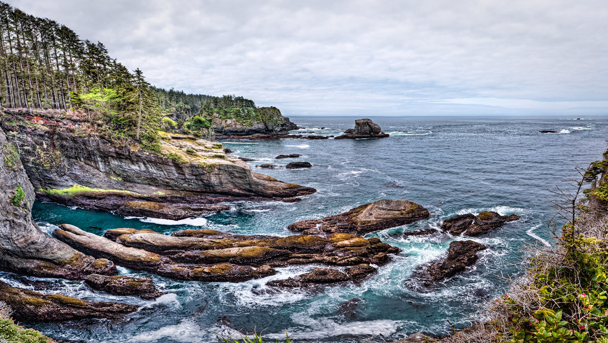
Salmon Facts
Salmon are anadromous.
They can adapt from freshwater to saltwater, and back again!
But they must be able to make that journey without tall barriers.
Notes:
Vocabulary such as the term anadromous is included in the PowerPoint, but is not crucial to student understanding. Feel free to allow students to define the ability of fish to travel to and adapt to salt and freshwater using their own words.

Slide 8
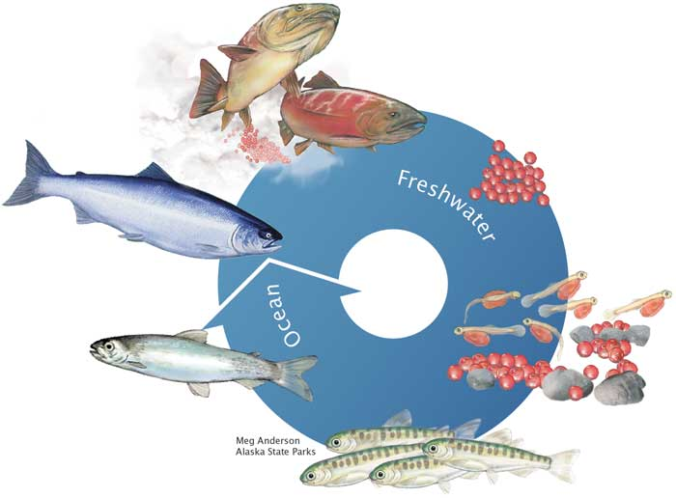
Salmon Life Cycle
Alaska Department of Fish and Game
Notes:
Highlight life stages spent in freshwater vs time spent in ocean.

Slide 9
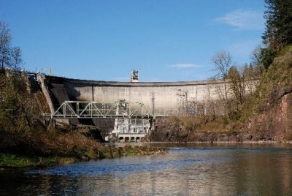
Habitat Threat Spotlight: Dams
Photo by Thomas O’Keefe
Merwin Dam on the Lewis River, Washington. Merwin Dam is the lowermost of the three dams blocking fish passage on the North Fork Lewis River
Notes:
Ask students to evaluate habitat below the dam.

Slide 10
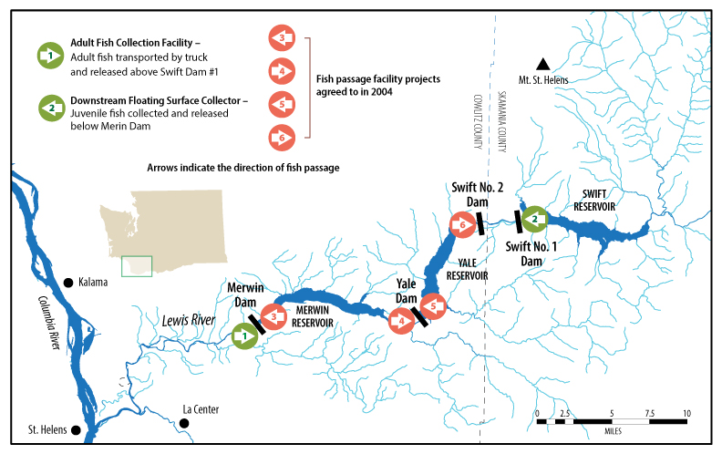
Lewis River Dams Fish Passage
Notes:
This graphic shows the current catch and haul operations (green arrows) on the Lewis river, along with the fish passage projects that are currently being evaluated. In the 2004

Slide 11
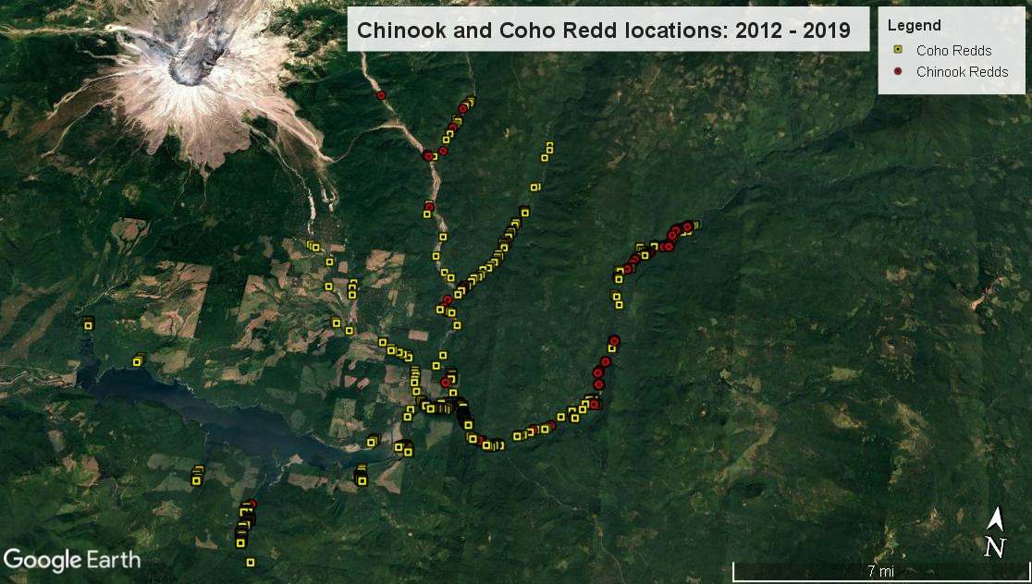
Lewis River Dams Fish Passage
Notes:
Between 2012 and 2019 fish biologists ran a trial program of trap and haul over the three Lewis river dams to see if salmon would repopulate the rivers and streams once fish passage was created. This map shows the distribution of coho salmon above the three Lewis river dams. The orange oval shows the Swift Reservoir created by the Swift dam. All of the redds created above the Swift Reservoir occur because of trap and haul efforts. This is important because it shows that if fish passage is created, we can expect fish to repopulate and spawn in these rivers and streams.

Slide 12
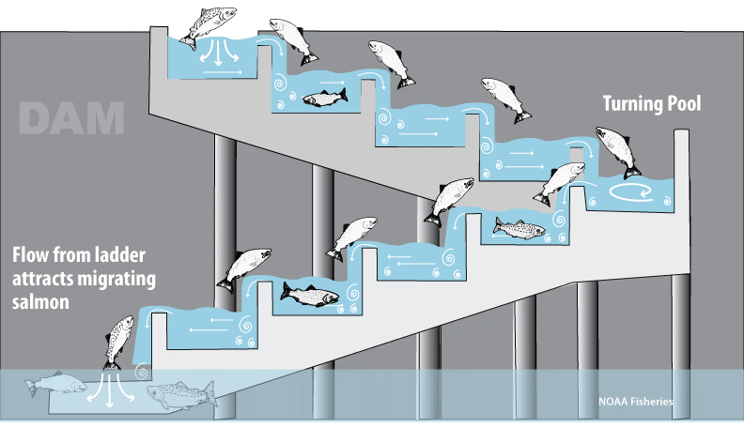
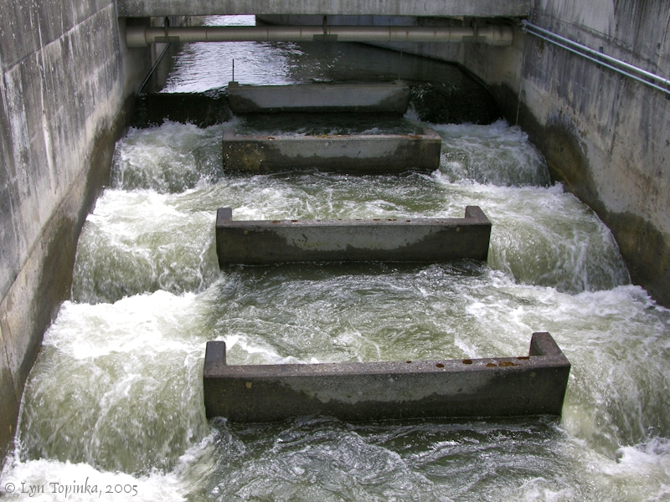
Fish Passage Solution:
Fish Ladders
Fish ladder at Bonneville dam
Notes:
Fish ladders are built at many large dams. They allow fish to swim up a series of steps pass over the dams. They don’t allow for easy movement of smaller fish down the dam.

Slide 13
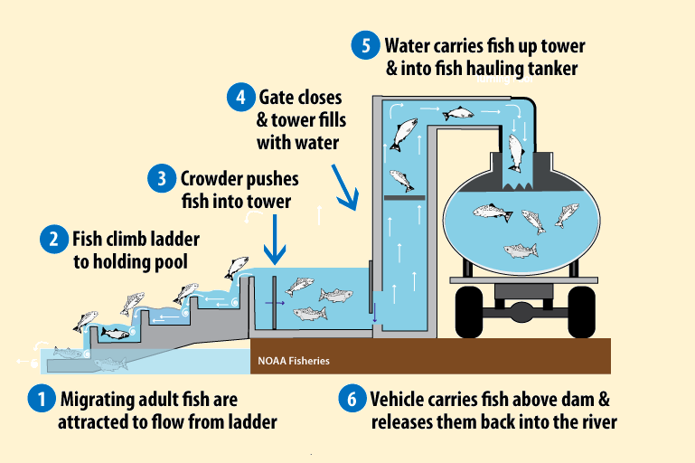
Fish Passage Solution:
Trap and Haul
Notes:
There are a variety of trap and haul operations, including ones that use elevators to move salmon up and over the dam. This fish elevator is known as a “pescalator”

Slide 14
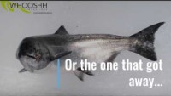
Fish Passage Solutions:
Salmon Cannon
Notes:
Whoosh also known as the “Salmon Cannon” can also be used after trapping to move them to the hauling trucks,. Or above the dam or barrier.

Slide 15
Fish Passage Solution: Dam Removal
(not being considered at Merwin Dam)
Notes:
Dam removal is not being considered for the Lewis River Dams, but has been used as a solution for fish passage on other dams in the state: Elwha, Salmon River, etc.

Slide 16
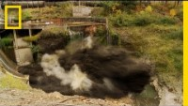
Fish Passage Solution: Dam Removal
Notes:
2 minute video shows opening of Condit Dam on the White Salmon River.

Slide 17
Fish Passage Solution
Evaluation Activity

Slide 18
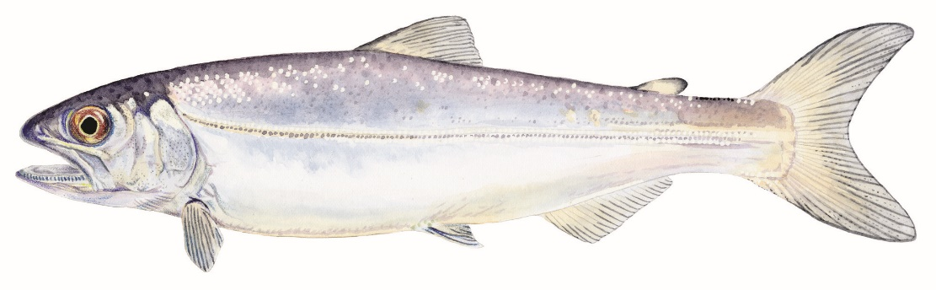
Salmon Habitat Needs
Food
Clean water
Cold water (between 40-50 degrees Fahrenheit)
Water with lots of oxygen
Places to hide
Places to rest
Free passage from the stream to the ocean

Slide 19
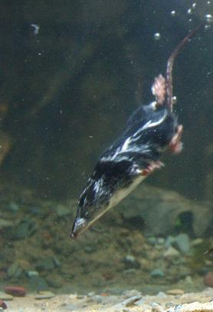
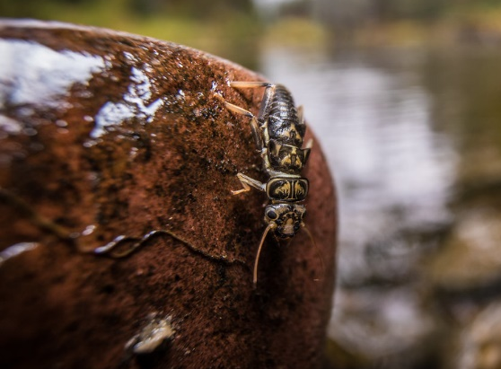
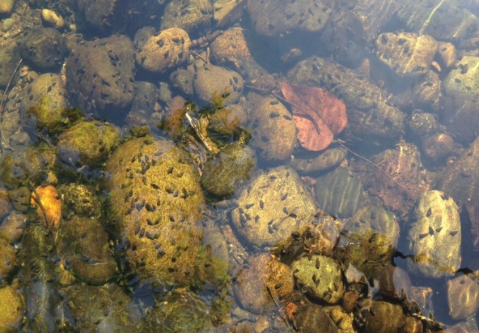
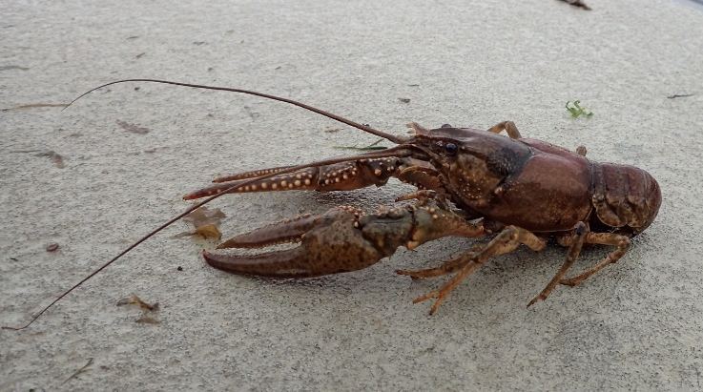
Salmon Habitat Needs: FOOD
Young salmon eat
macroinvertebrates such as stoneflies, dragonfly nymphs, mayflies, and beetles.
snails
worms
small fish
crayfish
small aquatic mammals, and more.
Stonefly courtesy of National Park Service
snails
Northern Crayfish
Water shrew by Robert A. MacArthur
Notes:
Macroinvertebrates are small aquatic animals without backbones that can be seen without a microscope.

Slide 20
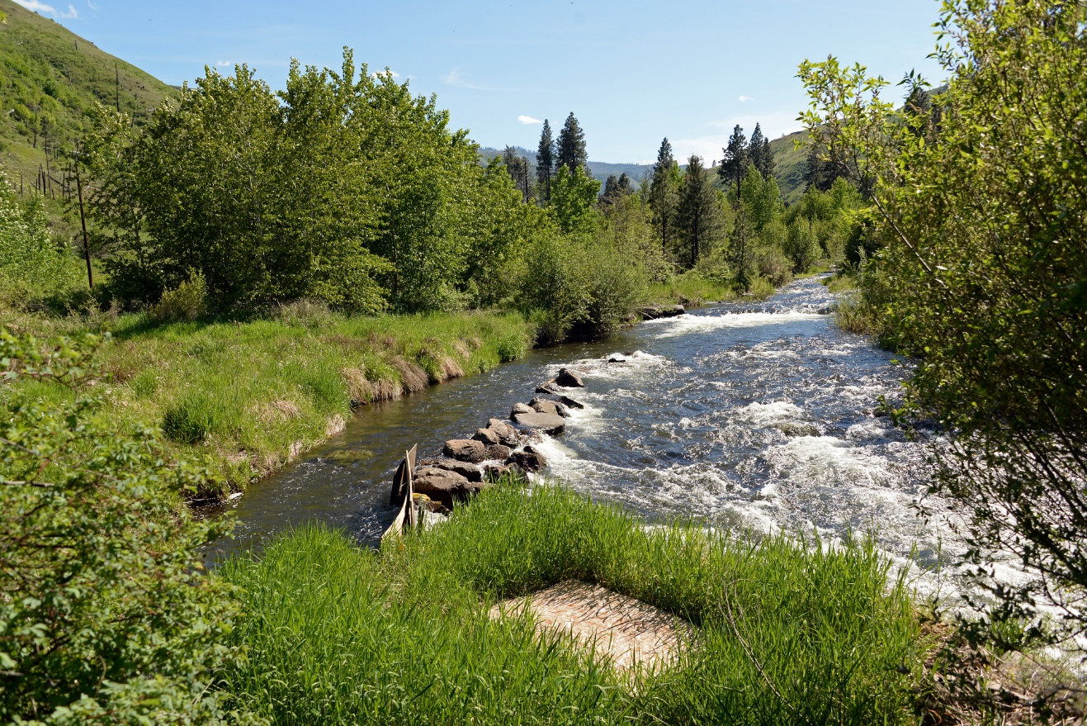
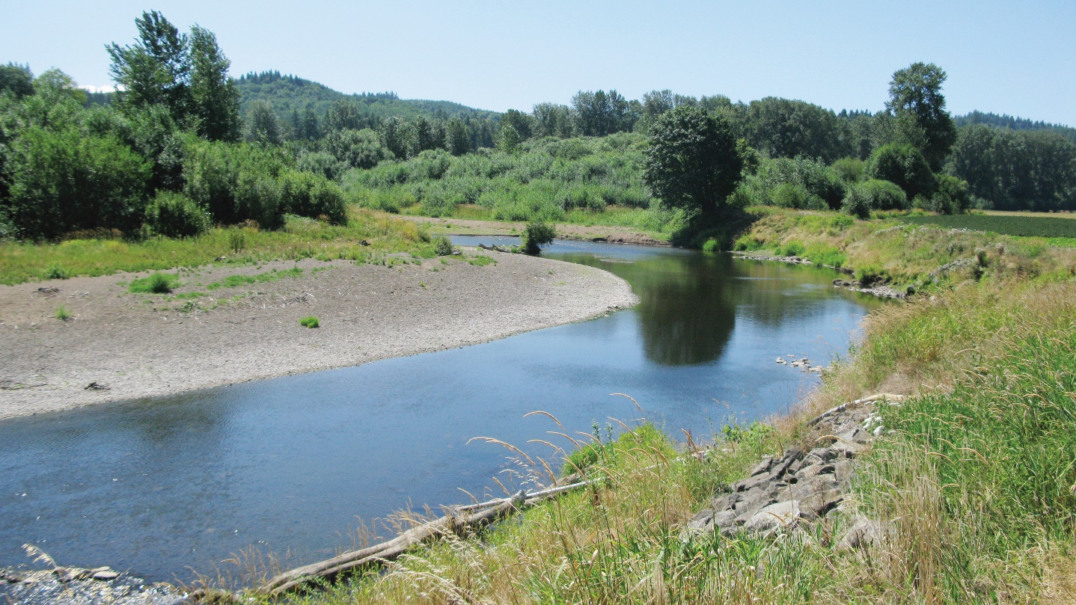
Salmon Habitat
Needs:
Clean, Cold Water
Overhanging vegetation
Notes:
Ask students to compare and contrast the two different parts of the river. Ask them to think-pair-share about why having overhanging vegetation is so important.
Overhanging vegetation keeps water cool! And it can provide habitat for salmon food to live!

Slide 21
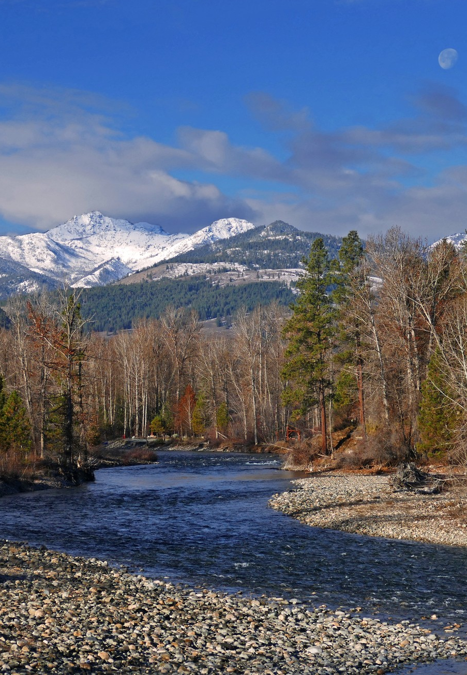
Salmon Habitat Needs: Water with lots of oxygen
Gradual channels
Water that moves quickly
Notes:
Salmon utilize both steep and gradual channels. Gradual channels are important for laying eggs. Quick moving water keeps the water cool and helps get oxygen into the water.
Teacher note: To help students understand how oxygen gets into water ask them to think about a waterfall. Why is the water in the waterfall white? It is full of air. Some of that air is oxygen.

Slide 22
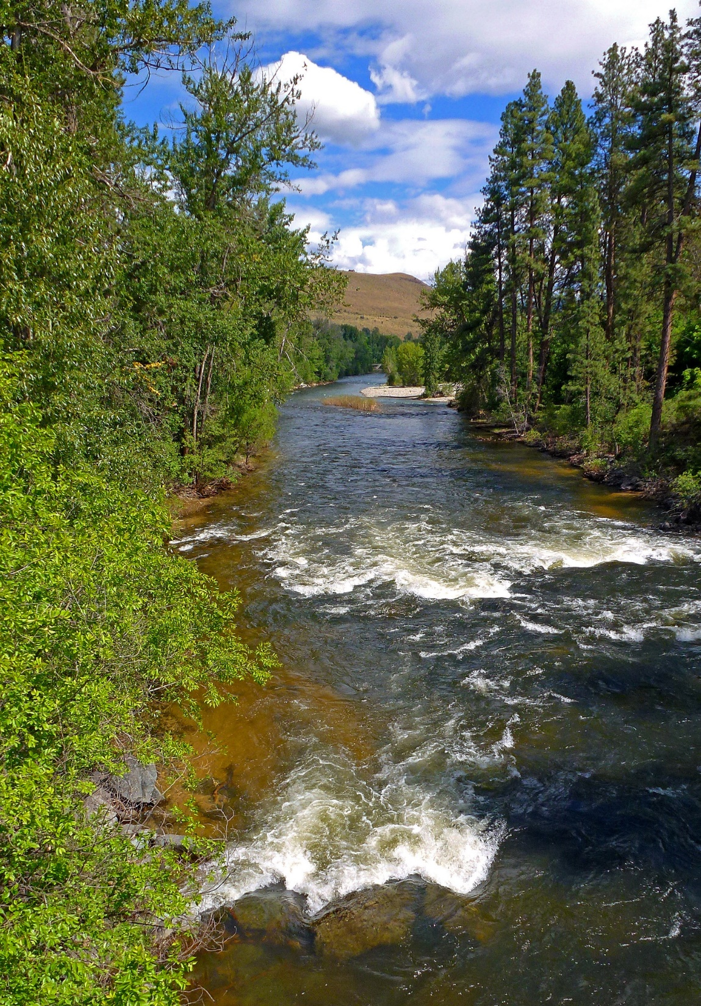
Salmon Habitat Needs: Water with lots of oxygen
Areas with boulders, cobbles, and pebbles (gravel).
Pocket water- water with lots of big rocks and tumbling currents.
Notes:
Loose gravel and cobbles help provide habitat for redds (fish nests) and moving water helps provide oxygen in the water for fish to breathe.

Slide 23
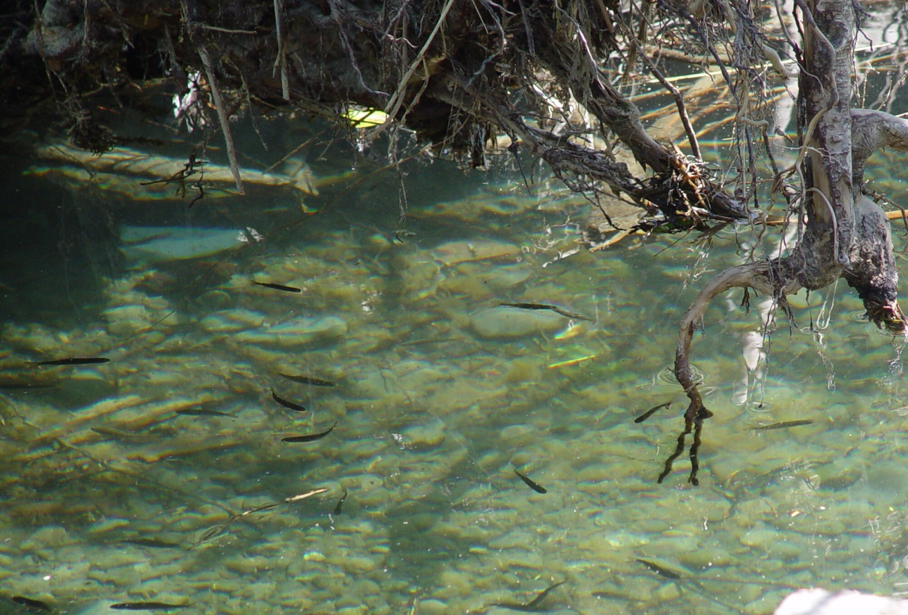
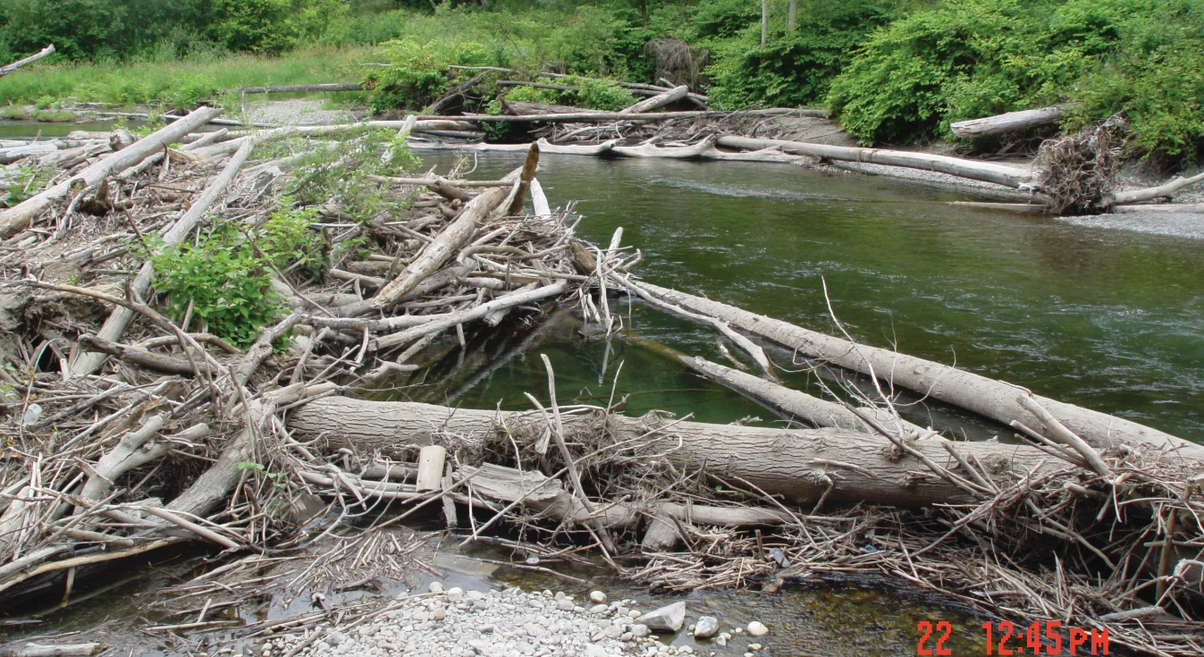
Salmon Habitat Needs: places to hide and rest
Large woody debris provides hiding places for young salmon, and resting places for returning spawners.
Notes:
Woody debris provides protection from predators, hiding places for juvenile and small fish and shade for cooler water temperatures.

Slide 24
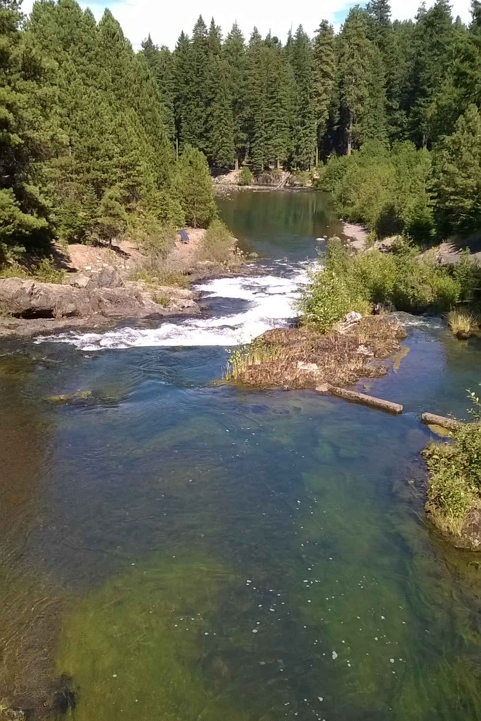
Salmon Habitat Needs: places to hide and rest
Pools
Notes:
Ask students if they can identify any pools in the picture before clicking to reveal the circles that highlight a couple.
Pools provide important resting and raising habitat for salmonids. Additionally, rivers and streams with many pools act as refuge from floods, drought, and extreme temperatures.

Slide 25
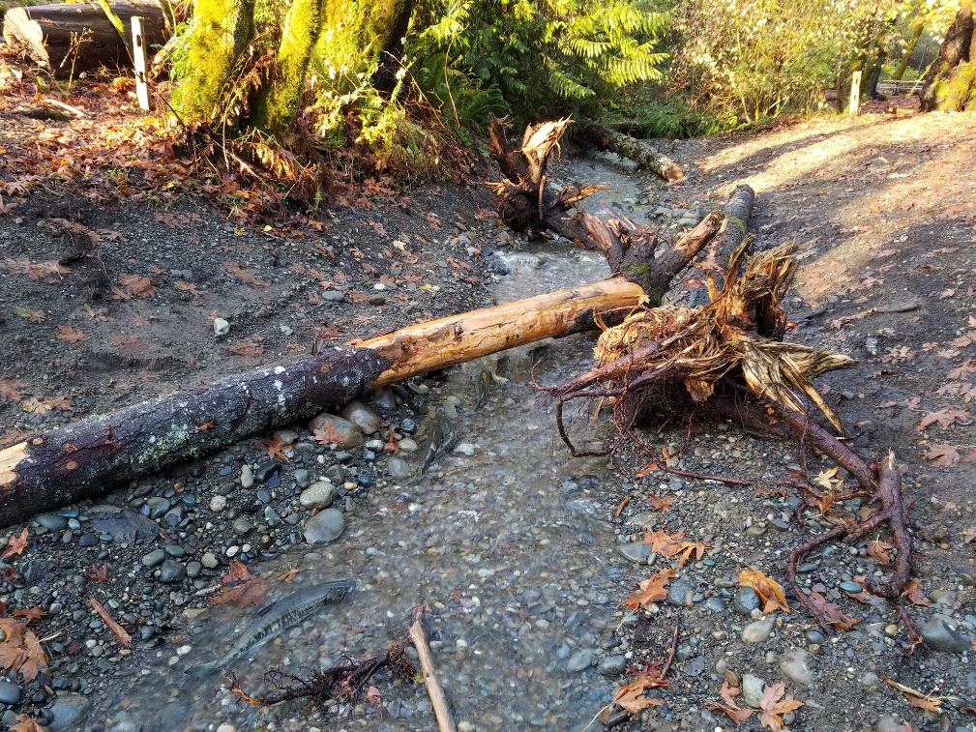
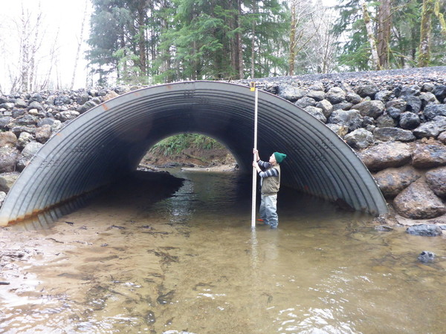
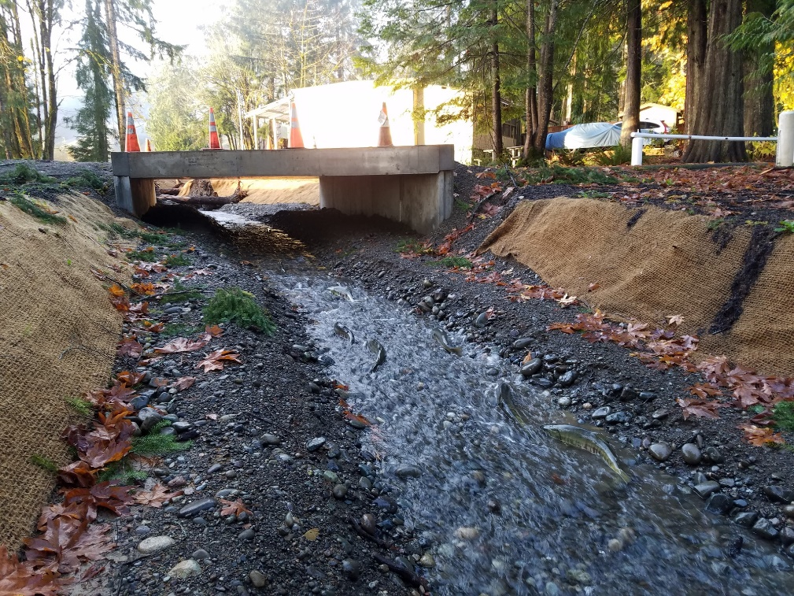
Habitat Needs: Ability to pass from stream to ocean and back
Notes:
Making large fish passage under bridges and adding woody debris to stream.

Slide 26
Is this a good salmon habitat?
Notes:
Overhanging vegetation
Woody Debris
Pools
Large boulders and gravel
Fast moving water

Slide 27
Is this good salmon habitat?
Notes:
No overhanging vegetation
Shallow water
Slow moving water
No woody debris

Slide 28
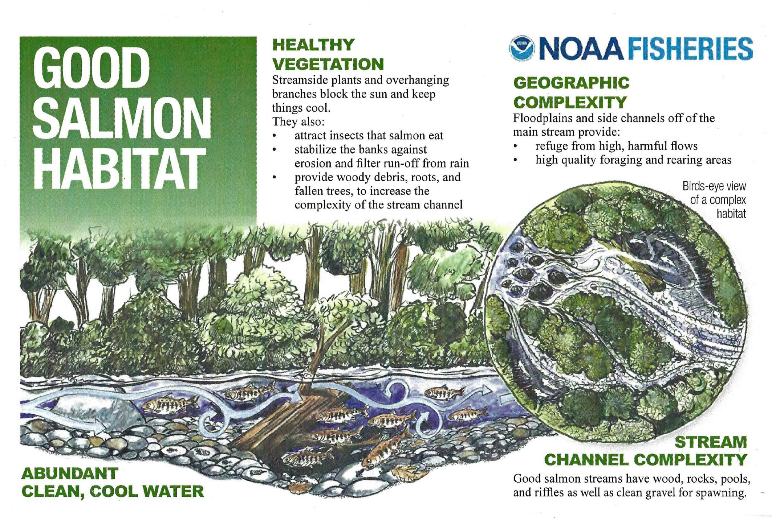

Slide 29
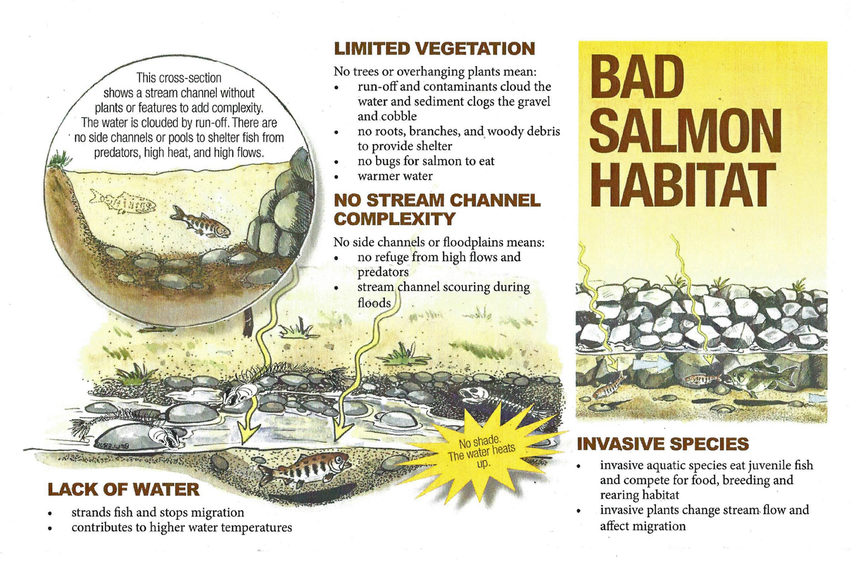

Slide 30
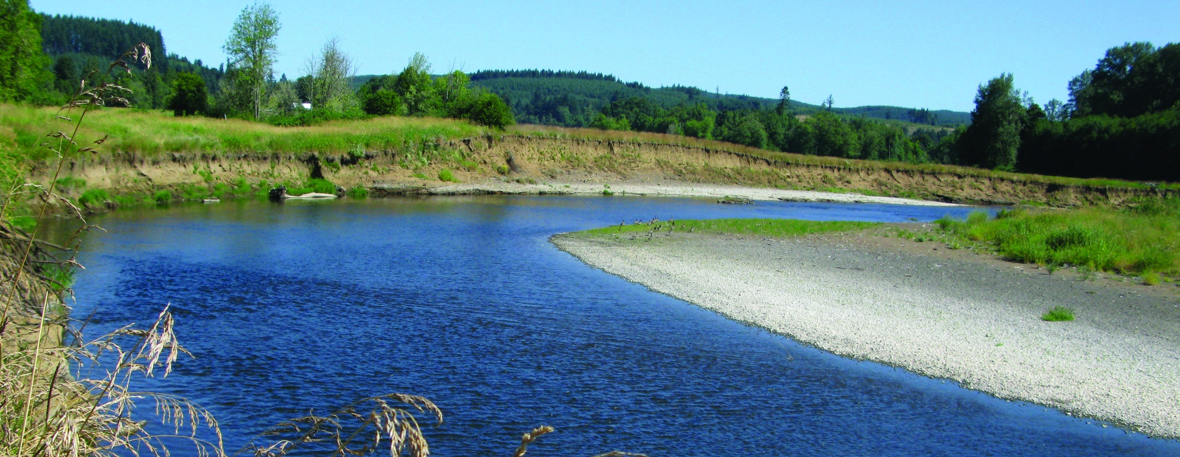
Salmon Habitat Threats
  Loss of river habitat due to:
    Dams blocking passage
    Culverts blocking passage
    Re-routing natural streams
  Pollution like garbage in recreation areas.
  Pesticide and fertilizer run off in water.
  Stream bank falling off (often due to tree/plant loss)
  High water temperature

Slide 31
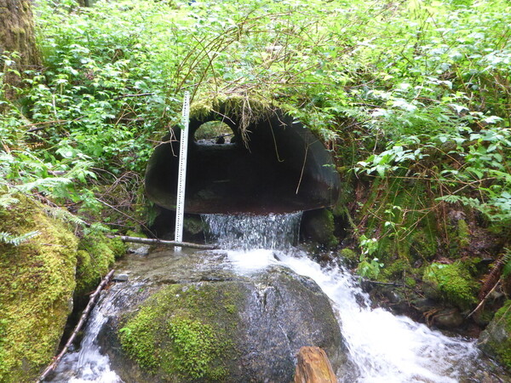
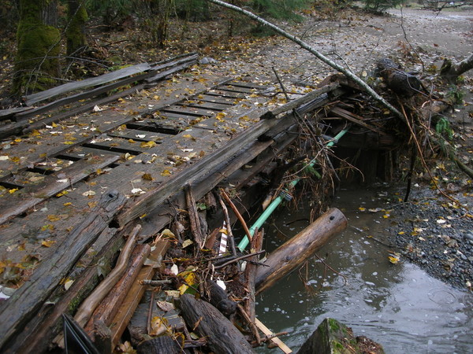
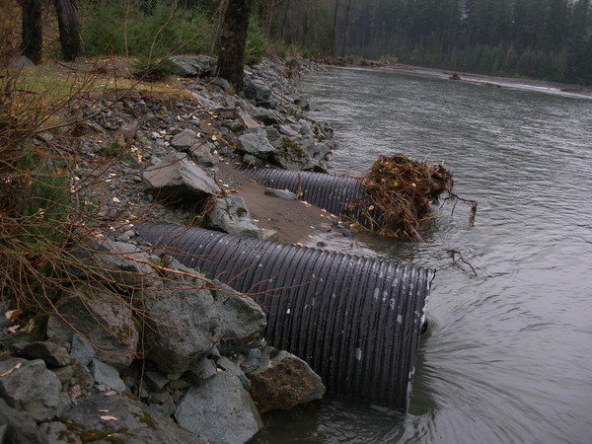
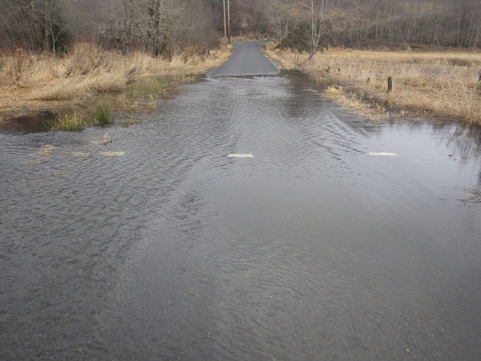
Culverts: Tunnels under roads and railroads
Notes:
Culverts can create challenges for fish passage by being too small, being “perched”( placed above stream) making it difficult for fish to move through them, or by getting clogged and causing flooding.

Slide 32
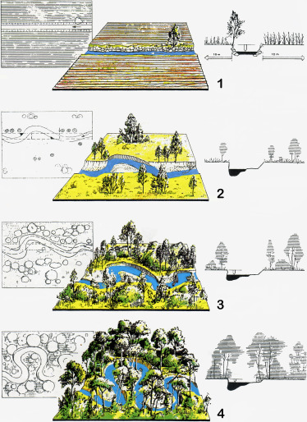
River Habitat
Restoration
Notes:
Changing a human-made straight channel back into a meandering river system with streamside vegetation

Slide 33
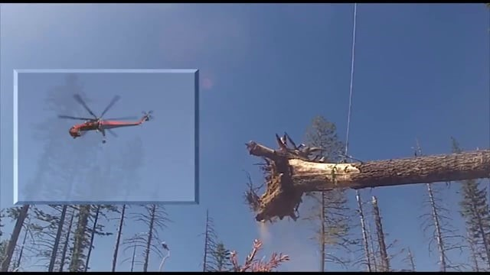
Habitat Restoration
Notes:
Example of habitat restoration done on the Tucannon River. Ask students how adding large trees could help change the river system to better support salmon.

Slide 34
Habitat Restoration

Slide 35
Salmon Habitat Needs
Complex stream channels
Overhanging vegetation
Woody debris
Gravel
Large rocks
Pocket water (oxygen in water)
Pools

