Slide 1
Washington Wildlife Lesson 1 Anchoring Phenomena

Slide 3
Washington Wildlife Lesson 2 Domestic vs Wild Animals

Slide 4
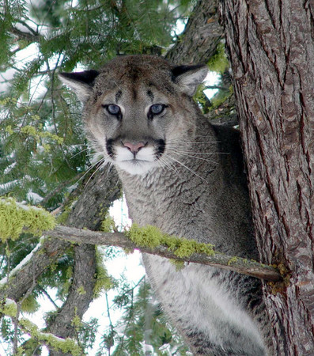

Slide 5
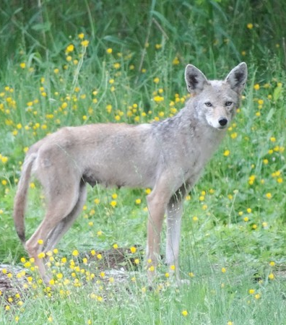
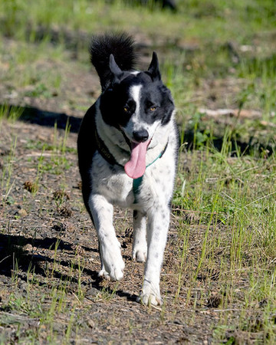

Slide 6
Washington Wildlife Lesson 2 Habitats
Where does Wildlife in Washington live?

Slide 7
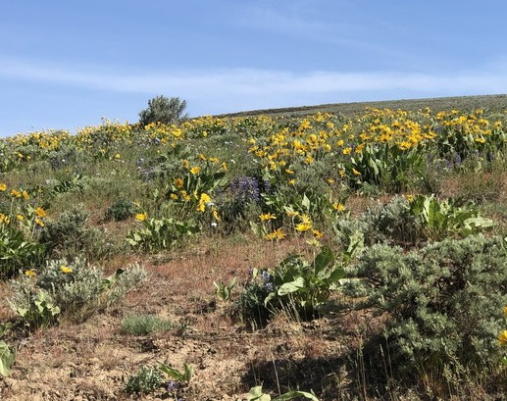
Sagebrush Steppe

Slide 8
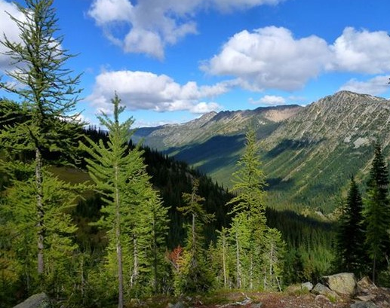
Mountain Habitat

Slide 9
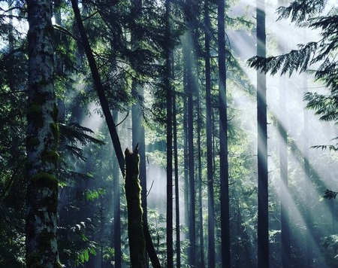
Forest Habitat

Slide 10
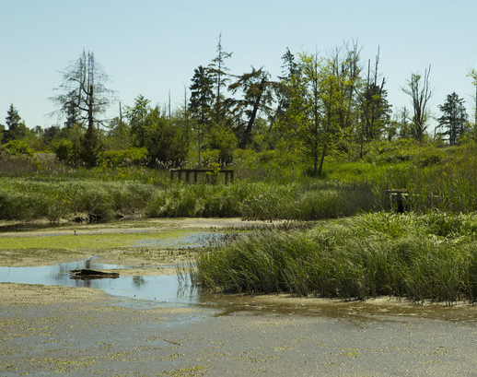
Wetland Habitat

Slide 11
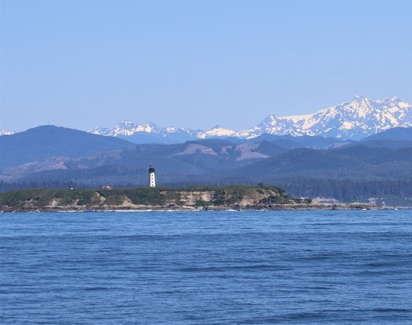
Marine Habitat

Slide 12
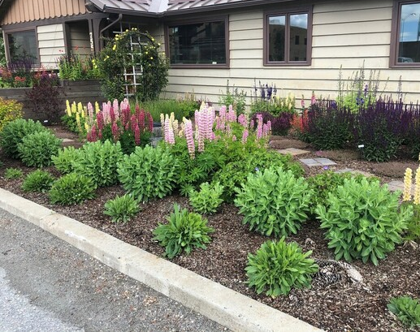
Urban Habitat

Slide 13
Washington Wildlife Lesson 3 Wildlife Parts and Features

Slide 14
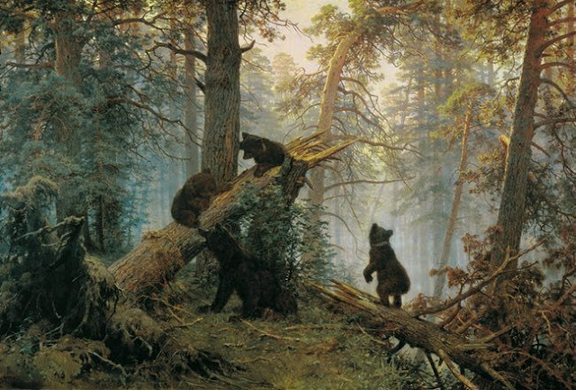
Morning in a Pine Forest
By Ivan Shishkin and Konstantin Savitsky. Painted in 1886

Slide 15
Washington Wildlife Lesson 5 Parents and Offspring
The following slides are not referenced in the unit plan but are included as an optional resource for class discussions of how animal parents and their offspring are similar, but not exactly the same.

Slide 16
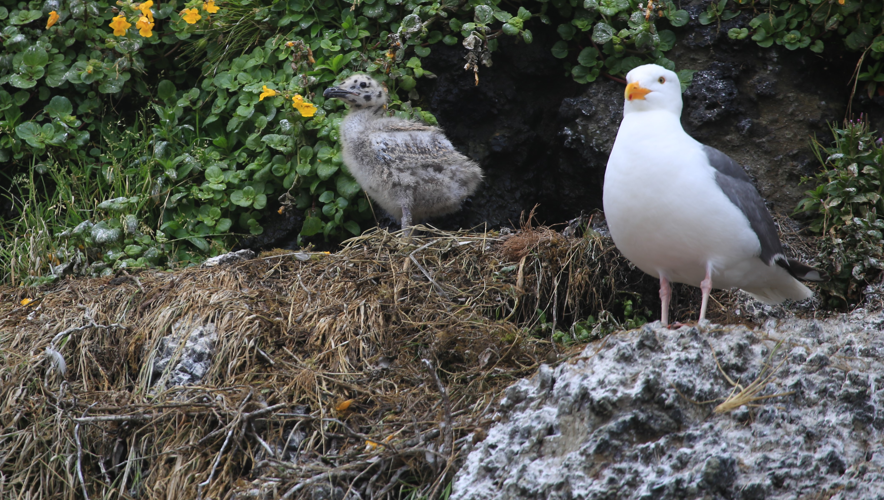
How do these babies look different from their parents?
Herring Gull
Notes:
Walk students through herring gul similarities and differences

Slide 17
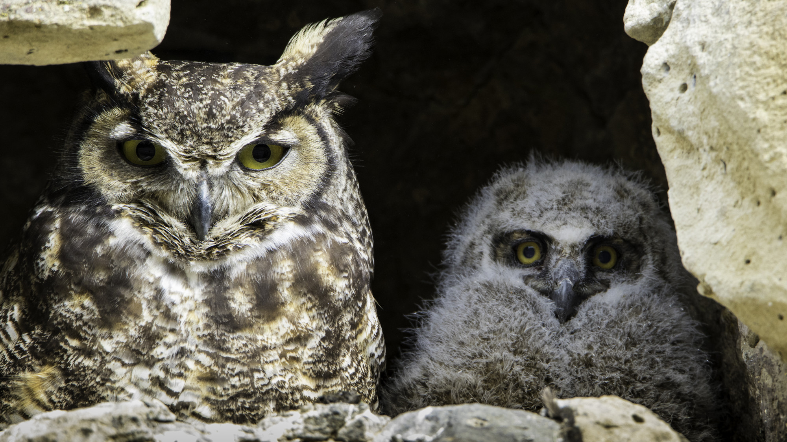
Great Horned
Owl
Notes:
Walk students through great horned owl similarities and differences

Slide 18
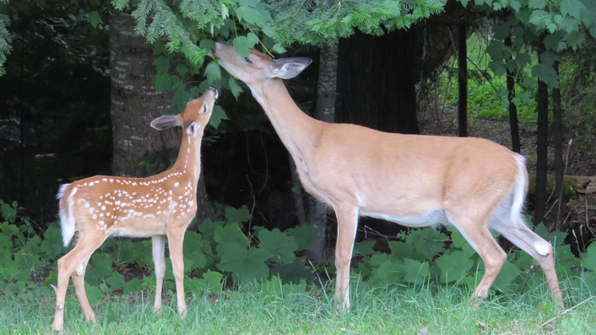
How do these babies look different from their parents?
White-tailed Deer

Slide 19
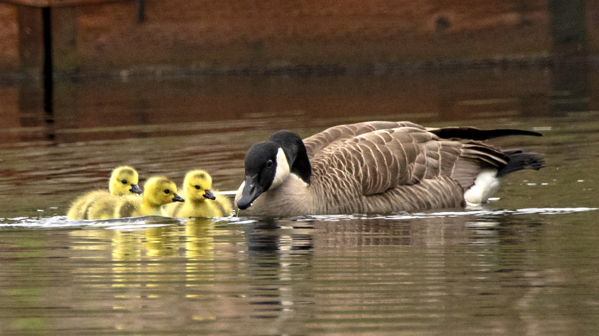
How do these babies look different from their parents?
Canada Goose

Slide 20
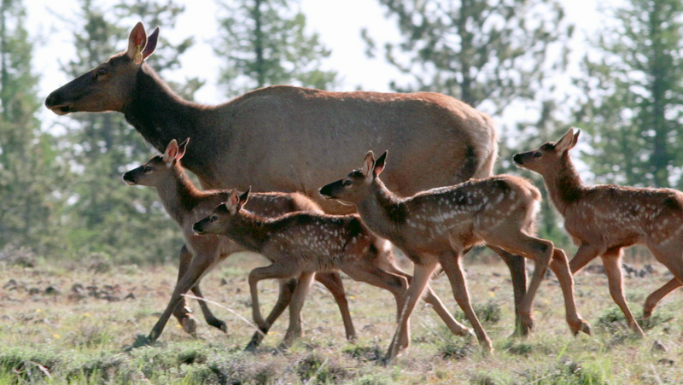
How do these babies look different from their parents?
Elk

Slide 21
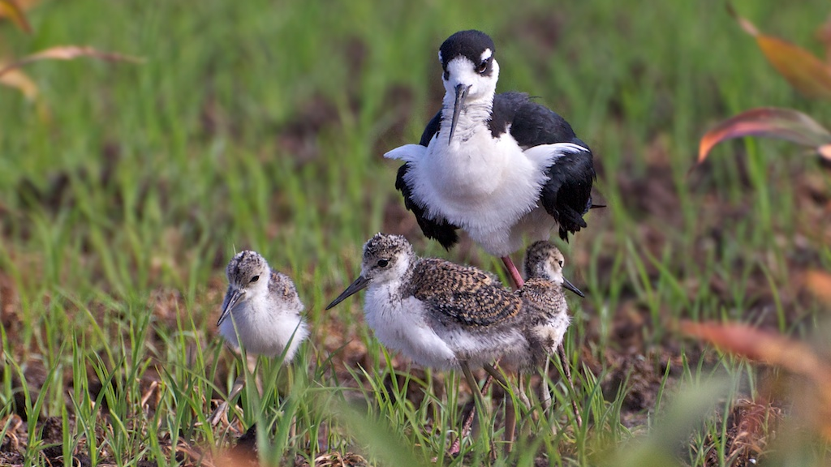
How do these babies look different from their parents?
Black-Necked Stilt

Slide 22
Washington Wildlife Lesson 6

Slide 24
Links for use with modes of parental care: Feeding, Teaching, Protecting
Hooded merganser-protecting
Otter at zoo-teaching
Harbor seal pup-protecting
Harbor seal swimming-comforting
Deer fawn-protecting and feeding
Mama bear and cub-teaching and protecting
Mama grizzly-feeding
Snowy plover on nest-protecting
Shrews-protecting
Sage Grouse (from 3:02-5:15) -teaching and protecting
Pileated woodpeckers-feeding
Fox cubs and vixen-feeding, comfort
Cougar and kit-cleaning and feeding

Slide 25
Washington Wildlife Lesson 6 Parental Care: Shelter

Slide 26
Birds shelter their young in nests
Their nests can be built in trees, on the ground, or in cavities or bird houses. The parents will sit on the eggs to keep them safe and warm.

Slide 27
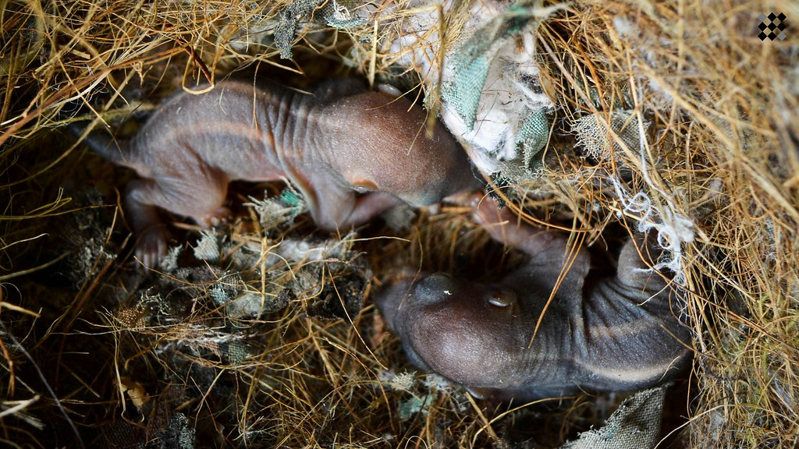
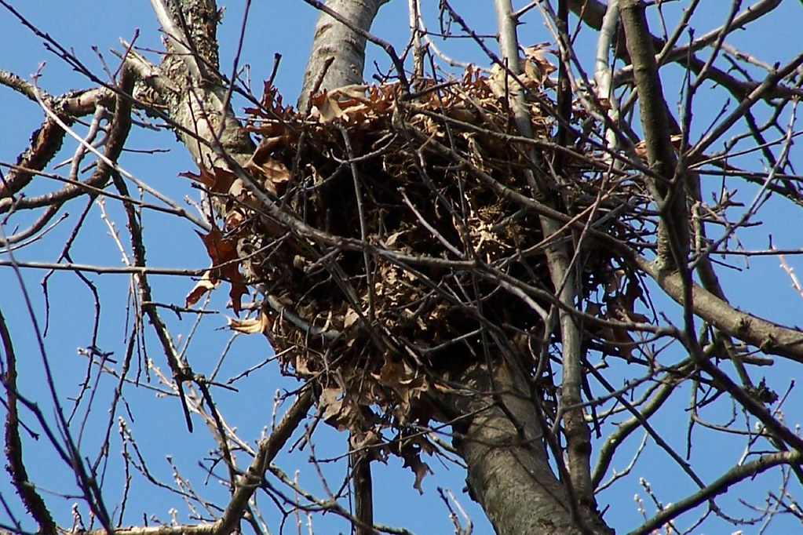
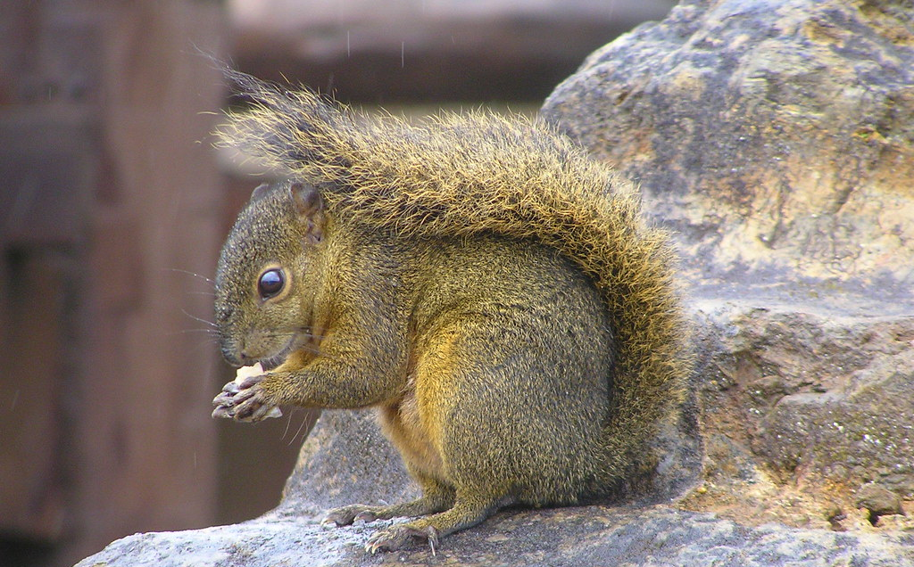
Squirrels shelter their young in nests in trees. They can build a nest of leaves, or use a hole in the tree.
"Baby Squirrels" by MaxIFaleel is licensed under CC BY 2.0.
"Squirrel" by ogwen is licensed under CC BY 2.0.
Squirrel nest in my back yard" by Heart Windows Art is licensed under CC BY-NC 2.0

Slide 28
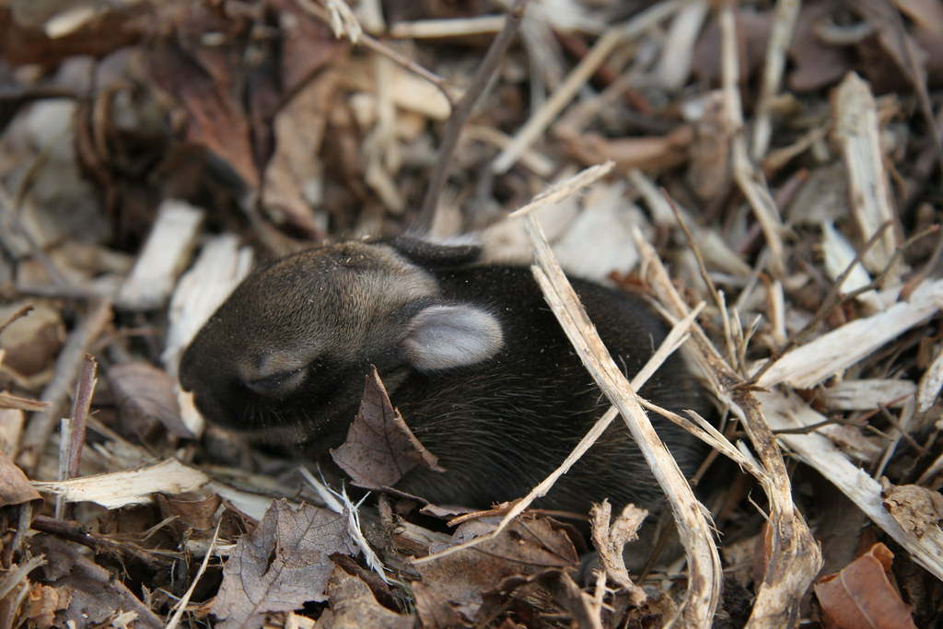
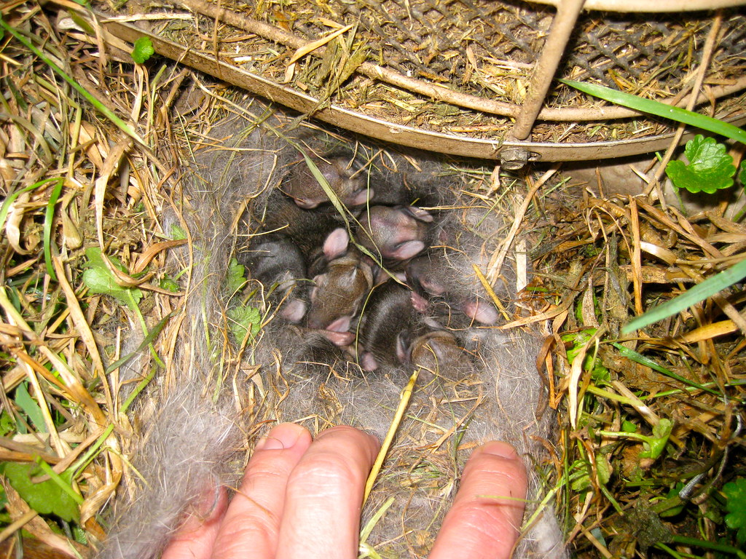
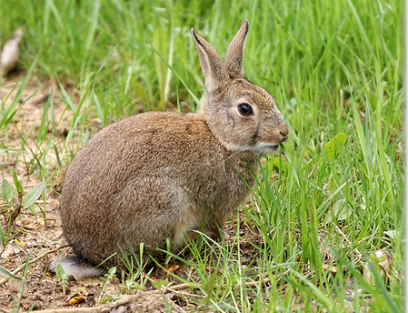
Rabbits shelter their young in nests or burrows. These are build in the ground and lined with fur to keep the babies safe and warm.
"Baby Rabbit out of it's nest" by Bob Reck is licensed under CC BY-NC-ND 2.0.
"Wild rabbit" by hehaden is licensed under CC BY-NC 2.0.
"Rabbits' Nest Day 3" by Nick Busse is licensed under CC BY-NC-SA 2.0.

Slide 29
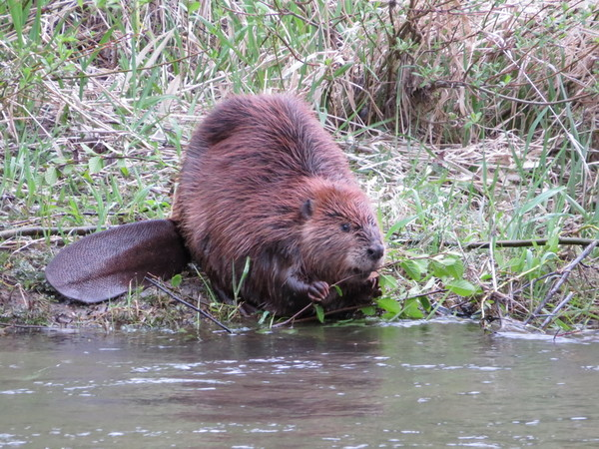
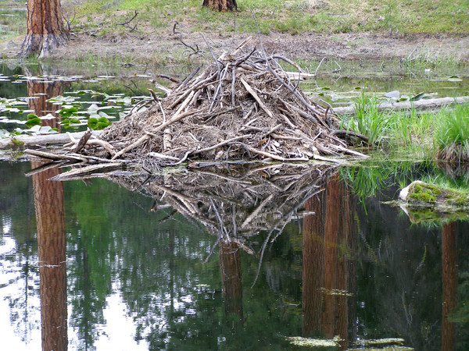
Beavers shelter their young in homes called lodges. The lodge is built in the middle of the beaver pond, and the entrance to the lodge is under water! This helps protect the kits from predators.

Slide 30
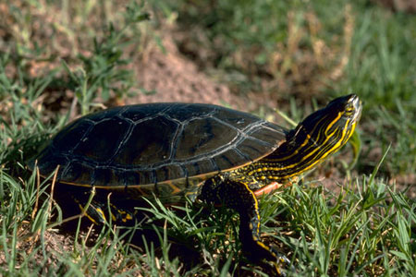
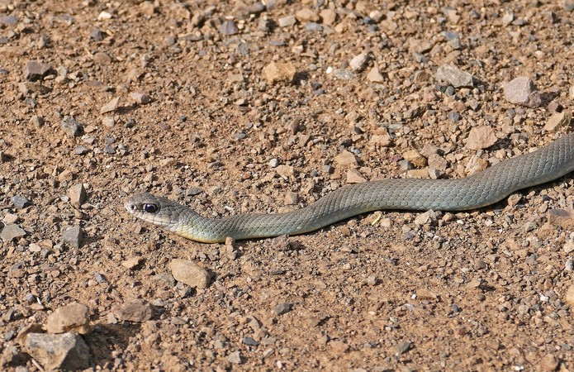
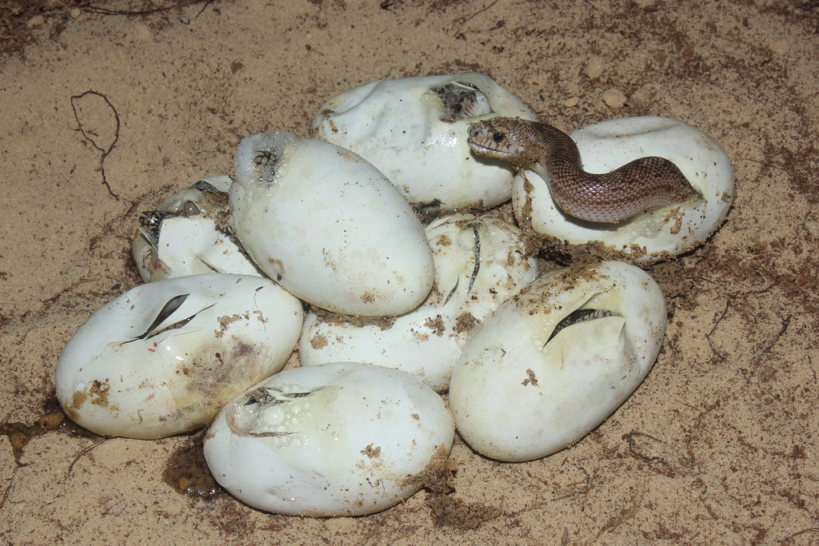
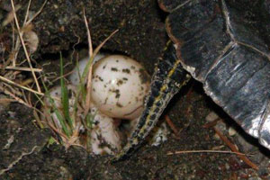
Many reptiles like snakes and turtles lay their eggs in nests to keep their eggs safe. The parents don’t stick around to help raise their young though. The babies fend for themselves when they hatch!
U.S. Fish and Wildlife
Washington Department of Fish and Wildlife
"Snake eggs Hatching" by MyFWC Florida Fish and Wildlife is licensed under CC BY-NC-ND 2.0.
Photo by Vanessa Kilburn, Washington Nature Mapping
http://naturemappingfoundation.org/natmap/facts/painted_turtle_712.html

