Slide 1
El salmón de Washington

Slide 4
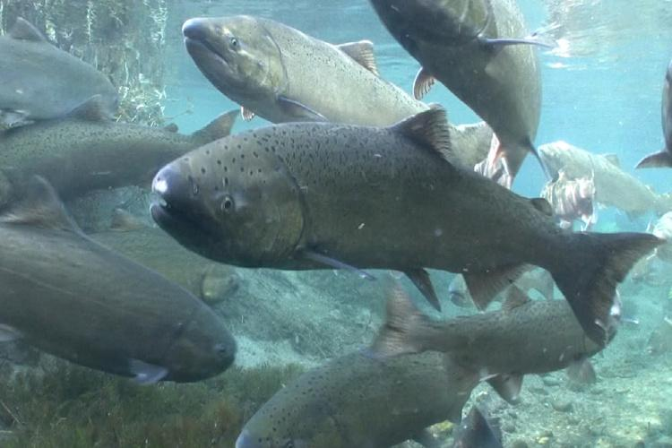
Necesidades de un hábitat fluvial

Slide 5
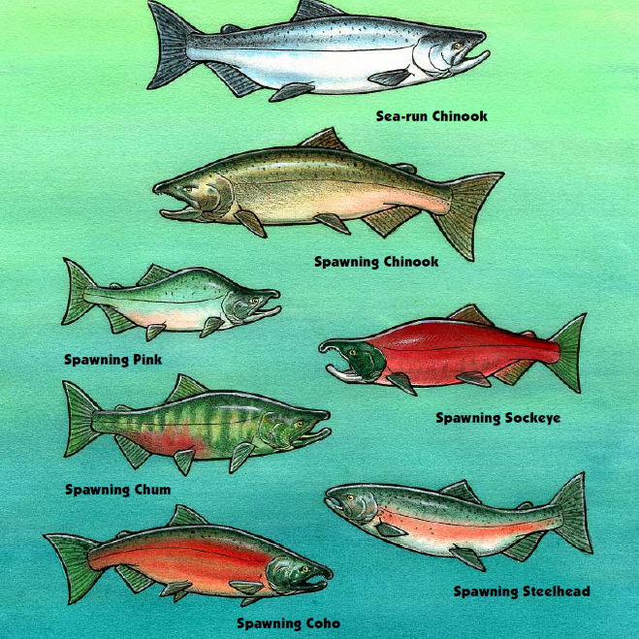
!Hay seis diferentes tipos de salmones del pacifico¡
Salmón Chinook
Salmon Coho
Salmón Pink
Salmón Cockeye
Salmón Chum
rainbow y steelhead (trucha)*
Todos los salmones viven parte de su vida en el agua dulce de los ríos.
Notes:
Rainbow and steelhead trout are the same species with different lifestyles. Rainbow trout spend their lives in freshwater and steelhead trout, like salmon migrate to the oceans and back to freshwater.

Slide 6
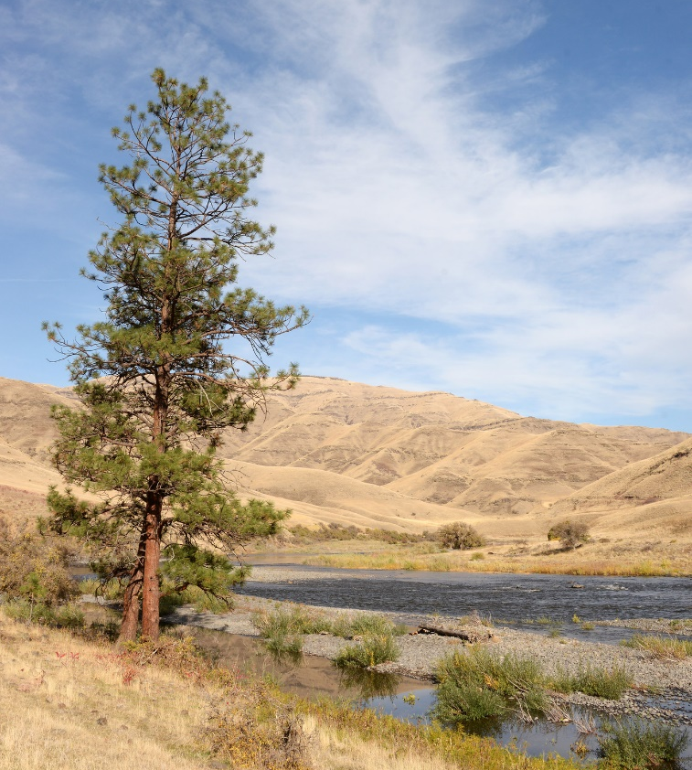
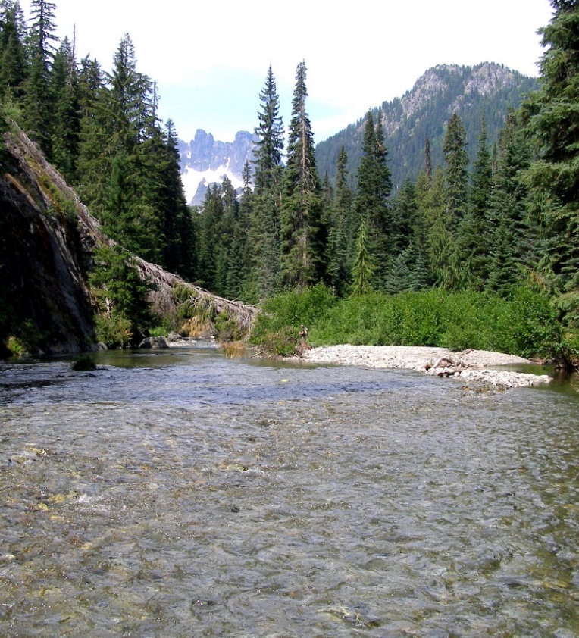
Datos sobre el salmón
El salmón es adaptable.
Han evolucionado para vivir en todo, desde los bosques en la montaña hasta los arroyos en los altos desiertos.
Notes:
You may want to introduce the term adaptable– the ability to adjust to new conditions.

Slide 7
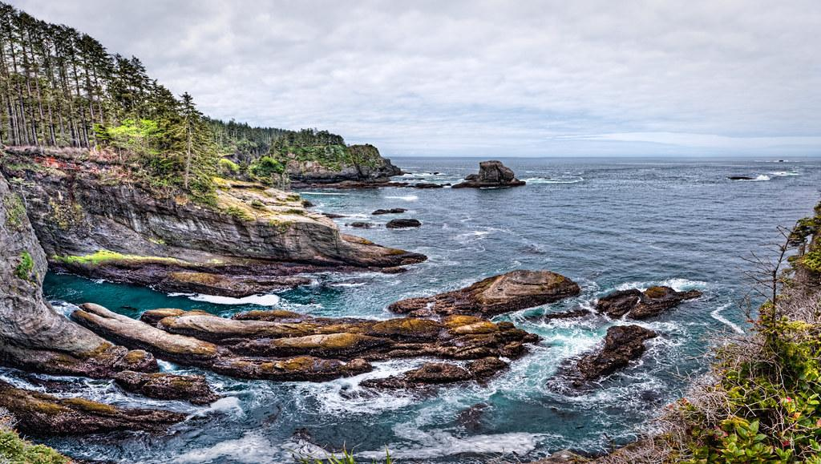
Datos sobre el salmón
El salmón es anádromo.
Ellos pueden adaptarse de agua dulce hacia el agua salada y volver de nuevo. Pero deben poder hacer el viaje sin alguna barrera.
Notes:
Vocabulary such as the term anadromous is included in the PowerPoint, but is not crucial to student understanding. Feel free to allow students to define the ability of fish to travel to and adapt to salt and freshwater using their own words.

Slide 8
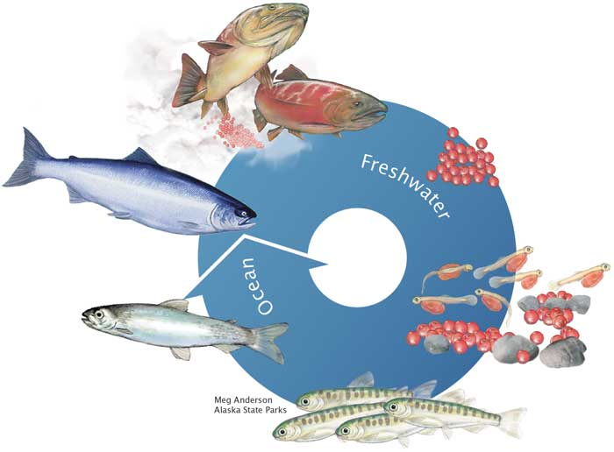
El ciclo de vida del salmón
Alaska Department of Fish and Game
Notes:
Highlight life stages spent in freshwater vs time spent in ocean.

Slide 9
Peligro de hábitat destacado: presas
Photo by Thomas O’Keefe
Merwin Dam on the Lewis River, Washington. Merwin Dam is the lowermost of the three dams blocking fish passage on the North Fork Lewis River
Notes:
Ask students to evaluate habitat below the dam.

Slide 10
Las presas del río Lewis pasaje de los peces.
Notes:
This graphic shows the current catch and haul operations (green arrows) on the Lewis river, along with the fish passage projects that are currently being evaluated. In the 2004

Slide 11
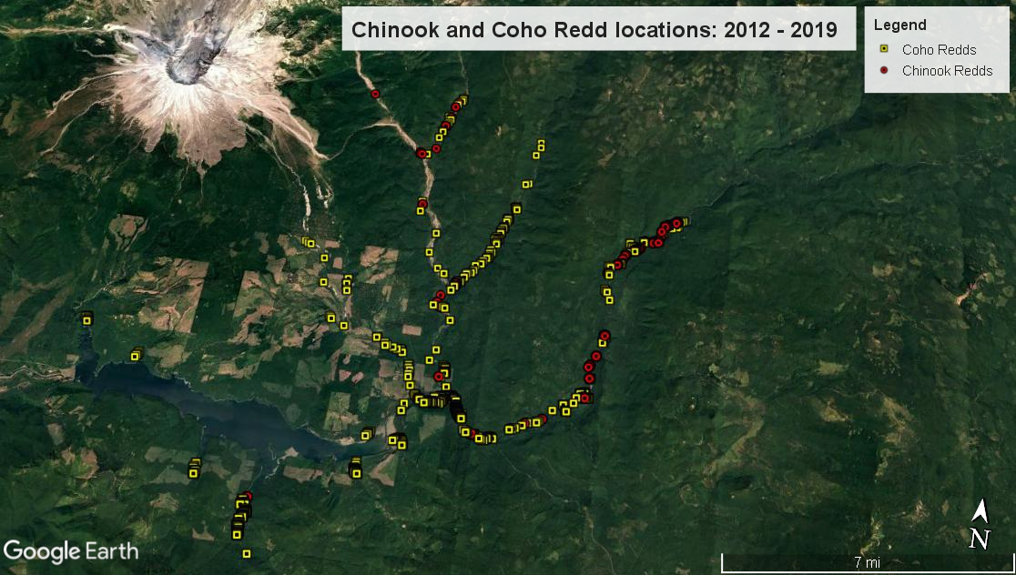
Las presas del río Lewis pasaje de los peces.
Notes:
Between 2012 and 2019 fish biologists ran a trial program of trap and haul over the three Lewis river dams to see if salmon would repopulate the rivers and streams once fish passage was created. This map shows the distribution of coho salmon above the three Lewis river dams. The orange oval shows the Swift Reservoir created by the Swift dam. All of the redds created above the Swift Reservoir occur because of trap and haul efforts. This is important because it shows that if fish passage is created, we can expect fish to repopulate and spawn in these rivers and streams.

Slide 12
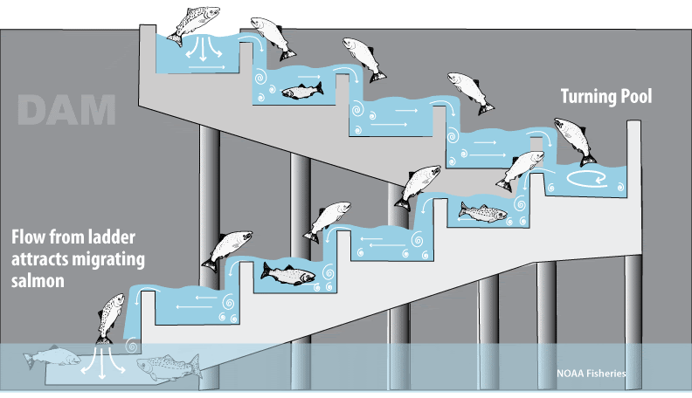
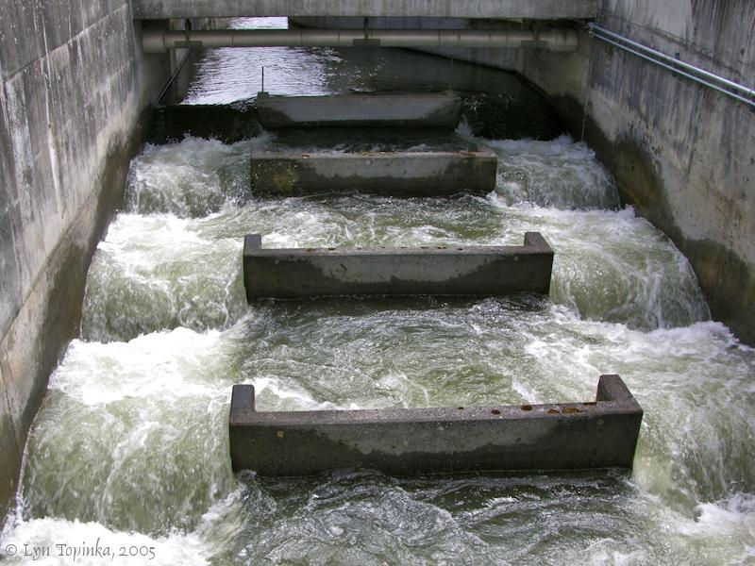
Solución del pasaje de los peces: escaleras de pescados
Fish ladder at Bonneville dam
Notes:
Fish ladders are built at many large dams. They allow fish to swim up a series of steps pass over the dams. They don’t allow for easy movement of smaller fish down the dam.

Slide 13
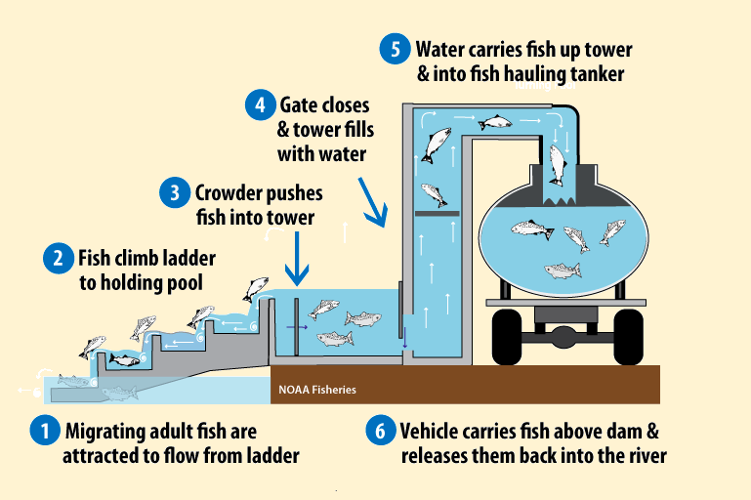
Solución del pasaje de los pescados: atrapar y acarrear
Notes:
There are a variety of trap and haul operations, including ones that use elevators to move salmon up and over the dam. This fish elevator is known as a “pescalator”

Slide 14
Solución del pasaje de los pescados: Cañón de salmón
Notes:
Whoosh also known as the “Salmon Cannon” can also be used after trapping to move them to the hauling trucks,. Or above the dam or barrier.

Slide 15
Solución del pasaje de los pescados: Presa de remoción (No ha sido considerada en la presa Merwin)
Notes:
Dam removal is not being considered for the Lewis River Dams, but has been used as a solution for fish passage on other dams in the state: Elwha, Salmon River, etc.

Slide 16
Solución del pasaje de los pescados: Remoción de la presa.
Notes:
2 minute video shows opening of Condit Dam on the White Salmon River.

Slide 17
Solución del pasaje de los pescados Actividad de evaluación

Slide 18
El hábitat del salmón necesita.
la alimentación
El agua limpia
Agua fría (entre 40-50 grados Fahrenheit)
Agua con suficiente oxígeno
Lugares de escondite
Lugares de descanso
Un pasaje libre desde los arroyos hasta el océano.

Slide 19
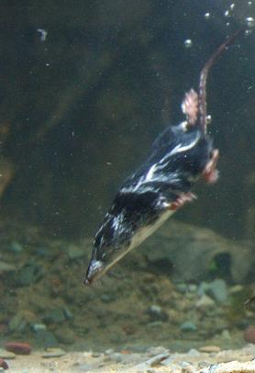
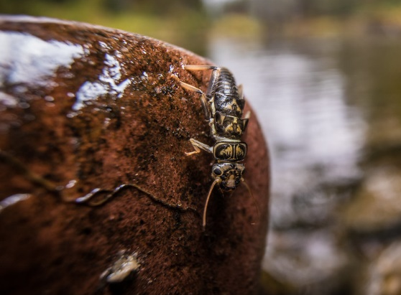
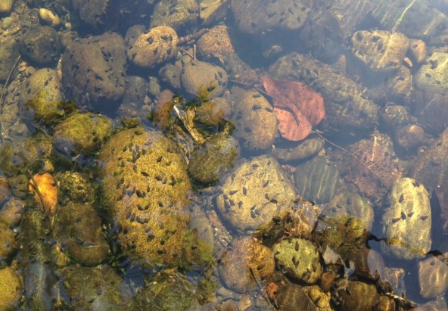
El hábitat del salmón necesita: la alimentación
los salmones joven comen
microinvértebrados (insectos) como plecoptera, libélula, ninfas, cachipollas y escarabajos
caracoles
lombrices
pequeños peces
cangrejo de río
pequeños mamíferos acuáticos
Stonefly courtesy of National Park Service
snails
Northern Crayfish
Water shrew by Robert A. MacArthur
Notes:
Macroinvertebrates are small aquatic animals without backbones that can be seen without a microscope.

Slide 20
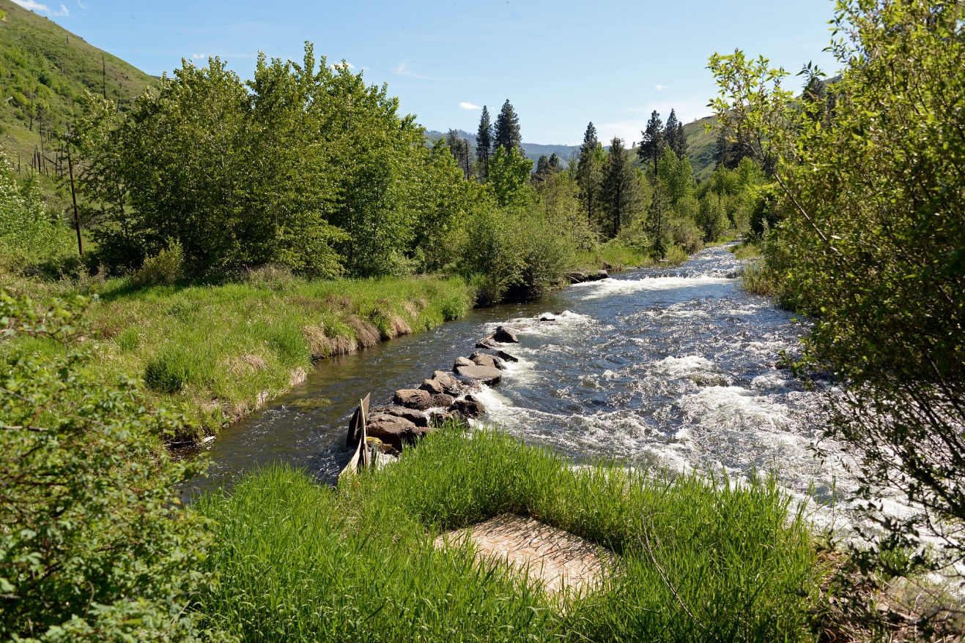
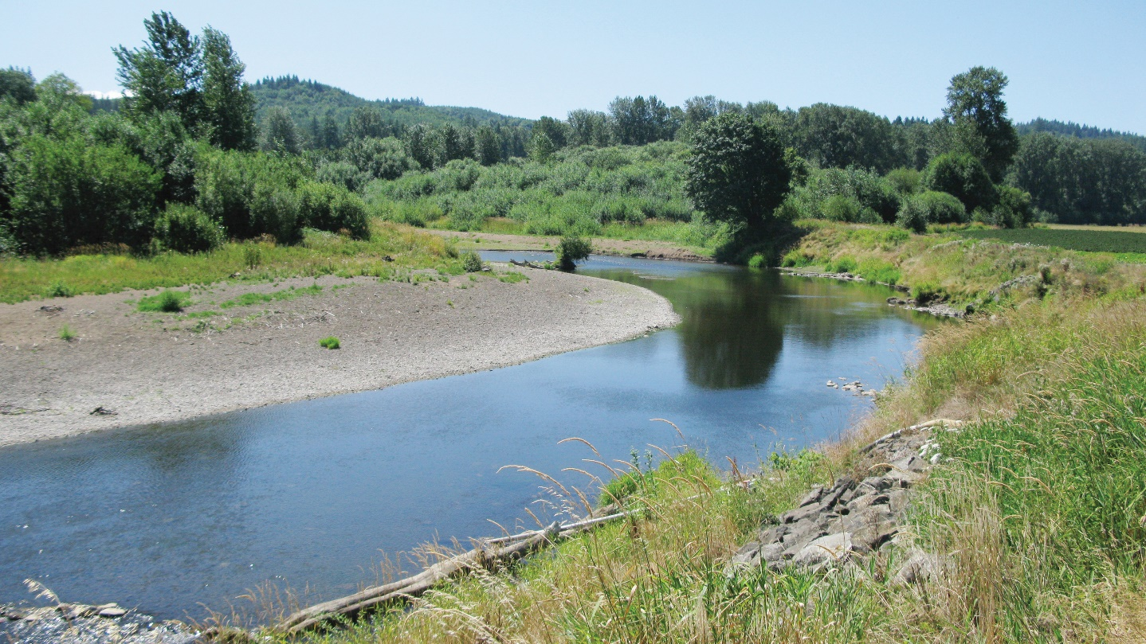
El hábitat del salmón: Agua, limpia y fría
vegetación abundante
Notes:
Ask students to compare and contrast the two different parts of the river. Ask them to think-pair-share about why having overhanging vegetation is so important.
Overhanging vegetation keeps water cool! And it can provide habitat for salmon food to live!

Slide 21
El hábitat del salmón necesita: el agua con mucho oxígeno
Canales graduales
Agua que se mueva con rapidez
Notes:
Salmon utilize both steep and gradual channels. Gradual channels are important for laying eggs. Quick moving water keeps the water cool and helps get oxygen into the water.
Teacher note: To help students understand how oxygen gets into water ask them to think about a waterfall. Why is the water in the waterfall white? It is full of air. Some of that air is oxygen.

Slide 22
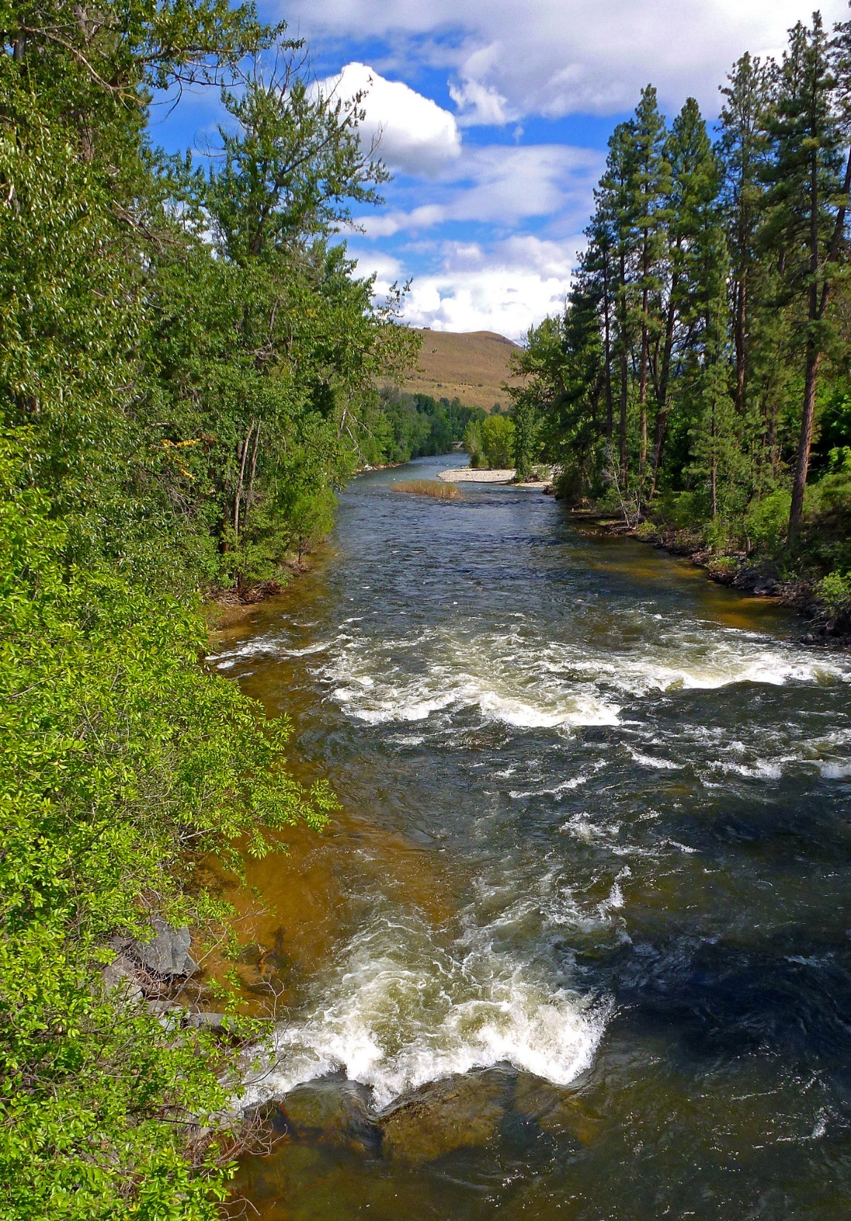
El hábitat del salmón necesita: Agua con mucho oxígeno
Áreas con rocas, adoquín y piedritas (grava).
Agua de bolsillo- agua con muchas rocas grandes corrientes caídas
Notes:
Loose gravel and cobbles help provide habitat for redds (fish nests) and moving water helps provide oxygen in the water for fish to breathe.

Slide 23
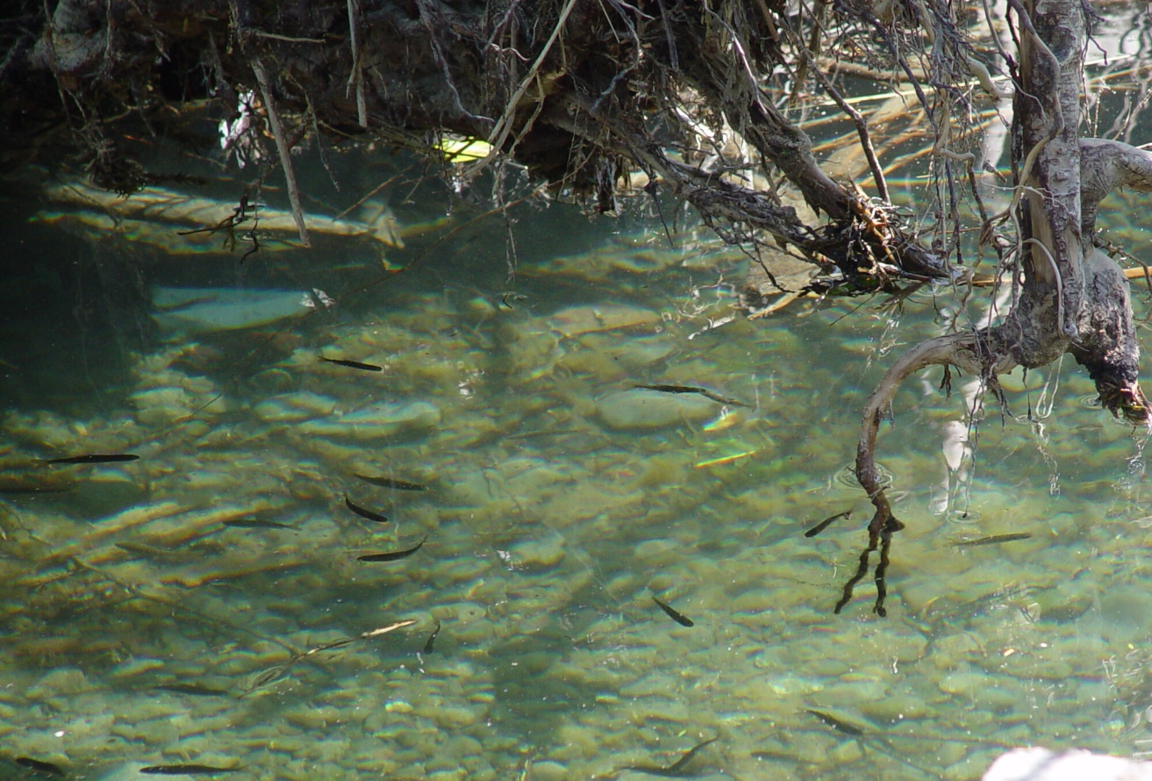
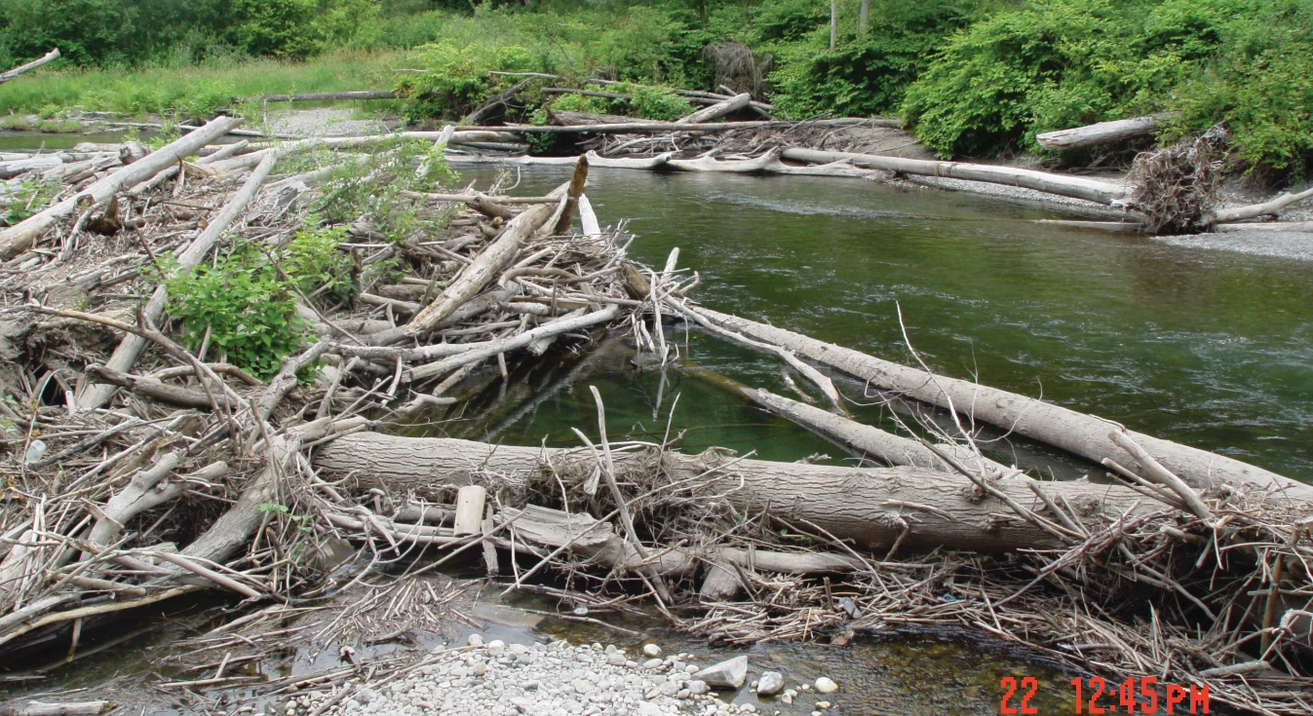
El hábitat del salmón: lugares para esconderse y descansar
Grandes escombros leñosos escondidos proveen un lugar para el salmón al igual que los lugares de descanso para la reproducción del salmón.
Notes:
Woody debris provides protection from predators, hiding places for juvenile and small fish and shade for cooler water temperatures.

Slide 24
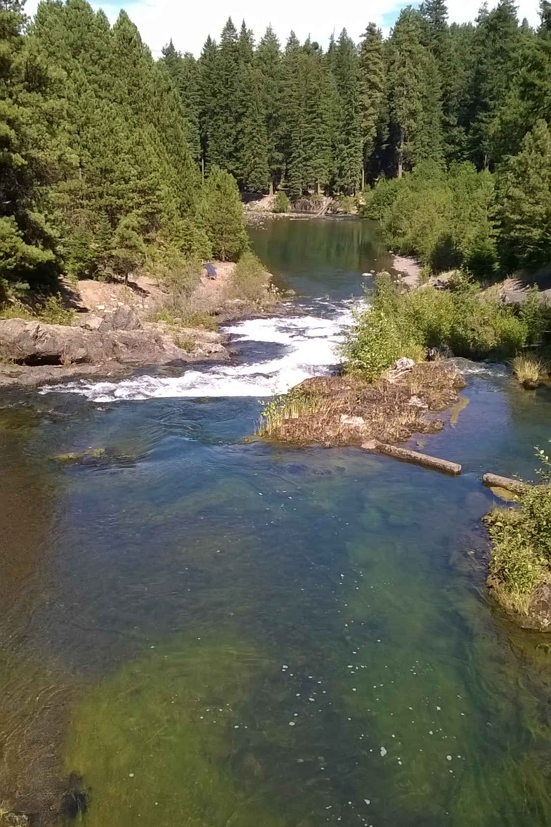
Salmon Habitat Needs: places to hide and rest
charcos de agua
Notes:
Ask students if they can identify any pools in the picture before clicking to reveal the circles that highlight a couple.
Pools provide important resting and raising habitat for salmonids. Additionally, rivers and streams with many pools act as refuge from floods, drought, and extreme temperatures.

Slide 25
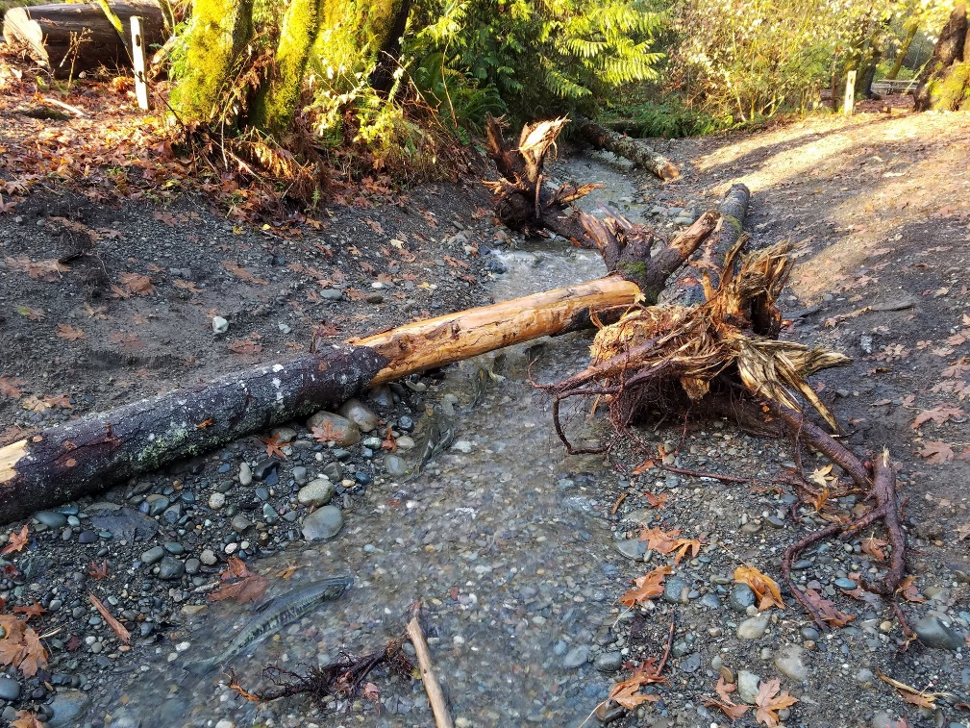
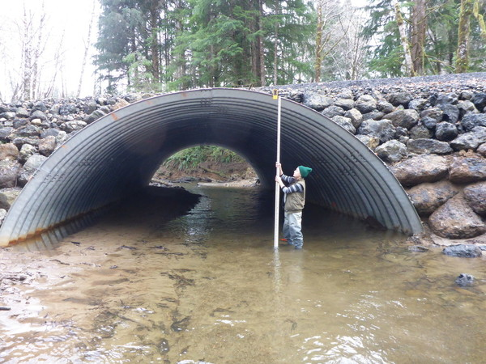
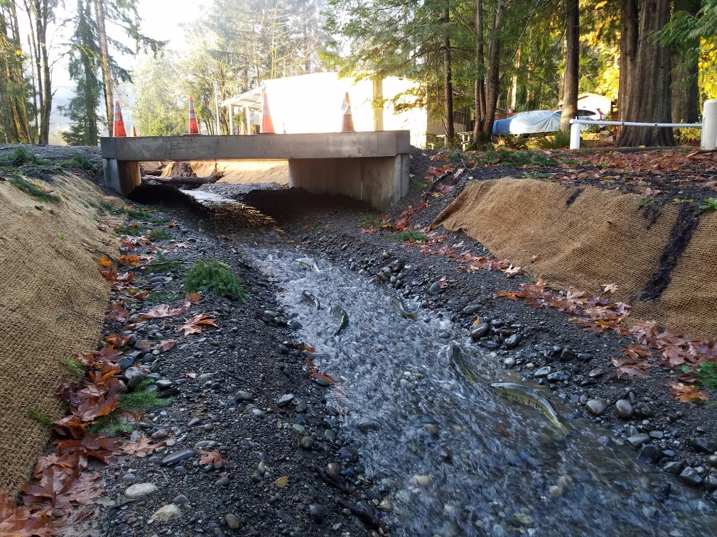
La hábitat necesita: la habilidad de pasar del arroyo al océano y en torno.
Notes:
Making large fish passage under bridges and adding woody debris to stream.

Slide 26
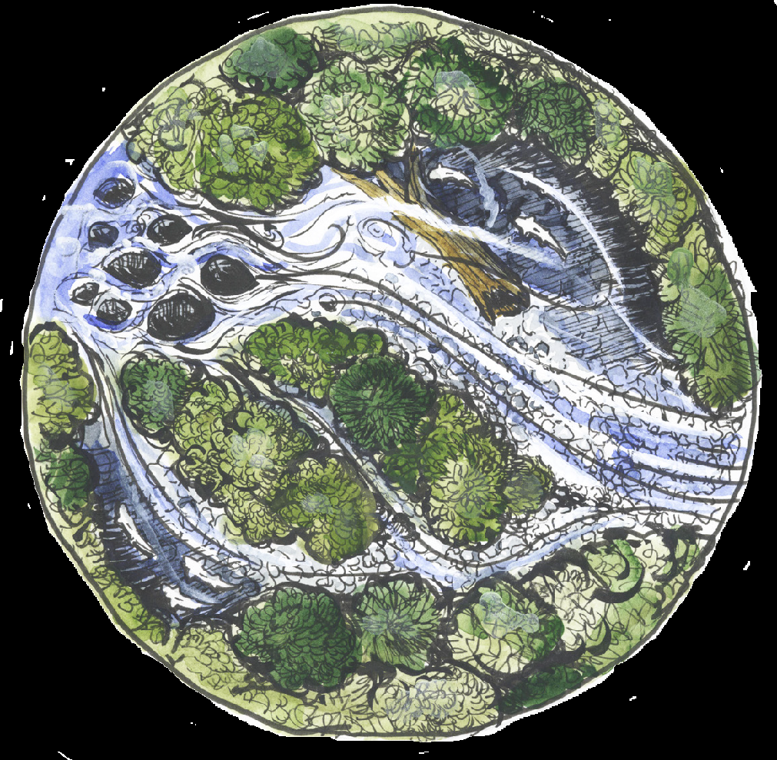
¿Es este buen hábitat para el salmón?
Notes:
Overhanging vegetation
Woody Debris
Pools
Large boulders and gravel
Fast moving water

Slide 27
¿Es este buen hábitat para el salmón?
Notes:
No overhanging vegetation
Shallow water
Slow moving water
No woody debris

Slide 28
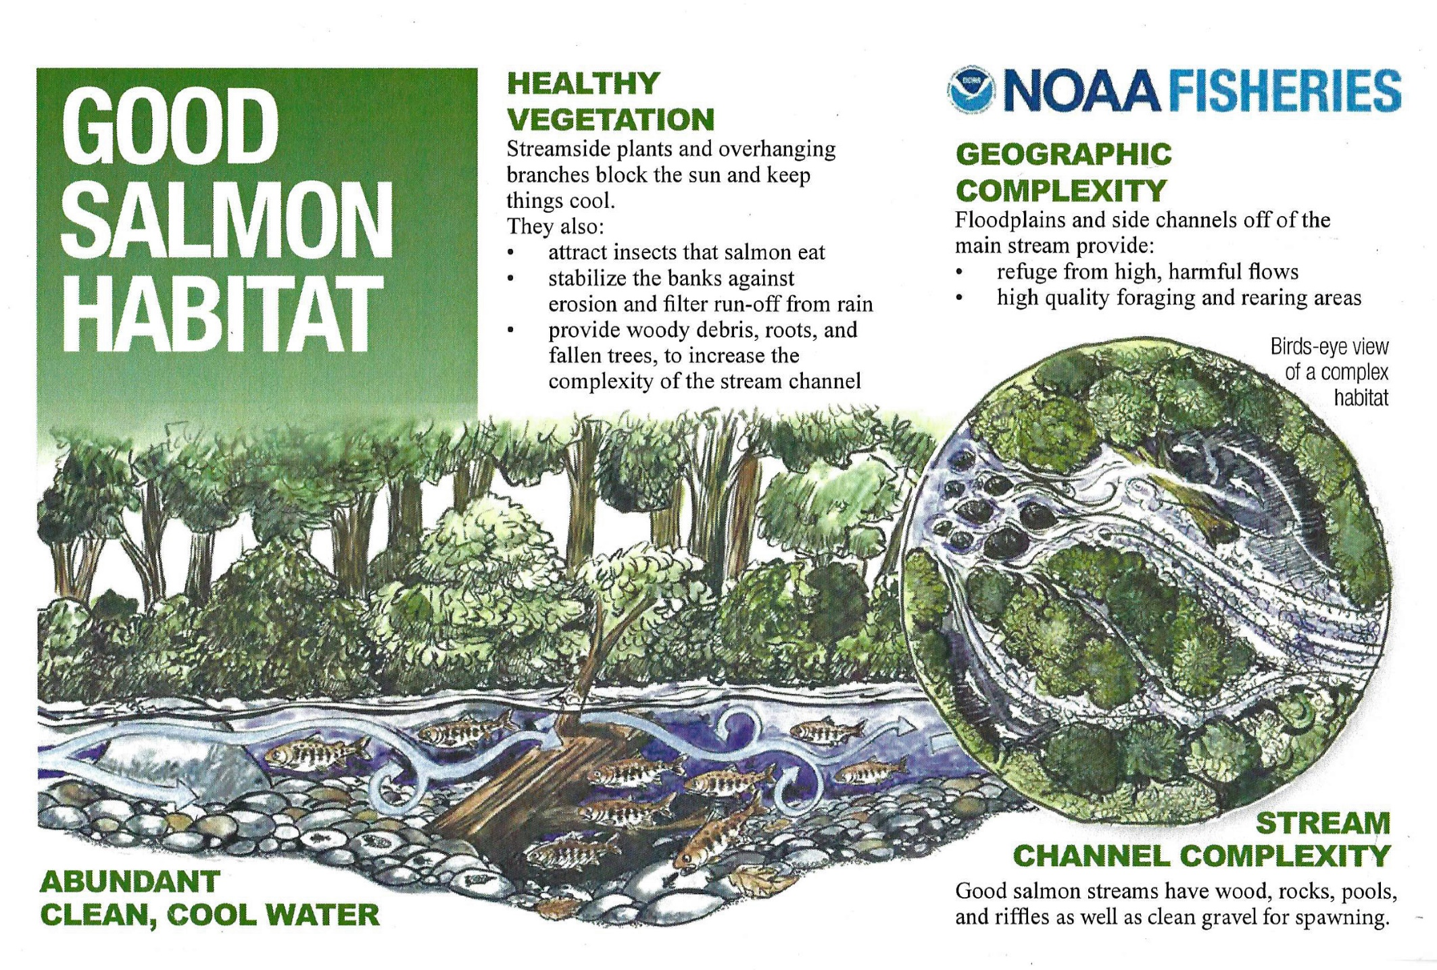

Slide 29
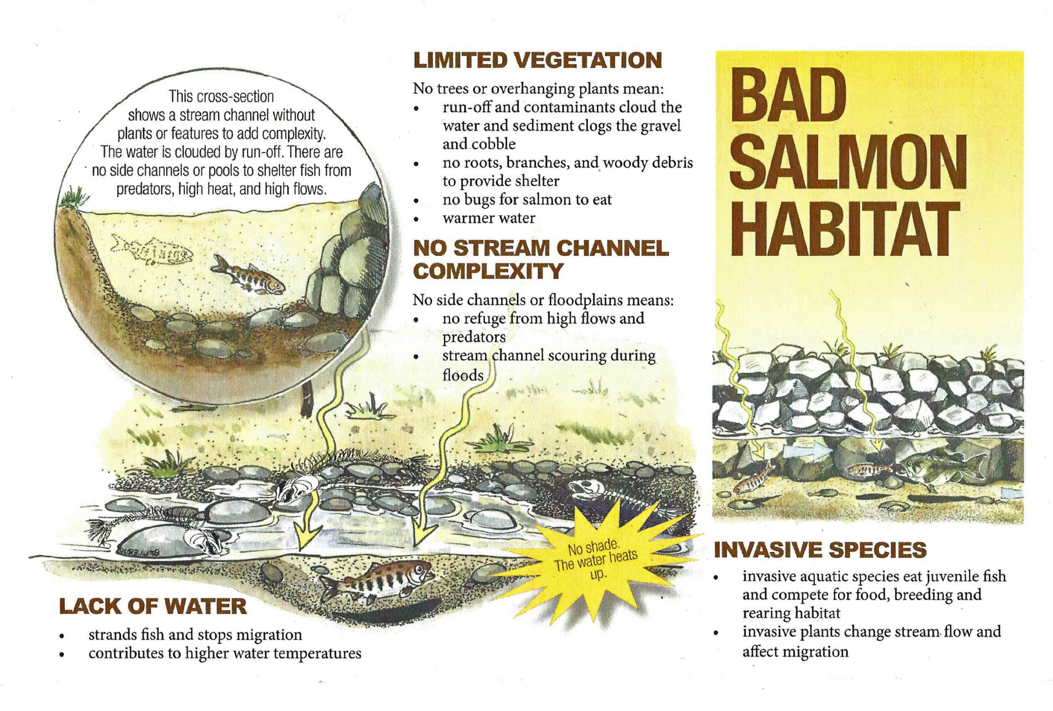

Slide 30
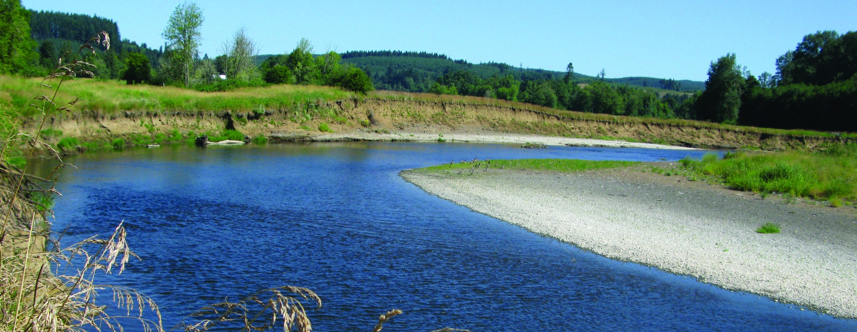
Amenazas al hábitat del salmón
pérdida del hábitat del río debido a:
presas que bloquean el paso
alcantarillas que bloquean el paso
Redireccionamiento de arroyos naturales
contaminación como basura en áreas recreación
escurrimiento de pesticidas y fertilizante en el agua
caída de la orilla del arroyo (por pérdida de árboles y plantas)
temperaturas altas del agua

Slide 31
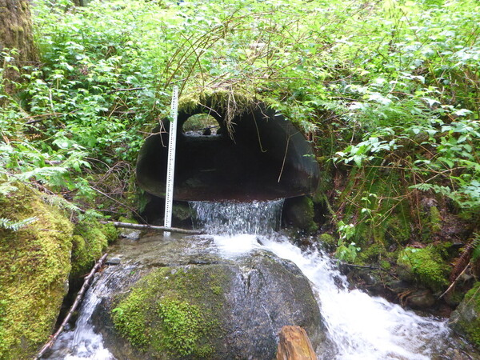
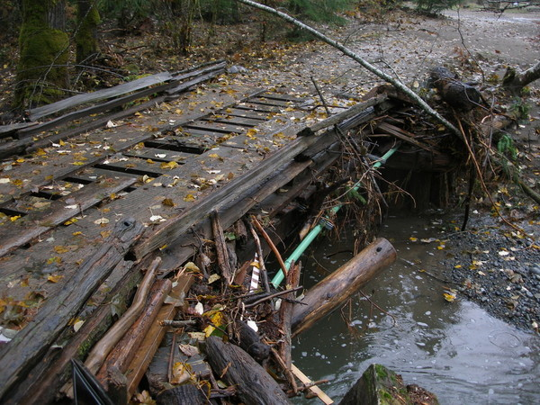
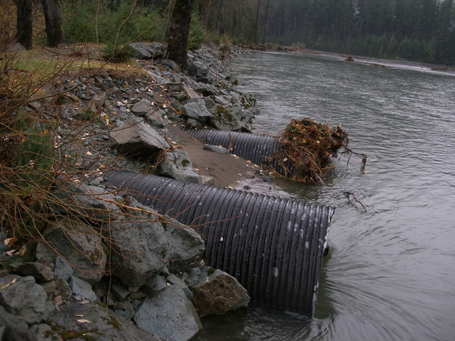
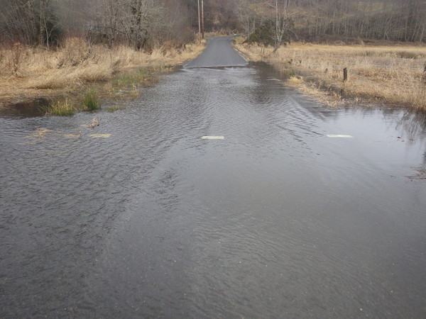
alcantarillas: túneles bajo carreteras y ferrocarriles.
Notes:
Culverts can create challenges for fish passage by being too small, being “perched”( placed above stream) making it difficult for fish to move through them, or by getting clogged and causing flooding.

Slide 32
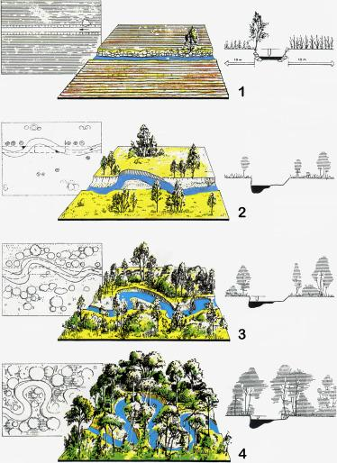
Restauración de la hábitat
Notes:
Changing a human-made straight channel back into a meandering river system with streamside vegetation

Slide 33
restauración de la hábitat
Notes:
Example of habitat restoration done on the Tucannon River. Ask students how adding large trees could help change the river system to better support salmon.

Slide 34
restauración de la hábitat

Slide 35
la hábitat de los salmones necesitan
canales de arroyos complejos
abundancia de vegetación
escombros leñosos
grava
rocas grandes
Pocket water (oxígeno en el in water)
Pools

