Slide 1



ZOOM MEET/ CALL LOGISTICS
You can turn your camera on and mute or unmute yourself through the control panel at the bottom of your screen.
We will keep folks muted during the beginning of our program, then will unmute folks when we open it up for questions and feedback. Callers can unmute yourself by pressing *6 on your phone.
We ask that you “raise their hand” to ask a question which you can access through the control panel at the bottom of the screen. You can also raise your hand by hovering over your face or name on the list of participants. Callers can raise their hand by dialing *9.
If you have any technical issues during the call, use the chat button and we will help you through those.
This meeting is being recorded.
Please do not use the chat for questions or comments on the presentation, we will take those live.

Slide 2
Public Meeting Guidelines and Etiquette
Please note the following guidelines for our meeting:
Upon joining the virtual meeting, your microphone will be muted automatically.
In case of any technical issues during the meeting, notify us in the chat, and we will help you. Please note that the chat will only be monitored for technical assistance.
Public comments are welcome and will be rotated between in-person and virtual attendees.
To ask a question or make a comment, please use your device's "raise hand" feature. If on the phone, dial *9 on Zoom / *5 on Microsoft Teams, and if using a computer, click the hand/reactions icon at the bottom of your screen.
During the comment period, the host will enable you to unmute yourself. You can then unmute yourself by pressing the mute button on your device or dialing *6 on your phone.
Keep discussions focused on the agenda items and questions at hand. Offensive, disrespectful, or derogatory language, including profanity, personal attacks, threats, or insults towards individuals, governments, or organizations, is strictly prohibited.
Assume positive intentions from those speaking and listen respectfully.
To ensure a balanced discussion, limit your comments to two minutes with one clarifying follow-up question.
Provide constructive feedback regarding the fisheries in which you participate. Remember that the most compelling comments are those that pertain to the topics under discussion.
WDFW staff may close public comment to stay on schedule with the agenda or to provide others who still need to comment with an opportunity to speak.
The Hybrid meetings will be recorded and posted online.
If you have further questions or comments, please submit them in written format on our public comment webpage: https://wdfw.wa.gov/fishing/management/north-falcon/public-input
Notes:
Mention key terms, Positive Intentions

Slide 3
Puget Sound Recreational Breakout Discussion
March 1, 2024

Slide 4
WDFW Team
Mark Baltzell, Statewide Salmon and Steelhead Manager
Dr. Kirsten Simonsen, Puget Sound Recreational Salmon Manager
Dr. Derek Dapp, FRAM modeling team
Hailey Rosenthal, Puget Sound Recreational Support Biologist
Ty Garber, FRAM modeling team
Sarah Richardson, Mark Selective Fisheries Biologist

Slide 5
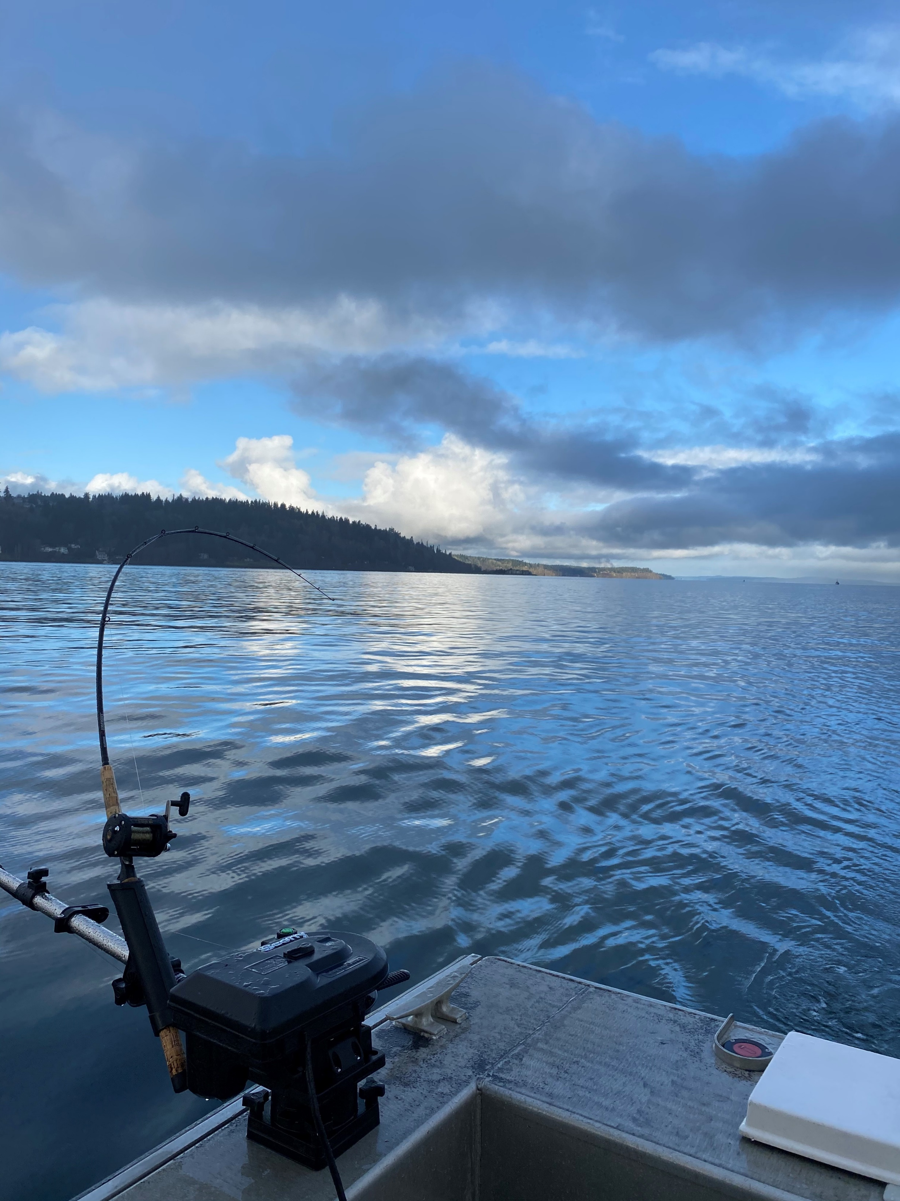
Agenda
Forecast Comparisons
Key Takeaways
Stocks of Concern
Recreational Considerations
Public Comment

Slide 6
Puget Sound Chinook Forecast Comparisons – Summer / Fall
Basin | Natural
 | 2023 | 2024 | Comparison
Skagit Summer / Fall | 12,235 | 10,449 | 0.85
Snohomish | 3,362 | 2,655 | 0.79
Stillaguamish | 710 | 503 | 0.71
Skokomish | 350 | 606 | 1.73
Mid HC | 12 | 14 | 1.17
Lake Washington | 764 | 765 | 1.00
Green River | 3,916 | 2,707 | 0.69
Puyallup | 1,591 | 2,615 | 1.64
Nisqually | 739 | 1,186 | 1.60
Elwha | 129 | 143 | 1.11
Dungeness | 403 | 240 | 0.60
Hoko | 1,571 | 2,030 | 1.29
Puget Sound Total (excl. Spring) | 25,782 | 23,913 | 0.93
Notes:
Totals including spring
2023: 31350
Skagit spring: 2303
White spring: 2805
Nooksack: 459
2024:28154
Skagit spring: 1630
White spring: 2612

Slide 7
Puget Sound Chinook Forecast Comparisons – Summer / Fall
Basin | Hatchery
 | 2023 | 2024 | Comparison
Skagit Summer / Fall | 502 | 639 | 1.27
Snohomish | 12,956 | 14,387 | 1.11
Stillaguamish | 504 | 390 | 0.77
Skokomish | 25,190 | 26,993 | 1.07
Hoodsport | 31,053 | 32,855 | 1.06
Lake Washington | 5,537 | 7,641 | 1.38
Green River | 23,334 | 22,937 | 0.98
Puyallup | 18,480 | 15,643 | 0.85
Nisqually | 13,450 | 15,425 | 1.15
South Sound Hatcheries | 27,673 | 26,615 | 0.96
Nooksack / Samish | 46,556 | 45,458 | 0.98
Elwha | 2,670 | 2,868 | 1.07
Dungeness | 540 | 1,036 | 1.92
Hoko | 907 | 1,228 | 1.35
Puget Sound Total (excl. Spring) | 209,352 | 214,115 | 1.02

Slide 8
Puget Sound Coho Forecast Comparisons
Basin | Natural
 | 2023 | 2024 | Comparison
Dungeness | 1,011 | 1,844 | 1.82
Elwha | 3,456 | 1,621 | 0.47
Other Strait | 15,624 | 22,052 | 1.41
Nooksack/Samish | 28,527 | 34,093 | 1.20
Skagit | 43,146 | 63,430 | 1.47
Stillaguamish | 30,238 | 30,809 | 1.02
Snohomish | 76,500 | 71,600 | 0.94
Lake Washington | 1,583 | 1,481 | 0.94
Green | 12,779 | 1,261 | 0.10
Puyallup | 16,524 | 9,543 | 0.58
Nisqually | 9,431 | 11,257 | 1.19
Deschutes | 324 | 731 | 2.26
Skokomish | 2,237 | 1,157 | 0.52
Other Hood Canal | 37,195 | 36,442 | 0.98
Total (other stocks included) | 297,258 | 302,168 | 1.02
Notes:
Misc 7 & 7A (incl. San Juans CoOps): 977; 1,011
Misc. Area 10,11,10E: 2,721; 5,786
Area 13 A-K wild, exc. Deschutes: 14,985; 8,050

Slide 9
Puget Sound Coho Forecast Comparisons
Basin | Hatchery
 | 2023 | 2024 | Comparison
Dungeness | 13,643 | 12,461 | 0.91
Elwha | 3,666 | 4,268 | 1.16
Nooksack/Samish | 66,565 | 72,320 | 1.09
Skagit | 21,053 | 27,254 | 1.29
Stillaguamish | 1,744 | 903 | 0.52
Snohomish | 63,994 | 34,728 | 0.54
Lake Washington | 19,971 | 22,609 | 1.13
Green | 97,977 | 87,353 | 0.89
Puyallup | 20,499 | 17,415 | 0.85
Nisqually | 7,467 | 3,623 | 0.49
Deschutes | 60,547 | 62,249 | 1.03
Skokomish | 24,372 | 27,776 | 1.14
Other Hood Canal | 48,906 | 38,367 | 0.78
Total (other stocks included) | 462,771 | 419,966 | 0.91
Notes:
Misc. Area 10,11,10E- 12,367; 8,640

Slide 10
Key Takeaways - Chinook
Overall
Natural (wild) and hatchery forecasts down slightly from 2023 for S/F Stocks
2023 total returns (wild & hatchery) as compared to 2022:
  Coast is similar
  Central sound is down
  South sound is up
Skagit
Weak forecasts in recent years
2022 – Stronger than predicted returns
2023 – returns similar to expected
2024 forecast lower than 2023
Samish
Continues to have good hatchery return
Snohomish
Natural forecasts are down relative to last year
Hatchery forecast good again in 2023
Stillaguamish
Remains in a poor population status and will continue to be a primary constrainer to many fisheries.
Returns similar to last year
  2022 returns relatively high
Hood Canal
Hatchery stocks similar to 2023 forecast

Slide 11
Key Takeaways - Coho
Overall
Hatchery and wild up compared to 10-yr average
This includes coho crash in 2015
Fraser / Thompson
Some improvements, but still depleted
Snohomish
Good Escapement numbers for 2023
Officially out of rebuilding
Will still be managed carefully to ensure continued good returns
Strait of Juan de Fuca
Some improvements, but some stocks still in depleted status
Likely to continue to be a primary constrainer to Strait fisheries
South Sound
Mixed bag of above and below average expected returns
Hood Canal
Similar forecast to 2023
Coastal Coho
Costal forecast down from 2023

Slide 12
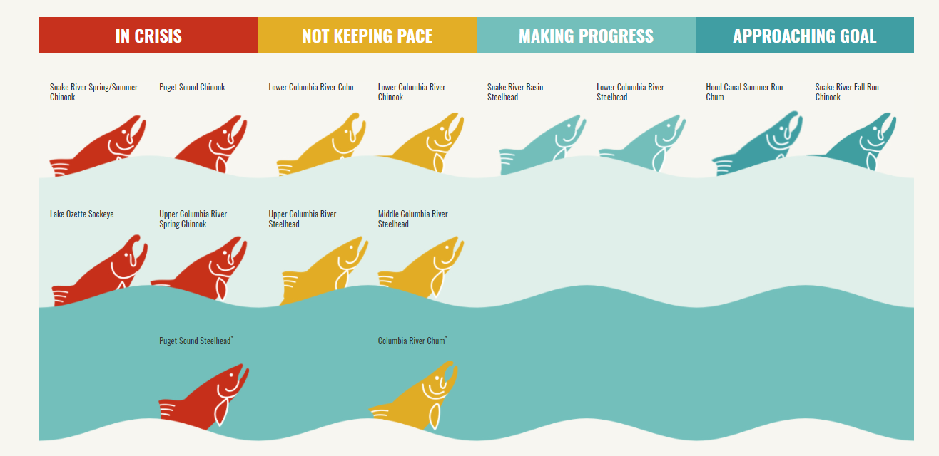
Challenges in Salmon Management
Puget Sound Chinook
Puget Sound Steelhead
*From 2020 State of the Salmon Report

Slide 13
Stocks of Concern - Chinook
Stillaguamish
  Likely to be primary constraining stock
  Recent forecasts: terminal run size of 900 – 1000
Skagit
  Weak forecasts in recent years (Springs: 2020/2021; S/F: 2021/2022)
  Stronger than predicted returns in 2022
  Poor outmigration in 2021
Snohomish
  2023 components of population below LAT
  2024 below lower bound
Nisqually
  Driver of marine fishery shaping in mid/South Sound in 2022/2023.
  Reduced in-river sport fishery in recent years.
  Improved forecast relative to 2023, but still likely to be constraining in 2024
Notes:
Talking point ideas:
Stillaguamish: As in recent years, it is likely that Stillaguamish will be the primary constraining Chinook stock in Puget Sound. In recent years, forecasts have hovered between a terminal run size of 900 and 1000 Chinook, which puts the stock slightly above the low abundance threshold. The first regional forecasting meeting for Stillaguamish and Snohomish is on January 27th, so we might have a better indication on the 2023 status in the next advisor update.
Skagit: Skagit Chinook stock have been forecast as weak for the past few years, with Skagit Springs forecast as below the low abundance threshold in 2020 and 2021, and Skagit Summer/Falls forecast as below the low abundance threshold in 2021 and 2022. Though Skagit Summer Falls were forecast as below the low abundance threshold in 2022, on a positive note, the run did return as stronger than forecast. Though it is unlikely to have a major effect on planning for this year, do note that Chinook outmigration in 2021 was the lowest on record due to flooding events, and that the flooding events in 2021 may affect Skagit returns in 2024 and beyond.
Snohomish: Snohomish was not a primary constraining Chinook stock last year, but it was one that we were considering as we were crafting fisheries because in 2022 its pre-season abundance was forecast below the lower bound threshold. Like Skagit, preliminary indications are that 2022 returns were stronger than forecast and that actual Snohomish escapement was above the lower bound threshold.
Nooksack Springs: We’re currently investigating issues in the Pacific Salmon Treaty modeling process that we think are affecting Nooksack Spring exploitation rates in the Chinook Technical Committee’s annual exploitation rate analysis. Issues have been discussed within the CTC and we think we have a path toward resolving those issues in future iterations of the exploitation rate analysis. However, we will not know if we were compliant with Pacific Salmon Treaty’s SUS obligations for Nooksack Springs until that process is concluded. At this time, we do not anticipate that Nooksack Springs will be a primary constraining stock in 2023, but we did want to make the advisors aware that this stock could come up in NOF discussions.

Slide 14
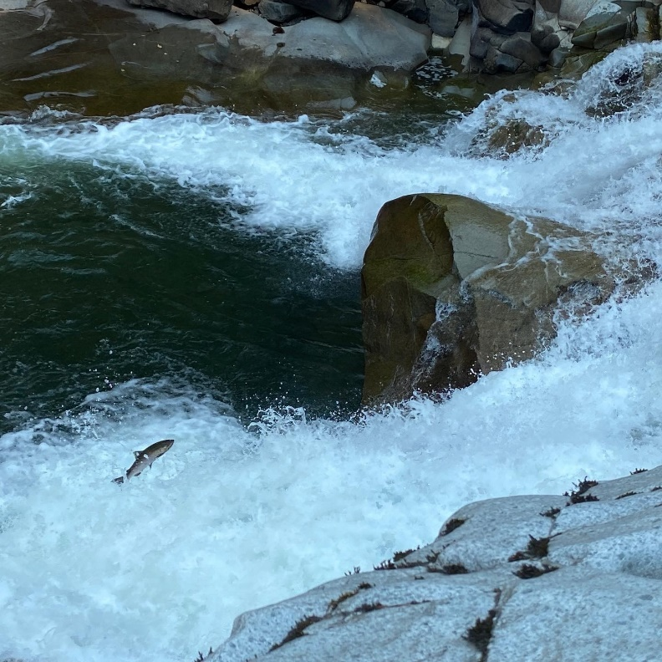
Stocks of Concern - Coho
Strait of Juan de Fuca Rivers
  Improved forecast for 2024
  Rebuilt as of 2024
Snohomish
  Stock crashed in 2015
  WDFW along with Comanagers and NOAA guidance developed a rebuilding plan
  Rebuilt as of 2022
Still concern over Thompson River (Canada)
Low water in Fall 2022 created issues
  Tough conditions for return
  Something to watch for future
  Drought may have affected outmigration too

Slide 15
NALF Runs
New Abundances Last year’s Fisheries
First model run of pre-season
Fisheries represent 2023
All forecasts for 2024 except:
Chin: Nooksack Springs, BC, OR Coastal,
Coho: BC

Slide 16
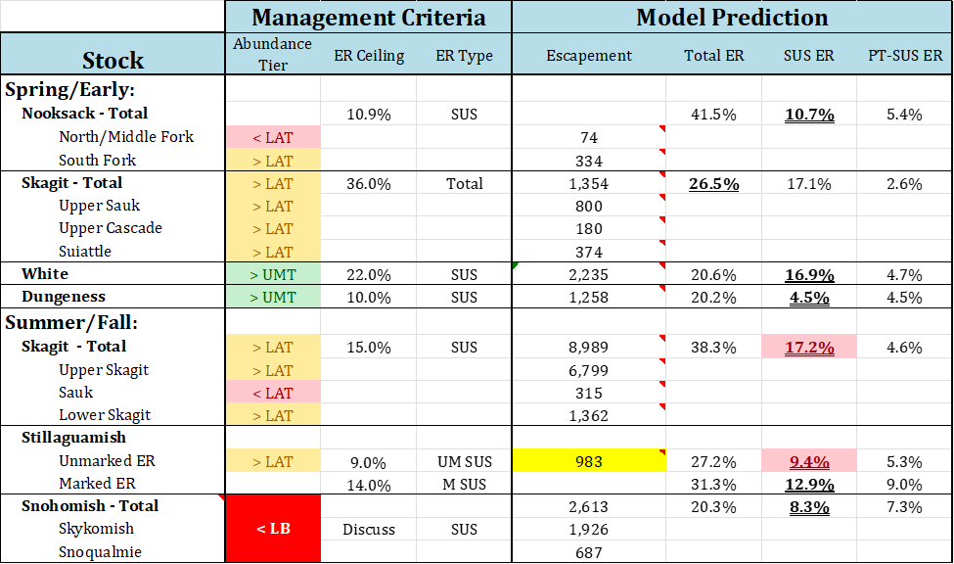
NALF Runs - Chinook

Slide 17
NALF Runs - Chinook

Slide 18
NALF Runs - Coho

Slide 19
NALF Runs - Coho

Slide 20
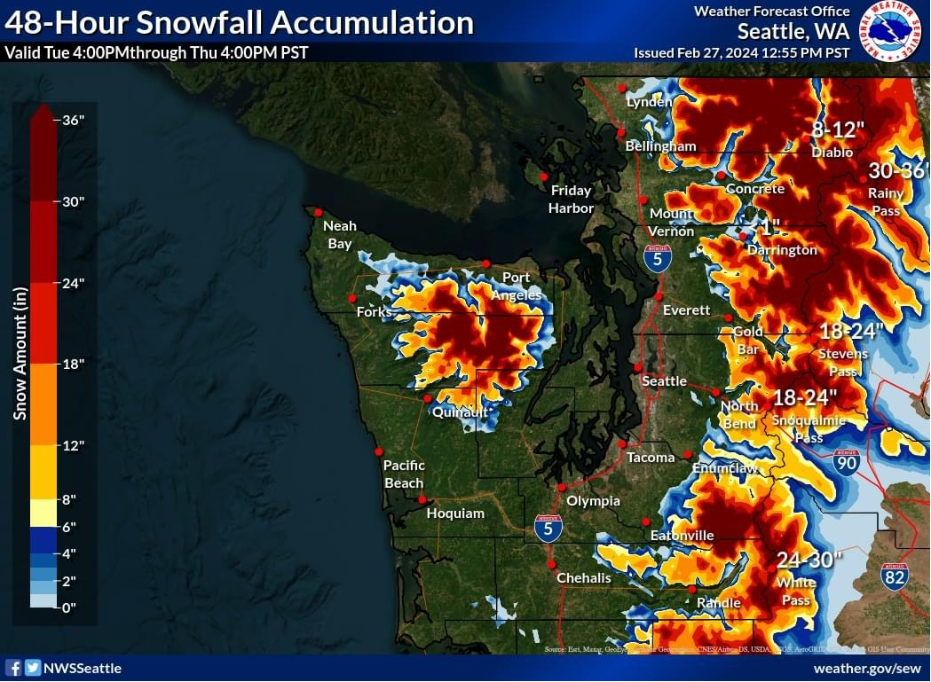
2024 Recreational Considerations
Stillaguamish Chinook conservation limits will continue to drive most recreational opportunity
Chinook directed fisheries vs time on the water
Environmental concerns
  Current El Nino
  Current low snowpack
Recent year variability and effort
trends
  Increases in effort over historical
  averages
* Total snowfall accumulation 2/27 – 2/28

Slide 21
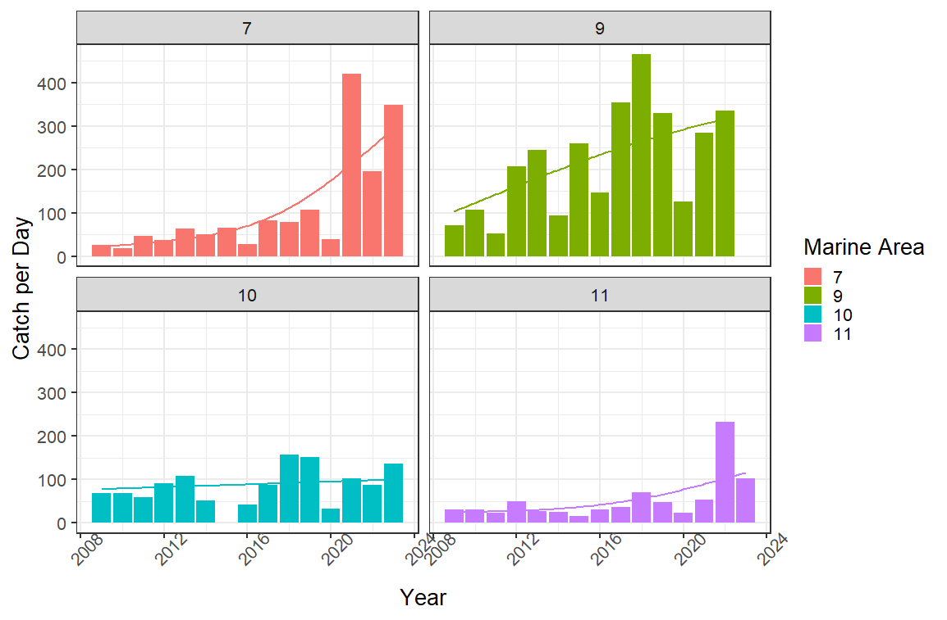
Challenges related to future recreational opportunity
MA-7 Average Catch per Day
2009 – 2018: 50
2019 – 2023: 222
MA-9 Average Catch per Day
2009 – 2016: 147
2017 – 2022: 315
MA-11 Average Catch per Day
2009 – 2021: 24
2022 – 2023: 172

Slide 22
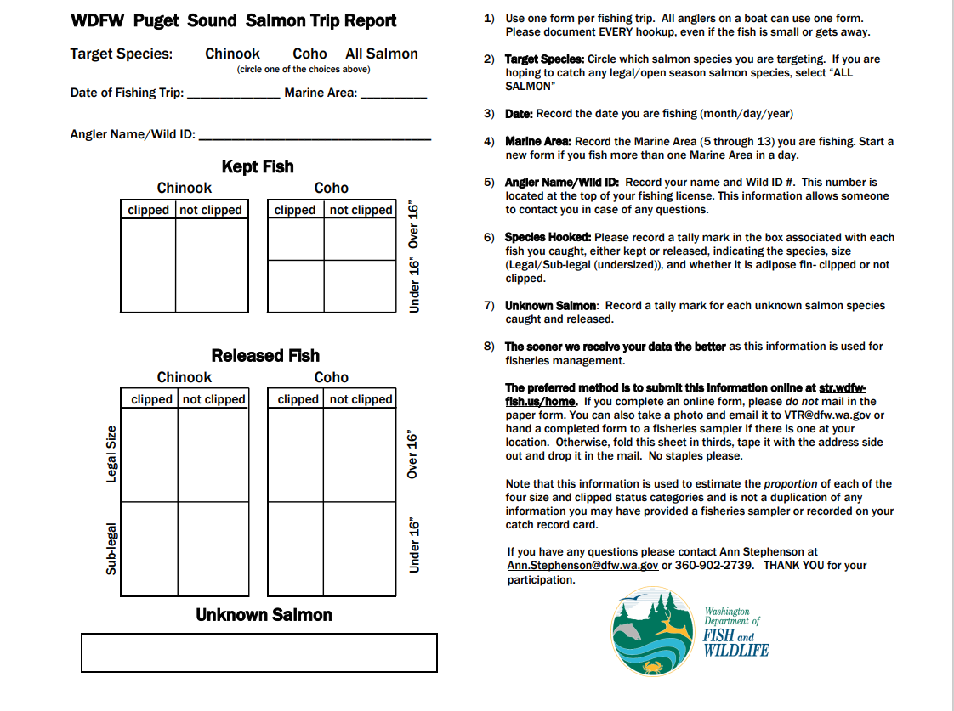
Citizen Science: Voluntary Trip Reports
https://str.wdfw-fish.us/home
Online preferred method for submission
Alternate methods of submission:
Give the form directly to a WDFW ramp sampler stationed at the boat ramp.
Return in via US mail.
Insert the form into a VTR collection box located at the boat ramp or in the fishing resort, if available.
Scan or take a high resolution photo and email to VTR@dfw.wa.gov.

Slide 23
Preliminary 2024 Washington Salmon Season Meeting Schedule
Date | Purpose | Location/Contact
March 6 - 11 | Pacific Fishery Management Council meeting | Doubletree by Hilton Fresno Convention Center 2233 Ventura Street, Fresno, CA 93721
March 13 (Wed) | WDFW and public North of Falcon meeting #1 | In-person and online Office Building 2 Auditorium, 1115 Washington St SE, Olympia, WA 98501 (time TBD)
March 19 (Tue) | Recreational Fisheries Discussion - Coastal Freshwater and Puget Sound | Zoom (6-8pm)
March 21 (Thu) | Columbia River fisheries | Ridgefield, WDFW office and Teams (hybrid) (10am)
March 21 (Thu) | Recreational Fisheries - Puget Sound freshwater and Puget Sound | Zoom (6-8 pm)
March 27 (Wed) | WDFW and public North of Falcon meeting #2 | In-person and online Lynnwood Embassy Suites, 20610 44th Avenue West, Lynnwood, WA 98036 (time TBD)

Slide 24
Preliminary 2024 Washington Salmon Season Meeting Schedule Cont.
Date | Purpose | Location/Contact
March 27 (Wed) | NE of McNary/Upper Columbia/Snake River | Location TBD, Clarkston, WA (6-8 pm)
March 28 (Thu) | Willapa/Grays Harbor fisheries | Zoom (6-8 pm)
April 6 - 11 | Pacific Fishery Management Council meeting | The Westin Seattle, 1900 5th Avenue, Seattle, WA 98101
April 16 (Tue) | Willapa/Grays Harbor final proposed fisheries | Zoom (6-8 pm)
On-line commenting – March-April https://wdfw.wa.gov/fishing/management/north-falcon
Puget Sound Sport Fishing Advisory Group
http://wdfw.wa.gov/about/advisory/pssfag
Full NOF schedule also available on our website:
https://wdfw.wa.gov/fishing/management/
north-falcon/public-meetings

Slide 25
Public Comment
On-line commenting – March-April https://wdfw.wa.gov/fishing/management/north-falcon
Puget Sound Sport Fishing Advisory Group
http://wdfw.wa.gov/about/advisory/pssfag/
Public Meetings
March 6-11 PFMC #1, Webinar, 9:00 am 1st Day
March 13 NOF #1, Lacey, WA and Zoom, 9:00 am
March 19 North Coast, Strait, HC Fisheries Discussion
Zoom, 6:00 pm
March 21 Puget Sound & FW Recreational Fisheries Discussion
Zoom, 6:00 pm
March 27 North of Falcon #2, Lynwood, WA and Zoom, 9:00 am
April 6-11 PFMC #2, Seattle, WA and Webinar, 9:00 am 1st Day

Slide 26
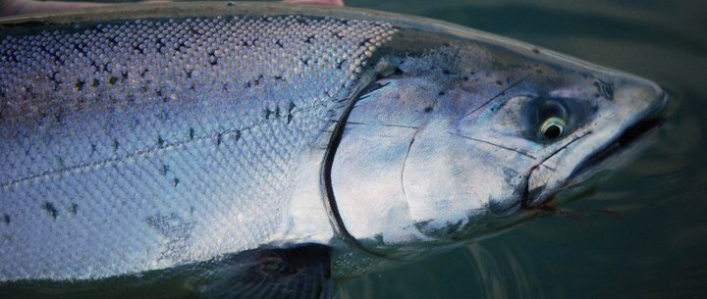
Questions/Comments?

Slide 27
Puget Sound Chinook Forecast Comparisons – Spring Stocks
Basin | Natural
 | 2023 | 2024 | Comparison
Skagit Spring | 2,303 | 1,630 | 0.71
White River Springs | 2,805 | 2,612 | 0.93
Nooksack Spring | 459 | NA
Puget Sound Spring Total | 5,567 | 4,242 | 0.76

Slide 28
Puget Sound Chinook Forecast Comparisons – Spring Stocks
Basin | Hatchery
 | 2023 | 2024 | Comparison
Skagit Spring | 5,031 | 4,788 | 0.95
White River Springs | 2,123 | 2,050 | 0.97
Nooksack Spring | 11,483 | NA
Puget Sound Spring Total | 18,637 | 6,838

