Slide 1
European green crabs
Lesson 1
Anchoring Phenomena
Part 1

Slide 2
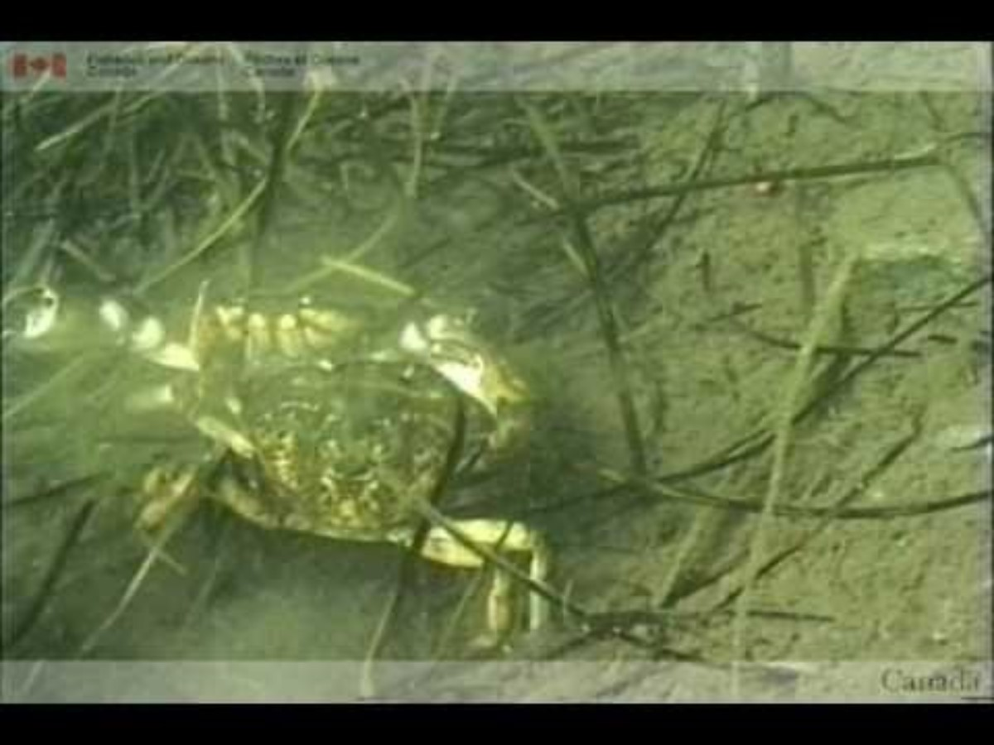
Notes:
Guiding questions: Where do you think this crab is?

Slide 3
Invasive European green crabs threaten Northwest shellfish industries –Oregon Public Broadcasting
Washington takes emergency action to stop thousands of invasive green crabs - Bellingham Herald
Over 400K invasive crabs trapped, killed as fight goes on-Kitsap Sun
Invasive crab threatening shellfish industry, salmon found in another western Washington bay -King 5
Governor issues emergency order over green crab infestation –AP News
"Efficient predator": Invasive European green crab found in new area of Washington state -CBS News
Notes:
These are all headlines from 2022

Slide 4

Notes:
Play until 6:45 min
https://www.youtube.com/watch?v=NKh8Lc31rm8

Slide 5
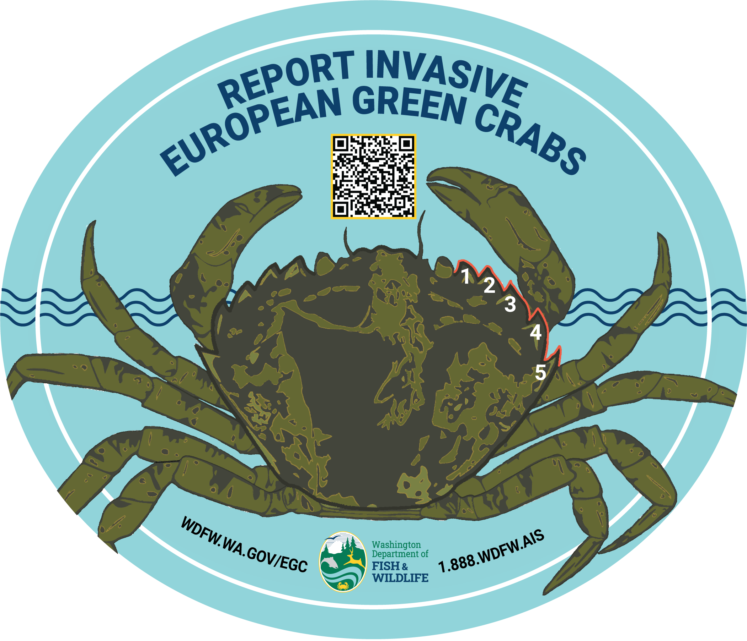

Slide 6
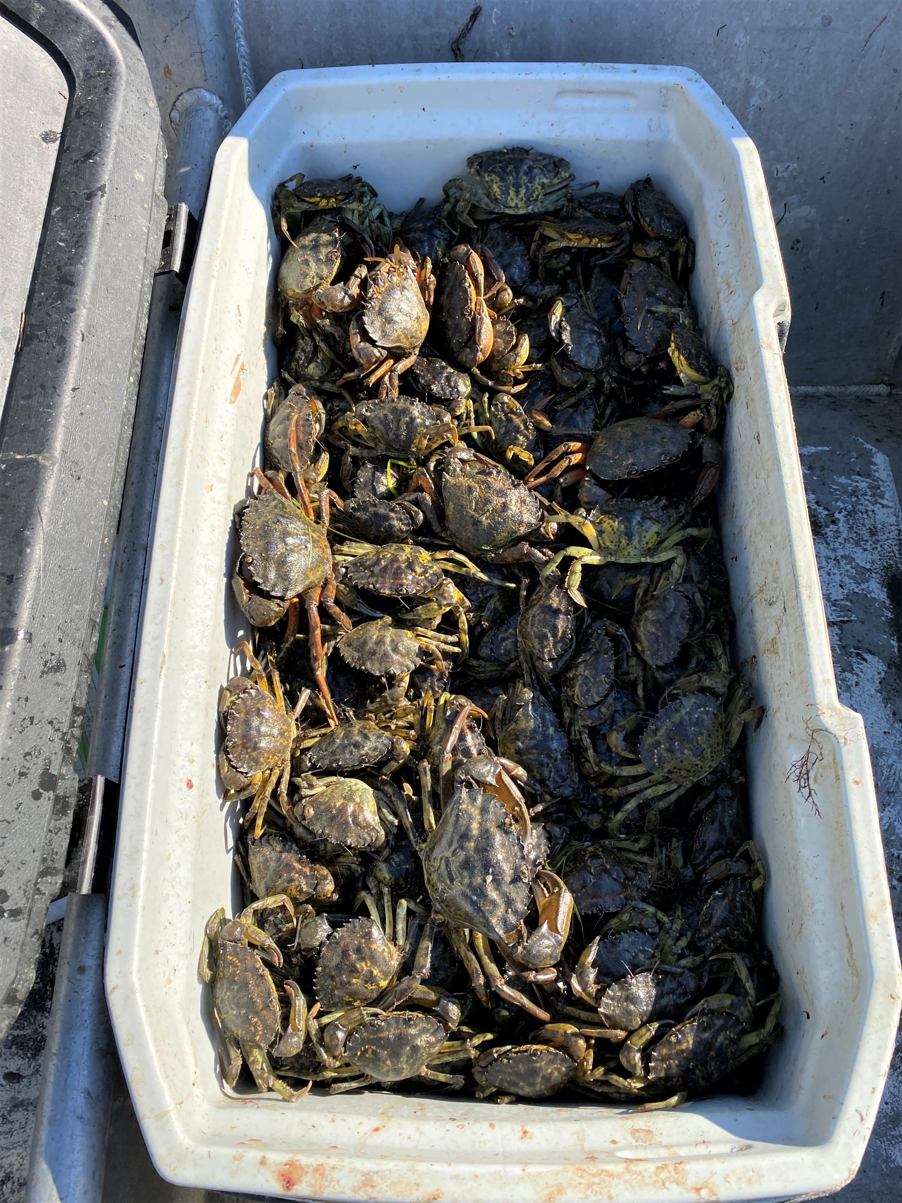
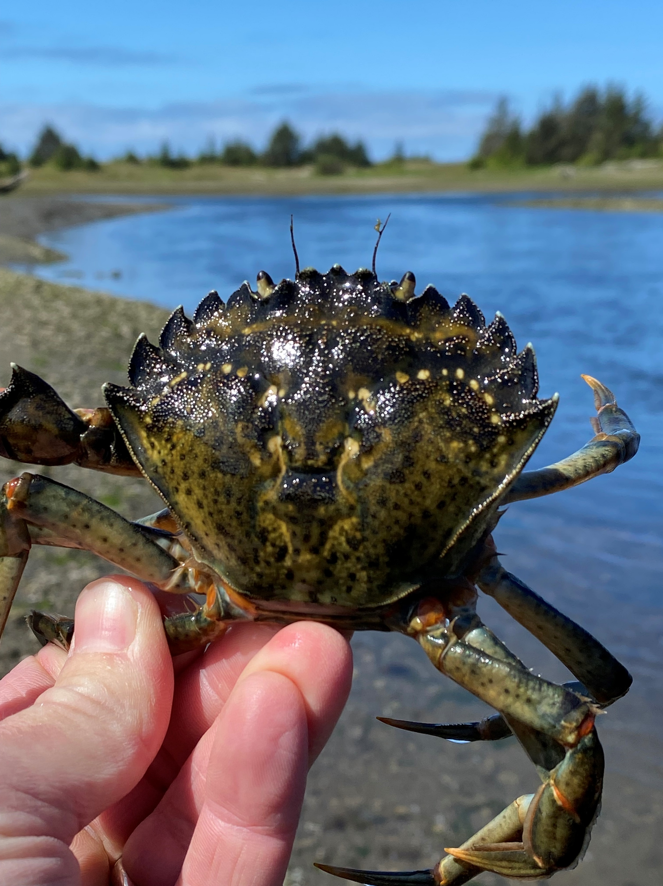
European green crab – an invasive species
Considered one of the world's worst invasive species.
Poses a threat to Washington’s environment, businesses, tribal and cultural resources.
A shore crab originally from Europe and North Africa.
Likes to live in shallow, sheltered waters including estuaries.

Slide 7
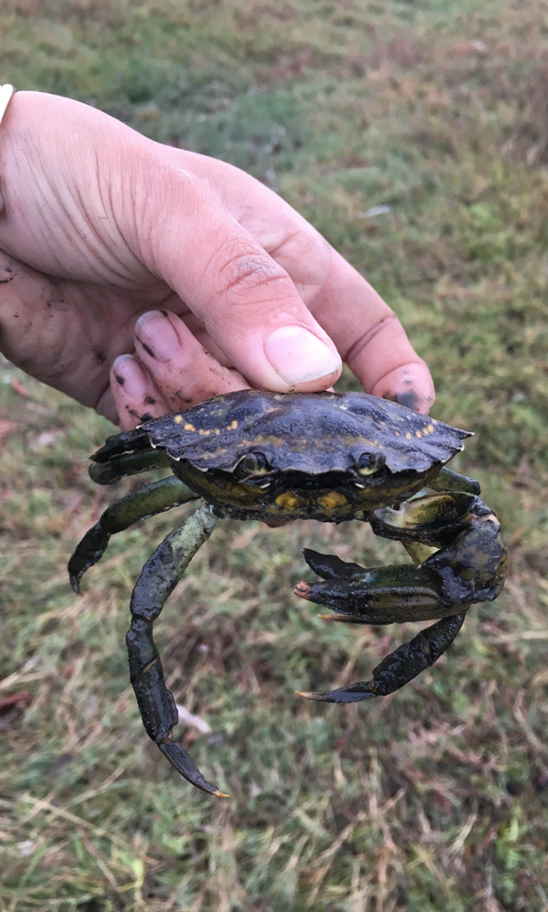
Why do we care?
Can change any ecosystem where they become established.
Threat to our native Dungeness crab.
Threat to shellfish industry
  Prey on bivalves and other crustaceans (clams, oysters, mussels, small crustaceans).
Compete with native fish and shore birds for food.

Slide 8
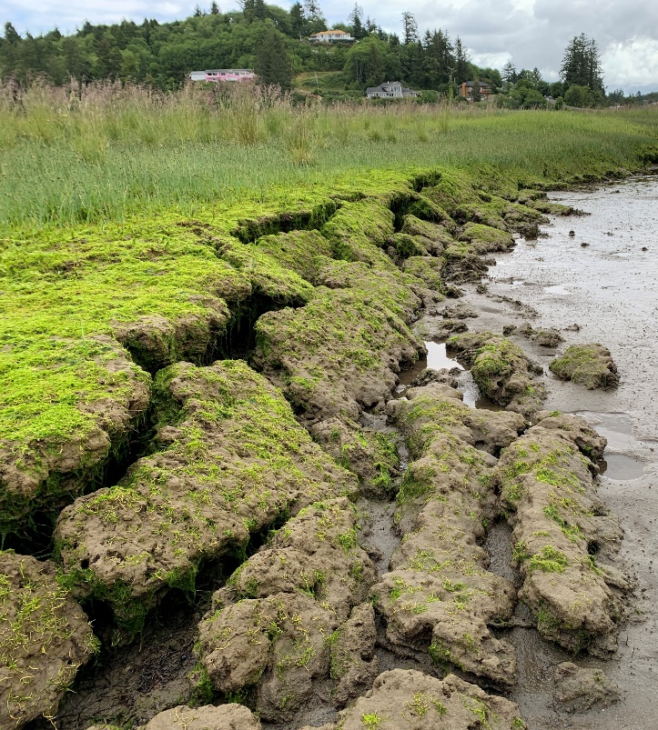
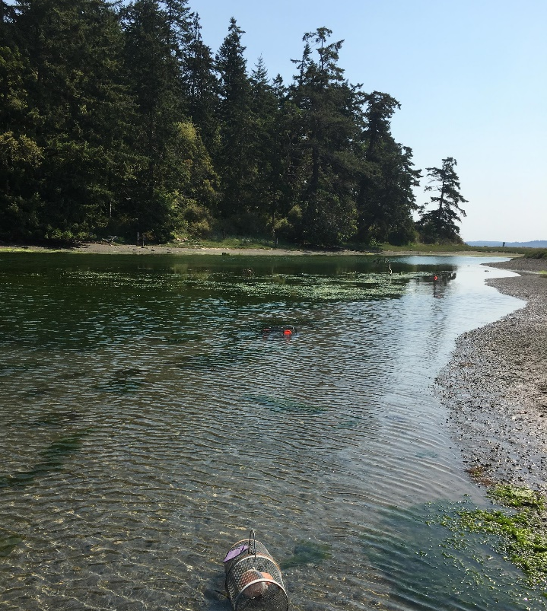
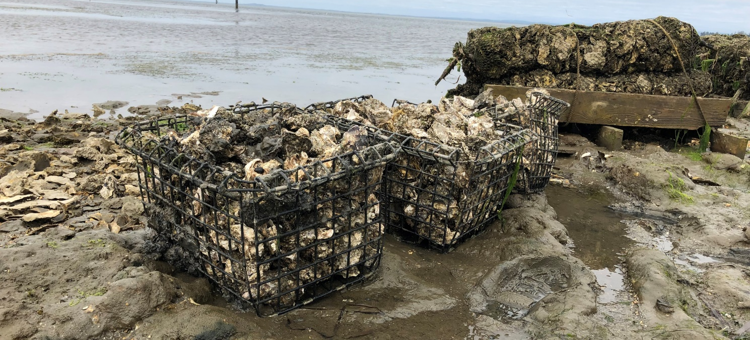
Habitat – where European green crabs can live
Habitat
    Protected rocky shores
    Cobble beaches
    Sandflats
    Tidal marshes
    Pocket estuaries
Temperatures 0-33°C (32-92°F)
They have wide tolerances and can be found in areas you wouldn’t expect to see them.
Notes:
Habitat
Green crab inhabited a wide range of habitats in shallow (typically less than 25 ft of water) sheltered areas including rocky intertidal, estuaries, mudflats, intertidal zones, and beaches.
They are generally found closer to some sort of cover or structure. This can be vegetation, shellfish beds, human structures.
Given their tolerance of lower salinities, EGC can be found near freshwater inputs like at the mouths of rivers
Juveniles have often been caught in seagrass beds, Juvenile green crab also utilized rocks, shell hash and other cover in the intertidal zone
Tolerances
Salinity: 4-54 parts per thousand
Temperature: 0-33 C (32-91.4 F)

Slide 9
European green crabs
Lesson 1
Anchoring Phenomena
Part 2 Mapping European green crabs and Emergency Order

Slide 10
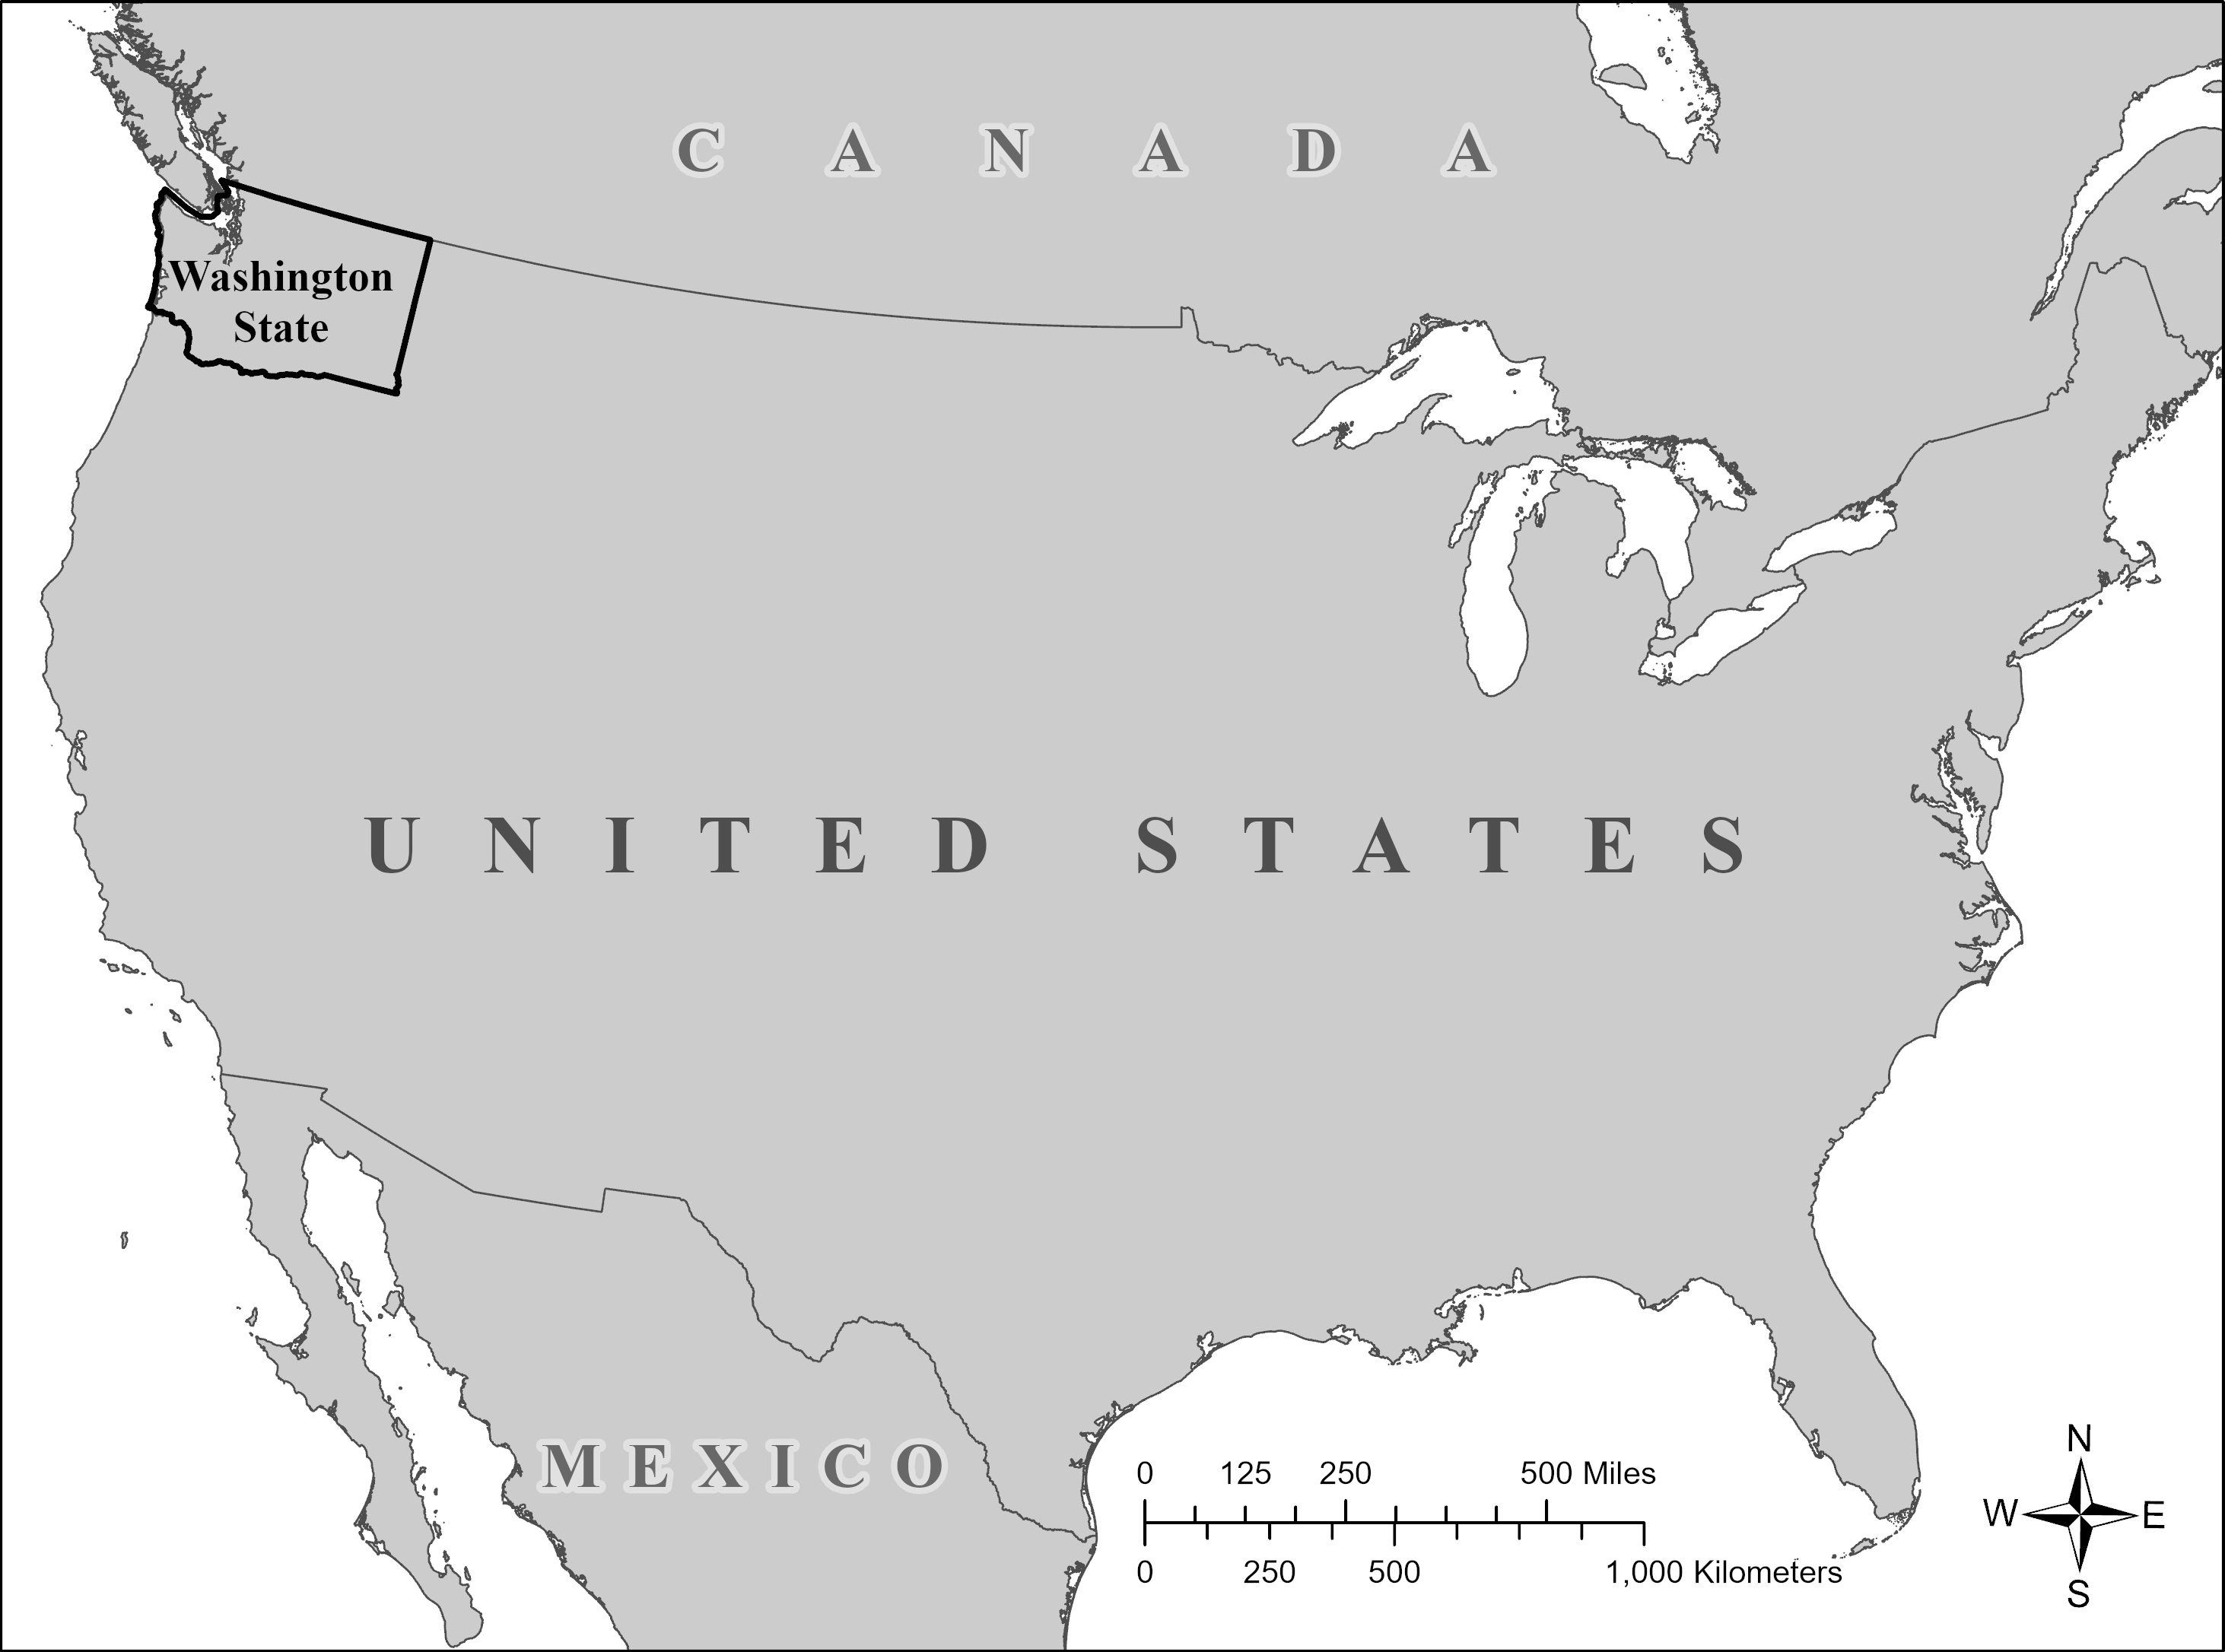
A
Notes:
Help orient students to the area of Washington state that we are discussing by zooming in from a map of the US to a map of Washington, and finally to the map of the coastal areas.

Slide 11
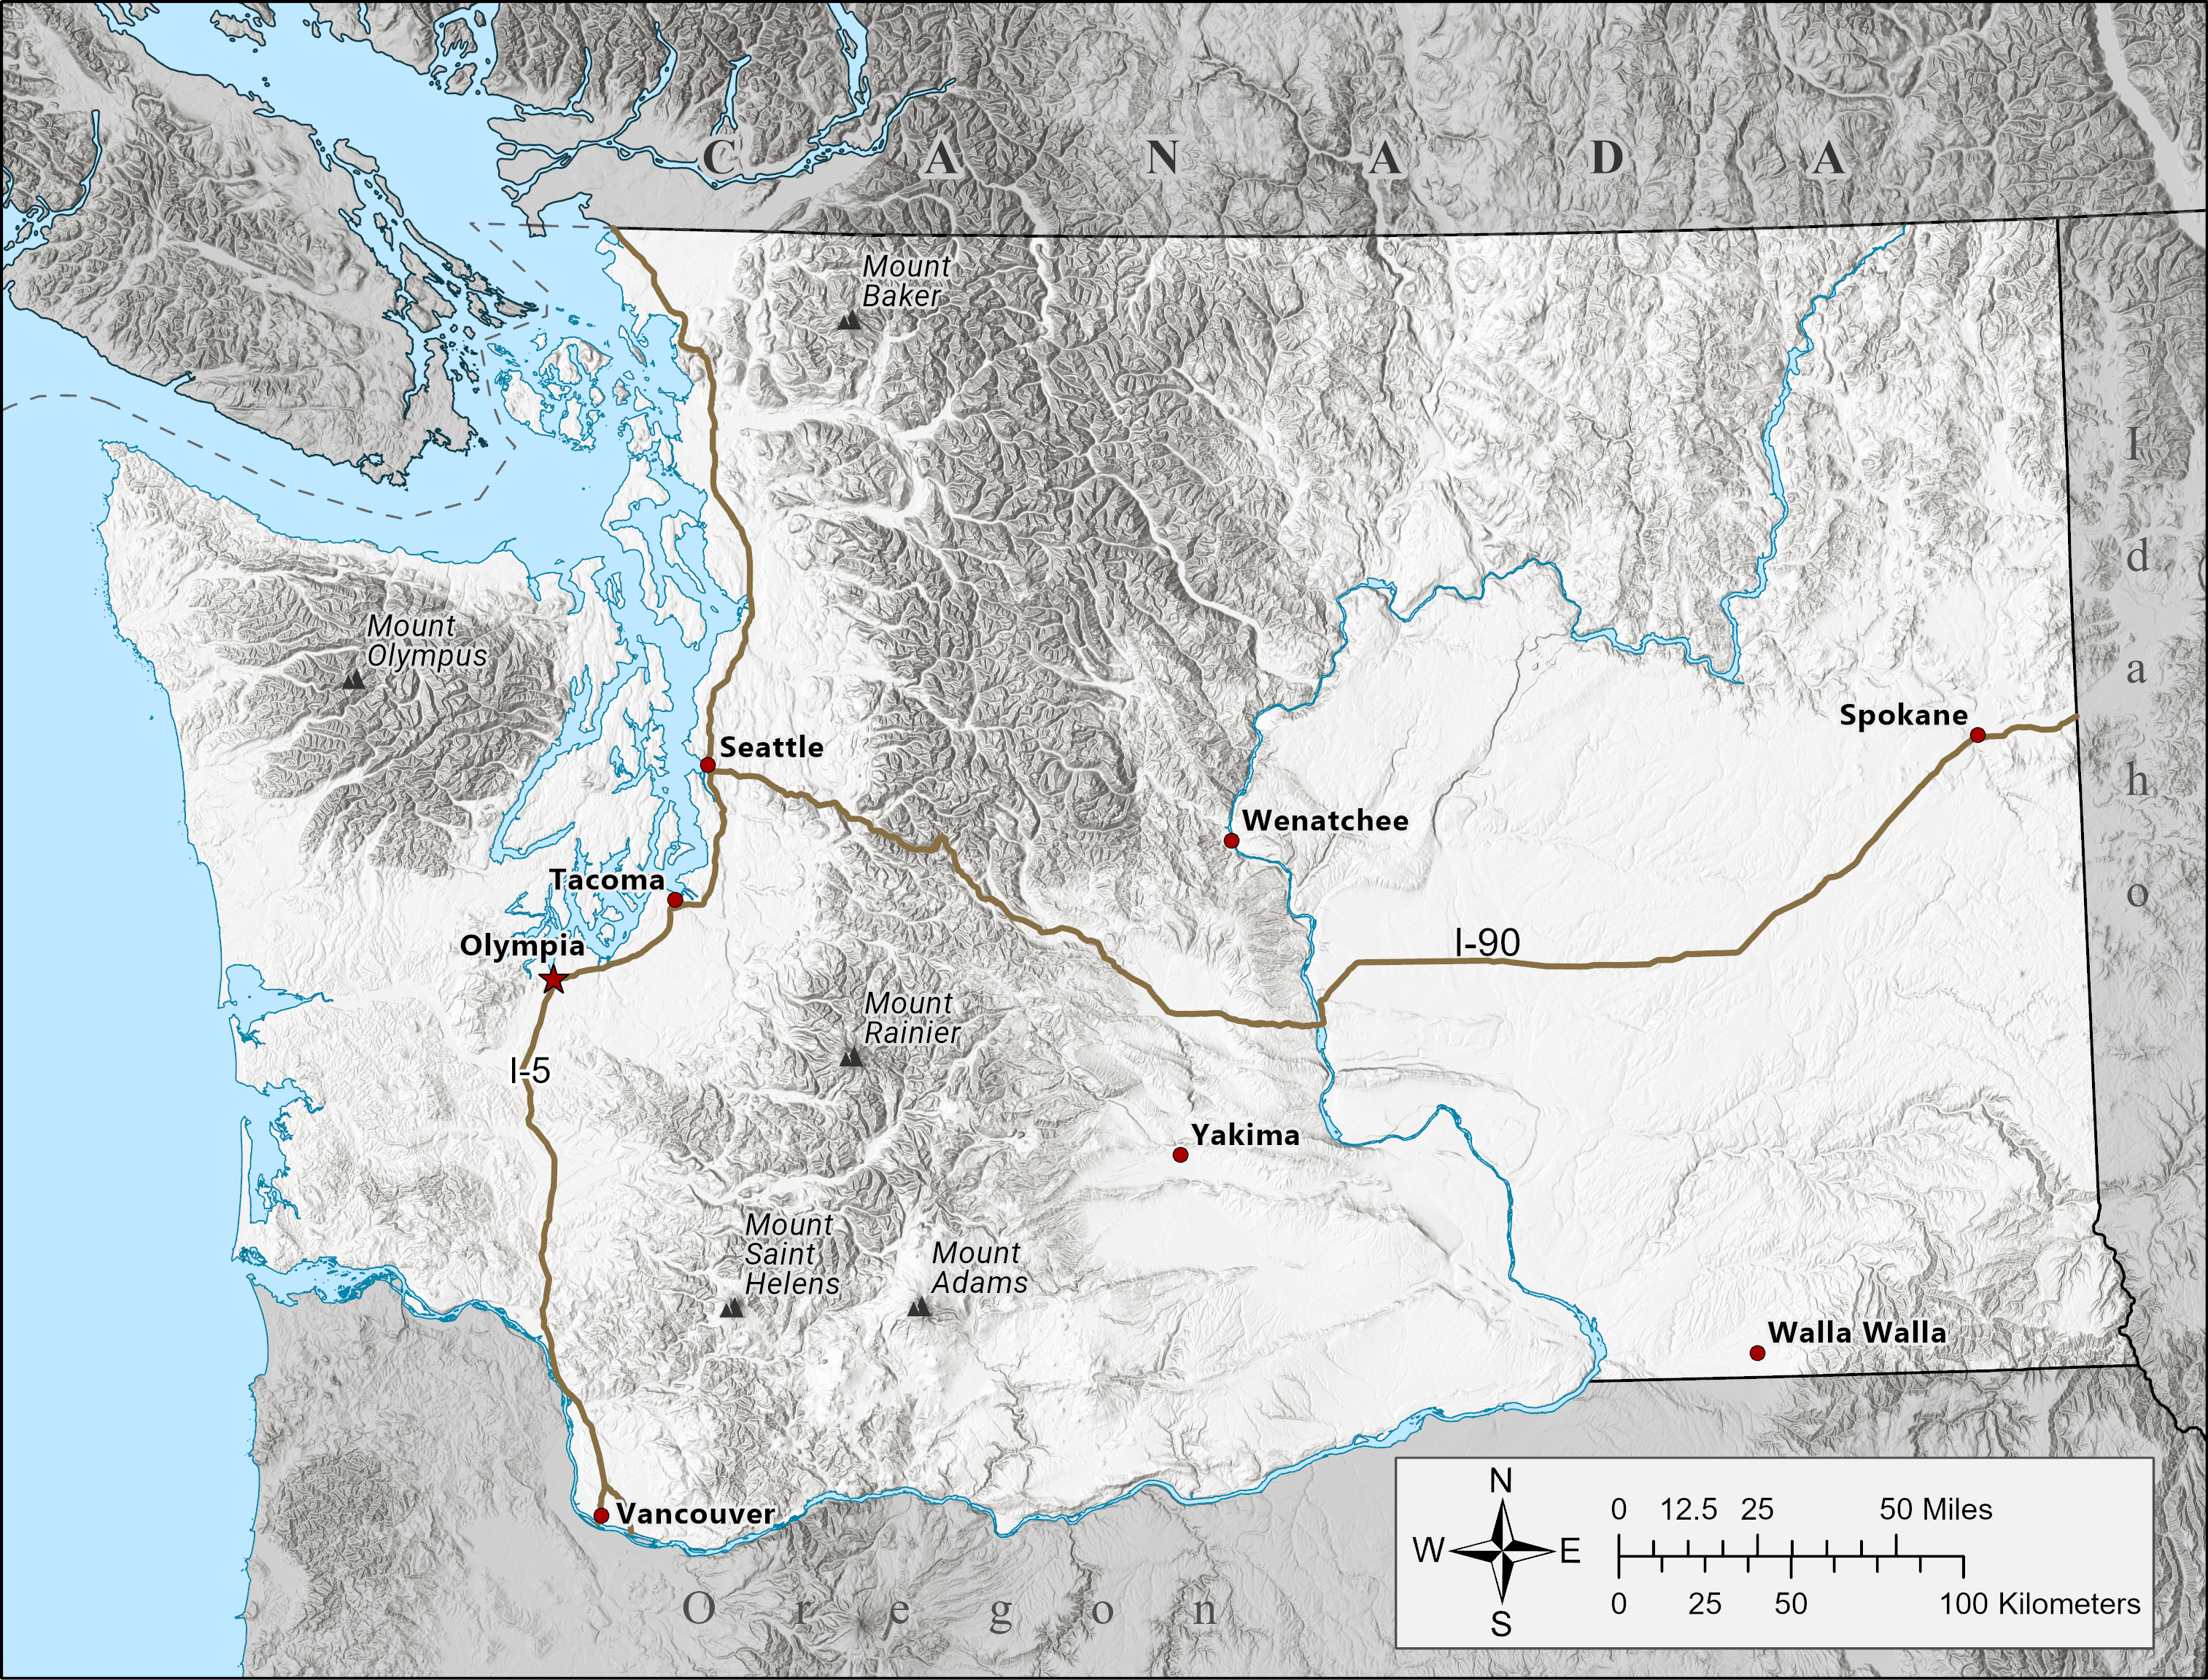

Slide 12
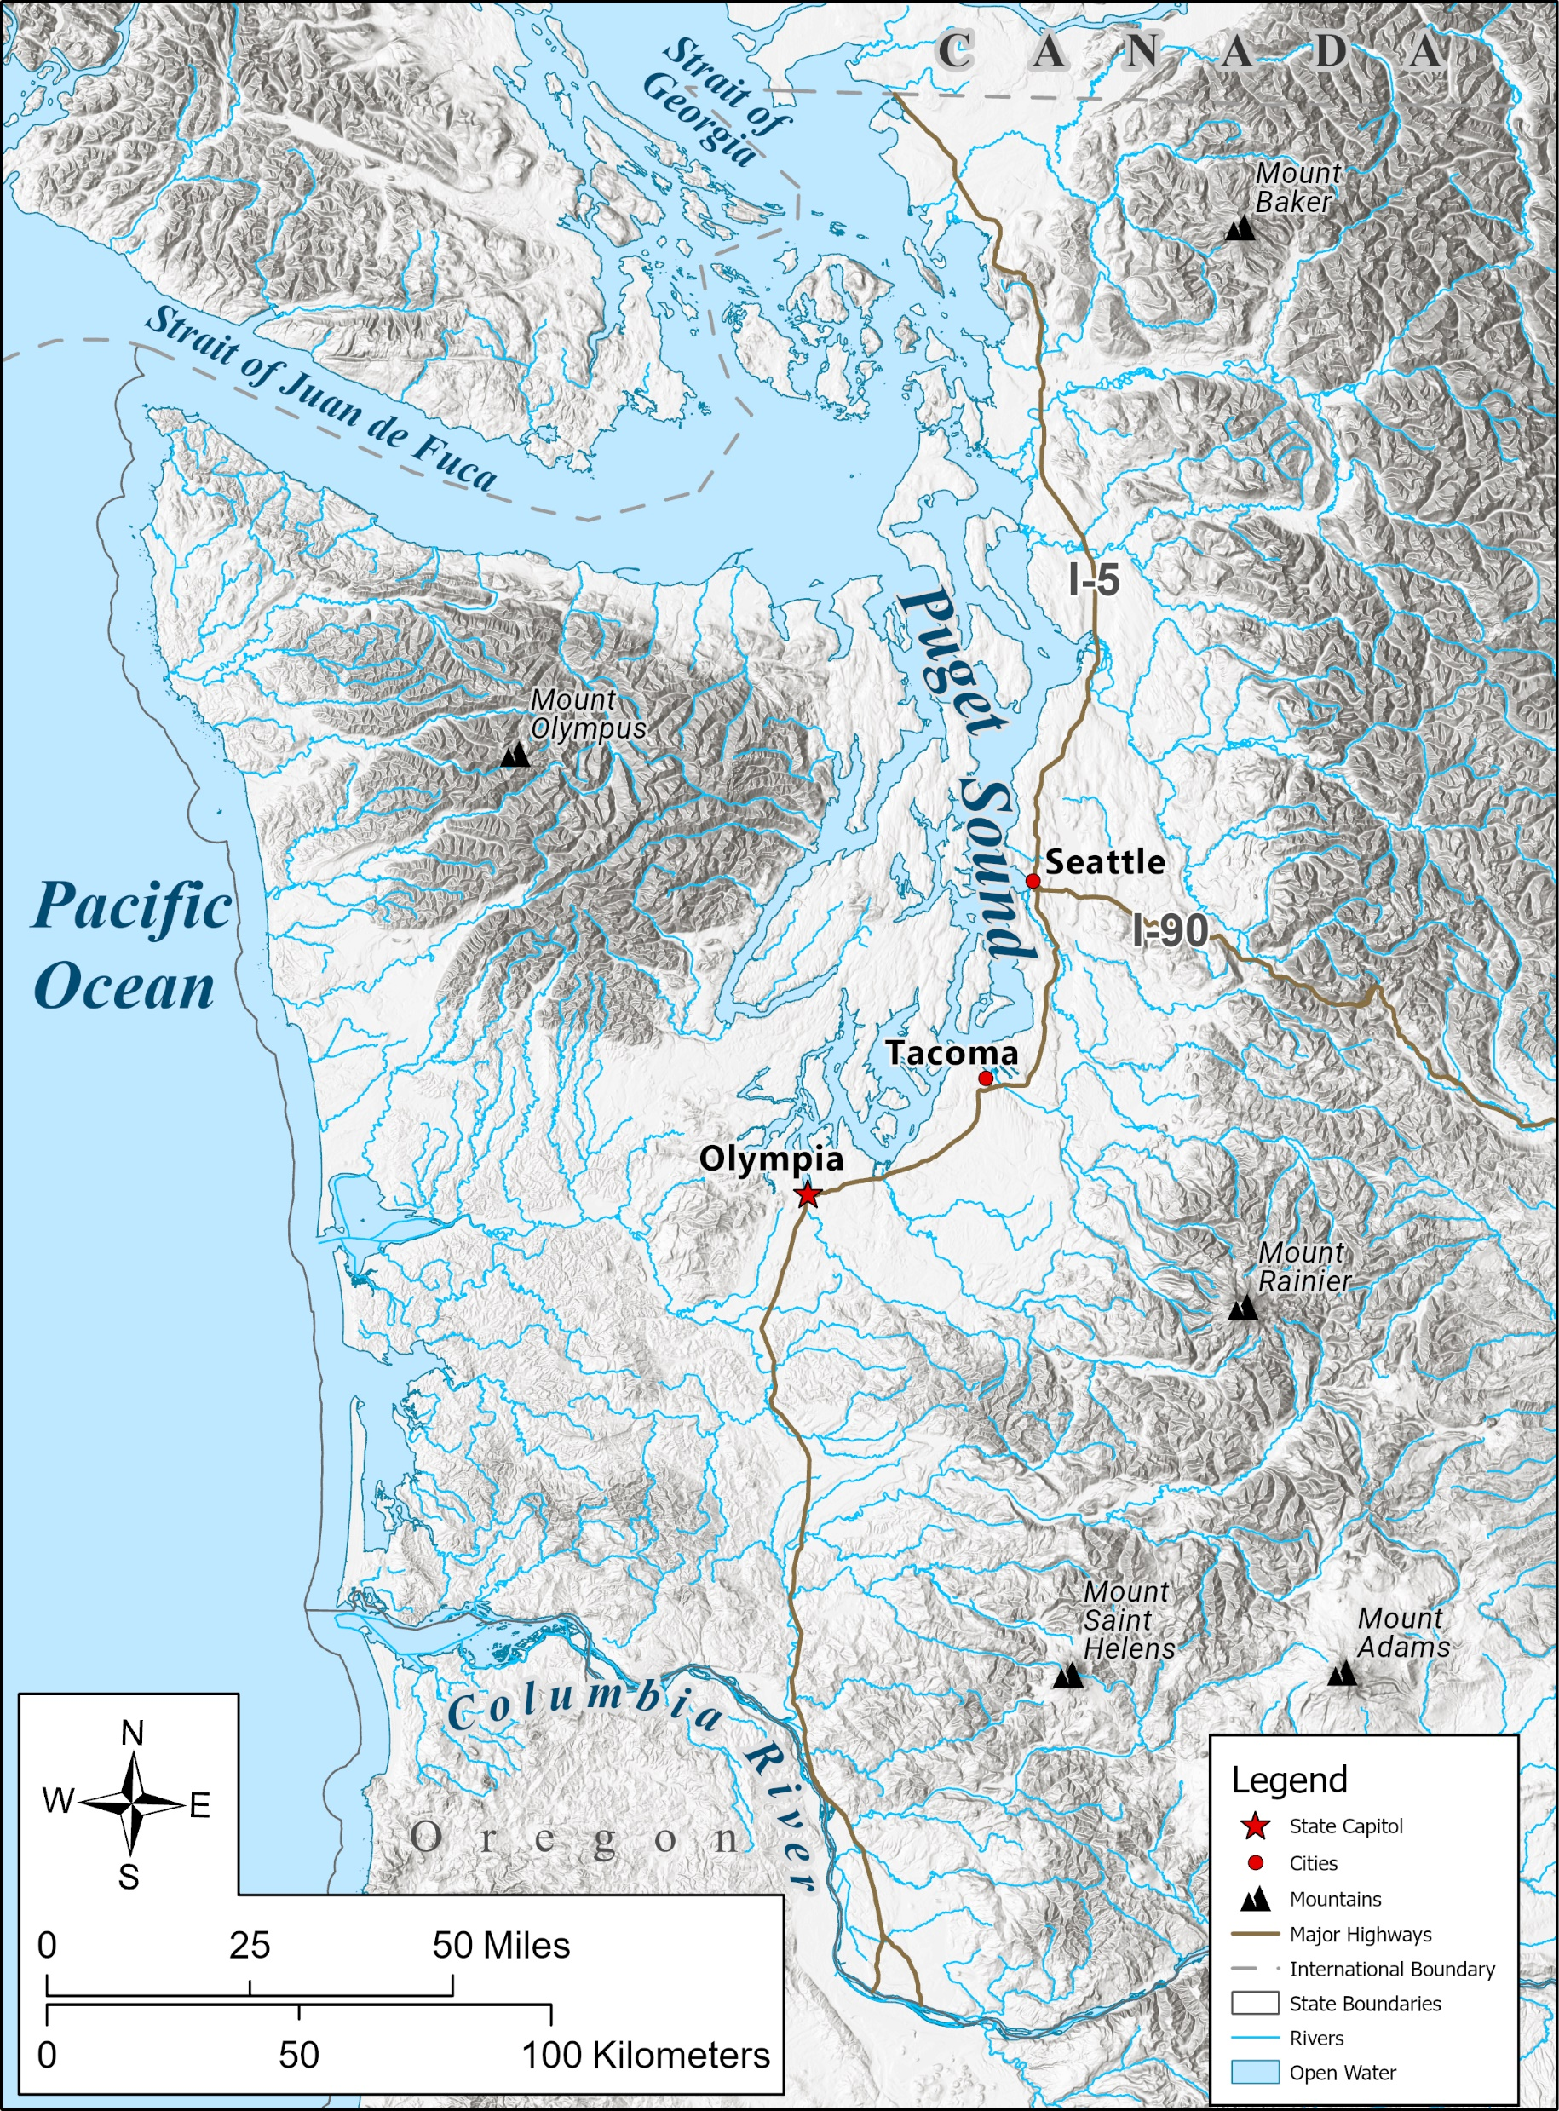

Slide 13

Notes:
Governor Jay Inslee issued an emergency order to increase the state’s response to a concerning increase in European green crabs in some areas of Washington state. These areas include Makah Bay, Grays Harbor, Willapa Bay, and the Lummi Nation’s Sea Pond near Bellingham.

Slide 14
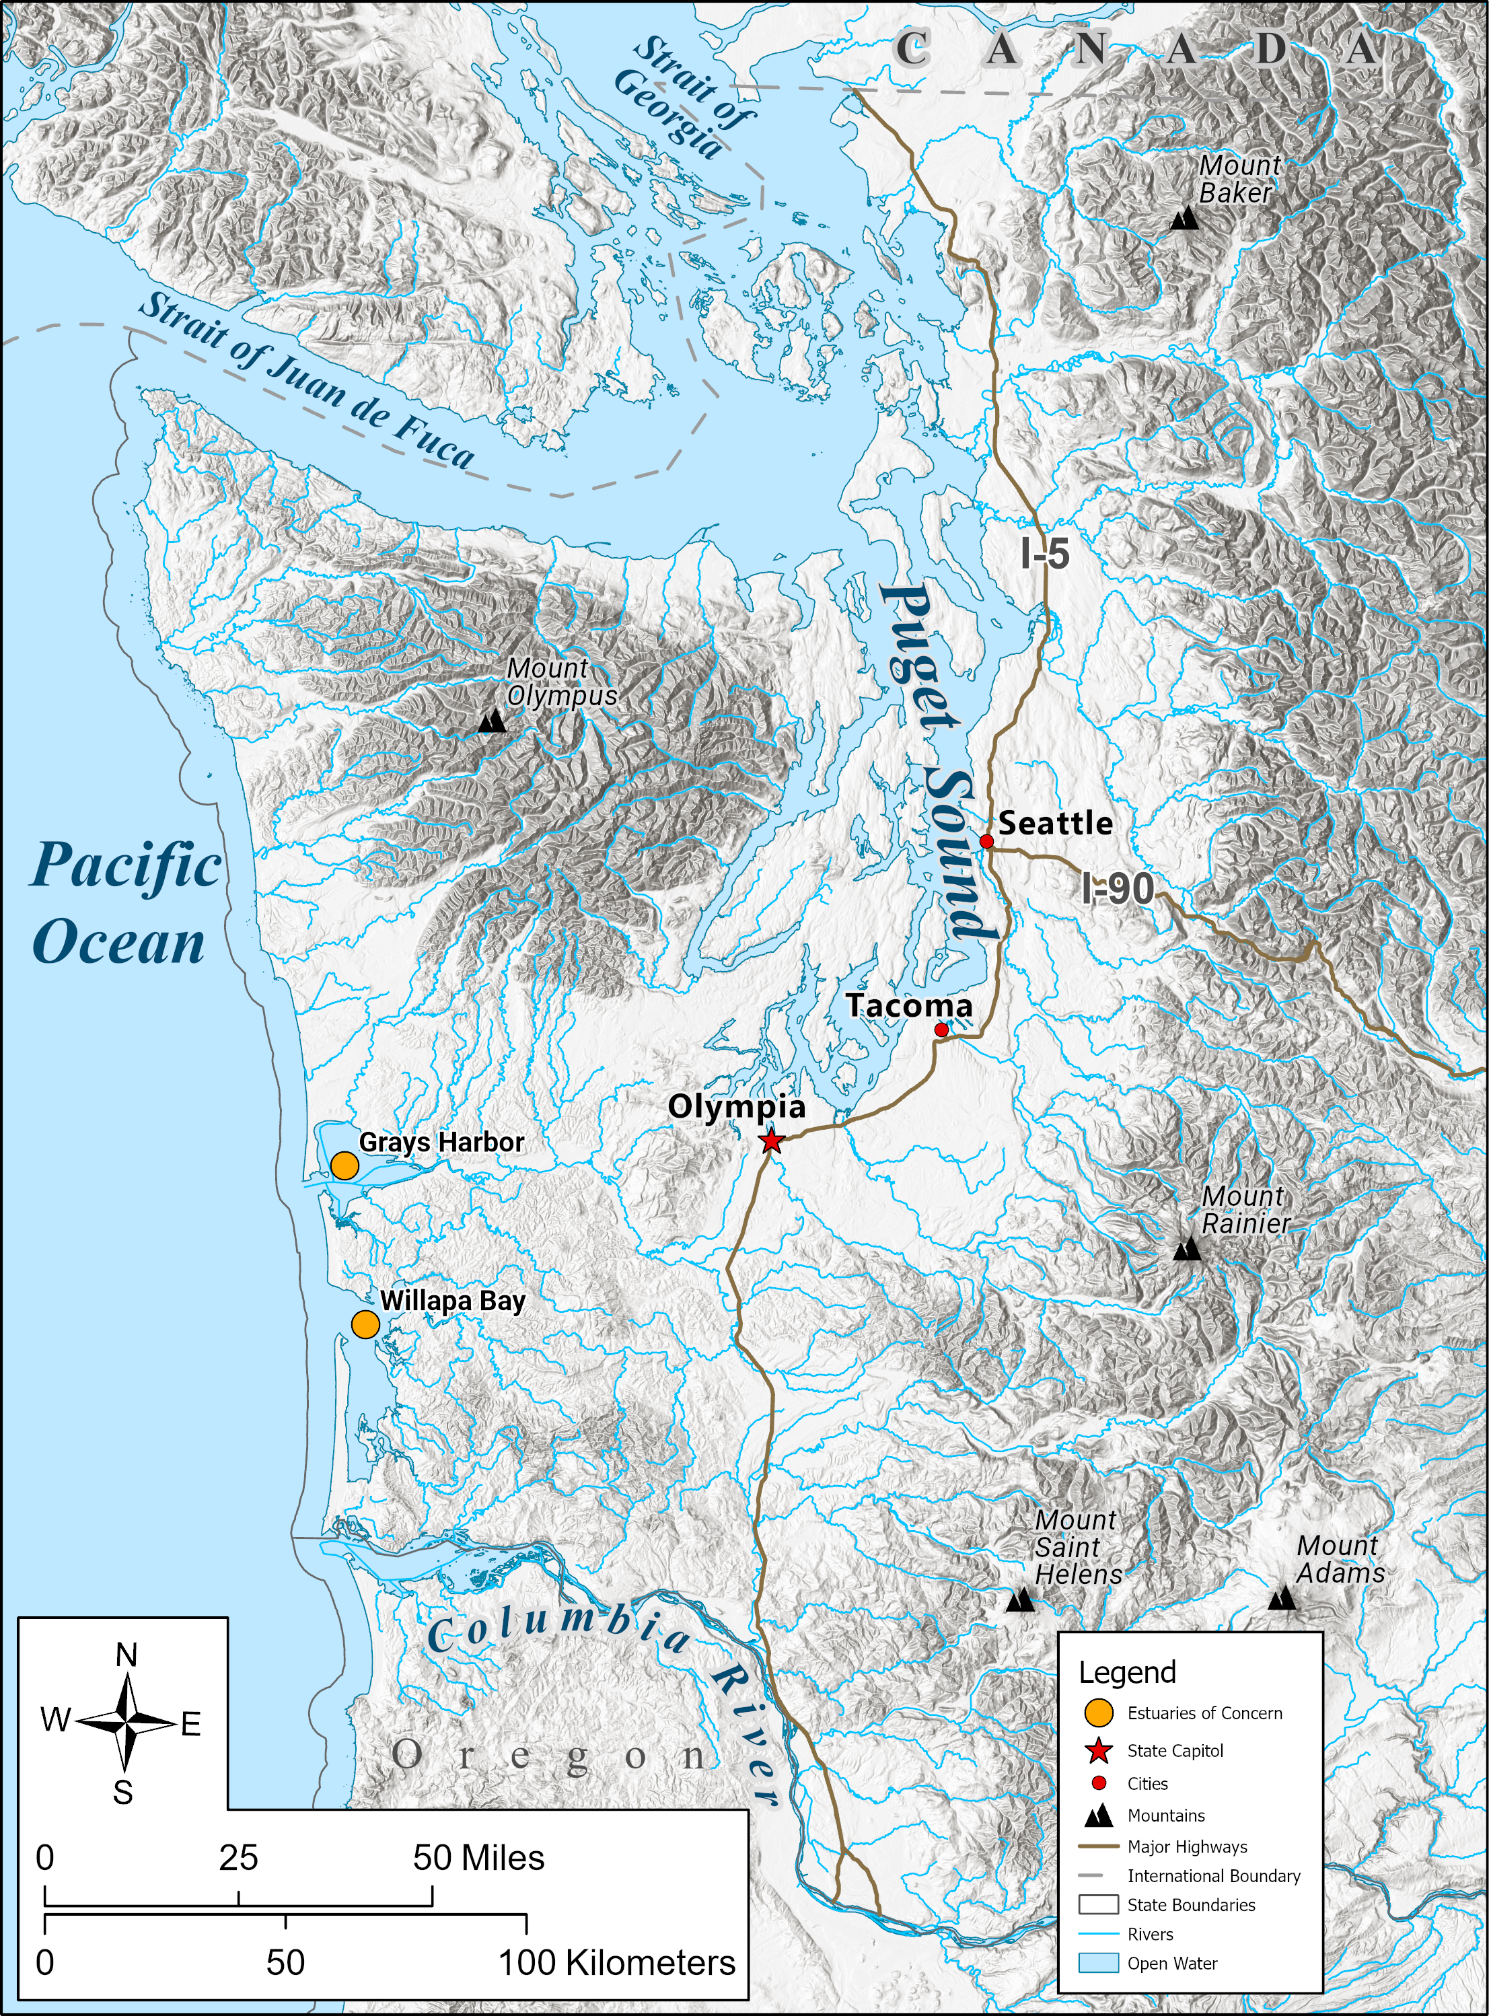
Notes:
According to the Washington Department of Fish and Wildlife, European green crabs were first found in Washington in 1998. They were found in Willapa Bay and Grays Harbor.

Slide 15
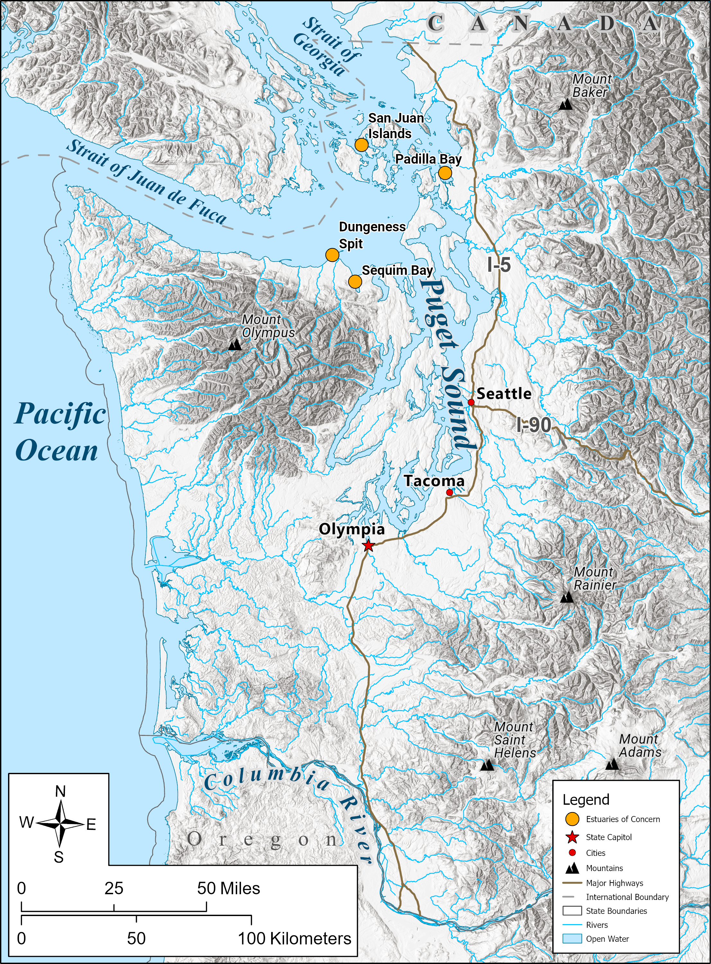
Notes:
Since 2016, green crabs have been found in Padilla Bay, Sequim Bay, Dungeness Spit, and the San Juan Islands.

Slide 16
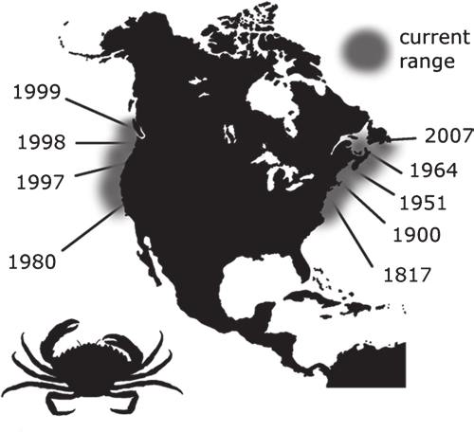
European green crab movement
European green crab distribution extent (Jeff Adams WSG)
Notes:
The dates listed above were when they were detected in these locations.

Slide 17
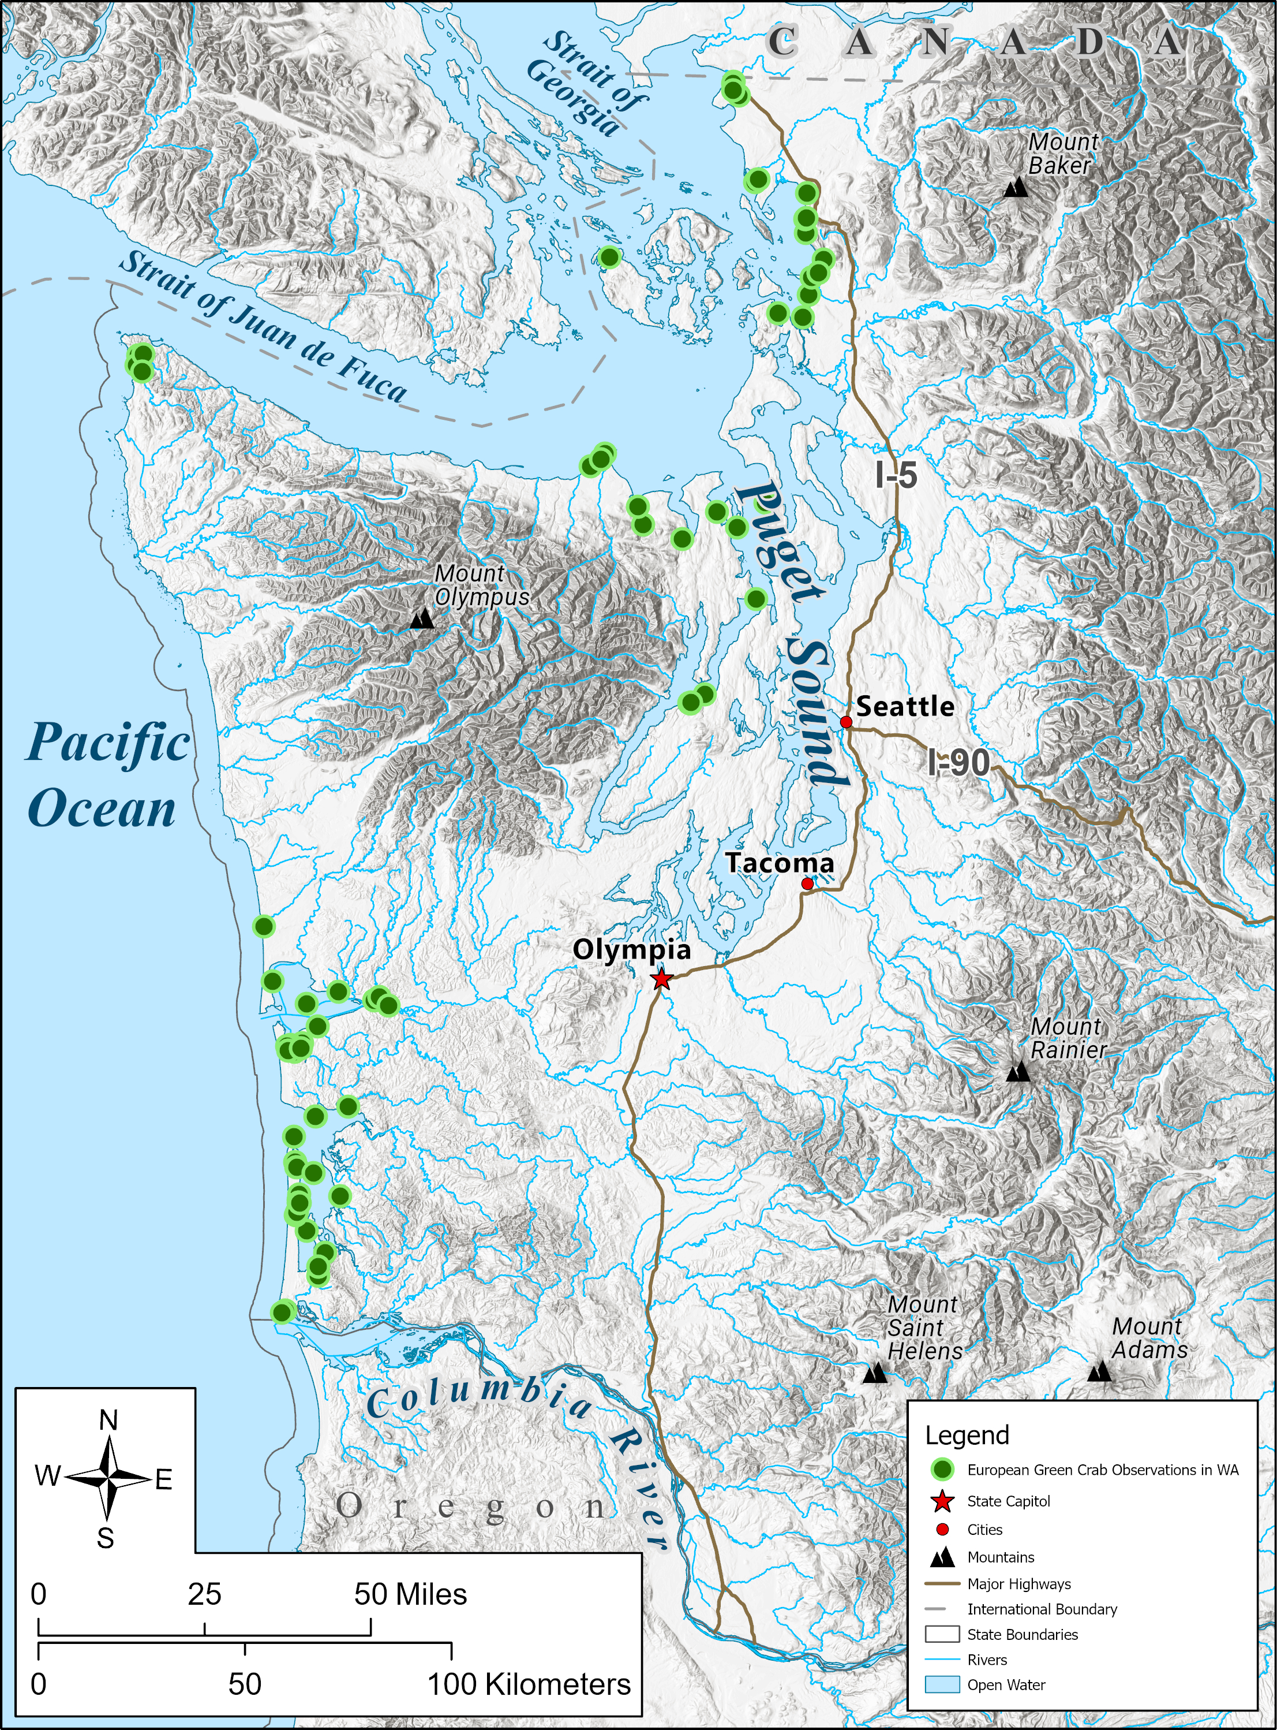
Notes:
This map shows the locations of European green crabs from their first siting in 1998 to 2023. For the most recent information on where European green crabs have been located see the European green crab hub at WDFW EGC Hub (arcgis.com)

Slide 18
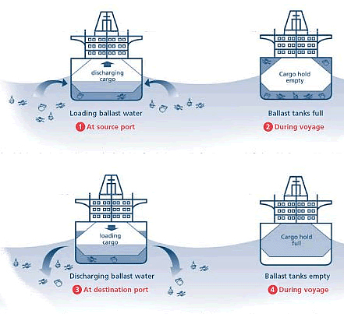
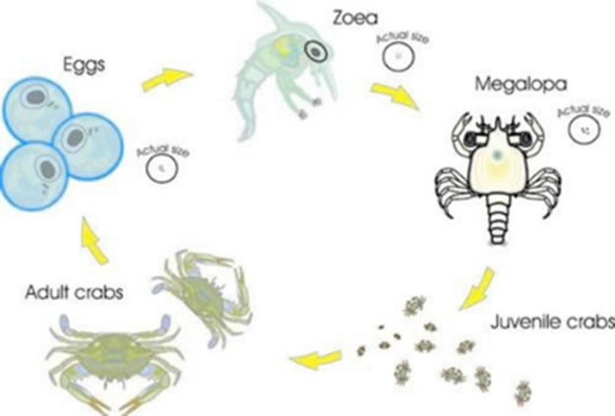
How did they get here?
Not 100% known.
  Most likely arrived via ballast water to the US.
Northward distribution from CA also unknown
  Likely from ocean currents moving the juvenile crab larva.
Ballast water – hitch-hiking invasive species. Source: http://globallast.imo.org/
European green crab life cycle
Notes:
Ocean currents carry zoea and megalopa stages of crabs.

Slide 19
European green crabs
Lesson 2
Part 1: What is an estuary?
Who lives in an estuary?
Notes:
Have students create T-chart in their notebooks or on a blank sheet of paper, with the heading “What is an Estuary” at the top, and the subheadings “Living” and “Nonliving” on either side of the vertical line. Have students take notes while watching the video.

Slide 20
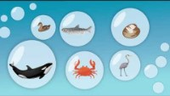
Notes:
https://www.youtube.com/watch?v=NKh8Lc31rm8

Slide 21
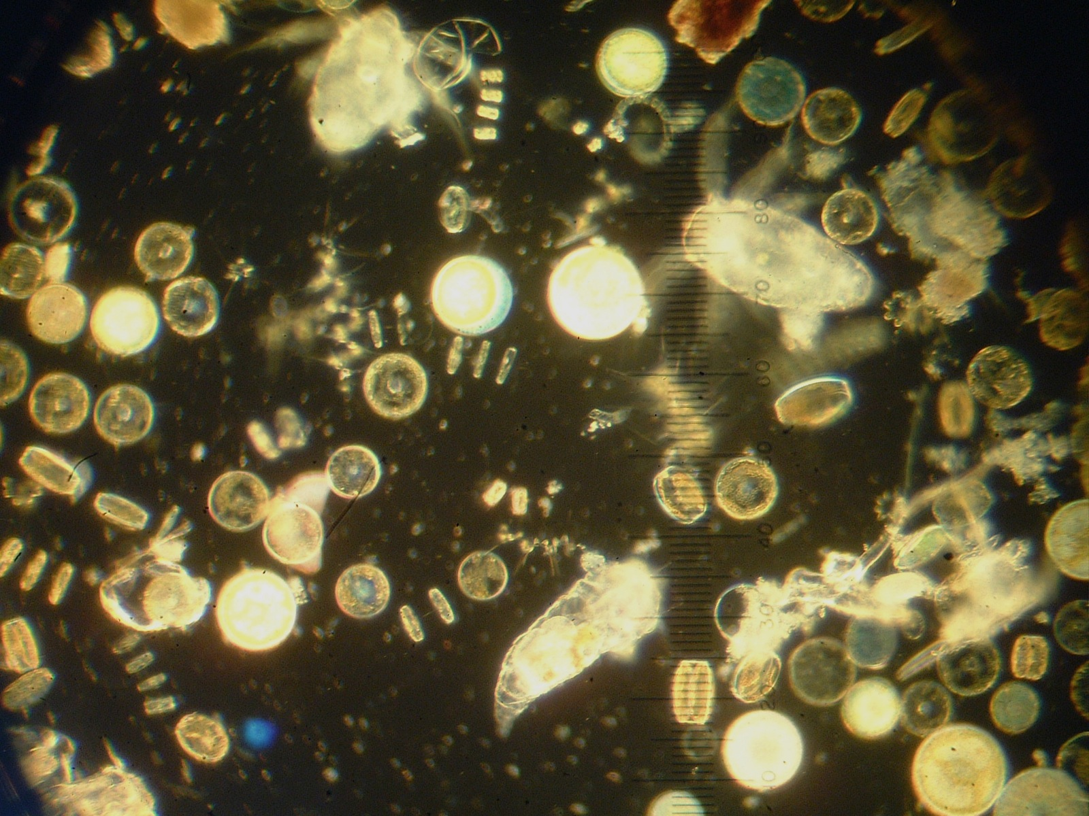
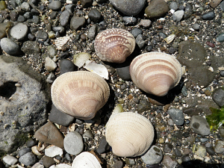

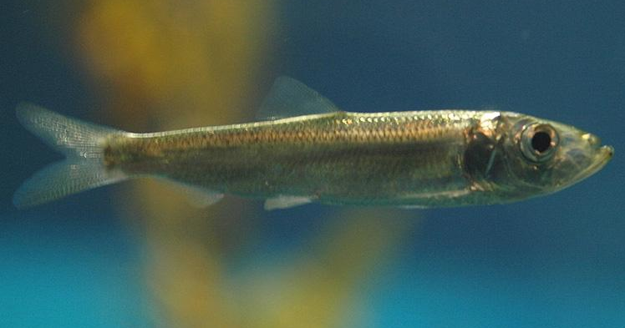
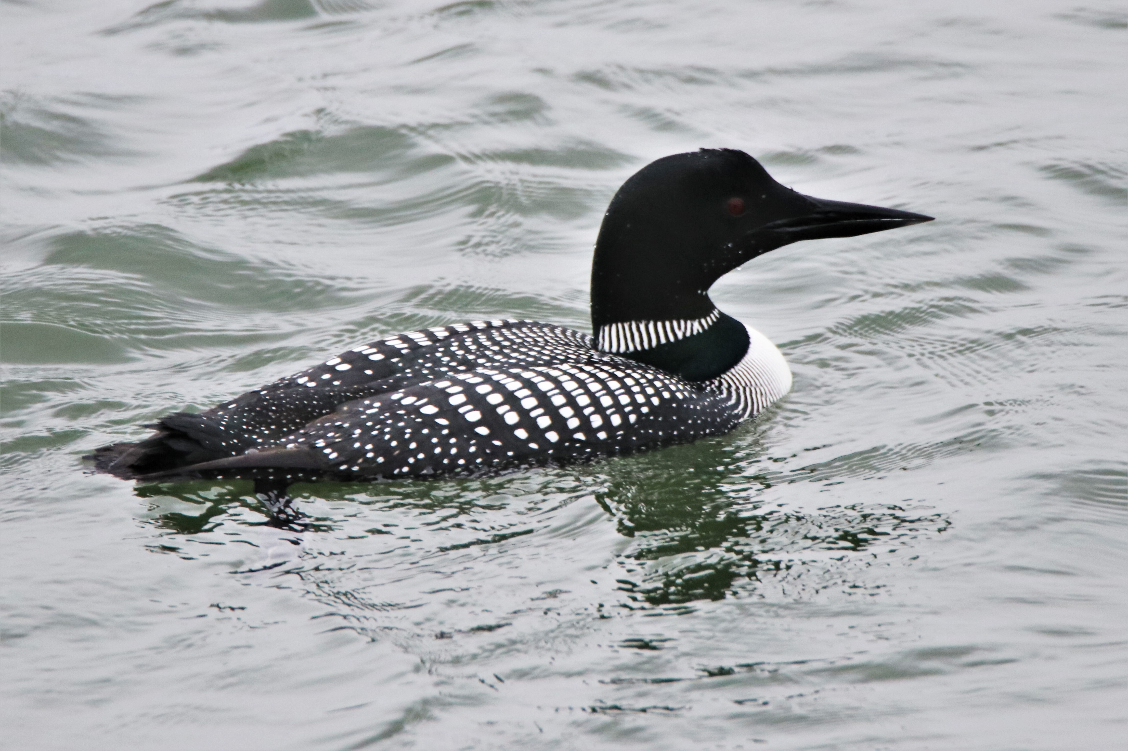
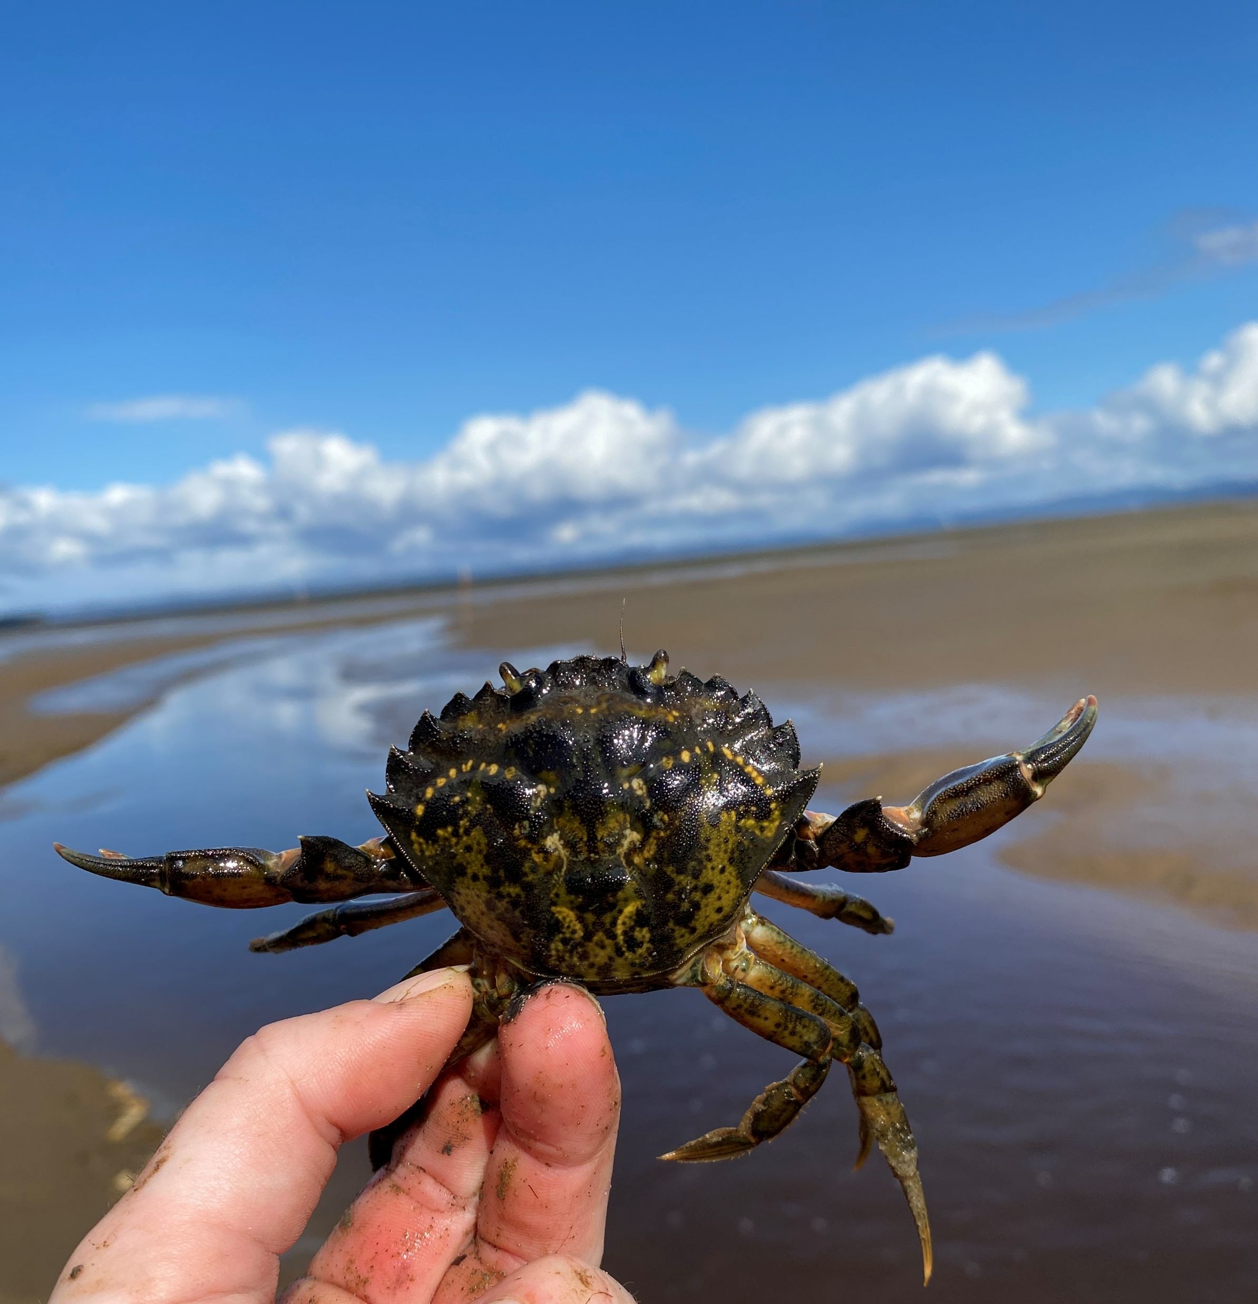
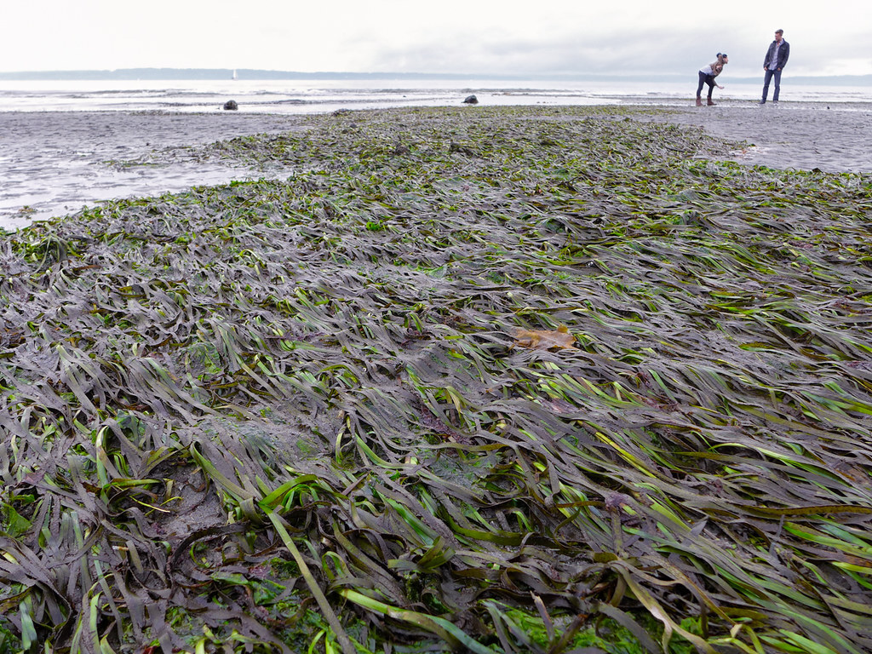
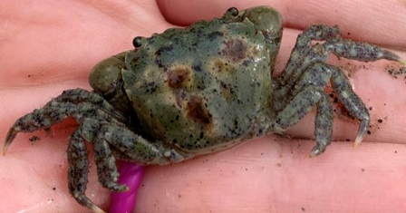
Photo by willapalens
Photo by NOAA
Photo by Dale Richard
Photo by Ingrid Taylar

Slide 22
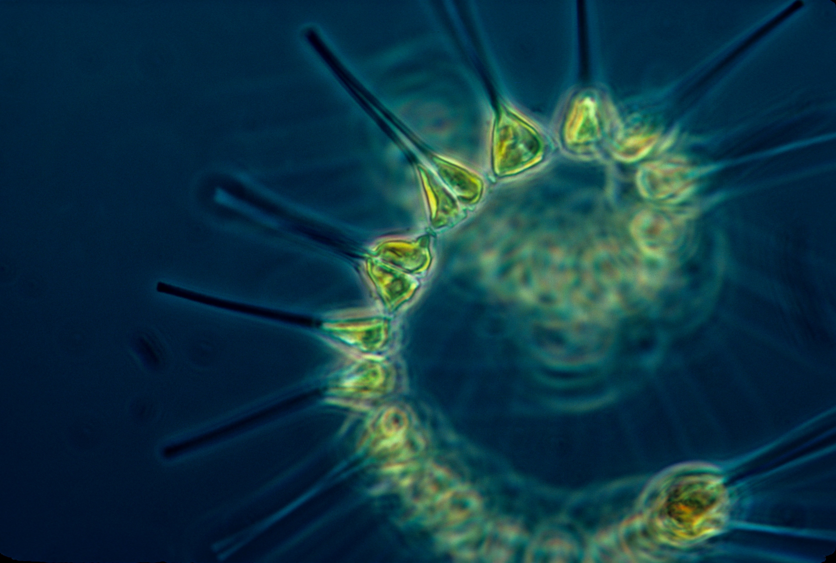
Phytoplankton
Plant-like microscopic organisms.
Eaten by:
  Littleneck clams
  Hairy shore crabs
  European green crab zoea (the form of crabs right after they hatch)
Photo by NOAA

Slide 23
Eelgrass
Plant
Eaten by:
  European green crabs
Photo by Ingrid Taylar

Slide 24
Littleneck clams
Eat:
  Phytoplankton
Eaten by:
  People
  European green crab zoea (the form of crabs right after they hatch)
Photo by WDFW

Slide 25
Pacific herring
Eat:
  Phytoplankton
  Hairy shore crabs
  European green crabs
Eaten by:
  Common loons
  Chinook salmon
  People
Photo by NOAA

Slide 26
Hairy shore crabs
Eat:
  Phytoplankton
Eaten by:
  Common loons
  Pacific herring
  European green crabs
Photo by WDFW

Slide 27
Common loon
Eat:
  Pacific herring
  Hairy shore crabs
  European green crabs
Photo by Dale Richard

Slide 28
People
Eat:
  Pacific herring
  Littleneck clams
  Chinook salmon
Photo by WDFW

Slide 29
European green crabs
Lesson 2
Part 2
Why are estuaries important?
Estuary Food Web

Slide 30
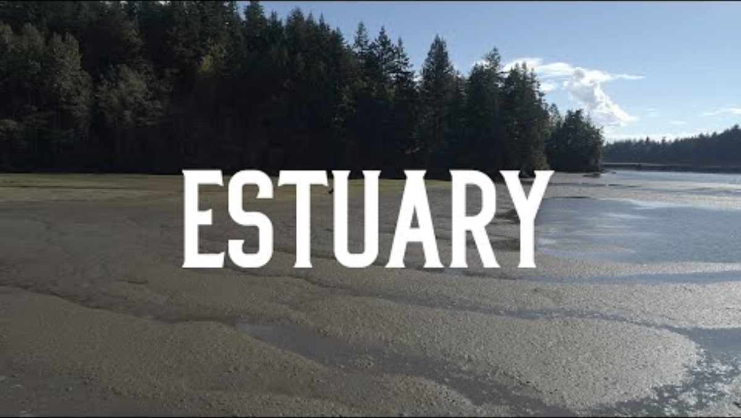

Slide 31
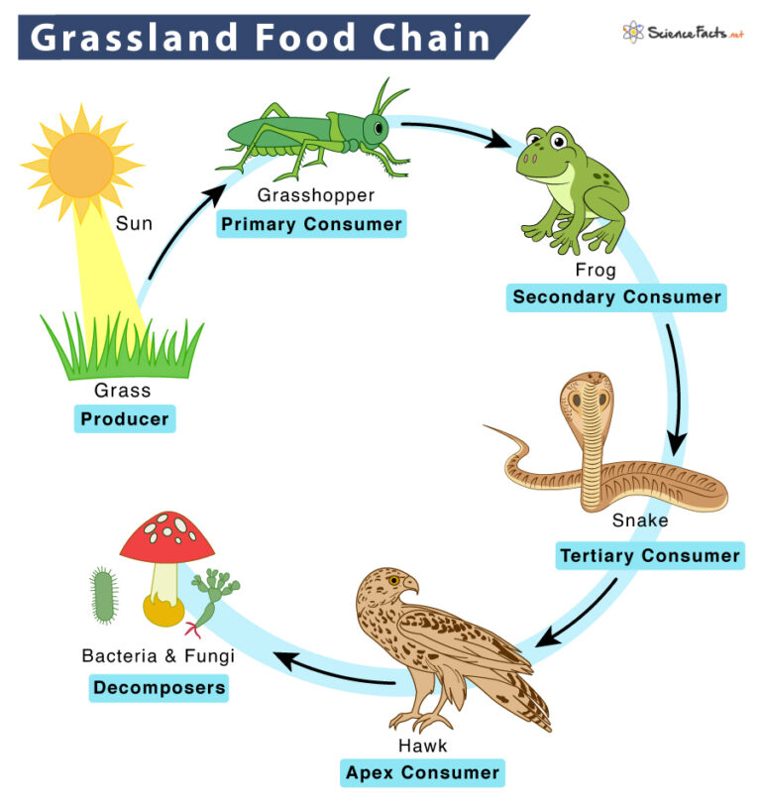
Example Food Chain
Notes:
Identify the trophic levels represented
Identify direction of energy in food chain
Optional to discuss nutrient cycling

Slide 32
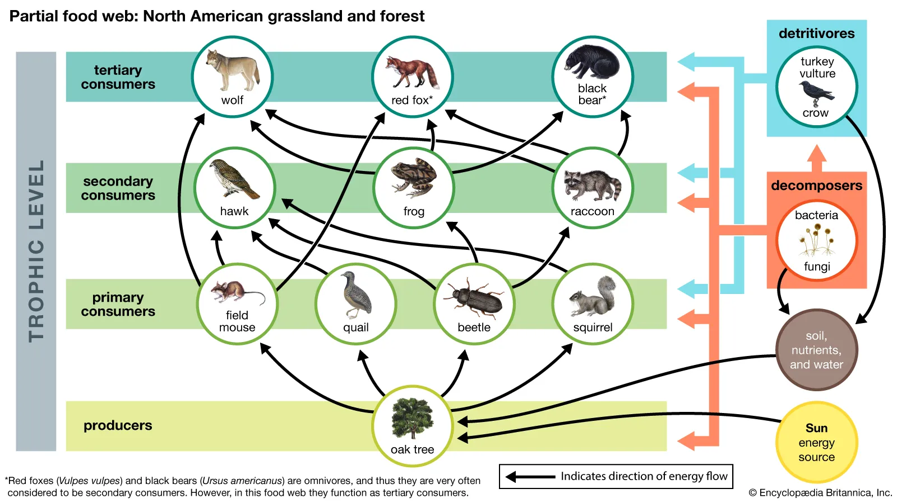
Example Food Web
Notes:
Identify trophic levels presented
Identify direction of energy flow
Discuss nutrient cycling
Identify some of the predator and prey species
Notice if some of the different trophic levels will actually feed on animals and plants a few levels lower. (example: black bears- as an omnivore will eat both berries, nuts and seeds (including acorns) and beetles and grubs.)

Slide 33
European green crabs
Lesson 2
Part 3
How could the introduction of European green crabs impact the estuary food web?

Slide 34
Adult European green crabs
Eat:
  Eelgrass
  Littleneck clams
  Hairy shore crabs
  European green crabs
  Phytoplankton
Eaten by:
  Common loons
  European green crabs
Photo by WDFW

Slide 35
European green crabs
Lesson 3
Part 1
Healthy Estuary Dynamics
Notes:
A female green crab can release nearly 200,000 eggs in one cycle.

Slide 36
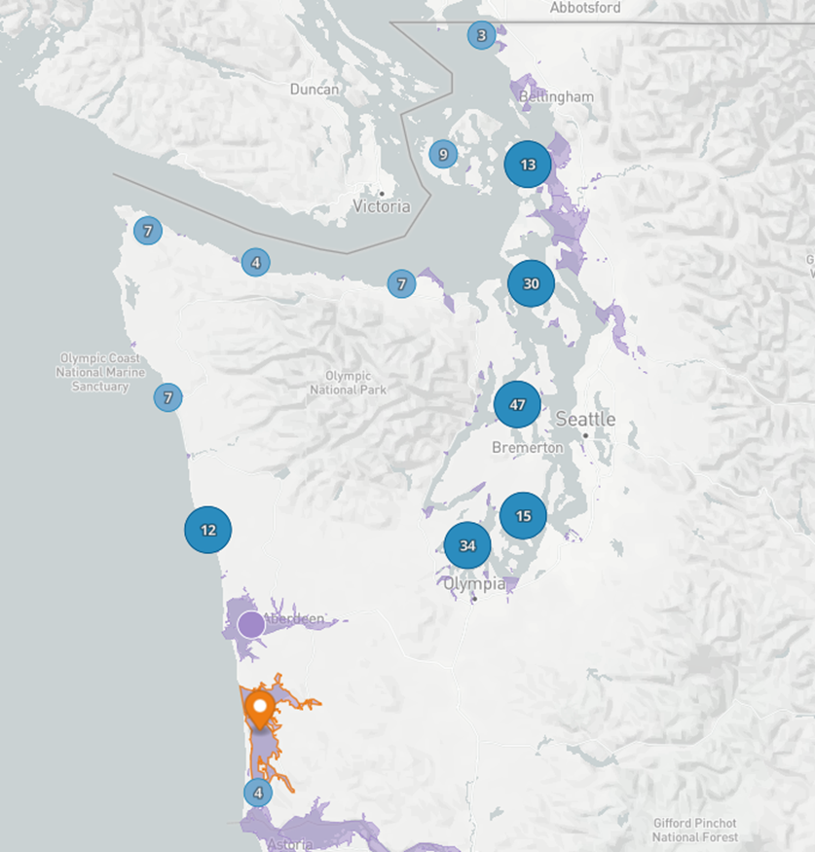
Estuary Survey Simulation:
Willapa Bay
Willapa Bay Estuary
Does not represent actual survey sites used by WDFW

Slide 37
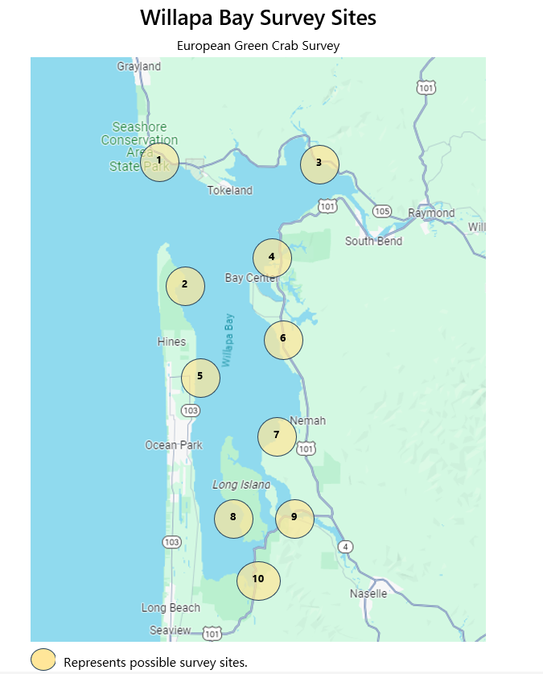
Estuary Survey Simulation:
Willapa Bay Survey Sites
Does not represent actual survey sites used by WDFW

Slide 38
European green crabs
Lesson 3
Part 3
Biodiversity
Notes:
A female green crab can release nearly 200,000 eggs in one cycle.

Slide 39
Biodiversity
The full range of life in all its forms. This includes the habitats in which life occurs, the ways that species and habitats interact with each other, and the physical environment and the processes necessary for those interactions

Slide 40
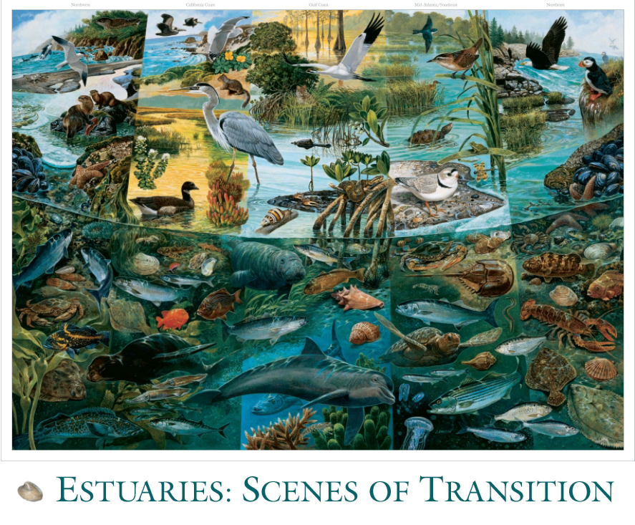
Estuary Biodiversity Challenge
How many different species can you find in this painting of an estuary?
Image from EPA Poster
Notes:
https://www.epa.gov/nep/exploring-estuaries-estuaries-scenes-transition-poster
This painting by John Dawson includes more than 100 different plants and animals that live in estuaries. It also shows several different types of estuaries—from the rocky shores of the Pacific Northwest to the warm beaches of the Gulf Coast.

Slide 41
Determining Biodiversity
Species Richness: the total number of species in an ecosystem.
  Richness does not take into account the number of individuals, or distribution of each species within the ecosystem.
  Based on the species in our survey simulation, what is the biodiversity richness of our simulated estuary over time?
  Compare the biodiversity richness
    At the beginning of our simulation
    At the end of our simulation
Notes:
Distribution tells us information about where individuals of a species are found. How could this be helpful for scientists to understand?

Slide 42
Determining Biodiversity
Simplified Biodiversity Index :
  A number value between 0-1 that represents how biologically diverse a given area is.
    Includes species richness
    Includes numbers of individuals
  Gives scientists a way to talk about and compare the biodiversity of different areas.
  Drawbacks: doesn’t include distribution of each species within the ecosystem.
    Distribution tells us information about where individuals of a species are found. How could this be helpful for scientists to understand?

Slide 43
Determining Biodiversity
Calculating Biodiversity Index
  The Simplified Diversity Index is a decimal number between 0 and 1. The closer the diversity index is to 1, the healthier and more diverse the habitat.
Data from beginning of survey and end of survey | Number of different animal species (# of species) | Total number of individuals of all species found (Total animals) | Simplified Biodiversity Index formula = # of species/total animals | Calculated Biodiversity Index
Beginning of survey
End of survey
Notes:
Did the estuary become more or less diverse over the course of our survey? Or did it stay the same?
How might scientists use this data to make decisions?

Slide 44
European green crabs
Lesson 4
Attack of the European green crab
Notes:
A female green crab can release nearly 200,000 eggs in one cycle.

Slide 45
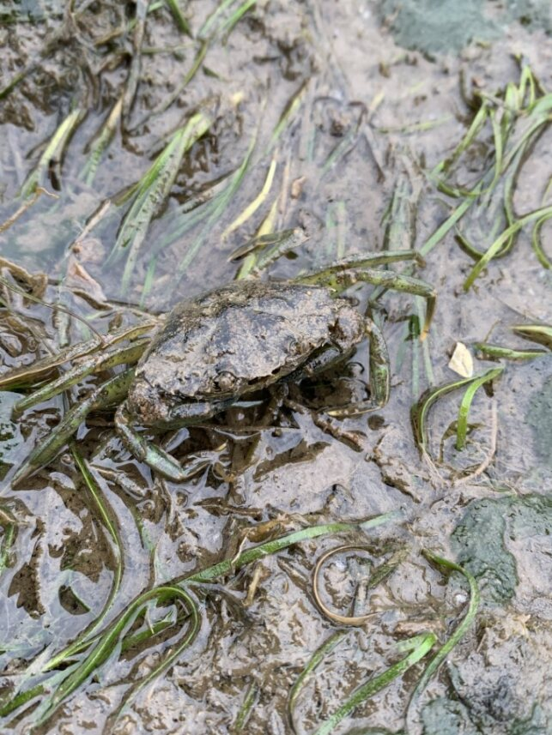
Large European green crab in Willapa Bay.

Slide 46
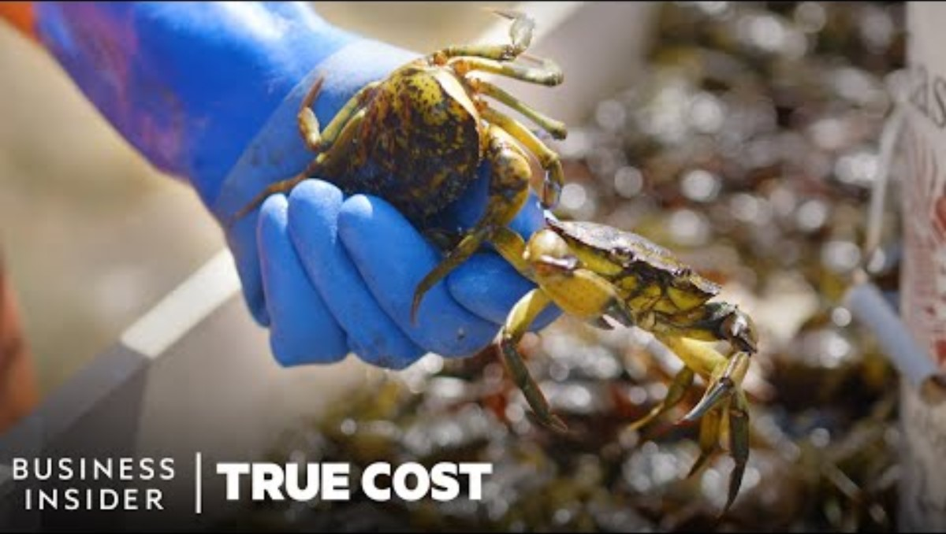
Notes:
Video should play from 3:05-4:44 . If you are interested in viewing the entire video, follow this link: True Cost of European Green Crabs Full Video

Slide 47
Determining Biodiversity
Calculating Biodiversity Index
  The Simplified Diversity Index is a decimal number between 0 and 1. The closer the diversity index is to 1, the healthier and more diverse the habitat.
Data from beginning of survey and end of survey | Number of different animal species (# of species) | Total number of individuals of all species found (Total animals) | Simplified Biodiversity Index formula = # of species/total animals | Calculated Biodiversity Index
Beginning of survey
End of survey
Notes:
Did the estuary become more or less diverse over the course of our survey? Or did it stay the same?
How might scientists use this data to make decisions?

Slide 48
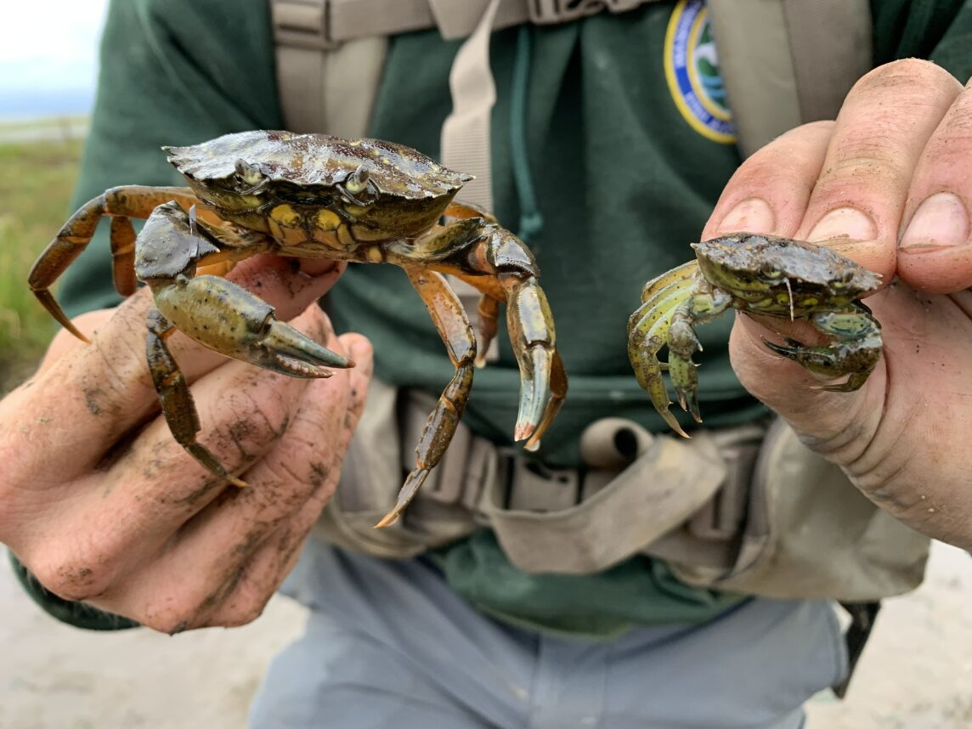
Two European green crabs from Willapa Bay.

Slide 49
European green crabs
Lesson 4 Part 5
The European green crab problem
Notes:
A female green crab can release nearly 200,000 eggs in one cycle.

Slide 50
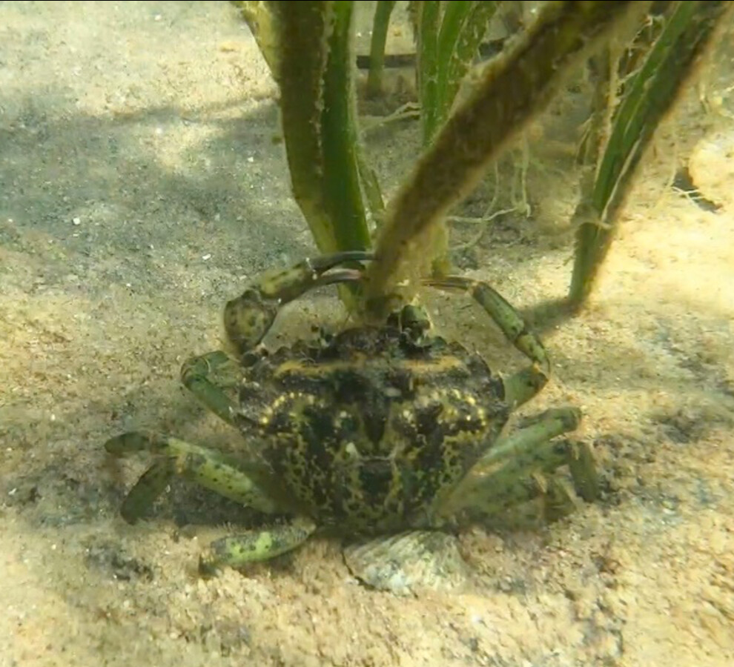
European green crabs can harm the environment
European green crabs (EGC) eat native clams, mussels, and other shellfish.
  They can even eat 40 small clams a day!
While digging for their next meal, green crabs can also destroy habitats that salmon and other species rely on, such as eelgrass beds.
Photo: Jack Dubinsky

Slide 51
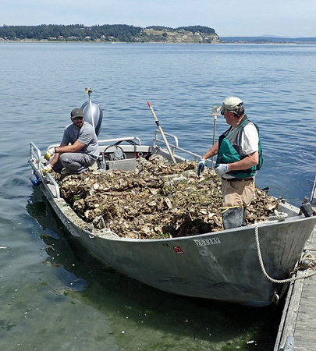
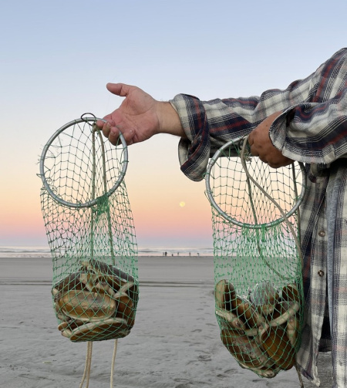
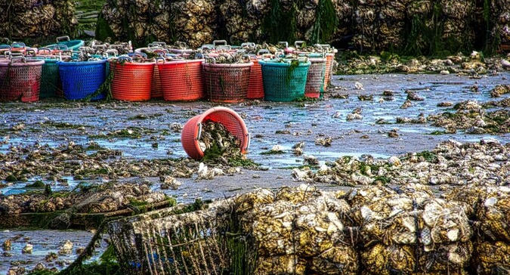
European green crabs can harm our economy
European green crabs have been blamed for collapse of Maine’s soft-shell clam industry.
EGC now threaten Washington shellfish farms and aquaculture industries.
Notes:
In the Pacific Northwest, the shellfish industry injects an estimated $270 million a year into the region's economy, bringing jobs to over 3,200 people, primarily in coastal communities. - Commercial Shellfish Aquaculture on the West Coast | NOAA Fisheries

Slide 52
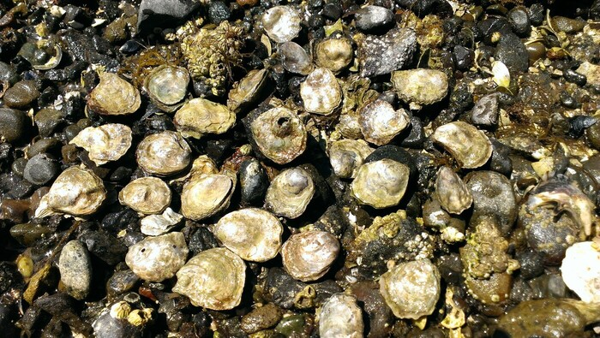
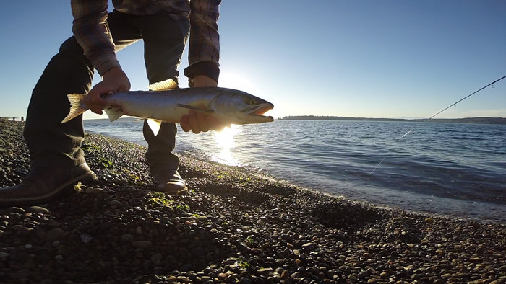
European green crabs can harm things that are important culturally
Native shellfish and fish are important culturally and as a food source to many Washingtons and tribal members.
If European green crabs made the populations of native shellfish and fish decline, it would be a great loss culturally and to many Washington tribes.

Slide 53
European green crabs
Lesson 5 Part 1
Invasive Species Management

Slide 54
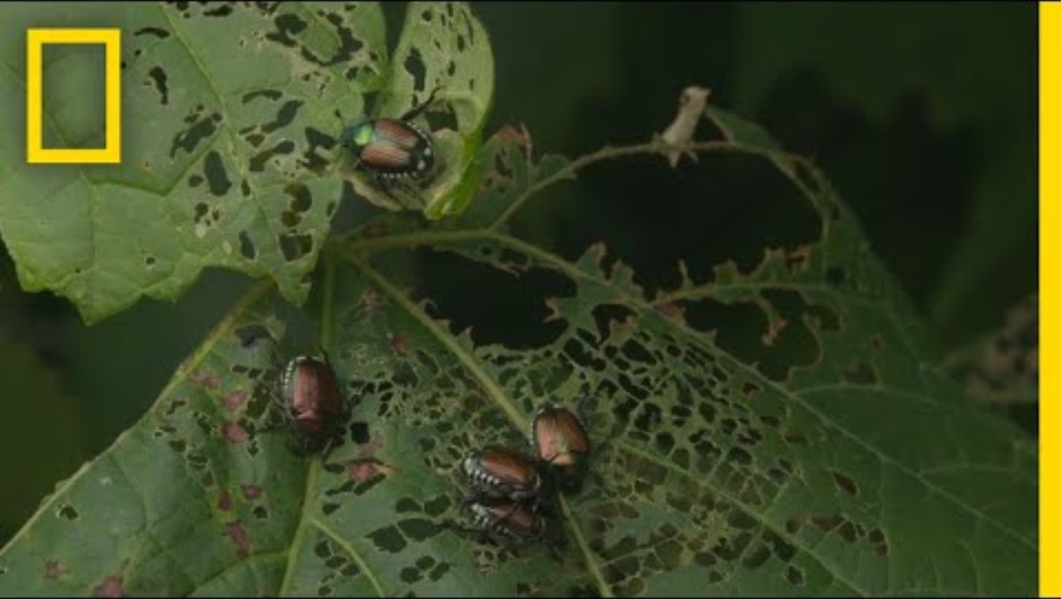
Notes:
https://youtu.be/gYNAtw1c7hI

Slide 55
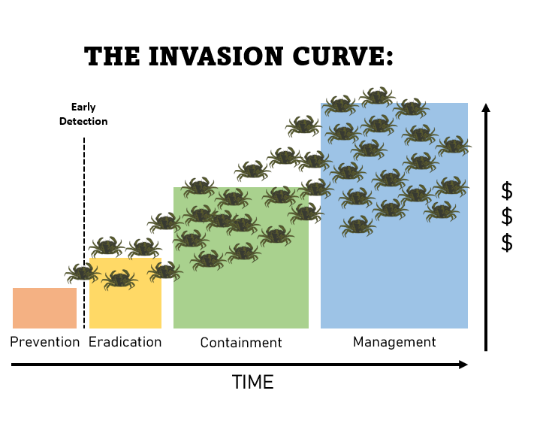
The invasion curve
The invasion curve shows the stages of the invasion of an invasive species.
(Also known as Suppression)
Graphic based on product by Big Island Invasive Species Committee
Notes:
An invasion curve depicts the spread of invasive species over time and the cost of that spread. The longer an infestation goes untreated, the bigger the cost - to the resources as well as monetarily. As the population of the invasive species grows, it gets more and more expensive to take effective actions to control them.
The words on the x axis describe what natural resource managers are trying to achieve at each stage of the invasion.

Slide 56
Prevention
Many of us take actions to prevent invasive species from getting to new areas.
This usually includes educational campaigns about what we can do.
(Also known as Suppression)
Graphic based on product by Big Island Invasive Species Committee
Notes:
Prevention costs the least out of all the stages on the invasion curve.

Slide 57
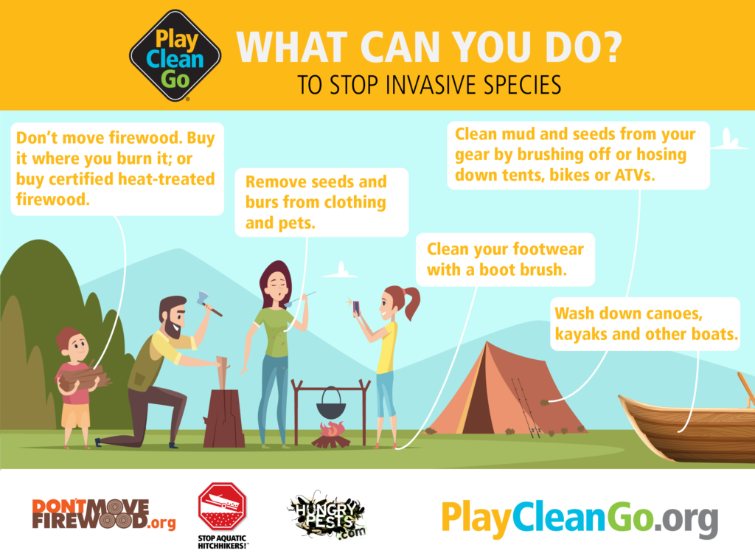
Notes:
This is just an example of a graphic used for education and outreach-especially useful at the prevention stage of the invasion curve

Slide 58
Early detection and rapid response
Early detection means detecting an invasive species just as they are beginning to invade a new area.
Rapid response means quickly responding to the detection of the invasive species with the goal of controlling its population.
The sooner we respond, the less it will cost in the long run.
(Also known as Suppression)
Graphic based on product by Big Island Invasive Species Committee

Slide 59
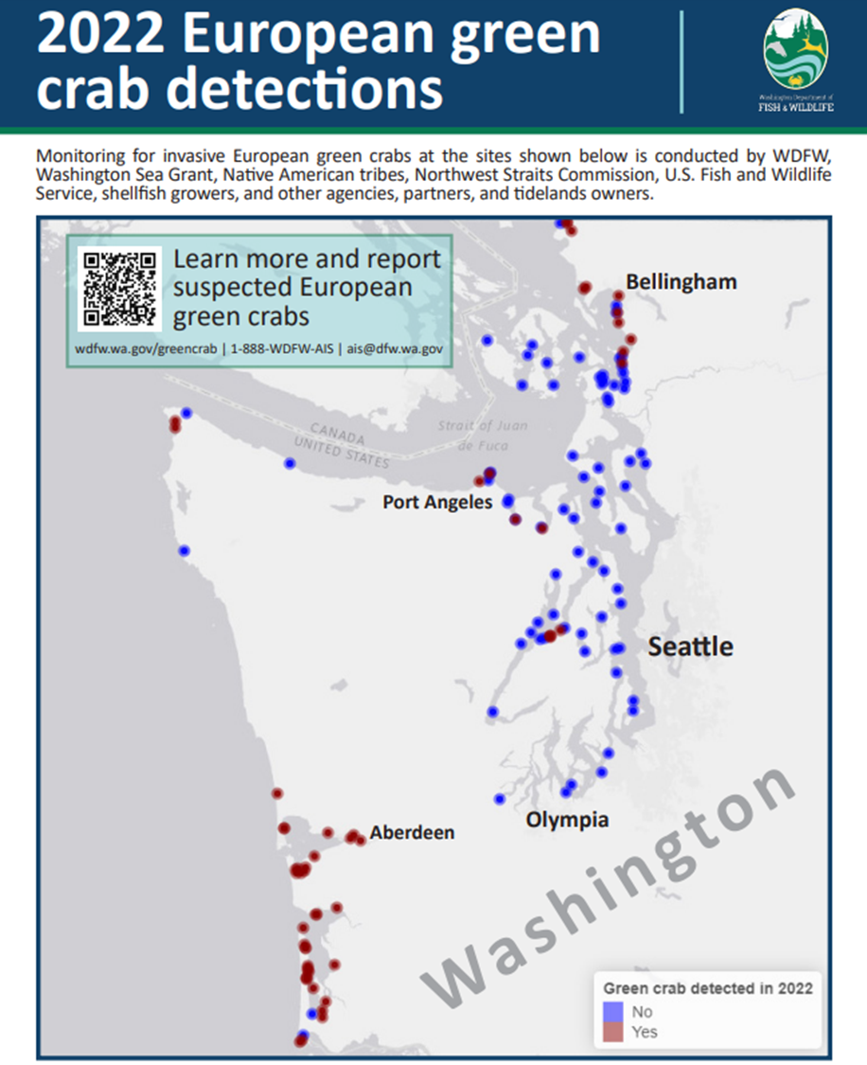
EEGGEG
European green crabs have not been found everywhere in Washington.
Notes:
EGC detection map
Include link to resources page

Slide 60
Early detection and rapid response to European green crabs in Washington
Washington Sea Grant leads a volunteer program for early detection of European green crabs in Washington called “Crab Team.”
If European green crabs are found in new locations, the Washington Department of Fish and Wildlife and partners will respond rapidly.
Notes:
The rapid response is trapping the crabs. Didn’t put this in here so as not to influence what the students decide is the best control choice.

Slide 61
Control
Control means taking actions to reduce the population of an invasive species.
Depending on the situation, this could lead to:
  Eradication – completely getting rid of the species from an area
  Containment – containing a species to a specific area
  Management – limiting the populations of invasive species and protecting remaining resources
Control Actions
Graphic based on product by Big Island Invasive Species Committee
Notes:
An example of a control action would be trapping for European green crabs.
At any given time, depending on the specific location and population of European green crabs, we could be at any of the phases (eradication, containment, management). Regardless of the stage, we would still be using the same control actions.

Slide 62
European green crabs
Lesson 5 Part 2
Evaluating solutions to the European green crab problem

Slide 63
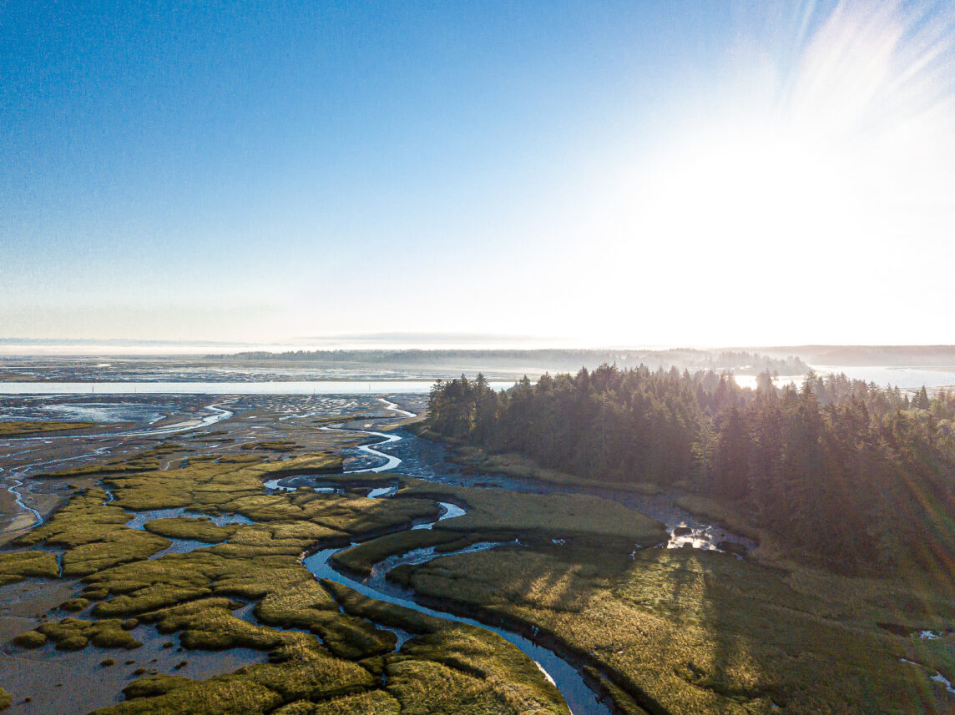
Washington’s goal: Functional eradication
Functional eradication means that the population of an invasive species is reduced to the point where harm to the ecosystem is minimized.
Estuary habitat in Grays Harbor on the Washington coast.

Slide 64
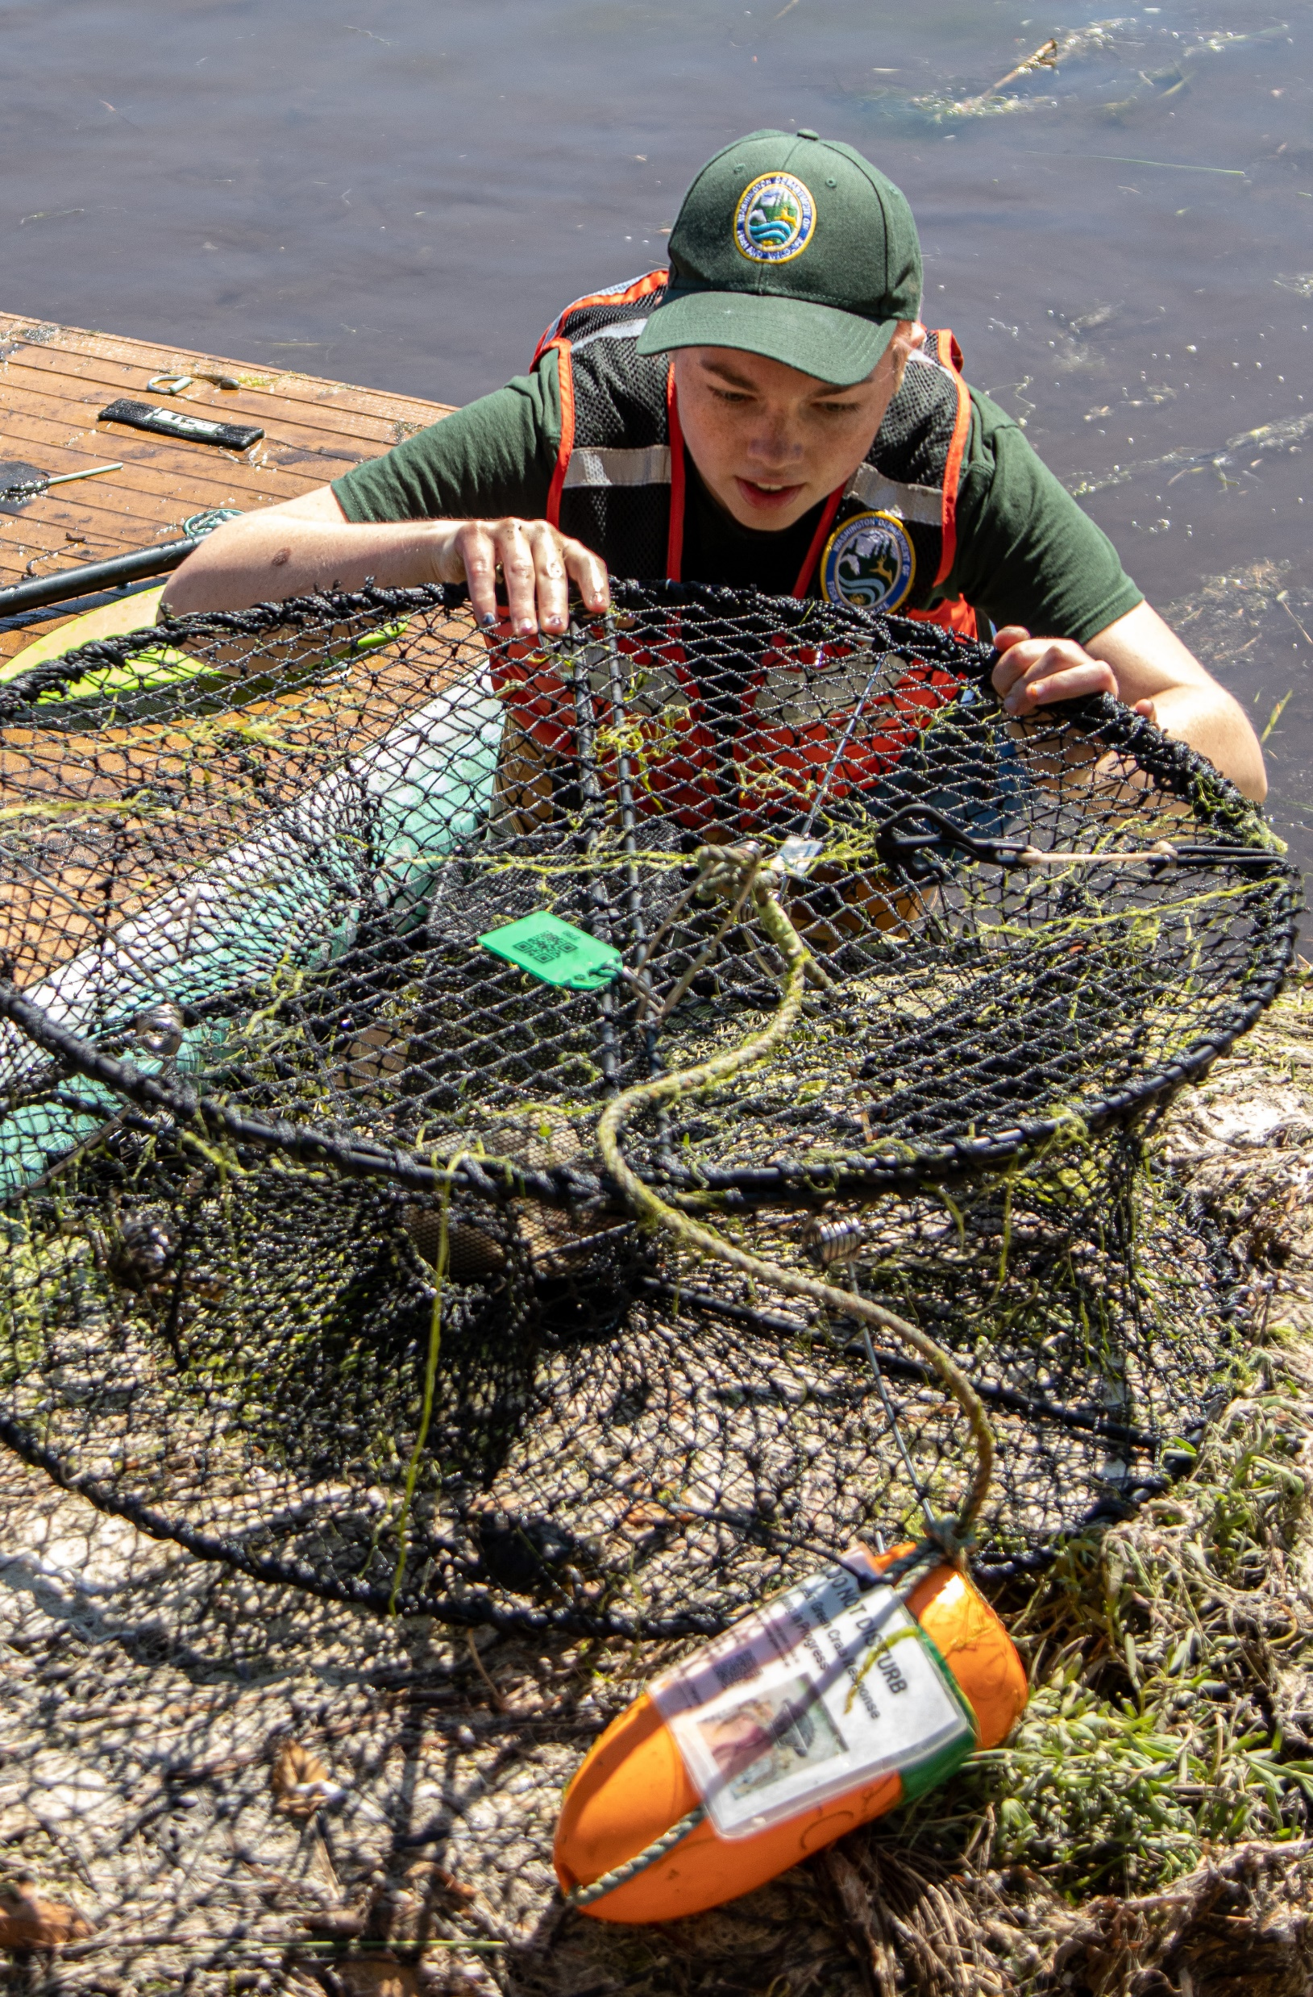
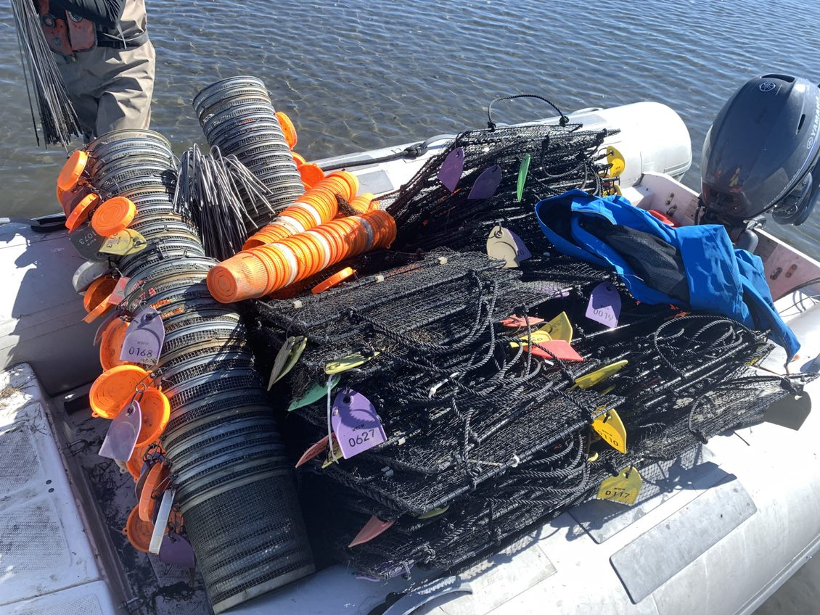
Control option 1: Selective harvest/trapping
Selective harvest would usually use traps to catch European green crabs in specific areas.
ONLY BY TRAINED PERSONEL
Notes:
Control Option 1: Selective Harvest/Trapping
Selective harvest usually uses traps to catch European green crabs in specific areas. Using traps is the easiest initial control method because it has few environmental concerns and requires little up-front research. The traps can specifically target European green crabs, causing little harm to other marine animals. Selective harvest can be very expensive, however, as it requires money to fund the trapping efforts, including buying traps, bait, and paying and training people doing the work
Only people trained for collection (not the general public). This is to avoid accidental trapping of native species.

Slide 65
Control option 1: Selective harvest/trapping
Benefits | Drawbacks

Slide 66


Control option 2: Chemical control
Chemical control would use chemicals to kill European green crabs.
Notes:
Control Option 2: Chemical Control
The use of chemicals such as pesticides to control European green crabs has been suggested as it would kill many crabs very quickly. Chemical control, however, has significant environmental concerns. The biggest concern is that all existing chemicals that would kill European green crabs would also kill other species, harming the local ecosystem. Because of these concerns, use of a chemical to control green crabs would require extensive environmental review which takes a lot of time and money. Additionally, a huge amount of the chemical would need to be used across the state. It could be very challenging to get enough supplies.

Slide 67

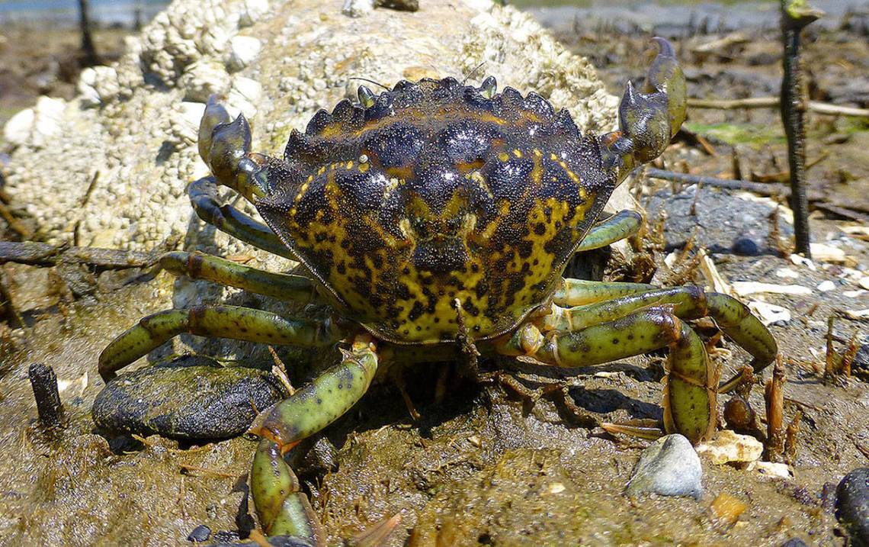

Control option 3: Biological control
Biological control would mean that a natural enemy or predator is introduced to control the European green crab population.
Nom nom
Notes:
Biological control would mean that a natural enemy or predator is introduced to control the European green crab population. A biological control would only reduce the impact or population of European green crabs, but they will never eradicate them. One of the biggest issues with biological controls is making sure that they don’t harm other organisms in addition to the European green crab. So far, no biological control has been found that effectively controls the European green crab population without harming other organisms. For biological controls to become an option, further research is needed, which requires funding.

Slide 68
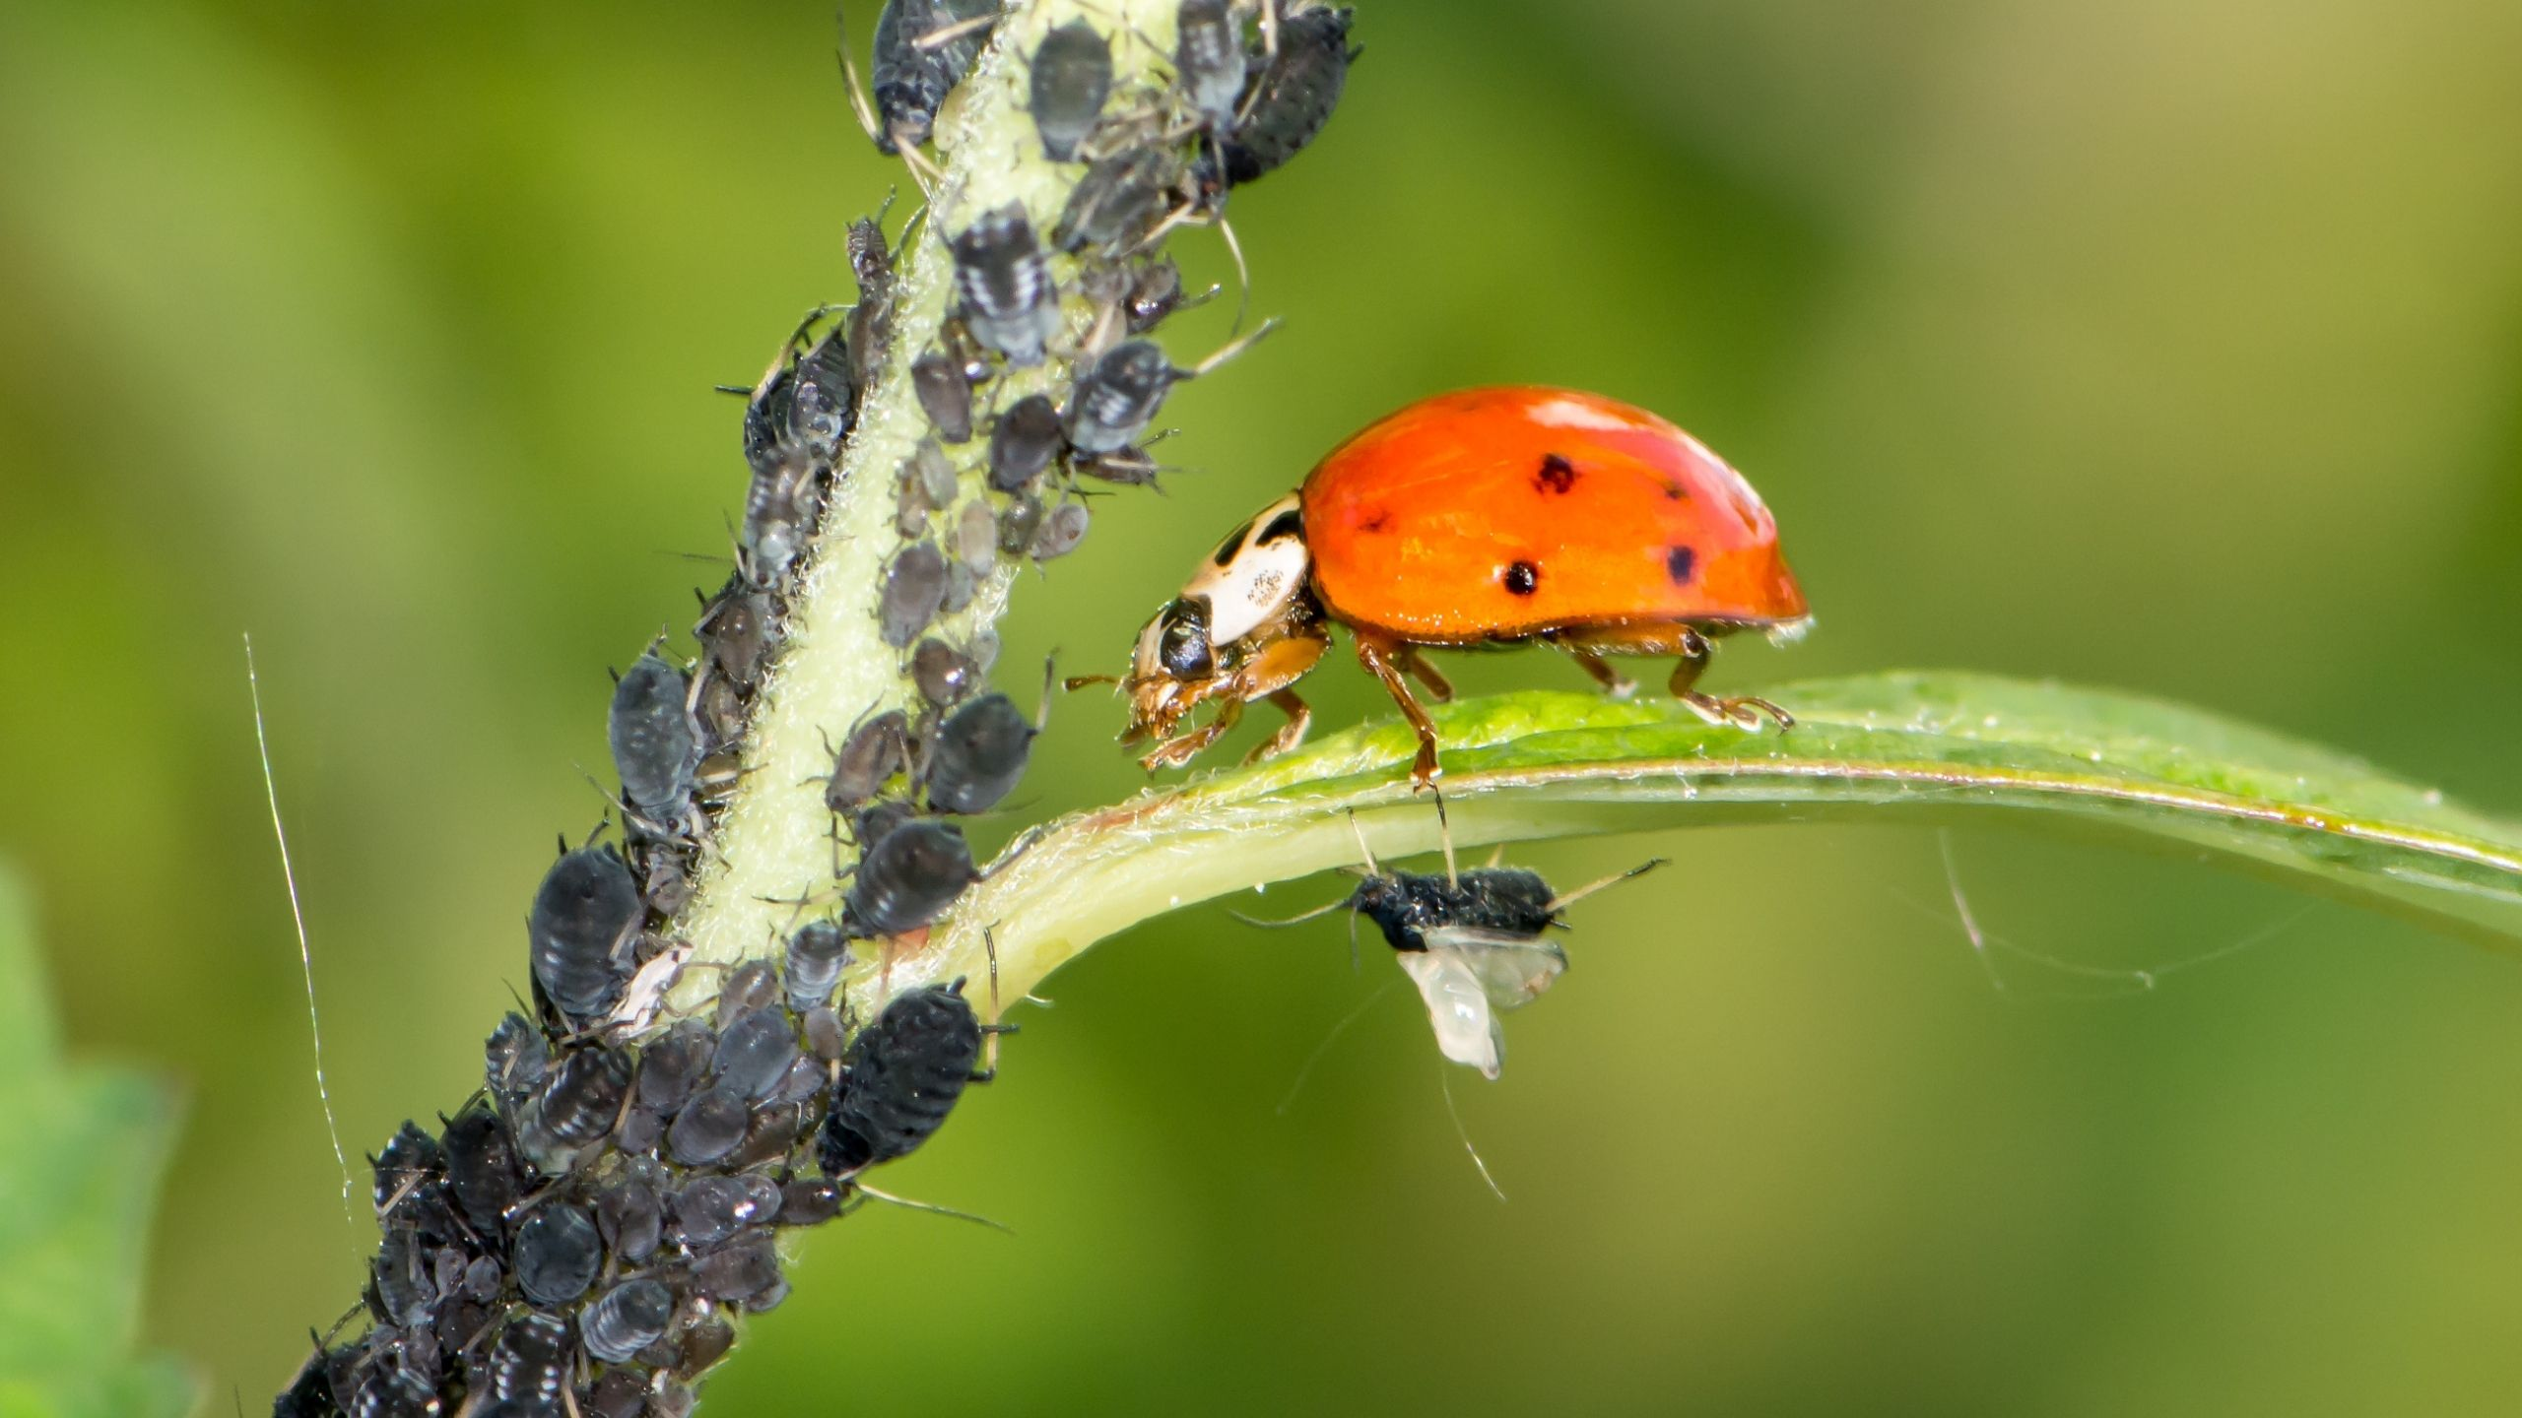
Biological control example: Ladybugs and aphids
Notes:
Releasing ladybugs into gardens to eat aphids and control their populations.

Slide 69
What control method would you use to functionally eradicate European green crabs in Washington?

Slide 70
European green crabs
Lesson 5 Part 3
What is Washington Doing?
Notes:
This is an ongoing emergency. Management strategies may change. For up-to-date information

Slide 72
Washington’s goal: Functional Eradication
Locations where there are lots of crabs:
  Selective Harvest/Trapping
Locations where there are few/no crabs
  Prevention/ Early Detection
  Selective Harvest/Trapping
Estuary habitat in Grays Harbor on the Washington coast.

Slide 73

Notes:
https://youtu.be/orYl6m6Iv4E

Slide 74

Notes:
https://youtu.be/96w-0bIWvC4
How do you trap a crab?

Slide 75

Truck full of European green crabs from the Washington coast.

Slide 76


Early Detection Though Community Science!
Notes:
Find more information about Washington Sea Grant Crab Team at https://wsg.washington.edu/crabteam/

Slide 77




Community Science Early
Detection
European green crabs live up to 6 years
They molt their exoskeletons as they grow
Notes:
Growth
Live up to 6 years
Females smaller than males.
Like all arthropods, EGC must molt their exoskeleton to grow. You may find these molts at sites. The frequency of molting is variable and is affected by resource availability (i.e. food) and fluctuation of seasonal temperature. Molting frequency is inversely proportional to age (as the crab increases with age, molting frequency decreases).

Slide 78

Notes:
https://youtu.be/jzZ3_HS_Mag

Slide 79

Report possible European green crabs to WDFW
You can report suspected EGC to the Washington Department of Fish and Wildlife. To do so, please:
Take detailed photos of the suspected EGC.
Note the location of the crab.
Report your sighting to WDFW:
  wdfw.wa.gov/greencrabs
  Via email at ais@dfw.wa.gov
  Via phone at 1-888-WDFW-AIS
Notes:
What should a member of the public do if they find a green crab?
Take detailed photos. If you are comfortable holding it, take pictures of front, dorsal (top), ventral (bottom), back and sides. If you are not comfortable holding it, take a picture from above doing your best to get the carapace teeth clearly visible.
Note the location. GPS coordinates great but any details so WDFW staff can visit the location is helpful.
Report your sighting to the Washington Department of Fish and Wildlife at wdfw.wa.gov/greencrab or contact us via email at ais@dfw.wa.gov or via phone at 1-888-WDFW-AIS.
Please do not kill the crab. While this might sound counterintuitive, most reports of European green crabs are misidentifications of native species. We greatly appreciate any reports from the public (false detections still provide useful information), but we would like to prevent the unnecessary deaths of native crabs.

Slide 80

The best way to identify a European green crab:
The five points (marginal teeth) on either side of their eyes!
Notes:
No other crab on the West Coast has exactly five spines – others either have more or less.

Slide 81








European green crabs are not always green!
Their color is variable, from green to yellow to red to orange.
Notes:
Color is not a good way to identify
Despite name color is variable (light to dark mottled green, red to orange)
Color related to time since last molt (when they shed their shell/carapace); light green means the molted recently, orange means it has been a while

Slide 82
European green crabs
Additional Resources

Slide 83
Background information StoryMap
https://wdfw-egc-hub-wdfw.hub.arcgis.com/pages/background-information

Slide 84

Notes:
This video is from before the governor’s emergency proclamation was released, but gives good context as to why we are so concerned.

