Slide 1
Grays Harbor Basin Salmon Management Policy Revisions
Public Comments Summary
September 27, 2024
Fish and Wildlife Commission Meeting
Marlene Wagner & Mike Scharpf
Fish Program

Slide 2
Outline of Presentation
Overview of revision process and materials
Description and summary of public comment period
Co-manager input
Proposed revision timeline

Slide 3
Grays Harbor Basin Salmon Management Policy Revision Process and Materials
June 14: Special Fish Committee Briefing
Meeting Materials
August 8-10: Fish Committee and FWC meeting
Meeting Materials
September 4: Town Hall Meeting
Meeting Link

Slide 4
Town Hall Comments
September 4, 2024, 6-7:30pm
Town hall can be viewed on WDFW’s YouTube page:
    Grays Harbor Basin Salmon Management Policy virtual public meeting
“Support” for policy
  Likes revisions & timeliness
  Language is clear and reads well
General comments
  How will new escapement goals be created?
Unrelated to policy
  Invasive species

Slide 5
Public Portal Comments
Comment period: August 13 – September 15, 2024
Policy posted and comments submitted at:
    Grays Harbor Basin Salmon Management Policy | Washington Department of Fish and Wildlife
“Support” for policy
  Provides opportunity for all user groups
“Opposed” to policy
  Not enough freshwater recreational priority
  Should have goal of 3 net free days
General comments
  Increase/lower escapement goals
Unrelated to policy
  Opposed to commercial fishing
  Raising daily limits
  Fishing closures
  Pinniped predation
  Hatchery production

Slide 6
Co-manager Input
Proposed new addition to the Guidance section:
Guidance #3: WDFW staff shall work with the Confederated Tribes of the Chehalis Reservation in management of the state share of harvestable salmon.

Slide 7

Grays Harbor Basin Salmon Management Policy: Proposed Revision Timeline

Slide 8
Proposed Revision Timeline
June 14 | Special Fish Committee | Briefing Link to materials | Provide an overview of expired policy. Review policy performance. Staff recommendations for possible revisions. Outcome: Staff directed to develop mark-up strike-through reflecting staff recommendations.
July |  |  | Staff meetings with co-managers. Outcome: Letters sent to Tribes, working to schedule meetings.
August 8-10 | Fish Committee; Fish and Wildlife Commission | Briefing Link to materials | Brief Commission on Draft Policy revisions. Outcome: Begin public comment process
August 13 – September 15 | Public Comment on WDFW website portal | Link to public comment portal | Collect written input on draft policy revisions and analyses.
September 4 | Public meeting | Link to meeting | Conduct public meeting to describe and collect input on draft policy revisions and analyses.
September 26-28 | Fish Committee; Fish and Wildlife Commission | Briefing; Public input | Briefing on public comment; Commission discussion
October 24-26 | Fish and Wildlife Commission | Decision | Commission final decision

Slide 9
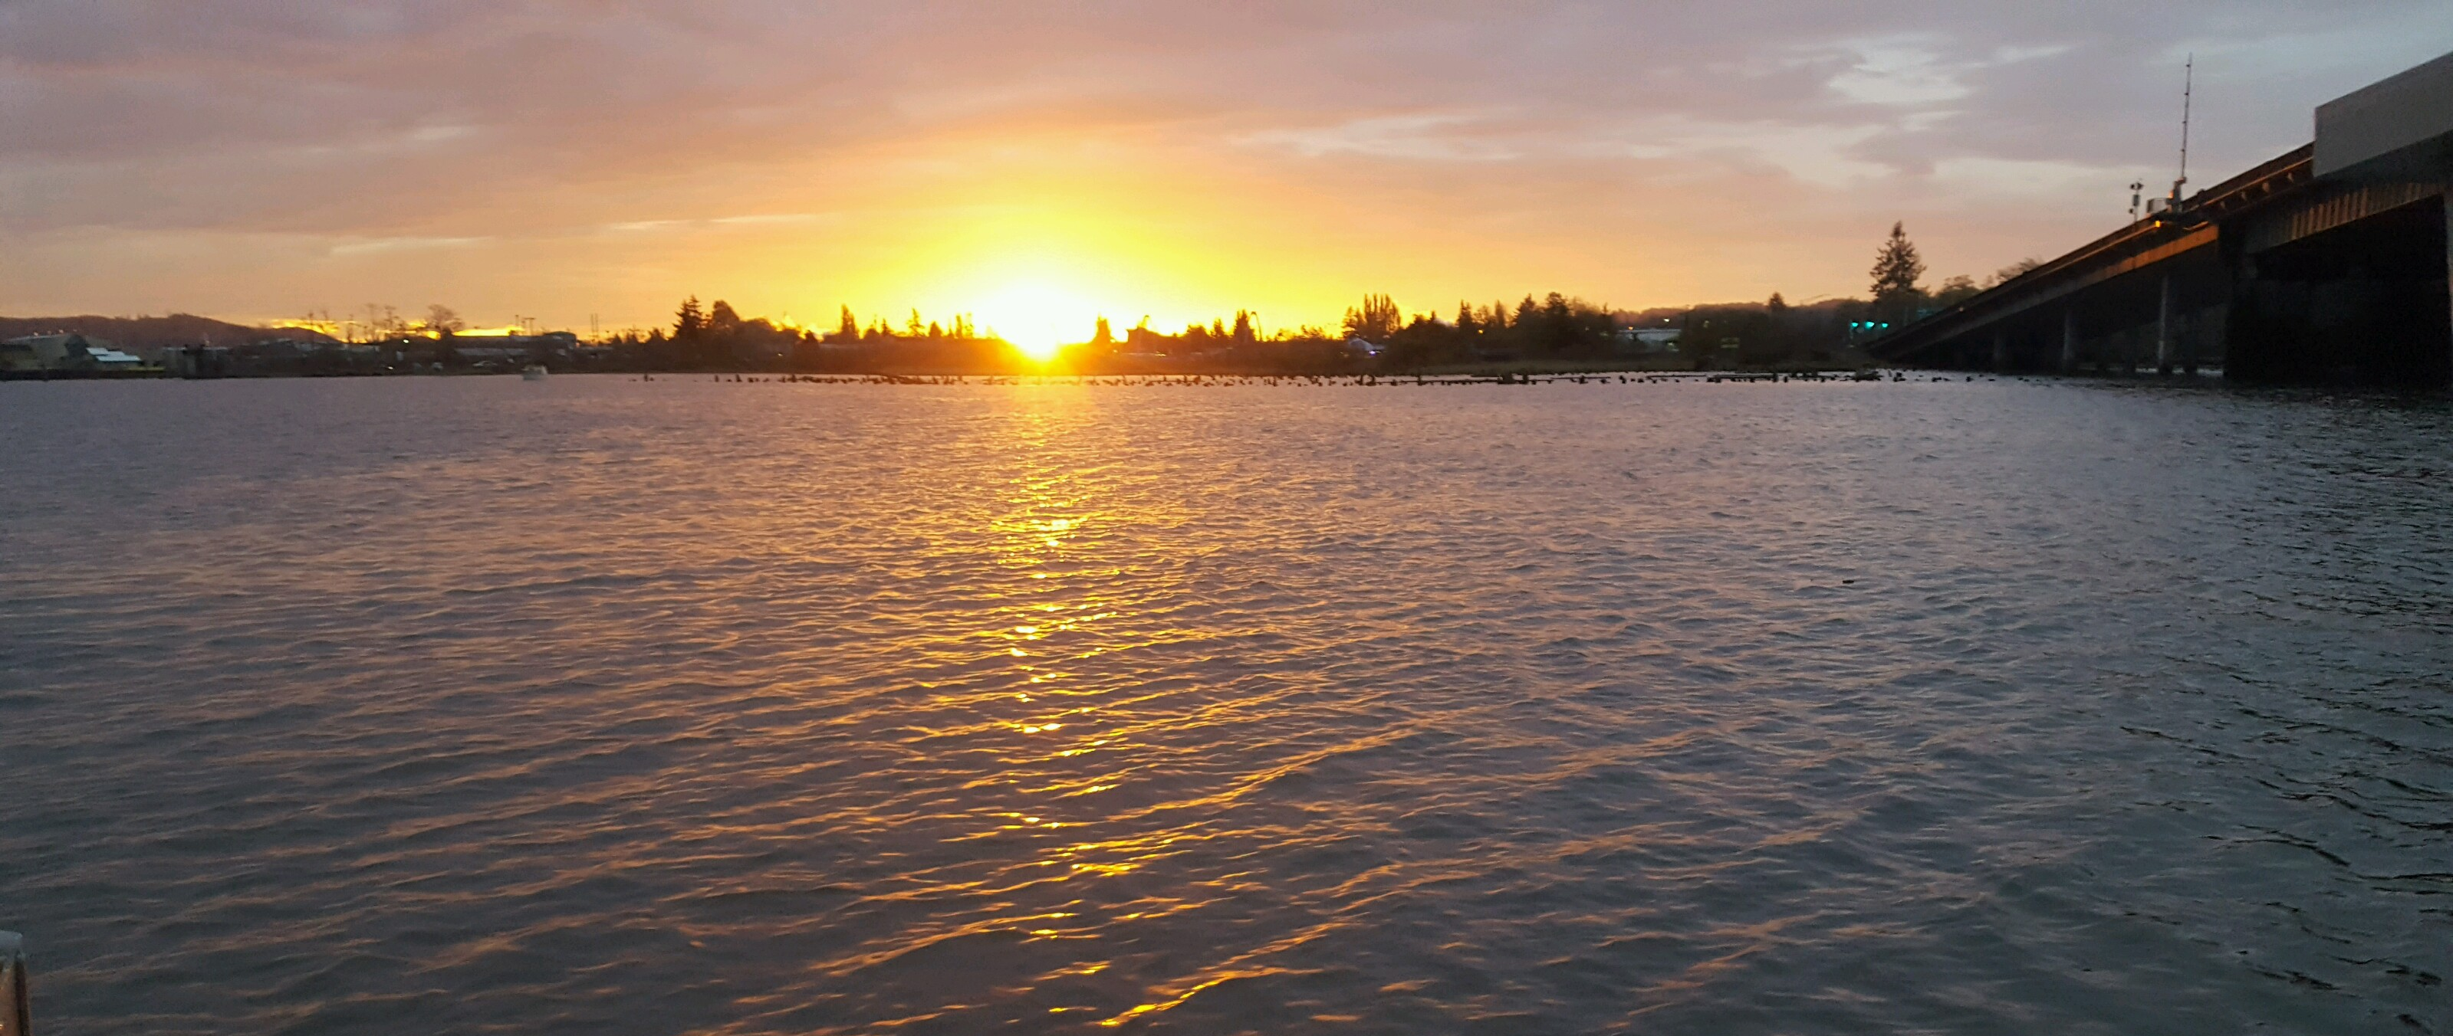
Questions & Discussion

