Slide 1

Improving the Survivability of Released Rockfish
Fish and Wildlife Commission Meeting December 6-7, 2013
Heather Reed, WDFW
Ron Garner, Puget Sound Anglers

Slide 2
Vulnerable Rockfish in Washington
Yelloweye and canary rockfish are considered overfished in ocean areas
  In Puget sound, these species and bocaccio rockfish have been listed under the Endangered Species Act
The primary tool used all along the US West Coast to rebuild these stocks is to prohibit retention
Under rebuilding plans only a small amount of mortality is allowed
On the coast, the WA recreational yelloweye harvest limit is 2.9 mt (in 2013 and 2014 ), that equates to approximately 1,000 fish
December 6, 2013 Fish and Wildlife Commission Meeting Presentation

Slide 3
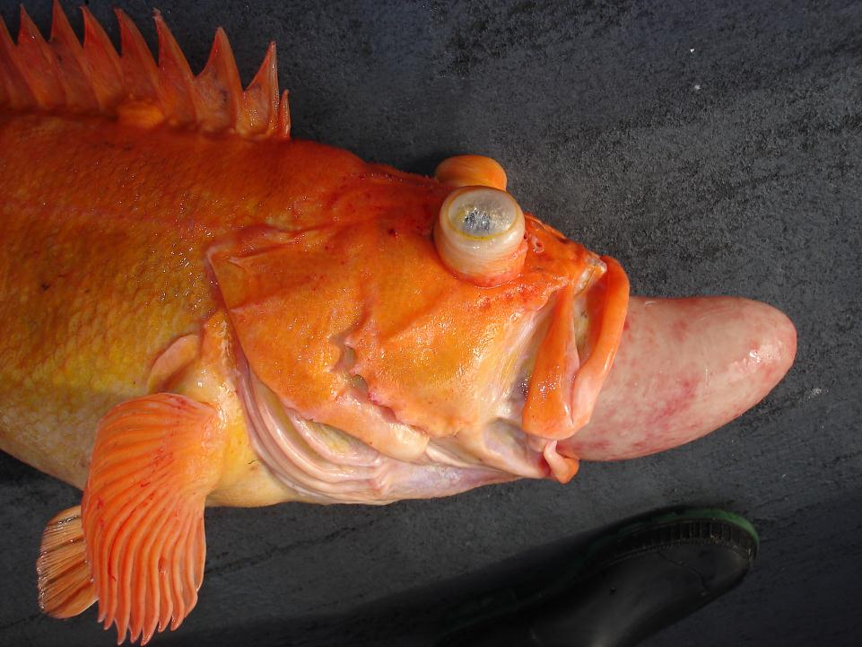
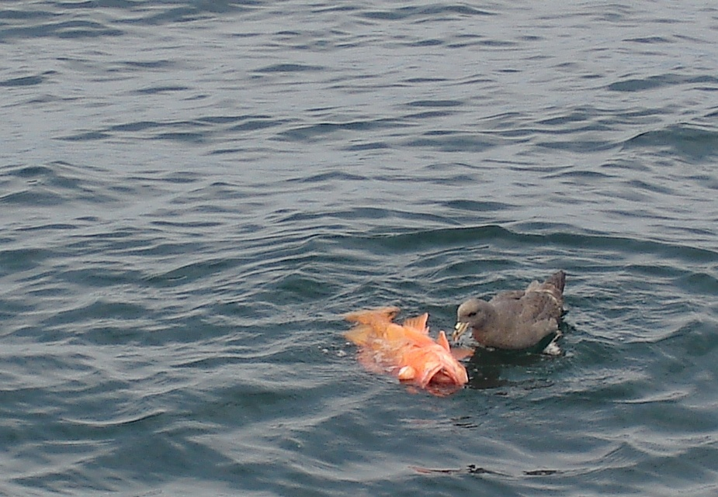
The Fate of Released Rockfish
Rockfish have swim bladders to regulate their position in the water column
Gases in the swim bladder expand when fish are brought to the surface causing bulging eyes and possibly forcing the stomach to expand –this is called barotrauma
No one likes to see “floaters”
December 6, 2013 Fish and Wildlife Commission Meeting Presentation

Slide 4
What Can We Do?
Get those rockfish down!
Recompression devices are simple and easy to use
Recent studies have shown that for many rockfish recompression improves survivability compared to fish released at the surface
Yelloweye and canary have shown high recompression survival when caught in deep water
December 6, 2013 Fish and Wildlife Commission Meeting Presentation

Slide 5
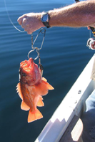
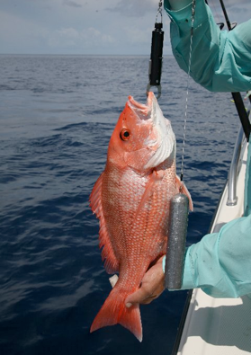
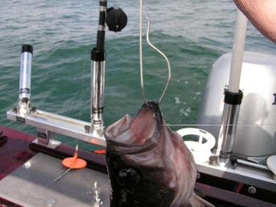
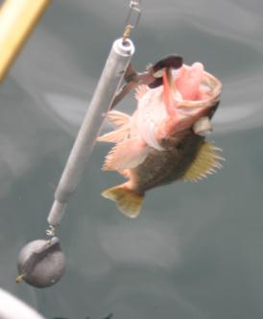
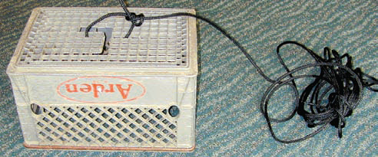
Types of Descending Devices
December 6, 2013 Fish and Wildlife Commission Meeting Presentation

Slide 6
Important to Remember
Chose the device that works best for you
Reduce the time on deck– survivability is greatest when fish are recompressed immediately – less than 2 minutes at the surface
Mortality can double with every 10 minutes at the surface
Limit handling time and avoid rough handling
When properly released even fish with severe signs of barotrauma can survive
Venting is not recommended as it may do more harm than good
December 6, 2013 Fish and Wildlife Commission Meeting Presentation

Slide 7
Getting the Word Out
WDFW
Puget Sound Anglers
Developed “Protect Washington’s Rockfish” brochure and posters
Updated WDFW web pages
Presented information and demonstration on the use of descending devices:
  Coastal charter offices and fishing groups
  Puyallup Sportsman Show
  Neah Bay and La Push for lingcod and halibut season openers
Developed “Save Our Fisheries” hand-outs
Purchase and distributed hundreds of free descending devices
Scheduled WDFW staff attendance at PSA meetings
Presented information and demonstration on the use of descending devices:
  Puyallup Sportsman’s Show
  Seattle Boat Show
December 6, 2013 Fish and Wildlife Commission Meeting Presentation

Slide 8
Mortality Rates for Released Yelloweye and Canary Rockfish
Species | Depth (fm) | Current Surface Mortality | Mortality with Descending Devices
Canary Rockfish | 0-10 | 21% | 21%
 | 10-20 | 37% | 21%
 | 20-30 | 53% | 21%
 | 30-50 | 100% | 37%
 | 50-100 | 100% | 45%
 | >100 | 100% | 100%
Yelloweye Rockfish | 0-10 | 22% | 21%
 | 10-20 | 39% | 21%
 | 20-30 | 56% | 21%
 | 30-50 | 100% | 27%
 | 50-100 | 100% | 45%
 | >100 | 100% | 100%
December 6, 2013 Fish and Wildlife Commission Meeting Presentation

Slide 9
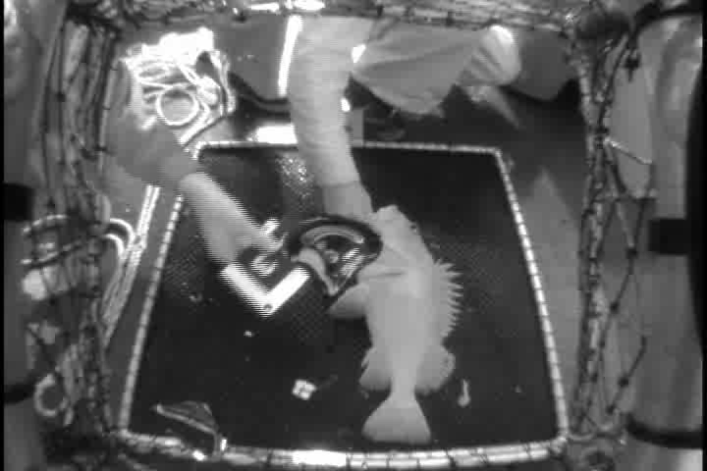
Video courtesy of the Oregon Dept. of Fish and Wildlife, Newport
December 6, 2013 Fish and Wildlife Commission Meeting Presentation

